Slide 1


Slide 2

Module
2
Outlines
Module 2(Sockets)
    Basics of Sockets - Low-level networking interface
      Definition, Sockets type, UDP & TCP sockets
    Socket Methods
    IPv4
    Simple Client/Server Programming
    Practical example (Client/Server)
    H.W2

Slide 3
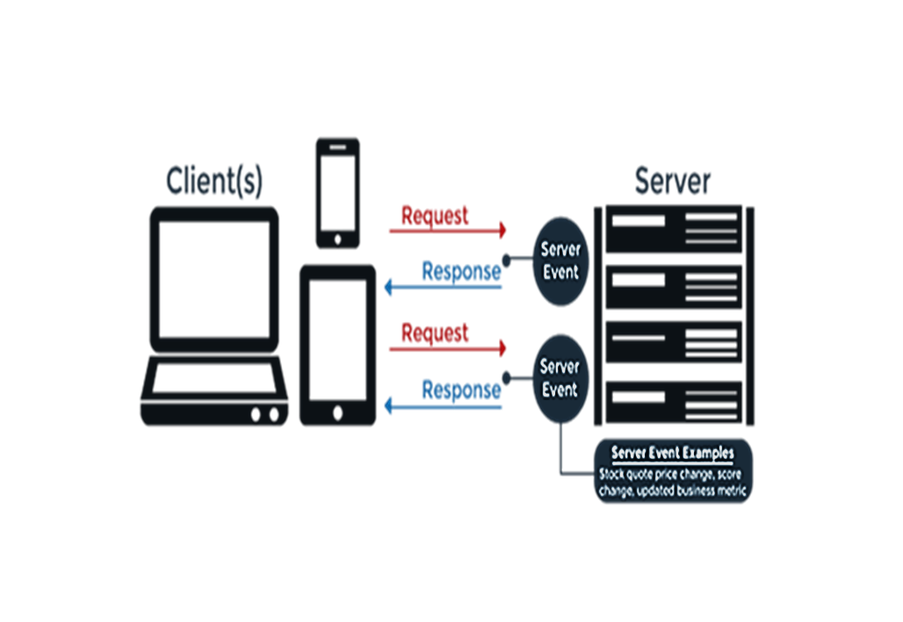
Module
2
Before starting …

Slide 4
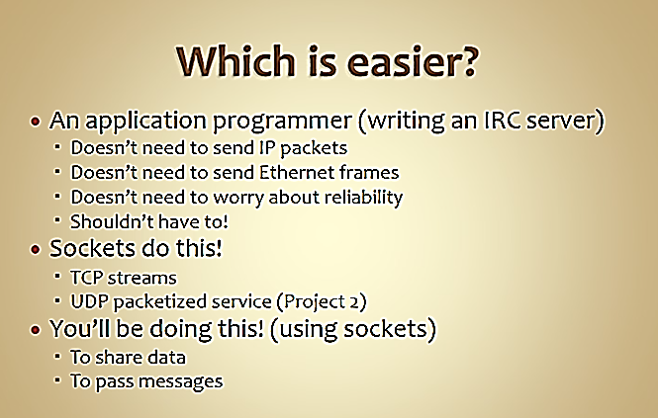
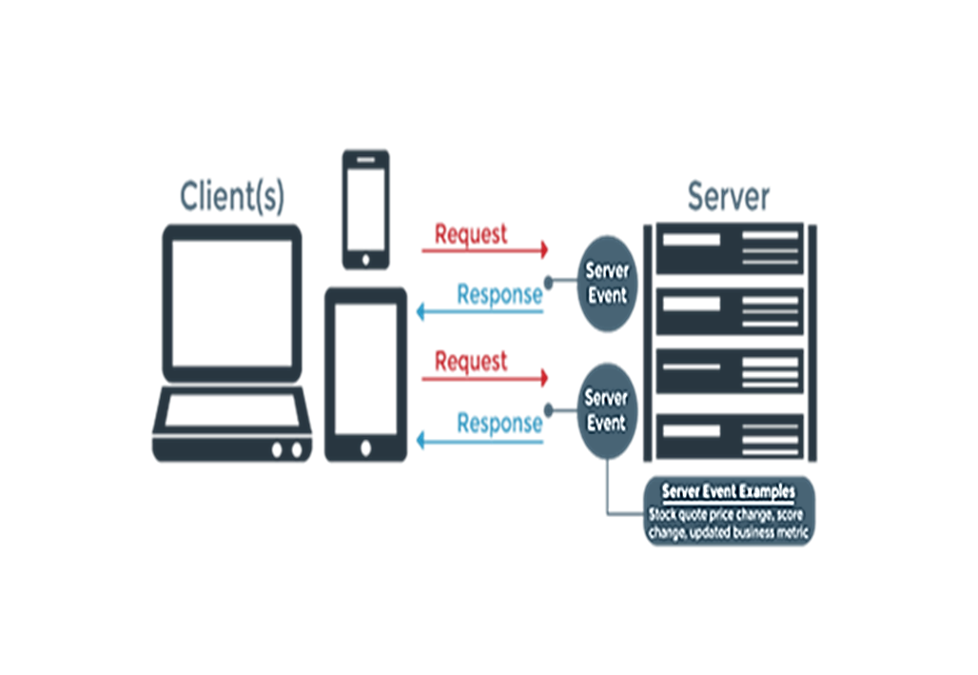
Module
2
So …

Slide 5
Module
2
Definition of Sockets
Socket is a link between two applications that can communicate with one another (either locally on a single machine or remotely between two machines in separate locations) —> (within a process, between processes on the same machine or between processes on different machines).
Basically, sockets act as a communication link between two entities, i.e. a server and a client. A server will give out information being requested by a client. For example, when you (client) visited this (https://esu.ac.ae/) page, the browser created a socket and connected you to the server of the university website.
So, socket is a communication mechanism.

Slide 6
Module
2
So: What is socket?
First appeared in ARPANET in 1971, and later became an API in the Berkeley Software Distribution (BSD) operating system released in 1983 called Berkeley sockets (4.1 BSD UNIX 1982).
An integer associated with a network connection.
Implemented as file descriptor.
Types of Internet Sockets:
  Datagram Socket for UDP communication.
  Stream Sockets for TCP connection.
  Raw Sockets.
An application programming interface (API):
is a set of protocols, routines, functions and/or commands that programmers use to facilitate interaction between distinct software services.
APIs allow one software service to access data from another software service without the developer's needing to know how the other service works.

Slide 7
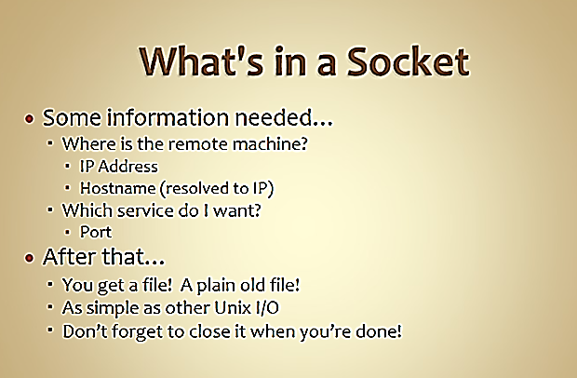

Module
2
So: What is in a socket?

Slide 8
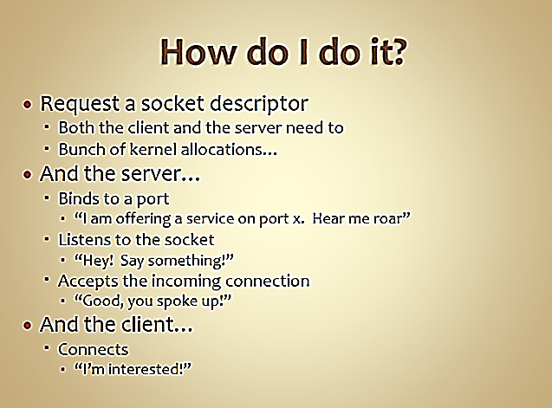
Module
2
How do I do a socket?

Slide 9
Module
2
UDP socket

Slide 10
Module
2
TCP socket

Slide 11
Module
2
Starting with Python
import socket
host_name = socket.gethostname()
ip_address = socket.gethostbyname(host_name)
print('Host name: ', host_name)
print('IP address: ', ip_address)
import socket
remote_host = 'www.python.org'
print('IP address of :',(remote_host,socket.gethostbyname(remote_host)))
err_msg= socket.error()
print('Is there any error?')
print(remote_host, err_msg)

Slide 12
Module
2
IPv4 (INTERNET Protocol v4)
Definition
IPv4 is the fourth version of IP, which establishes the rules for computer networks functioning on the principle of packet exchange.
  It can uniquely identify devices connected to the network through an addressing system. Whenever a device gets access to the Internet (whether it's a switch, PC, or other devices), it is assigned a unique, numerical IP address such as 192.149.252.76. The IPv4 uses a 32-bit address scheme allowing to store 2^32 addresses (4.19 billion addresses).
  The increasing end-users connected to the Internet leads to the exhaustion of IPv4 addresses. That’s also why the new Internet addressing system, IPv6, is being deployed to fulfill the need for more Internet addresses.

Slide 13
Module
2
IPv4 (INTERNET Protocol v4)

Slide 14
Module
2
IPv4 (INTERNET Protocol v4)
Features of IPv4
Connectionless Protocol
Allow creating a simple virtual communication layer over diversified devices
It requires less memory and ease of remembering addresses
Already supported protocol by millions of devices
Offers video libraries and conferences

Slide 15
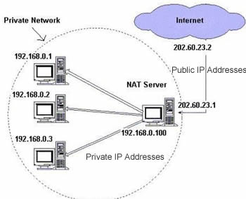
Module
2
Public IP vs Private IP

Slide 16
Module
2
Public IP vs Private IP

Slide 17
Module
2
IPv4 in Python
ipaddress — IPv4/IPv6 manipulation library
  Provides the capabilities to create, manipulate and operate on IPv4 and IPv6 addresses and networks.
  The functions and classes in this module make it straightforward to handle various tasks related to IP addresses, including checking whether or not two hosts are on the same subnet, iterating over all hosts in a particular subnet, checking whether or not a string represents a valid IP address or network definition, and so on.

Slide 18
Module
2
IPv4 in Python
To practice:
ipify : get your public IP address library. Try, installing ipify in your computer, then find your public IP address.

Slide 19
Module
2
IPv4: Built-in functions
import ipaddress
# Extracting the IP version:
addr1Ver = ipaddress.ip_address('192.0.2.1')
print('address 1 version: ', addr1Ver.version)
addr2Ver = ipaddress.ip_address('2001:db8::1')
print('address 2 version: ', addr2Ver.version)
# Obtaining the network from an interface
host1Net = ipaddress.ip_interface('192.0.2.1/24')
print('host 1 network: ', host1Net.network)
host2Net = ipaddress.ip_interface('2001:db8::1/96')
print('host 2 network: ', host2Net.network)
# Finding out how many individual addresses are in a network:
net4 = ipaddress.ip_network('192.0.2.0/24')
print('Individual network4: ', net4.num_addresses)
net6 = ipaddress.ip_network('2001:db8::0/96')
print('Individual network6: ', net6.num_addresses)
# Iterating through the “usable” addresses on a network:
net4 = ipaddress.ip_network('192.0.2.0/24')
for x in net4.hosts():
print('host', x)
# Obtaining the netmask (i.e. set bits corresponding to the network prefix)
# or the hostmask (any bits that are not part of the netmask):
net4 = ipaddress.ip_network('192.0.2.0/24')
print('Mask network4: ', net4.netmask)
print('Mask host4: ', net4.hostmask)
net6 = ipaddress.ip_network('2001:db8::0/96')
print('Mask network6: ', net6.netmask)
print('Mask host6: ', net6.hostmask)

Slide 20
Module
2
network service access
in Python
There are two levels of network service access in Python. These are:
Low-Level Access
You can access the basic socket support in the underlying operating system using python’s libraries, which allows you to implement clients and servers for both connection-oriented and connectionless protocols.
High-Level Access
Python also has libraries that provide higher-level access to specific application-level network protocols, such as FTP, HTTP, and so on.

Slide 21
Module
2
Sockets in Python
Sockets are created using a set of programming requests called socket API (Application Programming Interface). Python's socket library offers classes for handling common transports as a generic interface.
Sockets use protocols for determining the connection type for port-to-port communication between client and server machines. The protocols are used for:
    Domain Name Servers (DNS)
    IP addressing
    E-mail
    FTP (File Transfer Protocol) etc...

Slide 22
Module
2
IP & Ports

Slide 23
Module
2
Standard ports in Python
import socket
def find_service_name():
protocolname = ‘tcp'
for port in [21, 22, 23, 25, 80, 110, 119, 443]:
print ("Port: %s => service name: %s" %(port, socket.getservbyport(port, protocolname)))
print ("Port: %s => service name: %s" %(53, socket.getservbyport(53,'udp')))
if __name__ == '__main__':
find_service_name()

Slide 24
Module
2
Sockets terms
Domain
  Domain is the family of protocols that is used as the transport mechanism. These values are constants such as AF_INET for IPv4, AF_INET6 for IPv6, PF_UNIX, PF_X25, and so on.
Type
  Type means the kind of communication between two endpoints, typically SOCK_STREAM (TCP) for connection-oriented protocols and SOCK_DGRAM (UDP) for connectionless protocols.
Protocol
  This may be used to identify a variant of a protocol within a domain and type. Its default value is 0. This is usually left out.
Hostname
  This works as the identifier of a network interface. A hostname may be a string, a dotted-quad address, or an IPV6 address in colon (and possibly dot) notation.
Port
  Each server listens for clients calling on one or more ports. A port may be a Fixnum port number, a string containing a port number, or the name of a service.

Slide 25
Module
2
Python’s Socket Module
To implement socket programming in python, we need to use the Socket module. Following is a simple syntax to create a Socket:

Slide 26
Module
2
Python’s Socket Module
Socket_family:
AF_INET is used for IPv4 Internet addressing.
AF_INET6 is used for IPv6 Internet addressing.
AF_UNIX is the address family for Unix Domain Sockets (UDS)
Socket_type:
SOCK_DGRAM for user datagram protocol (UDP) → connection-less.
  SOCK_STREAM for transmission control protocol (TCP) → connection- oriented protocols.

Slide 27
Module
2
Create Socket in Python
import socket
# Create a UDP socket
sock = socket.socket(socket.AF_INET, socket.SOCK_DGRAM)
UDP socket
import socket
# Create a TCP/IP socket
sock = socket.socket(socket.AF_INET, socket.SOCK_STREAM)
TCP socket

Slide 28
Module
2
Sockets Methods
(Server)

Slide 29
Module
2
Sockets Methods
(Server)
import socket
import sys
# Create a TCP socket
sock = socket.socket(socket.AF_INET, socket.SOCK_STREAM)
# Bind the socket to the address given on the command line
# server_name = sys.argv[1] if len(sys.argv) > 1 else '.'
server_address = ('localhost', 10000)
print('starting up on port :', server_address)
sock.bind(server_address)
sock.listen(5)
while True:
print('waiting for a connection')
connection, client_address = sock.accept()
,
,
,

Slide 30
Module
2
Sockets Methods
(Client)

Slide 31
Module
2
Sockets Methods
(Client)
import socket
import sys
# Create a TCP/IP socket
sock = socket.socket(socket.AF_INET, socket.SOCK_STREAM)
# Connect the socket to the port where the server is listening
server_address = ('localhost', 10000)
print('connecting to port :', server_address)
sock.connect(server_address)

Slide 32
Module
2
Sockets Methods
(General)

Slide 33
Module
2
Simple Client/Server Programming
The Steps in Establishing a Socket on Server
Create a socket with the socket() system call
Bind the socket to an address using the bind() system call. For a server socket, an address consists of a port number on the host machine
Listen for connections with listen() system call
Accept a connection with the accept() system call. This call typically blocks until a client connects with the server
Send and receive data with the send(), and finally close the connection with the close()
The Steps in Establishing a Socket on Client
Create a socket with the socket() system call
Connect the socket to the address of the server using the connect() system call
Send and receive data. There are a number of ways to do this, but the simplest is to use the read() and write() or send() and recv() system calls

Slide 34

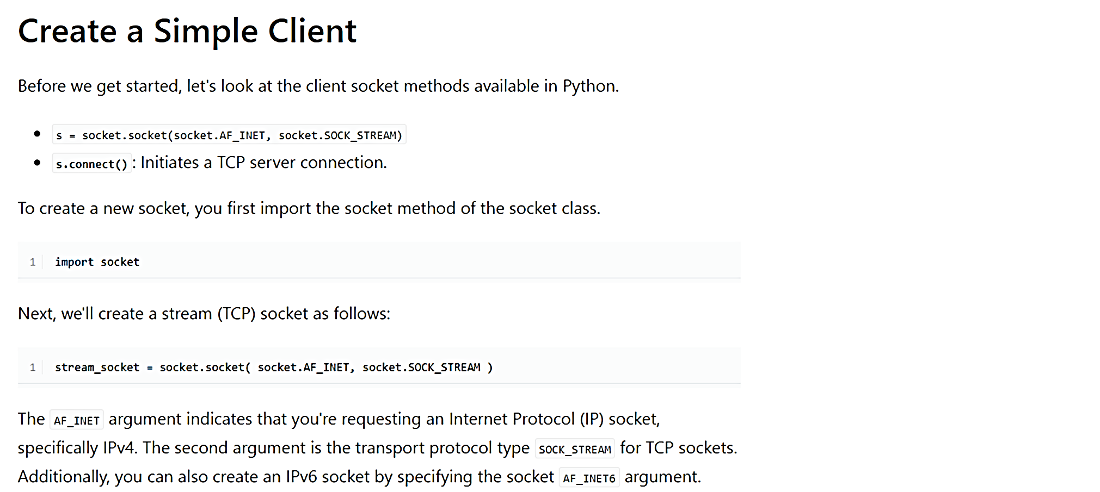
Module
2
Practical example (ClientTCP/ServerTCP)

Slide 35
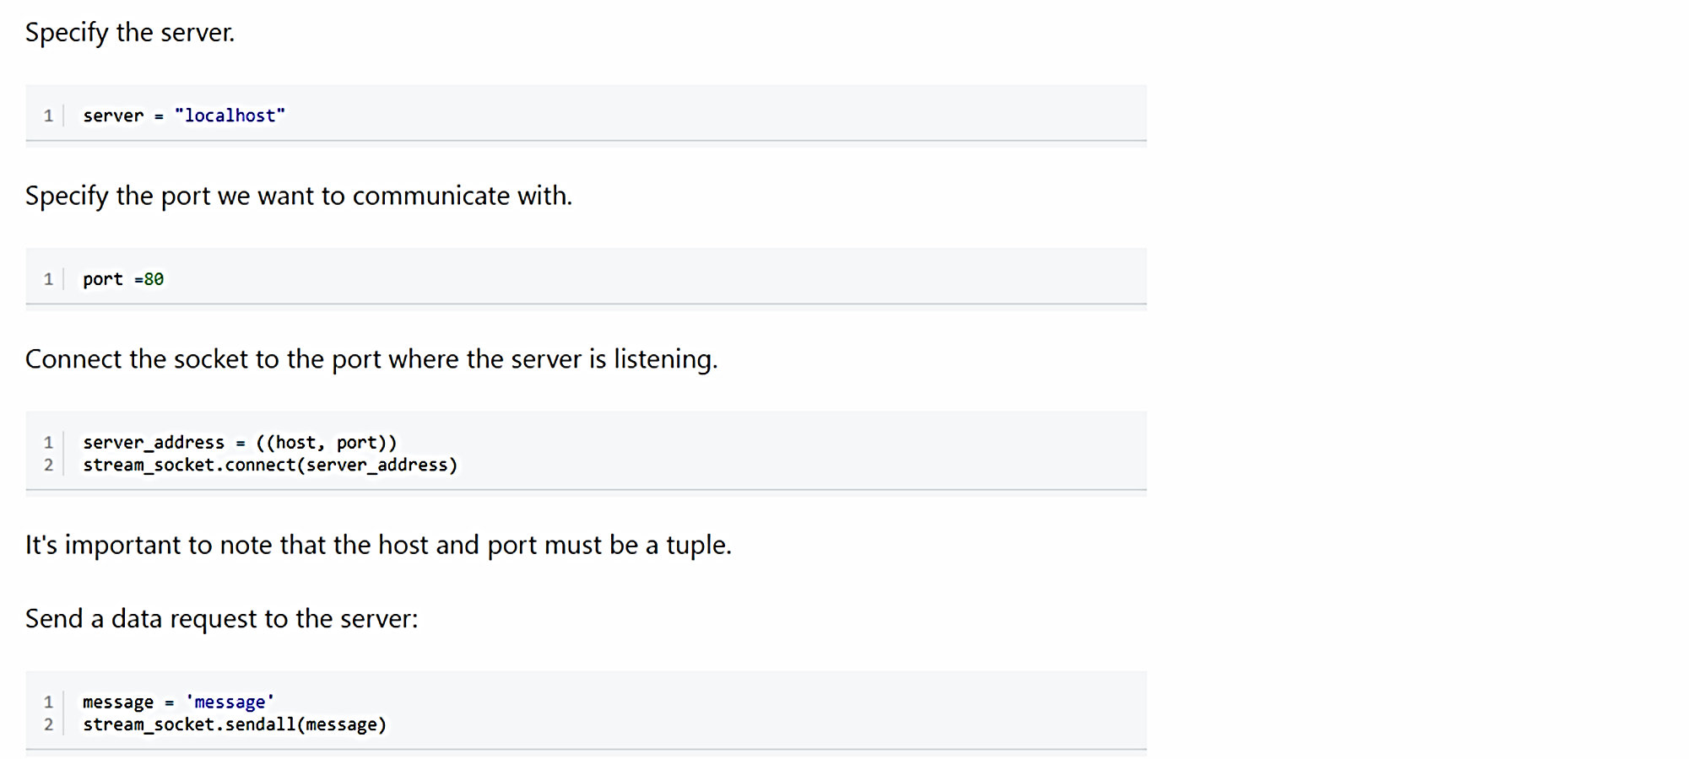
Module
2
Practical example (ClientTCP/ServerTCP)

Slide 36
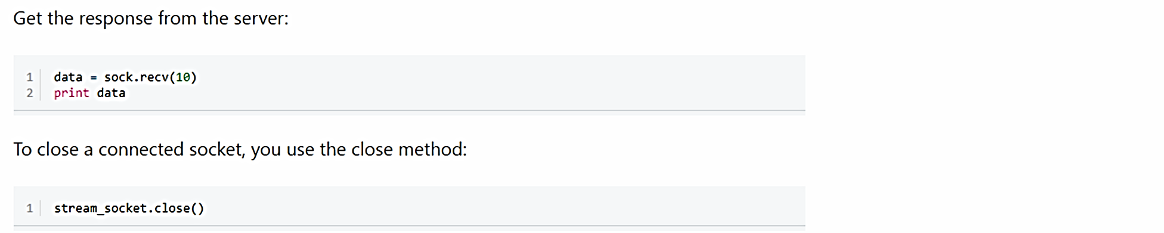
Module
2
Practical example (ClientTCP/ServerTCP)

Slide 37
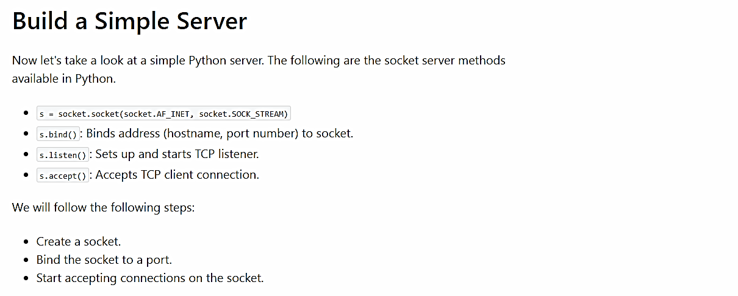
Module
2
Practical example (ClientTCP/ServerTCP)

Slide 38
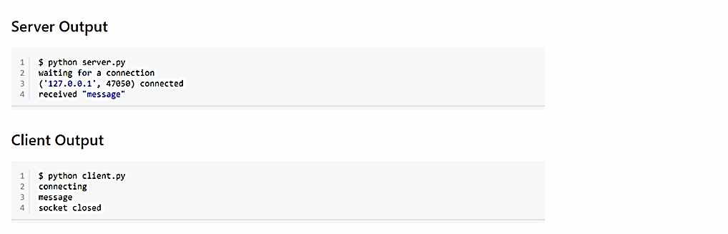
Module
2
Practical example (ClientTCP/ServerTCP)

Slide 39
Module
2
HW 2
Q1: Find the following errors in HW2 program between the client and the server:
1- syntax error (1)
2- logic error (1)
3- runtime error (1)
4- operational error (1)

Slide 40
Module
2
HW 2
Q2:

