Slide 1

Entrepreneurship & Innovation
Prepared by Dr. Amany Ramadan
ENT 611
Entrepreneurship & Innovation
Lecture 5

Slide 2


Franchising and the social Entrepreneur
Chapter
5
www.midocean.ae

Slide 3
Which Road to Take?
www.midocean.ae

Slide 4
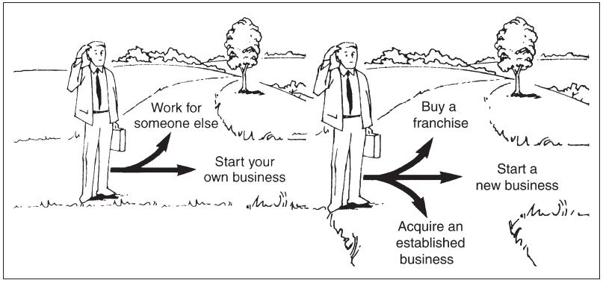
www.midocean.ae

Slide 5
Which Road to Take?

Slide 6
Franchising
A system in which semi-independent business owners (franchisees) pay fees and royalties to a parent company (franchiser) in return for the right to become identified with its trademark, to sell its products or services, and often to use its business format and system.
www.midocean.ae

Slide 7

MAC Franchising
www.midocean.ae

Slide 8

www.midocean.ae

Slide 9
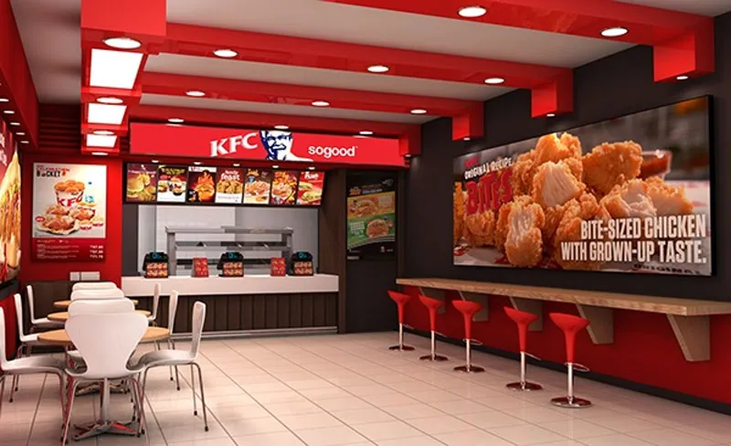
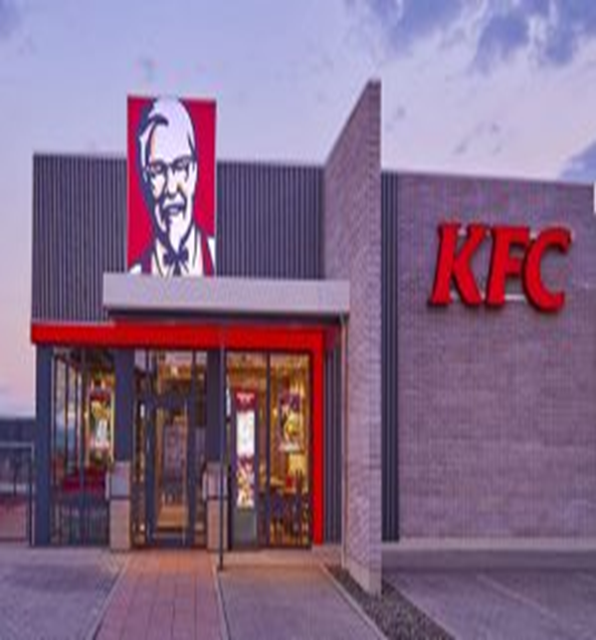
KFC franchising
www.midocean.ae

Slide 10
Franchising Basics
Essence of what franchisees purchase from the franchisors: Experience.
Key Question: “What can a franchise do for me that I cannot do for myself?”
www.midocean.ae

Slide 11
Franchise Fee
  One-time fee paid by the franchisee to the franchiser for the business concept, rights to use of trademarks, management assistance, and other related services from the franchiser.
www.midocean.ae

Slide 12
Royalty Fee
  Is a continuous fee paid by the franchisee to the franchiser usually based on a percentage of the franchisee’s gross revenue.
www.midocean.ae

Slide 13

The Franchising Relationship
Element
The Franchiser
The Franchisee
Site Selection
Design
Employees
Products and Services
Prices
Purchasing
Quality Control
Support
Oversees and approves; may choose site
Provides prototype design
Makes general recommendations and
training suggestions
Determines product or service line
Can only recommend prices
Establishes quality standards and suppliers
Sets quality standards and enforces them
with inspections; trains franchisees
Provides support through an established
business system
Chooses site with franchiser’s approval
Pays for and implements design
Hires, manages, and fires
employees
Modifies only with franchiser’s approval
Sets final prices
Must meet quality standards and purchase
only from approved suppliers
Maintains quality standards; trains employees
to implement quality systems
Operates business on a day-to-day basis with
franchiser’s support

Slide 14
Benefits of Franchising
A business system.
Management training and support.
Brand name appeal.
Standardized quality of goods and services.
Proven products and business formats.
Greater chance for success.
www.midocean.ae

Slide 15
Drawbacks of Franchising
Franchise fees and ongoing royalties.
Strict commitment to standardized operations.
Restrictions on purchasing.
  Approved suppliers only
Limited product line.
Unsatisfactory training programs.
Less freedom – “No independence”.
www.midocean.ae

Slide 16
Pure (Business format)
A system of franchising in which a
franchisor sells a franchisee a complete business format and system.
Business format franchising is the most common and the fastest growing of franchising. ( Ex: Macdonald’s , KFC, Pizza Hut……)
www.midocean.ae

Slide 17


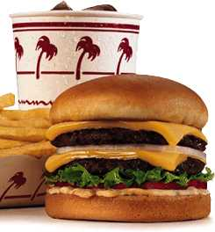
Example of Franchising Type
Pure (Business format)

Slide 18

Franchising:
Is a key part of the small business sector.
Increases the chance of business success for the entrepreneur.
www.midocean.ae

Slide 19

Social Entrepreneurship
www.midocean.ae

Slide 20
Mainstreaming into Government Policy
The United Kingdom remains one of two countries to have a government department for social enterprise, and is also the first to introduce public policy to support the growth and development of these organisations.
New Labour (1997-2010) sought to encourage social enterprise and social entrepreneurship:
Launched its first social enterprise strategy, titled Social Enterprise: a strategy for success (2002)
Social Enterprise Unit and launched a series of policies in an effort to establish what it described as an ‘enabling environment’
Coalition government (2010-2015) sought to position social entrepreneurship at the centre of the ‘Big Society’ agenda championed by David Cameron.
The Conservative government's Social Investment: A force for social change 2016 strategy publication, Minister for Civil Society Rob Wilson wrote: “We have ambitious plans for social investment over this Parliament and it remains a crucial element in the creation of a bigger, stronger society… Social investment can accelerate the growth of new businesses, transforming the impact of our public services, and support stronger communities to tackle the social challenges that they face.
www.midocean.ae

Slide 21
Three Concepts

Slide 22
Social Economy
The social economy: represents the organisations that pursue social goals not undertaken by either government or commercial businesses
Social economy businesses generate income and employment, both paid and voluntary, and aim to address social problems and meet community needs rather than operate for pure profit.
www.midocean.ae

Slide 23
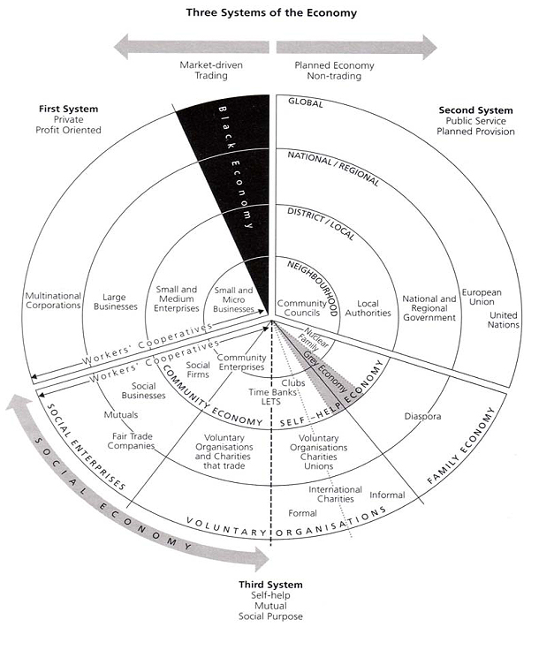

Slide 24
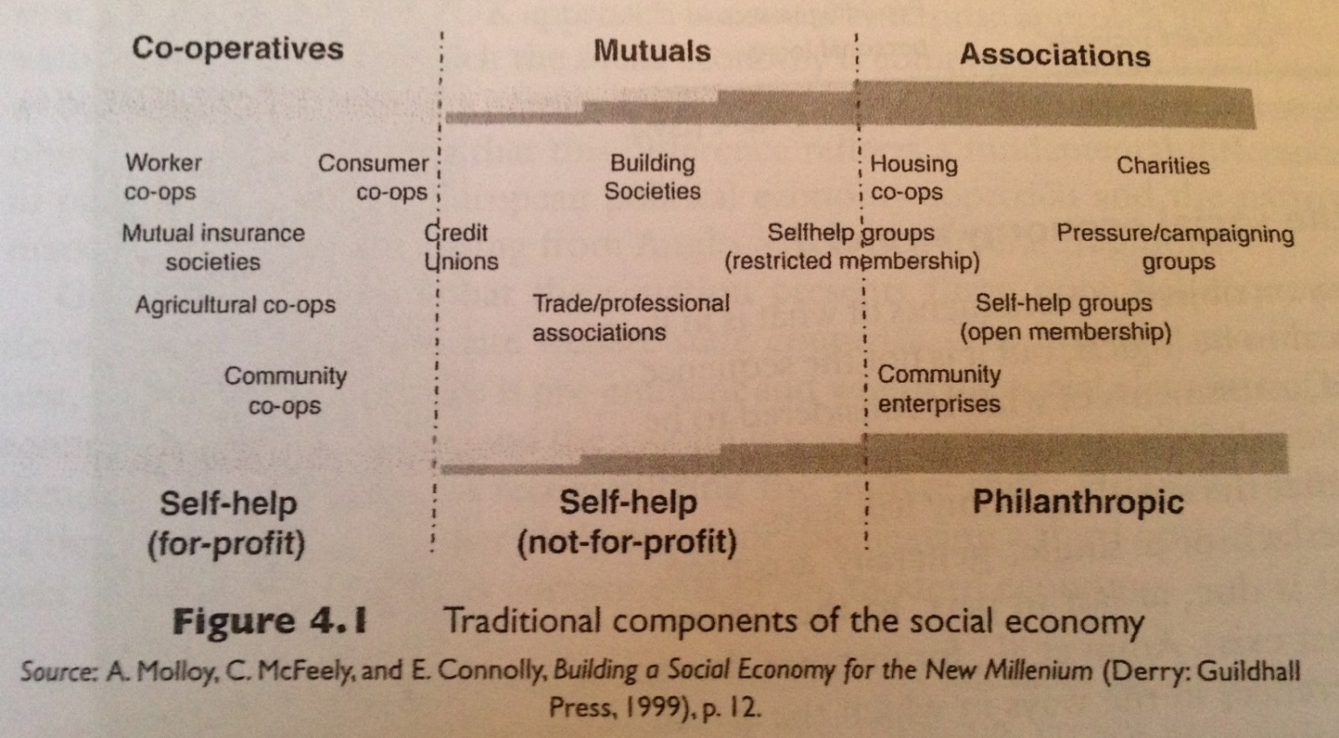
Notes:
This figure presents the social economy as a sector encompassing a range of organisations, with agencies positioned in different places in the range depending on their economic rationale and constitutional status. However, you should note that the social economy as areas of activity that overlapped between private, public ad voluntary sectors and saw it as flexible but characterised by a number of common features.

Slide 25
The Rise of the Social Economy
First conceptualised in the 19th century – ‘associations’ were formed to organise and protect communities of interest (Egyptian, Greek and Roman times).
1929-1932 – economic collapse led to the formation of consumption co-operatives for food and housing.
1970s Europe - a reaction to the crises on mass production system and a response to the overburdening welfare state.
www.midocean.ae

Slide 26
What is Social Enterprise?
Combining income generating activity with a social goal
Creating social change at a community level

Slide 27
According to the Social Enterprise Coalition, Social Enterprises are…
“…businesses trading for social and environmental purposes. Social enterprises are distinctive because their social and/or environmental purpose is absolutely central to what they do - their profits are reinvested to sustain and further their mission for positive change.”
“We have described and keep on describing organisations motivated by social objectives as non-profit organisations. We need to have another description: ‘non-loss ’organisations, because we don’t want to lose money and our objective is to address a particular problem. So we are non-loss businesses with social objectives.”
Muhammad Yunus, Founder of the Grameen Bank, Bangladesh
www.midocean.ae

Slide 28
Part 1: Characteristics of Social Enterprises
A combination of social, ethical and economic purposes and values.
Benefits for members or community rather than to reward investment.
‘People centred’ rather than ;investment centred’
Participative values.
Independent and self-governing.
Where trading takes place it is to address the aims of the organisations.
(Oatley, N. (1999). Developing the social economy, Local Economy, 14(4), 339-345).
www.midocean.ae

Slide 29
Part 2: Characteristics of Social Enterprises
Having a social purpose or purposes.
Achieving the social purpose by, at least in part, engaging in trade in the market place.
Not distributing profits to individuals.
Holding assets and wealth in trust for community benefits.
Democratically involving members of its constituency in the governance of the organisation.
Being independent organisations accountable to a defined constituency and to the wider community.
(Pearce, J. (2003). Social Enterprise in Anytown (London: Calouste Gulbenkian Foundation), 31-32).
www.midocean.ae

Slide 30
Key Differences
Explicit Social Aims – ‘triple bottom line’:
Private sector business primarily focus is on trading; social enterprises too have a commercial focus but will also have an explicit social and/or environmental purpose.
Funding:
Social enterprises often have a complex composition of sales income, commercial contracts, service level agreements and grant support.
Risk:
Social enterprises are usually governed by a Board of volunteers, which may mean that they are more risk averse in terms of pursuing business ventures.
Scale:
Start up costs may be much higher because social enterprise usually has to operate on a scale that is large enough to sustain its social commitment from the beginning
www.midocean.ae

Slide 31
Key Differences
Investment:
Social enterprises may have difficulty gaining access to traditional forms of investment such as loan finance.
Leadership / Entrepreneurship:
Leaders of social enterprises are usually driven by the social potential of the venture and will need to find support for the other areas of the enterprise
Stakeholders:
Social Enterprises usually have a wide range of stakeholders involved in their development, which can mean that there is a wide influence on the development process.
Sweat Equity:
“sweat equity” is invested to grow and build the enterprise but the purpose is not financial gain but social
www.midocean.ae

Slide 32
Social Entrepreneurship
Author | Definition of Social Entrepreneurship
Leadbeater (1997) | Individuals whose social capital enables them to promote social value through innovation
Brinckerhoff (2000) | Individuals who take wishes on the behalf of other people.
Thompson et al. (2000) | Individual who combines vision, values and resources to address an unmet need.
Dees (2001) | Individuals who act as 'change agents' in society
Institute for Social Entrepreneurs (2002) | Obtaining both a financial and social return on investment.
Mort et al. (2003) | Individual whose leadership and personal credibility can generate commitment to a social goal in others.
Haugh (2005) | Activities connected to the creation of social vale and organisations to pursue those social values.
Mair and Marti (2006) | Focus on creating social value over creating economic value.
Nicholls (2006) | Combination of accountability, effectiveness and impact.
Peredo and McLean (2006) | Aim to create social value; vision of an opportunity to create value; innovation; accept risks; and resourceful.

Slide 33
Social Entrepreneurs
Socially driven, ambitious leaders, with great skills in communicating a mission and inspiring staff, users and partners. In all cases they have been capable of creating impressive schemes with virtually no resources.
www.midocean.ae

Slide 34
Social Entrepreneurs
Create flat and flexible organisations, with a core of full-time paid staff, who work with few resources but a culture of creativity.
www.midocean.ae

Slide 35
Social Entrepreneurship Construct
risk tolerance
proactiveness
innovation
social
opportunity
recognition
social entrepreneurship
judgement
capacity
entrepreneurially
virtuous
Notes:
Global Entrepreneurship Monitor (GEM) claims that social entrepreneurial activity is highest amongst 18-24 year olds and there is no significance between men and women. This should be treated with caution as social entrepreneurship is so broad and involves individuals starting or managing alone or with others any form of social, community or voluntary activity.
Mort et al. argue that there social entrepreneurship is multidimensional and only exists when it incorporates the above 4 elements:
Creating better social value than their competitors which results in exhibiting virtuous behaviour.
Balanced judgement and ability to see through the complexity of the situation they face.
Similar to business entrepreneurs they are able to recognise opportunities.
Like business entrepreneurs are innovative, proactive and risk-takers in their decision making.
Virtue is key a element in the construct. It underpins the social entrepreneur’s judgement – positively good values such as love, integrity, honesty and empathy.

Slide 36

www.midocean.ae
Shaw, E. and Carter, E. (2007). Social entrepreneurship: Theoretical antecedents and empirical analysis of entrepreneurial processes and outcomes. Journal of Small Business and Enterprise Development, 14 (3), pp. 418-434.
Special Issue on Social Entrepreneurs' Behavior, September (2012). Entrepreneurship Theory and Practice, Volume 36, Issue 5, Pages 889–1102
Chapter
5
Readings

Slide 37
What is Industry Analysis?
Industry
  An industry is a group of firms producing a similar product or service, such as music, Pilates and yoga studios, and solar panel manufacturing.
Industry Analysis
  Is business research that focuses on the potential of an industry.
www.midocean.ae

Slide 38
Why is Industry Analysis Important?
Once it is determined that a new venture is feasible in regard to the industry and market in which it will compete, a more in-depth analysis is needed to learn the ins and outs of the industry.
The analysis helps a firm determine if the target market it identified during feasibility analysis is favorable for a new firm.
www.midocean.ae

Slide 39
Three Key Questions
When studying an industry, an entrepreneur must answer three questions before pursuing the idea of starting a firm.
Is the industry
accessible—in other
words, is it a realistic
place for a new
venture to enter?
Question 1
Does the industry
contain markets that
are ripe for innovation
or are underserved?
Question 2
Are there positions in
the industry that avoid
some of the negative
attributes of the
industry as a whole?
Question 3

Slide 40
How Industry and Firm-Level Factors
Affect Performance
Firm-Level Factors
  Include a firm’s assets, products, culture, teamwork among its employees, reputation, and other resources.
Industry-Level Factors
  Include threat of new entrants, rivalry among existing firms, bargaining power of buyers, and related factors.
Conclusion
  In various studies, researchers have found that from 8% to 30% of the variation in firm profitability is directly attributable to the industry in which a firm competes.
www.midocean.ae

Slide 41
Techniques Available to Assess Industry
Attractiveness
Assessing Industry Attractiveness
Study Environmental
and Business Trends
The Five Competitive
Forces Model

Slide 42
Studying Industry Trends
Environmental Trends
  Include economic trends, social trends, technological advances, and political and regulatory changes.
  For example, industries that sell products to seniors are benefiting by the aging of the population.
Business Trends
  Other trends that impact an industry.
  For example, are profit margins in the industry increasing or falling? Is innovation accelerating or waning? Are input costs going up or down?
www.midocean.ae

Slide 43
The Five Competitive Forces Model
Explanation of the Five Forces Model
  The five competitive forces model is a framework for understanding the structure of an industry.
  The model is composed of the forces that determine industry profitability.
  They help determine the average rate of return for the firms in an industry.
www.midocean.ae

Slide 44
The Five Competitive Forces Model
Explanation of the Five Forces Model (continued)
  Each of the five forces impacts the average rate of return for the firms in an industry by applying pressure on industry profitability.
  Well managed firms try to position their firms in a way that avoids or diminishes these forces—in an attempt to beat the average rate of return of the industry.
www.midocean.ae

Slide 45
The Five Competitive Forces Model

Slide 46




Thank You

