Slide 1


Accounting for Managers
Prepared by Dr. Emad Zaher
Assistant Professor of Accounting
MGM341
Lecture (10)
Planning for capital investments

Slide 2

Planning for Capital Investments
  Learning Objectives
LO 1 Describe capital budgeting inputs and apply the cash payback technique.
LO 2 Use the net present value method.
LO 3 Identify capital budgeting challenges.

Slide 3
Capital Budgeting and Cash Payback
Company capital budget authorization process:
  Proposals for projects are requested from each department.
  Proposals are screened by a capital budget committee.
  Officers determine which projects are worthy of funding.
  Board of directors approves capital budget.
  LO 1

Slide 4
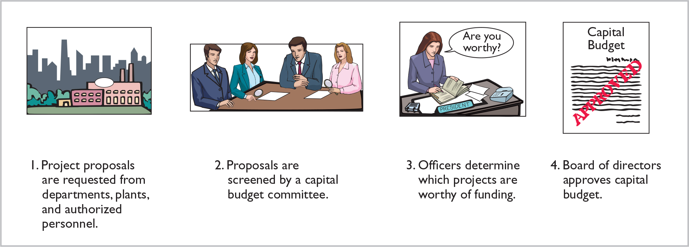
Authorization Process
Many companies follow a carefully prescribed process in capital budgeting.
  LO 1

Slide 5
Cost Flow Information
For purposes of capital budgeting, estimated cash inflows and outflows are the preferred inputs.
Why?
Ultimately, the value of all financial investments is determined by the value of cash flows received and paid.
  LO 1

Slide 6
Cost Flow Information
Typical cash flows relating to capital budgeting decisions.
Cash Outflows
Initial investment
Repairs and maintenance
Increased operating costs
Overhaul of equipment
Cash Inflows
Sale of old equipment
Increased cash received from customers
Reduced cash outflows related to operating costs
Residual value of equipment
  LO 1

Slide 7
Cost Flow Information
Capital budgeting decisions depend on:
  Availability of funds.
  Relationships among proposed projects.
  Company’s basic decision-making approach.
  Risk associated with a particular project.
  LO 1

Slide 8
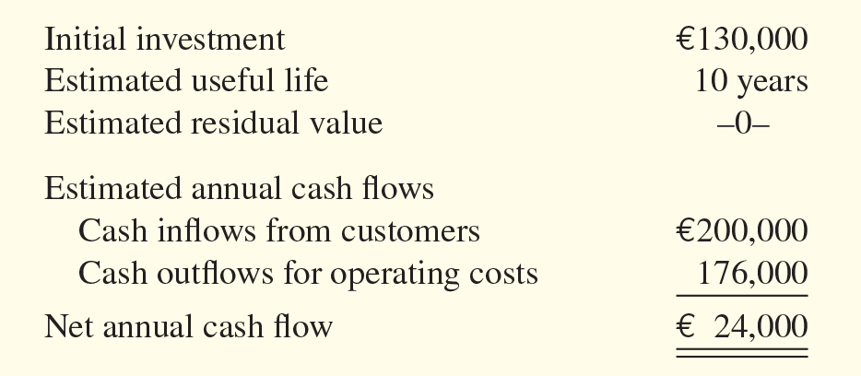
Illustrative Data
Sikkim Shipping is considering an investment of €130,000 in new equipment.
  LO 1

Slide 9
Cash Payback period

Slide 10
Cash Payback
Cash payback technique identifies the time period required to recover the cost of the capital investment from the net annual cash inflow produced by the investment.
Cash payback period for Sikkim is …
€130,000 ÷ €24,000 = 5.42 years
  LO 1

Slide 11
Cash Payback
Shorter payback period = More attractive the investment
In the case of uneven net annual cash flows, the company determines the cash payback period when the:
Cumulative net cash flows from the investment
Cost of the investment
=
  LO 1

Slide 14
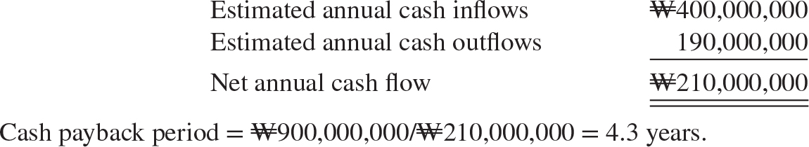
DO IT! 1 Cash Payback Period
Ghim Paper is considering adding another machine for the manufacture of corrugated cardboard. The machine would cost ₩900,000,000. It would have an estimated life of 6 years and no residual value. The company estimates that annual cash inflows would increase by ₩400,000,000 and that annual cash outflows would increase by ₩190,000,000. Compute the cash payback period.
  LO 1

Slide 16
Net Present Value Method
Discounted cash flow technique:
  Generally recognized as best approach.
  Considers both estimated total cash inflows and time value of money.
  Two methods:
    Net present value (NPV).
    Internal rate of return (IRR).
  LO 2

Slide 17
Net Present Value (NPV) method
  Cash inflows are discounted to their present value and then compared with the capital outlay required by the investment (see Decision Tools).
  The interest rate used in discounting is the required minimum rate of return.
  Proposal is acceptable when NPV is zero or positive.
  The higher the positive NPV, the more attractive the investment.
  LO 2

Slide 18
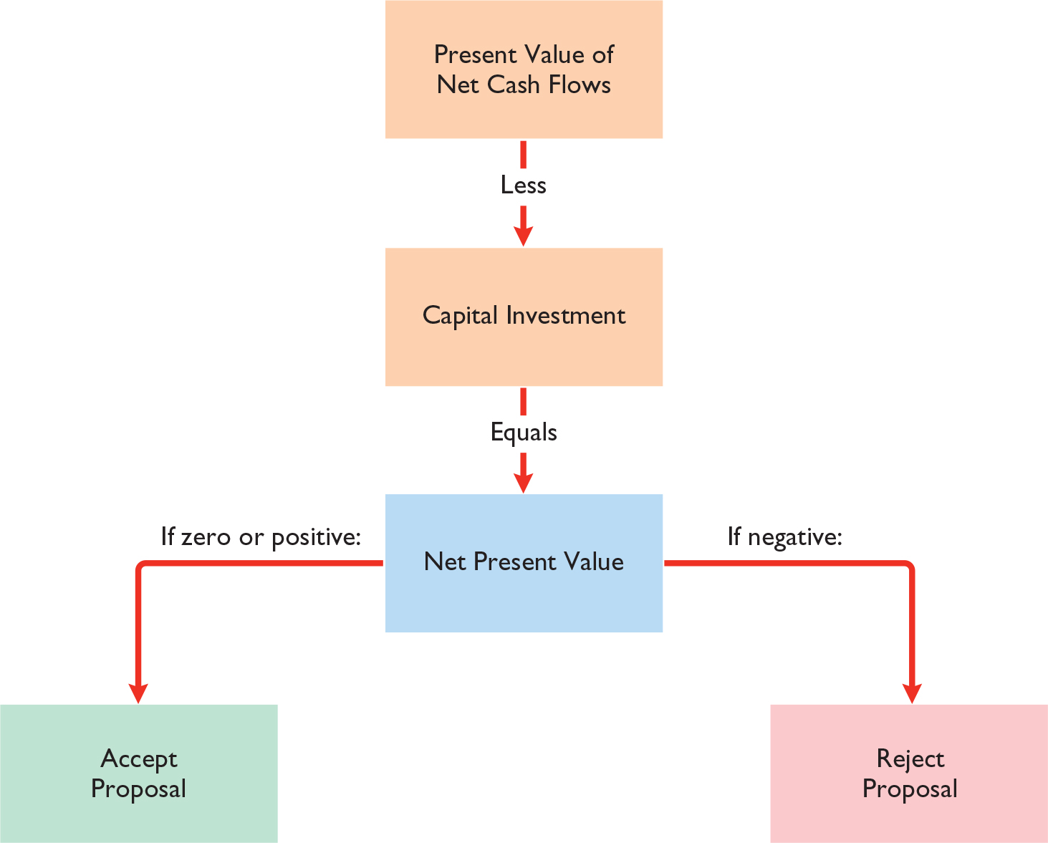
Net Present Value Method
Proposal is acceptable when net present value is zero or positive.
  LO 2

Slide 19
Computing Net Present Value

Slide 20
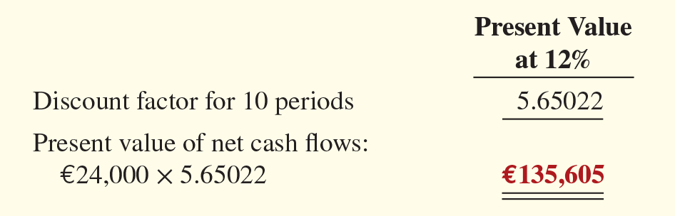
Equal Annual Cash Flows
Illustration: Sikkim Shipping company’s annual cash flows are €24,000. If we assume this amount is uniform over the asset’s useful life- Capital investments € 130.000, we can compute the present value of the net annual cash flows.
  LO 2

Slide 21
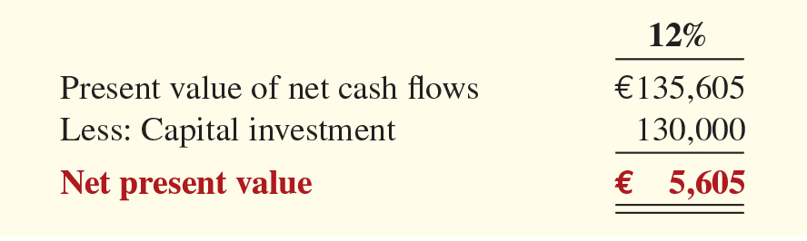
Equal Annual Cash Flows
Illustration: Calculate the present value.
The proposed capital expenditure is acceptable at a required rate of return of 12% because the net present value is positive.
  LO 2

Slide 22
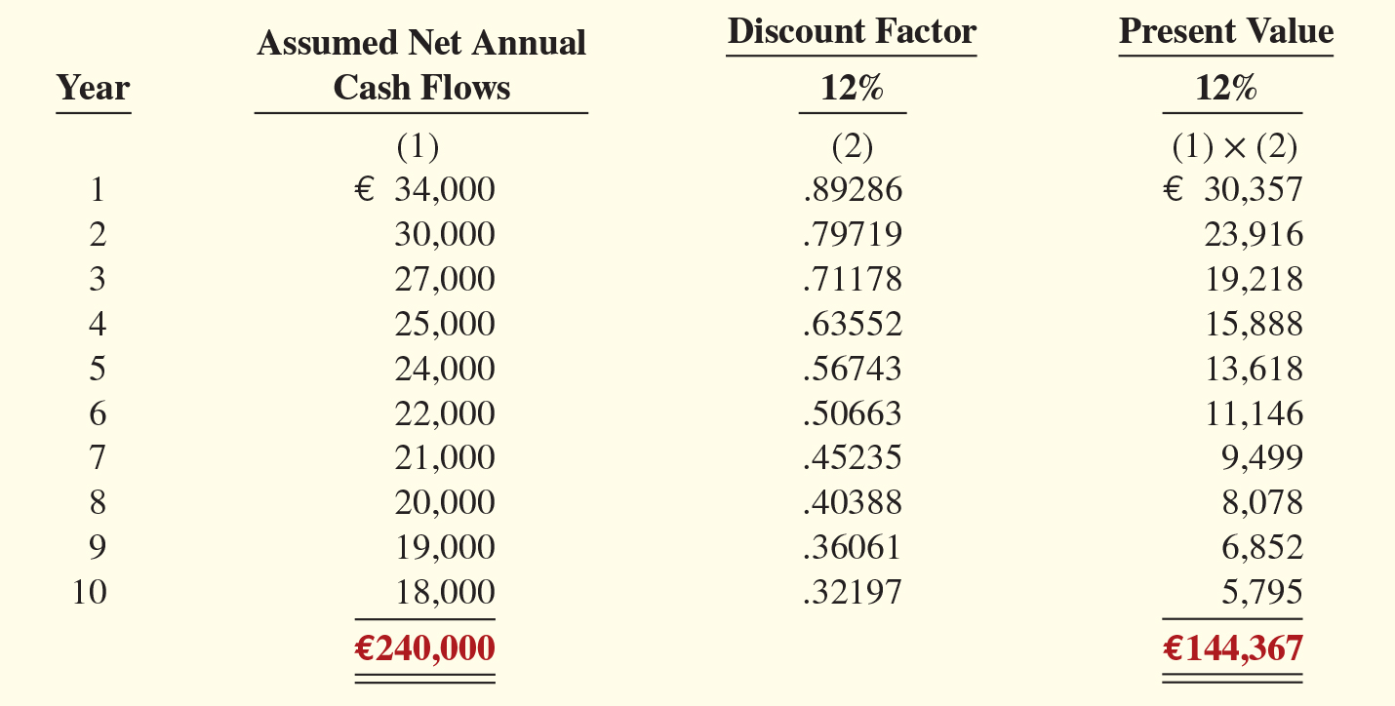
Unequal Annual Cash Flows
  LO 2

Slide 23
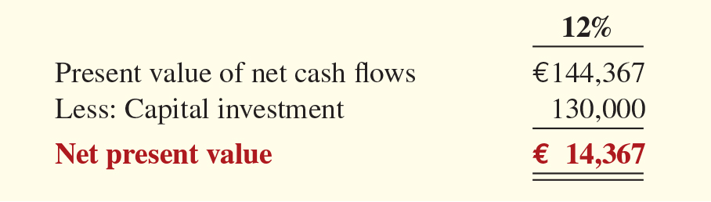
Unequal Annual Cash Flows
Illustration: Calculate the net present value.
Proposed capital expenditure is acceptable at a required rate of return of 12% because the net present value is positive.
  LO 2

Slide 24
Choosing a Discount Rate
In most instances a company uses a required rate of return equal to its cost of capital — that is, the rate that it must pay to obtain funds from creditors and shareholders (see Helpful Hint).
Discount rate has two elements:
  Cost of capital
  Risk
Rate also know as
  required rate of return.
  hurdle rate.
  cutoff rate.
  LO 2

Slide 25
Net Present Value (NPV) Method
Question
Compute the net present value of a $260,000 investment with a 10-year life, annual cash inflows of $50,000 and a discount rate of 12% - Present value factor 5.65022.
  $(9,062).
  $22,511.
  $9,062.
  $(22,511).
  LO 2

Slide 26
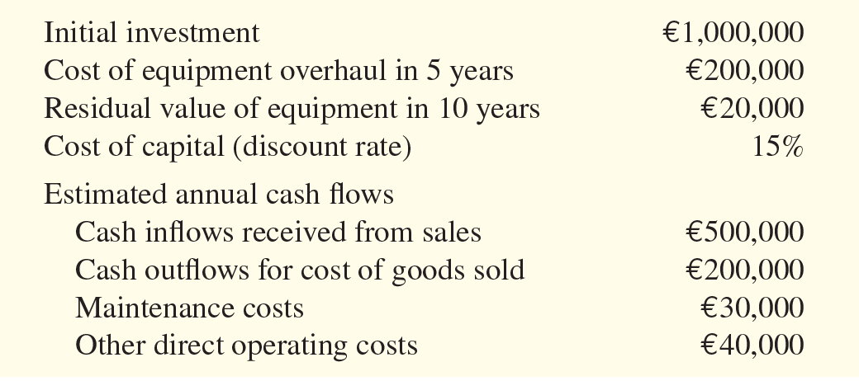
Comprehensive Example (1 of 3)
Best Taste Foods is considering investing in new equipment to produce fat-free snack foods.
Compute the net annual cash flow.
  LO 2

Slide 27
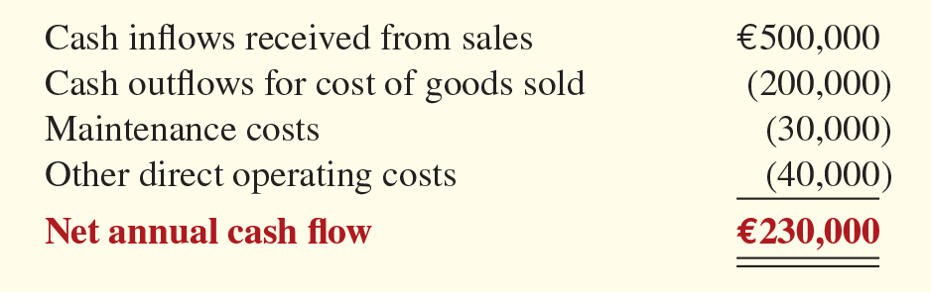
Comprehensive Example (2 of 3)
Compute the net annual cash flow.
  LO 2

Slide 28
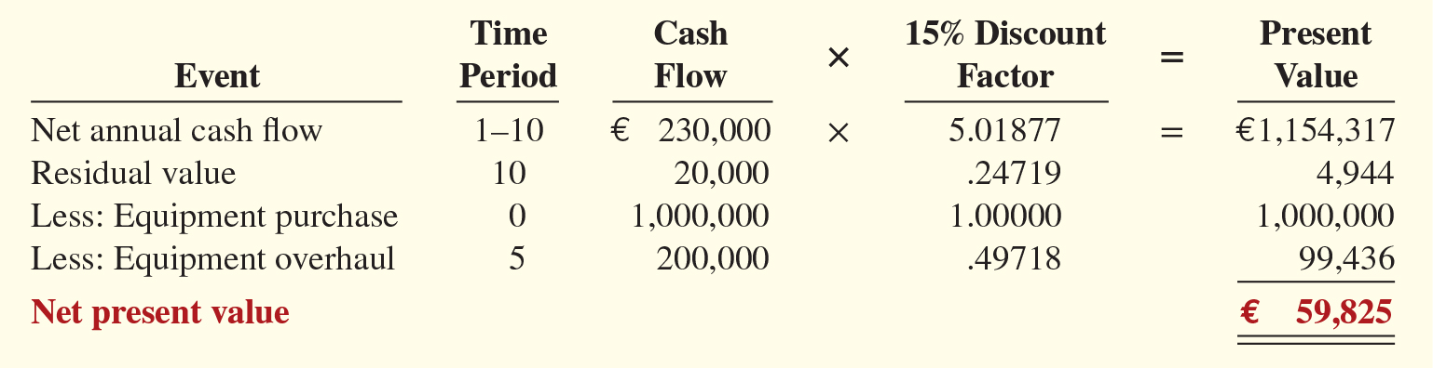
Comprehensive Example (3 of 3)
Compute the net annual cash flow.
  LO 2

Slide 29
DO IT! 2 Net Present Value
The machine would cost ₩900,000,000. It would have an estimated life of 6 years and no residual value. The company estimates that annual cash inflows would increase by ₩400,000,000 and that annual cash outflows would increase by ₩190,000,000. Management has a required rate of return of 9%- PV Factor 4.48592. Calculate the net present value on this project and discuss whether it should be accepted.
  LO 2

Slide 30
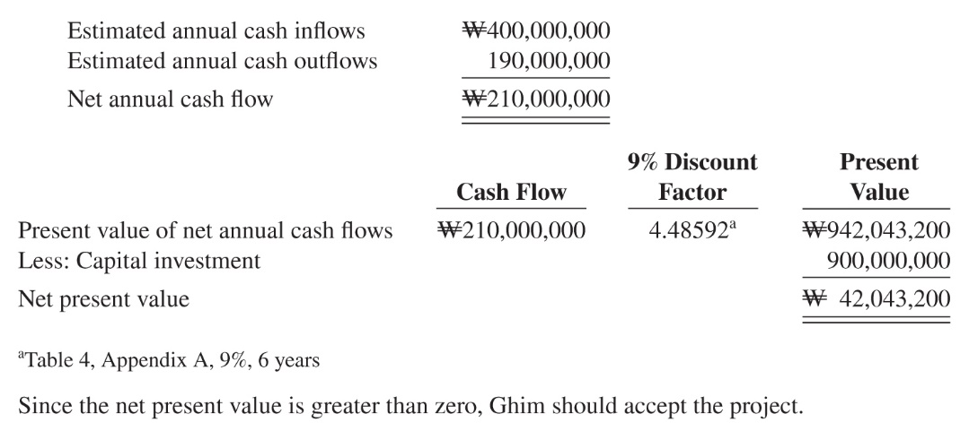
DO IT! 2 Net Present Value
Calculate the net present value on this project and discuss whether it should be accepted.
  LO 2

Slide 31
A manufacturing company is offered machine which costs LE 1500.000 and achieve an annual cash inflows of LE 500000 for six years, Do you advice the company to buy this machine given that the Present value factor 3.49

Slide 32
DO IT

Slide 33
For purposes of capital budgeting, estimated cash inflows and outflows are preferred for inputs into the capital budgeting decision tools.
Answer: True
2. The cash payback method is frequently used as a screening tool but it does not take into consideration the profitability of a project.
Answer: True
3. The net present value method can only be used in capital budgeting if the expected cash flows from a project are an equal amount each year.
Answer: False
. 4. In computing the net present value , the discount rate is referred to required rate of return.
Answer: True
5. The primary capital budgeting method that uses discounted cash flow techniques is the cash payback technique
Answer: False

Slide 34
6. If project A has a lower payback period than project B, this may indicate that project A may have a
a. lower NPV and be less profitable.
b. higher NPV and be less profitable.
c. higher NPV and be more profitable.
d. lower NPV and be more profitable.
Answer (C)
7. Net annual cash flow can be estimated by
a. deducting credit sales from net income.
b. adding depreciation expense to net income.
deducting credit purchases from net income.
adding advertising expense to net income.
Answer (B)

Slide 35



Thank You

