Slide 1

CYB 510 OPERATING SYSTEMS
Prepared by Prof. Dr. Lamiaa Fattouh
Lecture 4
CYB 510
CPU SCHEDULING

Slide 2
Determining Length of Next CPU Burst
The Real difficulty with the SJF algorithm is knowing the length of the next CPU request
We may not know but we can predict
Can be done by using the length of previous CPU bursts, using exponential averaging

Slide 3
Shortest-Job-First (SJR) Scheduling
SHORTEST JOB FIRST:
  Optimal for minimizing queueing time, but impossible to implement. Tries to predict the process to schedule based on previous history.
  Predicting the time, the process will use on its next schedule:
t( n+1 ) = w * t( n ) + ( 1 - w ) * T( n )
Here: t(n+1) is time of next burst.
t(n) is time of current burst.
T(n) is average of all previous bursts .
w is a weighting factor emphasizing current or previous bursts.

Slide 4
Priority Scheduling
SJF is priority scheduling where priority is the predicted next CPU burst T
Priority can be defined internally (to OS) or externally.
  Internal: CPU usage time, memory requirements, I/O usage
  External: importance, type, political issues
A priority number (integer) is associated with each process(small ≡ high)
The CPU is allocated to the process with the highest priority (smallest integer ≡ highest priority).
When a process arrives at ready state, its priority will be compared to priority of running process. If newly process has higher priority:
  Preemptive – it preempts the running one and old running one will be put into ready.
  Nonpreemptive- it does not preempt the running one and it will be put at the head of ready state.
Problem ≡ Starvation (indefinite blocking)– low priority processes may never execute
Solution ≡ Aging – As a process uses more execution time, dynamically decreases its priority or increase the priority of other lower processes (say increase priority by 1 every 15 min)

Slide 5
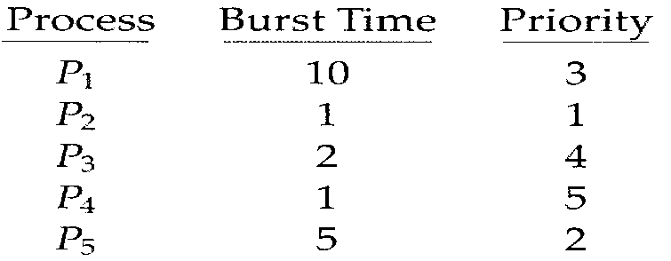
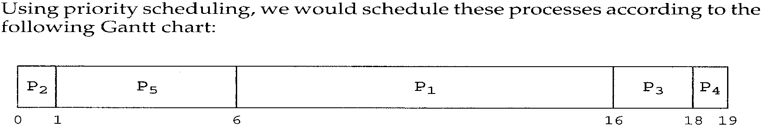
Priority Scheduling-Example
Highest
lowest
Average waiting time = (0+1+6+16+18)/5= 41/5= 8.2msec

Slide 6
Priority Scheduling-Example
Arrival time
0
3
2
1
4
Non-Preemptive
P1 P2 P5 P3 P4
0 10 11 16 18 19
Waiting time P₁=0
P₂= 10-3=7
P₅=11-4=7
P₃= 16-2=14
P₄=18-1=17

Slide 7
Priority Scheduling-Example
Arrival time
0
3
2
1
4
Preemptive
P₁ P₂ P₅ P₁ P₃ P₄
0 1 2 3 4 9 16 18 19

Slide 8
Round Robin (RR)-Interactive systems
In Timesharing systems that wish to provide “fair” distribution of CPU resources one process can’t monopolize CPU
RR can be considered FCFS with preemption.
Each process is assigned a single time interval (time-slice), called quantum, in which it is allowed to run (use CPU ) before it is preempted.

Slide 9
Round Robin (RR)-Interactive systems
Each process gets a small unit of CPU time, usually 10-100 milliseconds.
  If process is still running at the end of the quantum, CPU is given to another process from ready queue and that process is preempted ⇒ move to ready
    RR puts those processes in ready queue. Where?
    will put them at the end
If there are n processes in the ready queue and the time quantum is Q, each process gets 1/n of the CPU, in chunks of at most size Q (fairness)
No process waits for more than (N-1)Q time units before next quantum

Slide 10
Example of RR with Time Quantum = 4
Process Burst Time
P₁ 24
P₂ 3
P₃ 3
The Gantt chart is:
P₁
P₂
P₃
P₁
P₁
P₁
P₁
P₁
0
4
7
10
14
18
22
26
30
Average waiting time = (0+4+7+(10-4))/3= 17/3= 5.66msec

Slide 11
Typically, higher average turnaround than SJF, but better responsiveness.
Average = [((6-2)+(10-8))+(2+(8-4))+(4+(9-6))]/3=19/3= 6.33 msec. It gets better if the quantum is chosen smaller
Sure all above numbers ignore context switch time!
Quantum=2
P₁
P₂
P₃
P₁
P₂
P₃
P₁
P₁
0
2
4
6
8
9
10
12
30

Slide 12

Example of RR with Time Quantum= 4
EXAMPLE DATA:
  Process Arrival Service
  Time Time
  1 0 8
  2 1 4
  3 2 9
  4 3 5
Round Robin, quantum = 4, no priority-based preemption
P1
P2
P3
P4
P1
P3
P4
P3
0
4
8
12
16
20
24
25
26
Average wait = ( (12) + (4-1) + ((8-2)+(20-12)+(25-24)) + ((12-3)+(24-16)) )/4 = 12+3+15+17=
47/4= 11.75

Slide 13
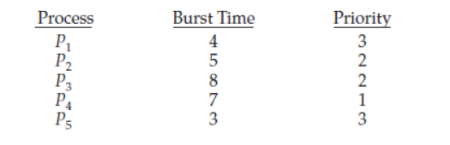
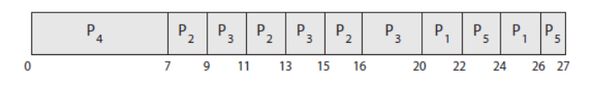
Round-robin and Priority scheduling
Another option is to combine round-robin and priority scheduling in such
a way that the system executes the highest-priority process and runs processes
with the same priority using round-robin scheduling. Time Quantum= 2

Slide 14
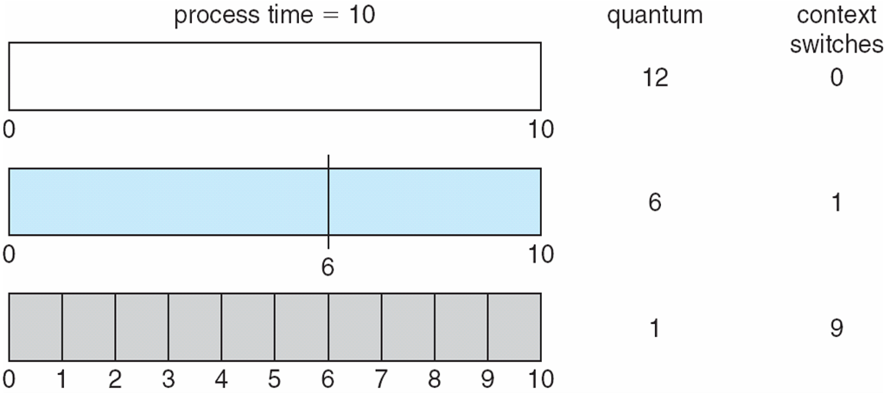
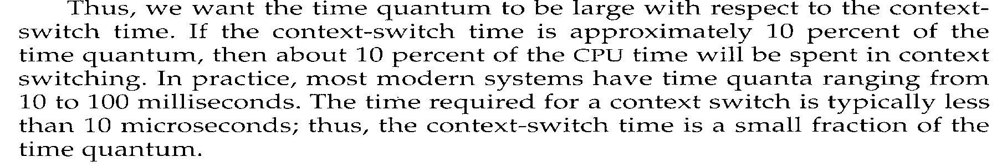
Time Quantum and Context Switch Time
Finish in
>1 Q
2 Q + Overhead
10 Q+9 * Overhead

Slide 15
Time Quantum and Context Switch Time
- Setting quantum too short → many process switches → lowers the CPU efficiency. Suppose: quantum = 20 msec. process switch = 5 msec. This yields a 20% CPU waste time and 80% usage.
- Setting the quantum too long → may cause poor response time to short interactive requests (e.g. 500 msec. And 5 → CPU wasted time less than 1%)

Slide 16
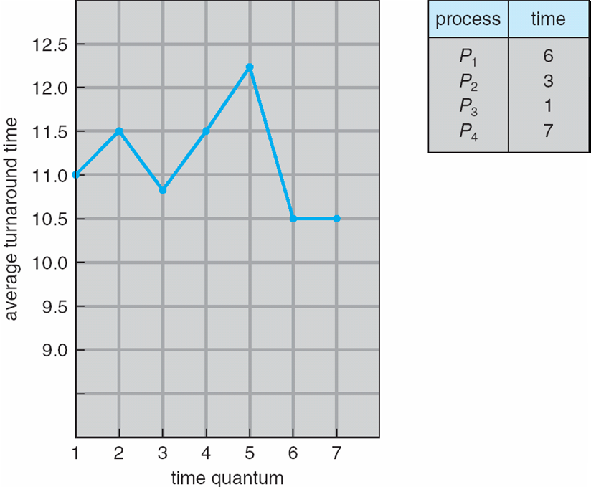
Turnaround Time Varies With The Time Quantum
Turnarround time depends on size of quantum .
Average turnaround time does not necessarily improves as time quantum size increase.

Slide 17
Multilevel Queue Scheduling
Suitable for the case where processes can be classified in different groups according to some process criteria (type, size, priority,... )
Multilevel Queue Scheduling partitions the Ready queue into several separate queues according to response time requirement .
Processes have different scheduling needs:
  foreground (interactive) -high response time and have external priority
  background (batch) – has less interaction and less priority

Slide 18
Multilevel Queue Scheduling
Each queue has its own scheduling algorithm
  foreground – RR
  background – FCFS
Scheduling must be done between the queues. Two possibilities
  1) Fixed priority scheduling; (i.e., serve all from foreground then from background). Possibility of starvation.
    If a student process is running and an interactive process enters the ready queue, the student process will be preempted.
    Means that no process can run from batch if processes exist in the higher priority queues--→ Starvation is possible

Slide 19
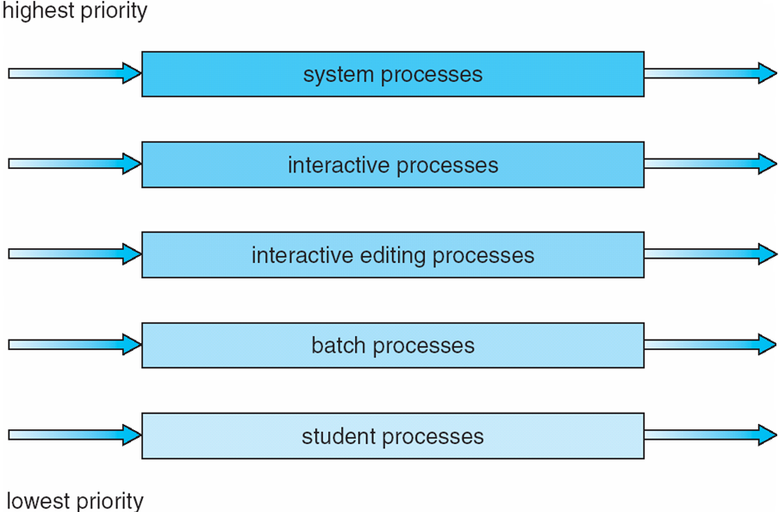
Multilevel Queue Scheduling(cont.)
  2) Time slice – each queue gets a certain amount of CPU time which it can schedule amongst its processes; i.e., 80% to foreground in RR and 20% to background in FCFS
Problem: normally a process enters a queue will remain there. System does not move it from queue to queue!. Permanent queue assignment

Slide 20
Multilevel Feedback Queue Scheduling
A process can move between the various queues:
  Separate processes according to their CPU bursts characteristics
    If a process uses too much CPU, move it to lower priority queue
  Use aging to prevent starvation
    If a process stay too long to get CPU, move it to higher priority queue
Multilevel-feedback-queue scheduler defined by the following parameters:
  number of queues
  scheduling algorithms for each queue
  method used to determine when to upgrade a process
  method used to determine when to demote a process
  method used to determine which queue a process will enter when that process needs service

Slide 21
Example of Multilevel Feedback Queue
Three queues with different Q and priority and scheduling algorithm:
  Q₀ – RR with time quantum 8 milliseconds (Highest priority)
  Q₁ – RR time quantum 16 milliseconds
  Q₂ – FCFS (Lowest priority)
Scheduling
  A new job enters queue Q₀ which is served FCFS basis . When it gains CPU, job receives 8 milliseconds. If it does not finish in 8 milliseconds, job is moved to queue Q₁.
  At Q₁ job is again served FCFS basis and receives 16 additional milliseconds. If it still does not complete, it is preempted and moved to queue Q₂.

Slide 22
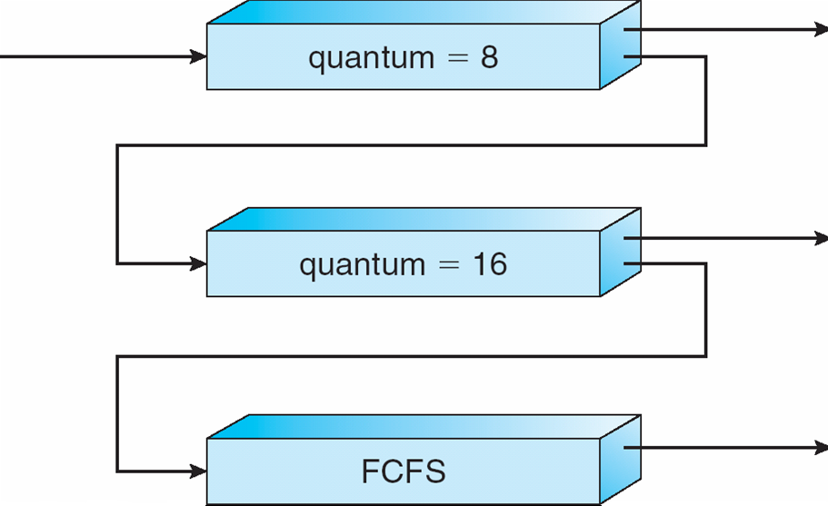
Multilevel Feedback Queue
Short Process has higher priority:
Always run processes in Q₀
Only when Q₀ is empty, processes in Q₁ or Q₂ (if Q₁ is empty)get CPU
Preempt running process from Q₁ or Q₂ when a process enters Q₀

Slide 23
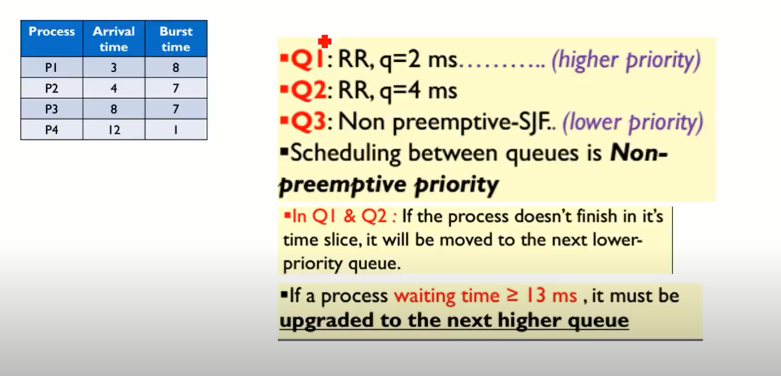
Multilevel Feedback Queue
2
4
SJF

Slide 24
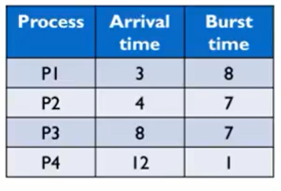

 | TIME= 13 | 22 | 23
P1 | 2 | 13
P2 | 1 | 12 | 13
P3 | 3 | 8 | 9
P4 | 1 | 1
P1
P2
P3
P4
3 4 7 8 12
P1
P2
P3
P1
P2
5 7 9 13 22 23
P1
P2
P3
11 18 21 26
P1
P2
P1
P3
P4
P2
P3
P1
P2
P3
3 5 7 11 13 14 18 22 24 25 26

Slide 25
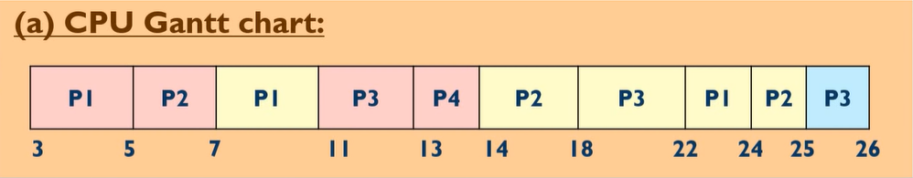
Multilevel Feedback Queue
P1=7-5+22-11=13
P2=5-4+14-7+24-18=14
P3=11-8+18-13+25-22=11
P4=13-12=1

Slide 26



P2 has been upgraded at time 24 from Q3 to Q2

Slide 27
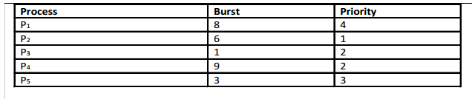
Test yourself
Priority
SJF
FCFS

Slide 28
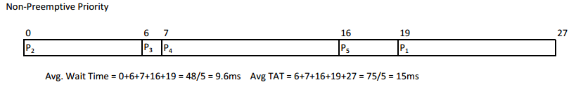
Answer : priority

Slide 29

Answer : SJF

Slide 30
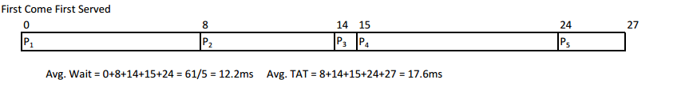
Answer : FCFS

Slide 31
End lecture 4
Thank You

