Slide 1


Ethical Hacking Essentials (EHE)
Master of Science in Cybersecurity
Dr. Kamal Alieyan
Everyone Smart University
Faculty of IT – 2022/2023

Slide 2


Module 05
Social Engineering Techniques and Countermeasures

Slide 3

Module Objectives
Creative idea
1
Understanding Social Engineering Concepts
Understanding Various Social Engineering Techniques
2
3
Understanding Insider Threats
4
Understanding Identity Theft
Understanding Different Social Engineering Countermeasures
5
Understanding Different Insider Threats and Identity Theft Countermeasures
6

Slide 4
Module Flow
01
03
Discuss Social Engineering Concepts and its Phases
Discuss Insider Threats and Identity Theft
04
02
Discuss Social Engineering Countermeasures
Discuss Social Engineering Techniques

Slide 5

What is Social Engineering?
Social engineering is the art of convincing people to reveal confidential information
Social engineers depend on the fact that people are unaware of the valuable information to which they have access and are careless about protecting it

Slide 6
Common Targets of Social Engineering
1
Receptionists and Help-Desk Personnel
2
Technical Support Executives
3
System Administrators
4
Users and Clients
5
Vendors of the Target Organization
6
Senior Executives

Slide 7
Impact of Social Engineering Attack on an Organization
1
2
3
Economic losses
Damage of goodwill
Loss of privacy
4
5
6
Dangers of terrorism
Lawsuits and arbitration
Temporary or permanent closure

Slide 8
Behaviors Vulnerable to Attacks
Authority
Urgency
Intimidation
Familiarity or Liking
Consensus or Social Proof
Trust
Scarcity
Greed

Slide 9
Factors that Make Companies Vulnerable to Attacks
Insufficient security
training
1
2
Unregulated access to information
3
4
Several organizational
units
Lack of security
policies

Slide 10
Why is Social Engineering Effective?
Social engineering does not deal with network security issues; instead, it deals with the psychological manipulation of a human being to extract desired information
01
Security policies are as strong as their weakest link, and human behavior is the most susceptible factor
02
It is difficult to detect social engineering attempts
There is no method that can be applied to ensure complete security from social engineering attacks
03
There is no specific software or hardware to defend against a social engineering attack
04

Slide 11

Phases of a Social Engineering Attack
Research the Target Company
Dumpster diving, websites, employees, tour of the company, etc.
Select a Target
Identify frustrated employees of the target company
Develop a Relationship
Develop a relationship with the selected employees
Exploit the Relationship
Collect sensitive account and financial information, as well as current technologies

Slide 12
Module Flow
01
03
Discuss Social Engineering Concepts and its Phases
Discuss Insider Threats and Identity Theft
04
02
Discuss Social Engineering Countermeasures
Discuss Social Engineering Techniques

Slide 13
Types of Social Engineering
Human-based Social Engineering
Computer-based Social Engineering
Mobile-based Social Engineering
“Sensitive information is gathered by interaction ”.
Techniques:
Impersonation
Vishing
Eavesdropping
Shoulder Surfing
Dumpster Diving
Reverse Social Engineering
Piggybacking
Tailgating
“Sensitive information is gathered with the help of computers”.
Techniques:
Phishing
Pop-up Window Attacks
Spam Mail
Instant Chat Messenger
Scareware
“Sensitive information is gathered with the help of mobile apps”.
Techniques:
Publishing Malicious Apps
Using Fake Security Apps
Repackaging Legitimate Apps
SMiShing (SMS Phishing)

Slide 14

Human-based Social Engineering
Impersonation
The attacker pretends to be someone legitimate or an authorized person
Attackers may impersonate a legitimate or authorized person either personally or using a communication medium such as phone, email, etc.
to reveal sensitive information
Posing as a Legitimate End User
The attacker gives this identity and asks for the sensitive information
“Hi! This is John from the Finance Department. I have forgotten my password. Can I get it?”
Posing as an Important User
The attacker poses as a VIP of a target company, valuable customer, etc.
“Hi! This is Kevin, CFO Secretary. I’m working on an urgent project and lost my system’s password. Can you help me out?”
Impersonation
Examples

Slide 15

Human-based Social Engineering (Cont’d)
Impersonation (Vishing)
An impersonation technique in which the attacker tricks individuals to reveal personal and financial information using voice technology such as the telephone system, VoIP, etc.
Vishing Example
Abusing the Over-Helpfulness of Help Desks
The attacker calls a company’s help desk, pretends to be someone in a position of authority or relevance and tries to extract sensitive information from the help desk
“A man calls a company’s help desk and says he has forgotten his password. He adds that if he misses the deadline on a big advertising project, his boss might fire him.
The help desk worker feels sorry for him and quickly resets the password, unwittingly giving the attacker a clear entrance into the corporate network.”

Slide 16

Human-based Social Engineering (Cont’d)
Eavesdropping
Shoulder Surfing
Dumpster Diving
Unauthorized listening of conversations, or reading of messages
Interception of audio, video, or written communication
Direct observation techniques such as looking over someone's shoulder to get information such as passwords, PINs, account numbers, etc.
Looking for treasure in someone else’s trash

Slide 17

Human-based Social Engineering (Cont’d)
Reverse Social Engineering
The attacker presents him/herself as an authority and the target seeks his or her advice before or after offering the information that the attacker needs
Piggybacking
An authorized person intentionally or unintentionally allows an unauthorized person to pass through a secure door e.g., “I forgot my ID badge at home. Please help me”
Tailgating
The attacker, wearing a fake ID badge, enters a secured area by closely following an authorized person through a door that requires key access

Slide 18

Computer-based Social Engineering
Pop-Up Windows
Hoax Letters
Chain Letters
Windows that suddenly pop up while surfing the Internet and ask for user information to login or sign-in
Emails that issue warnings to the user about new viruses, Trojans, or worms that may harm the user’s system
Emails that offer free gifts such as money and software on condition that the user forwards the mail to a specified number of people
Notes:
https://www.shutterstock.com/image-photo/phishing-attack-computer-system-449510734

Slide 19

Computer-based Social Engineering (Cont’d)
Instant Chat Messenger
Gathering personal information by chatting with a selected user online to get information such as birth dates and maiden names
Spam Email
Irrelevant, unwanted, and unsolicited emails that attempt to collect financial information, social security numbers, and network information
Scareware
Malware that tricks computer users into visiting malware infested websites, or downloading/buying potentially malicious software

Slide 20
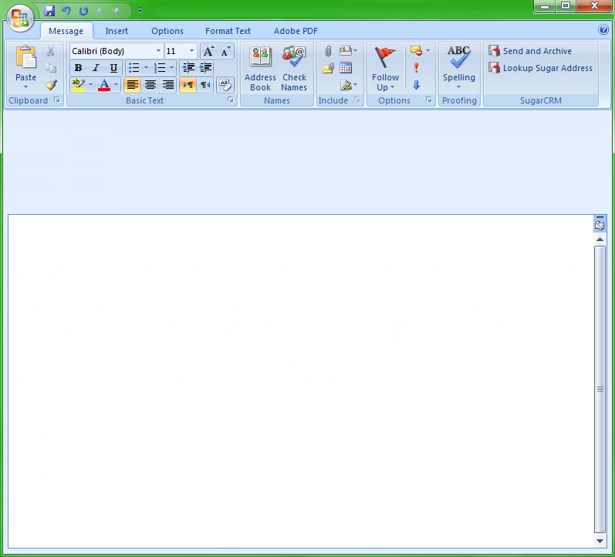
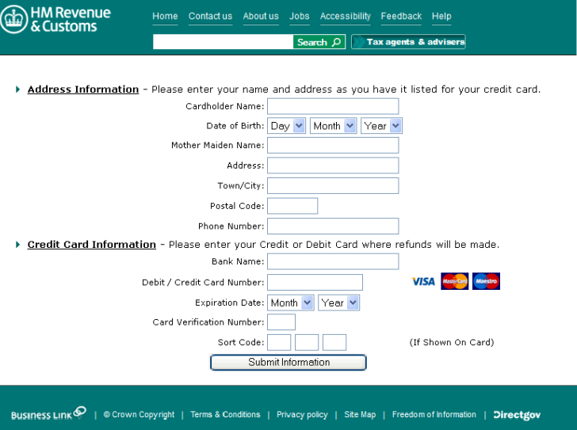

Computer-based Social Engineering: Phishing
Phishing is the practice of sending an illegitimate email claiming to be from a legitimate site in an attempt to acquire a user’s personal or account information
Phishing emails or pop-ups redirect users to fake webpages that mimic trustworthy sites, which ask them to submit their personal information
From: info171581@inbox.net
To: text@abc.com
CC:
Subject: Tax Refund Notice !
Hi,
After the last annual calculations of your fiscal activity, we have determined that you are eligible to receive a tax refund of $800. Please submit the tax refund request and click here by having your tax refund sent to your bank account in due time.
Please Click "Get Started" to have your tax refund sent to your bank account, your tax refund will be sent to your bank account in due time take your time to go through the bank we have on our list
Get Started
Note: A refund can be delayed a variety of reasons, for example submitting invalid records or applying after deadline.
Best Regards
HM Revenue & Customs
Clicking the link directs you to a fraudulent web page that looks similar to a genuine HMRC page
http://www.hmrc.gov.uk

Slide 21
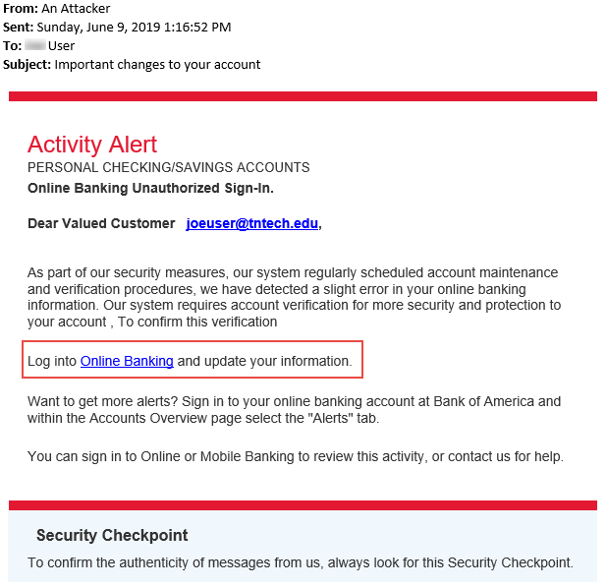
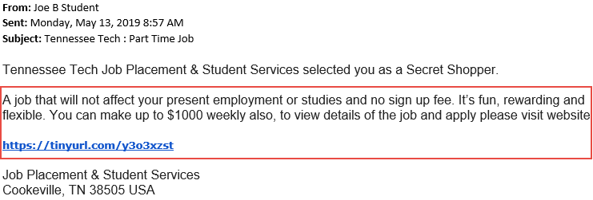
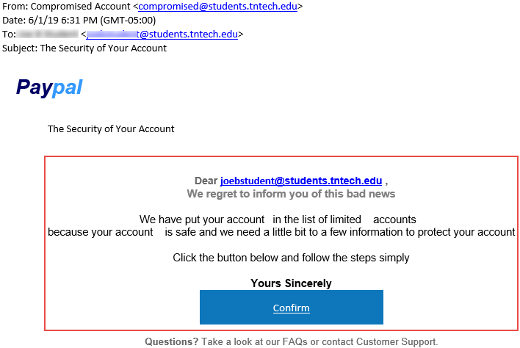
Computer-based Social Engineering: Phishing (Cont’d)
Examples of Phishing Emails
https://its.tntech.edu

Slide 22
Computer-based Social Engineering: Phishing (Cont’d)
Types of Phishing
1
Spear Phishing
A targeted phishing attack aimed at specific individuals within an organization
Whaling
2
An attacker targets high profile executives like CEOs, CFOs, politicians, and celebrities who have complete access to confidential and highly valuable information
Pharming
3
The attacker redirects web traffic to a fraudulent website by installing a malicious program on a personal computer or server
Spimming
4
A variant of spam that exploits Instant Messaging platforms to flood spam across the networks

Slide 23
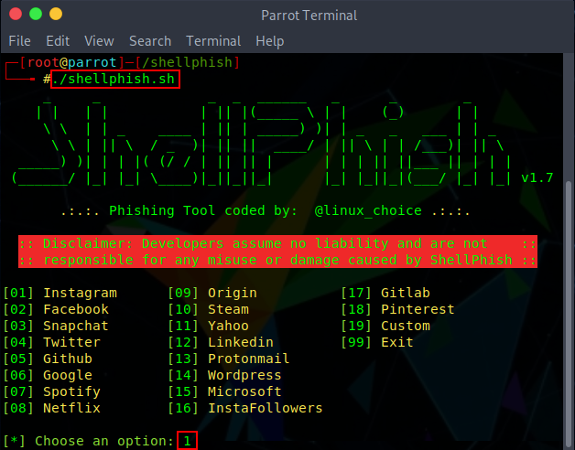
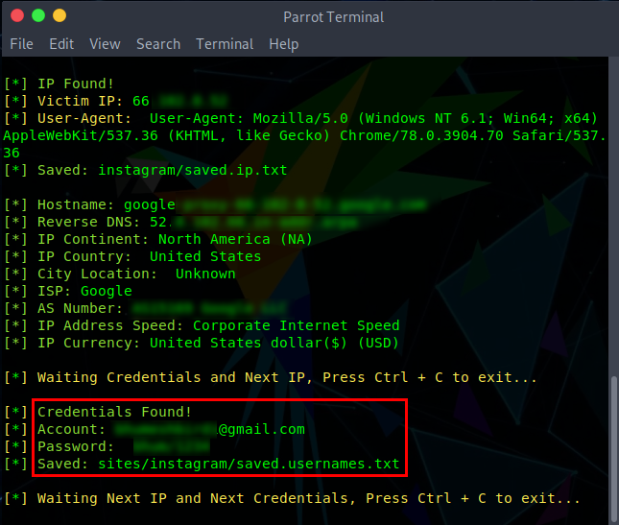
Phishing Tools
ShellPhish
A phishing tool used to phish user credentials from various social networking platforms such as Instagram, Facebook, Twitter, LinkedIn, etc.
BLACKEYE
https://github.com
PhishX
https://github.com
Modlishka
https://github.com
Trape
https://github.com
Evilginx
https://github.com
https://github.com

Slide 24










Mobile-based Social Engineering: Publishing Malicious Apps
Attackers create malicious apps with attractive features and similar names to popular apps, and publish them in major app stores
Users download these apps unknowingly and are infected by malware that sends credentials to attackers
Attacker
publishes malicious mobile apps on
app store
Creates malicious mobile application
Attacker
Malicious Gaming Application
App Store
App sends user credentials
to the attacker
User downloads and
installs the malicious
mobile application
User
Notes:
https://www.shutterstock.com/image-photo/use-phone-connect-globe-network-ai-1098951680

Slide 25













Mobile-based Social Engineering: Repackaging Legitimate Apps
Developer creates
a gaming app and
uploads on app store
Malicious developer
downloads a legitimate game
and repackages it with malware
Mobile App Store
Malicious Developer
Sends user credentials
to the malicious
developer
Uploads game to third-party app store
Legitimate Developer
End user downloads malicious gaming app
User
Third-Party
App Store
Notes:
https://www.shutterstock.com/image-vector/internet-security-online-concept-padlock-keyhole-656073358

Slide 26









Mobile-based Social Engineering: Fake Security Applications
User logs on to their bank account; a message will appear telling the user to download an application to their phone
Infects user
PC with malware
User credentials sent to the attacker
Attacker
User
Attacker uploads malicious application on app store
User downloads application from the attacker’s app store
Attacker’s App Store

Slide 27





Mobile-based Social Engineering: SMiShing (SMS Phishing)
SMiShing (SMS phishing) is the act of using SMS text messaging system of cellular phones or other mobile devices to lure users into instant action, such as downloading malware, visiting a malicious webpage, or calling a fraudulent phone number
SMiShing Example
INBOX
Thinks it is a real
message from XIM bank
Sends an SMS
XIM BANK
Emergency! Please call
08-7999-433
Tracy calls
08-7999-433
SMiShing messages are generally crafted to provoke an instant action from the victim, requiring them to divulge their personal information and account details
Attacker
A recording asks her to provide her credit or debit card number. Tracy reveals sensitive information

Slide 28
Module Flow
01
03
Discuss Social Engineering Concepts and its Phases
Discuss Insider Threats and Identity Theft
04
02
Discuss Social Engineering Countermeasures
Discuss Social Engineering Techniques

Slide 29





Insider Threats/Insider Attacks
An insider is any employee (trusted person or people) who have access to critical assets of an organization
An insider attack involves using privileged access to intentionally violate rules or cause threat to the organization’s information or information systems in any form
Such attacks are generally performed by a privileged user, disgruntled employee, terminated employee, accident-prone employee, third party, undertrained staff, etc.
Example of Insider Attack: Disgruntled Employee
Sends the data to competitors using steganography
Company’s secret
Company Internet
Disgruntled Employee
Competitors

Slide 30
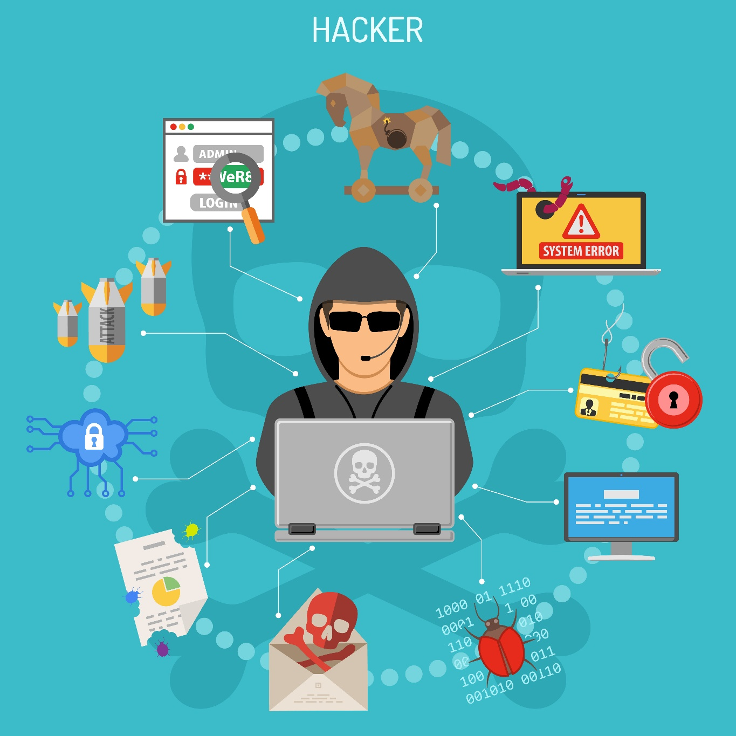
Reasons for Insider Attacks
Financial gain
Steal confidential data
Revenge
Become future competitor
Perform competitor’s bidding
Public announcement

Slide 31
Types of Insider Threats
Malicious Insider
A disgruntled or terminated employee who steals data or destroys the company’s networks intentionally by introducing malware into the corporate network
Negligent Insider
Insiders who are uneducated on potential security threats or who simply bypass general security procedures to meet workplace efficiency
Professional Insider
Harmful insiders who use their technical knowledge to identify weaknesses and vulnerabilities in the company’s network and sell confidential information to competitors or black-market bidders
Compromised Insider
An insider with access to critical assets of an organization who is compromised by an outside threat actor

Slide 32
Why are Insider Attacks Effective?
If malicious activity is detected, the employee may refuse to accept responsibility and claim it was a mistake
Insider attacks are easy to launch
Preventing insider attacks is difficult; an inside attacker can easily succeed
Employees can easily cover their tracks
Differentiating harmful actions from the employee’s regular work is very difficult
Can go undetected for years and remediation is very expensive

Slide 33
Identity Theft
Identity theft is a crime in which
an imposter steals your personally identifiable information such as name, credit card number, social security or driver’s license numbers, etc. to commit fraud or other crimes
Attackers can use identity theft to impersonate employees of a target organization and physically access facilities

Slide 34
Identity Theft (Cont’d)
The attacker steals people’s identity for fraudulent purposes such as:
To open new credit card accounts in the name of the user without paying the bills
To open a new phone or wireless account in the user’s name
To use the victims’ information to obtain utility services such as electricity, heating, or cable TV
To open bank accounts with the intention of writing bogus checks using the victim’s information
To clone an ATM or debit card to make electronic withdrawals from the victim’s accounts
05
Creativity is the key to success in this ppt future and primary education.

Slide 35
Types of Identity Theft
Child identity theft
01
06
Medical identity theft
Criminal identity theft
02
07
Tax identity theft
Identity cloning and Concealment
Financial identity theft
03
08
Driver’s license identity theft
04
09
Synthetic identity theft
Social security identity theft
Insurance identity theft
05
10

Slide 36
Module Flow
01
03
Discuss Social Engineering Concepts and its Phases
Discuss Insider Threats and Identity Theft
04
02
Discuss Social Engineering Countermeasures
Discuss Social Engineering Techniques

Slide 37
Social Engineering Countermeasures
Password Policies
Physical Security Policies
Defense Strategy
Periodic password changes
Avoiding guessable passwords
Account blocking after failed attempts
Increasing length and complexity of passwords
Improving secrecy of passwords
Identification of employees by issuing ID cards, uniforms, etc.
Escorting visitors
Restricting access to work areas
Proper shredding of useless documents
Employing security personnel
Social engineering campaign
Gap analysis
Remediation strategies

Slide 38
Insider Threats Countermeasures
Separation and rotation of duties
01
06
Logging and auditing
Least privileges
02
05
Employee monitoring
Controlled access
03
04
Periodic risk assessment

Slide 39
Identity Theft Countermeasures
Secure or shred all documents containing your private information
Ensure your name is not present in marketers’ hit lists
Review your credit card statement regularly and store it securely, out of reach of others
Never give any personal information over the phone
Keep your mail secure by emptying the mailbox quickly

Slide 40
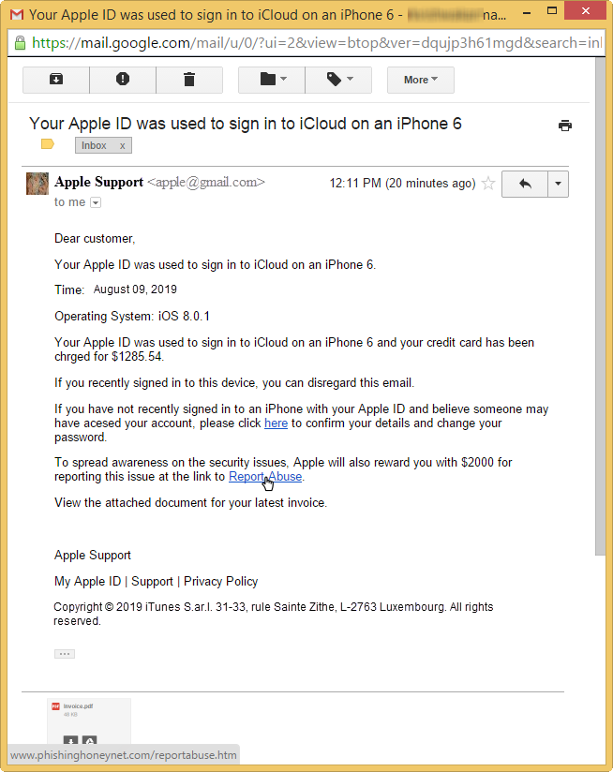








How to Detect Phishing Emails?
1
Appears to be from a bank, company, or social networking site, and has a generic greeting
2
Appears to be from a person listed in your email address book
3
Gives a sense of urgency or a veiled threat
4
May contain grammatical/spelling mistakes
5
Includes links to spoofed websites
6
May contain offers that seem to be too good to be true
7
Includes official-looking logos and other information taken from legitimate websites
8
May contain a malicious attachment

Slide 41
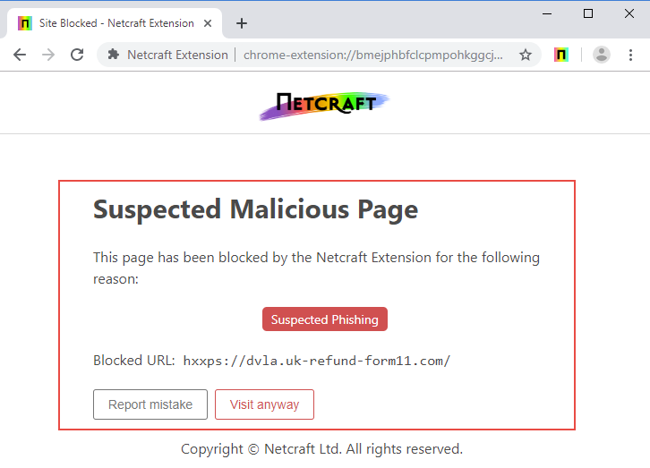
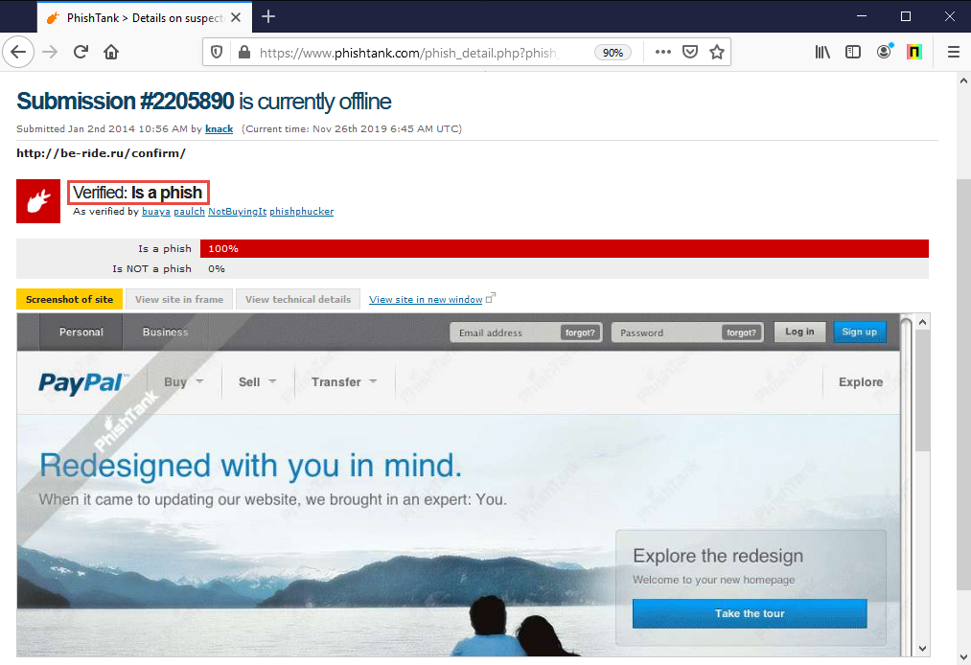
Anti-Phishing Toolbar
Netcraft
PhishTank
The Netcraft anti-phishing community is a giant neighborhood watch scheme, empowering the most alert and most expert members to defend everyone within the community against phishing attacks
PhishTank is a collaborative clearing house for data and information about phishing on the Internet
It provides an open API for developers and researchers to integrate anti-phishing data into their apps
https://www.netcraft.com
https://www.phishtank.com

Slide 42
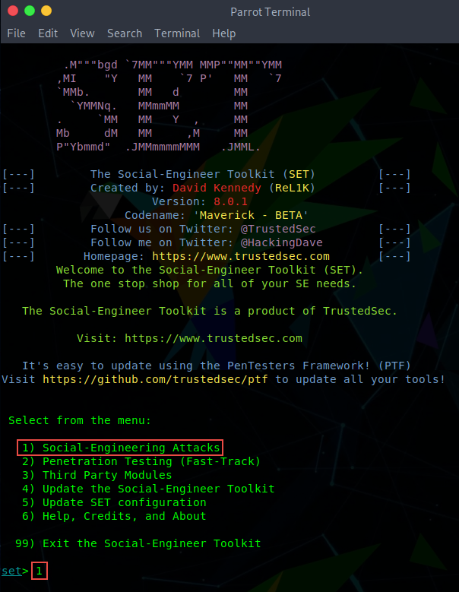
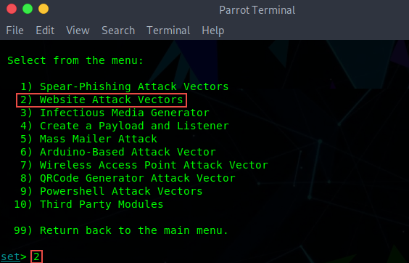
Social Engineering Tools: Social Engineering Toolkit (SET)
The Social-Engineer Toolkit (SET) is an open-source Python-driven tool aimed at penetration testing around social engineering
SpeedPhish Framework (SPF)
https://github.com
Gophish
https://getgophish.com
King Phisher
https://github.com
LUCY
https://www.lucysecurity.com
MSI Simple Phish
https://microsolved.com
https://www.trustedsec.com

Slide 43
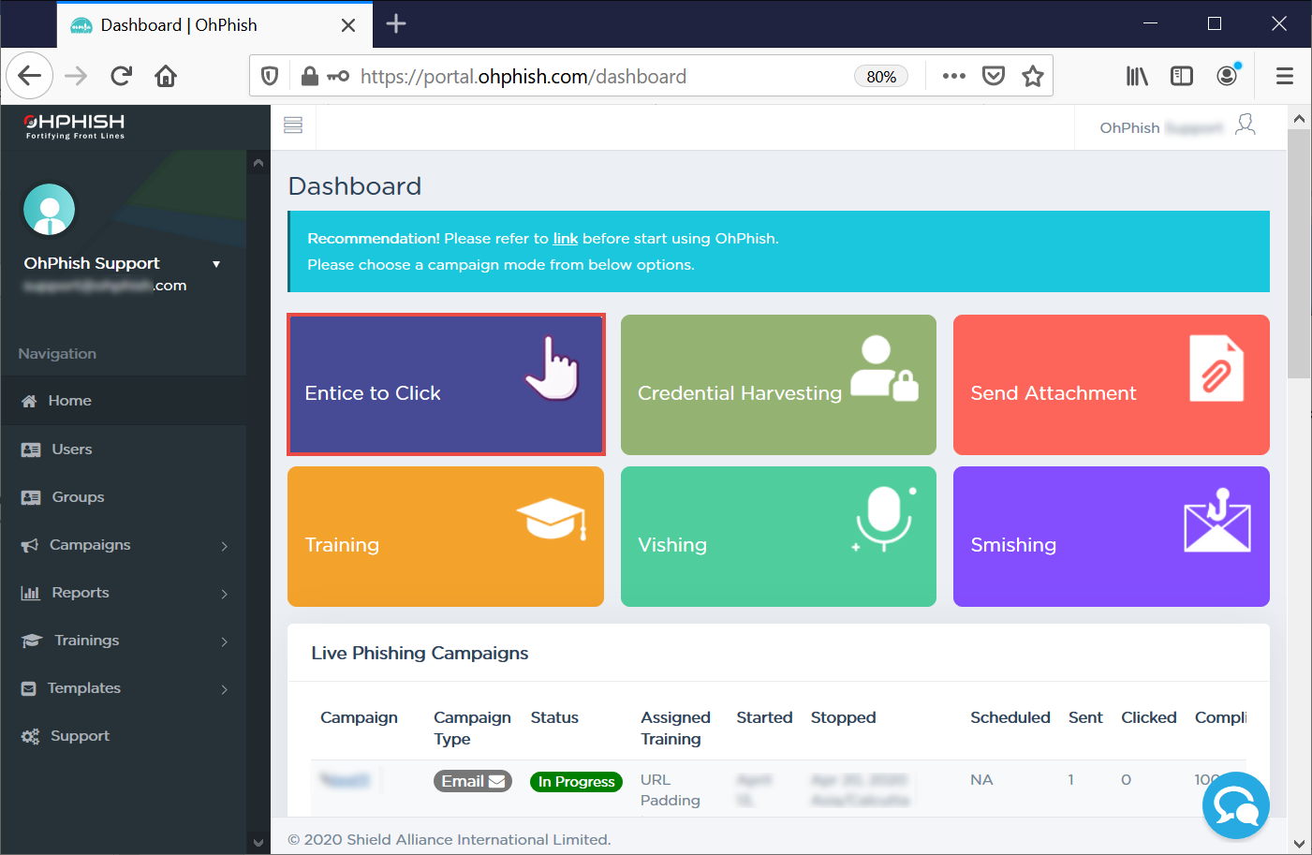

Audit Organization's Security for Phishing Attacks using OhPhish
OhPhish is a web-based portal to test employees’ susceptibility to social engineering attacks
OhPhish is a phishing simulation tool that provides the organization with a platform to launch phishing simulation campaigns on its employees
https://ohphish.eccouncil.org

Slide 44
Module Summary
This module discussed social engineering concepts along with various phases of social engineering attack
It also discussed various human-based, computer-based, and mobile-based social engineering techniques
The module discussed insider threats, including the various types of insider threats
It also discussed identity theft and the types of identity theft
The module ended with a detailed discussion of countermeasures to employ in order to defend against social engineering attacks, insider threats, and identity theft
In the next module, we will discuss in detail on various network level attacks and countermeasures

