Slide 1

PMG 506
Advanced Project Management
LECTURE 8
Everyone’s Smart
University
Project risk management

Slide 2

PMG506 Advanced Project Management (APM)
Introduction:
Lecture 1 Introduction to APM and Initial Project Strategy
Lecture 2 Project Quality Management
Project planning
Lecture 6 Initial project coordination and the project Charter
Lecture 7 Starting the project plan: The WBS
Lecture 8 Project risk management
Lecture 9 Budgeting, Estimating costs and risks
Project Initiation:
Lecture 3 Project Communication and team Management
Lecture 4 Managing conflicts and the art of communication
Lecture 5 Strategic Management and project selection
Project Execution
Lecture 10 Monitoring and information systems
Lecture 11 Project Control
Lecture 12 Project Auditing
Lecture 13 Project termination

Slide 3



Learning Outcomes
By the end of this lecture, you will be able to:
Understand how to identify project risks.
Assess the significance of different project risks.
Describe the four different responses to managing risks.
Understand the role contingency plans play in risk management process.
Describe the change control process

Slide 4
Every project manager understands risks are inherent in projects, deliveries are delayed, accidents happen, people get sick, etc. No amount of planning can overcome risk, or the inability to control chance events. In the context of projects, risk is an uncertain event or condition that, if it occurs, has a positive or negative effect on project objectives. A risk has a cause and, if it occurs, a consequence. For example, a cause may be a flu virus or change in scope requirements. The event is that team members get stricken with the flu or the product has to be redesigned. If either of these uncertain events occurs, it will impact the cost, schedule, and quality of the project.
Introduction

Slide 5



What is a project Risk?
Uncertain event
Occur?
Monitor or close
Effect on project objectives
Positive effect
Negative effect

Slide 6
Risk Management Process
Risk
  Uncertain or chance events that planning can not overcome or control.
Risk Management
  A proactive attempt to recognize and manage internal events and external threats that affect the likelihood of a project’s success.
    What can go wrong (risk event).
    How to minimize the risk event’s impact (consequences).
    What can be done before an event occurs (anticipation).
    What to do when an event occurs (contingency plans).

Slide 7

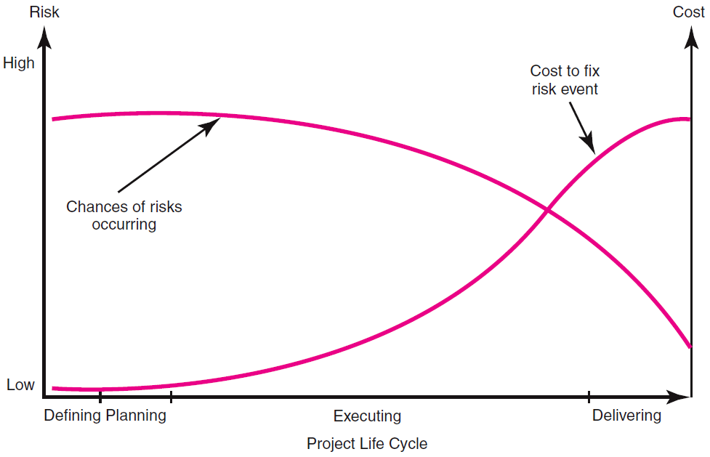
The Risk Event Graph
The chances of a risk event occurring (e.g., an error in time estimates, cost estimates, or design technology) are greatest during the early stages of a project. This is when uncertainty is highest, and many questions remain unanswered. As the project progresses toward completion, risk declines as the answers to critical issues (Will the technology work? Is the timeline feasible?) are resolved. The cost impact of a risk event, however, increases over the life of the project. For example, the risk event of a design flaw occurring after a prototype has been made has a greater cost or time impact than if the flaw were discovered during the planning phase of the project

Slide 8

Risk Management’s Benefits
A proactive rather than reactive approach.
Reduces surprises and negative consequences.
Prepares the project manager to take advantage
of appropriate risks.
Provides better control over the future.
Improves chances of reaching project performance objectives within budget and on time.

Slide 9
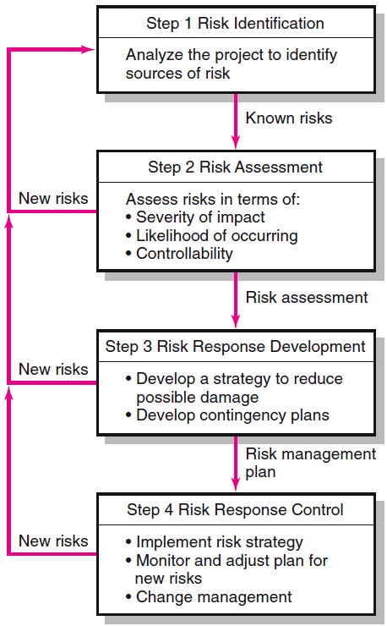

The Risk Management Process

Slide 10
Step 1: Risk Identification
Generate a list of possible risks through brainstorming, problem identification and risk profiling. Macro risks first, then specific events.
The risk management process begins by trying to generate a list of all the possible risks that could affect the project.
Typically, the project manager pulls together, during the planning phase, a risk management team consisting of core team members and other relevant stakeholders.
Research has demonstrated that groups make more accurate judgments about risks than individuals do.

Slide 11

Step 1: Risk Identification
The team uses brainstorming and other problem identifying techniques to identify potential problems.
Participants are encouraged to keep an open mind and generate as many probable risks as possible.
One common mistake that is made early in the risk identification process is to focus on objectives and not on the events that could produce consequences.
For example, team members may identify failing to meet schedule as a major risk. What they need to focus on are the events that could cause this to happen (i.e., poor estimates, adverse weather, shipping delays, etc.). Only by focusing on actual events can potential solutions be found

Slide 12

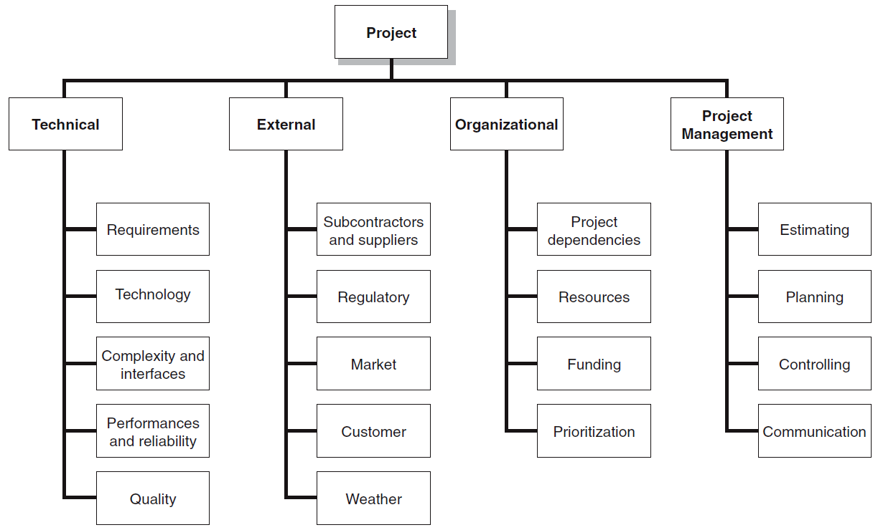
The Risk Breakdown Structure (RBS)
Organizations use risk breakdown structures (RBSs) in conjunction with work breakdown structures (WBSs) to help management teams identify and eventually analyze risks. This figure provides a generic example of a RBS. The focus at the beginning should be on risks that can affect the whole project as opposed to a specific section of the project or network.

Slide 13

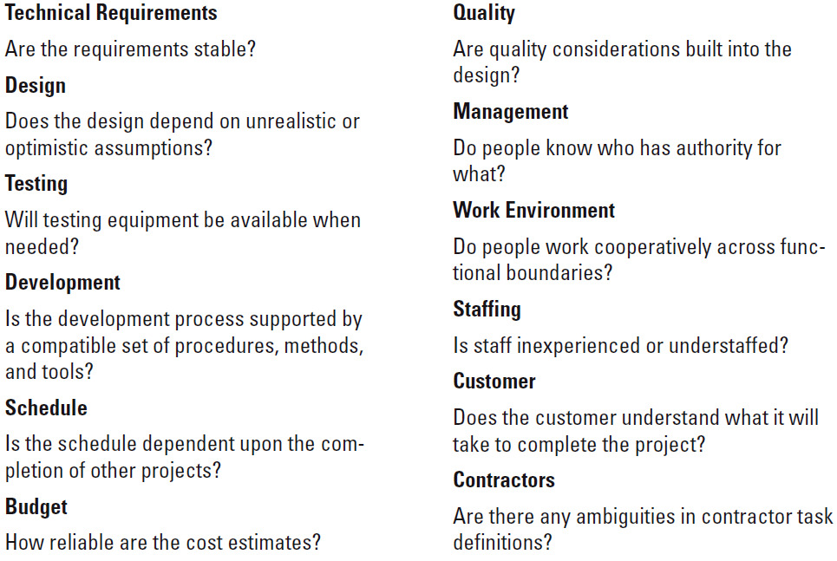
Partial Risk Profile for Product Development Project
A risk profile is another useful tool. A risk profile is a list of questions that address traditional areas of uncertainty on a project. These questions have been developed and refined from previous, similar projects.

Slide 14

Step 2: Risk Assessment
Step 1 produces a list of potential risks. Not all these risks deserve attention. Some are trivial and can be ignored, while others pose serious threats to the welfare of the project. Managers must develop methods for sifting through the list of risks, eliminating inconsequential or redundant ones and stratifying worthy ones in terms of importance and need for attention.
  Tools:
  Scenario analysis for event probability and impact
  Risk assessment matrix
  Failure Mode and Effects Analysis (FMEA)
  Probability analysis
    Decision trees, NPV, and PERT
  Semiquantitative scenario analysis

Slide 15

Scenario analysis for event probability and impact
Scenario analysis is the easiest and most used technique for analyzing risks. Team members assess the significance of each risk event in terms of:
Probability of the event.
Impact of the event.
Simply stated, risks need to be evaluated in terms of the likelihood the event is going to occur and the impact or consequences of its occurrence.
Example: The risk of a project manager being struck by lightning at a work site would have major negative impact on the project, but the likelihood is so low it is not worthy of consideration. Conversely, people do change jobs, so an event like the loss of key project personnel would have not only an adverse impact but also a high likelihood of occurring in some organizations. If so, then it would be wise for that organization to be proactive and mitigate this risk by developing incentive schemes for retaining specialists and/or engaging in cross-training to reduce the impact of turnover

Slide 16

Scenario analysis for event probability and impact
The quality and credibility of the risk analysis process require that different levels of risk probabilities and impacts be defined. These definitions vary and should be tailored to the specific nature and needs of the project.
For example, a relatively simple scale ranging from “very unlikely” to “almost certainly” may suffice for one project, whereas another project may use more precise numerical probabilities (e.g., 0.1, 0.3, 0.5, . . .).
Impact scales can be a bit more problematic since adverse risks affect project objectives differently. For example, a component failure may cause only a slight delay in project schedule but a major increase in project cost. If controlling cost is a high priority, then the impact would be severe. If, on the other hand, time is more critical than cost, then the impact would be minor.

Slide 17

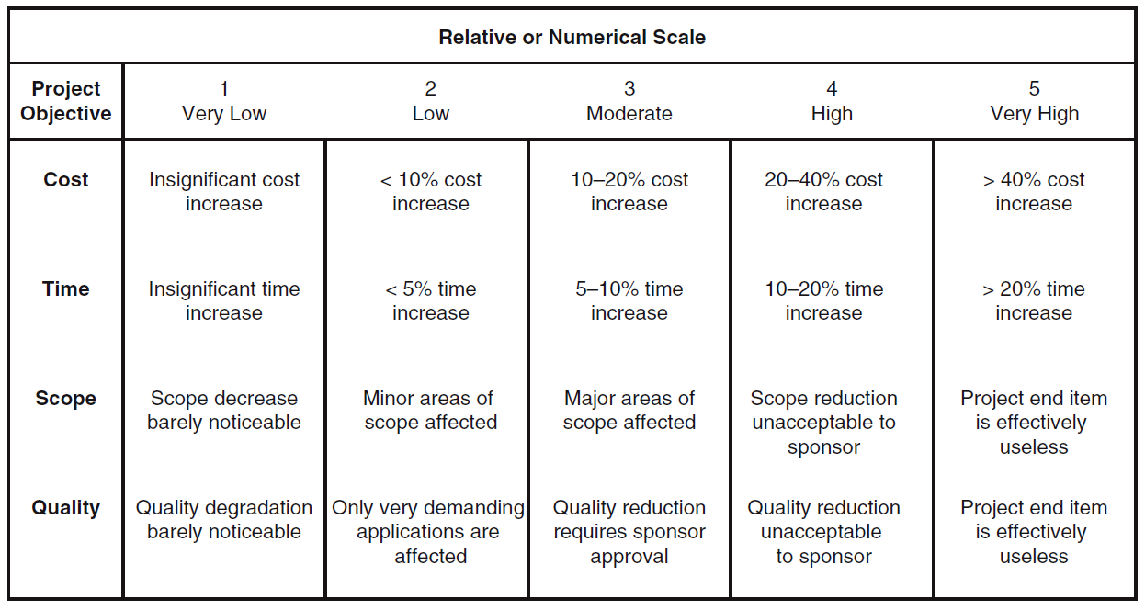
Defined Conditions for Impact Scales of a Risk on Major Project Objectives (Examples for negative impacts only)

Slide 18
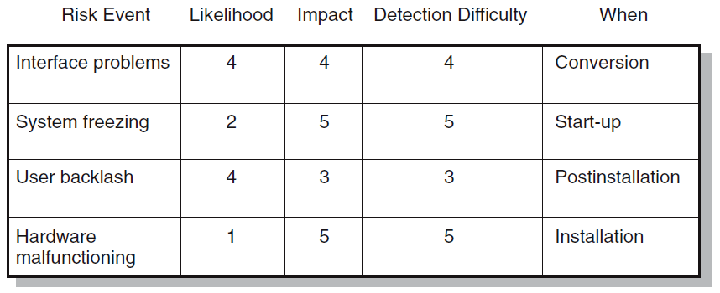
Risk Assessment Form
Documentation of scenario analyses can be seen in various risk assessment forms used by companies. This figure shows a partial example of a risk assessment form used on an IS project involving the upgrade from Windows 10 to Windows 11.
Notice that in addition to evaluating the severity and probability of risk events the team also assesses when the event might occur and its detection difficulty. Detection difficulty is a measure of how easy it would be to detect that the event was going to occur in time to take mitigating action, that is, how much warning would we have? So in the Windows 11 conversion example, the detection scale would range from 5 = no warning to 1 = lots of time to react.
Failure Mode and Effects Analysis (FMEA)
Impact × Probability × Detection = Risk Value

Slide 19
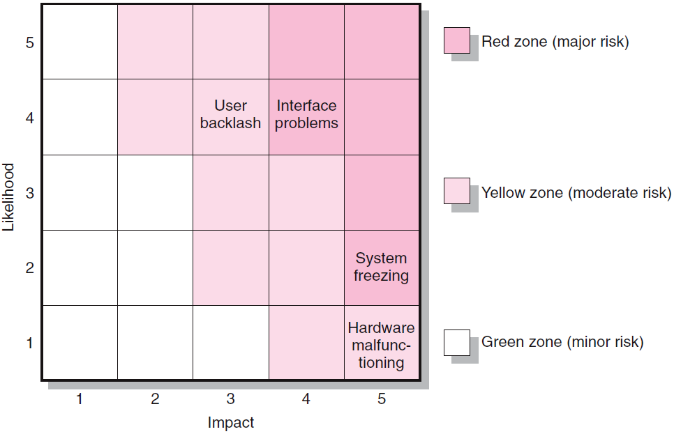
Risk Severity Matrix
Organizations find it useful to categorize the severity of different risks into some form of risk assessment matrix. The matrix is typically structured around the impact and likelihood of the risk event. For example, the risk matrix presented this figure consists of a 5 × 5 array of elements with each element representing a different set of impact and likelihood values.
Failure Mode and Effects Analysis (FMEA)
Impact × Probability × Detection = Risk Value
The matrix is divided into red, yellow, and green zones representing major, moderate, and minor risks, respectively. The red zone is centered on the top right corner of the matrix (high impact/high likelihood), while the green zone is centered on the bottom left corner (low impact/low likelihood). The moderate risk, yellow zone extends down the middle of the matrix. Since impact is generally considered more important than likelihood (a 10 percent chance of losing $1,000,000 is usually considered a more severe risk than a 90 percent chance of losing $1,000), the red zone (major risk) extends farther down the high impact column

Slide 20
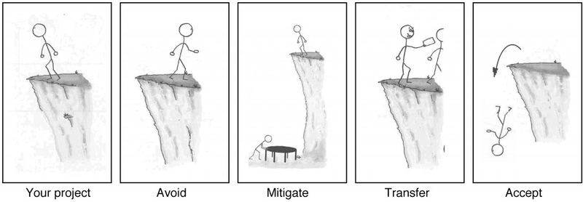
Step 3: Risk Response Development
  Mitigating Risk
    Reducing the likelihood an adverse event will occur.
    Reducing impact of adverse event.
  Avoiding Risk
    Changing the project plan to eliminate the risk or condition.
  Transferring Risk
    Paying a premium to pass the risk to another party.
  Retaining Risk
    Making a conscious decision to accept the risk.

Slide 21
Mitigating Risk
Reducing risk is usually the first alternative considered. There are basically two strategies for mitigating risk:
(1) reduce the likelihood that the event will occur and/or
(2) reduce the impact that the adverse event would have on the project.
Most risk teams focus first on reducing the likelihood of risk events since, if successful, this may eliminate the need to consider the potentially costly second strategy

Slide 22
Example:
Reduce the likelihood that the event will occur:
Testing and prototyping are frequently used to prevent problems from surfacing later in a project. An example of testing can be found in an information systems project. The project team was responsible for installing a new operating system in their parent company. Before implementing the project, the team tested the new system on a smaller isolated network. By doing so they discovered a variety of problems and were able to produce solutions prior to implementation
Other examples of reducing the probability of risks occurring are:
Scheduling outdoor work during the summer months.
Investing in up-front safety training.
Choosing high-quality materials and equipment.

Slide 23

Avoiding Risk
Risk avoidance is changing the project plan to eliminate the risk or condition. Although it is impossible to eliminate all risk events, some specific risks may be avoided before you launch the project. For example,
adopting proven technology instead of experimental technology can eliminate technical failure

Slide 24

Transferring Risk
Passing risk to another party is common; this transfer does not change risk. Passing risk to another party almost always results in paying a premium for this exemption.
Fixed price contracts are the classic example of transferring risk from an owner to a contractor. The contractor understands his or her firm will pay for any risk event that materializes; therefore, a monetary risk factor is added to the contract bid price.
Before deciding to transfer risk, the owner should decide which party can best control activities that would lead to the risk occurring. Also, is the contractor capable of absorbing the risk? Clearly identifying and documenting responsibility for absorbing risk is imperative.
Another more obvious way to transfer risk is insurance. However, in most cases this is impractical because defining the project risk event and conditions to an insurance broker who is unfamiliar with the project is difficult and usually expensive.
Performance bonds, warranties, and guarantees are other financial instruments used to transfer risk.

Slide 25

Retaining Risk
In some cases, a conscious decision is made to accept the risk of an event occurring. Some risks are so large it is not feasible to consider transferring or reducing the event (e.g., an earthquake or flood). The project owner assumes the risk because the chance of such an event occurring is slim.
In other cases, risks identified in the budget reserve can simply be absorbed if they materialize. The risk is retained by developing a contingency plan to implement if the risk materializes. In a few cases a risk event can be ignored, and a cost overrun accepted should the risk event occur

Slide 26

Contingency Planning
Contingency Plan
A contingency plan is an alternative plan that will be used if a possible foreseen risk event becomes a reality. The contingency plan represents actions that will reduce or mitigate the negative impact of the risk event. A key distinction between a risk response and a contingency plan is that a response is part of the actual implementation plan and action is taken before the risk can materialize, while a contingency plan is not part of the initial implementation plan and only goes into effect after the risk is recognized.

Slide 27

Risks of Not Having a Contingency Plan
Like all plans, the contingency plan answers the questions of what, where, when, and how much action will take place. The absence of a contingency plan, when a risk event occurs, can cause a manager to delay or postpone the decision to implement a remedy. This postponement can lead to panic, and acceptance of the first remedy suggested. Such after-the-event decision making under pressure can be potentially dangerous and costly.
Contingency planning evaluates alternative remedies for possible foreseen events before the risk event occurs and selects the best plan among alternatives. This early contingency planning facilitates a smooth transition to the remedy or work-around plan. The availability of a contingency plan can significantly increase the chances for project success

Slide 28

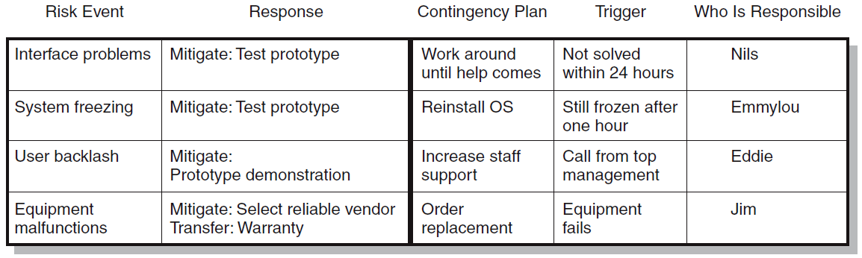
Risk Response Matrix
Risk response matrices are useful for summarizing how the project team plans to manage risks that have been identified.
The first step is to identify whether to reduce, share, transfer, or accept the risk. The team decided to reduce the chances of the system freezing by experimenting with a prototype of the system.
The project team is then able to identify and document changes between the old and new system that will be incorporated in the training the users receive. The risk of equipment malfunctioning is transferred by choosing a reliable supplier with a strong warranty program.

Slide 29
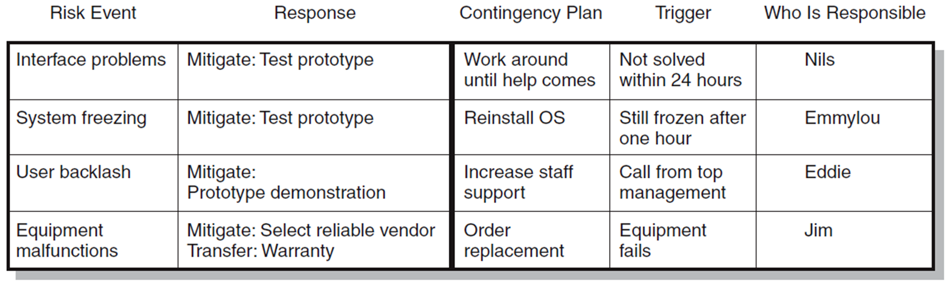

The next step is to identify contingency plans in case the risk still occurs:
if there is an interface problems, the team would attempt a workaround until vendor experts arrived to help solve the problem.
If the system freezes after installation, the team will first try to reinstall the software.
If user dissatisfaction is high, then the IS department will provide more staff support.
If the team is unable to get reliable equipment from the original supplier, then it will order a different brand from a second dealer.
The team also needs to discuss and agree what would “trigger” implementation of the contingency plan. In the case of the system freezing, the trigger is not being able to unfreeze the system within one hour or, in the case of user backlash, an angry call from top management.
Finally, the individual responsible for monitoring the potential risk and initiating the contingency plan needs to be assigned.

Slide 30

Opportunity Management Tactics
So far, we have focused on negative risks—what can go wrong on a project. There is a flip side—what could go right on a project? This is commonly referred to as a positive risk or opportunity.
An opportunity is an event that can have a positive impact on project objectives
For example, unusually favorable weather can accelerate construction work, or a drop in fuel prices may create savings that could be used to add value to a project. Essentially the same process that is used to manage negative risks is applied to positive risks.
Opportunities are identified, assessed in terms of likelihood and impact, responses are determined, and even contingency plans and funds can be established to take advantage of the opportunity if it occurs. The major exception between managing negative risks and opportunity is in the responses.

Slide 31

Opportunity Management Tactics
There are four different types of response to an opportunity:
Exploit
  Seeking to eliminate the uncertainty associated with an opportunity to ensure that it happens.
  Example: Examples include assigning your best personnel to a critical burst activity to reduce the time to completion or revising a design to enable a component to be purchased rather than developed internally.
Share
  Allocating some or all the ownership of an opportunity to another party who is best able to capture the opportunity for the benefit of the project.
  Examples include establishing continuous improvement incentives for external contractors or joint ventures.
Enhance
  Taking action to increase the probability and/or the positive impact of an opportunity.
Examples include choosing site location based on favorable weather patterns or choosing raw materials that are likely to decline in price.
Accept
  Being willing to take advantage of an opportunity if it occurs, but not taking action to pursue it.

Slide 32

Step 4: Risk Response Control
The results of the first three steps of the risk management process are summarized
in a formal document often called the risk register.
A risk register details all identified risks, including descriptions, category, and probability of occurring, impact, responses, contingency plans, owners, and current status. The register is the backbone for the last step in the risk management process: risk control

Slide 33

Step 4: Risk Response Control
  Risk control involves:
    Execution of the risk response strategy
    Monitoring of triggering events
    Initiating contingency plans
    Watching for new risks
  Establishing a Change Management System
    Monitoring, tracking, and reporting risk
    Fostering an open organization environment
    Repeating risk identification/assessment exercises
    Assigning and documenting responsibility for managing risk

Slide 34

Change Management Control
Sources of Change
  Project scope changes:
Scope changes in the form of design or additions represent big changes; for example, customer requests for a new feature or a redesign that will improve the product
  Implementation of contingency plans
when risk events occur, represent changes in baseline costs and schedules.
  Improvement changes
Improvement changes suggested by project team members represent another category.

Slide 35

Change Control System Process
Identify proposed changes.
List expected effects of proposed changes
on schedule and budget.
Review, evaluate, and approve or disapprove
of changes formally.
Negotiate and resolve conflicts of change, condition, and cost.
Communicate changes to parties affected.
Assign responsibility for implementing change.
Adjust master schedule and budget.
Track all changes that are to be implemented

Slide 36
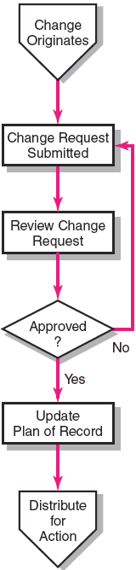
The Change Control Process

Slide 37
Benefits of a Change Control System
Inconsequential changes are discouraged
by the formal process.
Costs of changes are maintained in a log.
Integrity of the WBS and performance measures
is maintained.
Allocation and use of budget and management reserve funds are tracked.
Responsibility for implementation is clarified.
Effect of changes is visible to all parties involved.
Implementation of change is monitored.
Scope changes will be quickly reflected in baseline and performance measures.

Slide 38
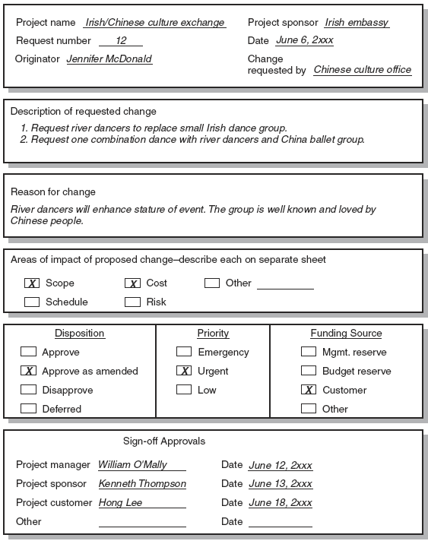
Sample Change Request Form

Slide 39
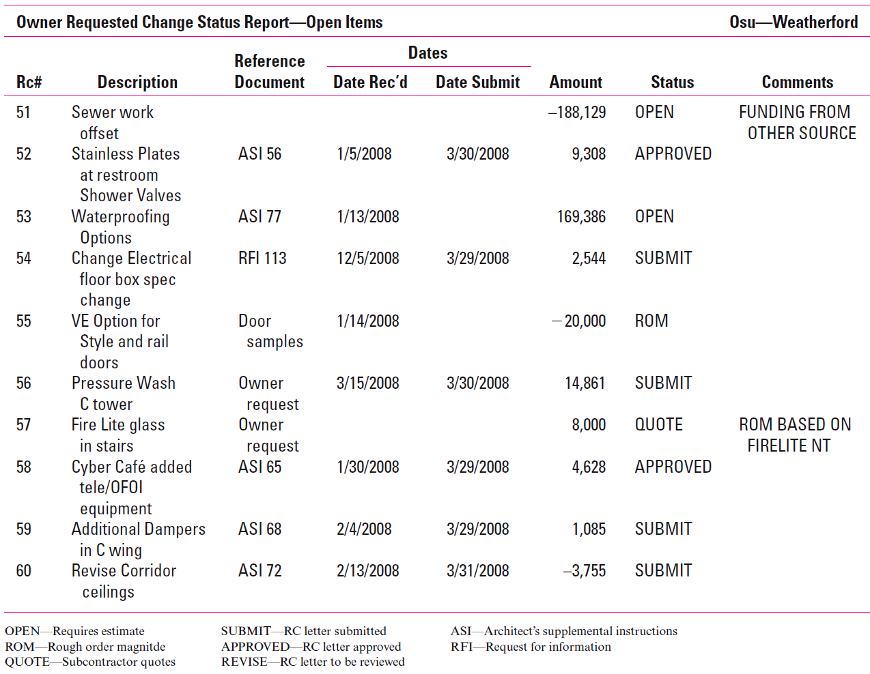
Change Request Log

Slide 40

Learning Summary and Evaluation 1
The main idea I have learnt?
A new word I have learnt today is? It means……
How could I apply these ideas towards my course studies and career aspiration?

Slide 41


Your hardware vendor left you a voicemail saying that a snowstorm in the Midwest will prevent your equipment from arriving on time. You identified a risk response strategy for this risk and have arranged for a local company to lease you
the needed equipment until yours arrives. This is an example of which risk response strategy?
A. Transfer
B. Acceptance
C. Mitigate
D. Avoid

Slide 42
Learning Check
Can you work out where you would put the following elements?
Risk
Opportunities Management
Risk register
1. An uncertain event or condition that, if it occurs, has a positive or negative effect on one or more projects objectives is called _______________.
2. A document you use to capture all known risks is called_______________.
3. The management of positive risk is called_____________.
How many did you get right?

Slide 43
Summary
To put the processes discussed so far in proper perspective one should recognize that the essence of project management is risk management. Every project management technique is really a risk management technique. Each in its own way tries to prevent something bad from happening.
Project selection systems try to reduce the likelihood that projects will not contribute to the mission of the firm.
Project scope statements, among other things, are designed to avoid costly misunderstandings and reduce scope creep.
Work breakdown structures reduce the likelihood that some vital part of the project will be omitted or that the budget estimates are unrealistic.
Teambuilding reduces the likelihood of dysfunctional conflict and breakdowns in coordination.
All the techniques try to increase stakeholder satisfaction and increase the chances of project success.

Slide 44
From this perspective managers engage in risk management activities to compensate for the uncertainty inherent in project management and that things never go according to plan.
Risk management is proactive not reactive. It reduces the number of surprises and prepares people for the unexpected.
Experience clearly indicates that using a formal, structured process to handle possible foreseen and unforeseen project risk events minimizes surprises, costs, delays, stress, and misunderstandings.
Risk management is an iterative process that occurs throughout the lifespan of the project.

Slide 45
When risk events occur or changes are necessary, using an effective change control process to quickly approve and record changes will facilitate measuring performance against schedule and cost.
Ultimately successful risk management requires a culture in which threats are embraced not denied and problems are identified not hidden.
Contingency plans increase the chance that the project can be completed on time and within budget. Contingency plans can be simple “work-arounds” or elaborate detailed plans. Responsibility for risks should be clearly identified and documented.

Slide 46
What is next?
In the next lecture, we will we cover the knowledge area and discuss Budgeting, Estimating project costs

Slide 47

Glossary
Risk - an uncertainty that can have a negative or, less frequently, a positive impact on
meeting project objectives.
Risk Management - a systematic process of identifying, analyzing, and describing potential risks and active monitoring and response during project execution.
Risk Matrix - a table that identifies, categorizes, and describes risks associated with a project, information on the probability of a risk event, and indicators that may precede the risk event.
Risk Analysis- the processing of identifying and describing potential risks, the probability of occurrence, and the potential project impacts. The results of the risk analysis are presented in a risk matrix.
Risk Response Strategy - a type of action that can be taken to respond to the risk and control the impacts from risk events--usually lowering negative impact on a project's scope, schedule, deliverable quality, or cost.
Risk Register - a document, usually in table format, that contains the full results of risk analysis and planning. It typically includes all the information from a risk matrix (risks organized by category, description, probability indicators) with information on risk responses.
Risk Management Plan - an assignment of responsibilities for risk monitoring and a description of actions to be taken in response to risk events.

Slide 48
Discussion Questions
What is the difference between qualitative and quantitative risk analysis? Which one is always done? Why is the other one not always done for every project?

Slide 49
Resources

Slide 50


