Slide 1


College of Management
Project Communications
Lecturer: Dr. Raef Baraka
PMG 112
Lecture 01

Slide 2


Reference Book:
Ch1: Introduction.
Ch2: Exploring Communication Theories.
Ch3: Knowing Your Audience.
Ch4: Starting with the Basics.
Ch5: Planning Project Communications.
Ch6: Managing and Monitoring Project Communications.
Ch7: Using Project Communication Tools.
Ch8: Communicating Change.
Ch9: Managing Conflict through Communication.
Ch10: Closing.

Slide 3

Chapter 1: Introduction to project communication
The purpose of this chapter is to help you:
Understand why project communication is so important.
Know what to expect from this course: what it will cover, who the audience is, how the course is structured, and key definitions.
Trace the evolution of project communications
As long as there is communication, everything can be solved.
—Robert Trujillo, bassist for the rock band Metallica
Dr. Raef Baraka

Slide 4

Introduction to project communication
Communication Definition
Communication is much more than simply sending and receiving information. It is a mechanism to reduce uncertainty, build trust, demonstrate leadership, generate support, manage change, mitigate conflict, and facilitate stakeholder satisfaction—all key elements to a project’s success.
Dr. Raef Baraka

Slide 5
Introduction to project communication
Communication Definition
Communication is how people work together to get things done. Without it, you would never see the doctor (or tell him what ails you). You would never meet with your colleagues (or discuss the tasks at hand with them). You would never understand your project assignment (or receive it in the first place).
Dr. Raef Baraka

Slide 6
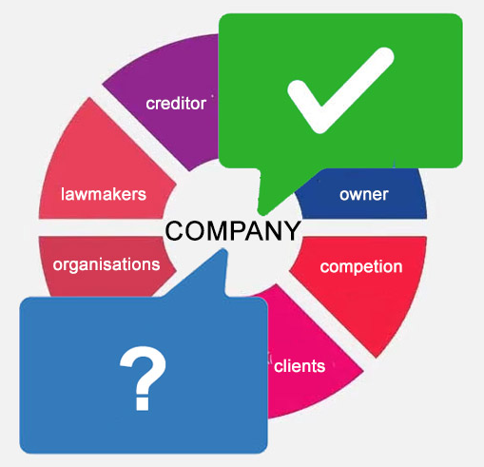
Introduction to project communication
Communication Definition
Communication is vital because the project is a new endeavor for every stakeholder involved. Even if every member of the team has worked together on dozens of projects before this one, every project is unique.
Communication is how stakeholders understand what this project is about, how it will affect them, and what role they may be expected to play.
Dr. Raef Baraka

Slide 7

Introduction to project communication
Why Is Communication So Important in Projects?
Communication Is at the Heart of Positive Employee Relationships

Slide 8
Introduction to project communication
Why Is Communication So Important in Projects?
Communication is a necessity in projects. But just how important, is it?
Effective communication to all stakeholders is “the most crucial success factor in project management.”
7.5 percent of every dollar spent on a project is at risk due to ineffective communication.
Effective communication leads to a 17-percent increase in finishing projects within budget.
Dr. Raef Baraka

Slide 9
Introduction to project communication
Why Is Communication So Important in Projects?
Communication is a necessity in projects. But just how important, is it?
Half of all unsuccessful projects fall short due to ineffective communication.
High-performing organizations create project communications management plans for nearly twice as many projects as low-performing organizations
High-performing organizations also perform significantly better at delivering the message on time, with sufficient detail and clarity, using nontechnical language, through appropriate communication channels/media.
Dr. Raef Baraka

Slide 10
Introduction to project communication
Why Is Communication So Important in Projects?
With so much evidence demonstrating the value that effective communication can bring to a project, why do project communications continue to fall short, thereby putting projects at risk?

Slide 11
Introduction to project communication
Why Is Communication So Important in Projects?
Two reasons for project communications continue to fall short?
First, project managers do not always follow or prioritize good communication practices. In one study of several projects at a large IT service provider, only a small percentage of the projects had a formal communications plan, and performance reports and lessons learned were not frequently utilized. This was despite the company having well-defined communication processes in its project management framework.
Dr. Raef Baraka

Slide 12
Introduction to project communication
Why Is Communication So Important in Projects?
Two reasons for project communications continue to fall short?
Second, project managers may take a narrow, transactional view of communication as a means of delivering information about the project. In a study of communication practices of project managers at a large international bank, 82 percent viewed communication as a means to transmit clear and complete information about the project.
Dr. Raef Baraka

Slide 13

Introduction to project communication
Basic definitions to ensure a common understanding
Communication.
Project communication.
Project communications management plan.
Project communication tools.
Project risk.
Stakeholders.
Traditional project teams.
Uncertainty management.
Uncertainty reduction.
Virtual project teams.

Slide 14
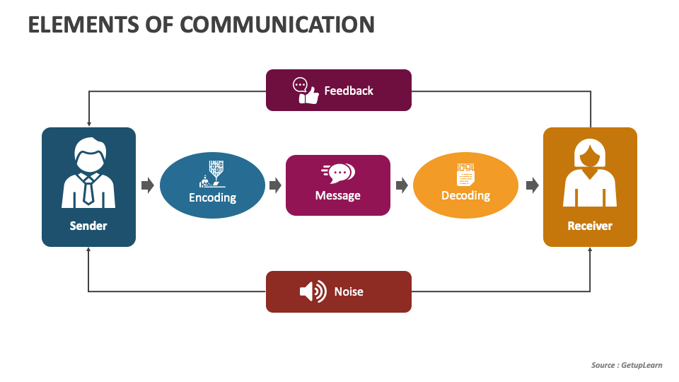
Introduction to project communication
Basic definitions to ensure a common understanding
Communication: There are three aspects of the term communication that we will explore in this course:
First, it is a discipline within the social sciences that studies the way in which human beings share meaning through verbal, nonverbal, and symbolic (words and images) messages.
Second, it is the act of transmitting and receiving those messages.
Third, it is the tools or methods we use to transmit those messages.
Dr. Raef Baraka

Slide 15
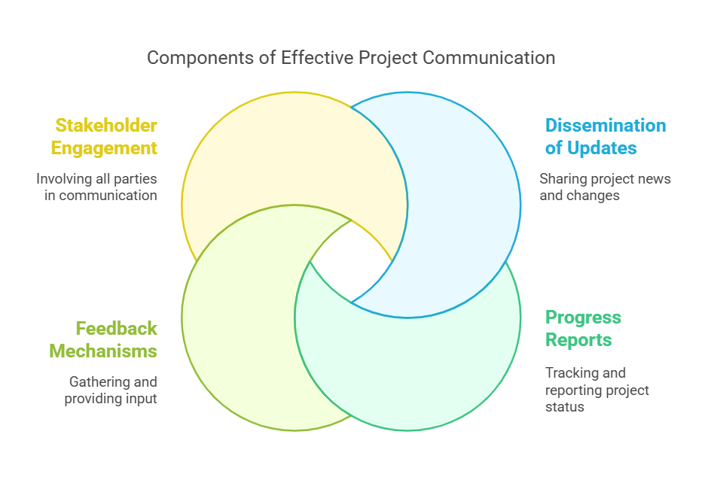
Introduction to project communication
Basic definitions to ensure a common understanding
Project communication:
This refers to the communication that takes place among project stakeholders and is related to some aspect of the project and its execution.
Dr. Raef Baraka

Slide 16
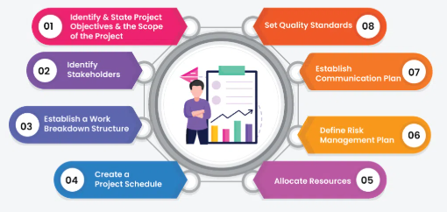
Introduction to project communication
Basic definitions to ensure a common understanding
Project communications management plan:
This is a plan that outlines when, how, and what to communicate to various stakeholder groups throughout the duration of the project.
Dr. Raef Baraka

Slide 17

Introduction to project communication
Basic definitions to ensure a common understanding
Project communication tools:
Project communication tools can be a wide range of technologies, documents, devices, interactions, and skills.
For this course, we define project communication tools as any mechanism or strategy to exchange information, reduce uncertainty, engage stakeholders, build trust, generate support for the project, and, ultimately, deliver project and team success.
Dr. Raef Baraka

Slide 18
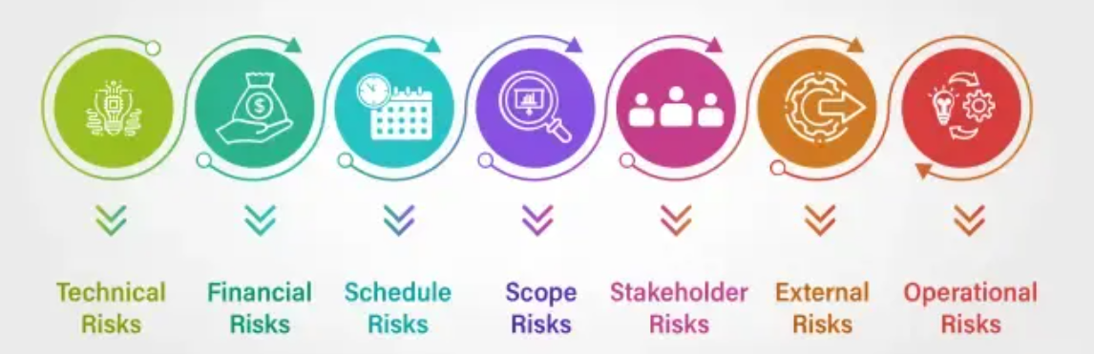
Introduction to project communication
Basic definitions to ensure a common understanding
Project risk:
A risk is an event or condition that may occur, resulting in a positive and/or negative effect on the project.
Dr. Raef Baraka

Slide 19

Introduction to project communication
Basic definitions to ensure a common understanding
Stakeholders:
Stakeholders are anyone who affects or is affected by the project. This includes the project team leadership who have authority over the project (such as the project sponsor), and others both inside and outside the organization who could be affected by the activities or outcomes of the project. At times we will distinguish different groups of stakeholders since communication needs and approaches can differ based on the stakeholders’ relationship to the project.
Dr. Raef Baraka

Slide 20

Introduction to project communication
Basic definitions to ensure a common understanding
Traditional project teams::
Traditional project teams are those that use a traditional (or “waterfall”) methodology. This is a linear approach where most of the planning for the entire project is done after the initiation of the project.
Dr. Raef Baraka

Slide 21

Introduction to project communication
Basic definitions to ensure a common understanding
Agile project teams::
Agile project teams are those that work on projects using an agile or iterative approach. Rather than planning the full project at initiation, agile projects are planned in sprints of a set period (for example, 1 week or 2 months) that have a set list of goals/deliverables. Once the sprint is complete, the project is evaluated, and the next sprint is planned. This allows for changes and decisions to be made throughout the project as it progresses.
Dr. Raef Baraka

Slide 22
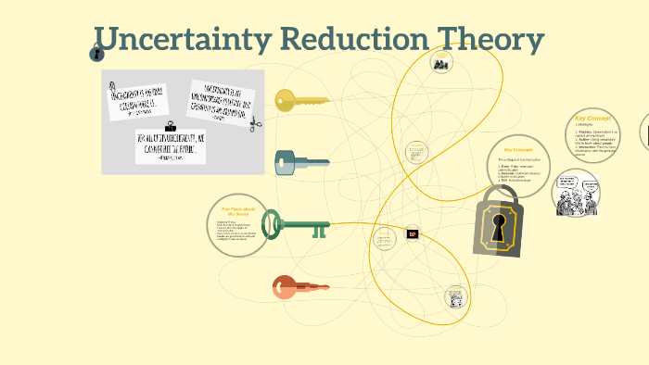
Introduction to project communication
Basic definitions to ensure a common understanding
Uncertainty Reduction Theory:
Uncertainty reduction theory (URT), the older and more well-known of the two theories we will review, defines uncertainty as “having a number of possible alternative predictions or explanations.”
This theory presumes that people always try to reduce or make sense of uncertainty from a cognitive, information-based perspective.
Dr. Raef Baraka

Slide 23

Introduction to project communication
Basic definitions to ensure a common understanding
Uncertainty Management Theory:
This is a theory in the field of communication that proposes that uncertainty is both a cognitive (knowledge-based) and emotional state. People may or may not communicate to reduce uncertainty.
Dr. Raef Baraka

Slide 24

Introduction to project communication
Basic definitions to ensure a common understanding
Virtual project teams:
Virtual (or distributed) project teams are those that involve individuals who are not geographically co-located.
These teams generally rely heavily on technology to maintain communication, as face-to-face interactions are limited or nonexistent..
Dr. Raef Baraka

Slide 25
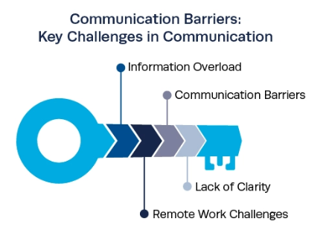
Introduction to project communication
Communication Barriers: Key Challenges in Communication
While the importance of communication is undisputed, project managers often grapple with a range of challenges that hinder effective communication:
Information Overload.
Communication Barriers.
Lack of Clarity.
Remote Work Challenges.

Slide 26

Introduction to project communication
Communication Barriers: Key Challenges in Communication
Information Overload:
In today's digital age, project managers are bombarded with various information from various sources. Distinguishing relevant information from noise can be overwhelming, leading to crucial details being missed. It can also be the case when project managers share information with stakeholders.
The right amount and level of information to share will depend on each stakeholder group or individual.
Dr. Raef Baraka

Slide 27

Introduction to project communication
Communication Barriers: Key Challenges in Communication
Communication Barriers:
Multidisciplinary teams may struggle to communicate due to differences in terminology, jargon, or cultural backgrounds.
Such barriers can impede understanding and collaboration. This is the most important and challenging aspect of communication to get right for project managers.
Dr. Raef Baraka

Slide 28

Introduction to project communication
Communication Barriers: Key Challenges in Communication
Lack of Clarity:
Vague or ambiguous communication can result in misunderstandings and confusion.
Project managers must strive for clarity in all communication channels to ensure everyone is on the same page.
Dr. Raef Baraka

Slide 29
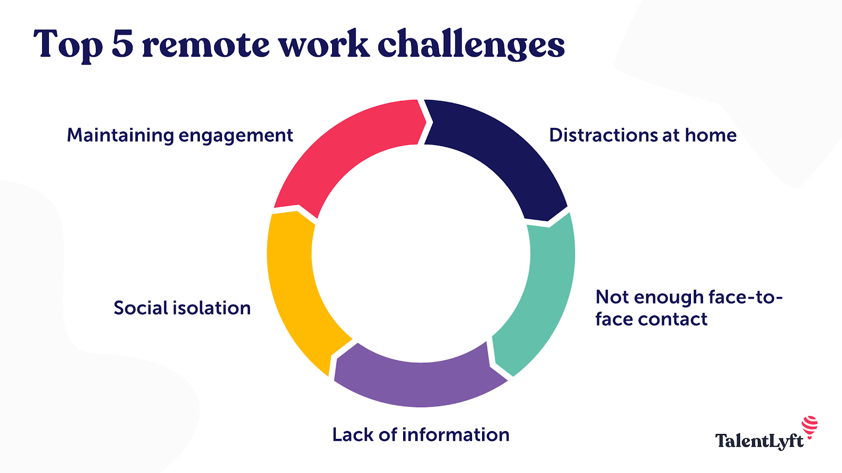
Introduction to project communication
Communication Barriers: Key Challenges in Communication
Remote Work Challenges:
The rise of remote work has introduced new hurdles to effective communication, such as time zone differences, technological glitches, and a lack of face-to-face interactions.
Project managers will need to adapt their communication to the circumstances of each stakeholder group.
Dr. Raef Baraka

Slide 30
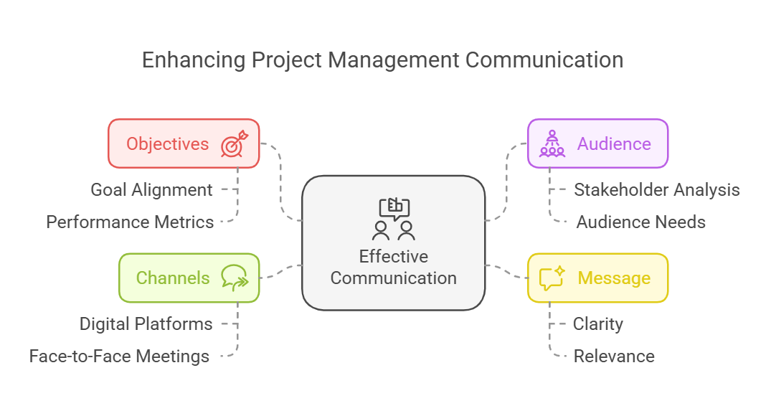
Introduction to project communication
Key factors in project management communication
Within the wider bracket of your project management communication process, there are several factors that define how effectively your communication strategy performs.
Therefore, in order to optimize for success, the following are some of the factors, an effective communication process must center around::
Objectives.
Audience.
Message.
Channels.

Slide 31
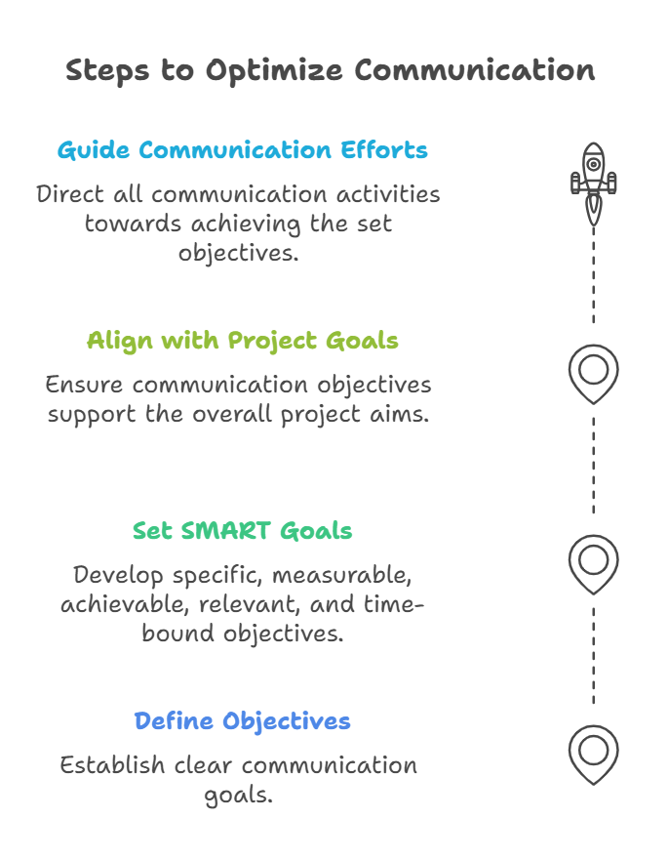
Introduction to project communication
Key factors in project management communication
Objectives:
Every message that’s sent out in the project management process, either to internal teams or to external stakeholders should have a specific project objective attached to it so the recipient can take action and close the loop.
Dr. Raef Baraka

Slide 32
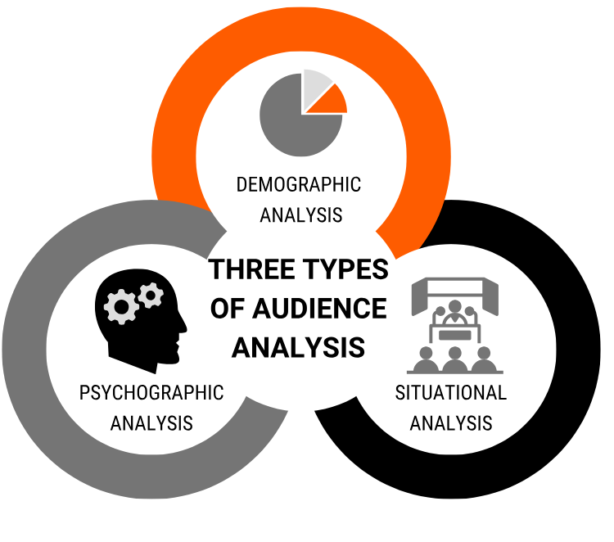
Introduction to project communication
Key factors in project management communication
Audience:
The audience in question refers to the recipient(s) (internal or external) of any messages sent out in the project management communication process.
One primary objective of every message sent out to an audience must be to convey meaning as easily as possible so the audience can take appropriate action with minimal or no friction.
Dr. Raef Baraka

Slide 33

Introduction to project communication
Key factors in project management communication
Message:
Messages sent out to project management stakeholders must be tailored both to convey meaning to the audience in an ideal fashion and as well, in a manner that’s within the capability of the originating stakeholder/source of the message.
Dr. Raef Baraka

Slide 34
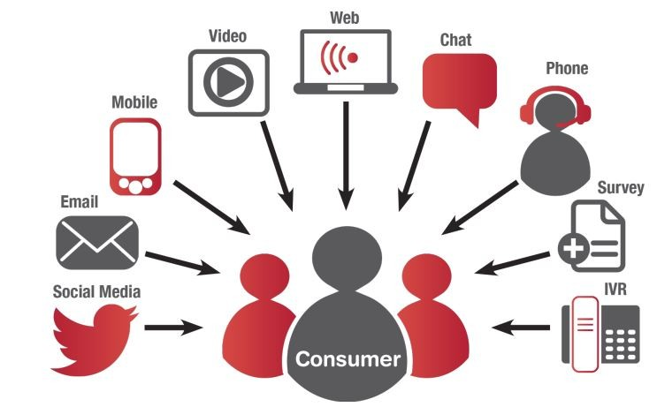
Introduction to project communication
Key factors in project management communication
Channels:
Clearly define communication channels for keeping stakeholders in the loop regarding any project under management.
Dr. Raef Baraka

Slide 35
Introduction to project communication
Lecture Summary
Communication Definition.
Why Is Communication So Important in Projects?
Two reasons for project communications continue to fall short?
Basic definitions to ensure a common understanding.
Communication Barriers: Key Challenges in Communication.
Key factors in project management communication.

Slide 36



Thank You

