Slide 1
MASTER OF SCIENCE IN ARTIFICIAL INTELLIGENCE · THESIS DEFENSE
Pneumonia Classification from
Chest X-ray Images
A comparative study of convolutional and transformer architectures, with a proposed CNN–Transformer hybrid
Presented by
Hussam alden Abushalha
Abdulaziz Dhafer Al Obud
Supervisor
Dr. Hagar Salah
College of Informatics · Midocean University
Notes:
BOTH — 25 s. Hussam opens: good morning, thank the committee, introduce both presenters and the title. Hand straight to the agenda.

Slide 2
AGENDA
Presentation Outline
01
Problem & Motivation
06
Models & Proposed Hybrid
02
Objectives
07
Results & Clinical Performance
03
Literature & Research Gap
08
Key Finding: Data Leakage
04
Research Framework
09
Conclusions
05
Dataset & Patient-Level Split
10
Limitations & Future Work
2
Notes:
HUSSAM — 25 s. State the split: I cover the problem through to the proposed model; Abdulaziz covers results, findings and conclusions. Total 15 minutes, questions after.

Slide 3
PROBLEM & MOTIVATION
Why Automated Pneumonia Detection?
#1
Variable
Scarce
infectious cause of death
in children under five
interpretation between
radiologists reading the same film
expert radiologists where
the disease burden is highest
The gap this work addresses
Published comparisons of CNN and transformer models differ in dataset, preprocessing and evaluation — the differences cannot be attributed to the architecture.
Reported gains are rarely subjected to a statistical significance test.
Splitting protocols are often not reported at all, and on this benchmark that choice materially changes the answer.
3
Notes:
HUSSAM — 50 s. Lead with the clinical need, then pivot fast to the methodological gap — that gap is what the thesis actually contributes to. Do not linger on the statistics.

Slide 4
OBJECTIVES
Aim and Objectives
Build and compare deep-learning classifiers that detect pneumonia in chest X-rays under one consistent protocol, and test whether fusing a CNN with a transformer improves on either alone.
1
2
3
4
Compare
Propose
Evaluate
Deploy
Fine-tune three CNNs and two transformers under identical conditions
Design a hybrid that fuses EfficientNetB0 with Swin Transformer features
Accuracy, sensitivity, specificity, ROC-AUC and a paired significance test
Serve the trained models through a working prototype application
4
Notes:
HUSSAM — 35 s. Read the aim once, then name the four objectives quickly. The committee will map the rest of the talk onto these four words.

Slide 5
LITERATURE REVIEW
What the Literature Reports — and What It Omits
15 studies reviewed (2023–2026)
The research gap
Transformers
97.6 – 98.6%
Not comparable
Singh, Shomsomi, Alshanketi
Every study uses a different dataset, preprocessing and protocol.
Hybrids / ensembles
98.7 – 99.4%
Not tested
Mustapha, Slimi, Yanar
Hybrid gains are reported without any significance test.
CNN families
95 – 98.7%
Not disclosed
Buriboev, Bundea, An, Ahmed
Splitting strategy is rarely stated — yet it changes the ranking.
Clinical validation
AUC 0.74
Hofmeister et al. (2024)
A warning
Hofmeister et al. showed a weak reference standard inflates apparent accuracy from 0.99 to 0.74.
5
Notes:
HUSSAM — 60 s. Do not walk through all 15 studies. Give the headline ranges on the left, then spend most of the time on the right-hand gap — especially Hofmeister, because it foreshadows our own leakage finding.

Slide 6
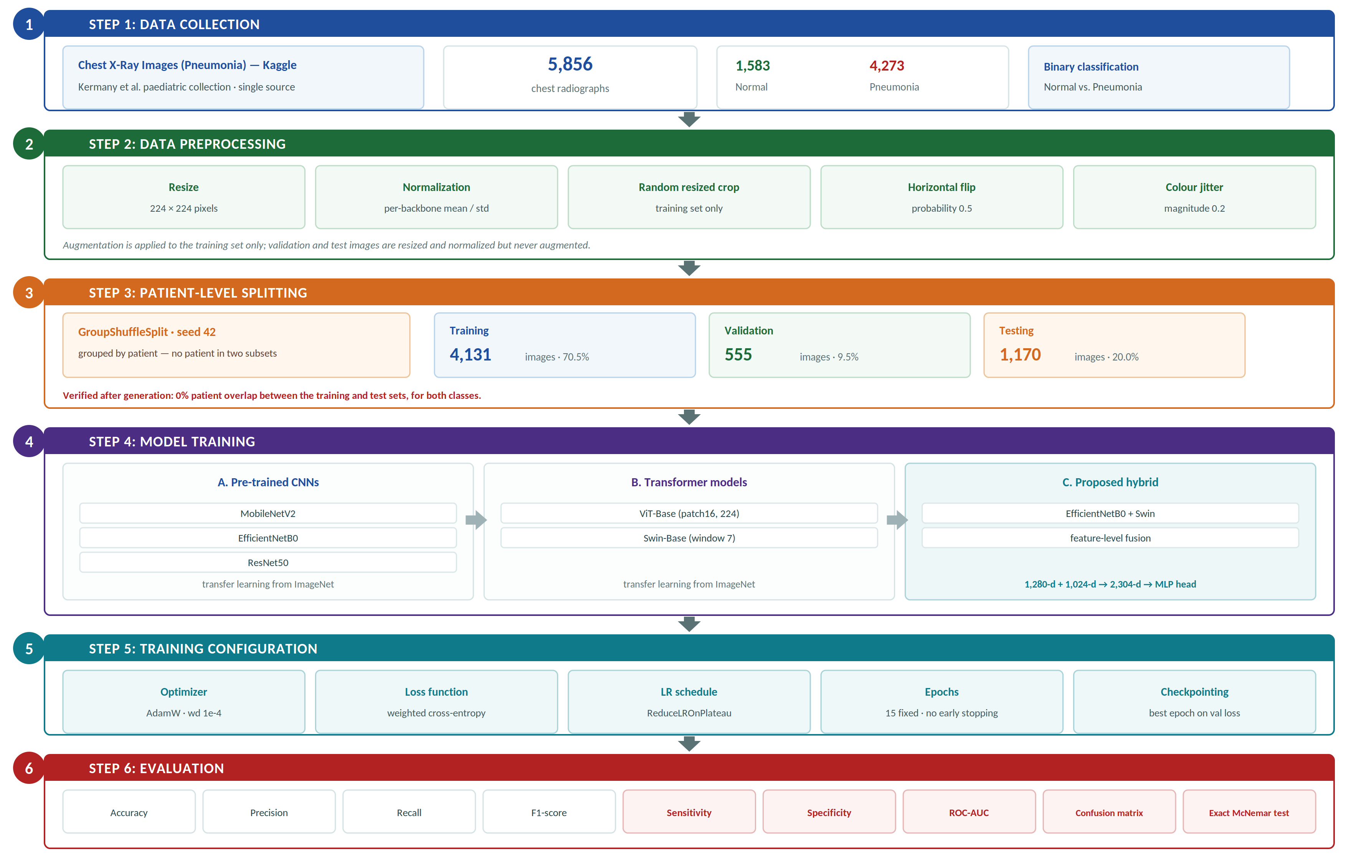
METHODOLOGY
Research Framework
One protocol, six models
Step 3
Patient-level grouping, not file-level — the decision that changes the answer
Step 4
Three CNNs, two transformers and the proposed hybrid, trained identically
Step 5
Weighted loss for class imbalance; best-epoch checkpointing, no early stopping
Step 6
Sensitivity, specificity and a paired significance test, not accuracy alone
6
Notes:
HUSSAM — 65 s. Walk the six steps top to bottom. Pause on step 3 — patient-level splitting is the decision that separates this work from the literature, and Abdulaziz returns to it later. Note step 4C: the proposed hybrid sits alongside the baselines, not instead of them.

Slide 7
DATA
Dataset and Patient-Level Splitting
Chest X-Ray Images (Pneumonia) — Kaggle
Why patient-level grouping matters
5,856 paediatric radiographs · 1,583 Normal and 4,273 Pneumonia · binary classification · all images resized to 224 × 224
The collection holds 4,273 pneumonia images from only 1,844 patients — an average of 2.3 radiographs each.
A file-level split scatters one patient's images across training and test, so the model is evaluated on a child it has already studied.
Subset | Normal | Pneumonia | Total
Training | 1,114 | 3,017 | 4,131
Validation | 155 | 400 | 555
Testing | 314 | 856 | 1,170
74.2% of pneumonia test images shared a patient with training under a file-level split
Our split is patient-disjoint and verified at 0% overlap.
7
Notes:
HUSSAM — 70 s. Give the dataset in one sentence, then spend the time on the right column. The 74.2% is the number the committee should remember from my half of the talk.

Slide 8
MODELS
Six Models Under One Protocol
CONVOLUTIONAL NETWORKS
TRANSFORMER MODELS
MobileNetV2
ViT-Base
Lightweight · depthwise separable convolutions
Global self-attention over 16 × 16 patches
EfficientNetB0
Swin-Base
Compound scaling · best accuracy-per-parameter
Hierarchical shifted-window attention
ResNet50
Proposed Hybrid
Residual connections · 25M parameters
EfficientNetB0 + Swin feature fusion
Identical data, augmentation, optimizer, schedule and epoch budget for every model — so differences reflect the architecture, not the setup.
8
Notes:
HUSSAM — 35 s. Name the six quickly. The line at the bottom is the point: a controlled comparison. Then move to the hybrid.

Slide 9
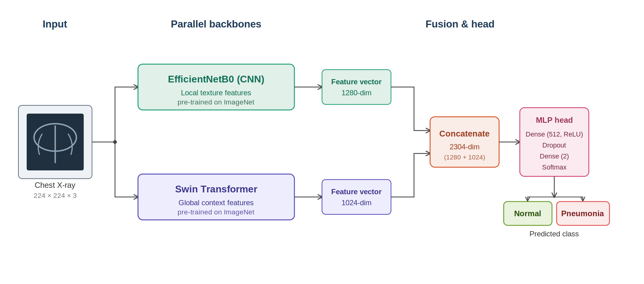
PROPOSED MODEL
Proposed CNN–Transformer Hybrid
Design rationale
Local features
EfficientNetB0 → 1,280-d
Global context
Swin Transformer → 1,024-d
Fusion
Concatenate → 2,304-d
Head
Dense 512 · ReLU · dropout 0.3 · softmax
Training
Hypothesis: convolutional networks capture local texture, transformers capture global context — fusing them should beat either alone.
Warm-start, 3 epochs head-only, then 8 end-to-end
9
Notes:
HUSSAM — 50 s. Explain the two branches and the fusion, then state the hypothesis explicitly and hand over: 'Abdulaziz will now show whether that hypothesis held.' End of Part 1 — about 7 minutes elapsed (target 6:55).

Slide 10
PART 2 · ABDULAZIZ DHAFER AL OBUD
Experimental Setup
Framework
Hardware
PyTorch 2.11 (CUDA 12.8) with timm
Intel Core i9-13900H · RTX 5060 · 32 GB
Optimizer
Loss
AdamW · weight decay 1e-4
Weighted cross-entropy (1.854 / 0.685)
Schedule
Learning rate
15 epochs · ReduceLROnPlateau
1e-4 CNNs · 3e-5 transformers
Checkpointing
Reproducibility
Best epoch on validation loss
Fixed seed 42 across split and init
Evaluated on the held-out patient-disjoint test set of 1,170 images.
10
Notes:
ABDULAZIZ — 35 s. Open by taking over clearly. Do not read every row; highlight that every model shared the configuration except the learning rate, which differs by family for standard reasons.

Slide 11
RESULTS
Overall Performance
Reading the numbers
Both transformers tie at 97.35%.
Every CNN falls between 94.87% and 95.38%.
Confidence intervals
96.26–98.13% for transformers vs 93.74–96.22% for EfficientNetB0; only ResNet50 overlaps, and marginally.
Highest AUC: Swin 0.9962, then ViT 0.9948 and the hybrid 0.9946.
Family matters. The model within a family does not.
11
Notes:
ABDULAZIZ — 65 s. Give the ranking, then the confidence-interval point — that is what makes this a real finding rather than a ranking on one test set. Be precise: the transformer interval is disjoint from MobileNetV2 and EfficientNetB0, and overlaps ResNet50 by about 0.2 points. If asked, say the family separation is clear but not absolute. Close with the italic line.

Slide 12
RESULTS
The Number That Matters Clinically
Accuracy differs by 2.5 points between the best and worst model. Missed pneumonia cases differ threefold.
14
17
23
42
43
47
false negatives
false negatives
false negatives
false negatives
false negatives
false negatives
ViT
Swin
Hybrid
ResNet50
MobileNetV2
EfficientNetB0
In a screening setting a missed pneumonia case costs far more than a false alarm — so sensitivity, not accuracy, is the metric that should drive the architecture choice.
Sensitivity (Pneumonia as positive)
Transformers 0.980 – 0.984 · Hybrid 0.973 · CNNs 0.945 – 0.951
Specificity runs the other way, by a far smaller margin (0.946 – 0.968). Tuned to 99% sensitivity, ViT costs 20 false positives — ResNet50 needs 75.
12
Notes:
ABDULAZIZ — 70 s. This is the most important results slide. Say the sentence at the top slowly. 14 versus 47 missed cases on the same 856 images is the argument for transformers. The threshold line at the end is the operational version of that argument: at screening-level sensitivity the transformers keep a usable specificity and the CNNs do not.

Slide 13
CONTRIBUTION
Key Finding: Patient-Level Data Leakage
We repeated the entire experiment on a file-level split of the same 5,856 images — the protocol used by much of the published literature.
Model | File-level split | Patient-disjoint | Difference | False negatives
MobileNetV2 | 95.82% | 94.87% | −0.95 | 38 → 43
EfficientNetB0 | 96.67% | 95.13% | −1.54 | 32 → 47
ResNet50 | 96.42% | 95.38% | −1.04 | 35 → 42
ViT | 97.18% | 97.35% | +0.17 | 24 → 14
Swin | 96.42% | 97.35% | +0.93 | 35 → 17
Hybrid | 96.59% | 97.01% | +0.42 | 33 → 23
Leakage flatters CNNs, not transformers
Every CNN scored up to 1.5 points higher under the leaky split, while transformers scored slightly lower. Convolutional receptive fields emphasise local texture — exactly what a second radiograph of the same chest provides. Offered as a hypothesis, not a demonstration.
Under a file-level split the six models were statistically indistinguishable. A study using that protocol would have concluded that architecture does not matter — which our leakage-free results show to be wrong.
13
Notes:
ABDULAZIZ — 80 s. The centrepiece of the defense. Explain what was changed and what was held constant, then read the dark box verbatim. Expect a question here — be ready to say the comparison confounds leakage with test-set composition, and that we present the mechanism as a hypothesis. Supporting point if pressed: of the fifteen studies reviewed, the only one that reports patient-level splitting explicitly (Usman et al., 2025) also reports the lowest accuracy at 79%.

Slide 14
PROPOSED MODEL — EVALUATION
Did the Hybrid Work?
Yes — against its own CNN branch
Significance testing — hybrid vs ViT
95.13% → 97.01%
Adding Swin features lifted EfficientNetB0 well past every convolutional baseline.
Only the images the two models disagree on carry information.
 | ViT correct | ViT wrong
Hybrid correct | 1,126 | 9
Hybrid wrong | 13 | 22
No — against the transformer alone
97.01% vs 97.35%
Behind both transformers, at roughly twice the parameters and inference cost.
p = 0.524
Not significant on either test — McNemar p = 0.524 at threshold 0.5, DeLong p = 0.832 across all thresholds. The hybrid leads on no measure.
14
Notes:
ABDULAZIZ — 75 s. Present this as an honest negative result — that is a strength, not a weakness. Explain McNemar in one sentence: only the 22 disagreements count, split 9 to 13, which is a coin flip. Add that DeLong tests the same question across every threshold rather than just 0.5, and also comes back non-significant (p = 0.832), so the result does not depend on where the cut-off sits.

Slide 15
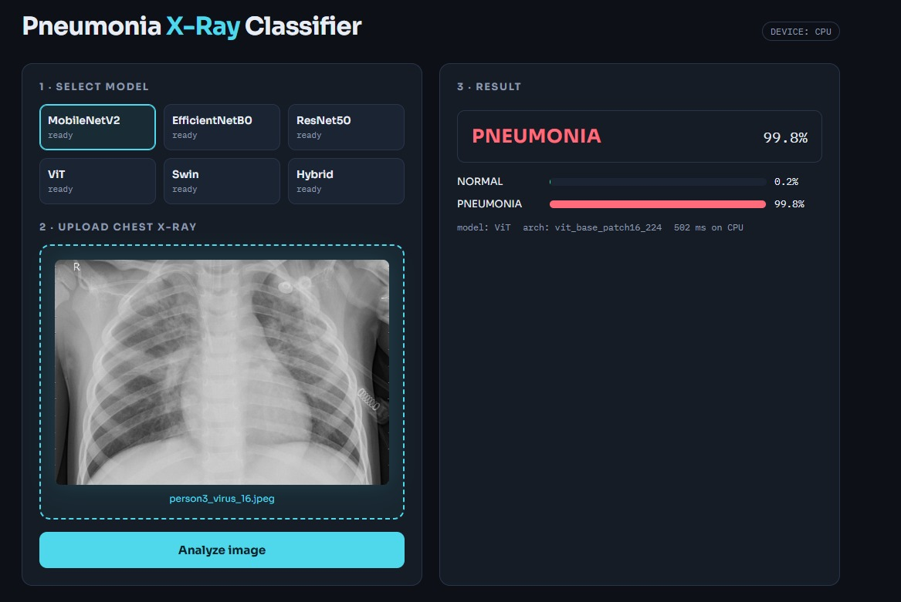
DEPLOYMENT
Prototype Web Application
From experiment to usable tool
Select any of the six trained models
Upload a chest X-ray and receive a prediction
Per-class probabilities, confidence and inference time
Runs locally — images never leave the machine
Research prototype — not a certified medical device.
15
Notes:
ABDULAZIZ — 30 s. Show it briefly and state the disclaimer clearly. If a live demo is planned, this is the slide to switch away from.

Slide 16
SUMMARY
Conclusions
1
Architecture family matters
Both transformers reached 97.35% against 94.87–95.38% for every CNN — the one difference whose confidence intervals are near-disjoint.
2
Fusion added nothing
The hybrid matched but did not beat a plain transformer — McNemar p = 0.524, DeLong p = 0.832 — at twice the cost. A negative result.
3
Protocol changes the answer
File-level splitting inflates CNN accuracy by up to 1.5 points and erases the gap between families entirely.
4
A working prototype
All six models are served through a local web application for interactive classification.
16
Notes:
ABDULAZIZ — 50 s. Four points, one sentence each. Emphasise that points two and three are contributions precisely because they are negative and methodological.

Slide 17
NEXT STEPS
Limitations and Future Work
LIMITATIONS
FUTURE WORK
Single centre
External validation
One paediatric dataset — no external validation
Multi-centre adult and paediatric cohorts
Single run
Explainability
One training run per model; variance unquantified
Grad-CAM and SHAP to verify clinically meaningful regions
Fixed threshold
Wider hybrid search
All results at threshold 0.5; the sweep is exploratory, not validated
Alternative pairings and attention-based fusion
Black box
Clinical comparison
No explainability analysis applied
Prospective evaluation against radiologist readings
17
Notes:
ABDULAZIZ — 40 s. Name the limitations confidently — volunteering them pre-empts half the questions. External validation is the one the committee will care about most.

Slide 18
Thank you
We welcome your questions.
Hussam alden Abushalha · Abdulaziz Dhafer Al Obud
Supervisor: Dr. Hagar Salah · College of Informatics, Midocean University
97.35%
1,170
0%
p = 0.524
best accuracy
test images
patient leakage
hybrid vs ViT
Notes:
BOTH — closing. Stand together for questions. Likely questions: why not external validation; is the leakage comparison confounded; why did the hybrid fail; would EfficientNetB0 + ViT do better.

