Slide 1
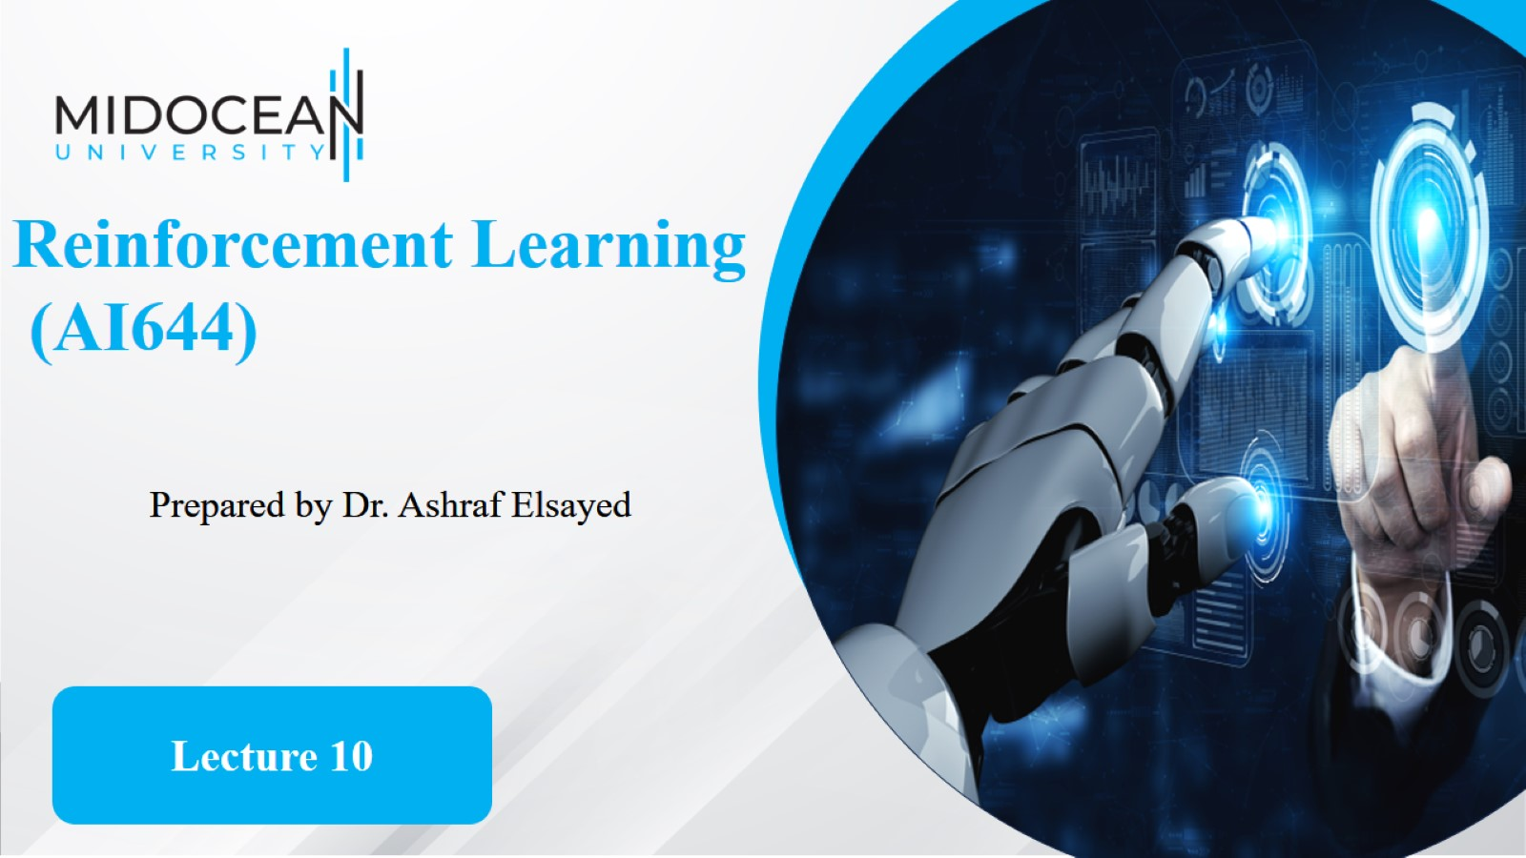

Slide 2


Slide 3

Dyna Architecture

Slide 4
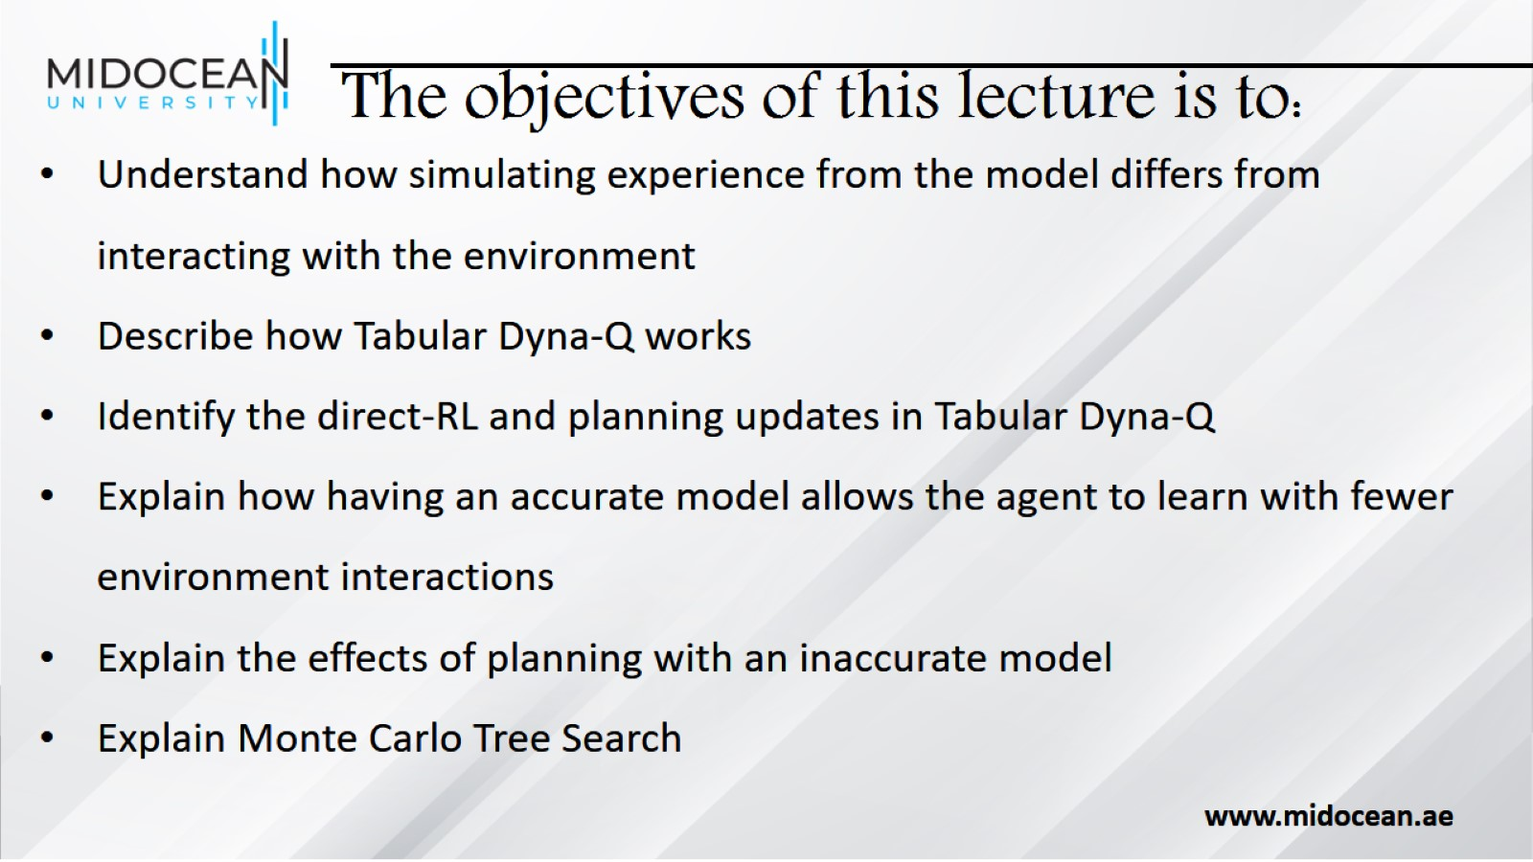
The objectives of this lecture is to:

Slide 5
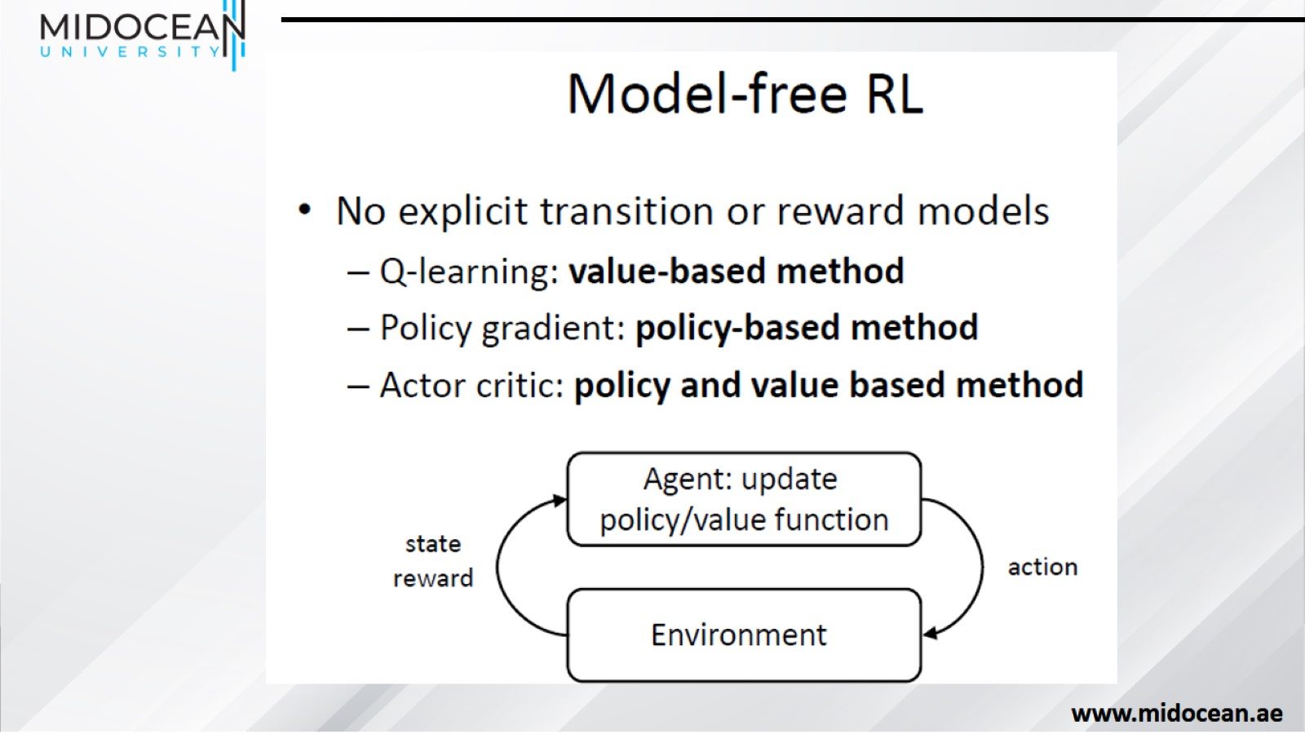

Slide 6
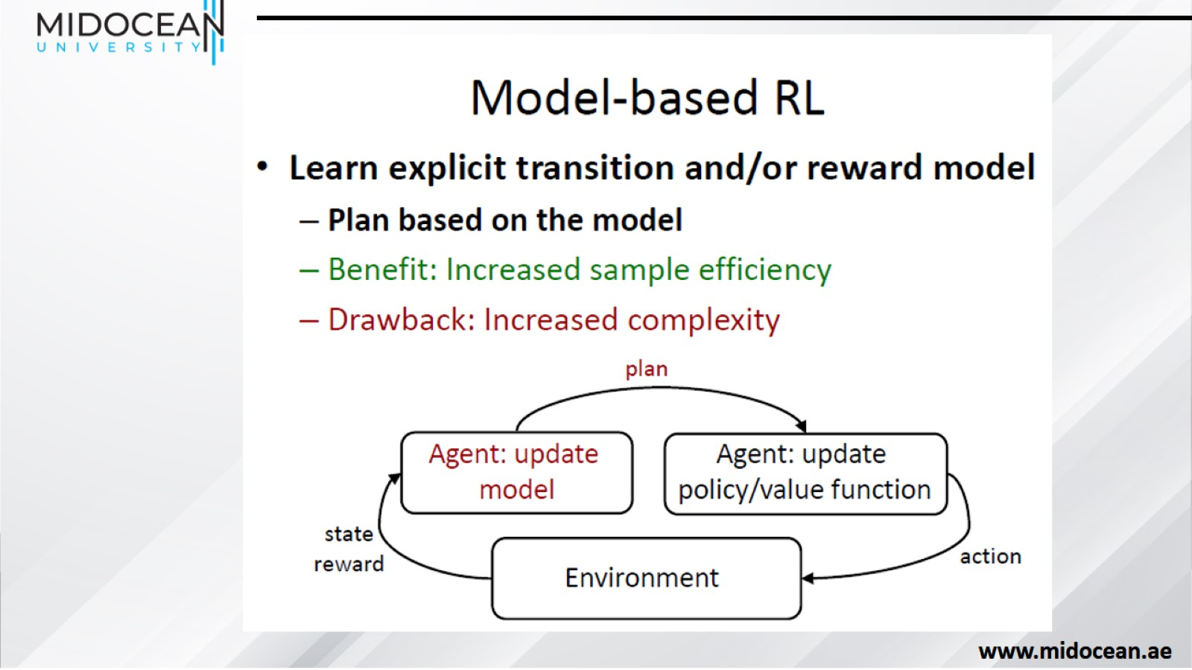

Slide 7
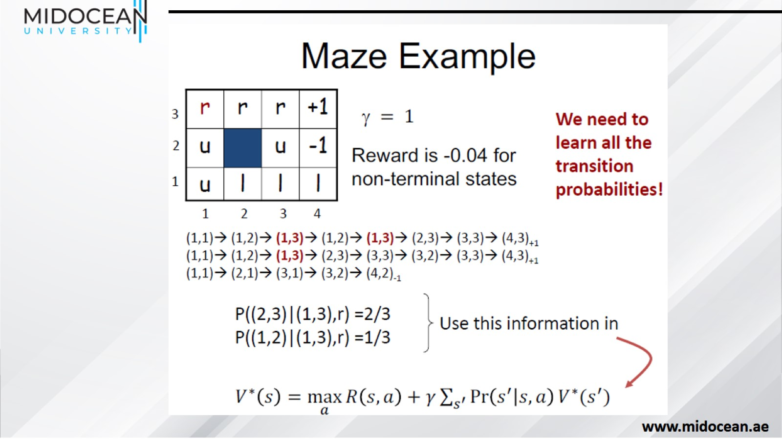

Slide 8
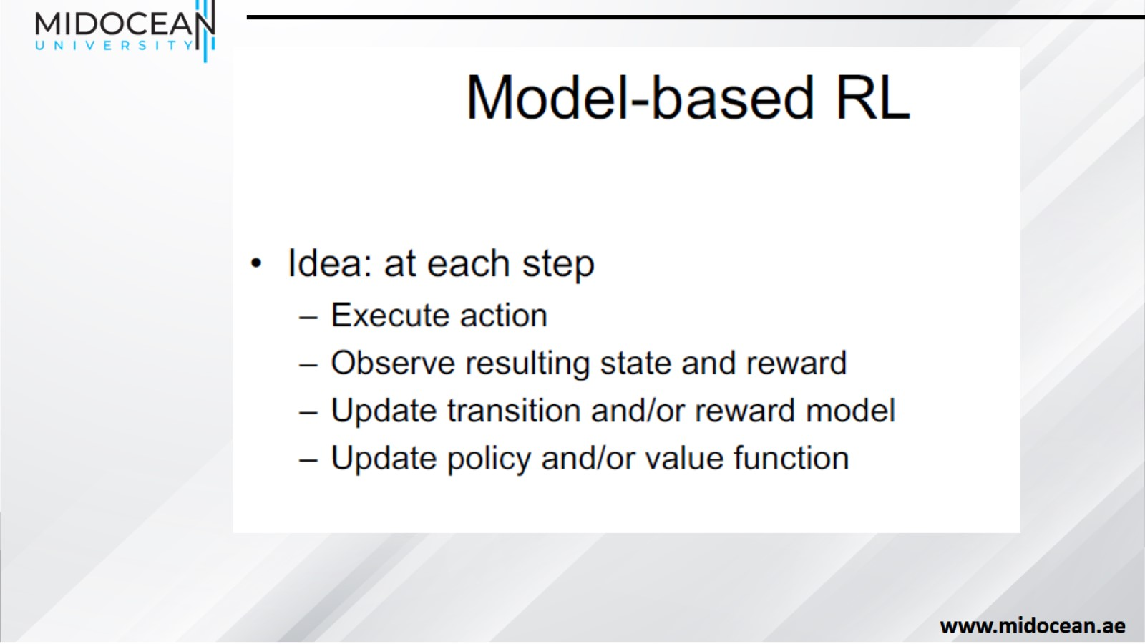

Slide 9
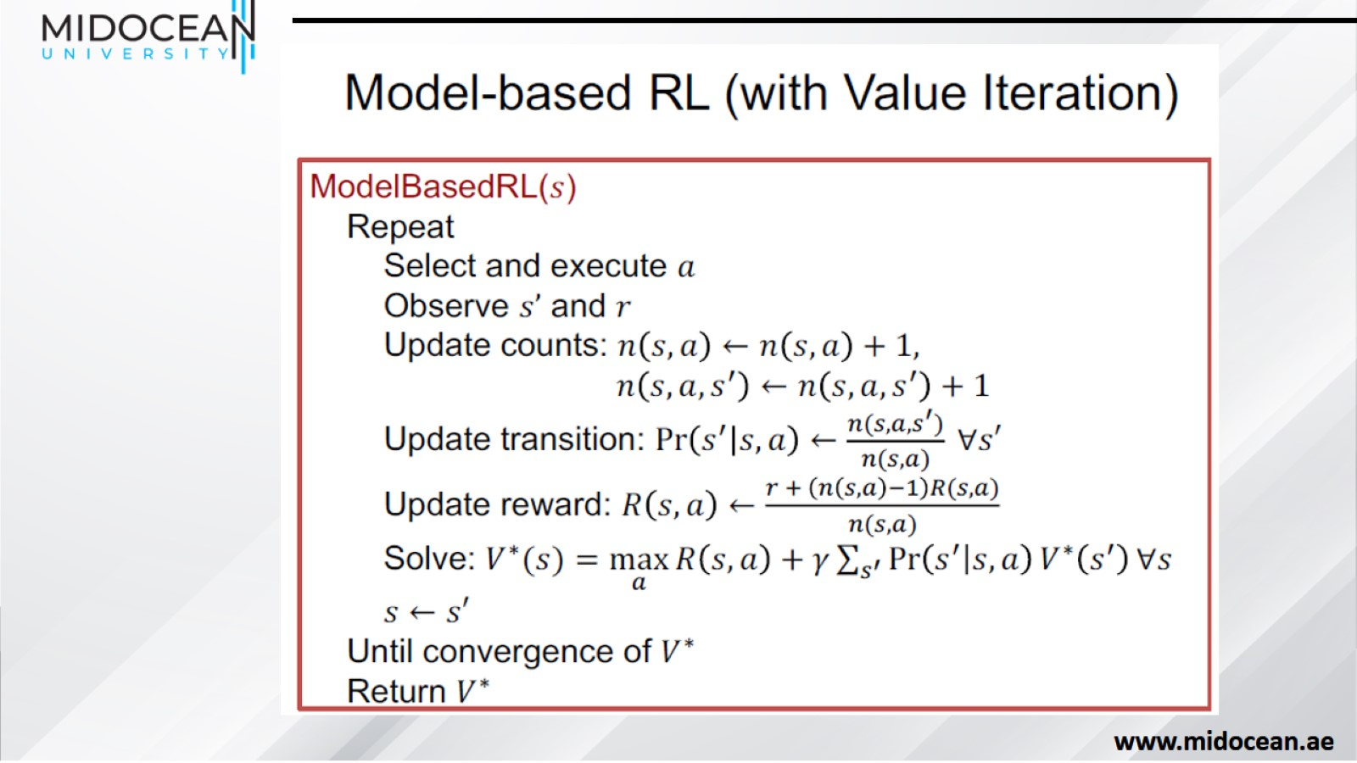

Slide 10
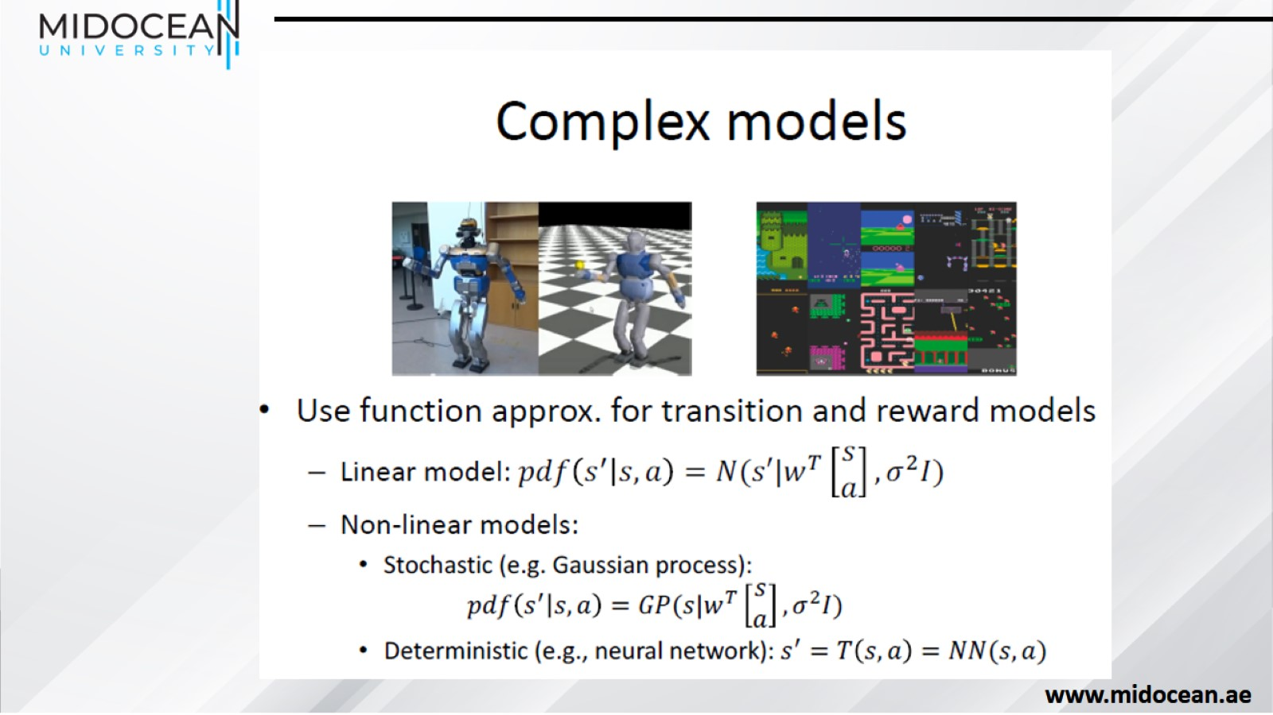

Slide 11
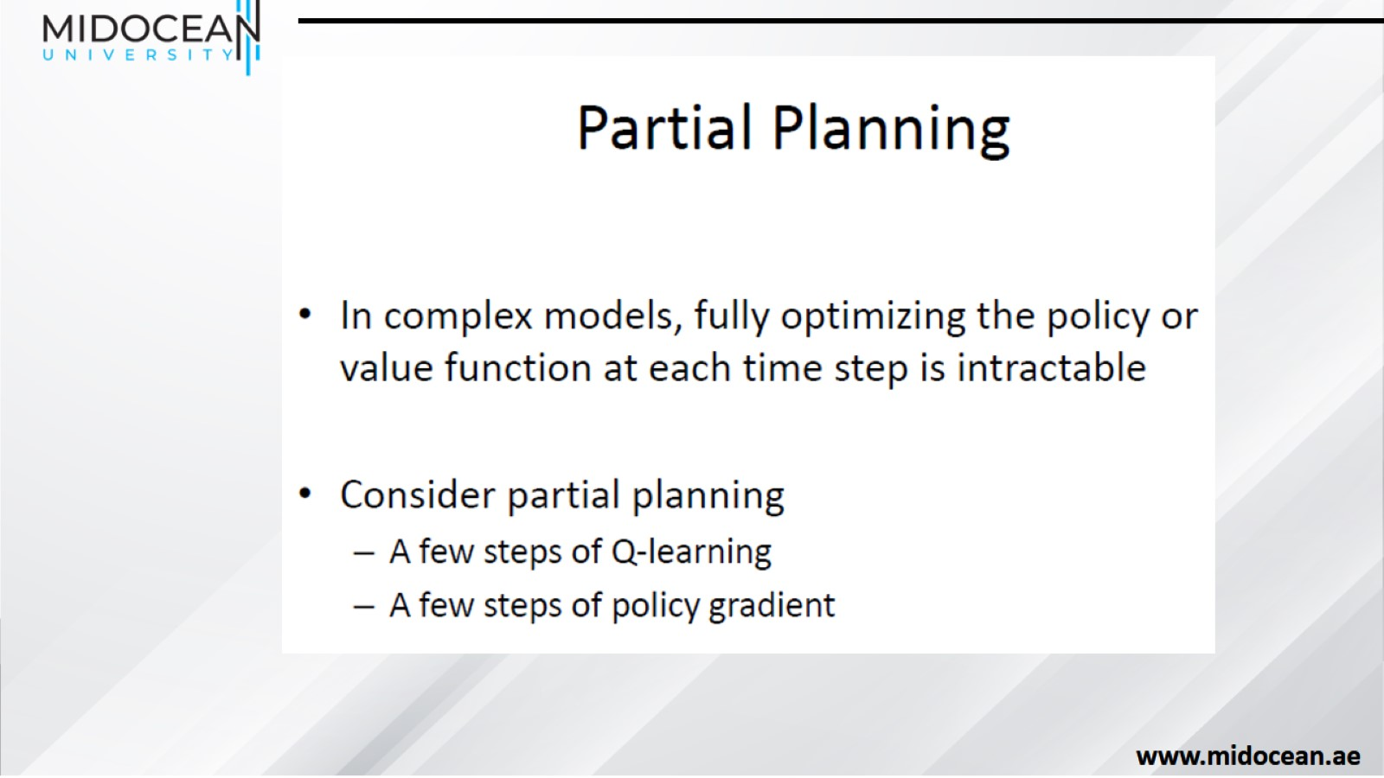

Slide 12
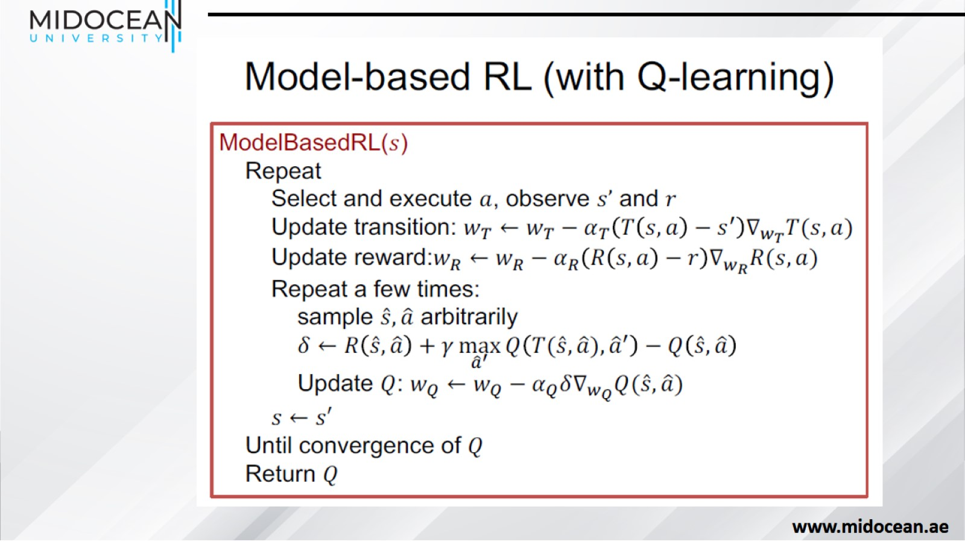

Slide 13
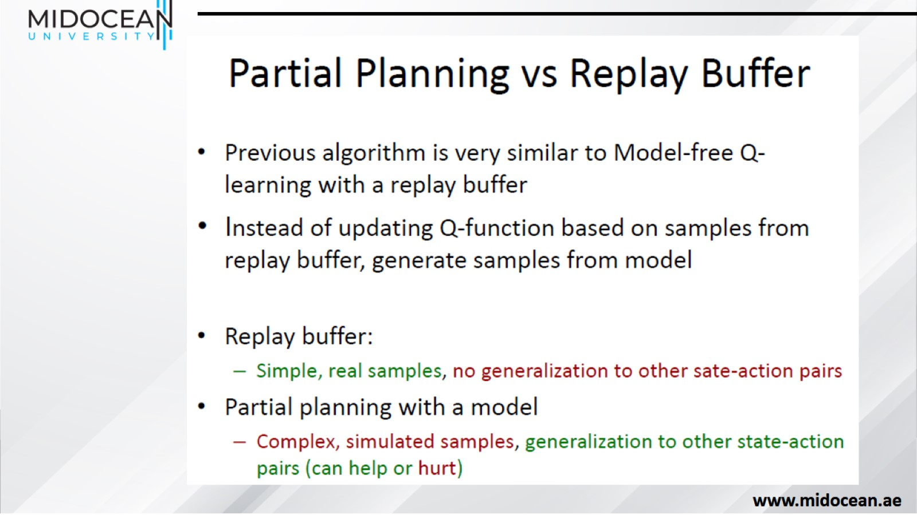

Slide 14
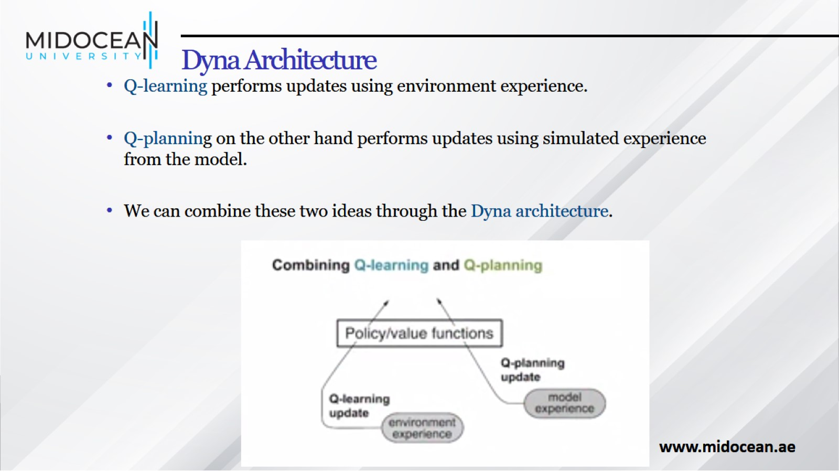
Dyna Architecture

Slide 15
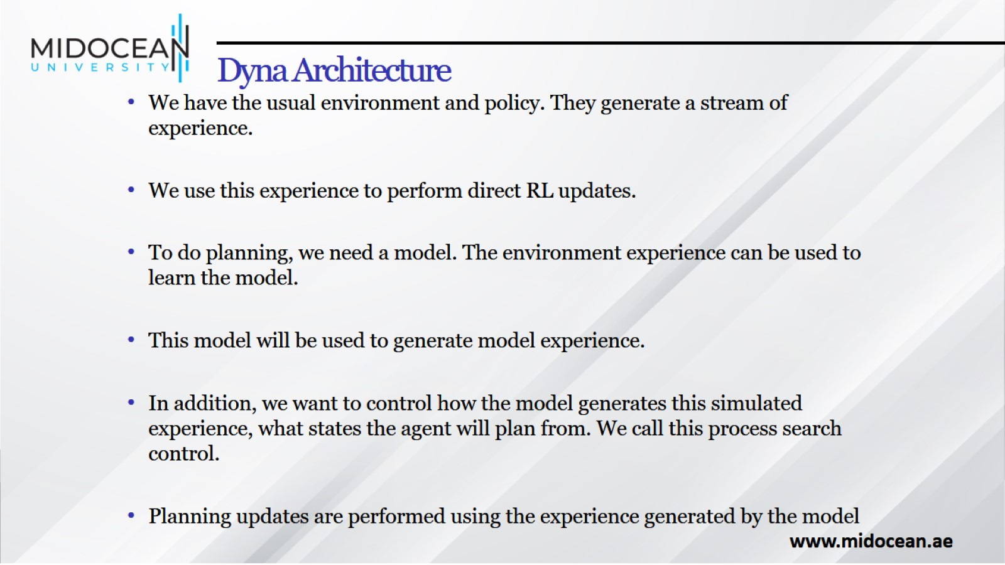
Dyna Architecture

Slide 16
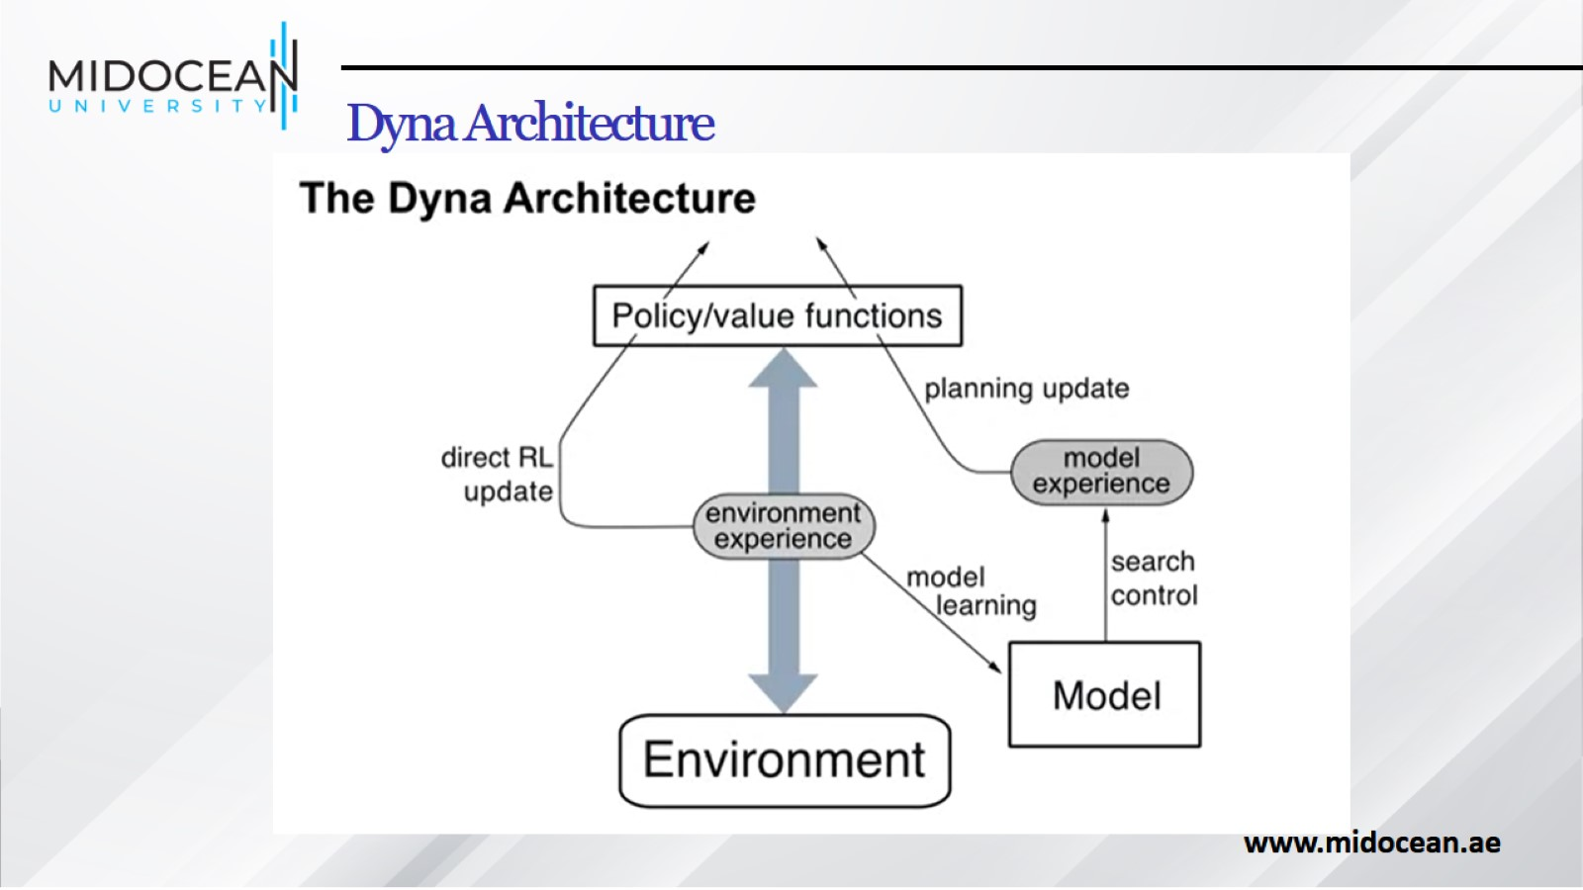
Dyna Architecture

Slide 17
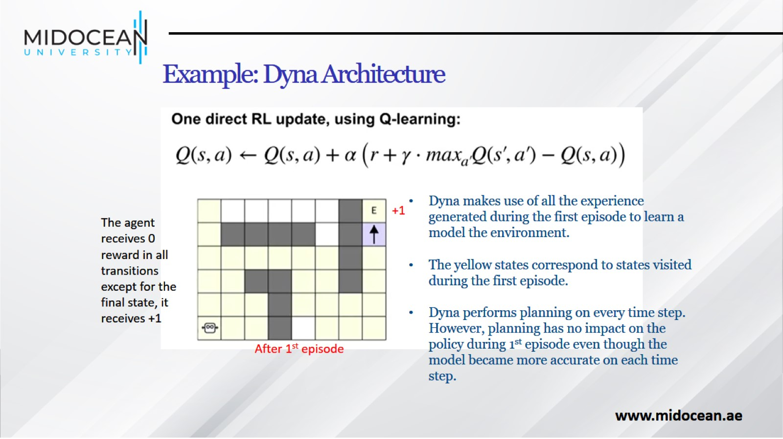
Example: Dyna Architecture

Slide 18
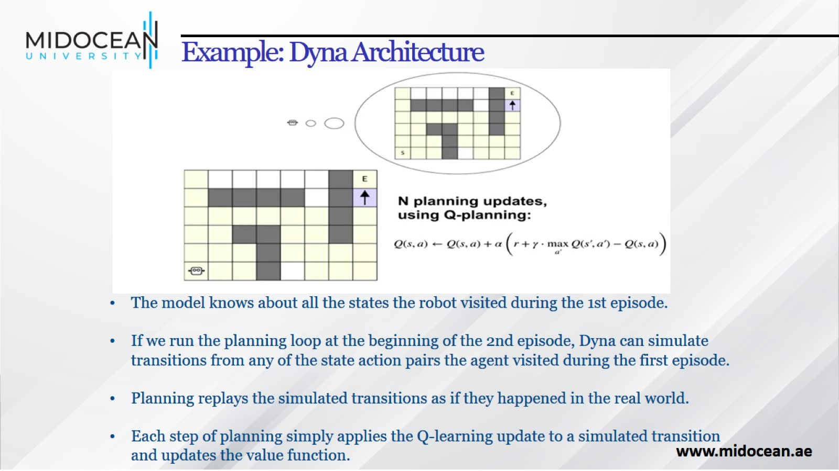
Example: Dyna Architecture

Slide 19
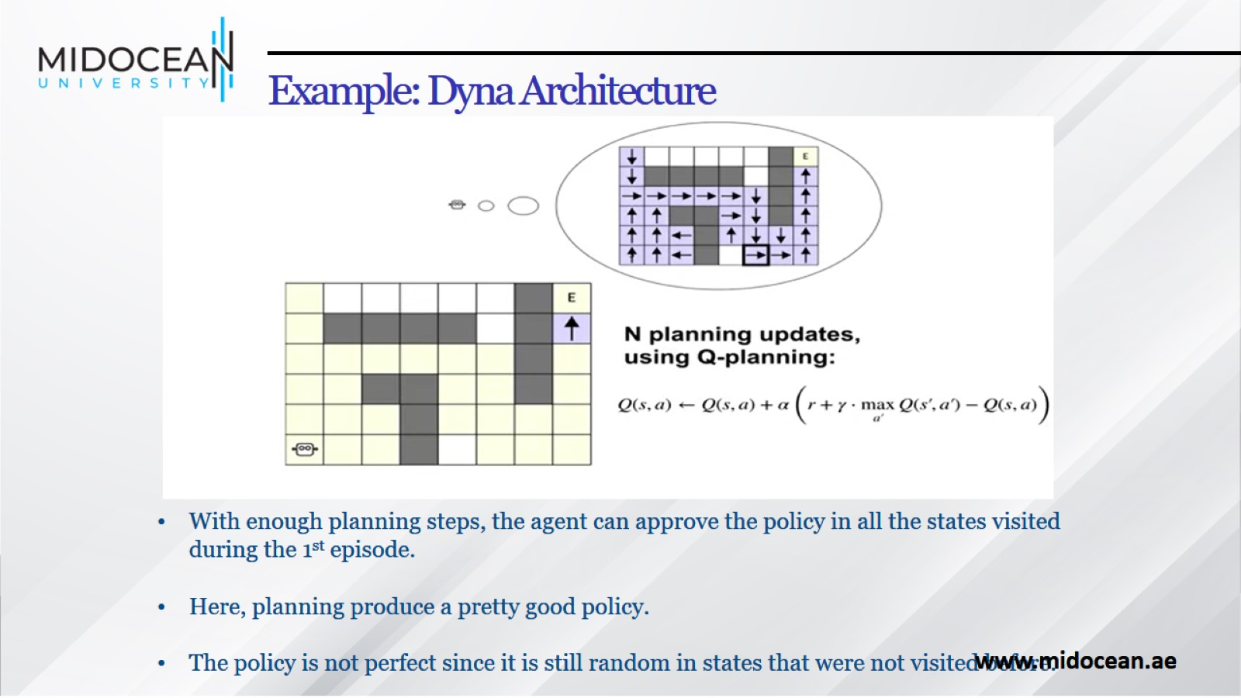
Example: Dyna Architecture

Slide 20
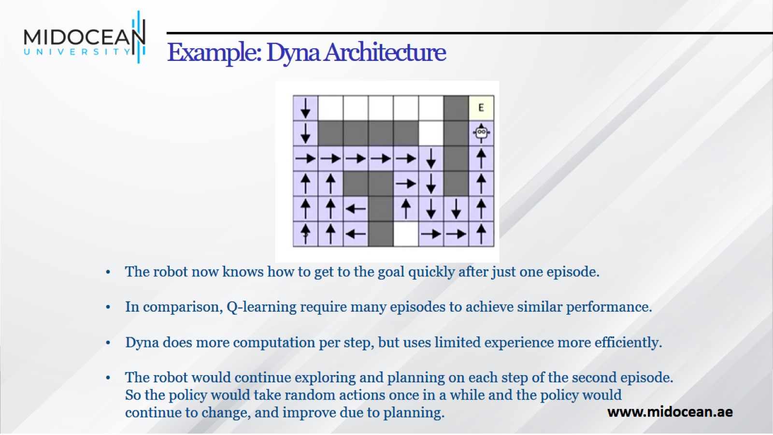
Example: Dyna Architecture

Slide 21
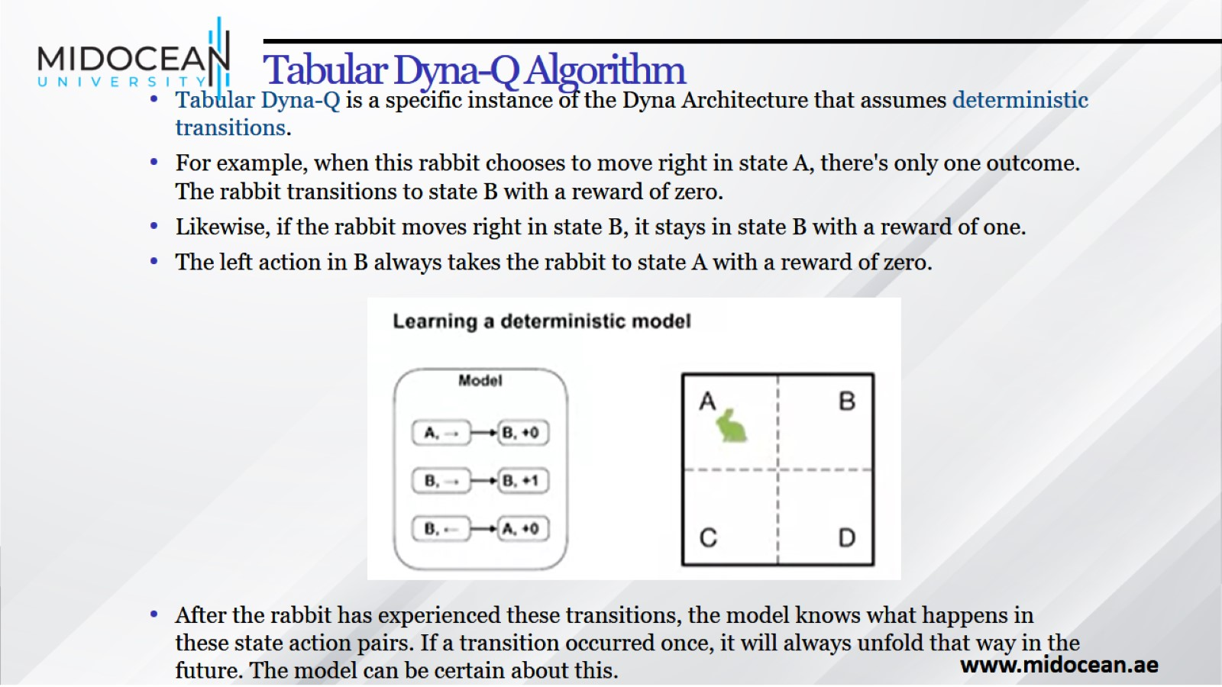
Tabular Dyna-Q Algorithm

Slide 22
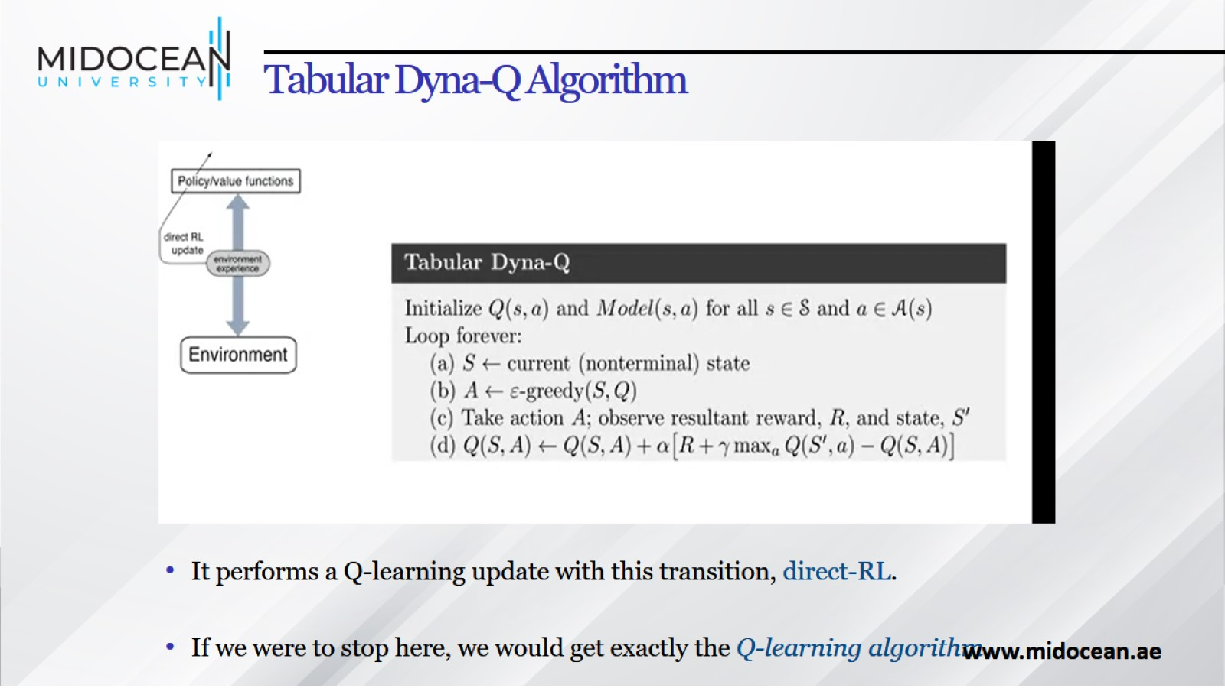
Tabular Dyna-Q Algorithm

Slide 23
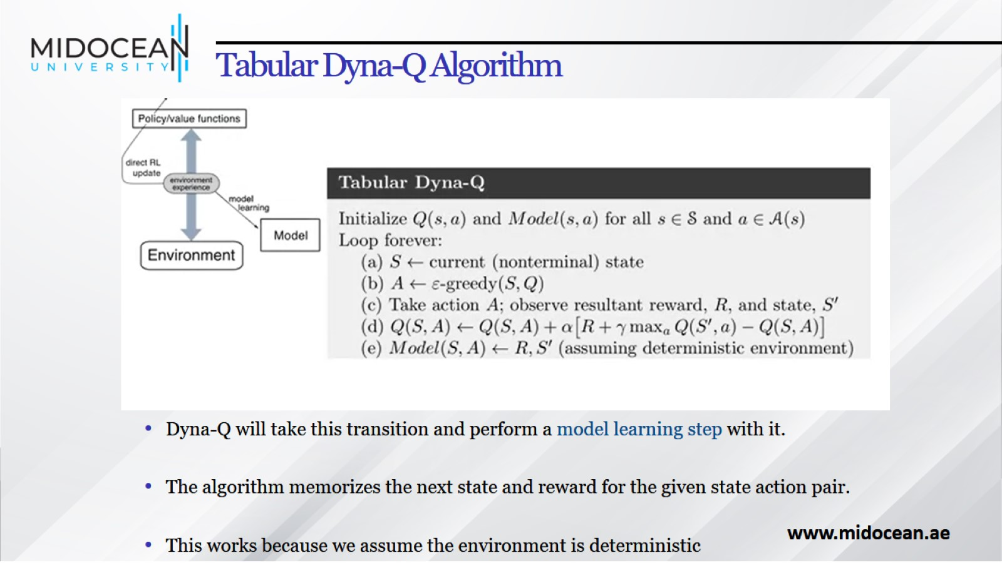
Tabular Dyna-Q Algorithm

Slide 24
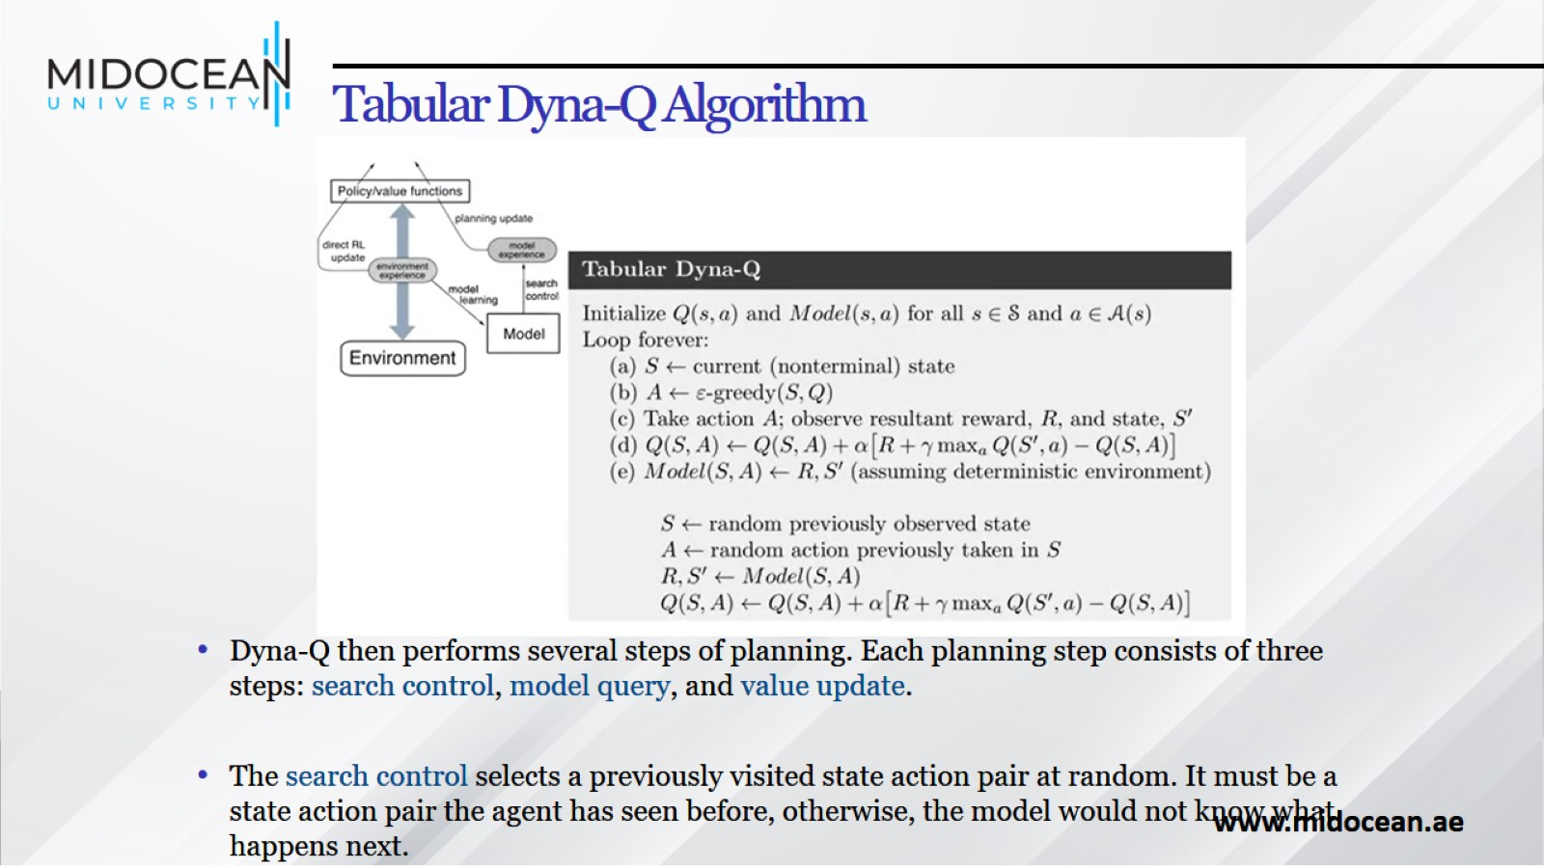
Tabular Dyna-Q Algorithm

Slide 25
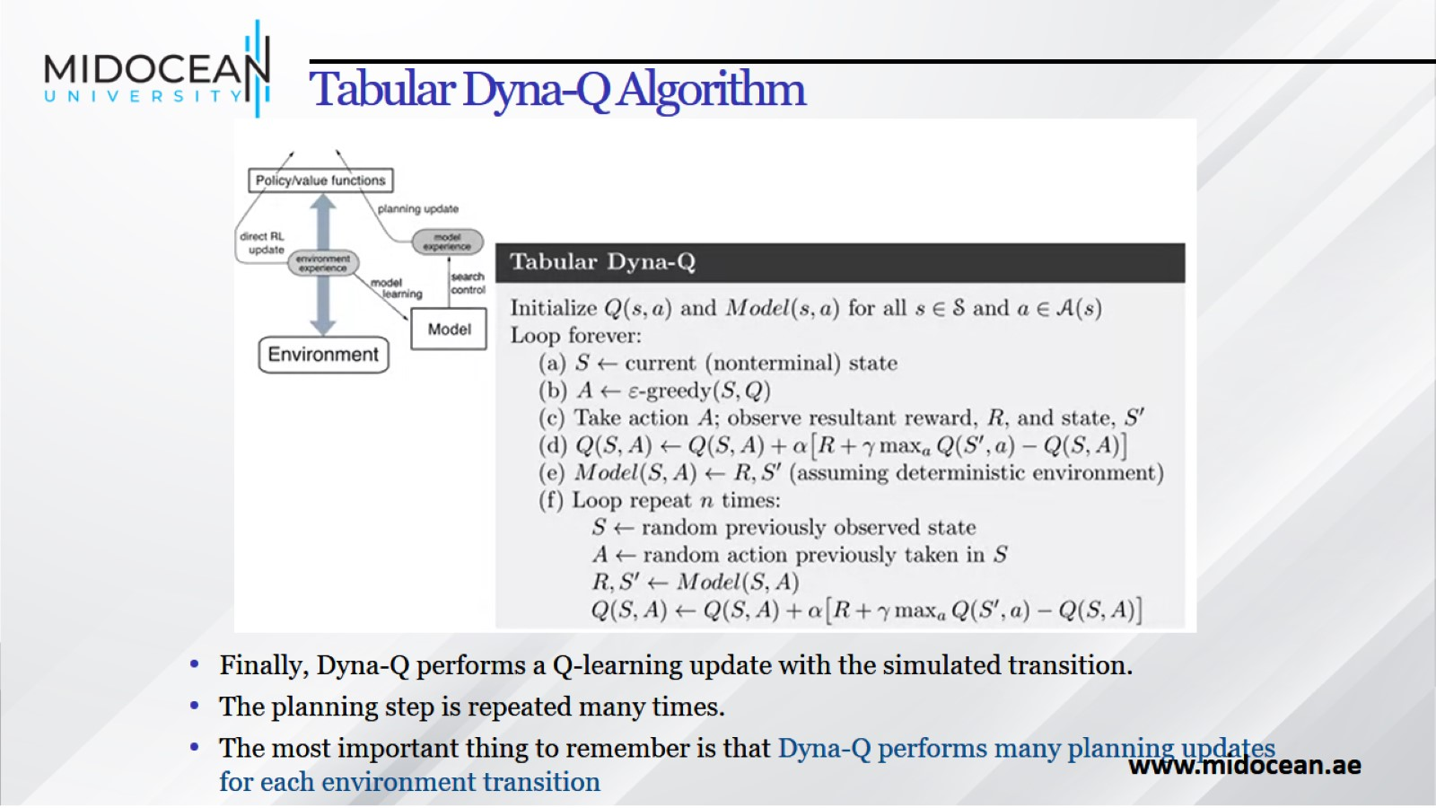
Tabular Dyna-Q Algorithm

Slide 26
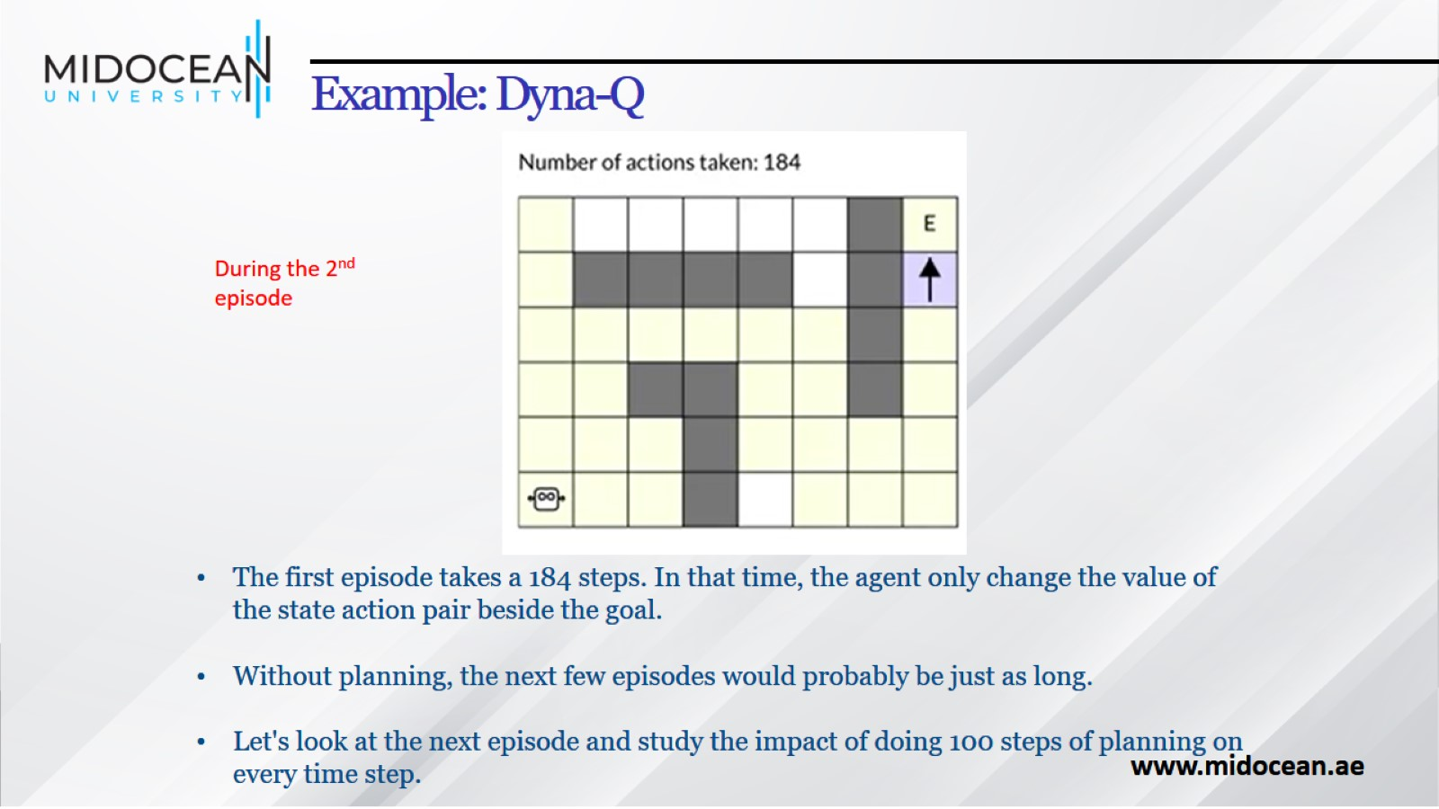
Example: Dyna-Q

Slide 27
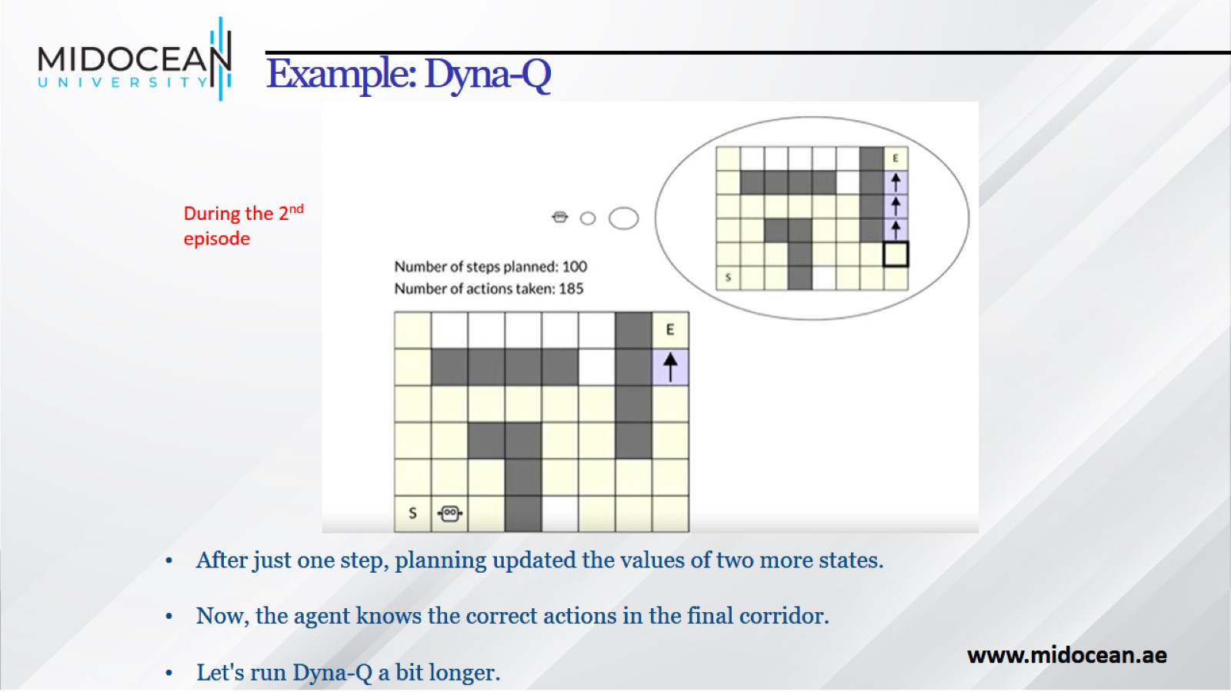
Example: Dyna-Q

Slide 28
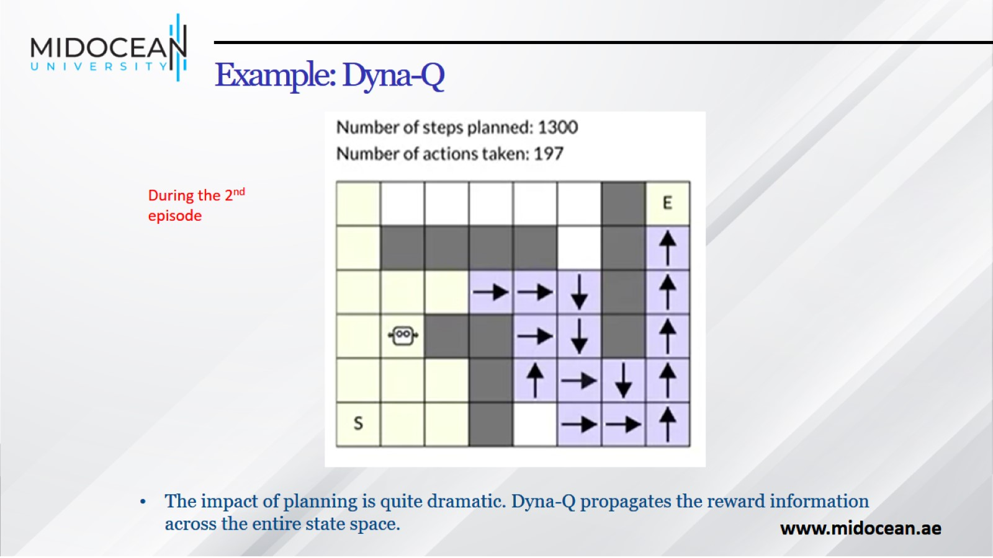
Example: Dyna-Q

Slide 29
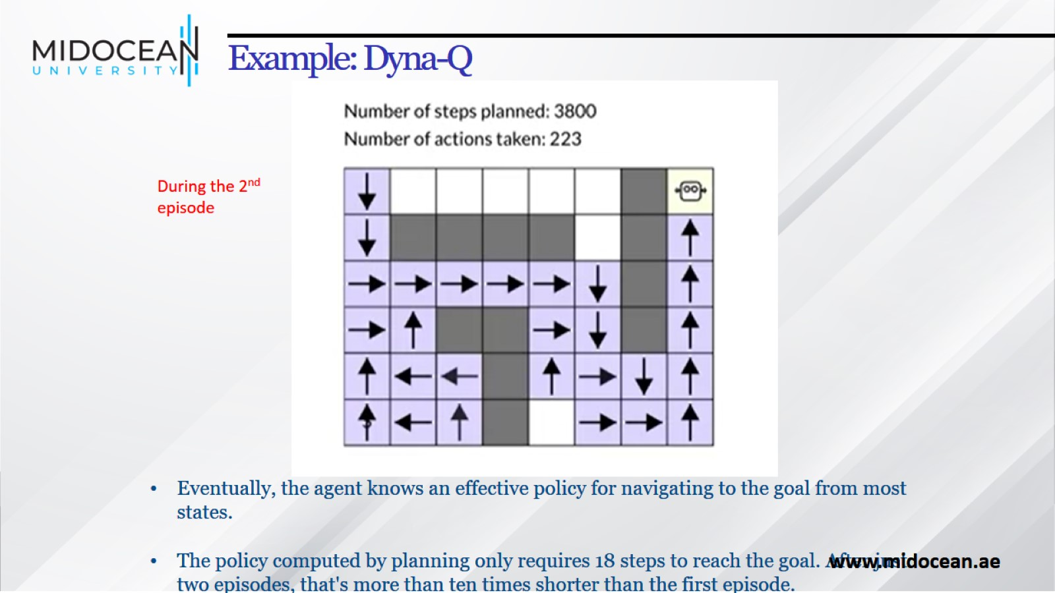
Example: Dyna-Q

Slide 30
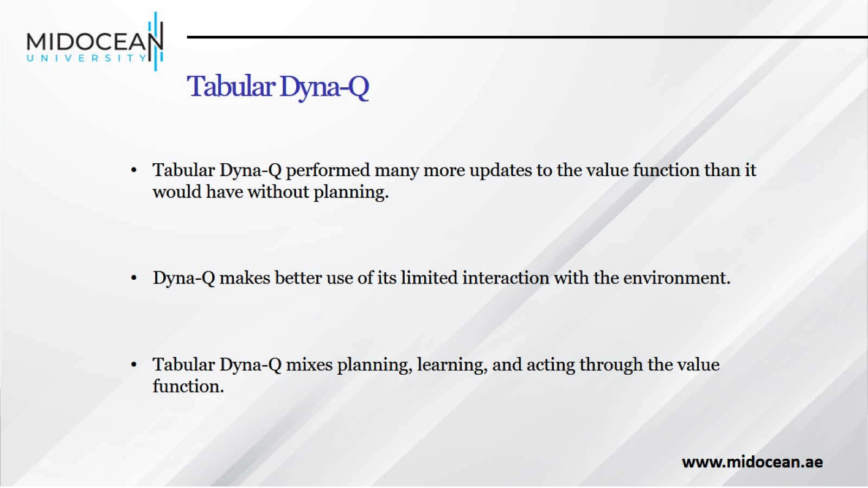
Tabular Dyna-Q

Slide 31
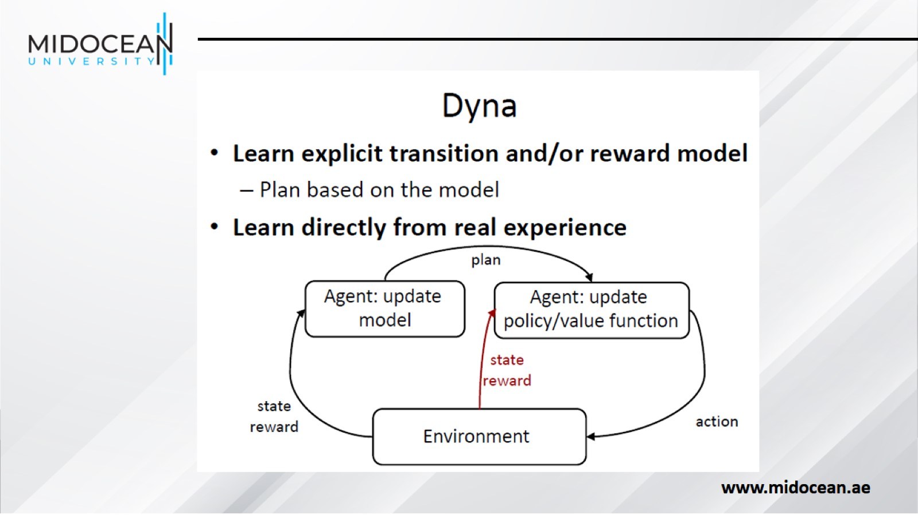

Slide 32
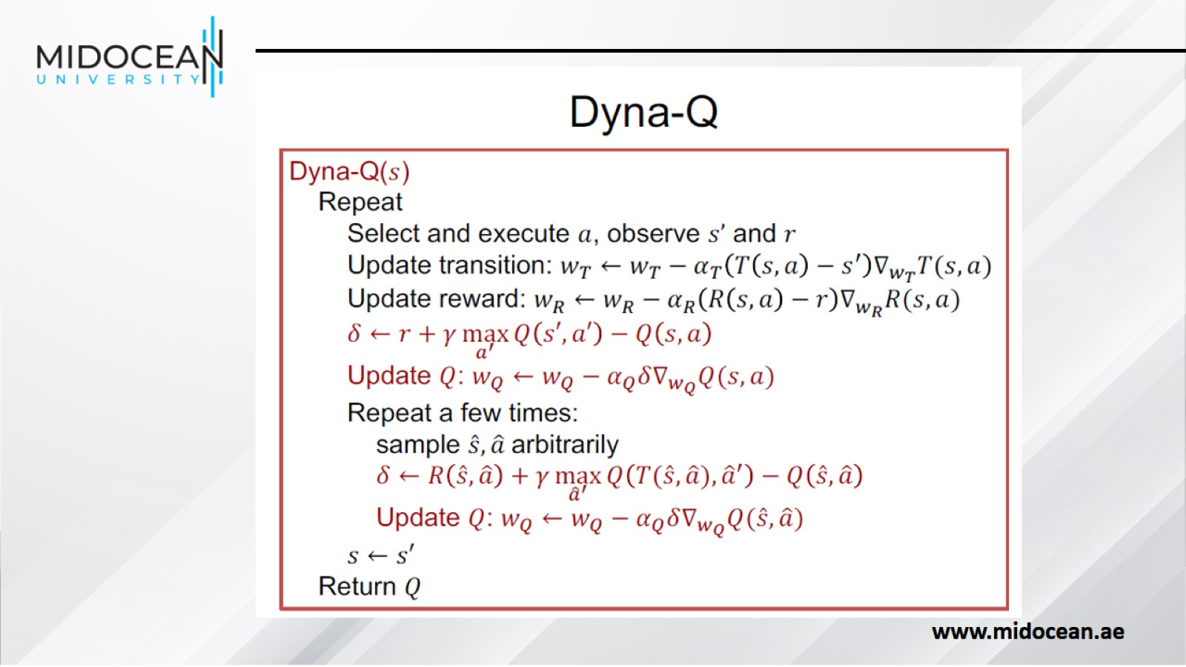

Slide 33
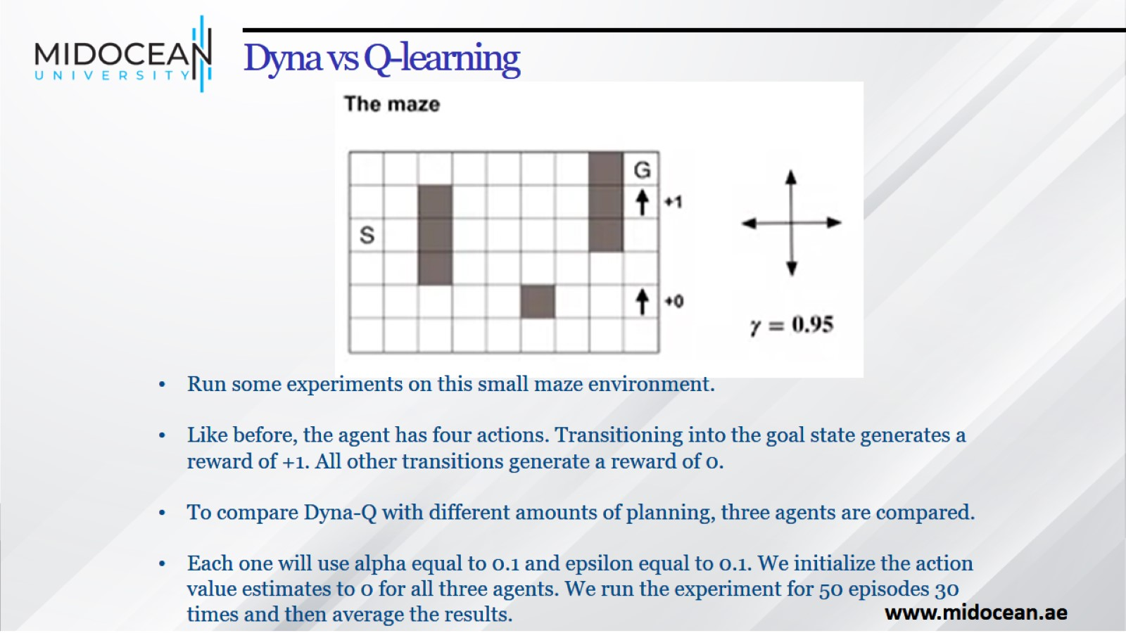
Dyna vs Q-learning

Slide 34
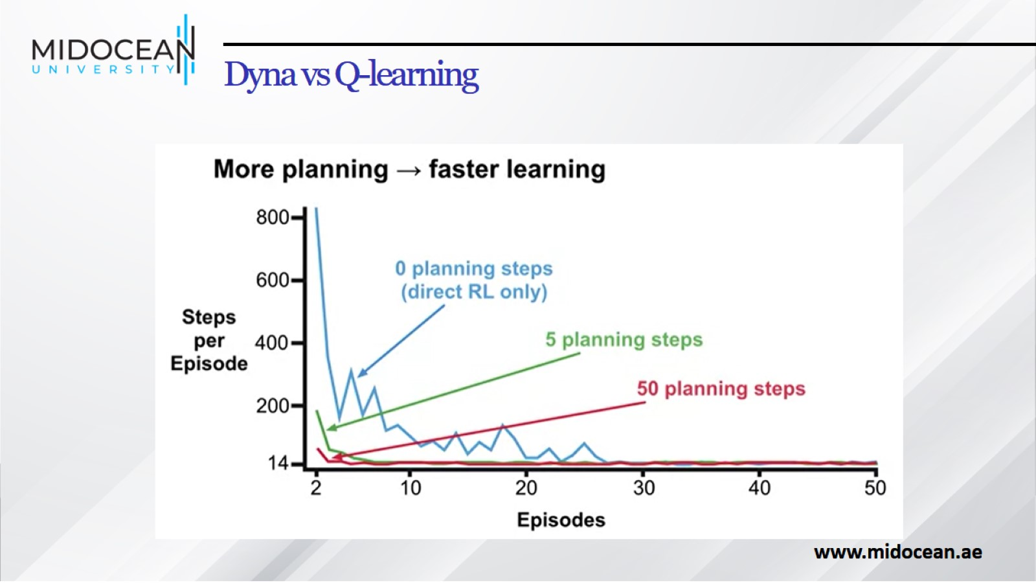
Dyna vs Q-learning

Slide 35
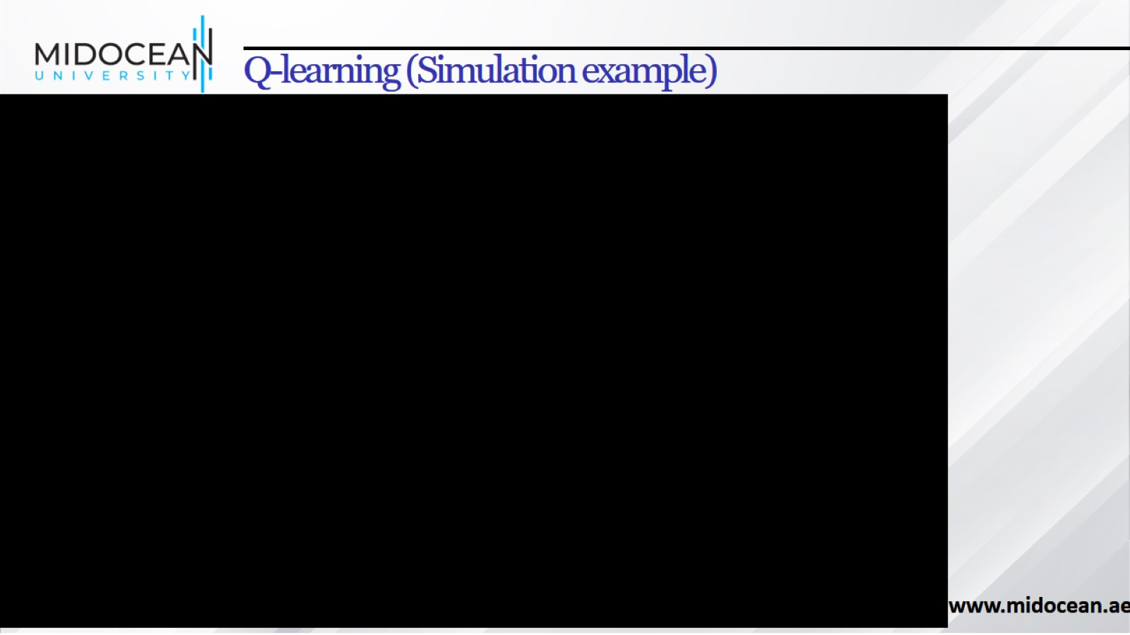
Q-learning (Simulation example)

Slide 36
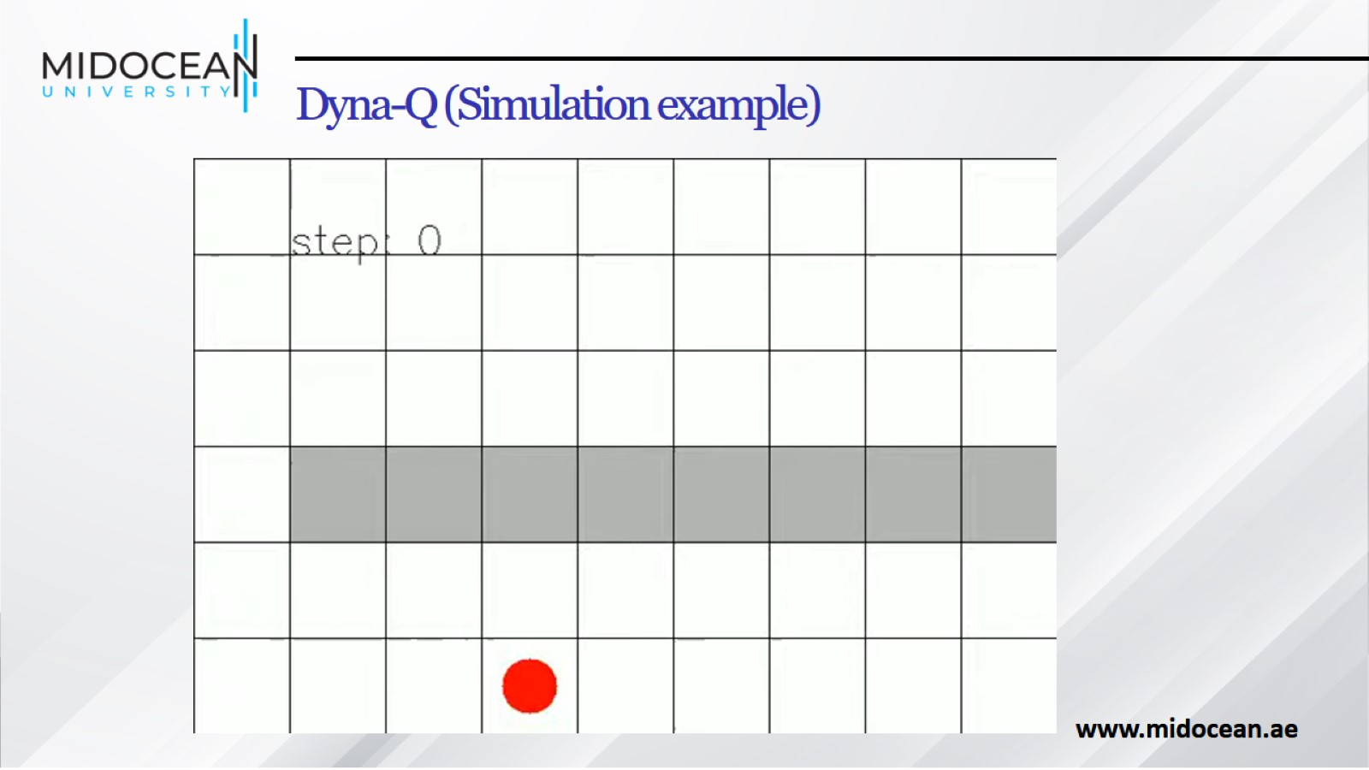
Dyna-Q (Simulation example)

Slide 37
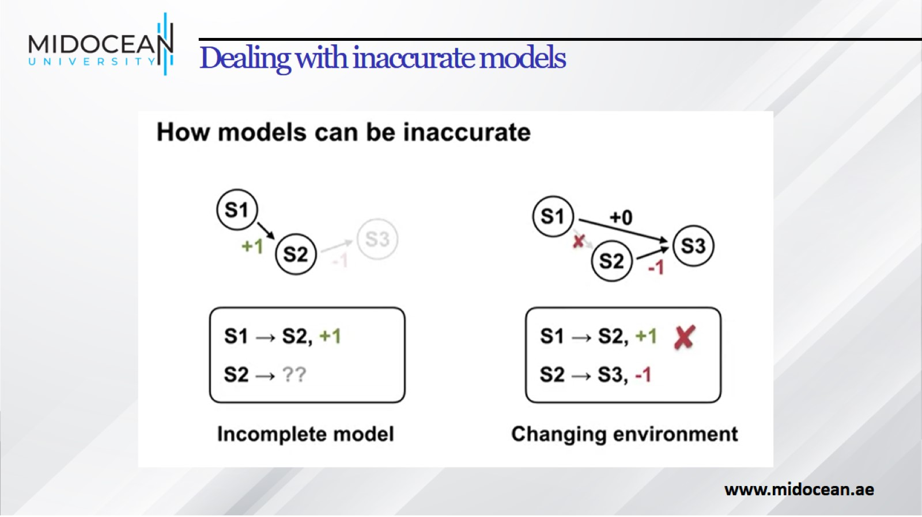
Dealing with inaccurate models

Slide 38
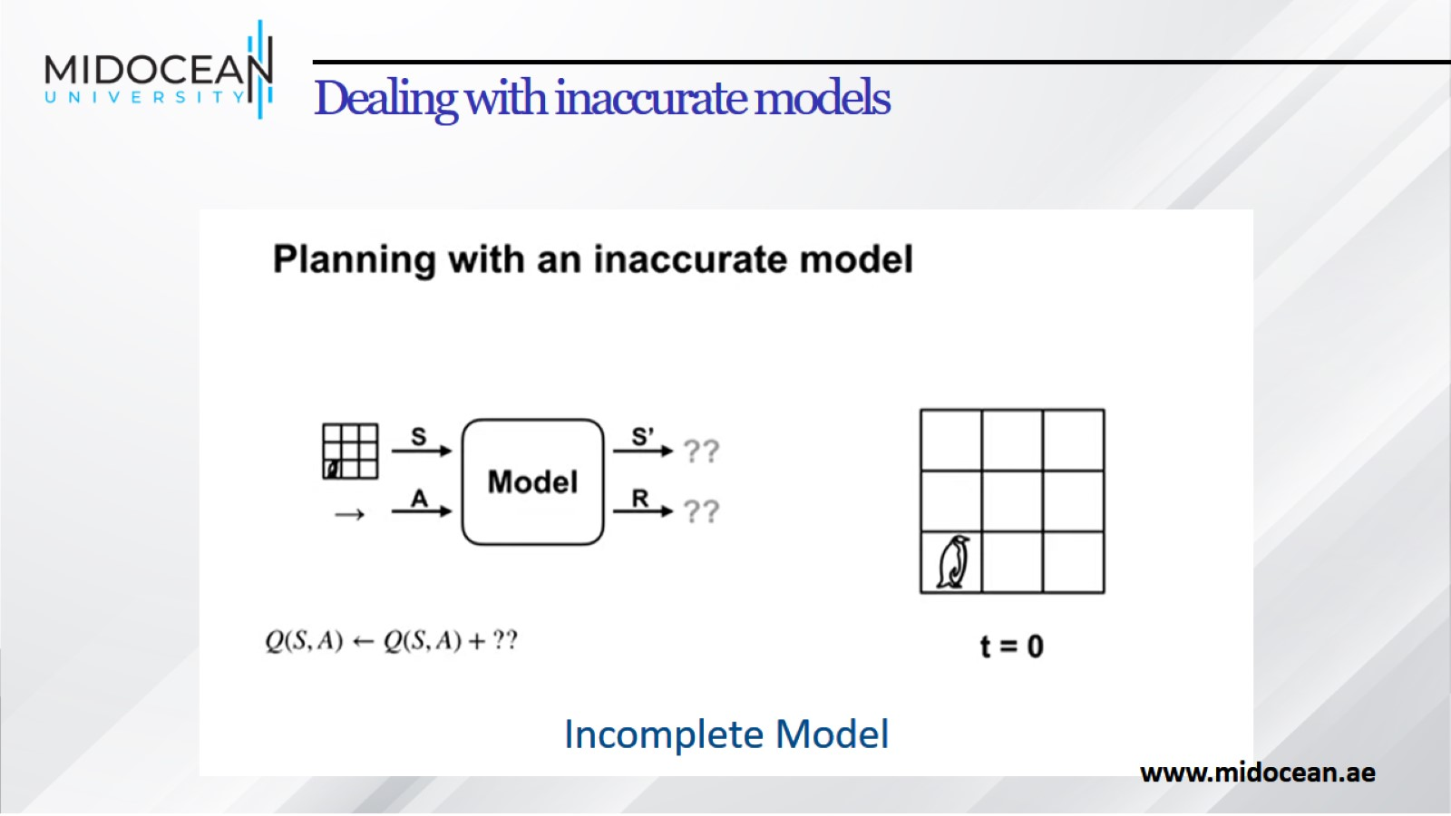
Dealing with inaccurate models

Slide 39
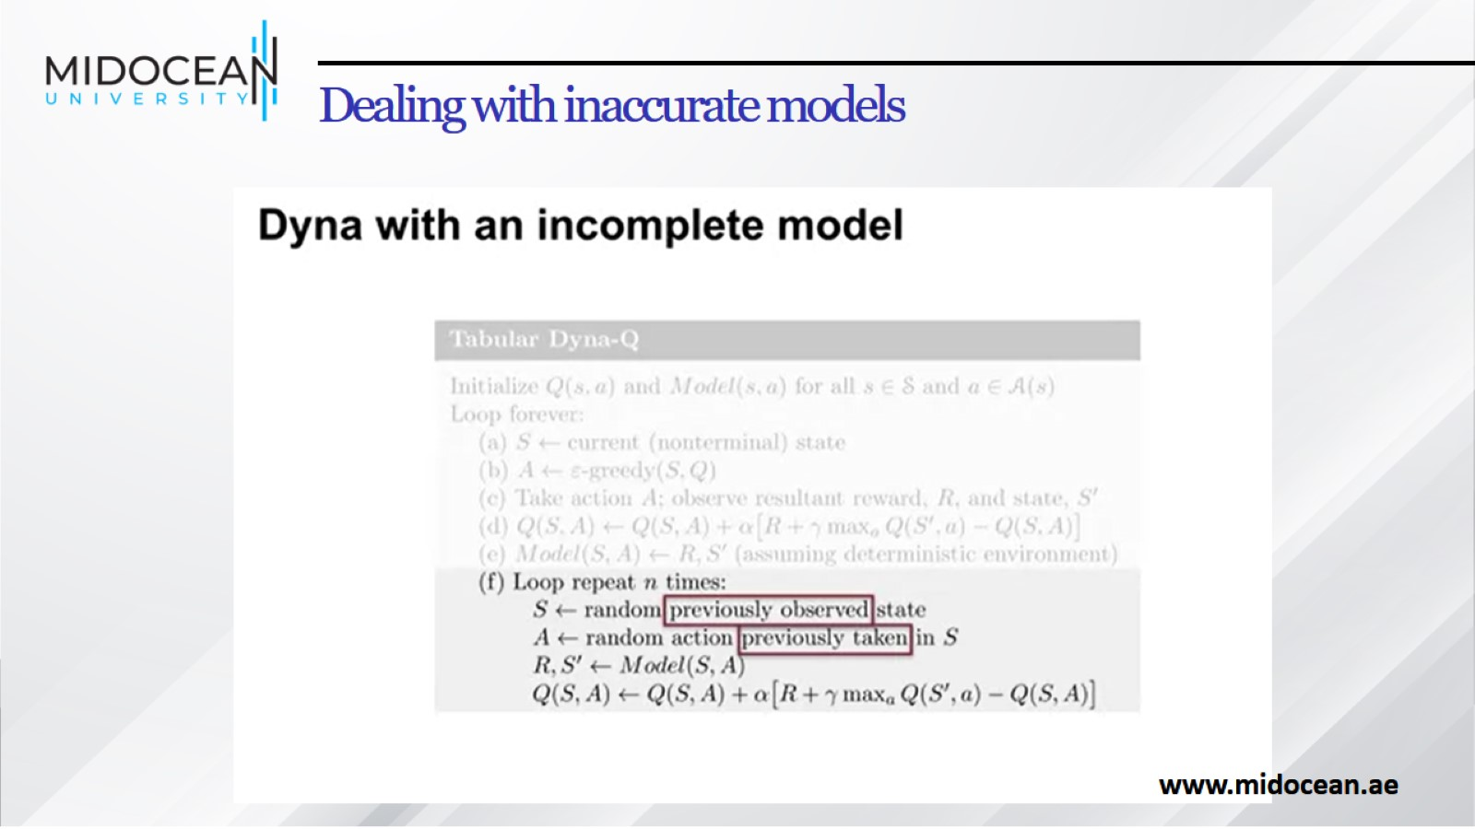
Dealing with inaccurate models

Slide 40
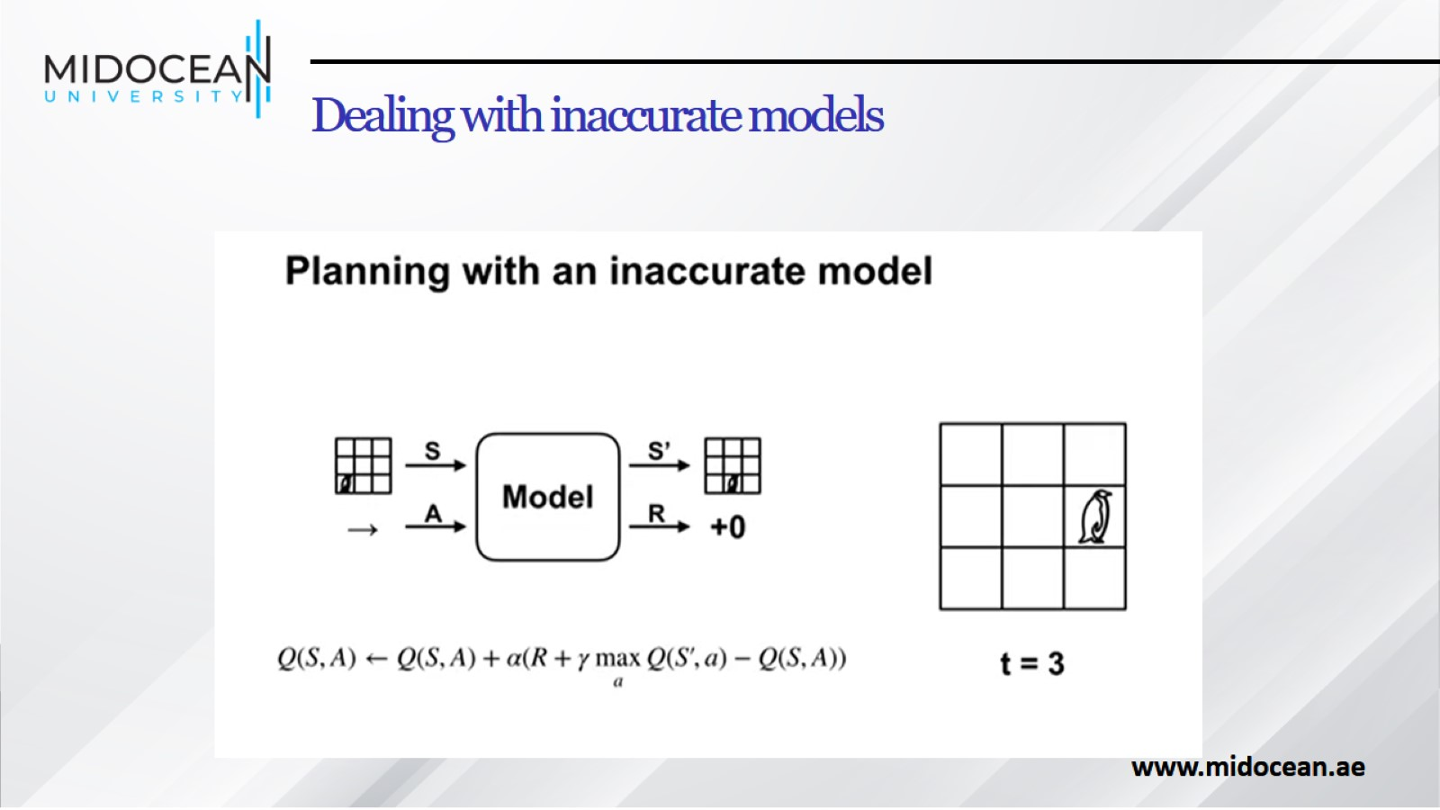
Dealing with inaccurate models

Slide 41
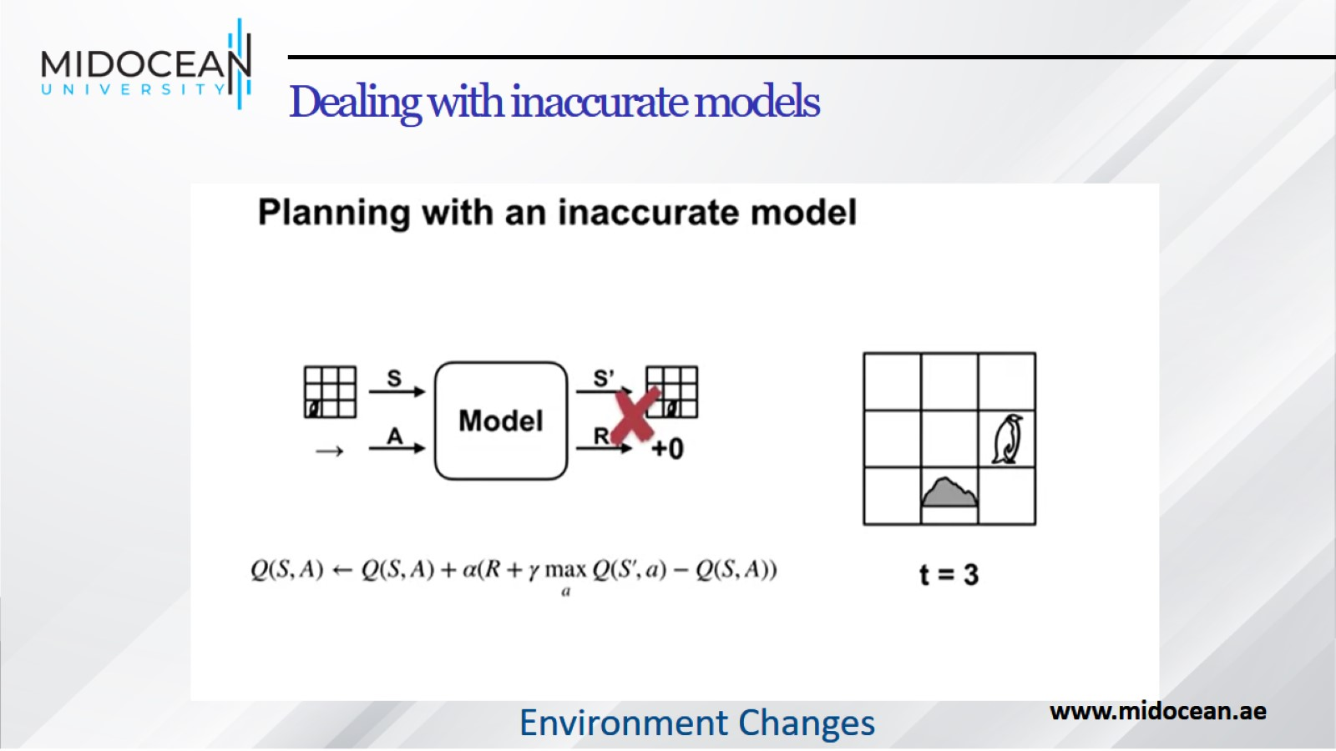
Dealing with inaccurate models

Slide 42
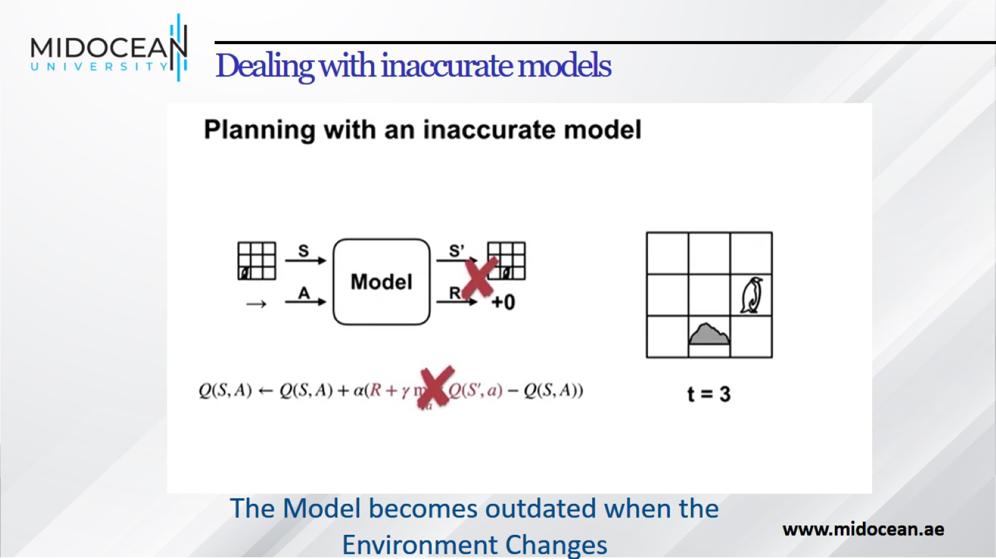
Dealing with inaccurate models

Slide 43
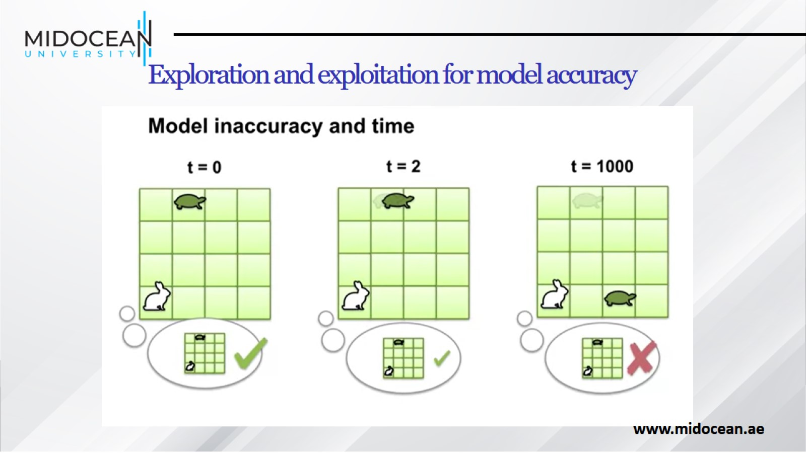
Exploration and exploitation for model accuracy

Slide 44
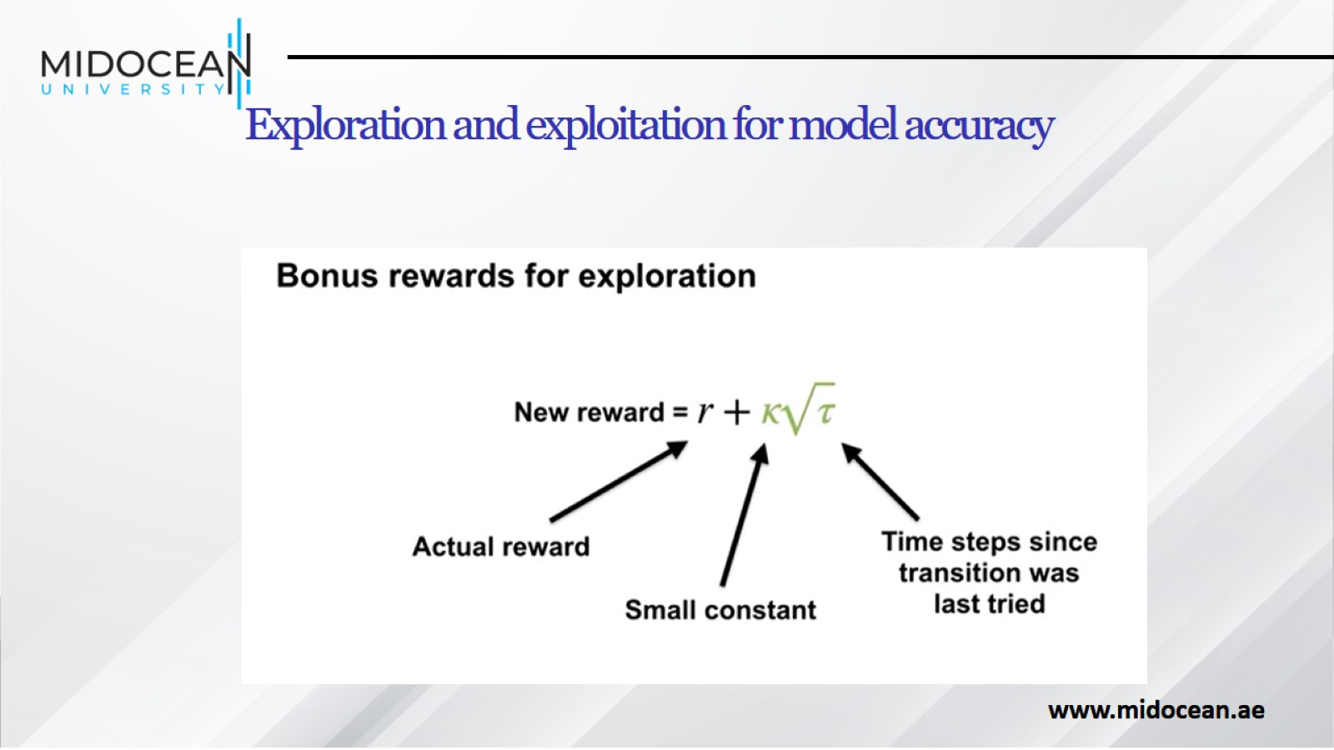
Exploration and exploitation for model accuracy

Slide 45
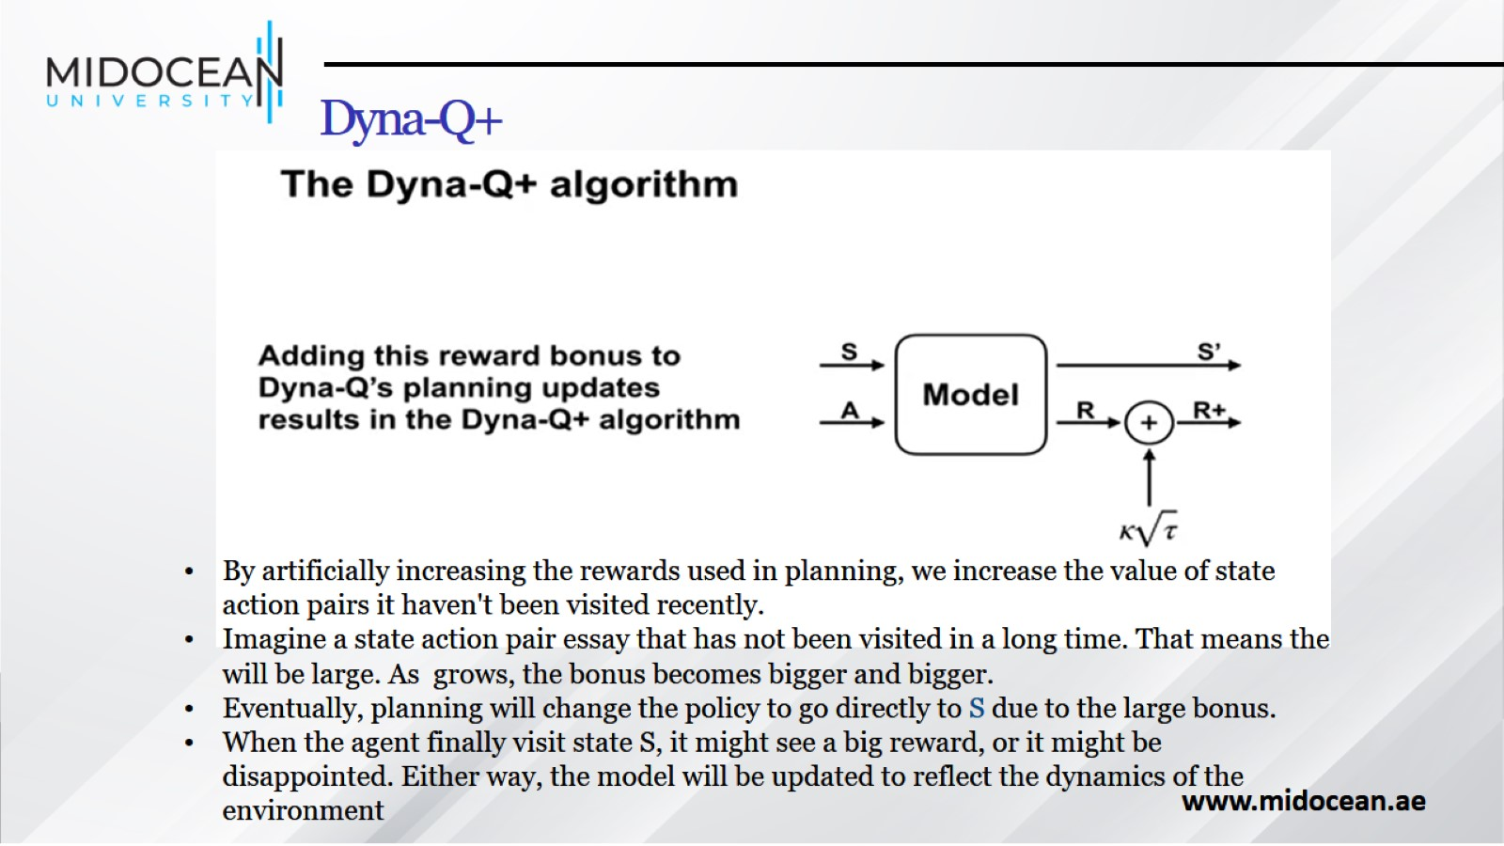
Dyna-Q+

Slide 46
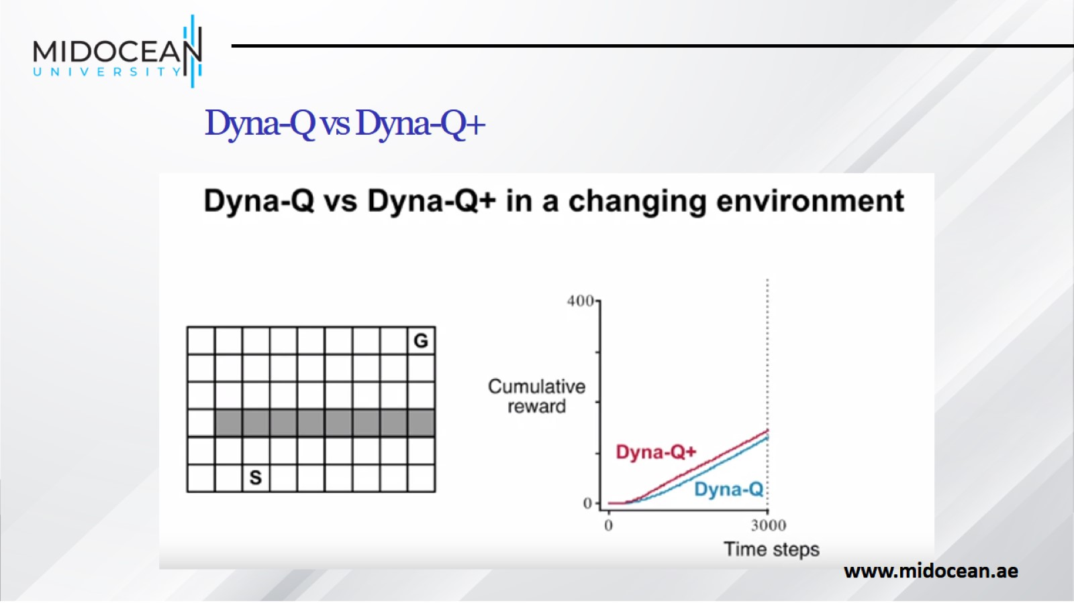
Dyna-Q vs Dyna-Q+

Slide 47
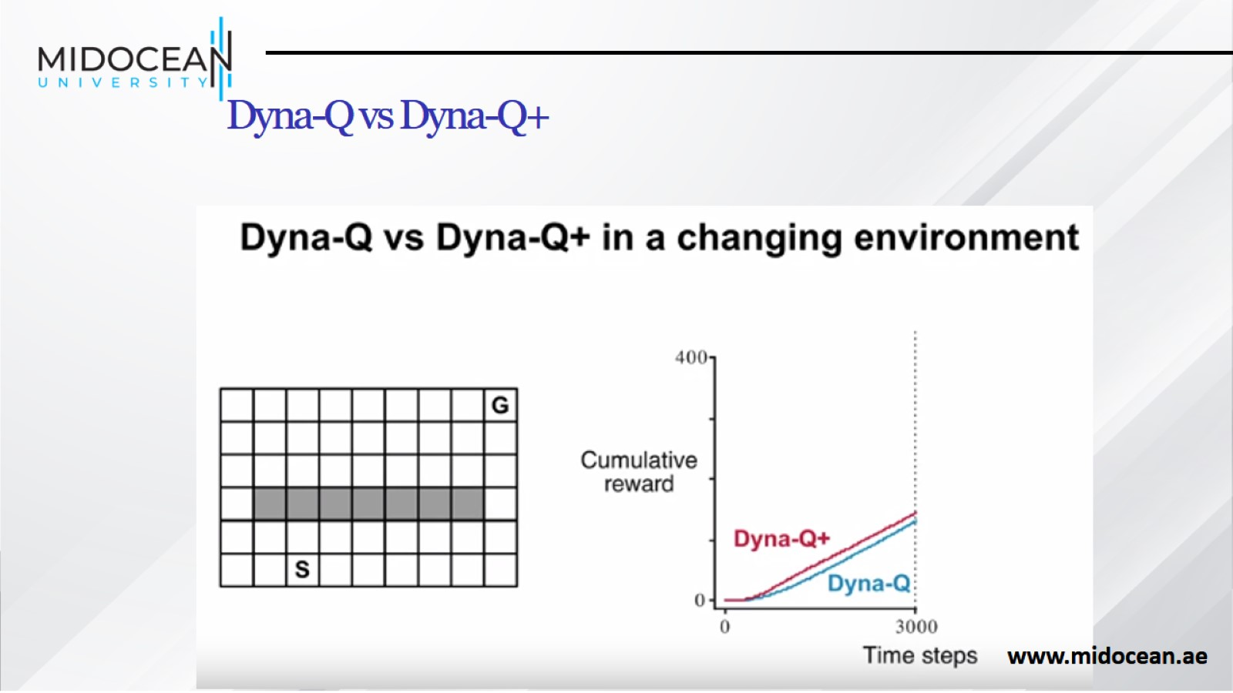
Dyna-Q vs Dyna-Q+

Slide 48
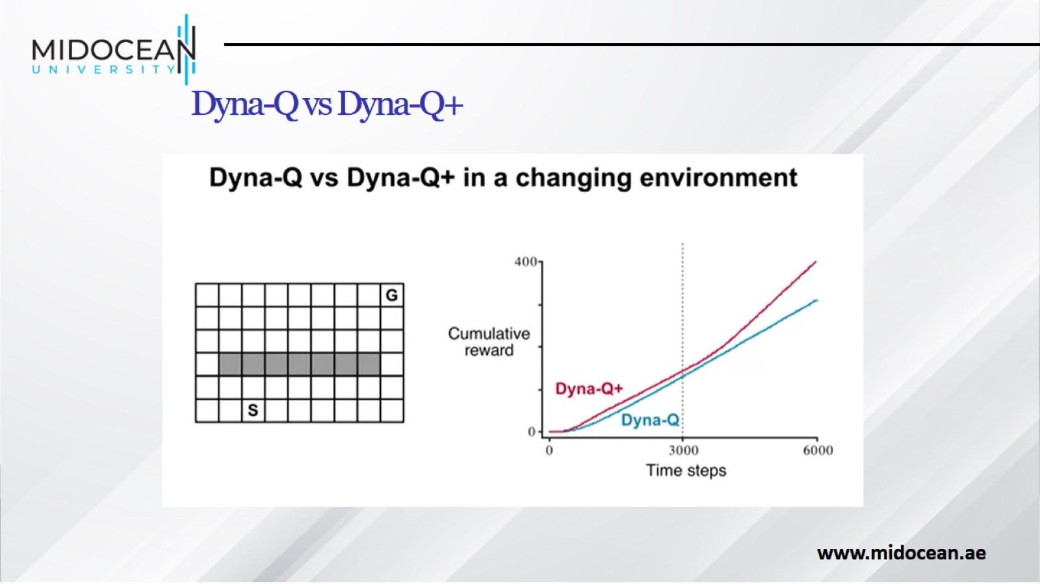
Dyna-Q vs Dyna-Q+

Slide 49
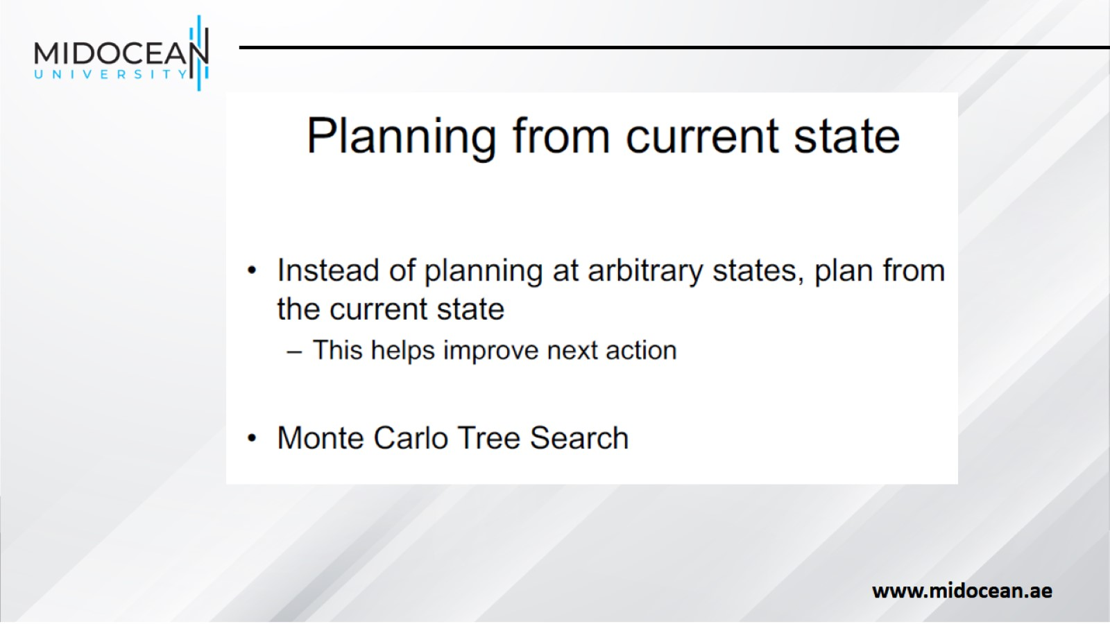

Slide 50
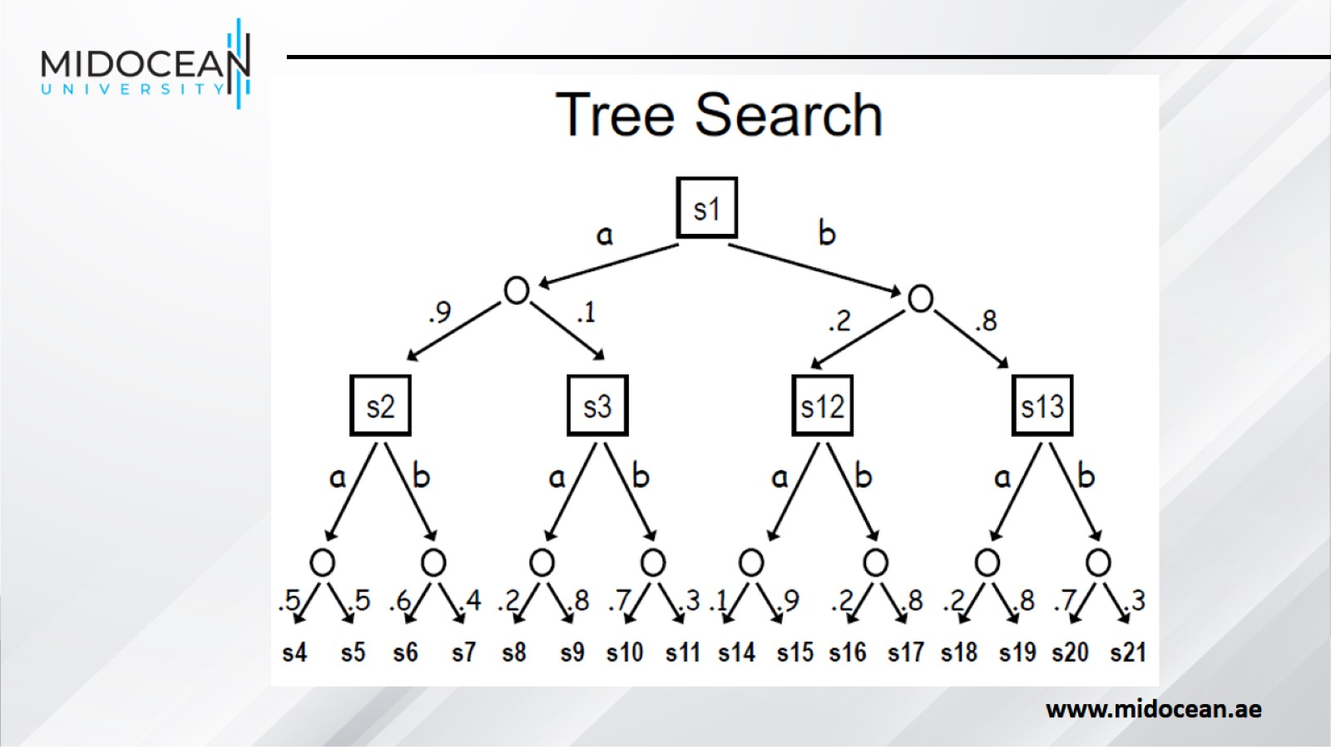

Slide 51
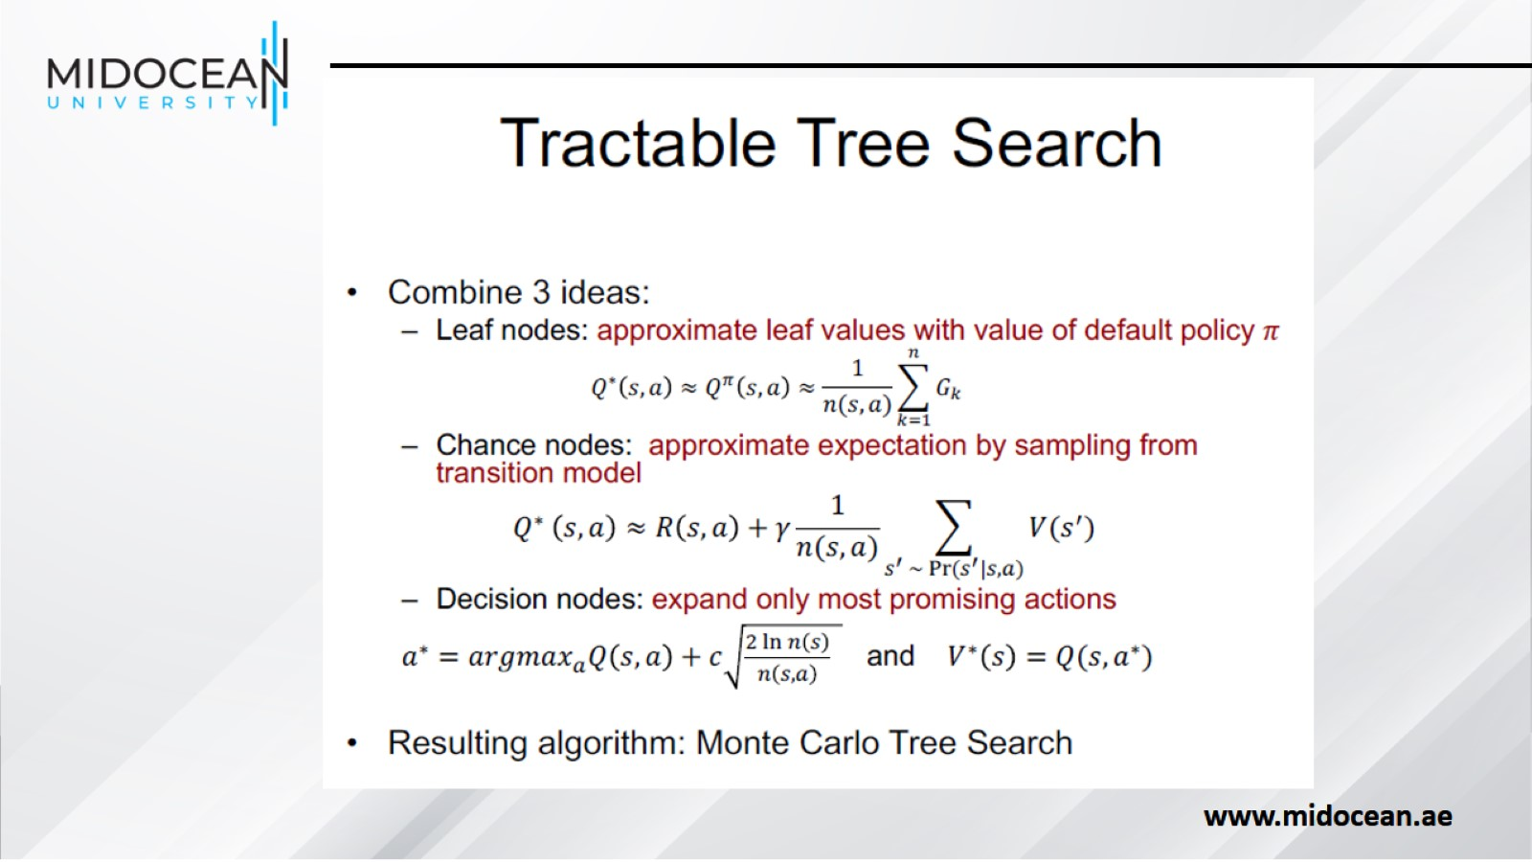

Slide 52
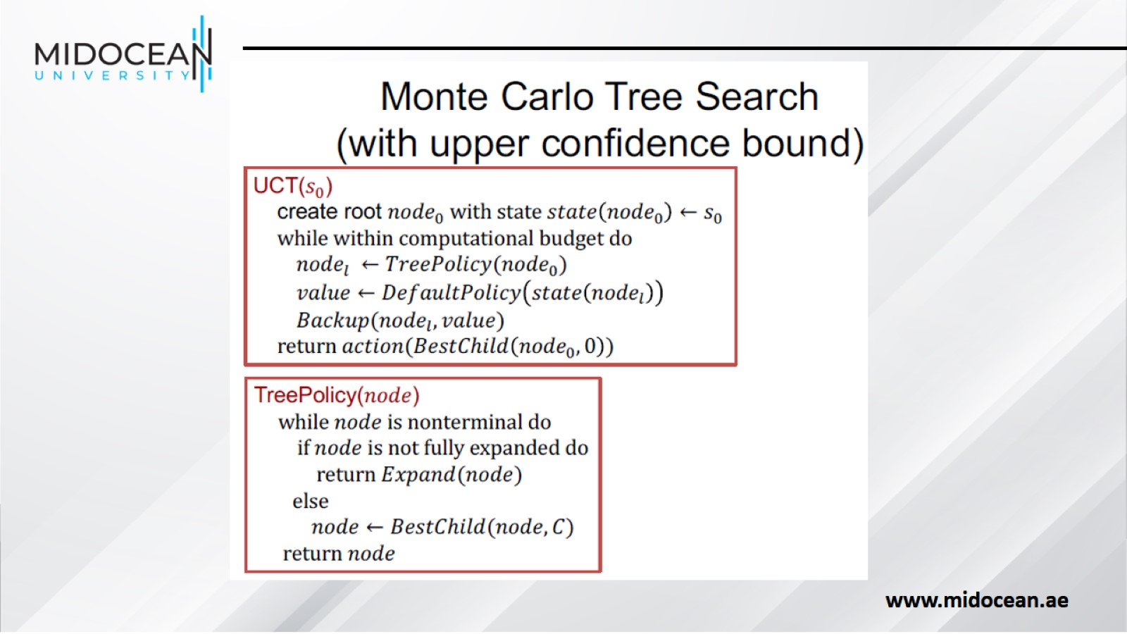

Slide 53


Slide 54


Slide 55


Slide 56


Slide 57

Summary:

Slide 58


Slide 59

Core Concepts and Early Algorithms

Slide 60

Motivation and Breakthroughs

Slide 61


Slide 62

Real-World Use Cases

Slide 63

Major Algorithmic Advances

Slide 64

Components and Algorithms

Slide 65

Advancements from 2024 to 2025

Slide 66


Slide 67

Current Limitations and Opportunities

Slide 68

Future Research Directions

Slide 69


Slide 70

Evolution of RL and DRL

Slide 71


