Slide 1



Machine Learning
Prepared by Dr. Yasser Abdelhamid
DS 620
Machine Learning
Lecture 9

Slide 2

Outline
Support vector machines (SVM)

Slide 3
Support vector machines(SVM)
Support Vector Machines are widely used and powerful machine learning algorithms
It is commonly used for
  Classification and
  Regression tasks.

Slide 4
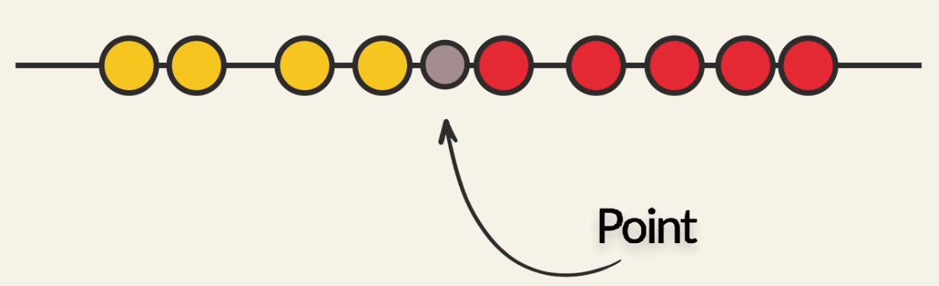
Hyperplane in one dimensional space
In one dimensional space a hyperplane is a point.

Slide 5
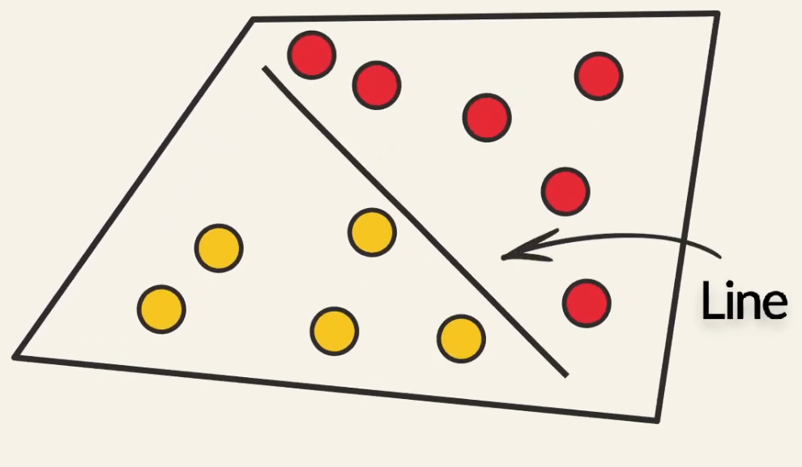
Hyperplane in two dimensional space
In two dimensional space a hyperplane is a line.

Slide 6
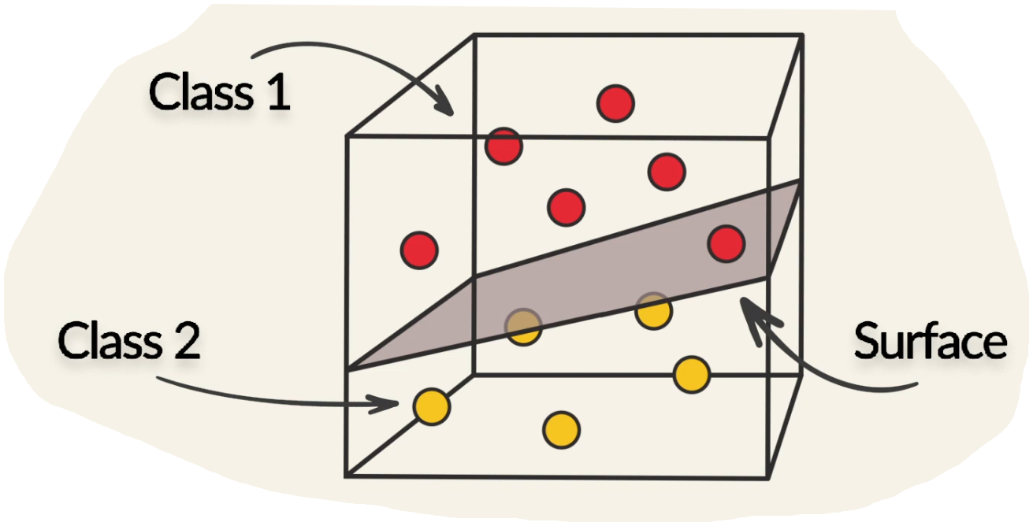
Hyperplane in Three dimensional space
In three dimensional space the hyperplane is a Plane/surface.

Slide 7
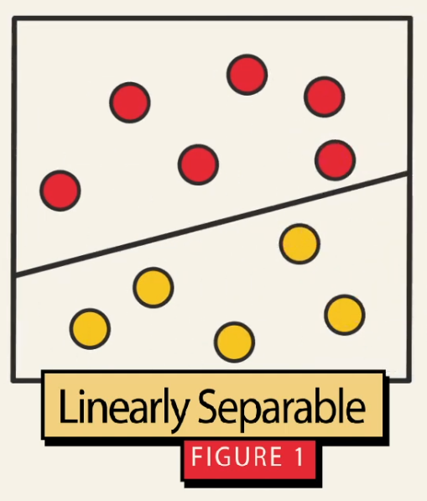
Linearly separable data
We can find a separating line between classes.

Slide 8
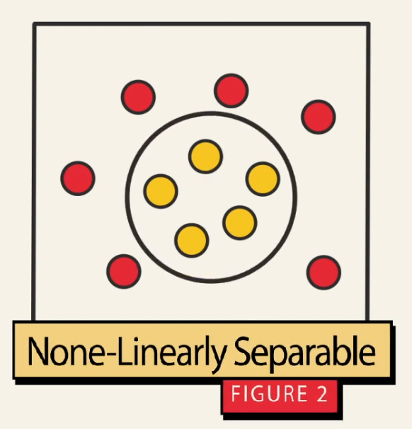
Non-linearly separable data
We can not find a separating line between classes.

Slide 9
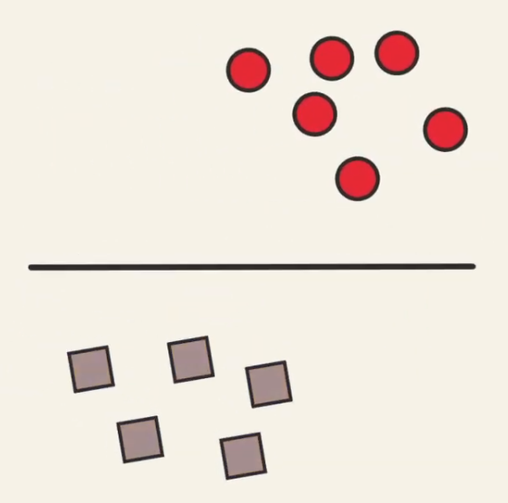
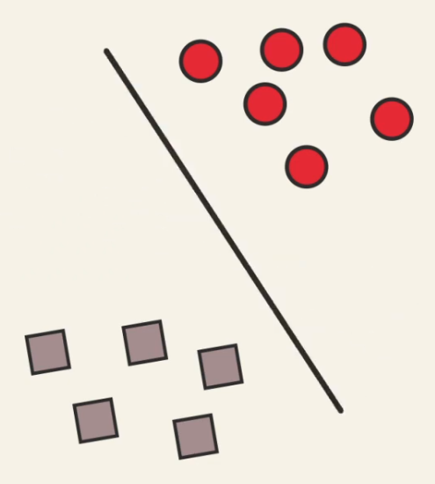
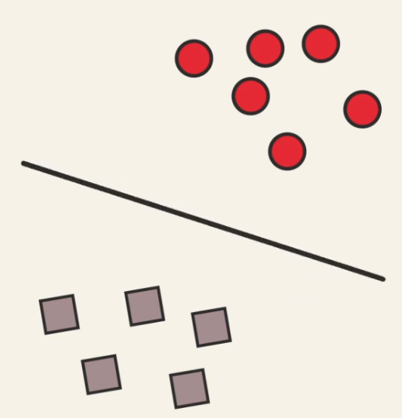
Finding the best line separator
Which of the following line separators gives the best classification results?

Slide 10
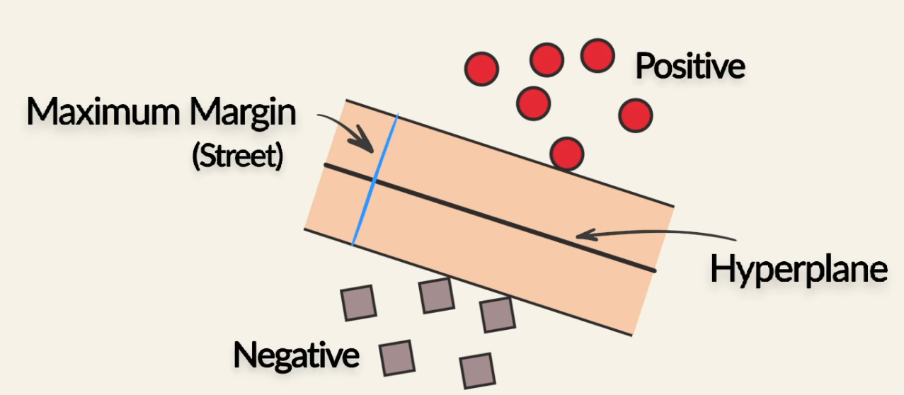
Maximum Margin Classifier
SVM can help us to choose the best hyperplane that maximizes the margin between classes.(Maximum Margin Classifier)

Slide 11
Support vector machines(SVM)
Support Vector Machines are a type of supervised learning algorithm that works by finding an optimal hyperplane in a high-dimensional feature space to separate different classes of data points.

Slide 12
Support vector machines(SVM)
The hyperplane is chosen in such a way that it maximizes the margin, i.e., the distance between the hyperplane and the nearest data points of each class.
The data points that are closest to the hyperplane are called support vectors.

Slide 13
Support vector machines(SVM)
By maximizing the margin,
  We can achieve better generalization on unseen data, and
  Improve the algorithm's ability to handle noise and outliers.

Slide 14
Linear SVM
In linear SVM, the goal is to find the best hyperplane that separates the data points of different classes.
The hyperplane can be represented by the equation:
w · x + b = 0,
where w represents the weights vector, x is the input feature vector, and b is the bias term.

Slide 15
Linear SVM
The objective of SVM is to find the optimal w and b values that maximize the margin while correctly classifying the training data.
To achieve this, we formulate an optimization problem that minimizes the objective function subject to certain constraints.

Slide 16
Linear SVM
To handle non-linearly separable data, we can introduce a slack variable ξ that allows for some misclassification of training samples.
This leads to the formulation of the soft-margin SVM, where the objective function includes a penalty term for misclassifications.

Slide 17
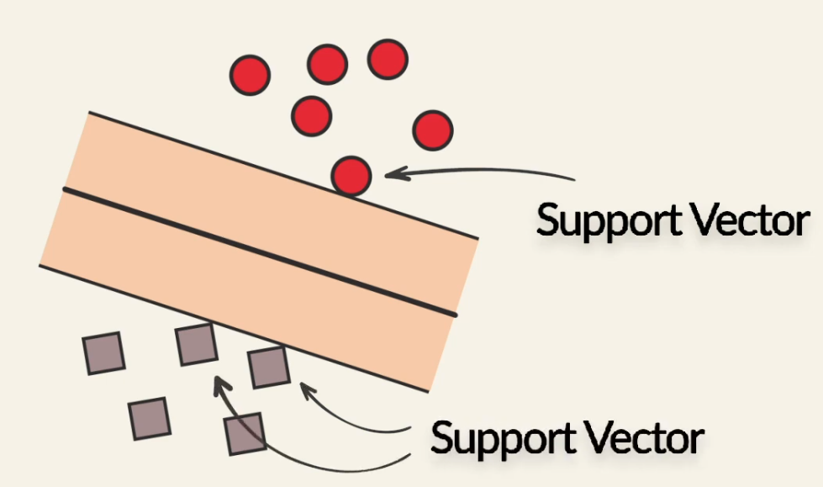
Support vectors
Support vectors are the data points that lie closest to the hyperplane. (The most difficult data points to classify)

Slide 18
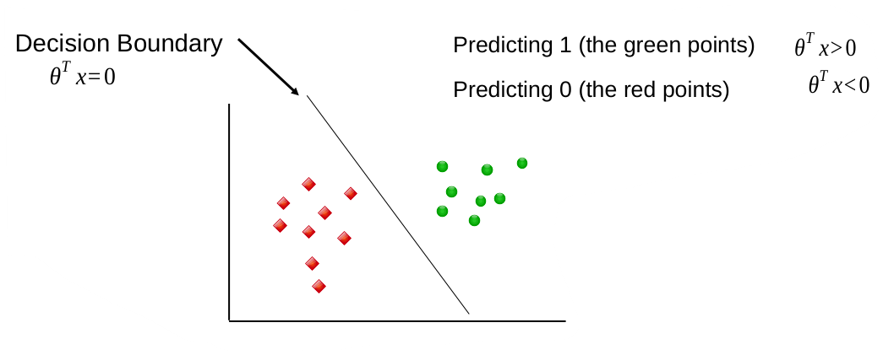
classification
Binary Classification can be view as the task of separating classes in feature spaces.
For a hypothesis h_{θ} ( x )= θ^{T} x
The goal of Classifier is to train a model that assigns a new unseen object into a specific category.
It places the object above or below the separator hyperplane

Slide 19
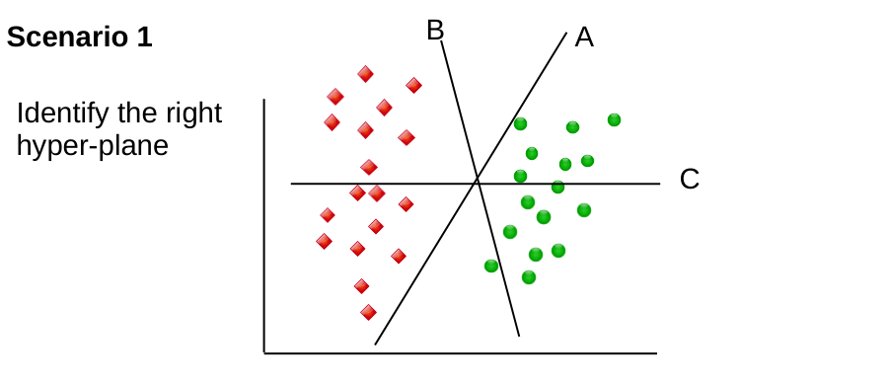
Classification
Classification is the process of categorizing the two classes with a hyperplane.
How can we Identify the (best) hyperplane

Slide 20
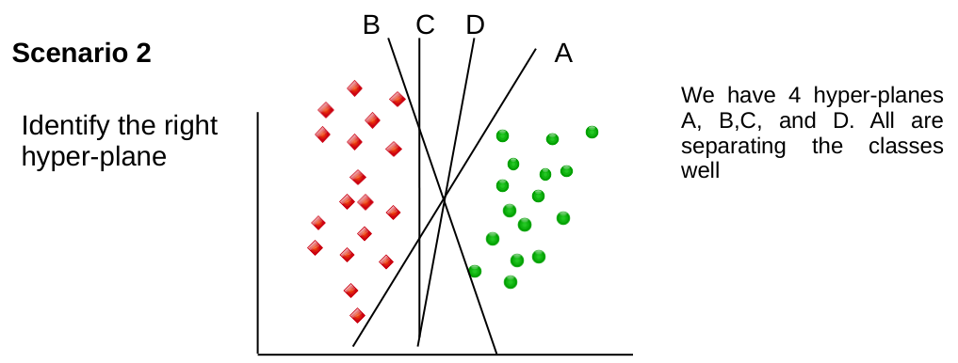
Multiple correct hyperplanes
What if we have more than one hyperplane?

Slide 21
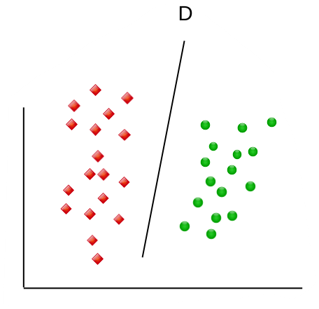
Maximum Margin Classifier (MMC)
D stays as far as possible from both classes.
By being right in the middle of the two classes, it is less “risky” to misclassify the unseen data, thus generalizes well on test data

Slide 22
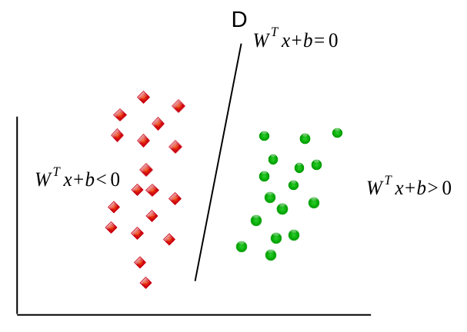
Maximum Margin Classifier (MMC)
MMC tries to find the best separator hyperplane. Here is a simple version of What MMC (as a kind of SVMs) do:
  1. Find hyperplanes that correctly classify the training data.
  2. Among all such hyperplanes, pick the one that has the greatest distance to the closest points.

Slide 23
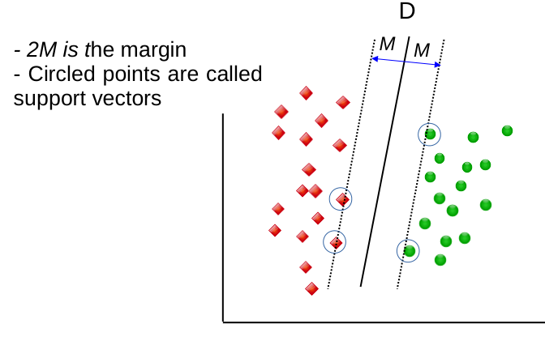
Maximum Margin Classifier (MMC)
The closest points that identify this hyper-plane are knows as support vectors.
The region around the line is knows as the Margin.
  Only support vectors matter, other training examples are ignored.
  Data that can be separated by a hyper-plane is known as Linearly separable data
  The hyperplane that classifies the linear separable data act as a linear classifier.

Slide 24
Support vector classifier
SVC is a classifier formally defined by a separating hyperplane W^{T}X+b=0
A hyperplane is a subspace of one dimension less than its ambient space.
This means a hyperplane of two dimension space is one dimension separator (line).
A hyperplane of three dimension space is two dimension separator (plane).

Slide 25
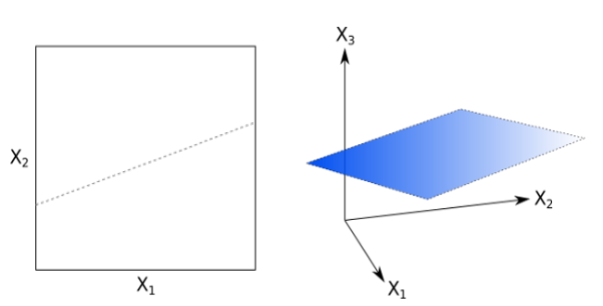
Support vector classifier
Elements above the hyperplane satisfy w^{T}x+b>0
Elements below the hyperplane satisfy w^{T}x+b<0
The weight vector W represents the orientation of the hyperplane and b represent the bias.
2D space separated by line (left).
3D space separated by plane (right)

Slide 26
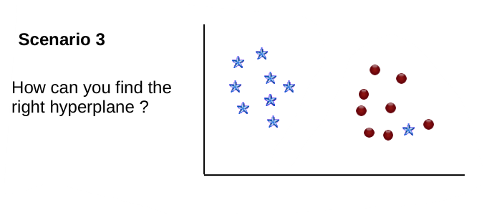
Allowing for Errors
Look at the case indicated in scenario 3,
How can we define the class separator?

Slide 27
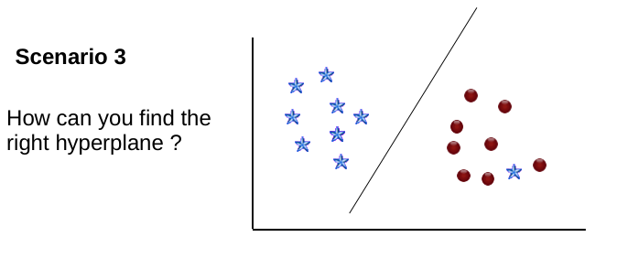
Allowing for Errors
SVC has a feature to ignore outliers and find the hyperplane that has maximum margin.
i.e SVC (hence SVM) is robust against outliers

Slide 28
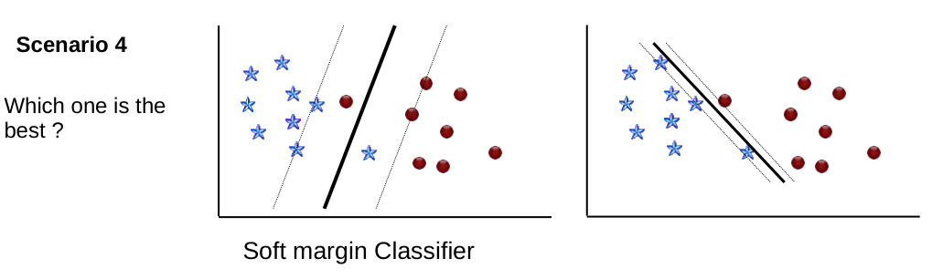
Soft margin classifier
For scenario 4, which separator is better.
Will you maximize the margin and allow misclassified instance?
Or
Will you choose to correctly classify with narrow margin ?

Slide 29
Allowing for Errors
How SVC let you handle this situation ?
  It allows you to specify how many errors you are willing to accept.
Providing a hyper parameter called ‘ C’ to your SVM.
This allows to control the trade-off between:
  A wide Margin
  Correctly classify the training data

Slide 30
Allowing for Errors
C is a non-negative “Tuning” parameter. If C=0, implies that no violation of the margin is possible
( in this case, we have MMC situation)
In addition to C, The SVC introduces a parameter ε_{i} called slack variable to each data point x_{i}
It allows the data points to be on the wrong side of the margin or hyperplane.

Slide 31
Slack variable
If ε_{i} =0, it states that the training point x_{i} is on the correct side of the margin,
For ε_{i} >0 that means x_{i} is on the wrong side of the margin.
For ε_{i} >1 means x_{i} is on the wrong side of the hyperplane

Slide 32
Non-linearly separable data
How can we deal with data set like this?

Slide 33
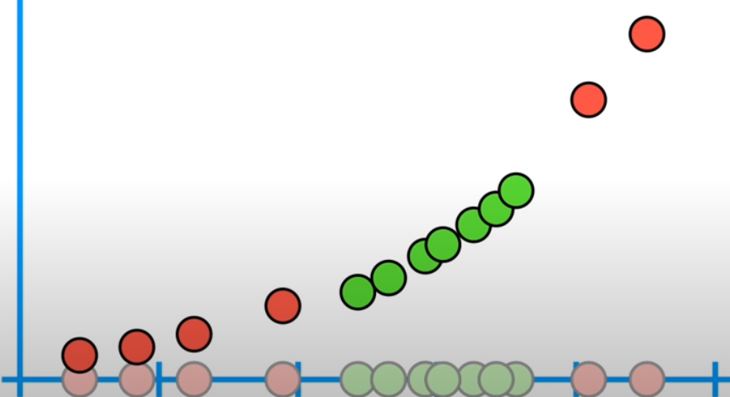
Moving data to higher dimension

Slide 34
Find a support vector classifier for the data in the new dimension

Slide 35
Use the classifier to classify new unseen examples

Slide 36
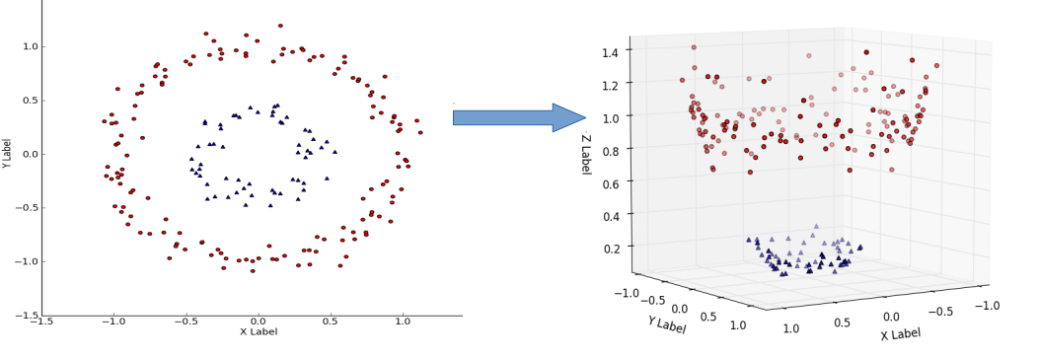
Transformation from 2D to 3D

Slide 37
How can we transform the data
Support vector machines use Kernel functions to systematically find support vector classifiers in higher dimensions

Slide 38
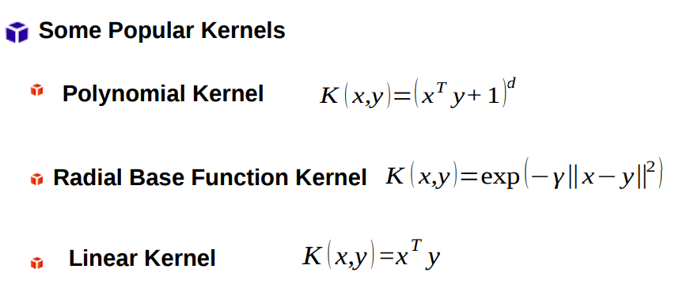
Kernel functions

Slide 39
When to use SVM?
Binary Classification
  SVMs excel in binary classification problems, where the task is to classify data into two distinct classes.
  SVMs aim to find an optimal hyperplane that separates the classes by maximizing the margin between the closest data points (support vectors) from each class.
  They can handle both linearly separable and non-linearly separable data by using different kernel functions.

Slide 40
Data with Clear Margin
SVMs work well when there is a clear margin of separation between the classes.
If the classes are overlapping or inseparable, SVMs may struggle to find an appropriate decision boundary.
In such cases, kernel tricks can be used to transform the data into a higher-dimensional space where it becomes separable.

Slide 41
High-Dimensional Feature Spaces
SVMs are effective when dealing with high-dimensional feature spaces, where the number of features is large compared to the number of samples.
SVMs can handle such cases without suffering from the "curse of dimensionality" as they rely only on a subset of the training points (the support vectors) to define the decision boundary.

Slide 42
Outlier Detection
SVMs are robust to outliers due to their reliance on support vectors.
The decision boundary is determined by these critical points, making it less sensitive to outliers that lie far from the decision boundary.

Slide 43
SUmmary
Support vector machines

Slide 44

Thank You

