Slide 1


Slide 2
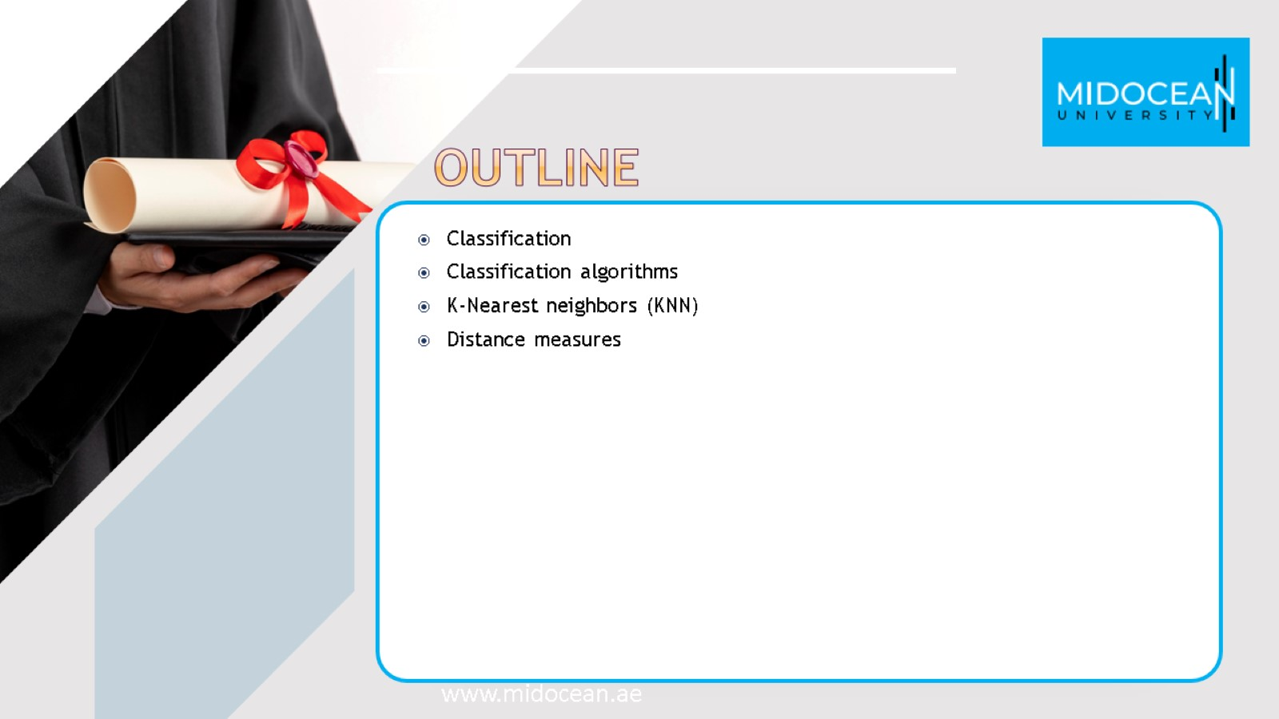

Slide 3

classification

Slide 4
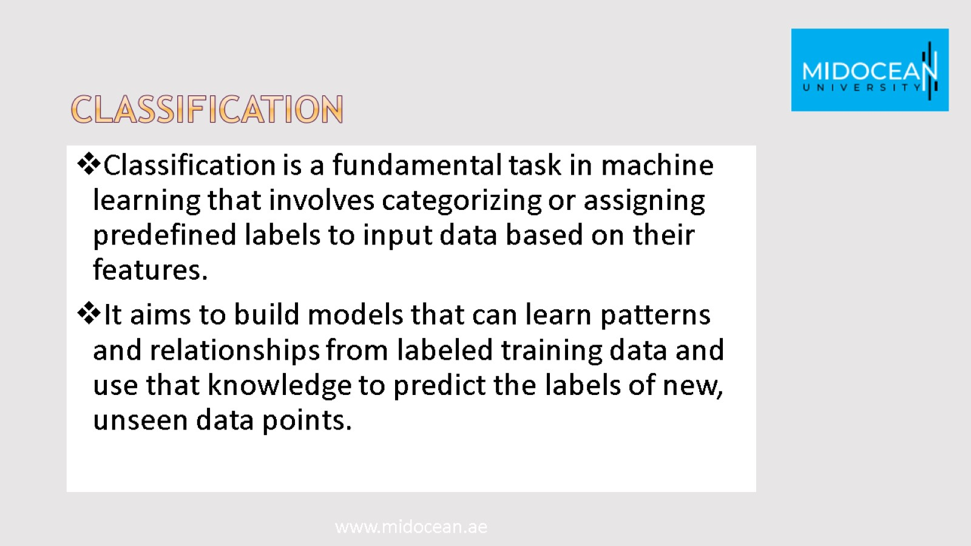
classification

Slide 5
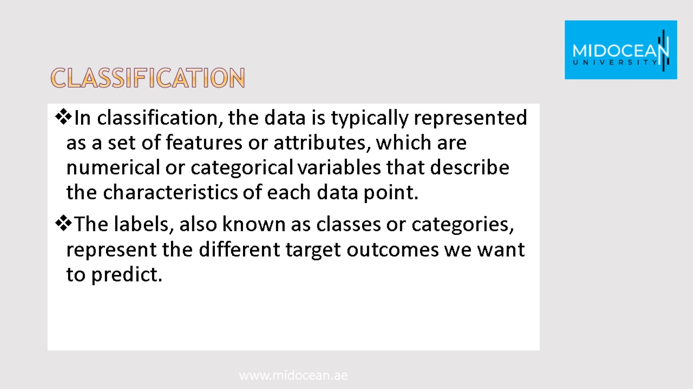
classification

Slide 6
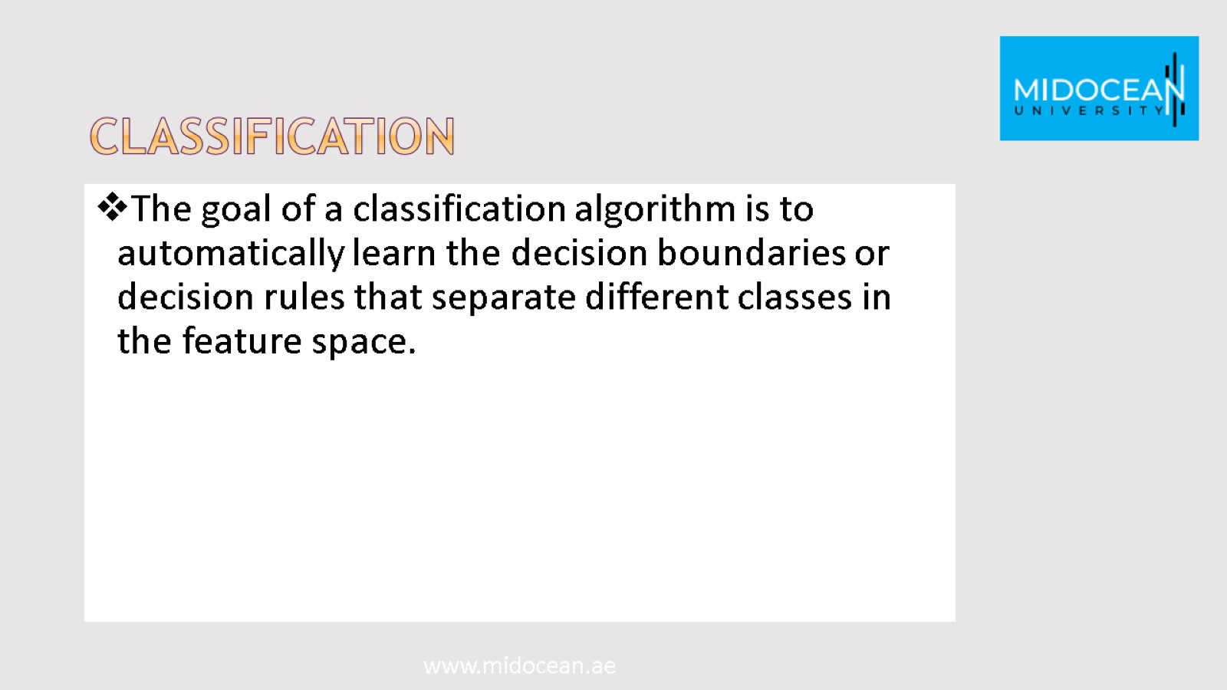
classification

Slide 7
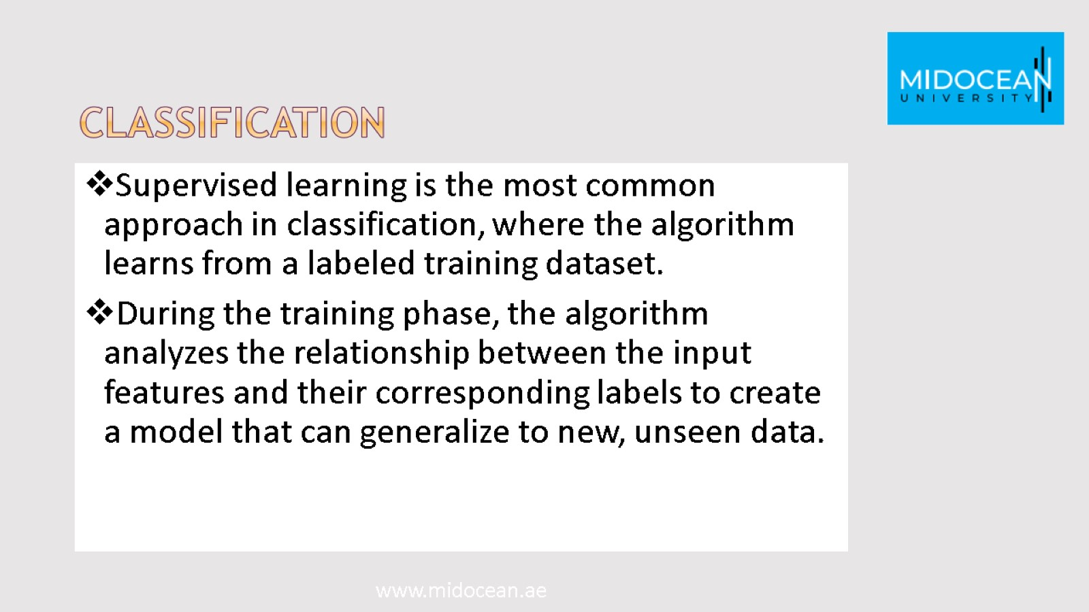
classification

Slide 8
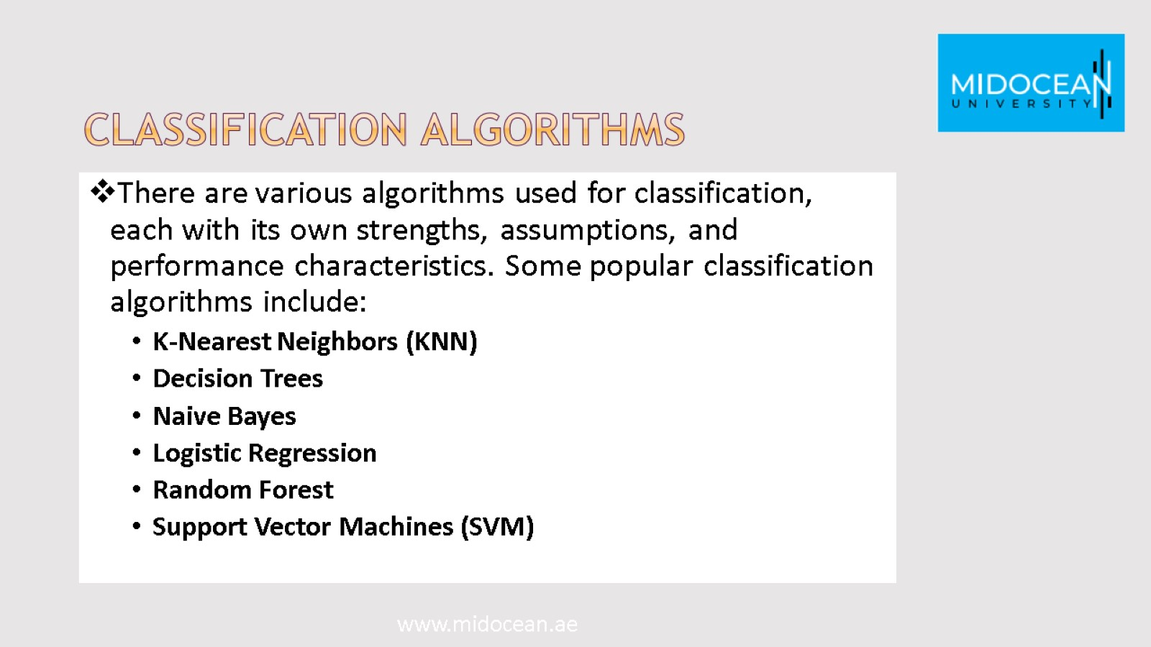
Classification algorithms

Slide 9
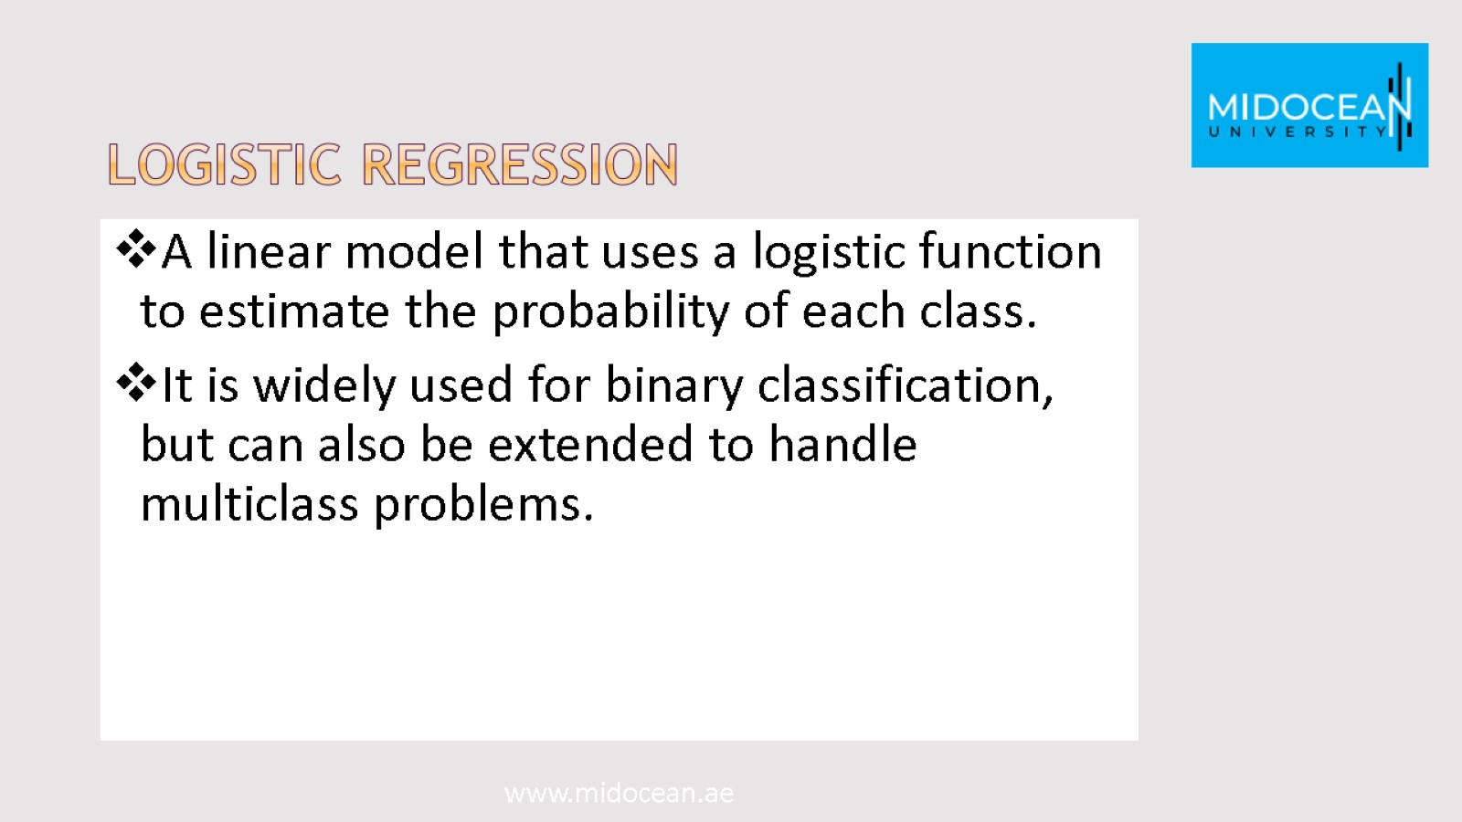
Logistic Regression

Slide 10
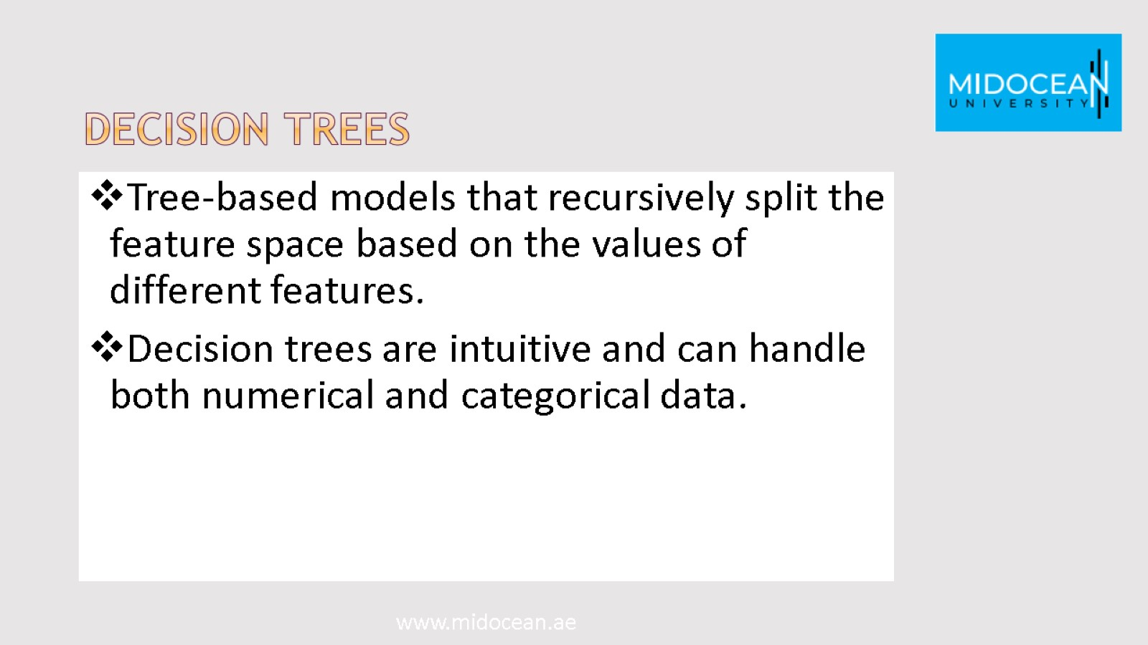
Decision Trees

Slide 11
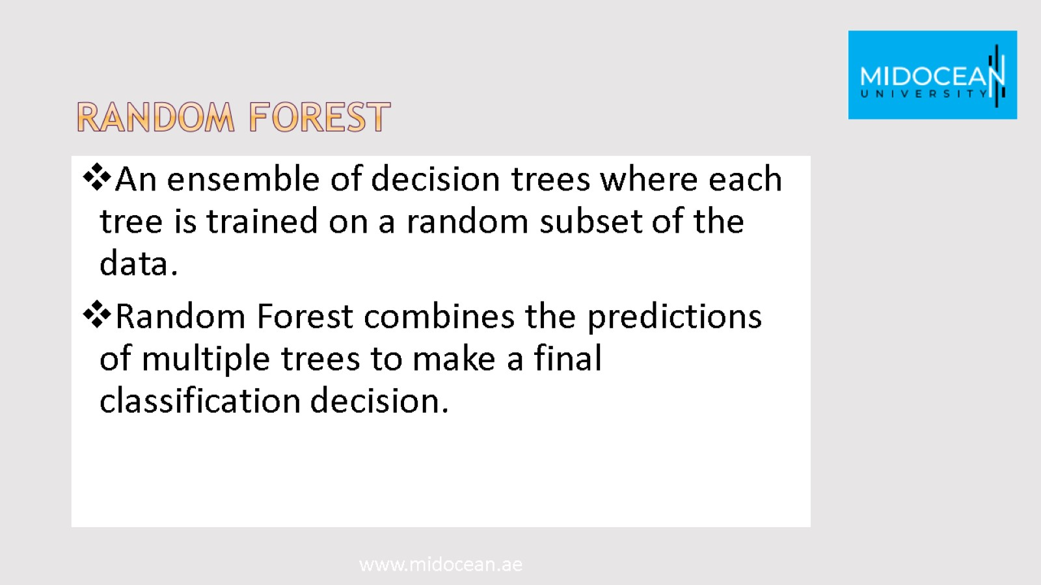
Random Forest

Slide 12
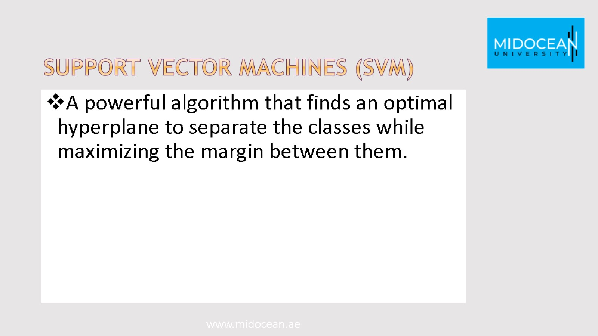
Support Vector Machines (SVM)

Slide 13
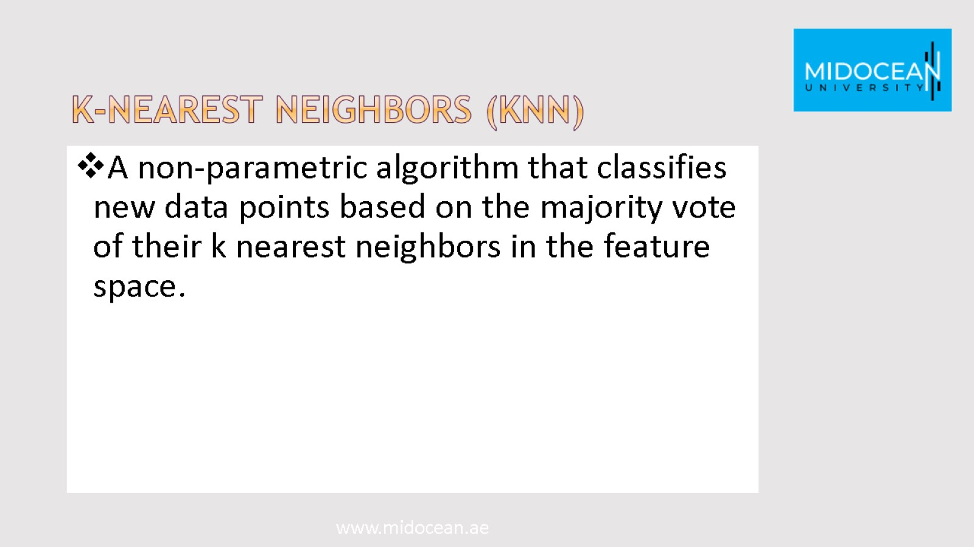
K-Nearest Neighbors (KNN)

Slide 14
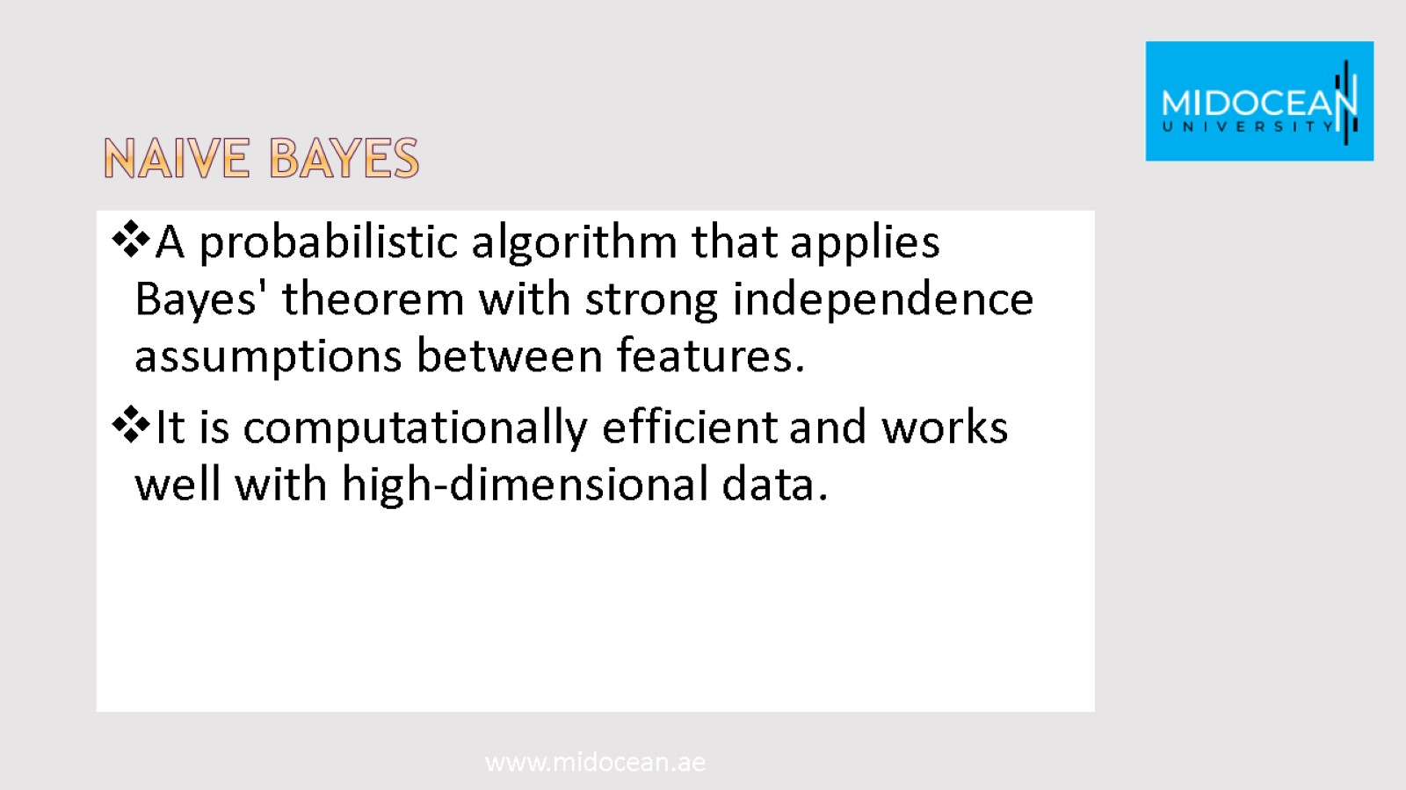
Naive Bayes

Slide 15

K-nearest neighbors (Knn)

Slide 16
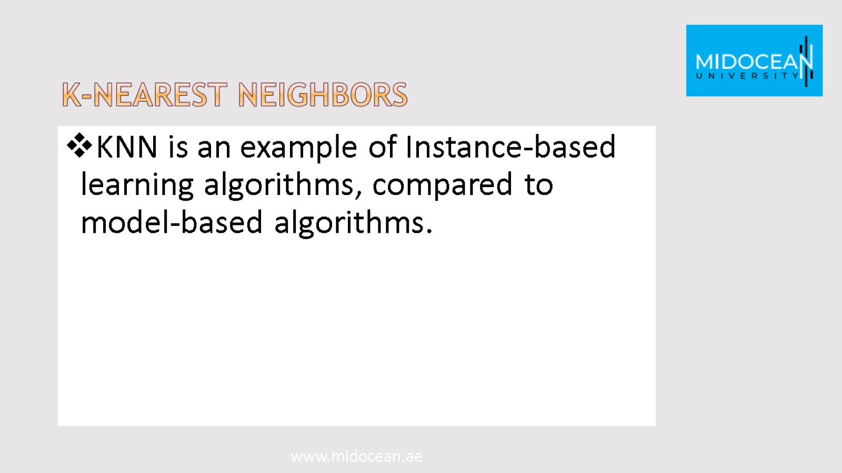
K-Nearest neighbors

Slide 17
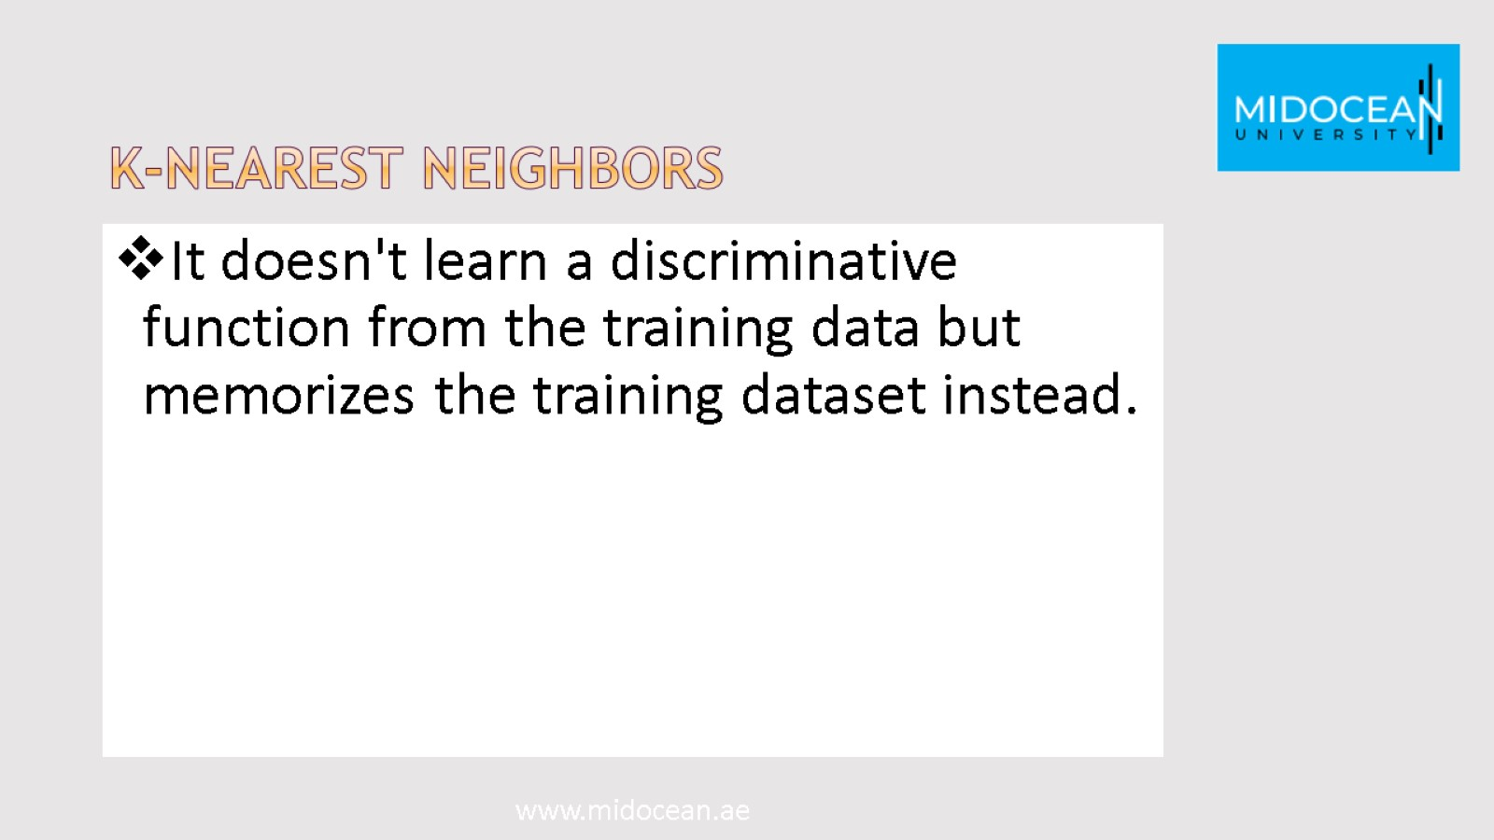
K-Nearest neighbors

Slide 18
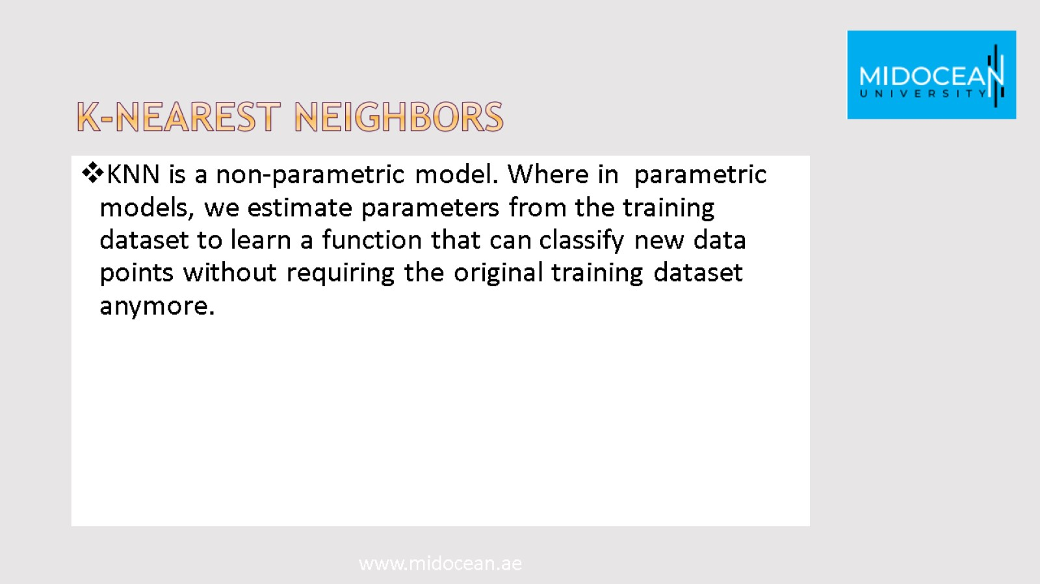
K-Nearest neighbors

Slide 19
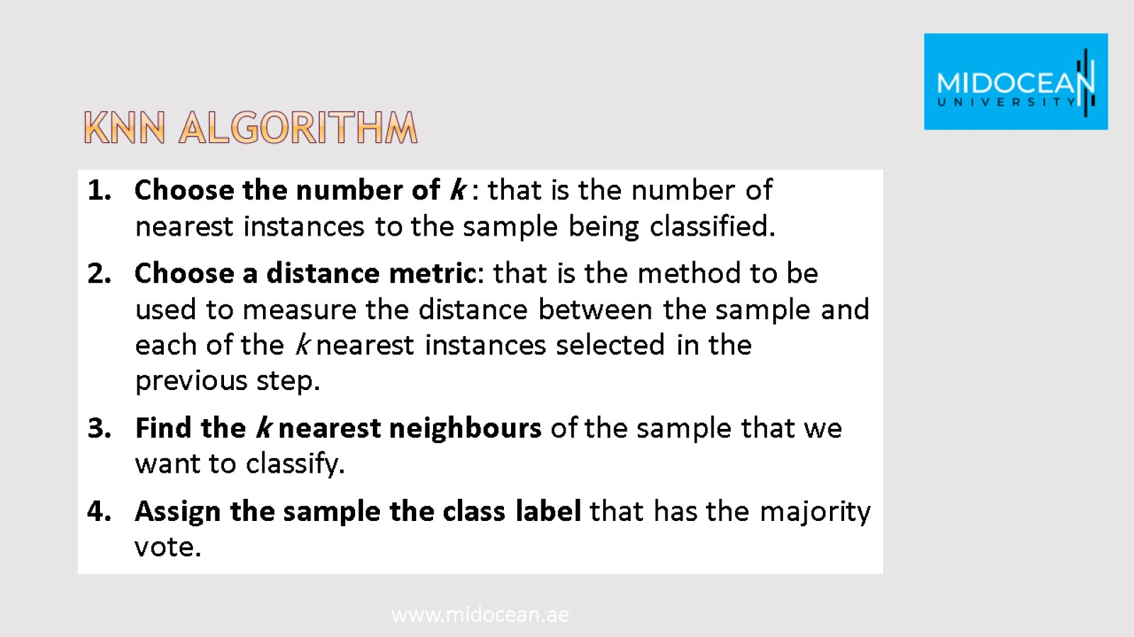
KNN algorithm

Slide 20
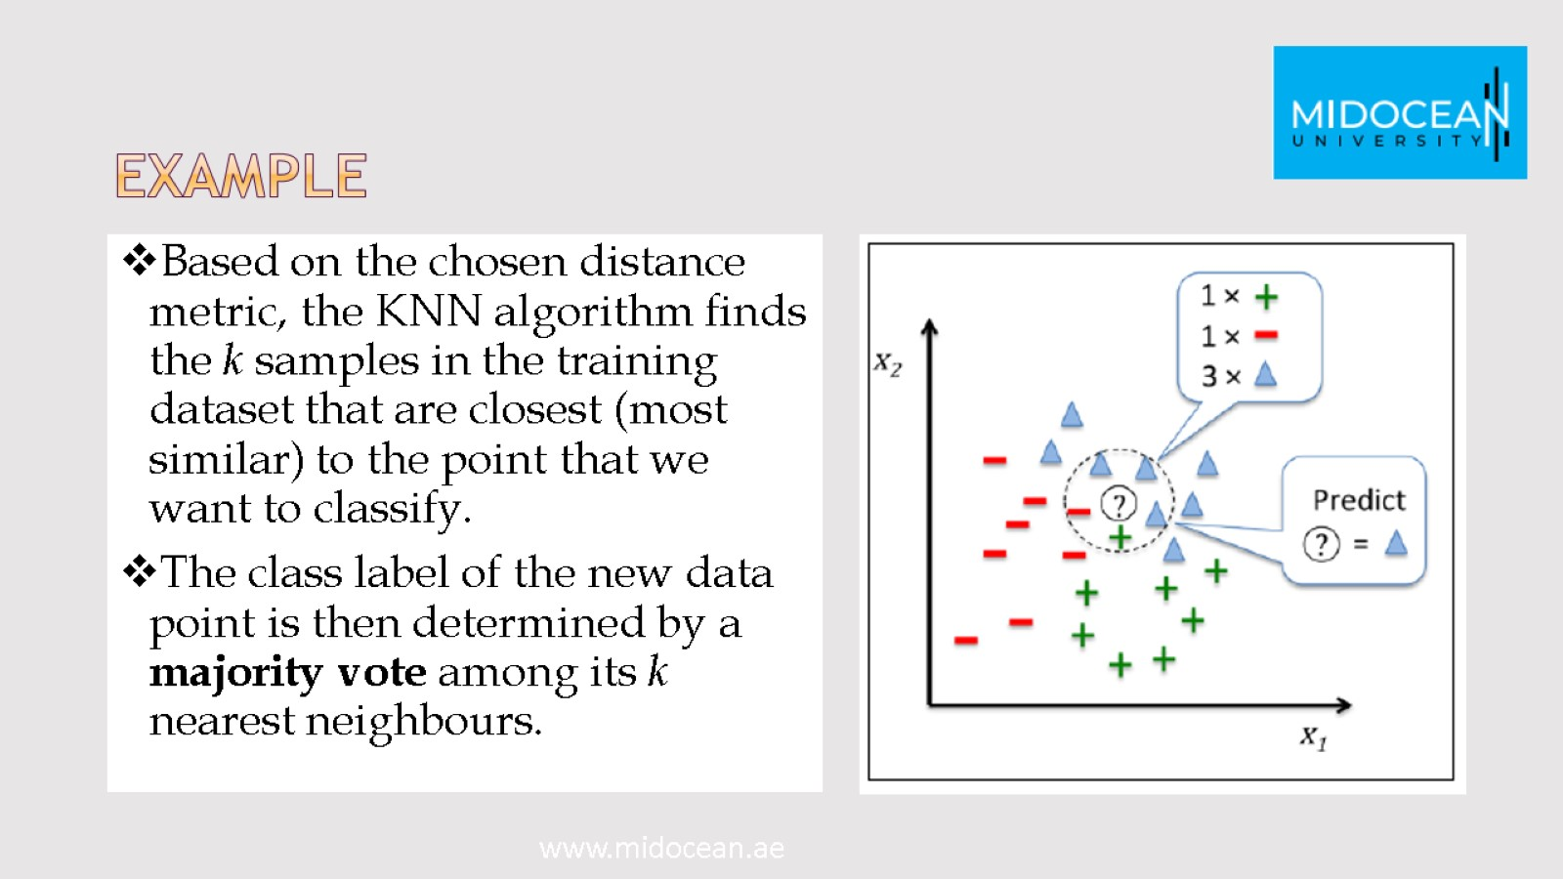
Example

Slide 21

Advantages of KNN algorithm

Slide 22
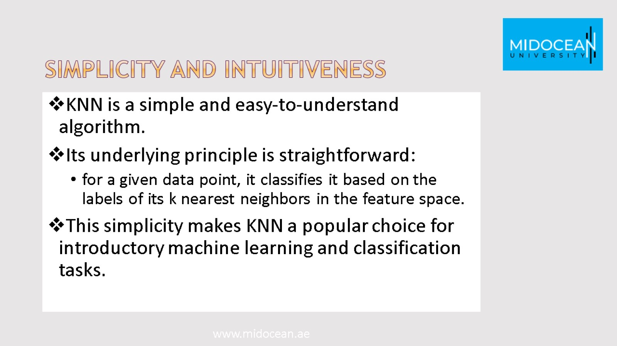
Simplicity and Intuitiveness

Slide 23
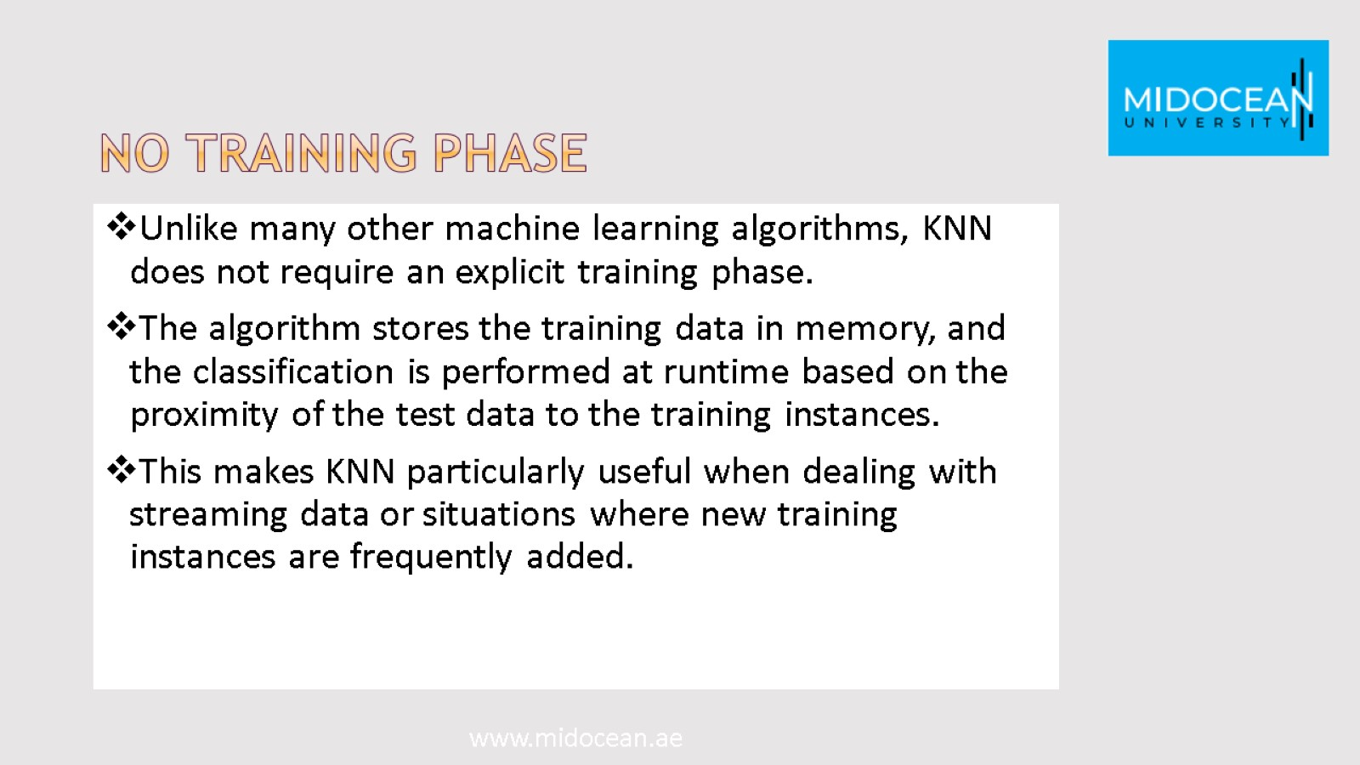
No Training Phase

Slide 24
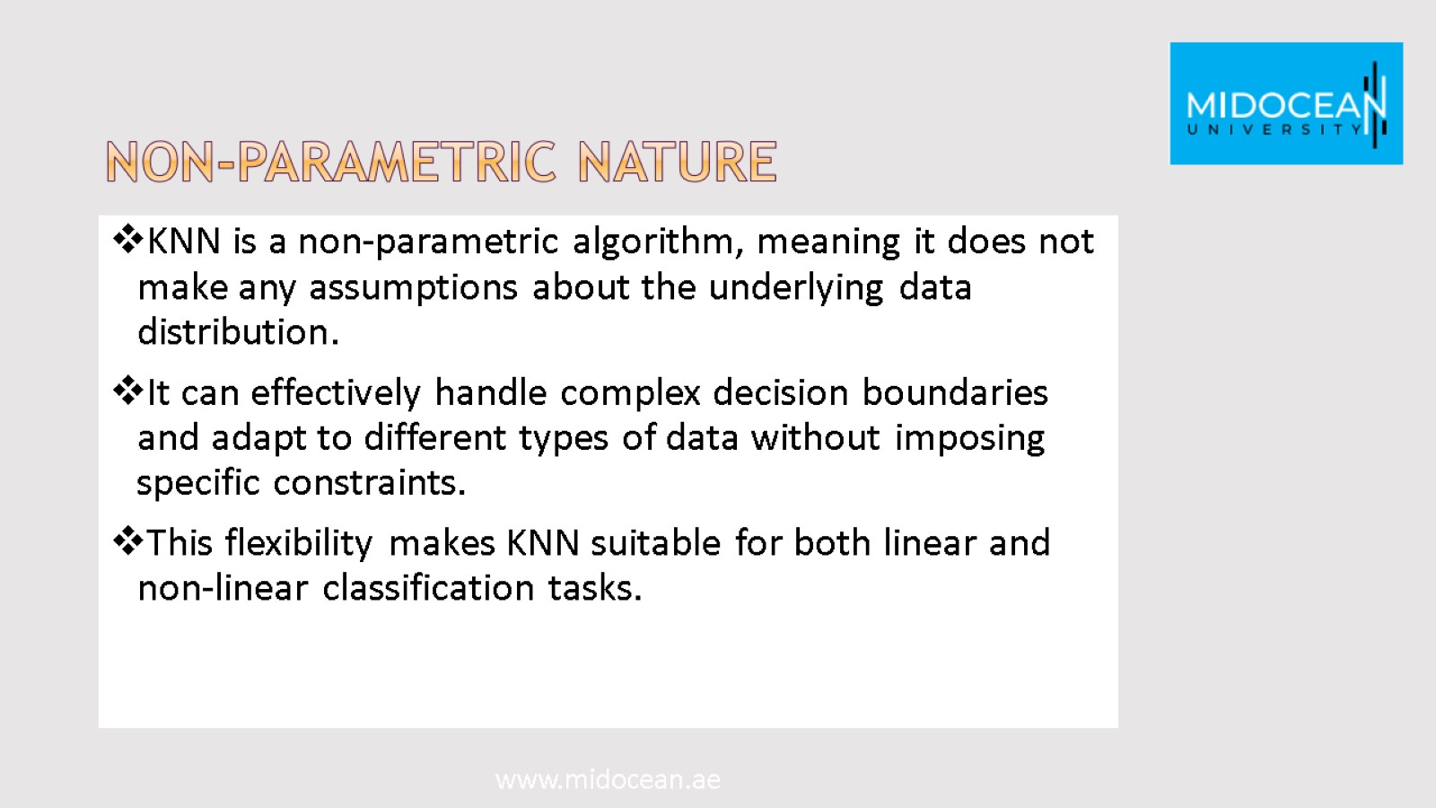
Non-parametric Nature

Slide 25
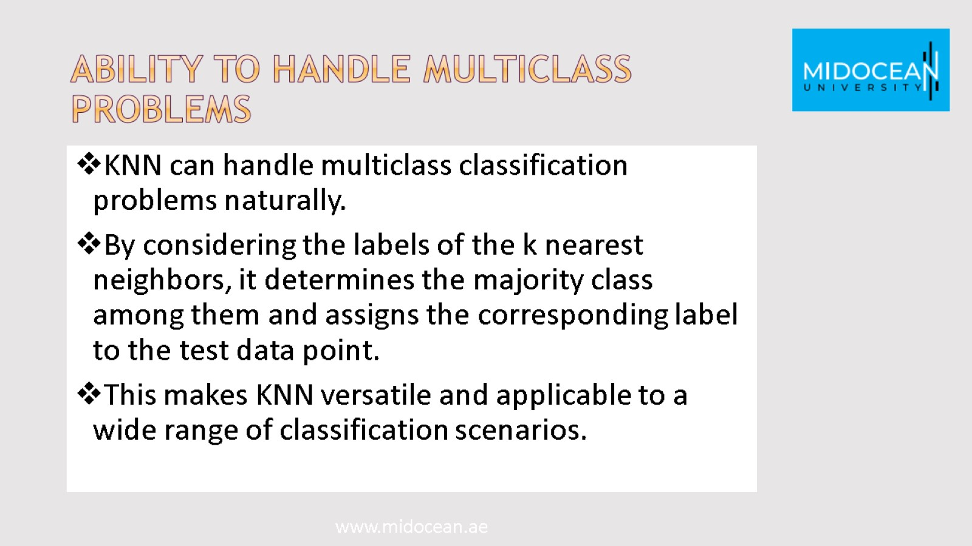
Ability to Handle Multiclass Problems

Slide 26
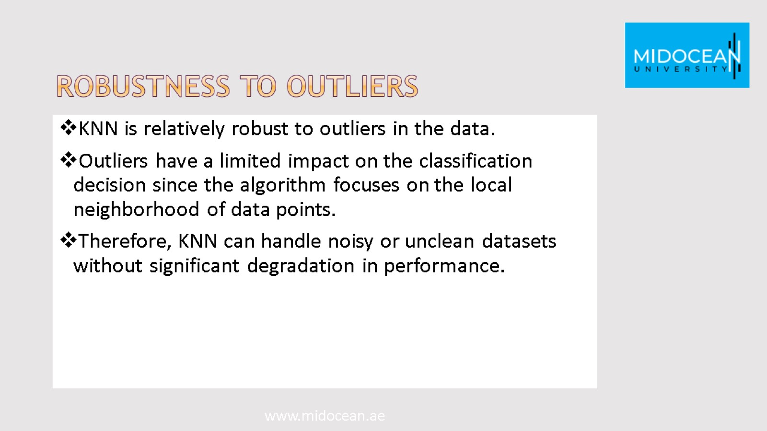
Robustness to Outliers

Slide 27
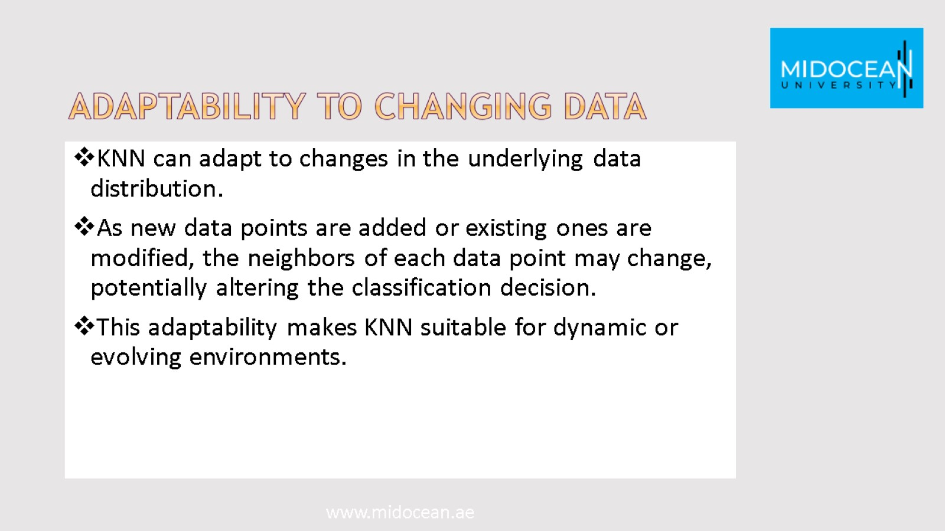
Adaptability to Changing Data

Slide 28
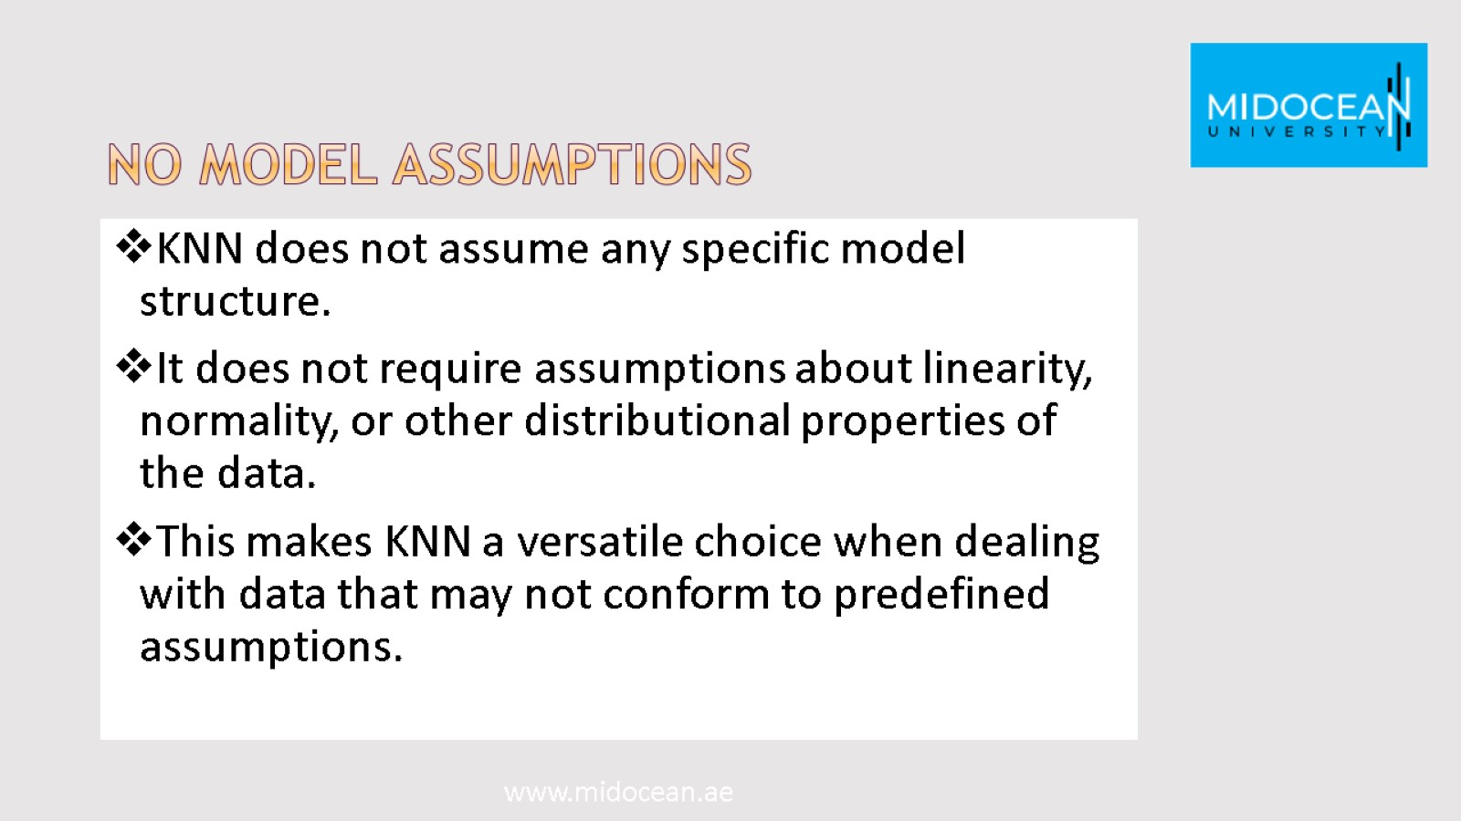
No Model Assumptions

Slide 29
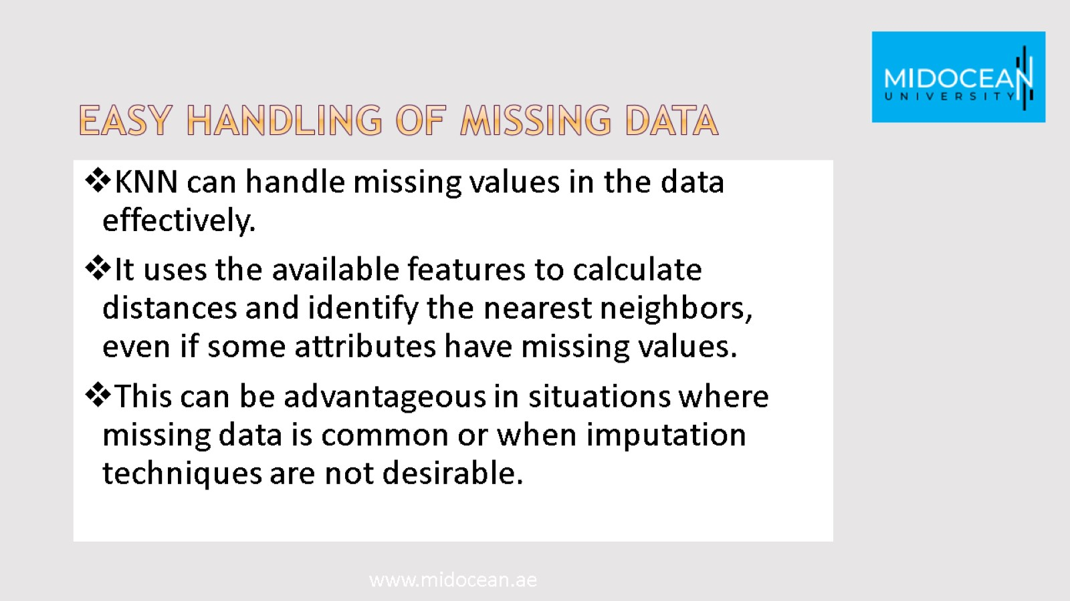
Easy Handling of Missing Data

Slide 30

KNN disadvantages

Slide 31
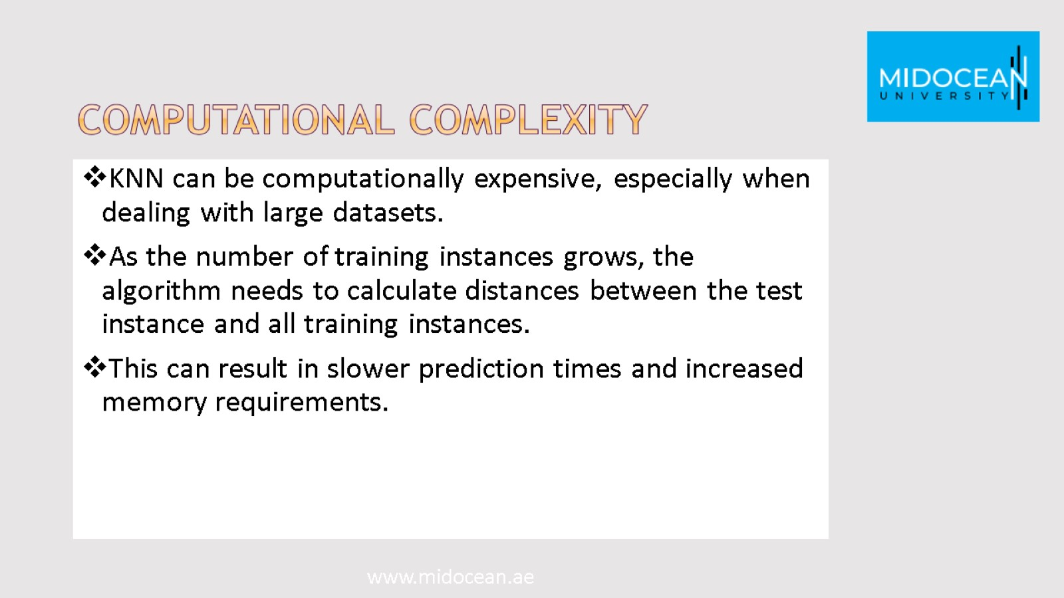
Computational Complexity

Slide 32
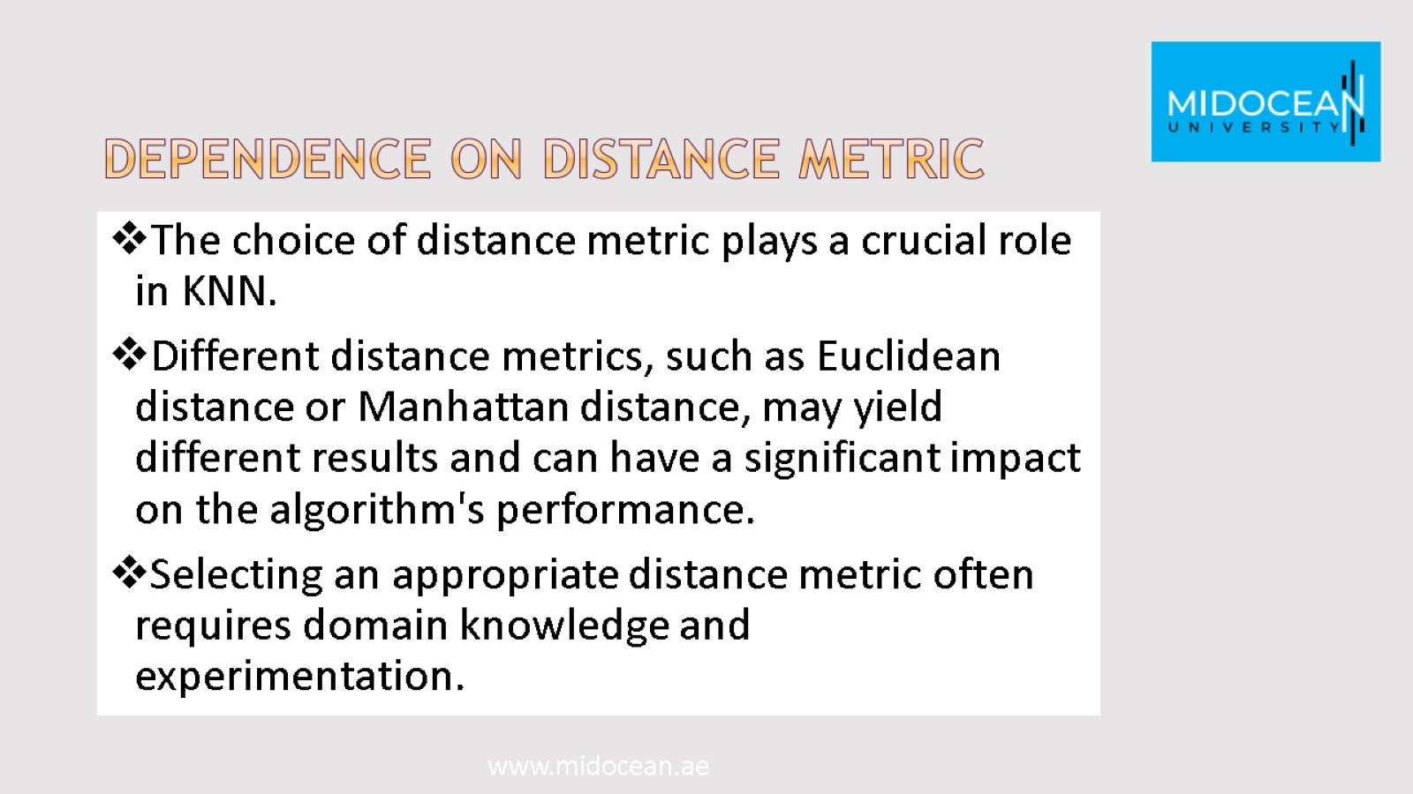
Dependence on Distance Metric

Slide 33
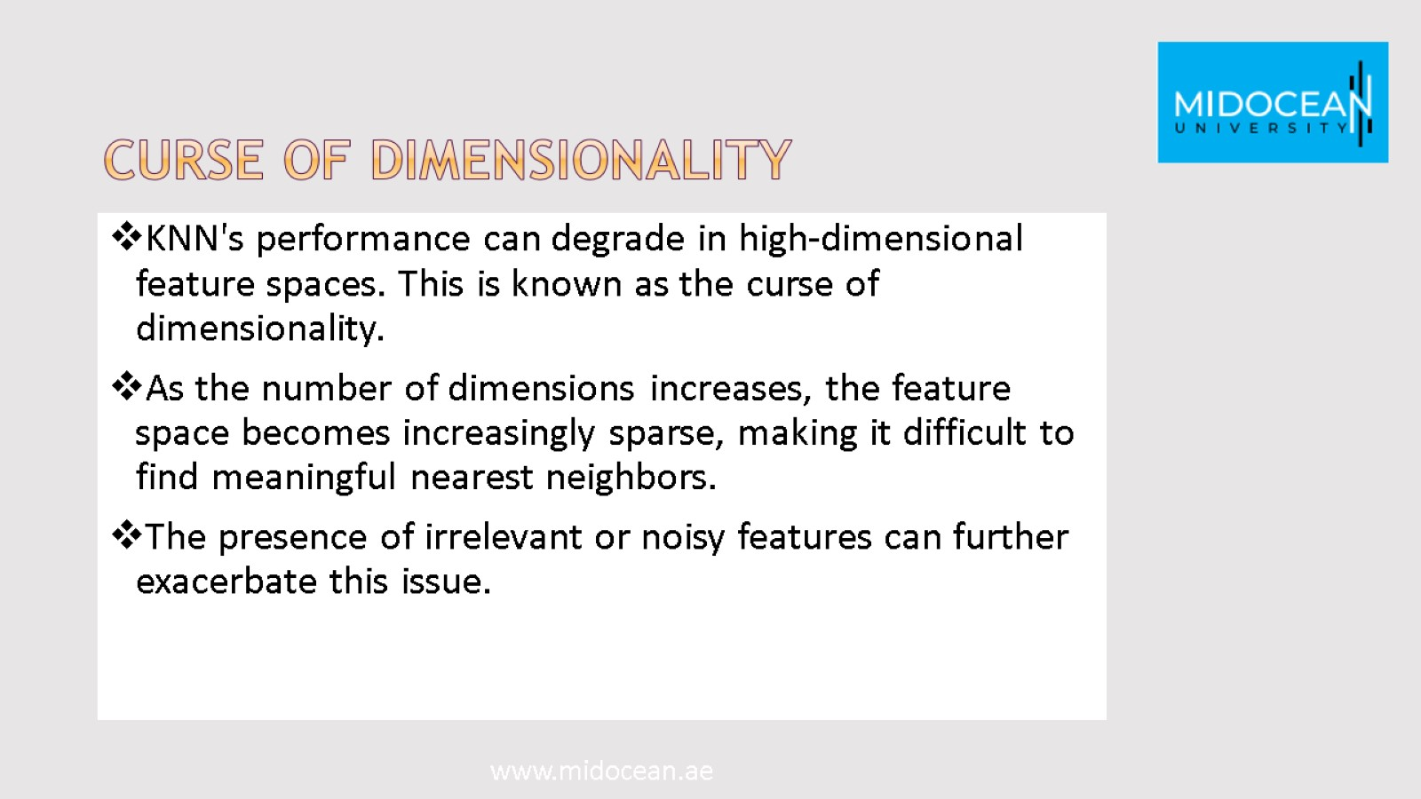
Curse of Dimensionality

Slide 34
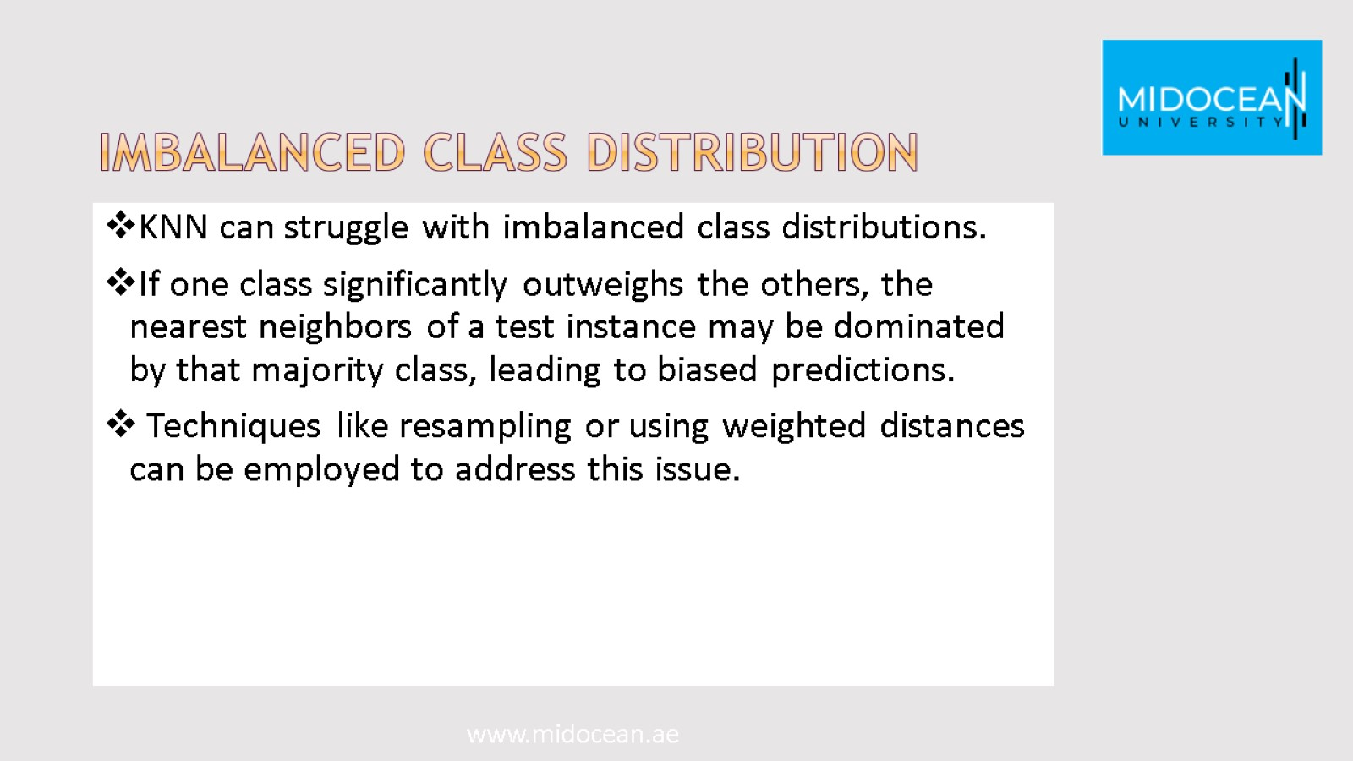
Imbalanced Class Distribution

Slide 35
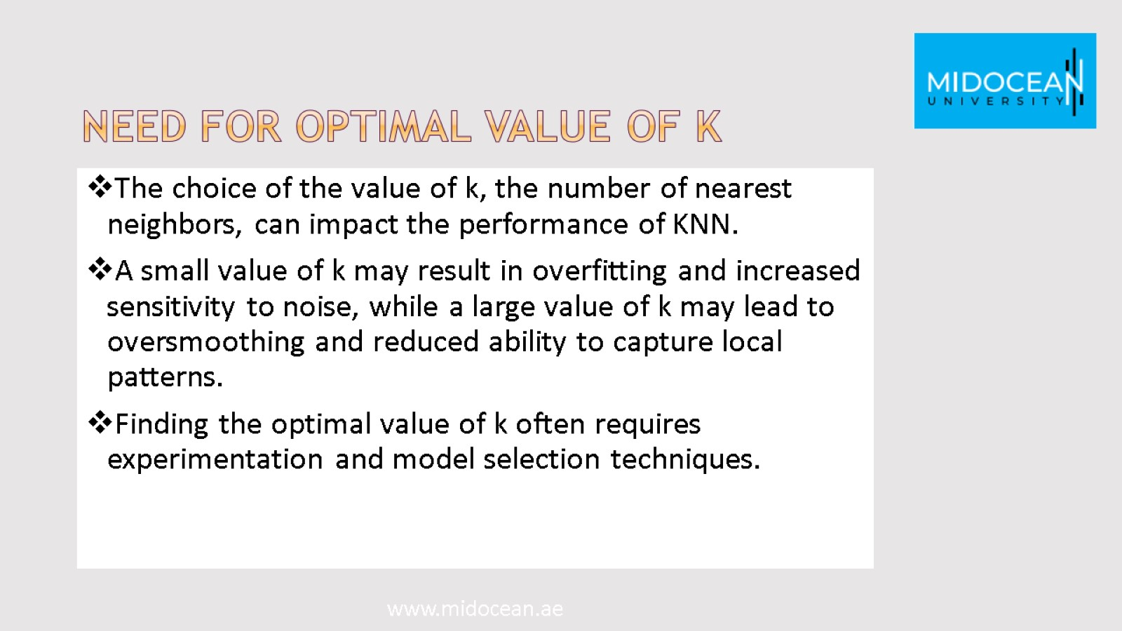
Need for Optimal Value of k

Slide 36
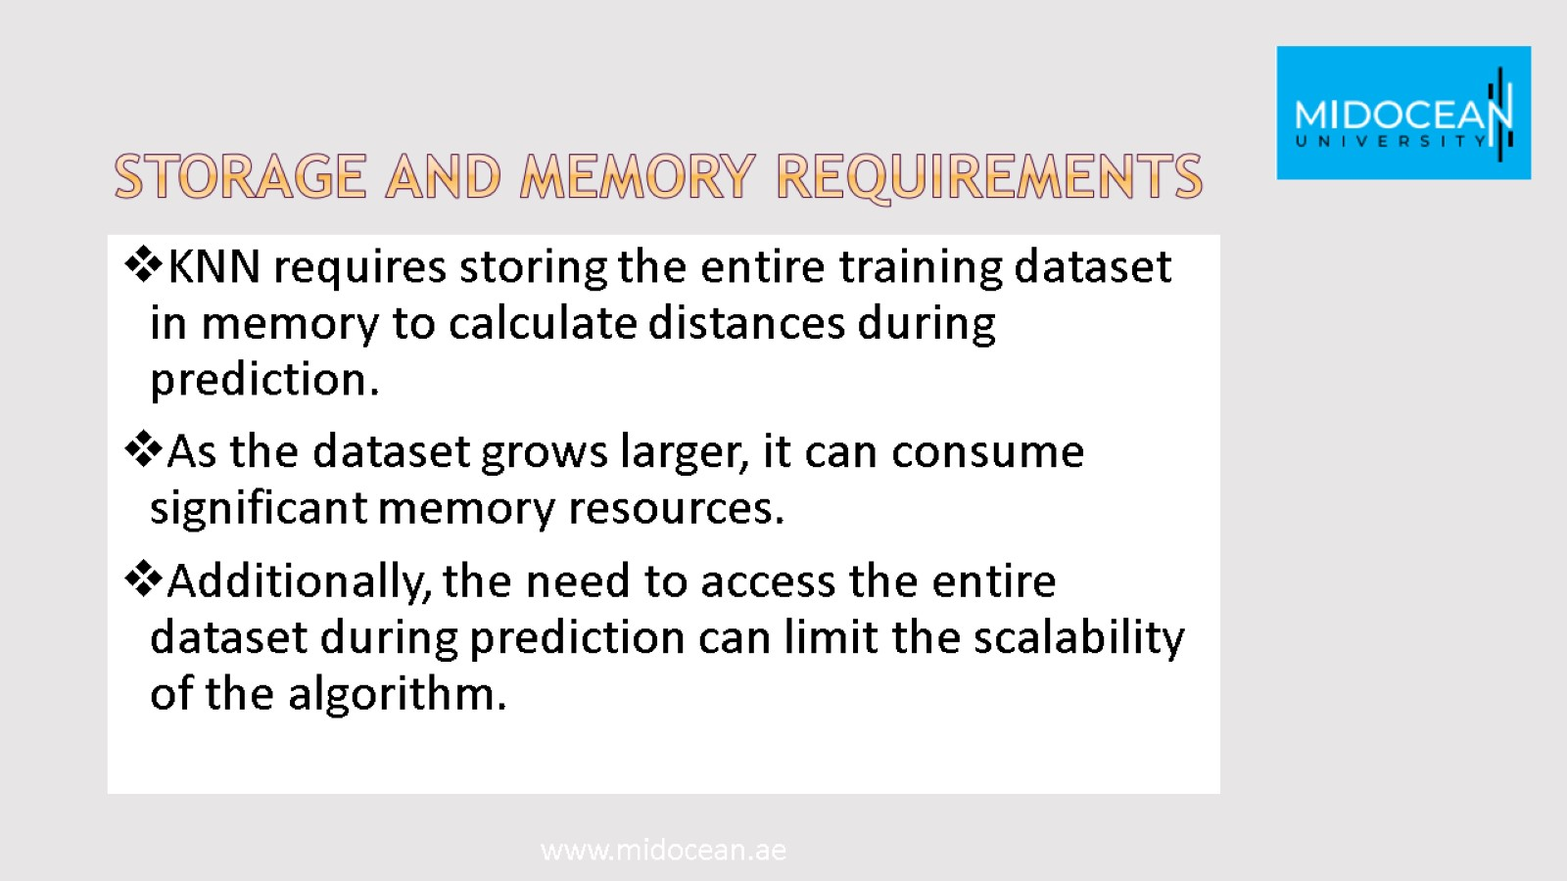
Storage and Memory Requirements

Slide 37
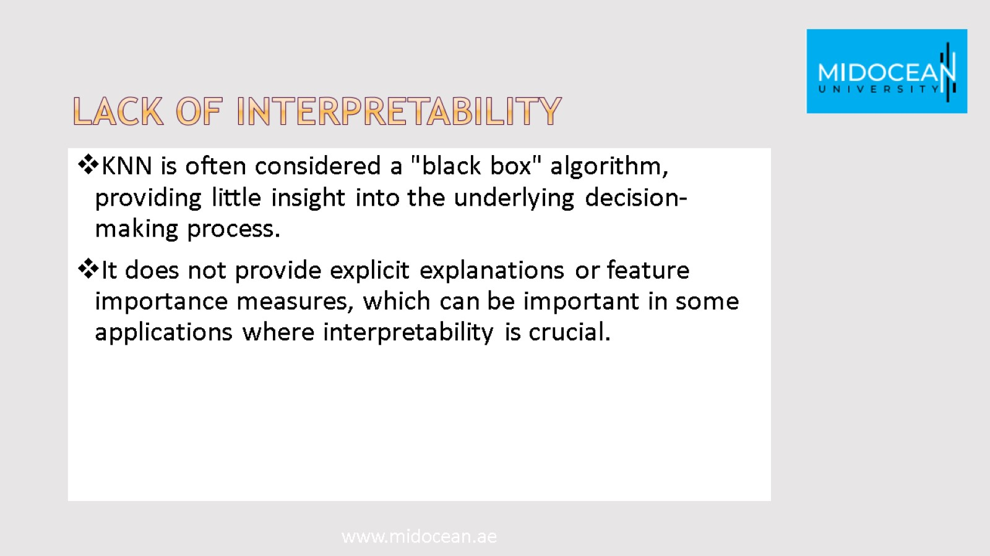
Lack of Interpretability

Slide 38

Distance Measures

Slide 39
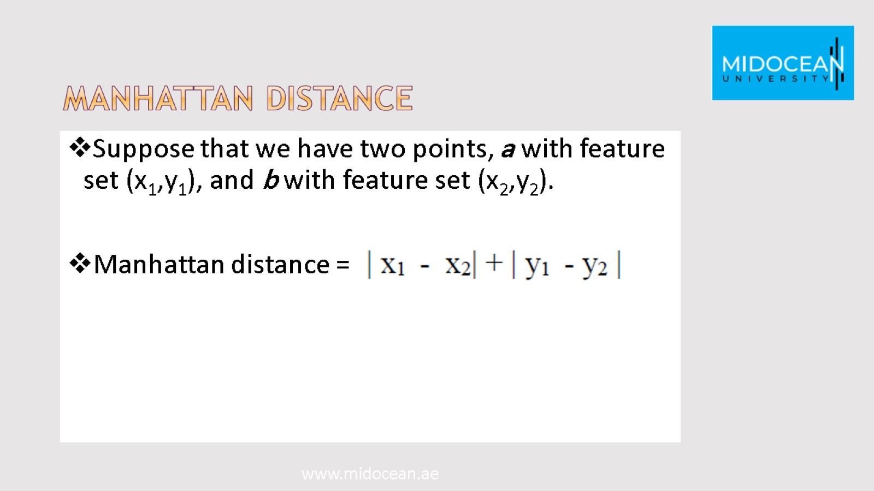
Manhattan distance

Slide 40
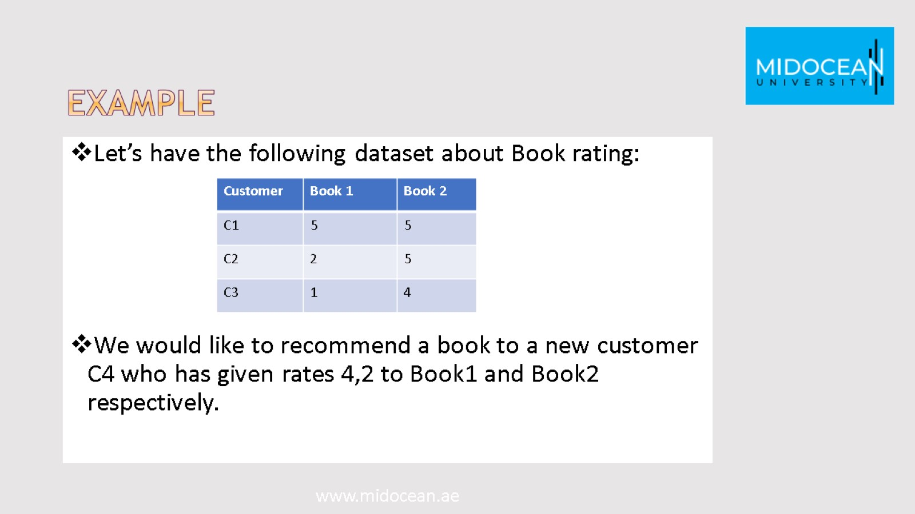
Example

Slide 41
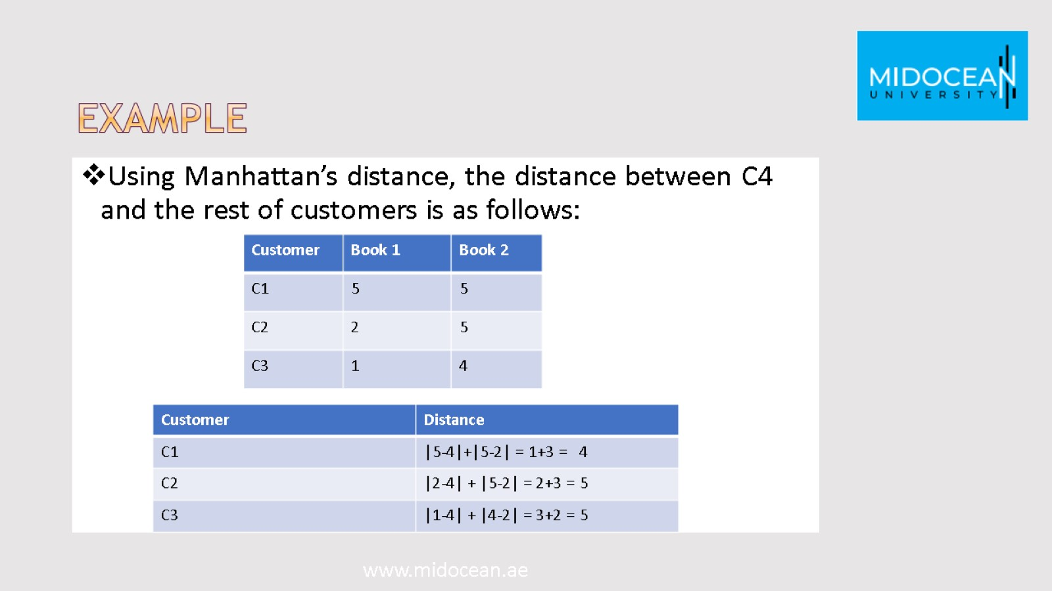
Example

Slide 42
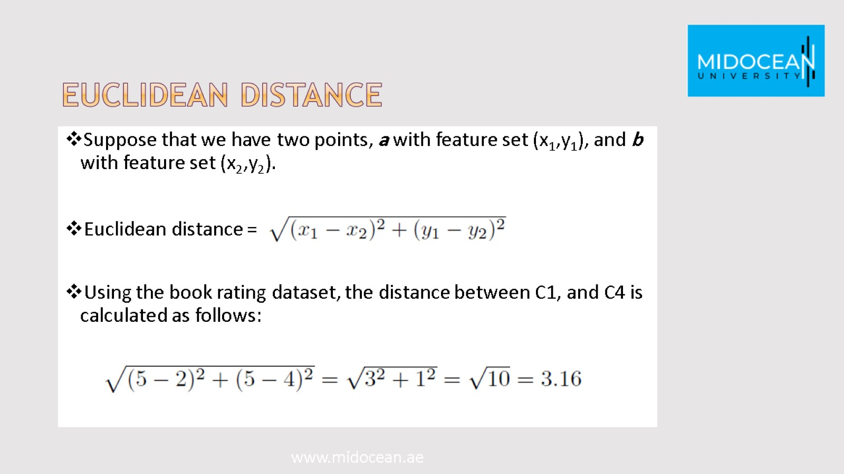
Euclidean distance

Slide 43
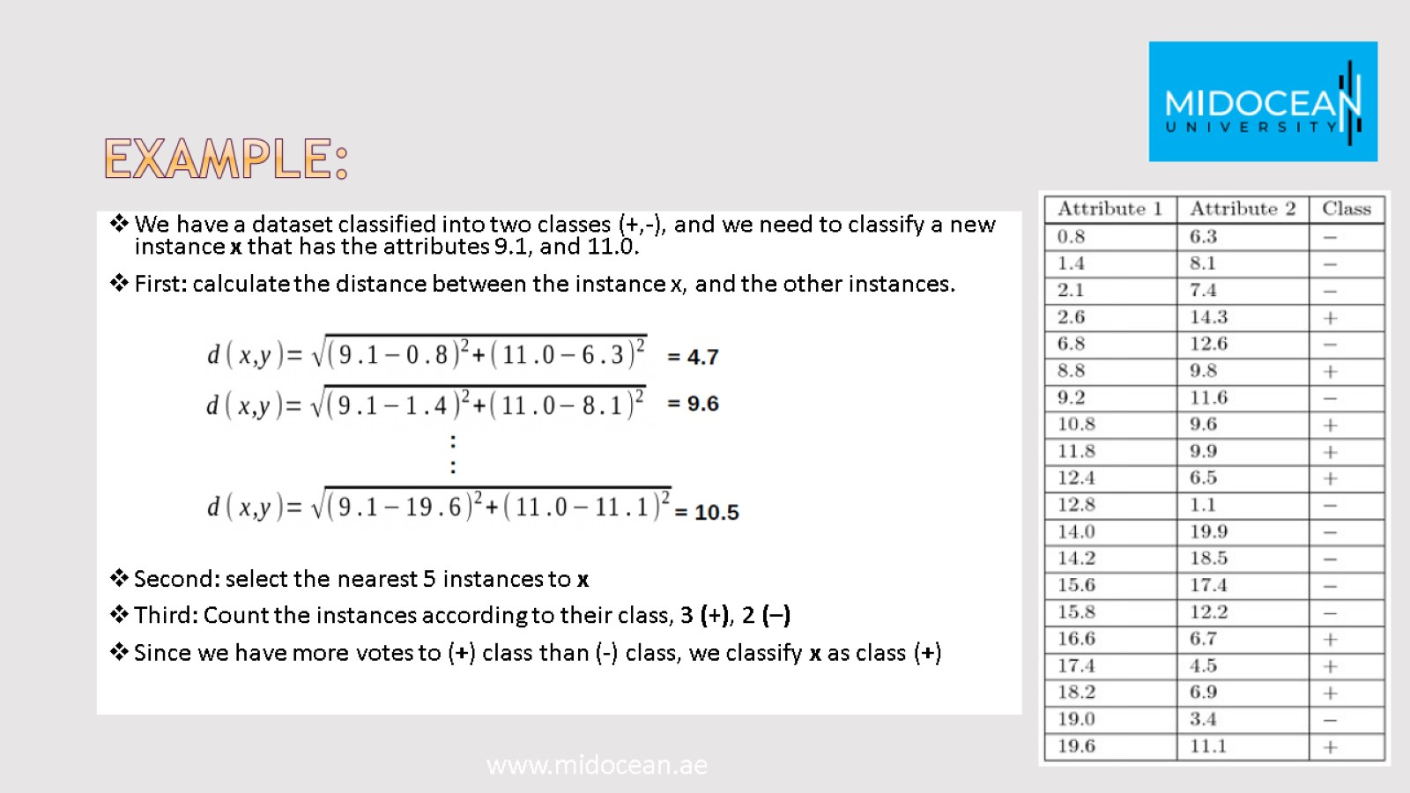
Example:

Slide 44


Slide 45


