Slide 1

Entrepreneurship & Innovation
Prepared by Dr. Amany Ramadan
ENT 611
Entrepreneurship & Innovation
Lecture 7

Slide 2


Building a Powerful Marketing Plan
Chapter
7
www.midocean.ae

Slide 3

Chapter
The lecture will cover the following:
0
History
Introduction
Principles of GM
Elements that make GM successful
Implementing GM strategies
Traditional vs. Guerrilla marketing
Types of GM
Marketing mix
Advantages and disadvantages
Conclusion
www.midocean.ae

Slide 4
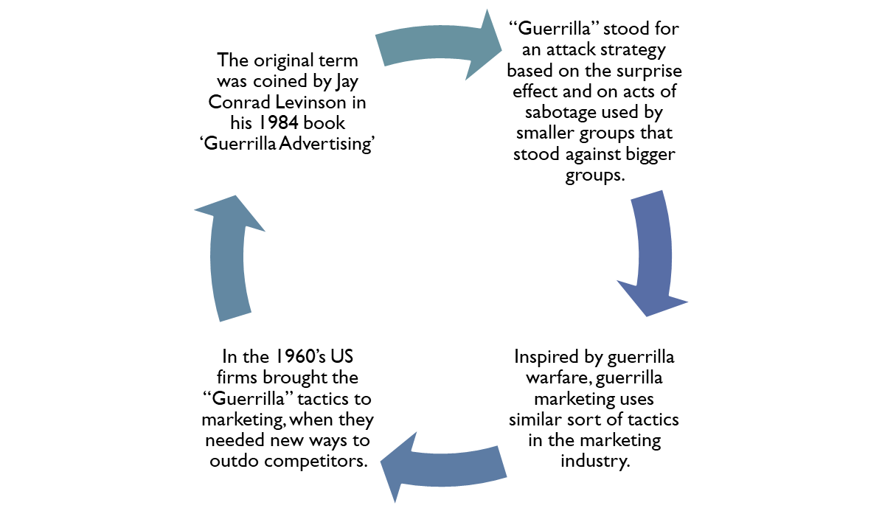
Chapter
History
7
www.midocean.ae

Slide 5
Chapter
Introduction
7
Guerrilla Marketing is an alternative marketing form.
Relies heavily on unconventional marketing strategy, high energy and imagination.
It is about taking the consumer by surprise and create copious amounts of social buzz.
Aims to strike the consumer at a more personal and memorable level
The failure of classical, conventional forms of advertising to be effective is becoming increasingly evident giving rise to a demand for innovative marketing strategies such as guerrilla marketing.
www.midocean.ae

Slide 6
Chapter
What is Guerrilla Marketing
7
Guerrilla Marketing is an advertising strategy that focuses on low-cost unconventional marketing tactics that yield maximum results.
Guerrilla marketing is often ideal for small businesses that need to reach a large audience without breaking the bank.
It also is used by big companies in grassroots campaigns to compliment on-going mass media campaigns.
Individuals have also adopted this marketing style as a way to find a job or more work.
www.midocean.ae

Slide 7
Chapter
GUERRILLA MARKETING PRINCIPLES
7
Completely Unexpected: Guerrilla campaign must include a surprise situation. That situation can be created by using usual objects in an unusual place and vice versa or by staging an event that people were not prepared to take part in.
Drastic: Extremeness intensifies the surprise and is helpful when trying to reach a large audience without spending a lot (by creating a word-of-mouth effect).
Humorous: Humour also plays a role in turning campaigns viral, which means reaching a larger audience. Mixing surprise with humour is a key strategy to a successful guerrilla campaign.
www.midocean.ae

Slide 8
Chapter
One-Shot Game
7
Due to the importance of the surprise factor in it, a certain guerrilla-marketing concept can only be executed during a limited period of time and should not be used twice on the same target market.
Cheap: It requires a small budget in comparison to other marketing methods.
Goodwill and Customer Benefit: Should always include an act of goodwill on the part of the company in order to make consumers feel satisfied and valued.
www.midocean.ae

Slide 9
Chapter
ELEMENTS THAT MAKE GUERRILLA MARKETING SUCCESSFUL
7
Cost Advantages Guerrilla marketing tactics cost a fraction of the amount required for traditional marketing strategies.
The cost-efficiency of guerrilla tactics allows small businesses with small marketing budgets to achieve larger impacts than they could going head-to-head via traditional media.
Standing Out Guerrilla marketing messages have the ability to stand out among the endless barrage of marketing messages that consumers see on a daily basis.
www.midocean.ae

Slide 10
Chapter
Brand Building Guerrilla marketing strategies
7
Brand Building Guerrilla marketing strategies themselves can help to develop an edgy or "hip" brand image.
This can be especially advantageous when marketing to young people or when trying to establish a unique identity for themselves.
Lasting Impressions Much of guerrilla marketing relies on face-to-face interaction with potential customers.
When guerrilla marketing tactics on the street are tied with social-media driven promotions, the bond between a company and its new customers can grow even stronger.
www.midocean.ae

Slide 11
Chapter
Building a Guerrilla Marketing Plan
7
Guerrilla marketing strategies:
Are unconventional, low-cost, and creative marketing techniques that allow a small company to realize a greater return from its marketing investment than do larger rivals.
Do not require large amounts of money to be effective – just creativity.
Get people talking,
Think outside the box.
www.midocean.ae

Slide 12
Chapter
IMPLEMENTING GUERRILLA STRATEGIES
7
Utilize Social Networking Sites Websites like Face book, MySpace and YouTube receive millions of hits each day.
Post any attention-grabbing ideas you can think of, on these sites and link your main website so that viewers can find out more about your facility.
Partner With Local Businesses Dedicate a section of your website to coupons, accessible to members, from local retailers.
In exchange for providing the retailers with exposure, have them promote your business on their website or by visibly placing your brochures at their locations
www.midocean.ae

Slide 13
Chapter
IMPLEMENTING GUERRILLA STRATEGIES
7
Enlist Member Participation Ask members who have achieved great success to serve as role models.
Speak Up Offer your services as a speaker for community organizations and local businesses. Your presentations should be creative and unconventional, selling the benefits of exercise, not your business.
Create “Free” Mailboxes Similar to the “mailboxes” set up with auto dealership brochures. Inside of each mailbox, place your facility’s marketing materials complete with free guest passes.
Use of Imagination & Small budgets
www.midocean.ae

Slide 14
Chapter
IMPLEMENTING GUERRILLA STRATEGIES
7
Meme “What can we give”
Target is to build long-term relationship ( Dialog ) Starts
after the deal : Use of Capital Big budgets
Logo “What will we get?” To sell is a target
Monolog
Finishes after deal 13 Traditional Marketing Guerrilla Marketing
www.midocean.ae

Slide 15
Chapter
GUERRILLA MARKETINGIN MARKETING MIX
7
Guerrilla Marketing has changed over the years. Today Guerrilla Marketing is often only used in the form of a campaign.
The balance in the marketing mix shifts towards one of the 4 P’s. 70% of the campaigns put their focus on promotion. The remaining 30% place their focus equally on price, place and product.
Price (10%) Even though we live in a world where prices play a big role within the purchase decision, only 10% of all Guerrilla activities focus on price .
Promotion (70%) In most cases Guerrilla Marketing appears in the form of promotion.
Distribution (10%) The distribution of a product can also be a special experience for the customer. A good distribution can boost sales tremendously.
Packaging (10%) Also the packaging, the form, and the brand can be a vehicle for Guerrilla Marketing
www.midocean.ae

Slide 16
Chapter
Types of Guerrilla Marketing
7
Alternative Marketing ◦ This is a popular type of guerrilla marketing which uses non-traditional ways of advertising a product. Generally, this form of marketing involves using some form of a publicity statement that is released by the company that does not directly market or promote the product but creates an appeal base for the product in question, thereby informing consumers of its existence.
Ambient Marketing ◦ Of all the different categories of guerrilla marketing that exist, ambient marketing tends to cost the most. This is because of the fact that this type of marketing usually involves making use of a venue and then recreating it, the fees for which can be quite high. In this form of marketing, you use the one thing that is best synonymous with the company and then place it in other venues or things, which would normally not be associated with your company or products.
www.midocean.ae

Slide 17
Chapter
Types of Guerrilla Marketing
7
Astroturfing ◦ This form of marketing is very similar to the grassroots movement in which individuals promote a product because of the good experience they have had with it. But unlike the latter, which is an honest promotion, in astroturfing (which is generally done through blogs), the people promoting the products are often on the payroll of the company or own the company themselves. The bloggers do not reveal that they are connected to the company.
Experiential Marketing ◦ In this form of marketing, the attempt is to allow a prospective consumer to experience the product in question, so that they have something tangible to connect with. The company allows people to experience the product in question. It is often stated that this form of marketing allows the consumer to make a more informed and intelligent decision.
www.midocean.ae

Slide 18
Chapter
Types of Guerrilla Marketing
7
Presume Marketing ◦ This is the form of guerrilla marketing where the company aims at making people realize the presence of the product. They try to achieve this by placing products in those places where they are bound to get a lot of recognition and exposure. Product placement in movies and television shows is often considered to be a type of presume marketing. On the Internet when you place notes or photographs on different websites you are indulging in presume marketing.
Tissue Packing Marketing ◦ Made popular in Japan, this form of advertising as the name suggests, involves promoting products on the cover of tissue papers. Since it is such a commonly used product and can be retained for a while, it is a great way of ensuring that the product remains in the memory of the consumer. This technique is generally considered to be more useful than advertising on flyers.
www.midocean.ae

Slide 19
Chapter
Types of Guerrilla Marketing
7
Undercover Marketing ◦ Also known as stealth marketing, it involves the use of a celebrity to advertise the product by using it in public places. They vocalize their loyalties to the product that they are using. In this manner, the celeb is encouraging fans to use the same product that he is using and is creating awareness about the product.
Viral Marketing ◦ This type of guerrilla marketing uses different social networking sites and popular games and videos to create recognition for the brand and the product. The technique is such that if a commercial captures the attention of the target base, it will be circulated by them without the company having to incur any costs. The reason it is called viral marketing is because of the comparison that has been made to the spread of computer viruses.
www.midocean.ae

Slide 20
Chapter
Types of Guerrilla Marketing
7
Wild Posting ◦ Unlike other types which tend to be subtle, this form involves over-the-top promotion of your product by placing posters wherever they can be placed and making the message hard to miss. Of course, the cost factor involved in this form of marketing is very less which makes it effective in the long run.
www.midocean.ae

Slide 21

www.midocean.ae
Chapter
7
Examples of Guerrilla Marketing

Slide 22

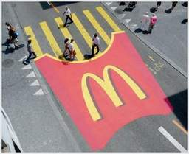
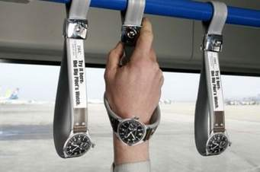
Some Examples of Guerrilla Marketing

Slide 23
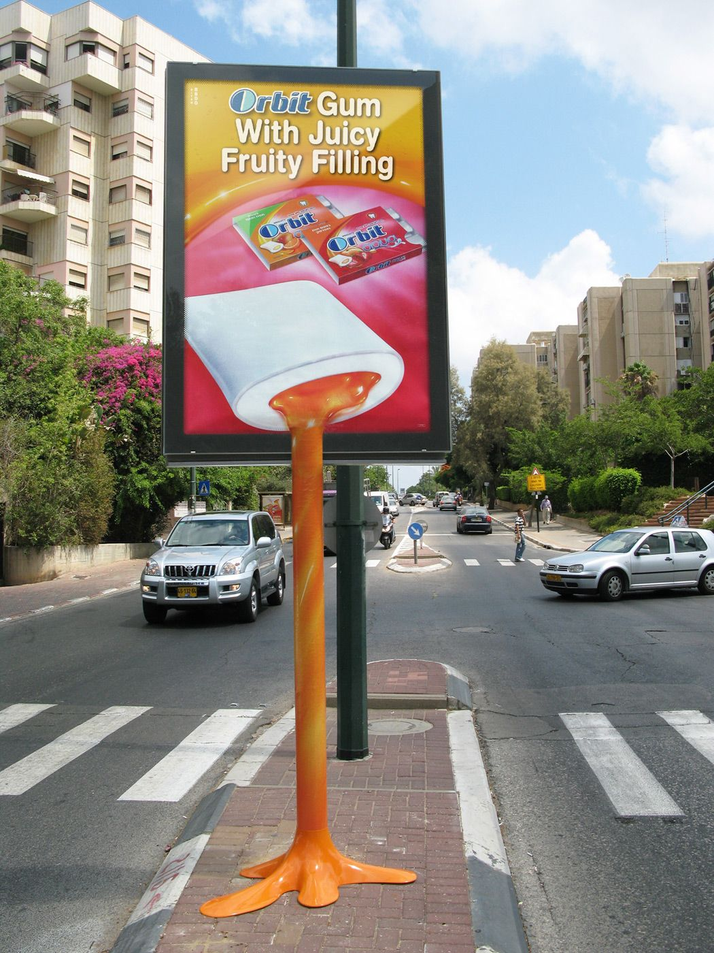
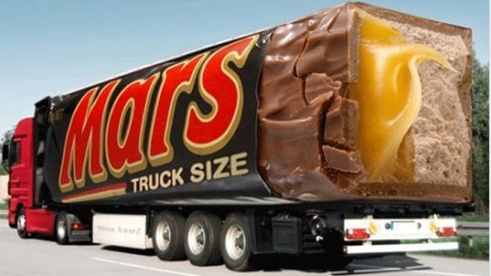

Slide 24
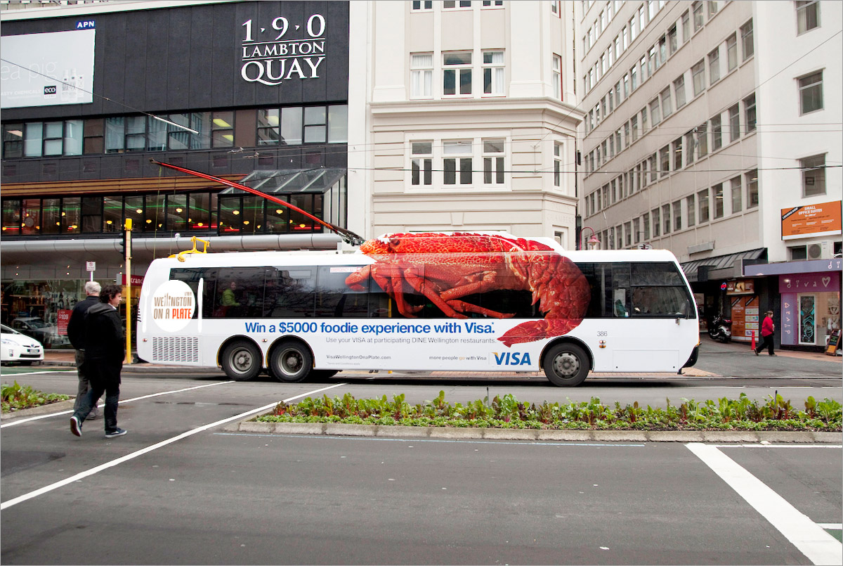

Slide 25
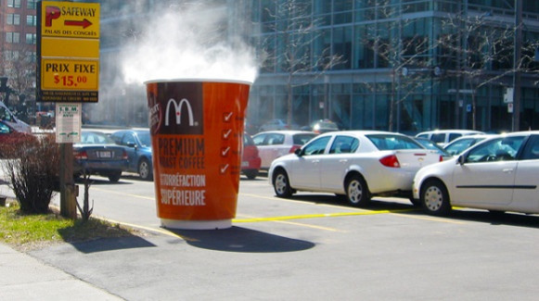

Slide 26
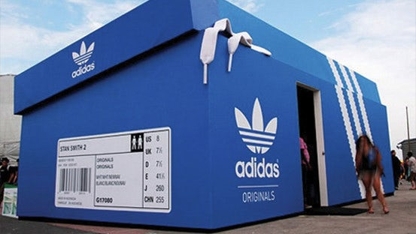

Slide 27
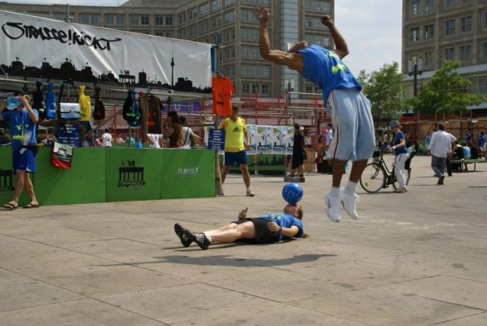

Slide 28
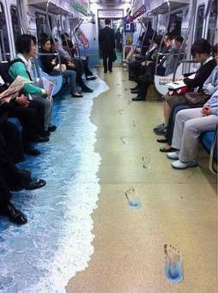

Slide 29
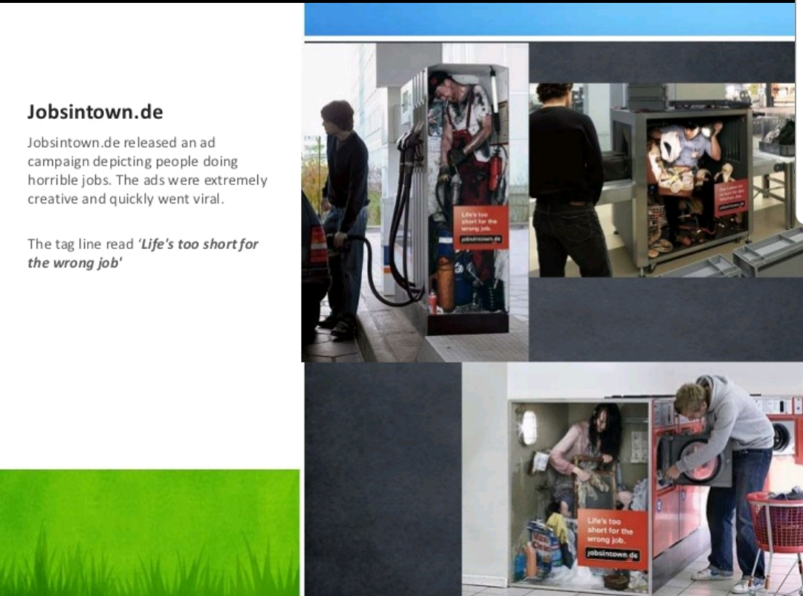

Slide 30
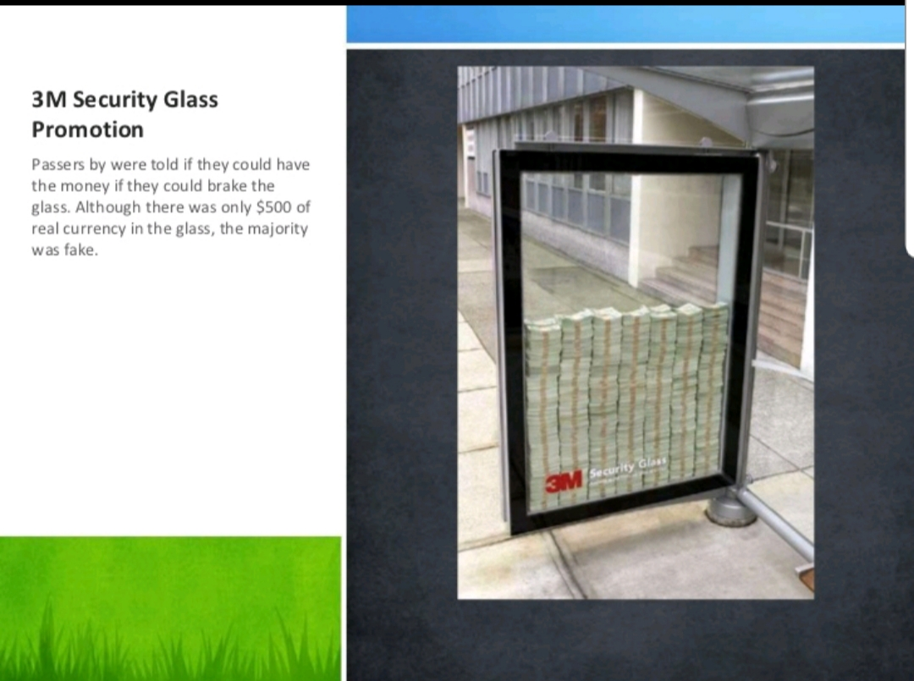

Slide 31
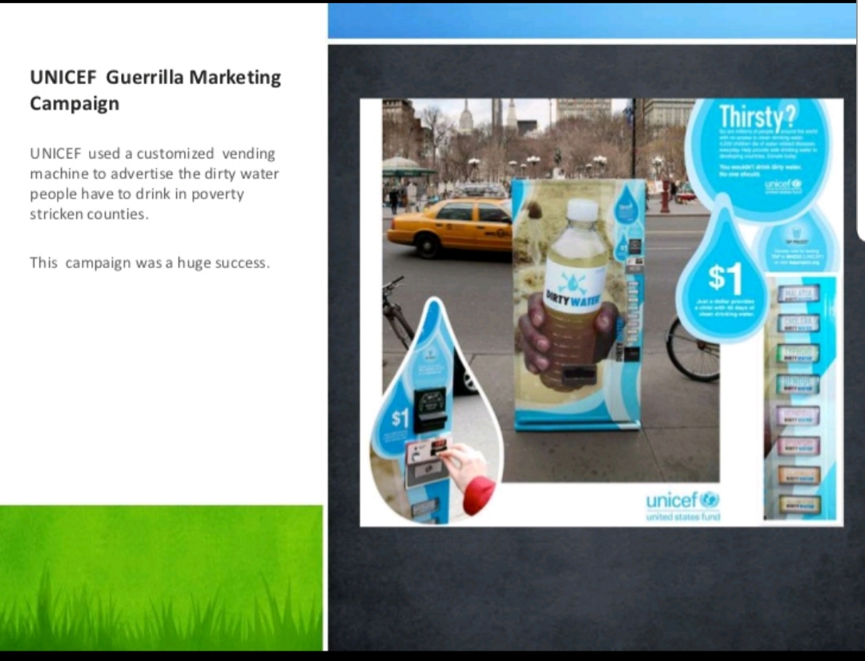

Slide 32
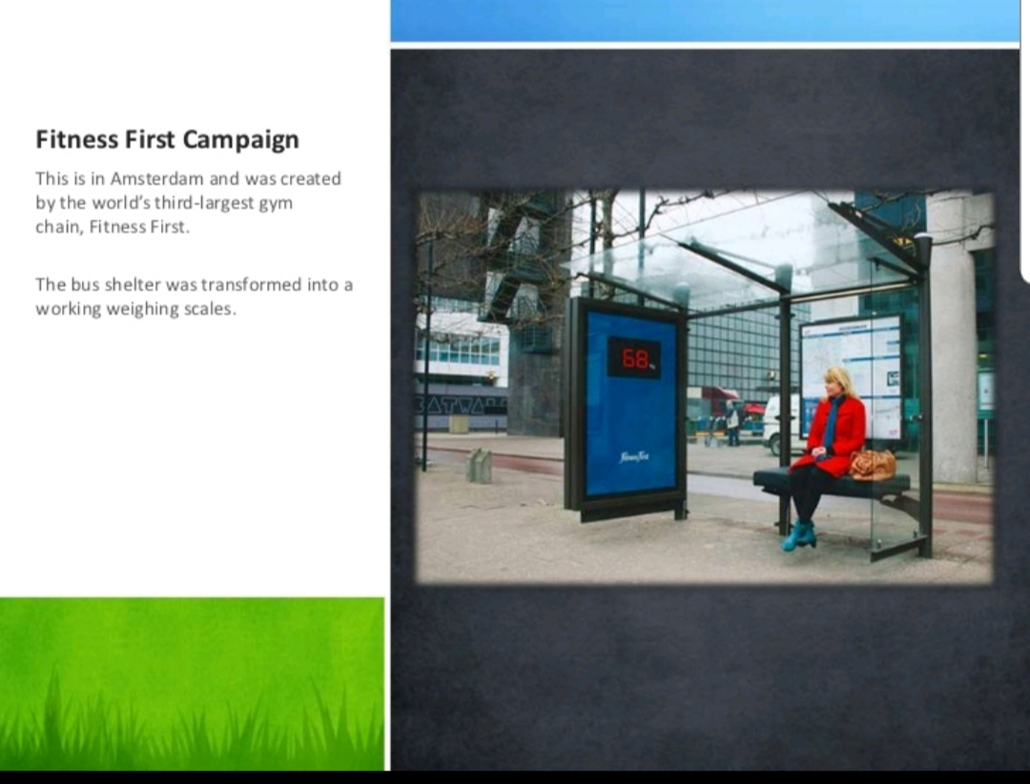

Slide 33
Chapter
A Seven-Sentence Marketing Strategy
7
What is the purpose of your marketing?
Who is your target market?
What is your niche?
What are the benefits and competitive advantage?
What is your company’s identity?
What tactics, strategies, and weapons will you use to carry out your marketing?
How much money will you spend on your marketing; in other words, what is your marketing budget?
www.midocean.ae

Slide 34
Chapter
How Guerrilla Marketing is good !
7
It helps create a memorable experience: ◦ Guerrilla marketing basically requires creativity. The success and uniqueness of this type of campaign depend upon how creative you can get with your idea. An efficacious guerrilla marketing campaign has a potential of eliciting strong emotions in consumers. It further helps create a memorable experience such that people can remember the brand being advertised.
Enables you to build partnerships: Through guerrilla marketing, you can collaborate with local businesses, organizations, and charities to produce a campaign. This would enable you to build partnerships, target your ideal audience and also gain a larger exposure as you would also be engaging with your partner’s audience.
It is low on cost: The methods involved in guerrilla marketing are almost always low or even no cost. Creating a Facebook page, promoting products or services on it and circulating your innovative ideas on it costs nothing. Employing guerrilla marketing, you can use unconventional methods to engage with consumers in new and exciting ways. It actually provides a cost-effective way to build brand awareness at minimal or no cost.
www.midocean.ae

Slide 35
Chapter
How Guerrilla Marketing is good !
7
Helps your brand go viral: ◦ Guerrilla marketing can help your brand (product, or service) go viral within a short time span. It can actually help you rack up millions of views quickly! That’s because a majority of the population is on one or the other social media platform and keen to share their day-to-day activities with the world. Guerrilla marketing companies can use this to their advantage and make extraordinary campaigns that go viral
Enhances customer base: Guerrilla marketing basically aims at attracting new customers, encouraging old customers to buy again, and upselling. But the idea is to do it in such a way that surprises them. The entire process ends up with the customer being convinced enough to buy the products or services being advertised and in most favorable cases, becoming loyal customers
www.midocean.ae

Slide 36
Chapter
How Guerrilla Marketing is good !
7
Guerilla Marketing requires a greater level of dedication and energy than traditional advertising venues, which often consist of throwing large amounts of money at other people to do the work for you. If you are looking for a quick fix, Guerilla Marketing is not your solution. You will not see instant or overnight results stemming from your efforts. An investment of time is required in order to achieve your business sales goals. o Guerilla Marketing is not for the thin-skinned or faint of heart. At the very least, you will have a few detractors who find fault in your methods. At worst, you may be threatened with legal action (which is why it's so important to check your local laws before engaging in a Guerilla Marketing campaign).
Time investment. One of the biggest factors in the “success” of a strategy is how much you’ve invested in it in the first place. If you invest too much and don’t see a corresponding benefit, you’ll end up wasting your time and money—and guerrilla strategies take a long time to think up, plan, and execute. • Unpredictability. Guerrilla strategies are also inherently less predictable than other forms of marketing and advertising. You can’t guarantee exposure, impressions, or even a growth rate here. In fact, depending on the tactics you use, much of your success will come down to timing and luck. • Difficulty in measurement. Since much of your campaign will revolve around random in-person interactions and generating more visibility, it’s notoriously hard to measure the results of your campaign in the first place.
www.midocean.ae

Slide 37
Chapter
Advantages
7
Guerilla Marketing works - but it is not completely fail safe. It is, after all, advertising; which is far from an exact science. The number of variables involved in advertising guarantees that nothing is 100 percent effective.
As with any advertising campaign, you will not be able to pinpoint exactly what works and what does not. Obtaining measurable results is difficult (but not impossible, unlike other marketing techniques).
www.midocean.ae

Slide 38
Chapter
Disadvantages
7
Guerilla Marketing works - but it is not completely fail safe. It is, after all, advertising; which is far from an exact science. The number of variables involved in advertising guarantees that nothing is 100 percent effective.
As with any advertising campaign, you will not be able to pinpoint exactly what works and what does not. Obtaining measurable results is difficult (but not impossible, unlike other marketing techniques).
www.midocean.ae

Slide 39
Chapter
7
ADVANTAGES OF GUERRILLA MARKETING
Cost effective
Allows increased interaction
Brand recognition  Unique and eye catching.
Guerilla marketing is specifically tailored to meet the needs of small businesses, whereas traditional advertising venues are complicated.
DISADVANTAGES OF GUERRILLA MARKETING
If one is looking for a quick fix, guerrilla marketing is not the solution. An investment of time is required in order to achieve business sales goals.
At the very least, there will be a few detractors to find fault in one’s methods,Not completely failsafe.
Subject to interpretation
Difficult to measure
Limited visibility
Maintaining creative edge
www.midocean.ae

Slide 40
Chapter
How to Set Up a Guerrilla Marketing Campaign?
7
Know your audience and its hidden psychographics. A guerrilla campaign’s success depends on how apt the content is and how well the promotional channel delivers it. Buyer segments have conspicuous habits – ones your competitors know and keep track of. And then they have hidden habits, preferences and pain points which others don’t articulate or pay attention to. You as the company need to identify what lies beyond the obvious and target this need or requirement through your strategies. ◦ Choose the strategy that will work for you. Do you want a viral video to speak about your brand? Or do you feel that stealth marketing is the right direction for you? Based on the resources you have available, the reach you want from the effort and your budget any of the several guerrilla marketing strategies discussed in this article may prove to be the right fit
Calculate the ROI. And make sure you don’t stop at the monetary profit. It is essential to factor in the cost of a failed guerrilla campaign. Will it impact present conversions? Or will the slip up go unnoticed? ◦ Leverage traction. Guerrilla campaigns can’t be duplicated. If they are repeated too many times, they lose their effectiveness. So you must structure a strong follow up to your marketing efforts including more promotional acts and ways to convert the traction and interest into buyers.
www.midocean.ae

Slide 41
Chapter
A Guerrilla Marketing Plan
7
Pinpoints the specific target markets the company will serve.
Determines customer needs and wants through market research.
Analyzes a firm’s competitive advantages.
Helps to create a marketing mix that meets customer needs and wants.
www.midocean.ae

Slide 42
Chapter
Market Research
7
Market research is the vehicle for gathering the information that serves as the foundation for the marketing plan.
Never assume that a market exists for your company’s product or service; prove it!
Market research does not have to be time consuming, complex, or expensive to be useful.
  online surveys
  Trend-tracking
www.midocean.ae

Slide 43
Chapter
Tracking Trends
7
Read many diverse current publications
Monitor blogs
Watch the top 10 TV shows
See the top 10 movies
Talk to at least 150 customers a year
Talk with the 10 smartest people you know
Listen to your children and their friends
www.midocean.ae

Slide 44
Chapter
7
Relationship Marketing(Customer Relationship Management)
Involves developing and maintaining long-term relationships with customers so that they will keep coming back to make repeat purchases.
www.midocean.ae

Slide 45
Chapter
7
Guerrilla Marketing Principles
Find a niche and fill it.
Don’t just sell; entertain!
Strive to be unique.
Connect with customers on an emotional level.
Embrace social networking.
(Social networks sites, such as Facebook allow entrepreneurs to connect with potential and existing customers at little or no cost)
Create online videos.
www.midocean.ae

Slide 46
Chapter
7
Online Videos
Study: 19% of Internet users watch online videos every day.
Online video guidelines:
Be funny.
Connect with current events.
Keep it short.
www.midocean.ae

Slide 47
Chapter
7
Guerrilla Marketing Principles
Focus on the customer.
Only 6% of customers who experience a problem contact the company to complain.
31% tell family members, friends, and colleagues about their negative experience.
6% of those people tell their “horror stories” to six or more people.
www.midocean.ae

Slide 48
Chapter
7
Guerrilla Marketing Principles
Create an identity for your business through branding.
Embrace social networking.
Start a blog.
Create online videos.
Focus on the customer.
Be devoted to quality.
Concentrate on innovation.
www.midocean.ae

Slide 49
Chapter
7
Guerrilla Marketing Principles
Be dedicated to service and customer satisfaction.
Listen to customers.
Set standards and measure performance.
Hire the right employees.
Train employees to deliver superior service.
www.midocean.ae

Slide 50
Chapter
7
Dedication to Service
Treat employees with respect and show them how valuable they are.
Use technology to provide improved service.
View customer service as an investment, not an expense.
www.midocean.ae

Slide 51
www.midocean.ae
It is very effective, but it requires right research, preparations and find the right information.
Guerilla marketing will not work, if you do not focus on the right target and send out a relevant message using the right vehicle on the right frequency.
The aspect of Guerilla marketing is focusing on uniqueness to the target, which in several cases leads to publicity, which could result in attention to the media, an economical way of getting the message to the target market.
Chapter
7
Learning Outcomes

Slide 52


Thank You

