Slide 1


Project Management Technologies
PMG 312
Prepared by Dr. Majid Ghaleb
Introduction lecture

Slide 2



Project Management Technologies
PMG 312
Introduction
Prepared by
Dr. Prepared by Dr. Majid Ghaleb

Slide 3
AGENDA
Academic Agenda
Course Objectives
Course Description
Learning Outcomes
Topics

Slide 4
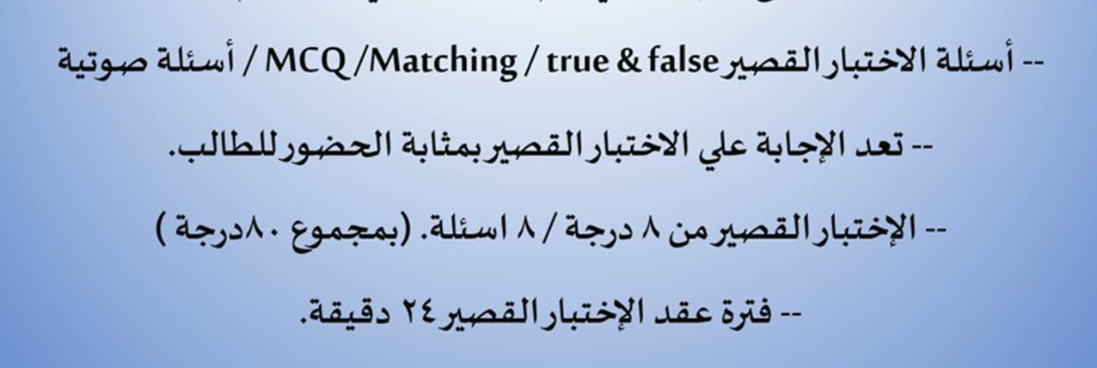
Quizzes & Exams

Slide 5

Final Exam

Slide 6
Course objectives
The objective of quality activities in project management is to:
Ensure that what is delivered meets the objectives of the customer and other relevant stakeholders in the most straightforward path.
Minimizing waste of resources .
Maximizing the probability of attaining the desired outcome.
Quality management processes and practices help produce deliverables and outcomes that meet project objectives and align to the expectations, uses, and acceptance..

Slide 7
Introduction
Project Management Technologies focus on recognizing the impact of technologies on project management and empowering project managers to achieve business objectives

Slide 8
Course Description
Credit Hours: 3 credit hours
The materials and reference for this course will be:
The textbook.
Lecture notes and slides.
Required Textbook: Project Management Tools And Techniques by Sater Carstens; Gary L. Richardson; Ronald B. Smith

Slide 9
Learning Outcomes
This course will provide you with a complete overview and a basic understanding of the Project Management Cycle.
Understand different common tools for project management.
Appraise the features, advantages, and disadvantages of typical information systems, from simple spreadsheets to enterprise systems, and demonstrate which project contexts may be best suited for certain types of PMIS and why.

Slide 10
Learning Outcomes
Given a complex project context and its plan, use one or more information systems to recommend a suite of tools, and demonstrate how the information systems will be used to monitor and control project deliverables.
Demonstrate how collaboration and communication tools that are provided in a PMIS can be used in various types of projects and defend the best practices in the use of these tools.
Use a step-by-step process to manage projects faster while using fewer resources.
Avoid common pitfalls and mistakes in managing projects.
Explore different online tools that can be incorporated in the project management tasks.

Slide 11

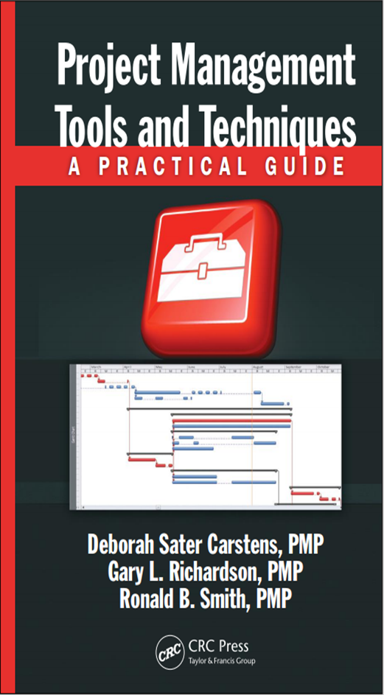
Reference

Slide 12
Course Topics
Section I—Role of the project
Section II—Project formulation using tools and techniques
Section III—Developing project scope
Section IV—Tools and techniques for developing the project plan
Section V—Project execution
Section VI—Advanced tools and techniques..

Slide 13
Section I: Role of the project
This section is designed to give an introduction to the project management by covering the following learning objectives:
Identify the importance of good tools and techniques for managing and running projects. For example, using add-ins to MS Project 2010 and complementary software such as Word, Excel, and PowerPoint are included.

Slide 14

Section I : Role of the project
Recognize that projects should have a standardized life-cycle development approach, which is called a methodology.
This includes requirements definition, workshops, brainstorming, developing the project business case, and discussing how to evaluate and prioritize project proposals.

Slide 15
Section I : Role of the project
Even though a methodology is described as a standard approach for an organization, it should always be viewed as a living organism that needs to be matched with each project and updated for improvements based on lessons learned and general experience.

Slide 16
Section I : Role of the project
Understand the root cause behind power and politics in an organization.
For many organizations, power and politics occur due to internal conflicts over scarce labor resources, monetary resources, facility (space) resources, and equipment resources.

Slide 17
Section I : Role of the project
Understand the different forms of organizational structures.
Every organizational culture is different, but regardless of the culture, every project, in order to be successful, needs support from its host organization.
So that the organizational structure is supportive and not restrictive to the accomplishment of the project goals

Slide 18

Section I : Role of the project
Six different types of organizational structures :
Centralized structures
Functional structures
Projectized structure
Matrix
Virtual structure
Composite systems
Each of these structures has distinct characteristics.
There are benefits and challenges for each of these structures that must be understood to use them effectively or manage their shortcomings if the choice is dictated.

Slide 19
Section II :Project formulation using tools and techniques
This section focuses on the beginnings of a project—
How to pick the right projects
The importance of business objectives
Common selection criteria, and gaining support for the project
Discuss what a project charter is and the importance of having one.

Slide 20
Section II :Project formulation using tools and techniques
Most organizations have too many requests for new projects but have limited:
Money
Human Resources
Equipment to implement them all
So a consistent selection process is needed that will benefit the overall organization.

Slide 21
Section II :Project formulation using tools and techniques
Upon completion of this section, the following tools and techniques should be understood regarding why they are required as part of the project selection process:
Understand common business factors and priorities when approving a new project while working with limited IT resources.
Identify mechanics for selecting the right projects using financial decision models, including feasibility study, payback period, NPV, and depreciation and income tax.

Slide 22
Section II :Project formulation using tools and techniques
Identify mechanics for selecting the right projects using nonfinancial models, including project questionnaire assessment, comparing different projects based on different criteria, and weighted criteria.
Understand the mechanics of the management of applications and project charters

Slide 23
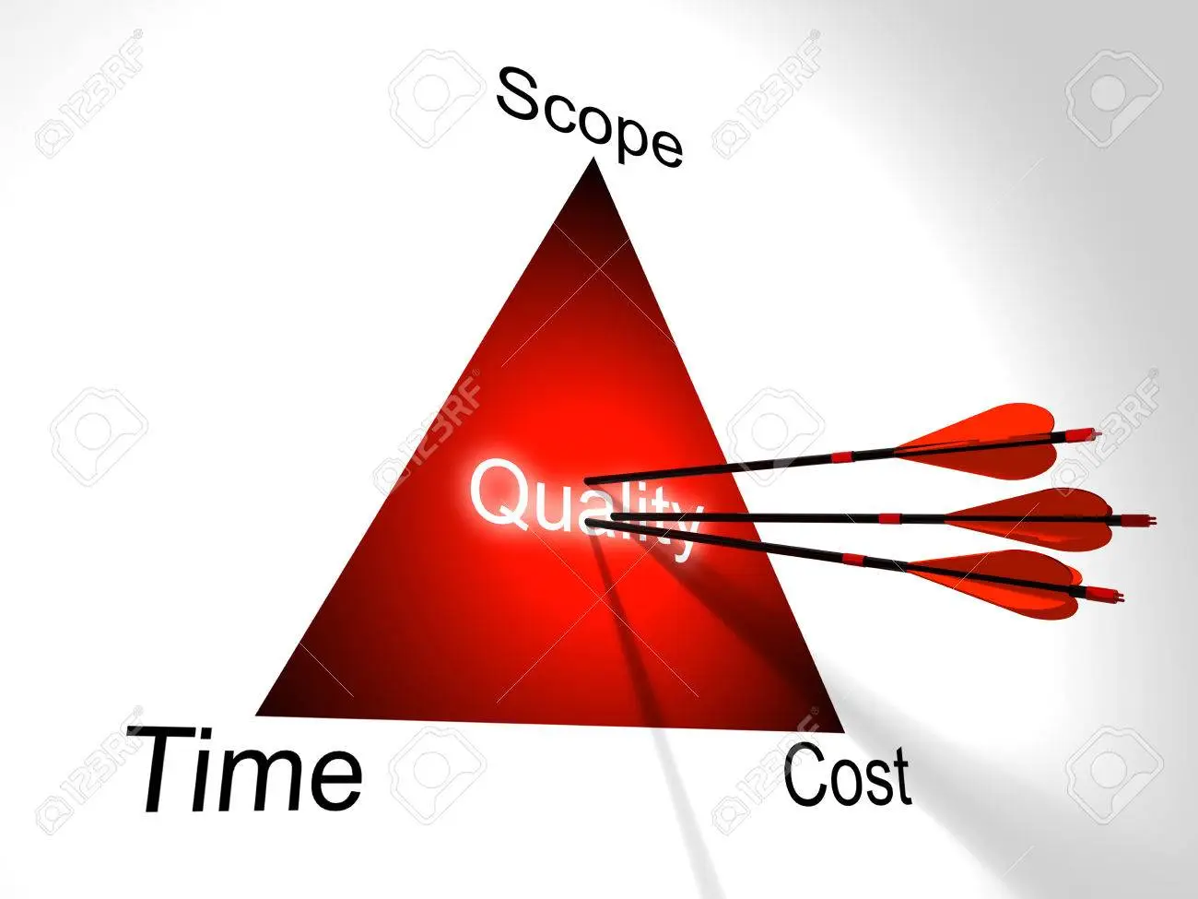
Section III : Developing project scope
This section focuses on translating the original project goal into a work unit-oriented structure with initial time and cost estimates.
Scope definition is considered as the key initiation step for a project and one that is necessary for future success.

Slide 24
Section III : Developing project scope
Develop the scope management plan as part of the scope planning process.
Develop the scope statement as part of the scope definition process.
Identify, analyze, refine, and document project requirements, assumptions, and constraints to produce a technical project and product scope definition.

Slide 25
Section III : Developing project scope
Development of a deliverables-oriented WBS created from the initial project charter, scope statement, and other project specification documents.
From this definition, step technical work units are defined and will be used to facilitate detailed project planning, which is then used in the executing, monitoring and controlling, and closing processes.

Slide 26
Section III : Developing project scope
Estimating tools and techniques are described to show how development of project work unit specifications leads to a total project budget.
Introduce the relationship of scope, time, cost, and resources into the overall management equation.

Slide 27
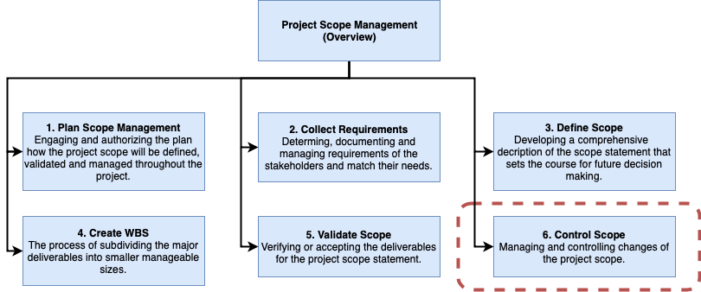

Slide 28
Section IV :Tools and techniques for
developing the project plan
This section highlights the key components for developing a “raw” project plan.
In this regard, these mechanics represent a core project management process that should be followed for initiating the project plan.

Slide 29
Section IV :Tools and techniques for
developing the project plan
Previous foundation work for developing the project scope through the WBS process and initial work unit estimates has been described in Section III and we are now ready to move on to the next two legs of the project planning journey, that is, schedule and budget.
The first cut project schedule evolves directly from the scope definition and work estimating

Slide 30
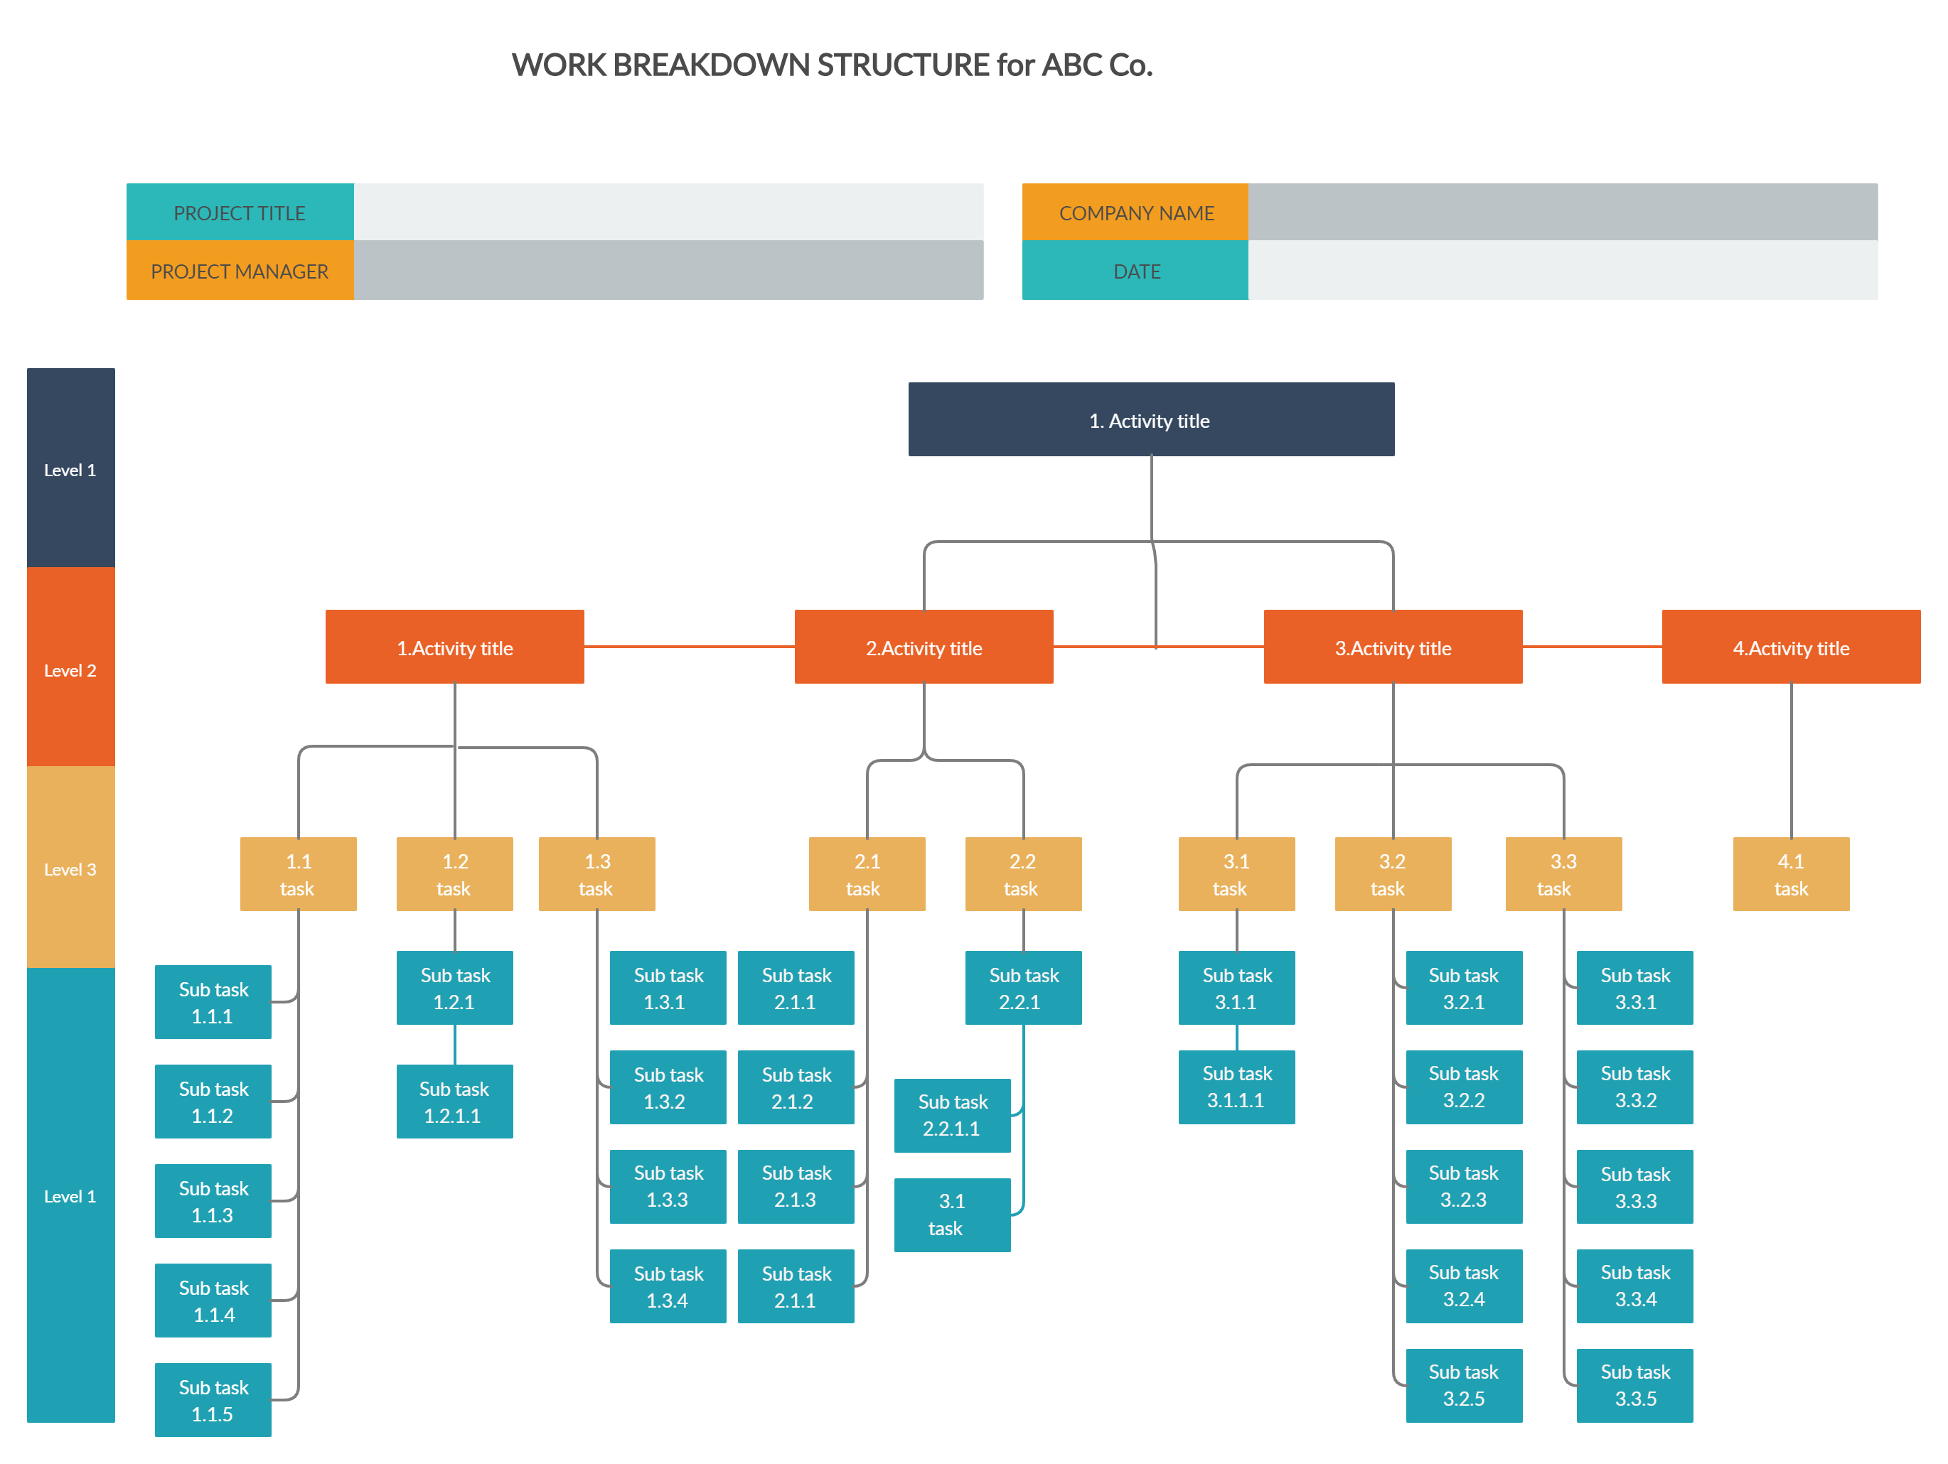

Slide 31
Section IV—Tools and techniques for
developing the project plan
Project schedules are basically derived from linked WBS activities.
The main new mechanical ingredient to add at this point is resource allocations to these work activities in order to derive estimated durations and the sequencing of those activities.(Critical path calculation)

Slide 32
Section IVTools and techniques for
developing the project plan
In this section, the project plan is represented as a direction aggregation of scope definition, work estimation, and resource allocation to the effort.
The result is called the first cut plan, which implies more processes will need to be added to this view.

Slide 33
Section IV—Tools and techniques for
developing the project plan
In this section, the following mechanics and concepts should be understood regarding why they are required as part of the core schedule and cost planning process:
Identify mechanics for translating the WBS into a first cut schedule.
Identify mechanics for translating the first cut schedule into a first cut budget through resource allocation.
Understand management concepts for tweaking a plan’s scope, time, and cost to better satisfy the key stakeholders.
Understand the general processes required to obtain management approval for the derived project plan.

Slide 34
Section V : Project execution
This section provides an overview of tools and techniques to help the PM successfully execute a project.
- The section addresses a portion of the project life cycle.
- The tools and techniques discussed better equip a PM with the managing the project performance, cost, schedule, outcome, scope, and resources

Slide 35
Section V : Project execution
The learning objectives for this section are listed as follows:
Understand the difference between metrics and measures to track project performance.
Describe the earned value (EV) suite of status evaluation techniques to provide the PM with sophisticated tools to examine project performance.
Identify different types of project status reports to be utilized by the PM to successfully track the project progress.

Slide 36
Section VI: Advanced tools and techniques
The methods described in this section focused on a different aspect of project decision-making from early in the project selection process through the execution phase.

Slide 37
Section VI: Advanced tools and techniques
The learning objectives for this section are
Understand the PERT model as it relates to variable time scheduling.
Describe how simulation modeling can be used to model future project performance..

Slide 38
Section VI: Advanced tools and techniques
Outline the basic mechanics of the risk model to illustrate how simulation tools can help with the evaluation of the project performance.

Slide 39

Section VI: Advanced tools and techniques
Understand project, program, and portfolio management as it applies to an enterprise EPMO (Enterprise project management office)

Slide 40
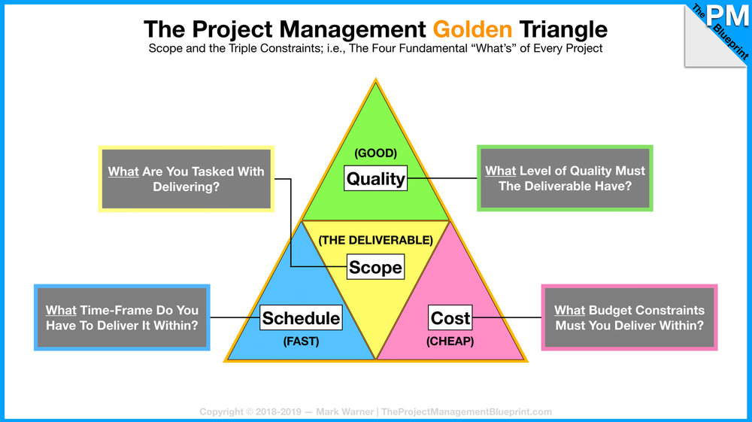
Summary
www.midocean.ae

Slide 41
Summary
PMG 312- L10
AI in Project Management
Key Updates in the 8th Edition of the (PMBOK®)
Enterprise project management Office - EPMO

Slide 42



Thank You

