Slide 1



Business Data Analysis
MGM509
Lecture 6
What Makes a Good Model? Decision-Analytic Thinking in Practice
Prepared by
Eng. Ahmed Hussein, MBA, PfMP©, PMP©, CMP APMG

Slide 2

Lecture
What we will cover
6
What makes a model “good” in real-world deployment
Performance measures beyond simple accuracy
Cost-sensitive evaluation and decision thresholds
Practical examples of decision-focused modeling
Summary tools to assess model usefulness
6 – 2

Slide 3
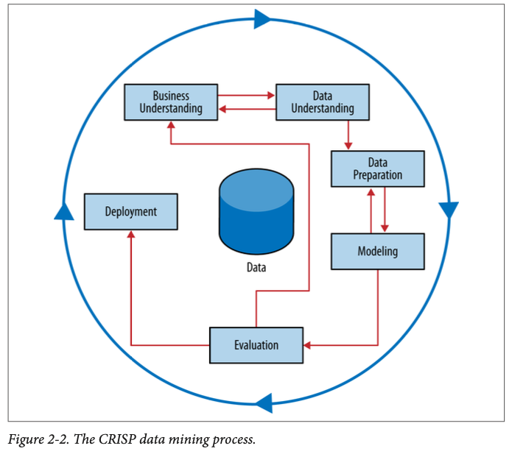
Data Mining Process Overview (CRISP-DM)
Lecture
6
Cross Industry Standard Process for Data Mining
Not strictly sequential; often involves loops and iteration
Evaluating Model Performance is done during Evaluation Phase
6 – 3

Slide 4


Decision Analytic Thinking, Performance Measures, and Cost Sensitive Evaluation
Lecture
06
6 – 4

Slide 5
Lecture
What Is Decision-Analytic Thinking?
6
It’s about viewing modeling through a business decision lens, not just a statistical one.
A technically accurate model may still be useless if it doesn’t help the business act effectively.
Core question: “Does this model help me make better decisions?”
It’s not about perfect predictions — it’s about better outcomes.
6 – 5

Slide 6
Lecture
Modeling for Business Utility
6
Business objectives may include:
  Reducing false alarms (cost-saving)
  Catching rare but critical events (fraud, churn)
  Maximizing revenue or minimizing loss
Decision Analytic Thinking asks:
  What happens if we act on this prediction?
  What are the costs and benefits of correct vs. incorrect decisions?
6 – 6

Slide 7
Predictive Modeling in Business Context
Lecture
6
Model Focus | Traditional Data Science | Decision Analytics
Objective | Maximize accuracy | Maximize business value
Evaluation metric | RMSE, Accuracy, AUC | Expected cost/benefit
Output | Prediction | Action or decision guidance
For example, a model with slightly lower accuracy but higher net profit (after marketing cost) is a better model.
6 – 7

Slide 8
Lecture
Model Performance in Context
6
Performance must be contextualized by the value of correct and incorrect outcomes. Always ask: “What decisions will this model influence?”
  Predicting fraud → avoids loss
  Predicting churn → improves retention strategy
  Predicting sales → informs inventory and staffing
Model Prediction
Business Action
Financial Outcome
Decision Flow
6 – 8

Slide 9

Lecture
Why Accuracy Isn’t Always Enough?
6
Real business value comes from correctly identifying the actionable minority (e.g., true churners).
Accuracy =
Skewed or imbalanced data is when one output is more dominant than the other. For ex. Churn Rate is 10% and Non-Churn is 90%
Hypothetically, if your model does nothing and just assumed all customer will Not Churn → you will have 90% accuracy.
$$\begin{aligned}\frac{Number of Correct decisions made}{Total number of decisions made}\end{aligned}$$
6 – 9

Slide 10
Beyond Accuracy – The Confusion Matrix
Lecture
6
The confusion matrix provides a foundation for all other evaluation metrics:
Positive = will Churn, Negative = will Not Churn
Why it matters:
  Accuracy alone can hide important trade-offs (especially with imbalanced classes when the interesting class has less frequency)
  We must measure how the model succeeds and fails
 | Predicted: Positive | Predicted: Negative
Actual: Positive | True Positive (TP) | False Negative (FN)
Actual: Negative | False Positive (FP) | True Negative (TN)
6 – 10

Slide 11
Lecture
Thinking in Terms of Cost and Benefit
6
Prediction Outcome | Cost or Benefit Example
True Positive (TP) | Retained customer = revenue gain
False Positive (FP) | Wasted retention cost on loyal user
False Negative (FN) | Lost opportunity to retain
True Negative (TN) | No action taken, no cost
Positive = will Churn, Negative = will Not Churn
Good models help maximize return from each decision based on predictions.
The true value of a model lies in the business impact of its predictions.
6 – 11

Slide 12
Lecture
Expected Value of a Model
6
Expected Value (EV): The weighted average of all possible outcomes based on:
  Probability
  Associated payoff or cost
EV formula for a model:
Even a model with lower accuracy may have higher expected value if it supports more profitable actions.
6 – 12

Slide 13
Business Question ≠ Data Science Question
Lecture
6
Business question: What decision should we make to improve outcomes?
Data question: What patterns exist in the data?
Gap example: Predicting churn (data science) ≠ Knowing who to retain profitably (business)
Solution: Incorporate:
  Business constraints (budget, capacity)
  Action costs and outcomes
  Risk tolerance
6 – 13

Slide 14
Aligning Models with Business Objectives
Lecture
6
Models should support business strategies, not replace them.
Begin with the business question, not the data science technique.
Examples:
- Business Question: “Who is likely to churn?” → Predictive Model: Churn probability
- Business Question: “Who should we target with retention offers?” → Decision Model: Optimize ROI based on churn risk + offer cost
6 – 14

Slide 15
Lecture
Model Fidelity vs. Model Value
6
Model fidelity: How accurately it fits the training data
Model value: How much it helps drive better outcomes
Sometimes a simpler, less accurate model is more useful:
  Easier to explain
  Faster to deploy
  More robust over time
The best model is the one that makes the best decisions — not just predictions.”
6 – 15

Slide 16
Lecture
Precision, Recall, and F1 Score
6
Metric | Formula | Meaning
Precision | TP / (TP + FP) | % of predicted positives that were correct
Recall | TP / (TP + FN) | % of actual positives identified
F1 Score | 2 × (Precision × Recall) / (Precision + Recall) | Balance between precision and recall
TP = True Positive, FP = False Positive, TN = True Negative, FN = False Negative
Use Cases:
  High precision: useful when cost of false positives is high
  High recall: crucial when false negatives are very costly
6 – 16

Slide 17
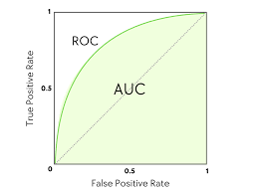
Lecture
ROC Curve and AUC
6
ROC Curve (Receiver Operating Characteristic Curve)
- Plots: True Positive Rate vs. False Positive Rate at different thresholds
AUC (Area Under Curve):
- Ranges from 0.5 (random guessing) to 1.0 (perfect classifier)
- Measures model’s ability to distinguish classes across thresholds
- AUC is useful when the ranking of predictions is more important than exact probabilities.
6 – 17

Slide 18
Lecture
Cost-Sensitive Evaluation
6
Not all errors cost the same!
Solutions:
  Use cost matrices to simulate real-world decisions
  Adjust thresholds to reflect acceptable trade-offs
Type of Error | Business Example | Potential Cost
False Positive | Targeted non-churner with incentive | Marketing budget waste
False Negative | Missed churner | Lost revenue
6 – 18

Slide 19
False Positives vs. False Negatives – A Deliberate Trade-Off
Lecture
6
Example:
  Fraud detection: prioritize low false negatives
  Email marketing: prioritize high precision
Tuning the threshold controls your risk appetite
Strategy | Effect
Lowering threshold | Increases recall, more false positives
Raising threshold | Increases precision, more false negatives
6 – 19

Slide 20
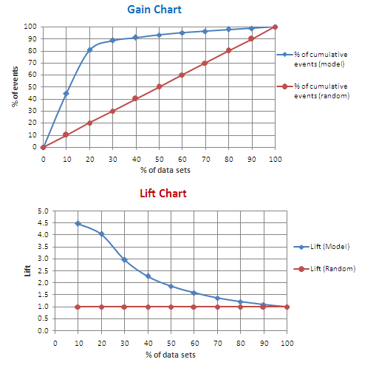
Lecture
Lift and Gains Charts
6
Used to assess how well the model helps prioritize actions:
  Lift chart: Compares model’s ability vs. random targeting
  Gains chart: Shows cumulative % of positive cases captured as you move through ranked list
Use Case:
  Target top 10% of customers based on model scores → Gain = % of actual churners found
6 – 20

Slide 21
Choosing the Right Metric for the Right Job
Lecture
6
Key Message:
  Don’t chase generic benchmarks
  Select metrics based on business priorities, costs, and decisions
The best evaluation metric is the one that reflects the value of your actions.
Business Problem | Suggested Focus
Churn Prediction | Recall, Lift
Credit Risk | AUC, Precision
Email Campaign | Precision, Gains
Fraud Detection | Recall, Cost-sensitive
6 – 21

Slide 22
Comparing Models – It Depends on Your Goal
Lecture
6
You can’t always say “Model A is better than Model B” without context.
Key Question: Which model supports better decisions for this business use case?
Model A | Model B
Higher accuracy | Higher recall
Better for common cases | Better at catching rare events
Slower but interpretable | Faster but complex
6 – 22

Slide 23
When High Accuracy ≠ Better Decisions
Lecture
6
Predicting churn example:
  Model with 95% accuracy (but poor recall on actual churners)
Better choice: A model with 80% accuracy but catches twice as many actual churners
Insight:
  High accuracy can hide poor performance on the important class
  Always assess impact on business outcomes, not just prediction metrics
6 – 23

Slide 24
Lecture
Adjusting Decision Thresholds
6
Most models output probabilities, not direct decisions.
You control where to draw the line:
  Default = 0.5 (probability of class membership)
  Adjust to favor recall or precision depending on costs
Tuning thresholds helps optimize for decision goals, not generic metrics
Threshold ↑ | Precision ↑ | Recall ↓
Threshold ↓ | Precision ↓ | Recall ↑
6 – 24

Slide 25
Business Rules vs. Data-Driven Models
Lecture
6
Best Practice: Combine both → Use models to support, refine, or challenge business rules
“A good model doesn’t replace human logic — it complements it.”
Business Rules | Machine Learning Models
Easy to understand | May be complex
Based on domain logic | Based on patterns in data
Static and rigid | Adaptive and flexible
6 – 25

Slide 26
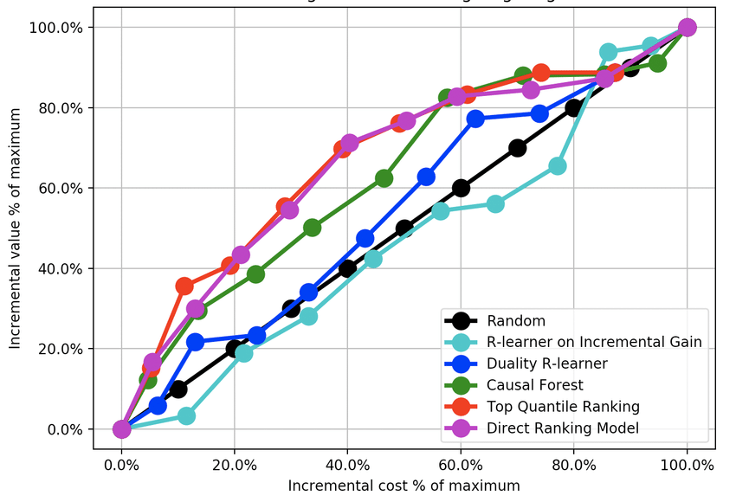
Lecture
Cost Curves – Visualizing Trade-Offs
6
Cost Curves plot model performance across different cost and class distributions
Helps answer: “Which model is better if the cost of false positives changes?”
Allow decision-makers to compare models under uncertainty
Cost curves extend ROC analysis to include business-driven comparisons.
6 – 26

Slide 27
Lecture
Segment-Based Model Evaluation
6
A model might work well overall, but poorly for key subgroups.
Implication: Test performance within segments like:
  Customer types
  Regions
  Product lines
Helps ensure model is fair, effective, and interpretable across your business landscape
Segment | Precision | Recall
Young customers | 0.80 | 0.60
Long-tenure users | 0.45 | 0.30
6 – 27

Slide 28
Lecture
Managing Multiple Objectives
6
A good model balances multiple competing business goals — not just one metric.
Real-world decisions involve trade-offs:
Solution: Use multi-objective optimization:
  Adjust thresholds
  Build separate models for different outcomes
  Use expected cost-benefit to guide decisions
Goal | Conflict
Maximize conversions | May increase false positives
Avoid false alarms | May miss true positives
Increase revenue | May increase risk
6 – 28

Slide 29
Lecture
06
Sample Cases
6 – 29

Slide 30
Churn Prediction with Cost Constraints
Lecture
6
Scenario:
  Predict which customers will churn
  Offer a discount to retain them
Decision Considerations:
  Offering everyone a discount is too costly
  Offering too few means losing customers
A “Good” Model:
  Targets high-risk customers
  Balances retention cost vs. lifetime value
  Maximizes net revenue impact
Success is defined by ROI of action, not prediction precision alone
6 – 30

Slide 31
Fraud Detection – Managing False Negatives
Lecture
6
Challenge:
  Fraud is rare but very costly
  Missing one fraud (false negative) = big loss
  Investigating honest users (false positives) = cost too
A “Good” Model:
  Prioritizes recall (catch more fraud)
  Minimizes false negatives, even at cost of more alerts
  Can integrate with human review queue for verification
Value lies in early, accurate alerts, not model elegance
6 – 31

Slide 32
Credit Scoring in Regulated Environments
Lecture
6
Context:
  Banks use models to approve/decline loans
  Must comply with regulations on fairness and interpretability
Simpler models may be preferred if they are auditable and meet business/legal needs
A “Good” Model:
  Is explainable (e.g., logistic regression, decision trees)
  Avoids bias or adverse impact
  Meets thresholds for acceptable risk (e.g., default probability < 10%)
6 – 32

Slide 33
Dynamic Pricing – Balancing Revenue and Risk
Lecture
6
Use Case:
  Predict demand to set prices dynamically
  Must avoid pricing too high (loss of sales) or too low (lost margin)
Success = Increase in average order value without hurting conversion
A “Good” Model:
  Learns from past customer sensitivity
  Adjusts based on time, competition, and inventory
  Allows for controlled testing (A/B) to validate gains
6 – 33

Slide 34
Cross-Selling – Using Lift over Precision
Lecture
6
Goal: Suggest add-ons to increase average basket size
Predictive precision may be low, especially in e-commerce
But if uplift (Lift) over random is high, model is valuable
A “Good” Model:
  Ranks users/items based on likely response
  Targets top percentile for offers
  Focuses on conversion lift, not raw accuracy
“Lift” answers: How much this model is better than random at picking good targets?
6 – 34

Slide 35
Lecture
06
Summary Tools
6 – 35

Slide 36
Operationalizing Model-Based Decisions
Lecture
6
Even the best model fails if it’s not actionable
A “Good” Model:
  Integrates into workflow or system (CRM, payment gateway, marketing tools)
  Is monitored regularly for performance decay
  Triggers clear decisions: who to target, approve, flag, or ignore
Model value is realized only when it improves decisions at scale.
6 – 36

Slide 37
Lecture
Interpretability and Trust
6
A “good” model is as understandable as it is effective
A technically strong model may fail if stakeholders can’t understand or trust it.
Why Interpretability Matters:
  Executives must justify decisions (e.g., lending, pricing)
  Regulators may require explainability
  Front-line teams need confidence in system outputs
Model Type | Interpretability
Decision Tree | High
Logistic Regression | Medium
Neural Network | Low
6 – 37

Slide 38
Lecture
Fairness and Ethical Considerations
6
Models can unintentionally discriminate if they reflect biased training data.
Key Risks:
  Disparate impact across age, gender, race
  Proxy bias (e.g., ZIP code as income proxy)
  Denying opportunity based on irrelevant factors
A “Good” Model:
  Is tested for fairness metrics (e.g., equal opportunity)
  Avoids protected attributes where not legally or ethically appropriate
  Encourages ethical reflection during design
6 – 38

Slide 39
Lecture
Adaptability to Change
6
Data patterns shift over time:
  New behaviors (e.g., post-pandemic)
  Market changes (e.g., inflation, tech disruption)
Robustness over time = sustained business value
A “Good” Model:
  Performs well today and can be retrained tomorrow
  Is monitored regularly for concept drift
  Can be updated incrementally without full retraining
6 – 39

Slide 40
Lecture
Scalability and Ease of Deployment
6
A “Good” Model:
  Runs efficiently in production systems (CRM, web app, batch jobs)
  Is maintainable by non-experts
  Plays well with company infrastructure (e.g., APIs, cloud)
Model pipelines that include:
  Preprocessing
  Prediction
  Action automation
A model’s true success is in execution, not experimentation
6 – 40

Slide 41
Lecture
Human-in-the-Loop Modeling
6
Many decisions benefit from combining human and machine judgment.
The best models augment decision makers, not replace them.
Benefits:
  Improves accuracy and accountability
  Builds user confidence in predictions
  Helps surface edge cases the model can’t capture
Use Case | Model Role | Human Role
Loan Approval | Score applicant | Override if warranted
Fraud Detection | Flag transactions | Confirm with investigation
Hiring | Rank candidates | Evaluate final fit
6 – 41

Slide 42
Lecture
The Value of Simplicity
6
Simple models often win in practice
The most complex model isn’t always the most useful — sometimes, clarity is power.
Benefit | Why It Matters
Easier to implement | Faster deployment
Easier to understand | Better stakeholder buy-in
Easier to maintain | Less technical debt
Often good enough | High accuracy isn’t always required
6 – 42

Slide 43
Reflection – Good Models Enable Good Decisions
Lecture
6
The purpose of modeling is not to build the best model. It’s to make the best decisions.
Ask yourself:
  Would a business team know what to do with the model’s output?
  What decision changes if the prediction changes?
  Is the model actionable, not just accurate?
Takeaway: Good models drive value through better, faster, or more scalable decisions.
6 – 43

Slide 44
Lecture
Model Evaluation Checklist
6
Use this checklist to assess whether your model is truly good:
🔲 Does it align with a specific business objective?
🔲 Are costs and benefits of predictions considered?
🔲 Have you evaluated precision, recall, AUC, lift, or other task-appropriate metrics?
🔲 Is the model understandable and explainable?
🔲 Can it be deployed and maintained in your real-world system?
🔲 Is it fair and unbiased toward sensitive populations?
6 – 44

Slide 45
Lecture
Key Points
6
A good model is one that supports better decisions — not just one with high accuracy.
Accuracy can be misleading; business context, costs, and outcomes matter more.
Evaluation metrics must align with business goals.
Use precision, recall, lift, or cost-benefit analysis depending on what the organization values (e.g., minimizing fraud, maximizing retention ROI).
Thresholds and trade-offs matter.
Adjusting decision thresholds helps optimize for different goals like minimizing false positives or capturing more true positives.
Interpretability, fairness, and deployability are as important as performance.
A simpler, understandable model may be more useful — especially in regulated, ethical, or high-stakes domains.
The best model improves decisions, not just predictions.
Models should be judged by how well they integrate into workflows and help real users make better choices.
6 – 45

Slide 46

For Discussion Panel and Next Lecture:
Chapter 7 “Decision Analytic thinking I: What is a Good Model?”
Lecture
6
For Discussion Panel and Next Lecture
6 – 46

Slide 47



Thank You

