Slide 1


E-Commerce
Prepared by Dr. Magdy Alhaj
MGM 212
Lecture 5

Slide 2


E-business strategy.
Lecture 5
MGM 212
Prepared by
Dr. Magdy Alhaj
www.midocean.ae

Slide 3
Lecture
COURSE OUTLINE
05
Lecture 1: Introduction to e-business and e-commerce.
Lecture 2: E-commerce fundamentals.
Lecture 3: E-business infrastructure.
Lecture 4: - E-environment.
Lecture 5: E-business strategy.
Lecture 6: E-procurement.
Lecture 7: E-marketing.
Lecture 8: Customer relationship management.
Lecture 9: Analysis and design.
Lecture 10: Implementation and maintenance.
www.midocean.ae

Slide 4
Lecture
05
LECTURE OUTLINE
1.Introduction.
2. What is e-business strategy?
3. Strategic analysis.
4. Strategic objectives.
5. Strategy definition.
6. Strategy implementation.
7. Information systems strategy and e-business strategy.
www.midocean.ae

Slide 5
Lecture
05
LEARNING OBJECTIVES
After completing this chapter the student should be able to:
1. Follow an appropriate strategy process model for e-business.
2. Apply tools to generate and select e-business strategies.
3. Outline alternative strategic approaches to achieve e-business.
www.midocean.ae

Slide 6

Lecture
TITLE OF LECTURE
E-business strategy
05
1.Introduction:
Developing an e-business strategy requires a fusion of existing approaches to business, marketing, supply chain management and information systems strategy development. In addition to traditional strategy approaches, commentators have exhorted companies to apply innovative techniques to achieve competitive advantage. Around the start of the new millennium, many articles, fueled by the dot-com hype of the time, urged CEOs to ‘innovate or die’.
www.midocean.ae

Slide 7
Lecture
TITLE OF LECTURE
E-business strategy
05
We start the chapter by introducing e-business strategy and then discuss appropriate strategy process model to follow as a framework for developing e-business strategy. The chapter is structured around this four-stage strategy process model:
1 Strategic evaluation.
2 Strategic objectives.
3 Strategy definition.
4 Strategy implementation.
www.midocean.ae

Slide 8
Lecture
TITLE OF LECTURE
E-business strategy
05
2. What is e-business strategy?
Strategy defines the future direction and actions of an organization or part of an organization. Johnson and Scholes define corporate strategy as:
the direction and scope of an organization over the long-term: which achieves advantage for the organization through its configuration of resources within a changing environment to meet the needs of markets and to fulfil stakeholder expectations.
www.midocean.ae

Slide 9
Lecture
TITLE OF LECTURE
E-business strategy
05
Johnson and Scholes, note that organizations have different levels of strategy, particularly for larger or global organizations. These are summarized within Figure 5.1. They identify corporate strategy which is concerned with the overall purpose and scope of the organization, business unit strategy which defines how to compete successfully in a particular market and operational strategies which are concerned with achieving corporate and business unit strategies.
www.midocean.ae

Slide 10
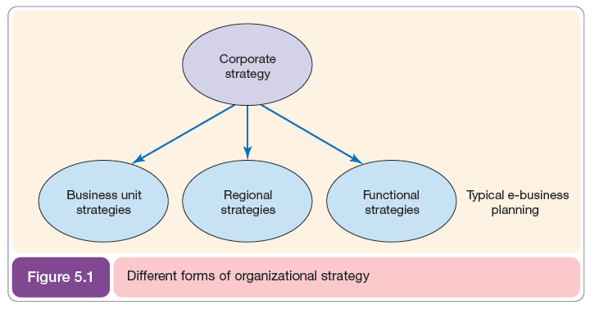
Lecture
TITLE OF LECTURE
E-business strategy
05
www.midocean.ae

Slide 11
Lecture
TITLE OF LECTURE
E-business strategy
05
- The imperative for e-business strategy
the implications if e-business strategy is not clearly defined. The following:
1. Missed opportunities from lack of evaluation of opportunities or insufficient resourcing of e-business initiatives. These will result in more savvy competitors gaining a competitive advantage.
2. Inappropriate direction of e-business strategy (poorly defined objectives, for example, with the wrong emphasis on buy-side, sell side or internal process support).
www.midocean.ae

Slide 12
Lecture
TITLE OF LECTURE
E-business strategy
05
3. Limited integration of e-business at a technical level resulting in silos (separate organizational team with distinct responsibilities which does not work in an integrated manner with other teams) of information in different systems;
4. Resource wastage through duplication of e-business development in different functions and limited sharing of best practice.
www.midocean.ae

Slide 13
Lecture
TITLE OF LECTURE
E-business strategy
05
- Strategy process models for e-business
Before developing any type of strategy, a management team needs to agree the process they will follow for generating and then implementing the strategy. A strategy process model provides a framework that gives a logical sequence to follow to ensure inclusion of all key activities of e-business strategy development. It also ensures that e-business strategy can be evolved as part of a process of continuous improvement.
www.midocean.ae

Slide 14
Lecture
TITLE OF LECTURE
E-business strategy
05
Note the use of two-way arrows in Figure 5.4 to indicate that each stage is not discrete, but rather it involves referring backwards or forwards to other strategy elements. Each strategy element will have several iterations.
www.midocean.ae

Slide 15
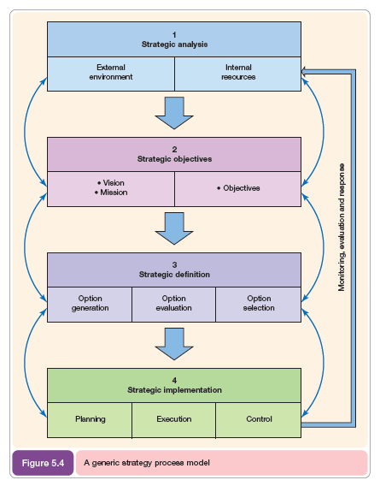
Lecture
TITLE OF LECTURE
E-business strategy
05
www.midocean.ae

Slide 16
Lecture
TITLE OF LECTURE
E-business strategy
05
3. Strategic analysis:
Strategic analysis or situation analysis involves review of:
- the internal resources and processes of the company. to assess its e-business capabilities and results to date in the context of a review of its activity in the marketplace.
-the immediate competitive environment (micro-environment). including customer demand and behavior, competitor activity, marketplace structure and relationships with suppliers, partners and intermediaries.
www.midocean.ae

Slide 17
Lecture
TITLE OF LECTURE
E-business strategy
05
- the wider environment (macro-environment) in which a company Operates. this includes economic development and regulation by governments in the form of law and taxes together with social and ethical constraints such as the demand for privacy.
www.midocean.ae

Slide 18
Lecture
TITLE OF LECTURE
E-business strategy
05
- Resource and process analysis
Resource analysis for e-business is primarily concerned with its e-business capabilities, i.e. the degree to which a company has in place the appropriate technological and applications infrastructure and financial and human resources to support it. These resources must be harnessed together to give efficient business processes.
www.midocean.ae

Slide 19
Lecture
TITLE OF LECTURE
E-business strategy
05
Jelassi and Enders distinguish between analysis of resources and capabilities:
1. Resources are the tangible and intangible assets which can be used in value creation. Tangible resources include the IT infrastructure, bricks and mortar and financial capital. Intangible resources include a company’s brand and credibility, employee knowledge, licenses and patents.
2. Capabilities represent the ability of a firm to use resources effectively to support value creation. They are dependent on the structure and processes used to manage e-business.
www.midocean.ae

Slide 20
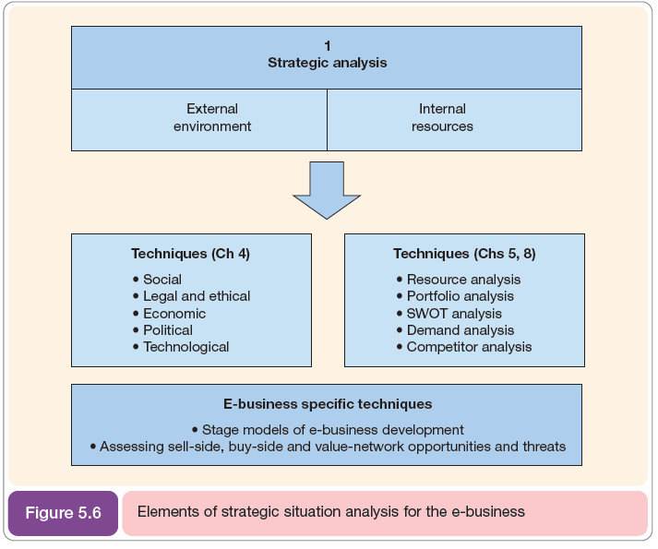
Lecture
TITLE OF LECTURE
E-business strategy
05
www.midocean.ae

Slide 21
Lecture
TITLE OF LECTURE
E-business strategy
05
- Organizational and information systems SWOT analysis
SWOT analysis is a relatively simple yet powerful tool that can help organizations analyze their internal resources in terms of strengths and weaknesses and match them against the external environment in terms of opportunities and threats. In an e-business context, a SWOT analysis of e-business-specific issues can combine SWOT related to corporate, marketing, supply chain and information systems, or a separate SWOT can be performed for each.
www.midocean.ae

Slide 22
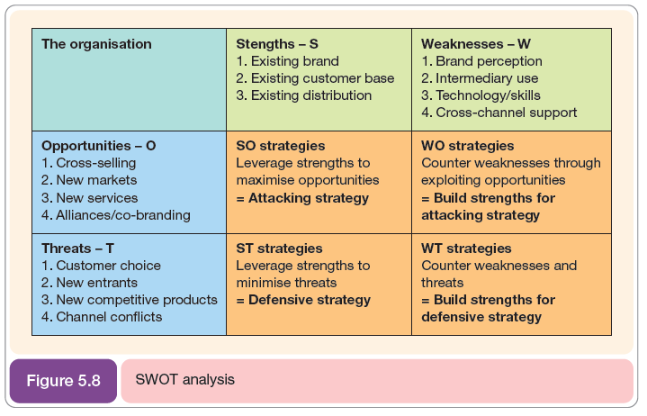
Lecture
TITLE OF LECTURE
E-business strategy
05
www.midocean.ae

Slide 23
Lecture
TITLE OF LECTURE
E-business strategy
05
- Human and financial resources
Resource analysis will also consider these two factors:
1 Human resources. To take advantage of the opportunities identified in strategic analysis the right resources must be available to deliver e-business solutions. The importance of having a human resources approach that enables the recruitment and retention of staff. The need for new structures and cultures to achieve e-business is also covered.
2. Financial resources. Assessing financial resources for information systems is usually conducted as part of investment appraisal and budgeting for enhancements to new systems.
www.midocean.ae

Slide 24
Lecture
TITLE OF LECTURE
E-business strategy
05
- Competitive environment analysis
As well as assessing the suitability of the internal resources of an organization for the move to e-business, external factors are also assessed as part of strategic analysis.
- Assessing competitive threats
Michael Porter’s classic model of the five main competitive forces that affect a company still provides a valid framework for reviewing threats arising in the e-business era. It is instructive to assess how the Internet may change the competitive environment.
www.midocean.ae

Slide 25
Lecture
TITLE OF LECTURE
E-business strategy
05
- Competitor analysis
Competitor analysis is also a key aspect of e-business situation analysis, but since it is also a key activity in producing an e-marketing plan which will feed into the e-business strategy.
www.midocean.ae

Slide 26
Lecture
TITLE OF LECTURE
E-business strategy
05
4. Strategic objectives:
Defining and communicating an organization’s strategic objectives is a key element of any strategy process model since:
(1) the strategy definition and implementation elements of strategy must be directed at how best to achieve the objectives,
www.midocean.ae

Slide 27
Lecture
TITLE OF LECTURE
E-business strategy
05
(2) the overall success of e-business strategy will be assessed by comparing actual results against objectives and taking action to improve strategy.
(3) clear, realistic objectives help communicate the goals and significance of an e-business initiative to employees and partners.
www.midocean.ae

Slide 28
Lecture
TITLE OF LECTURE
E-business strategy
05
5. Strategy definition:
In this section the key strategic decisions faced by a management team developing e-business strategy are reviewed. For each of the areas of strategy definition that we cover, managers will want to generate different options, review them and select them. We start by considering the sell-side-related aspects of e-business and then review the buy-side related aspects.
www.midocean.ae

Slide 29
Lecture
TITLE OF LECTURE
E-business strategy
05
- Selection of e-business strategy options
When reviewing e-business strategy options, there will be a range of possible strategies and e-business service alternatives to be evaluated. Limited resources will dictate that only some applications are practical. For example, typical alternative e-business strategy options for an organization which has a brochure ware site might be to implement.
www.midocean.ae

Slide 30
Lecture
TITLE OF LECTURE
E-business strategy
05
6. Strategy implementation:
Strategy implementation includes all tactics used to achieve strategic objectives.
- Failed e-business strategies
There are many case studies of successes with e-business strategy, but unsurprisingly there are few companies that want to have their mistakes detailed in public.
www.midocean.ae

Slide 31
Lecture
TITLE OF LECTURE
E-business strategy
05
- E-business strategy implementation success factors for SMEs
Of course, government statistics show that a high proportion of new businesses fail within 2 to 3 years of start-up regardless of whether they are online or offline and good planning practice and financial risk management are important in both.
www.midocean.ae

Slide 32
Lecture
TITLE OF LECTURE
E-business strategy
05
7. Information systems strategy and e-business strategy:
An essential part of any e-business strategy is consideration of how information systems strategy supports change. The importance to e-business success of utilizing information systems to manage information is highlighted by Willcocks and Plant who found in a study of 58 major corporations in the USA, Europe and Australasia that the leading companies were astute at distinguishing the contributions of information and technology, and considering them separately.
www.midocean.ae

Slide 33
Lecture
TITLE OF LECTURE
E-business strategy
05
They make the point that competitive advantage comes not from technology, but from how information is collected stored, analyzed and applied.
www.midocean.ae

Slide 34
Lecture
TITLE OF LECTURE
E-business strategy
05
An established aspect of information systems strategy development is the focus of information systems strategy on business impact or alignment. In the business-alignment approach, a top-down approach is used to review how information systems can be used to directly support a defined business strategy. Referring to e-business strategy, Pant and Ravichandran say:
- Alignment models focus on aligning the information system’s plans and priorities with organizational strategy and business goals.
www.midocean.ae

Slide 35
Lecture
TITLE OF LECTURE
E-business strategy
05
- Elements of information systems strategy
Developing an information systems strategy for e-business involves many different perspectives, rather than a single perspective such as hardware technologies or applications to deploy. Ward and Griffiths suggest an IS strategy plan contains three elements:
1. Business information strategy. How information will support the business. This will include applications to manage particular types of business.
2. information systems functionality strategy. Which services are provided?
3. information systems / information technology strategy.
www.midocean.ae

Slide 36
Lecture
TITLE OF LECTURE
E-business strategy
05
- Investment appraisal
In the e-business context, investment appraisal can refer to:
1. Overall levels of spending on information systems to support e-business.
2. Decisions about which business applications to invest in (portfolio analysis).
3. Assessment of the cost/benefit for individual applications.
www.midocean.ae

Slide 37



TITLE OF LECTURE
E-business strategy
References:
E-Business and E-Commerce Management : strategy, implementation and practice, fourth edition.
By: dave chaffey.
Chapter 5
Thank You
www.midocean.ae

