Slide 1

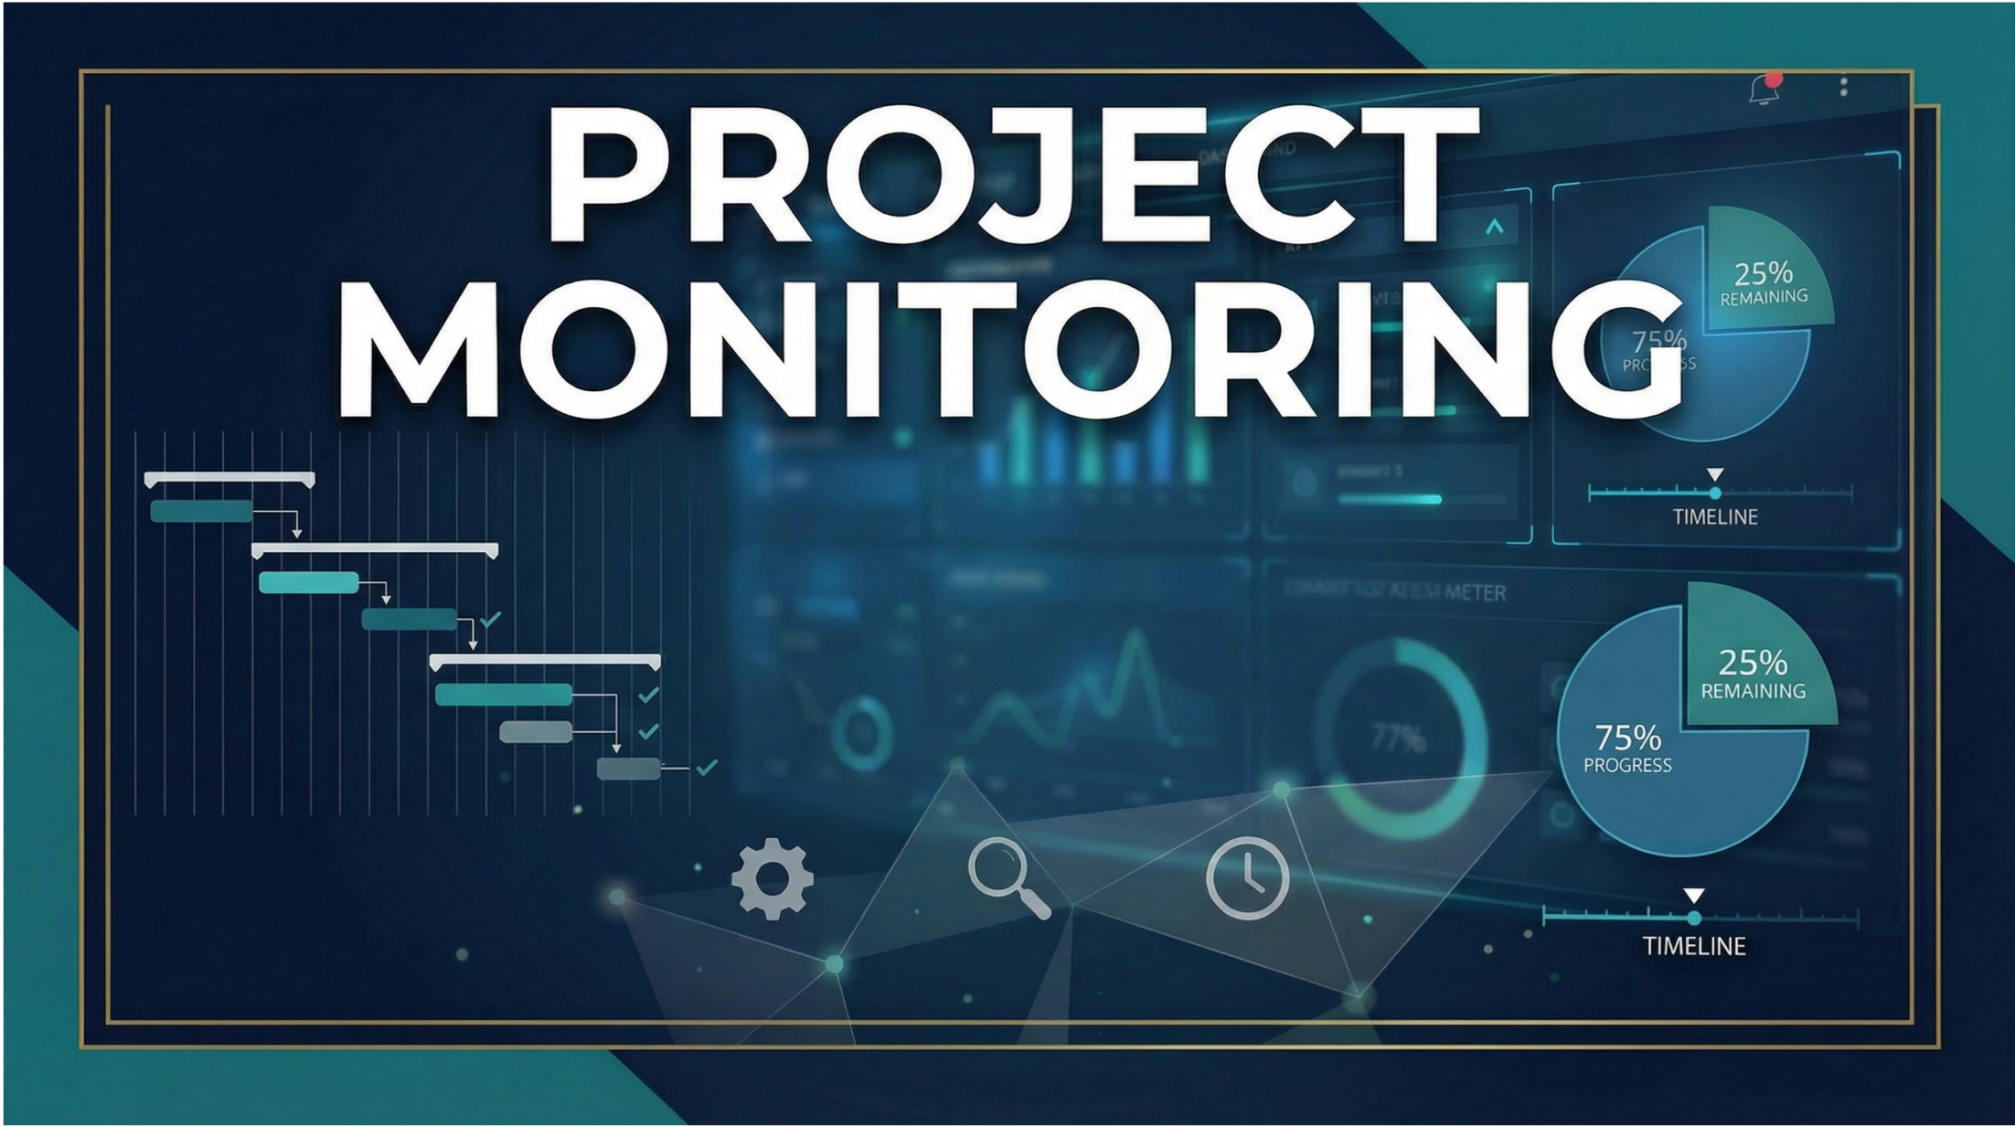

PROJECT MONITORING
PMG333
Lecture 05
QUALITY MONITORING
Prepared by
Dr. Bassel alhassan

Slide 2
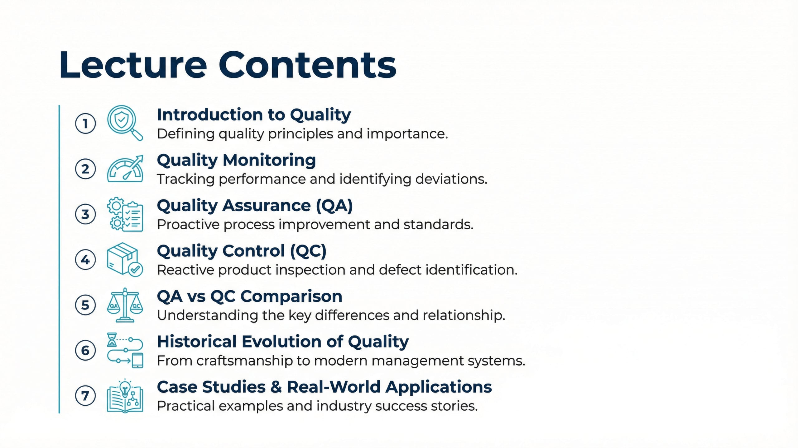
Lecture
05
Lecture Contents
1 - 2

Slide 3
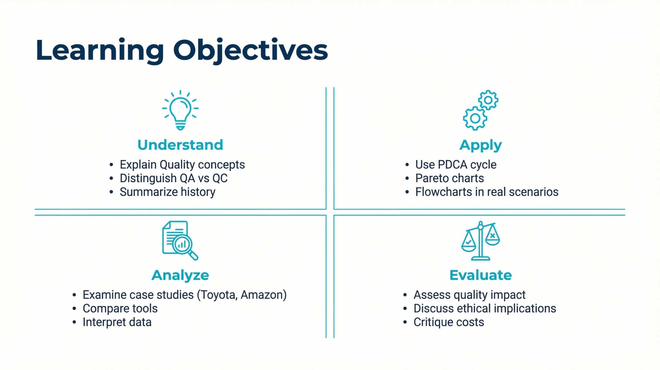
Lecture
05
Learning Objectives
1 - 3

Slide 4
Lecture
05
Today's wisdom
Edwards Deming
"Quality does not just happen; it is achieved by conscious effort."
Edwards Deming
1 - 4

Slide 5
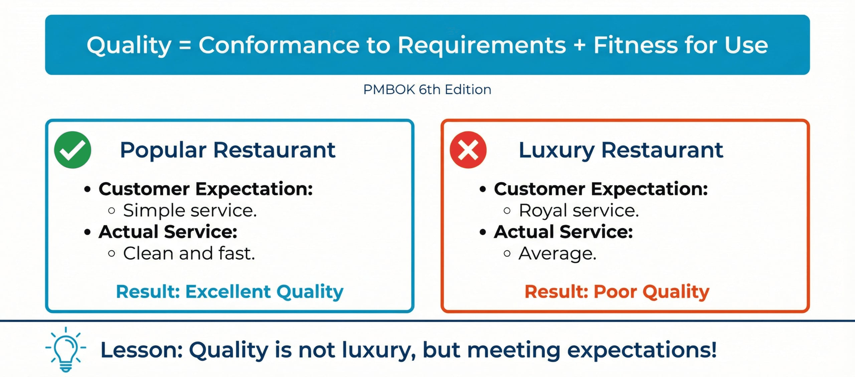
Lecture
05
What is Quality?
vv
1 - 5

Slide 6
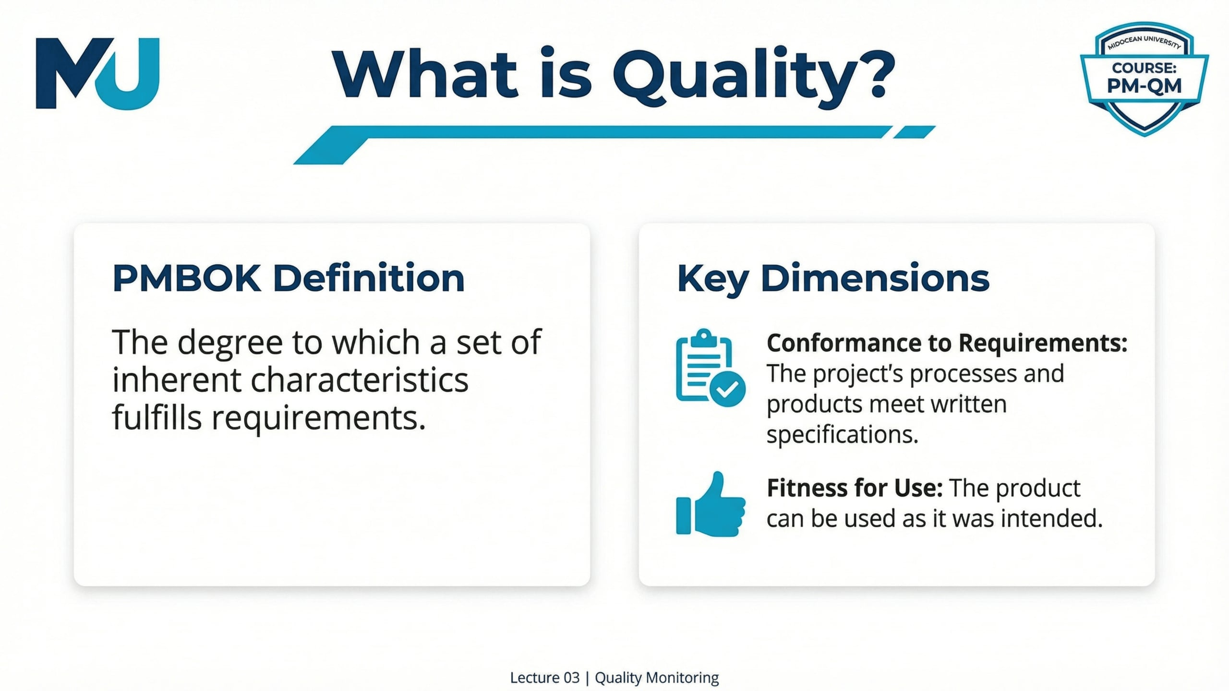
Lecture
05
What is Quality?
1 - 6

Slide 7
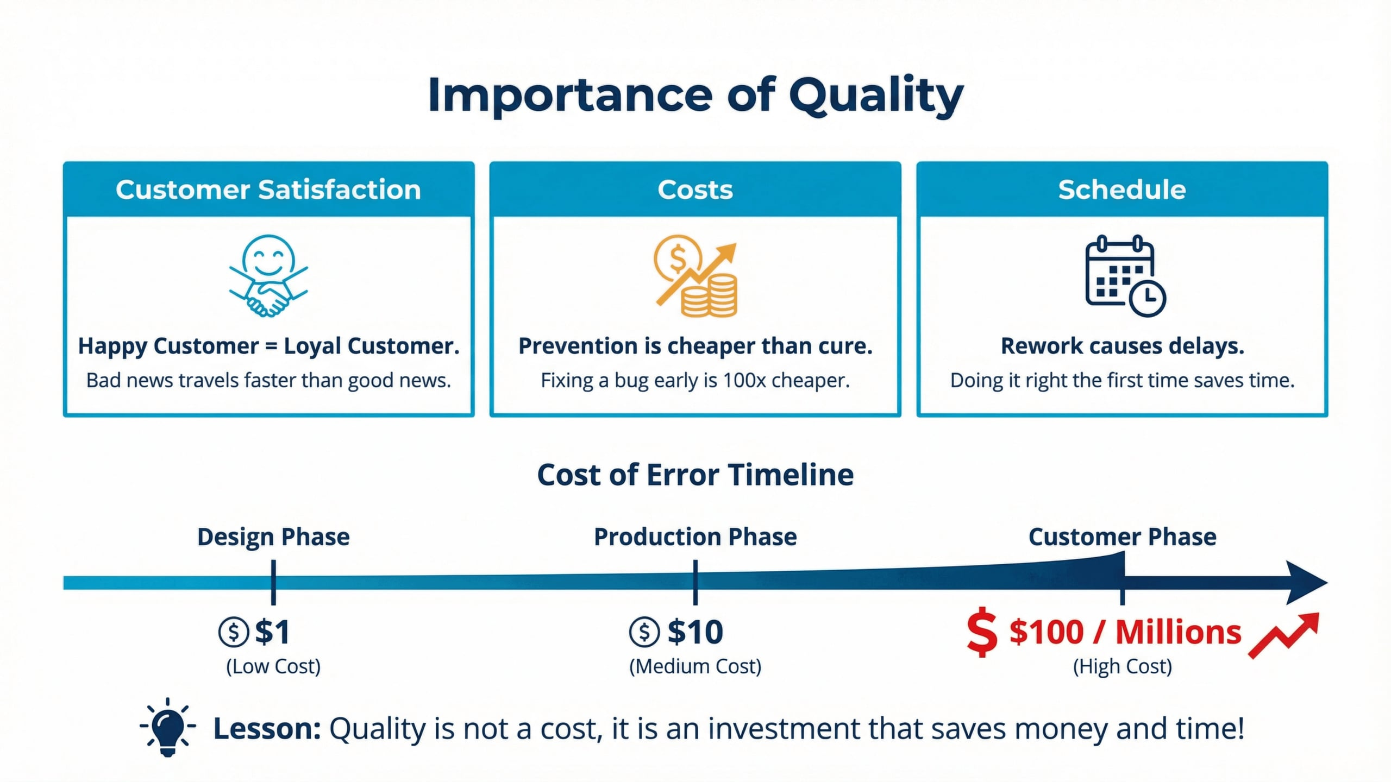
Lecture
05
Importance of Quality
1 - 7

Slide 8
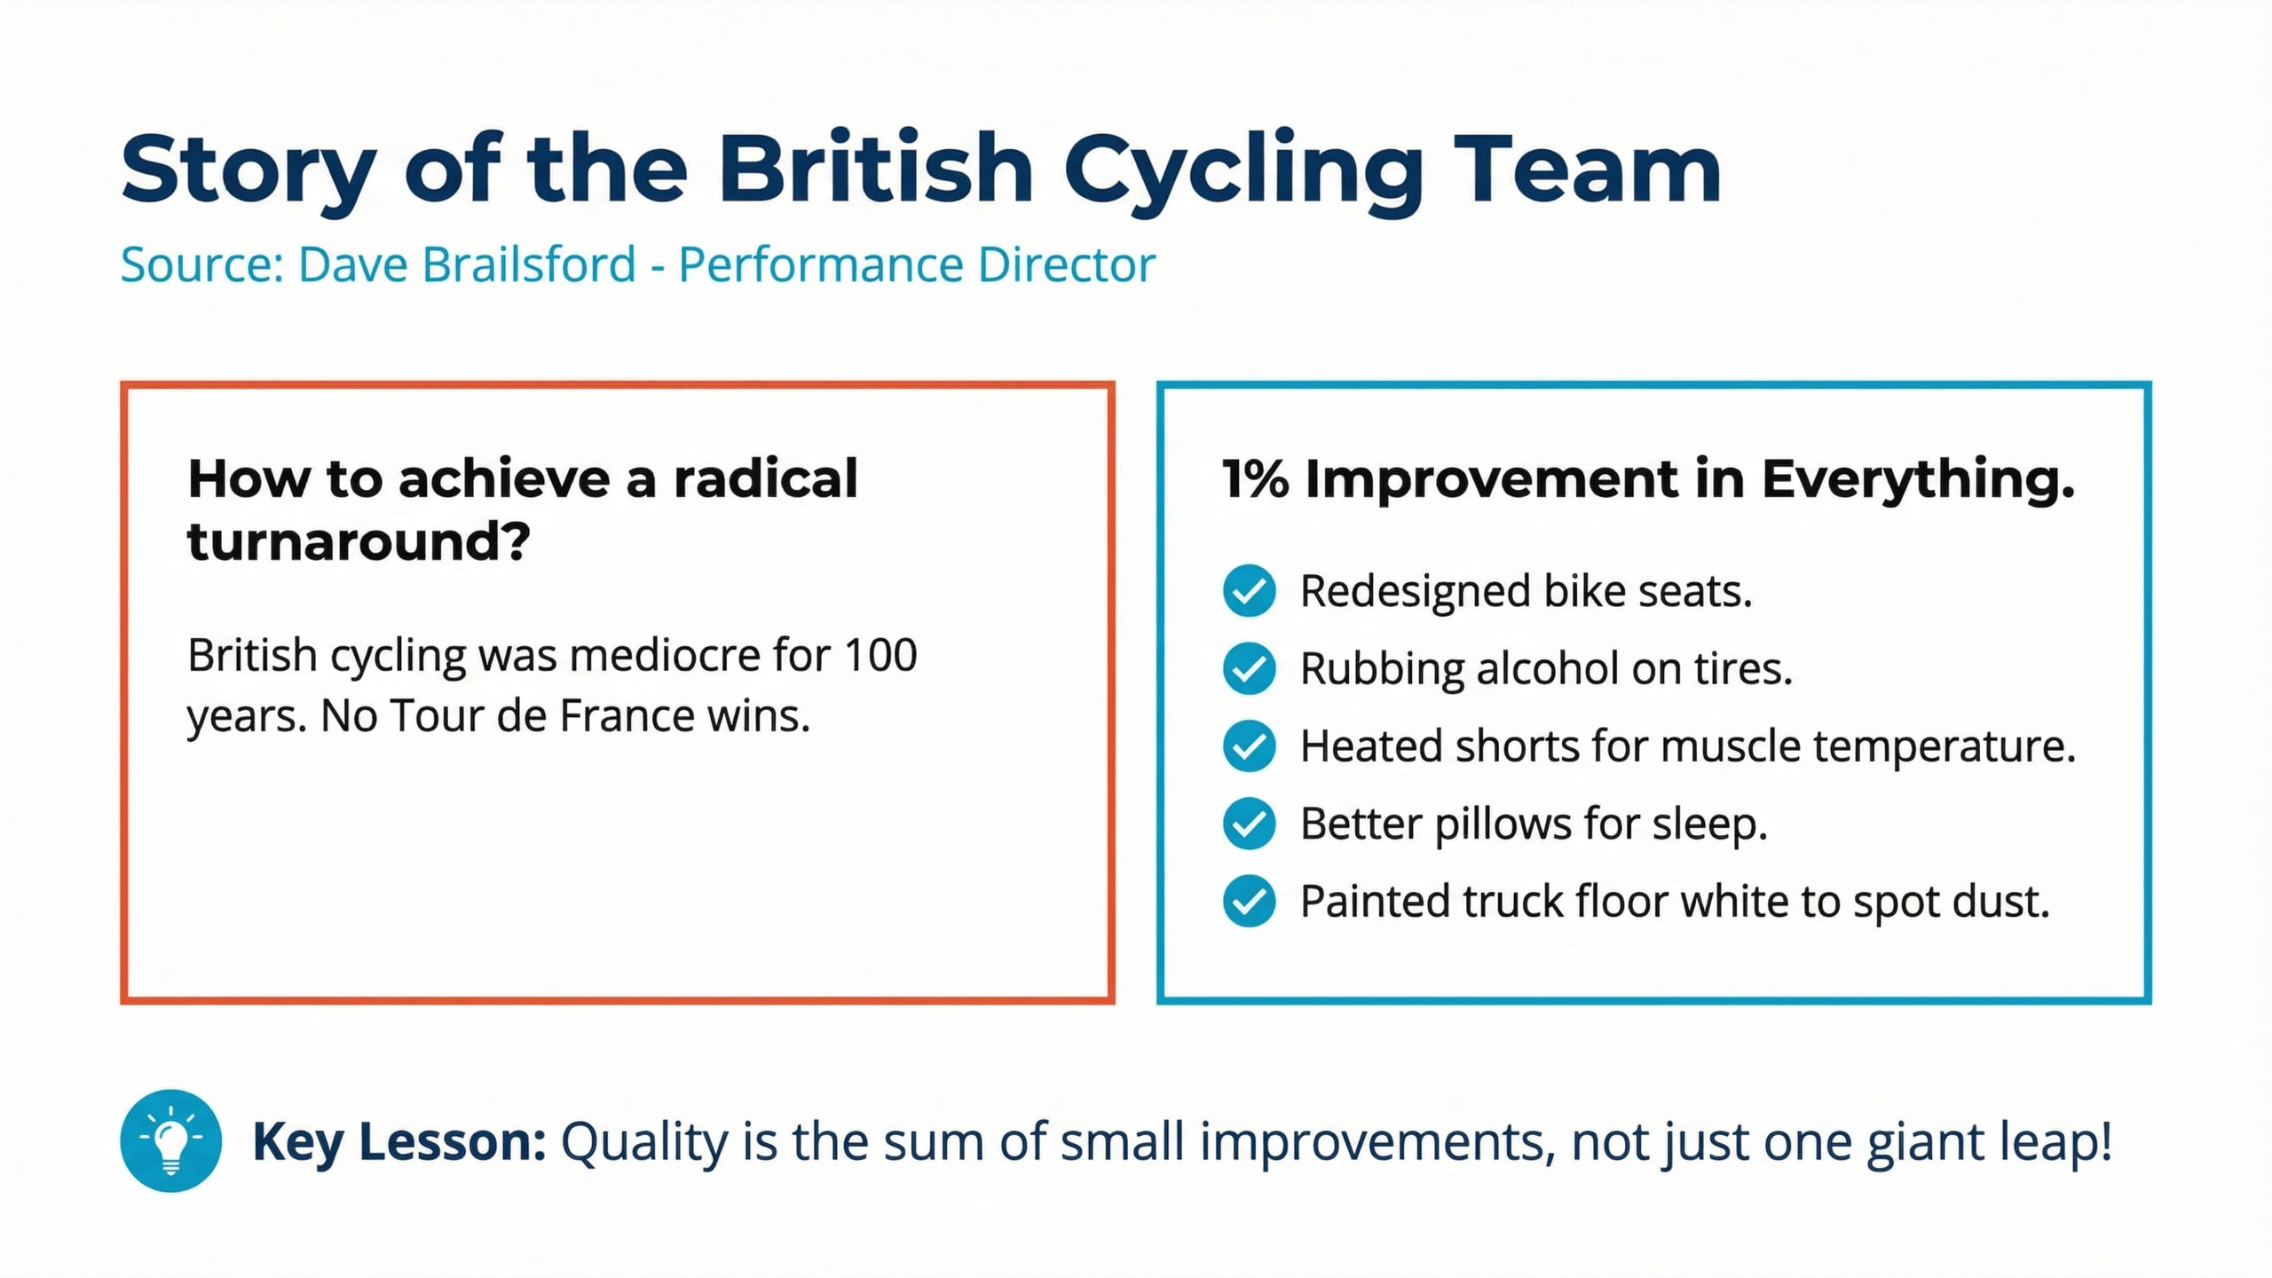
Lecture
05
Story of the British Cycling Team
1 - 8

Slide 9
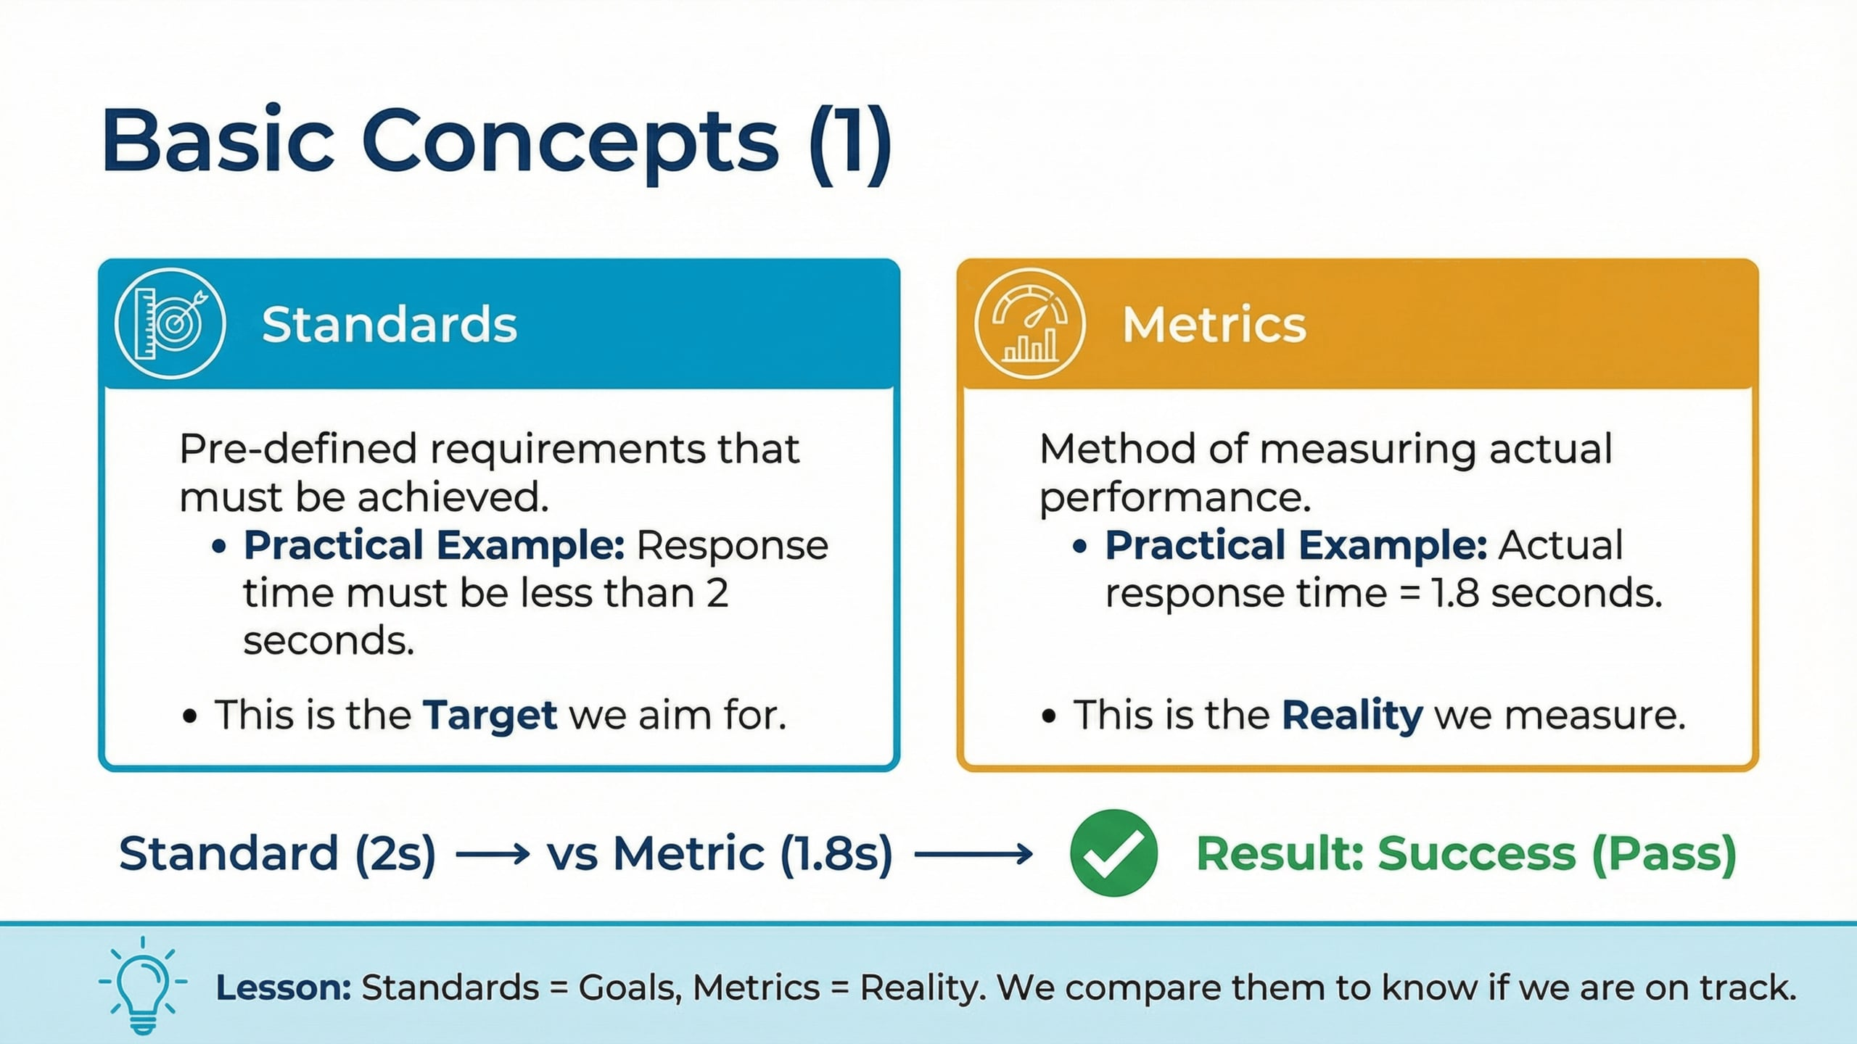
Lecture
05
Basic Concepts 1
1 - 9

Slide 10
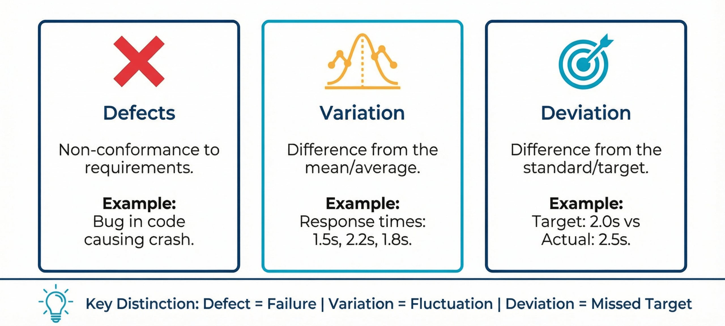
Lecture
05
Basic Concepts 2
vv
1 - 10

Slide 11
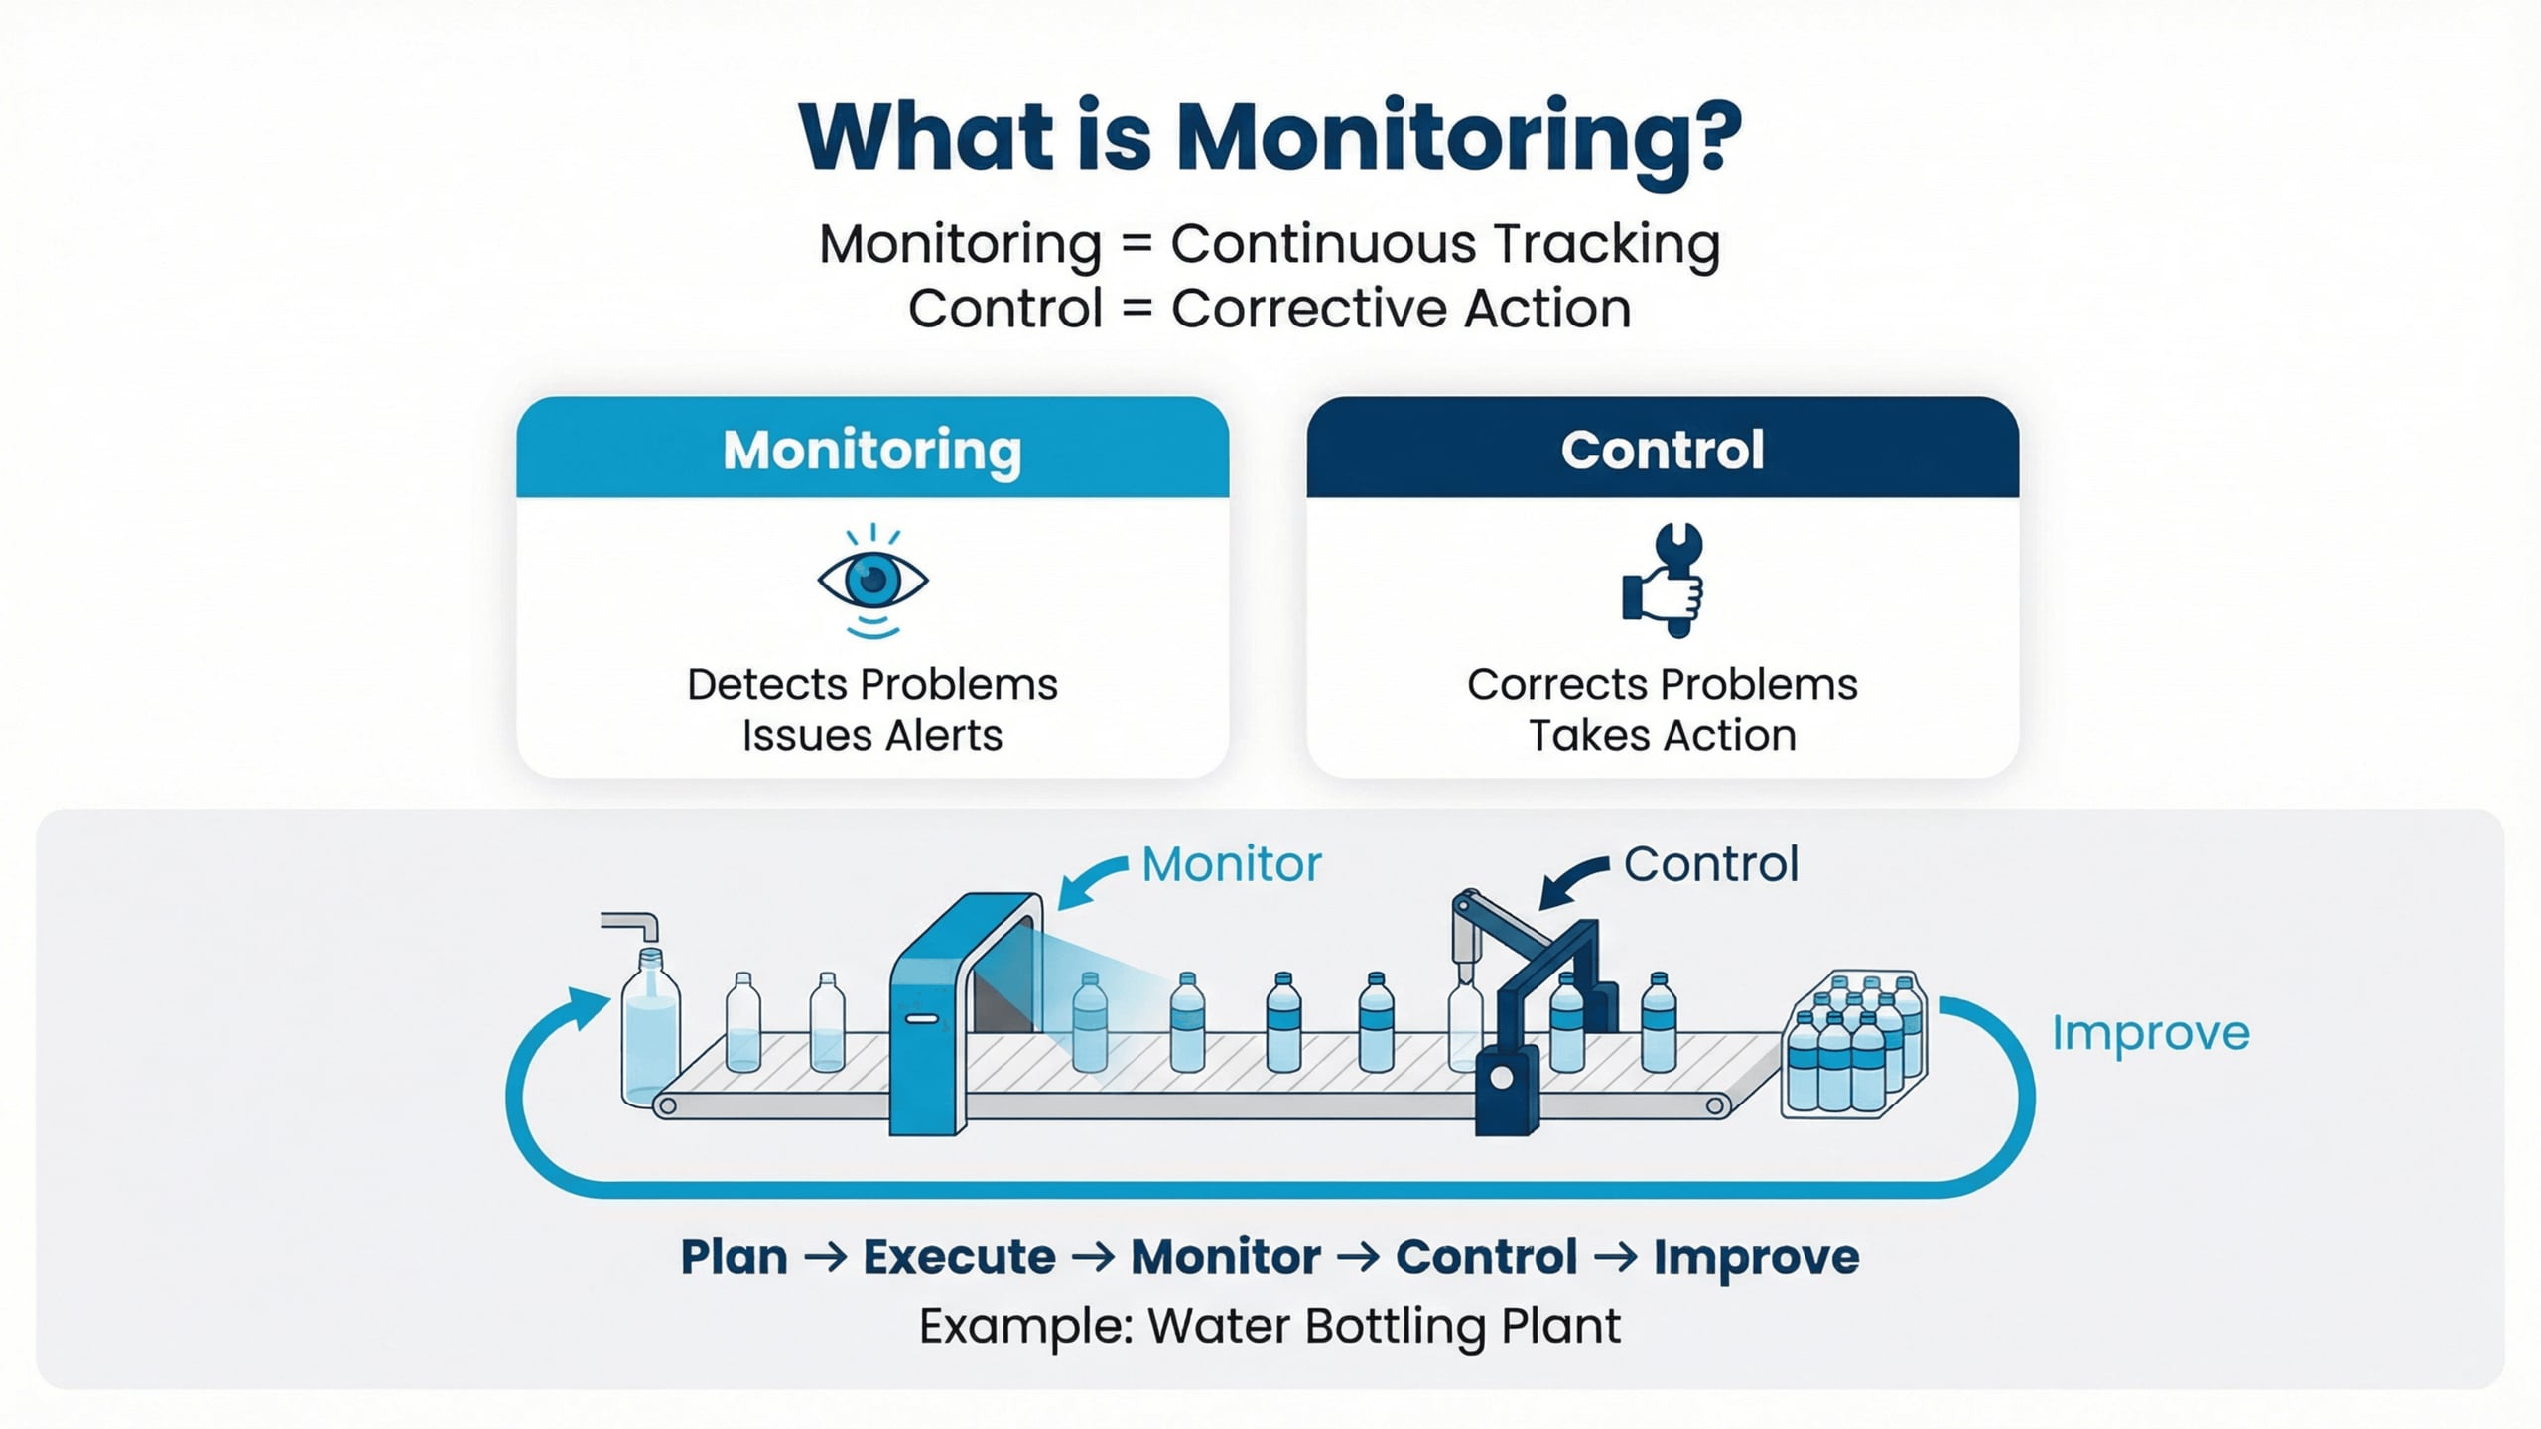
Lecture
05
What is Monitoring?
1 - 11

Slide 12

Lecture
05
1 - 12

Slide 13
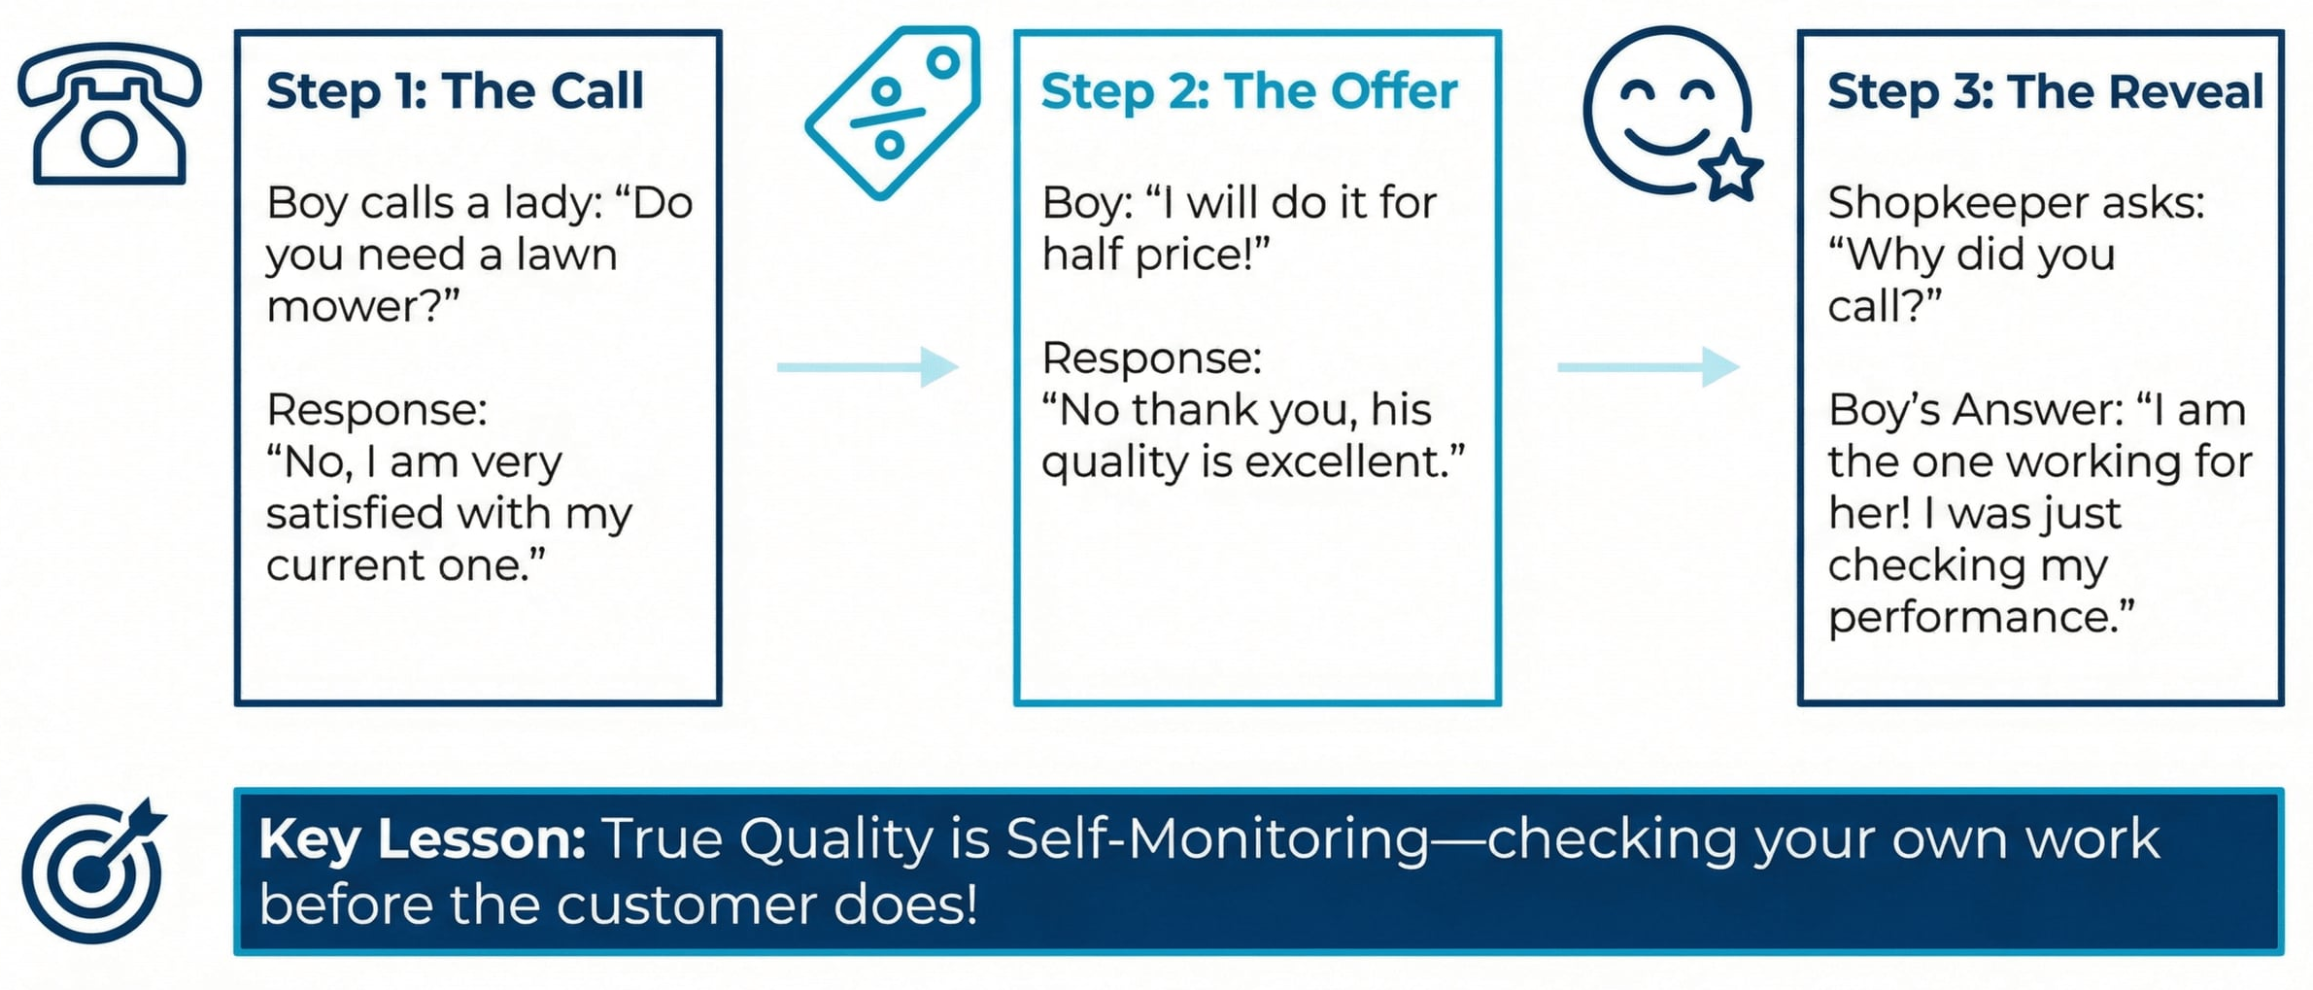
Lecture
05
Story of the Little Boy?
1 - 13

Slide 14
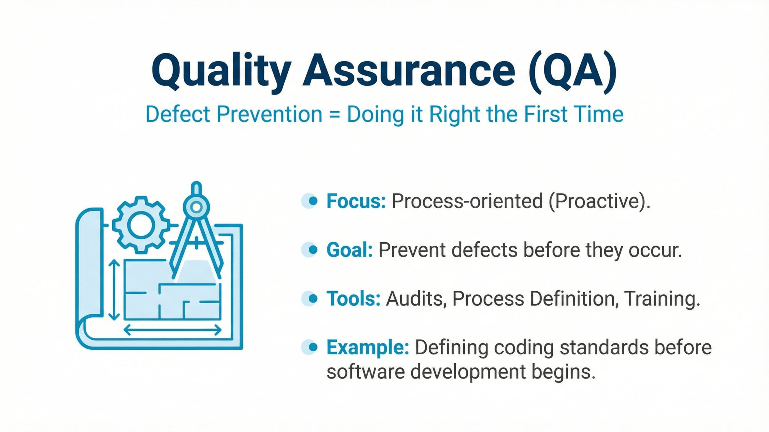
Lecture
05
Quality Assurance (QA)
1 - 14

Slide 15
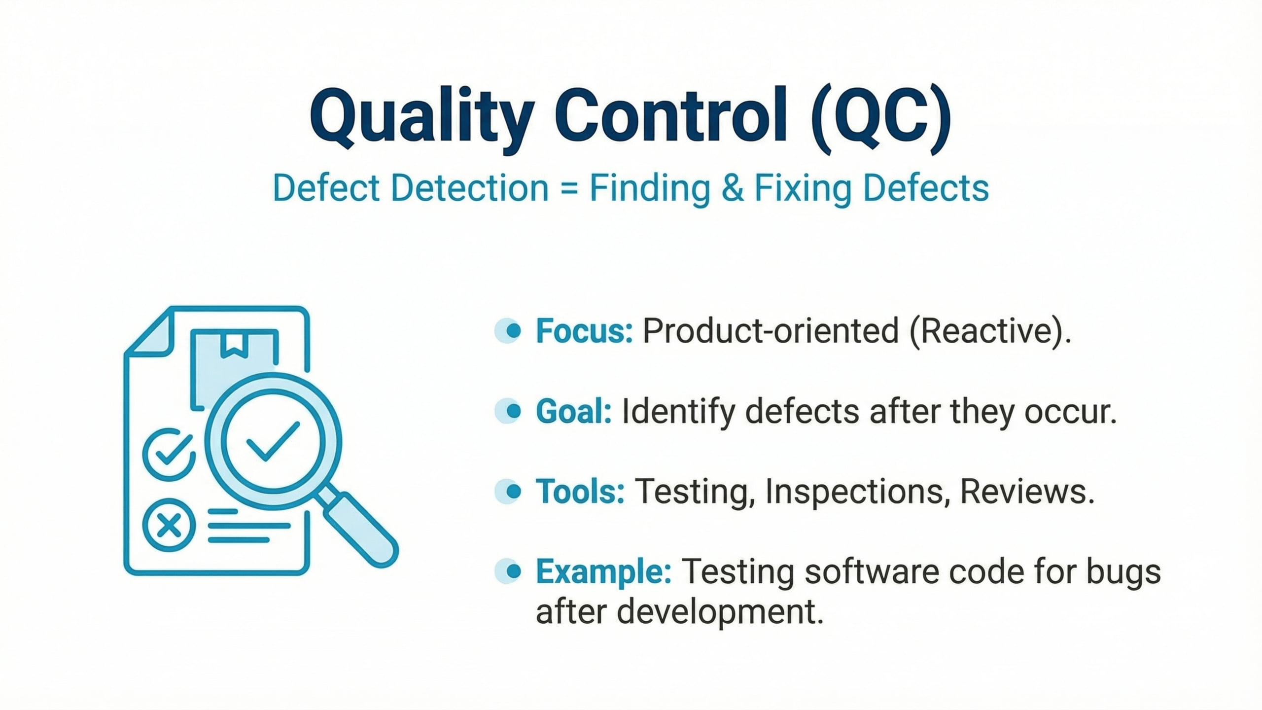
Lecture
05
Quality Control (QC)
1 - 15

Slide 16
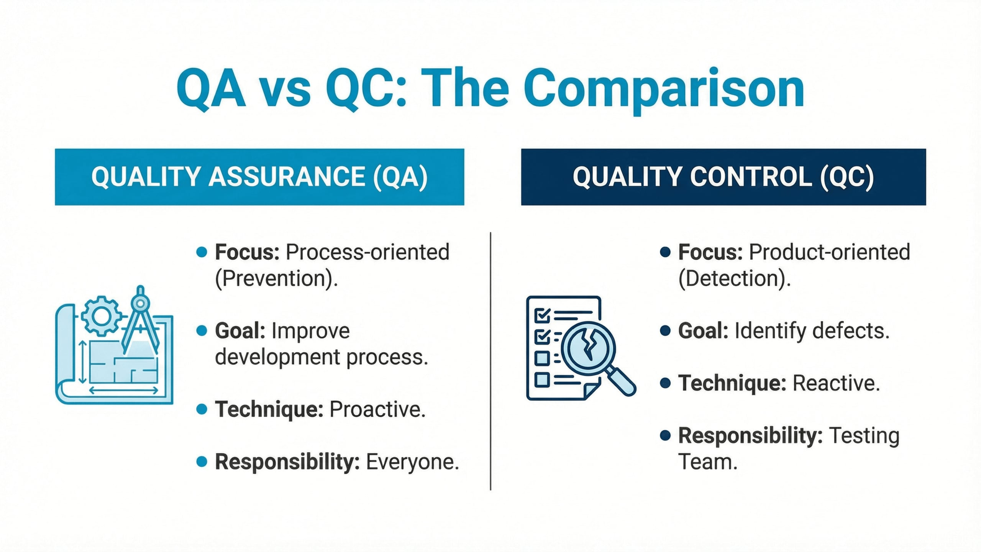
Lecture
05
QA VS QC
1 - 16

Slide 17
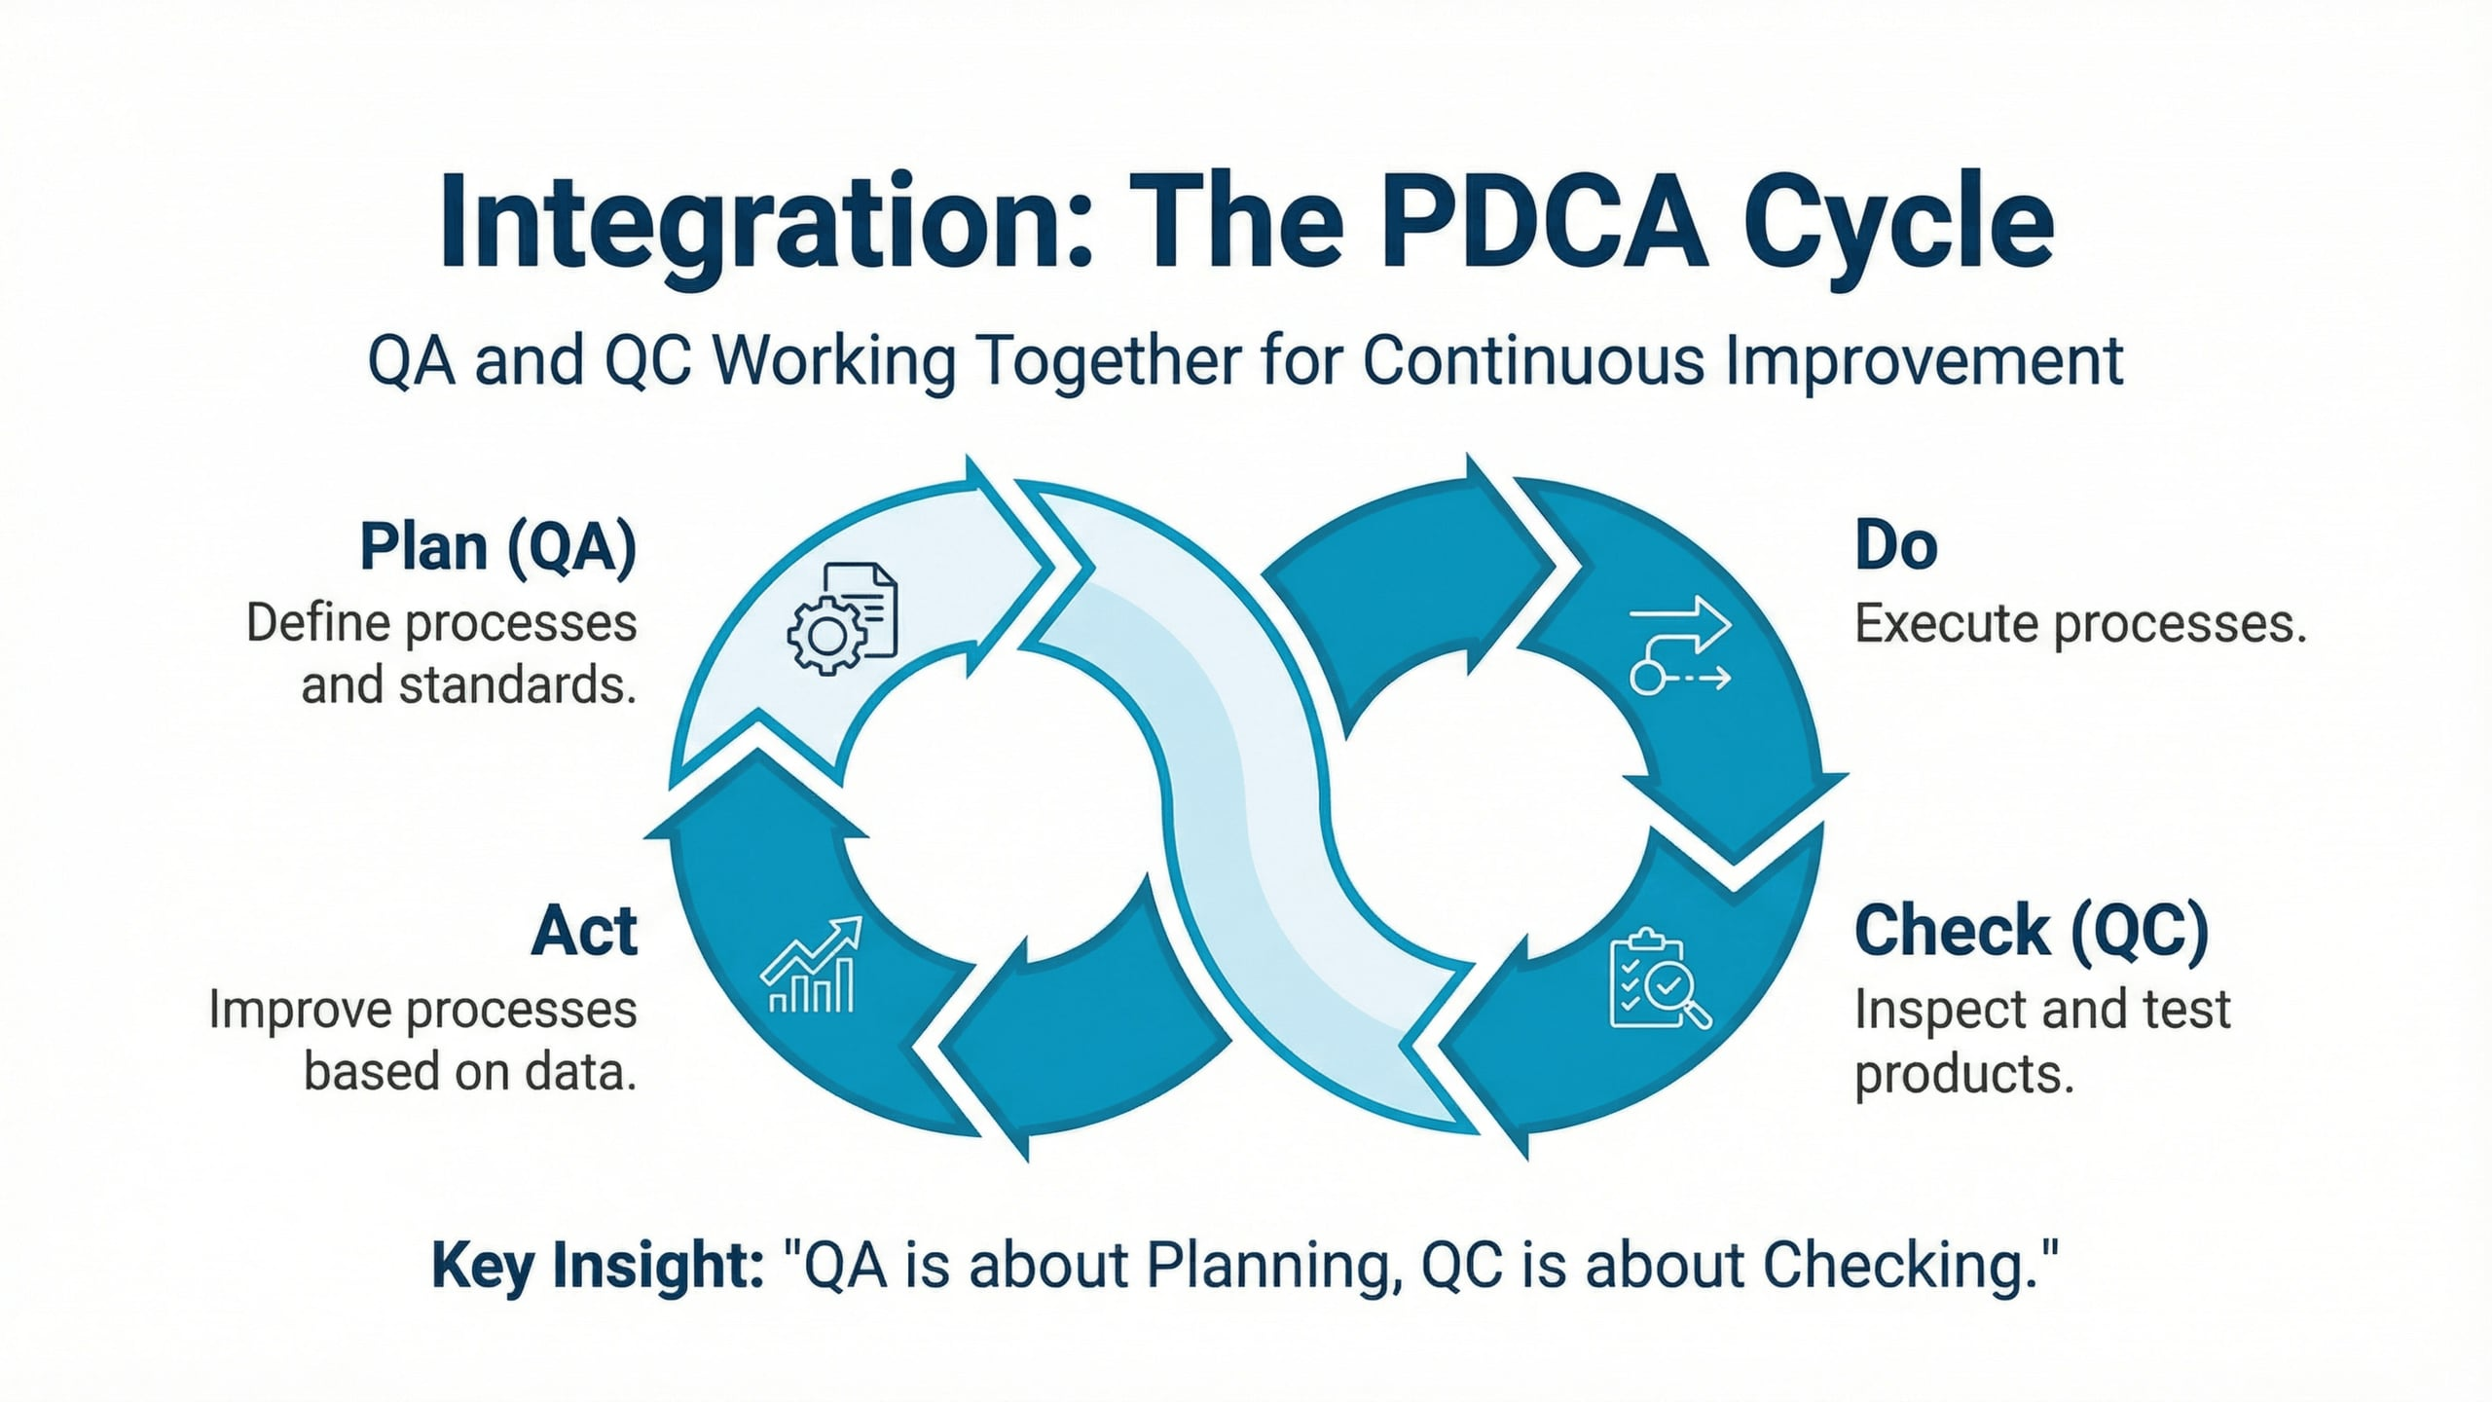
Lecture
05
The PDCA Cycle
1 - 17

Slide 18
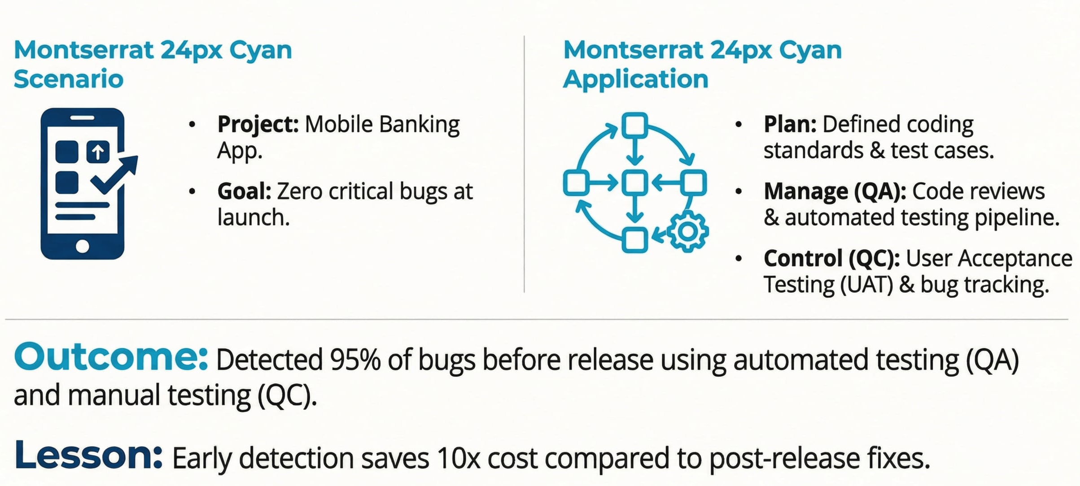
Lecture
05
Case Study: Software Project
1 - 18

Slide 19
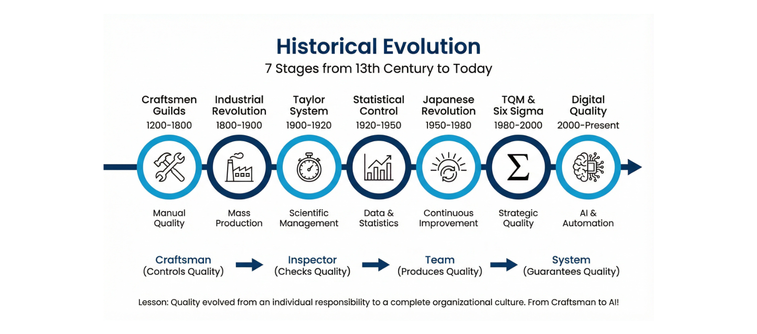
Lecture
05
Quality Evolution Timeline
vv
1 - 19

Slide 20
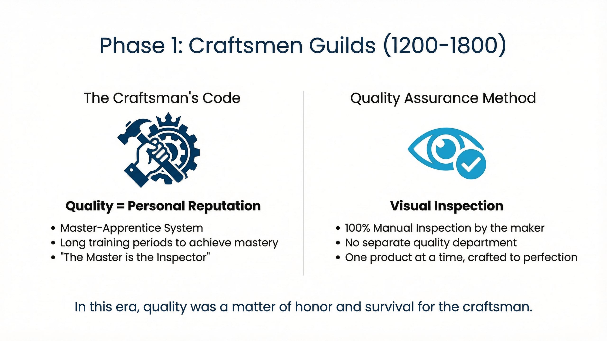
Lecture
05
Craftsmen GILDS
vv
1 - 20

Slide 21
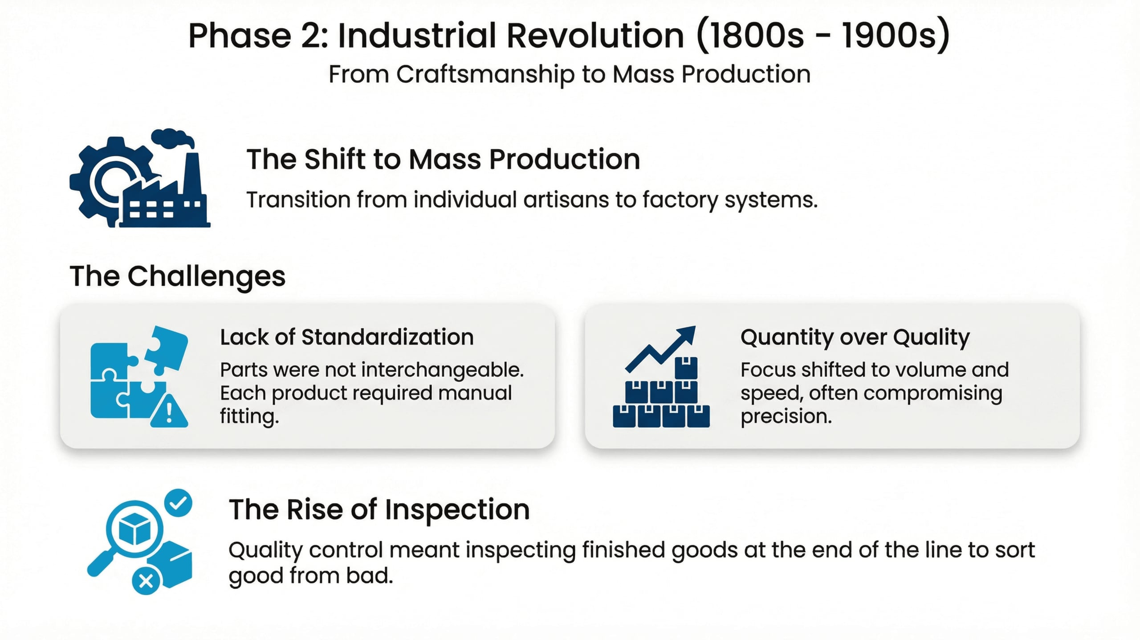
Lecture
05
Phase2: Industrial Revolution
vv
1 - 21

Slide 22
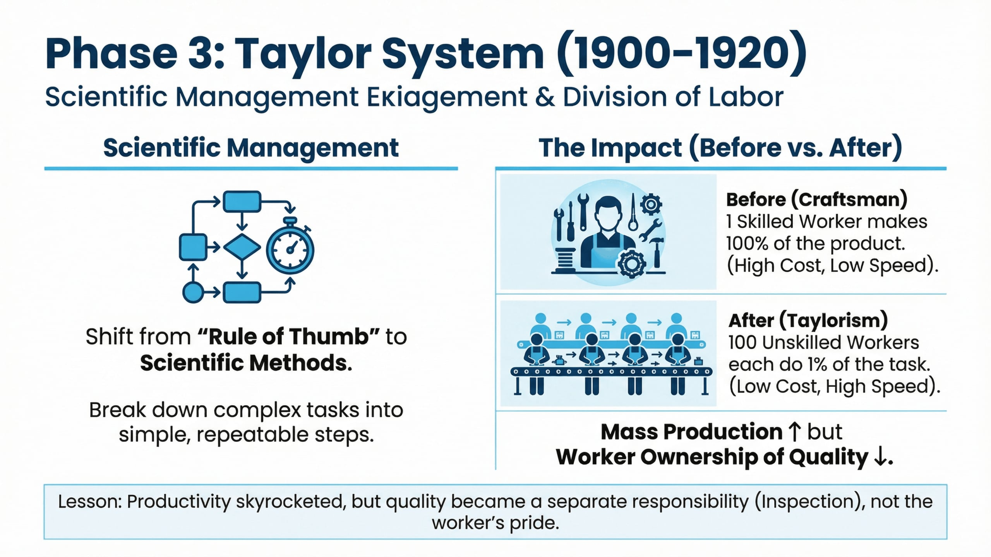
Lecture
05
Phase 3: Taylor System
vv
1 - 22

Slide 23
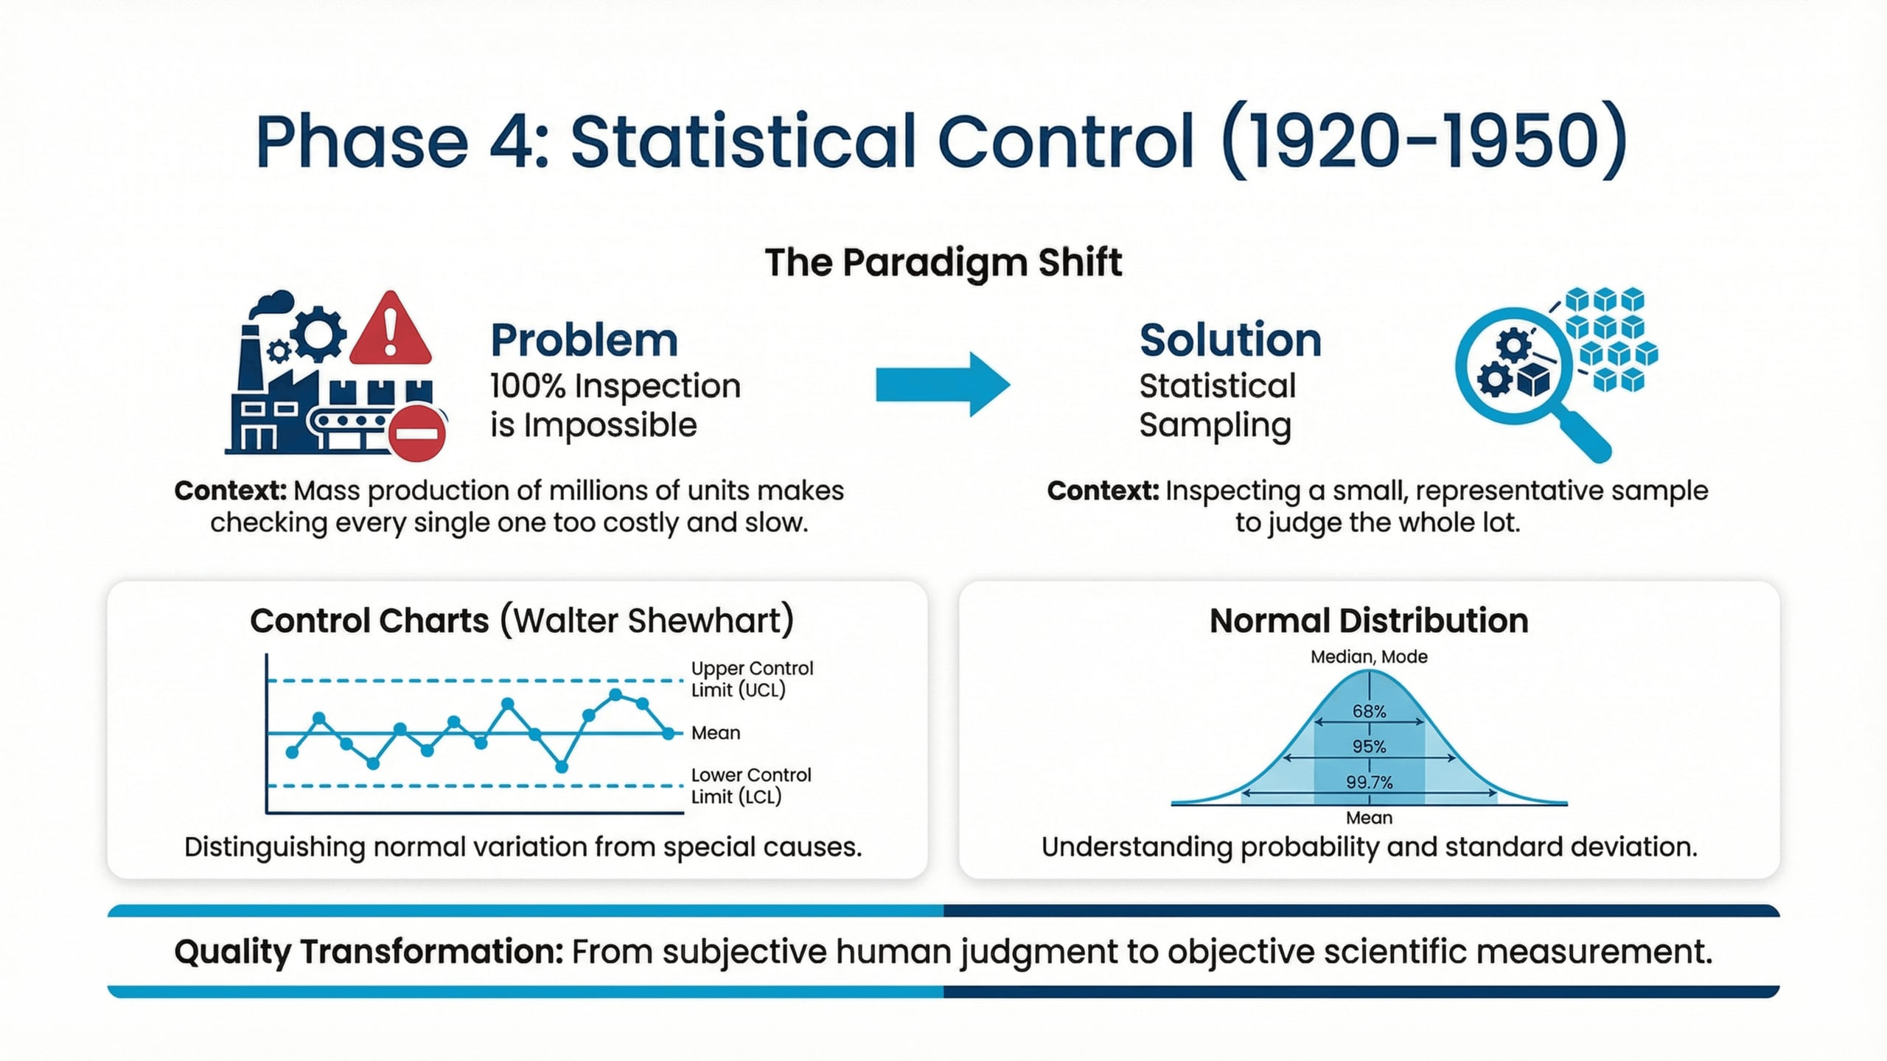
Lecture
05
Phase 4: Statistical Control
vv
1 - 23

Slide 24
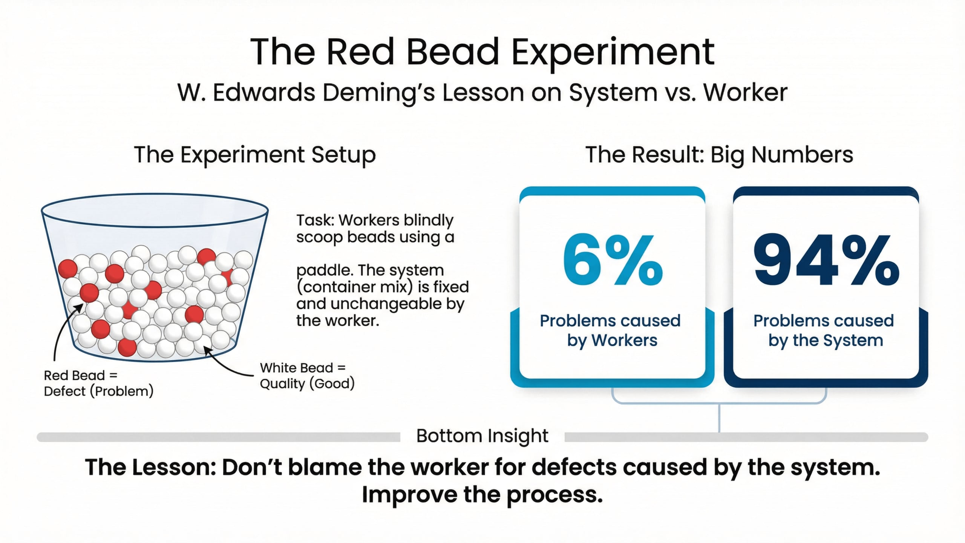
Lecture
05
The Red Bead Experiment
1 - 24

Slide 25
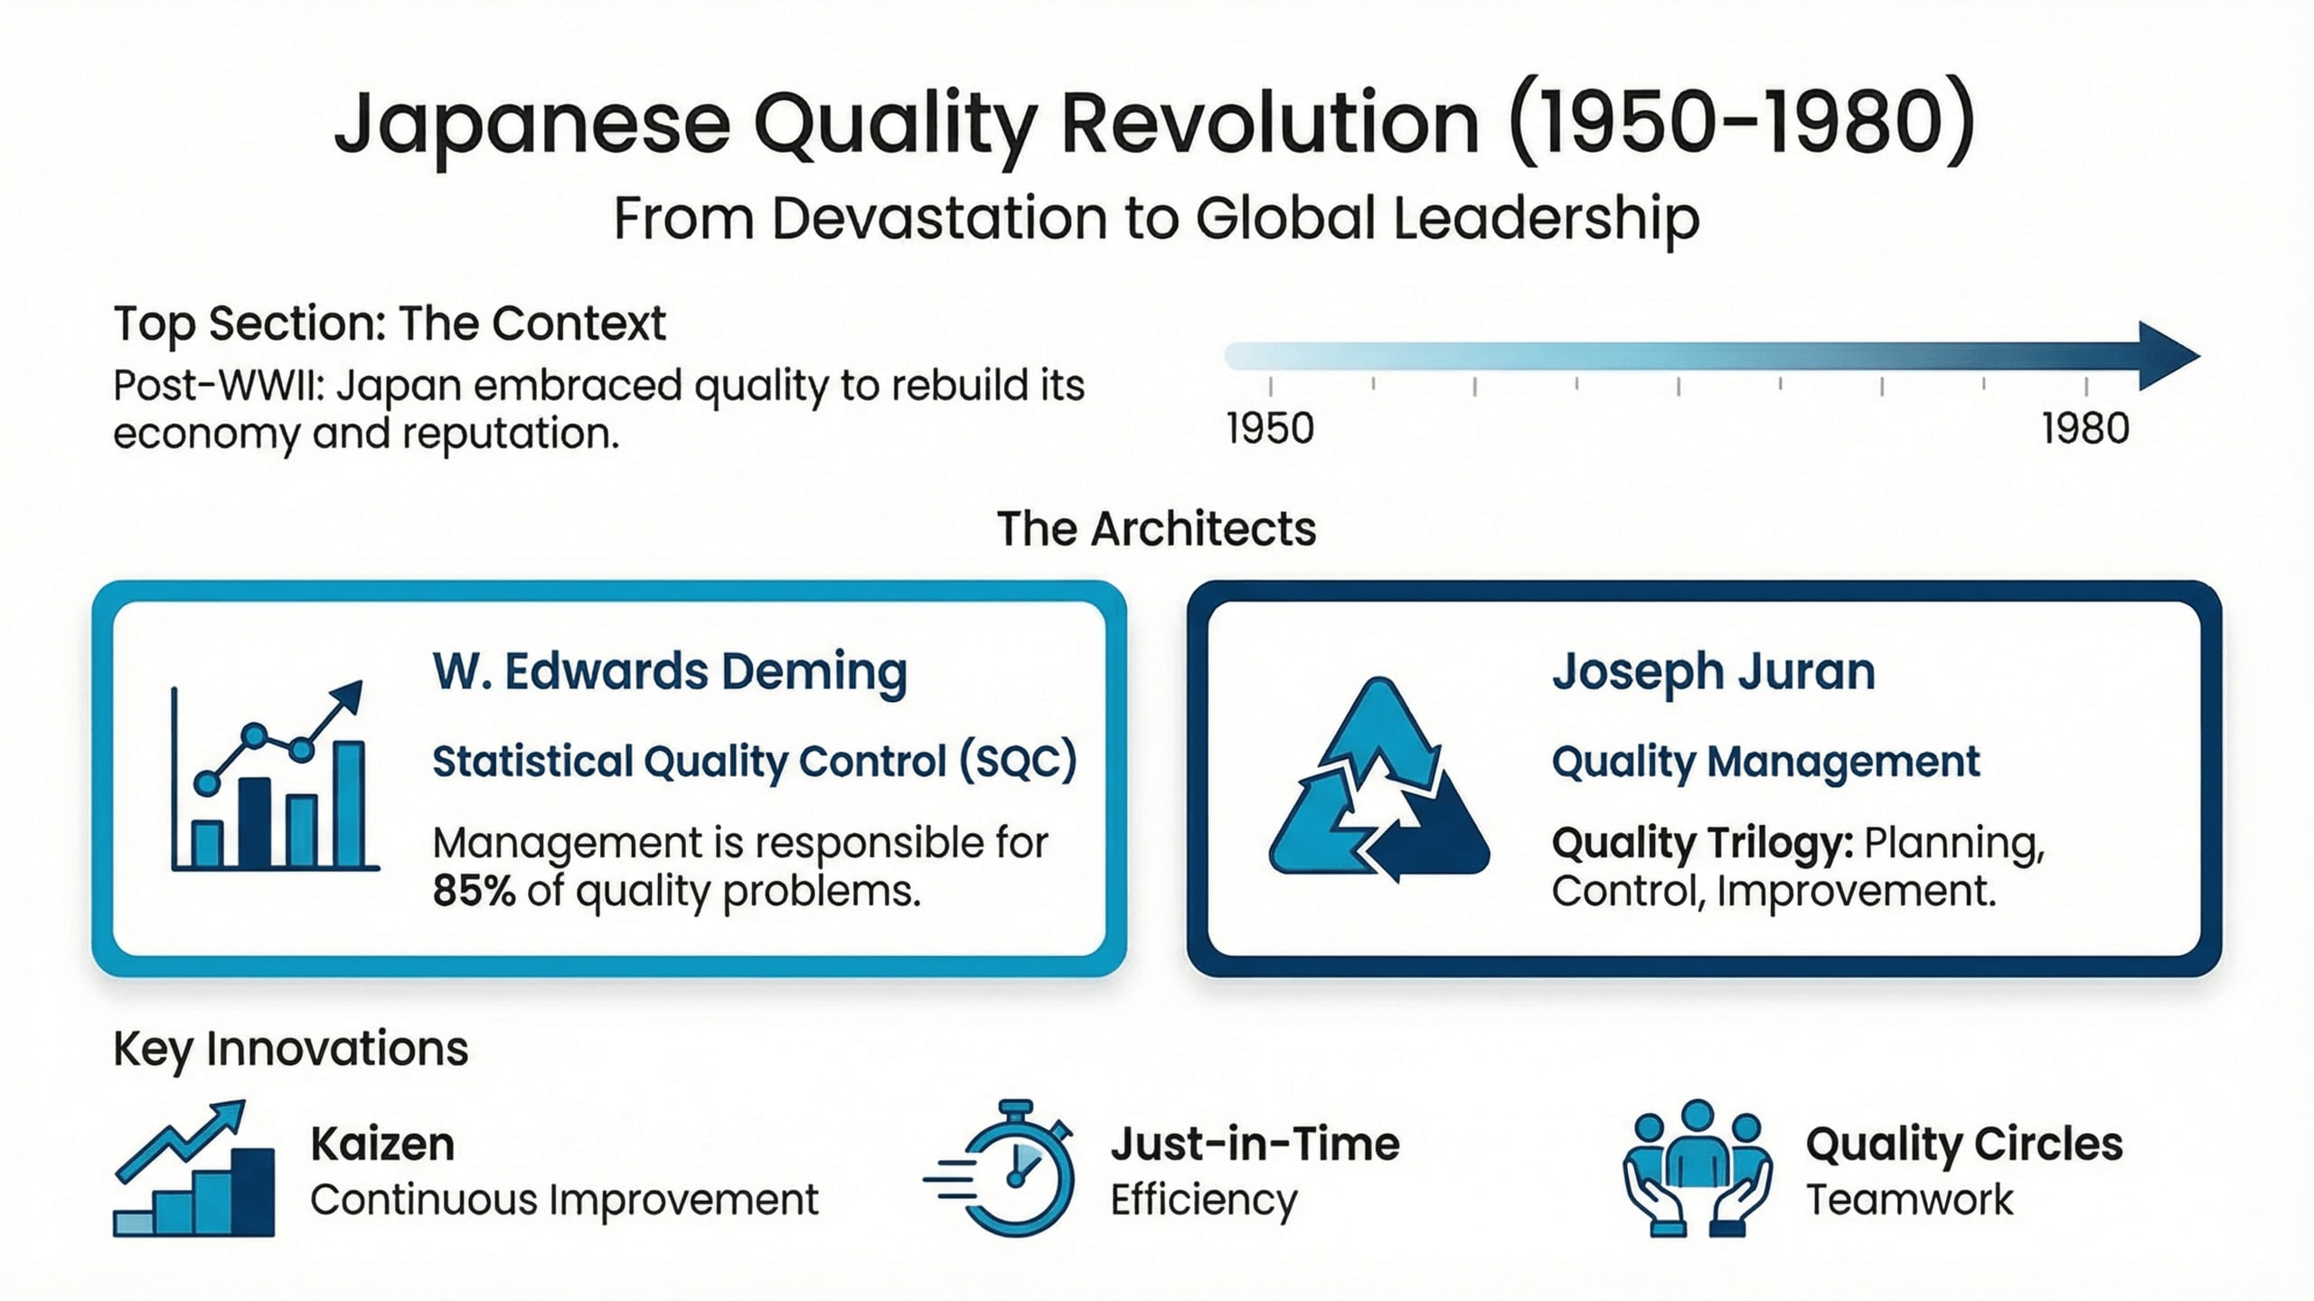
Lecture
05
Phase 5: Japanese Quality Revolution
1 - 25

Slide 26
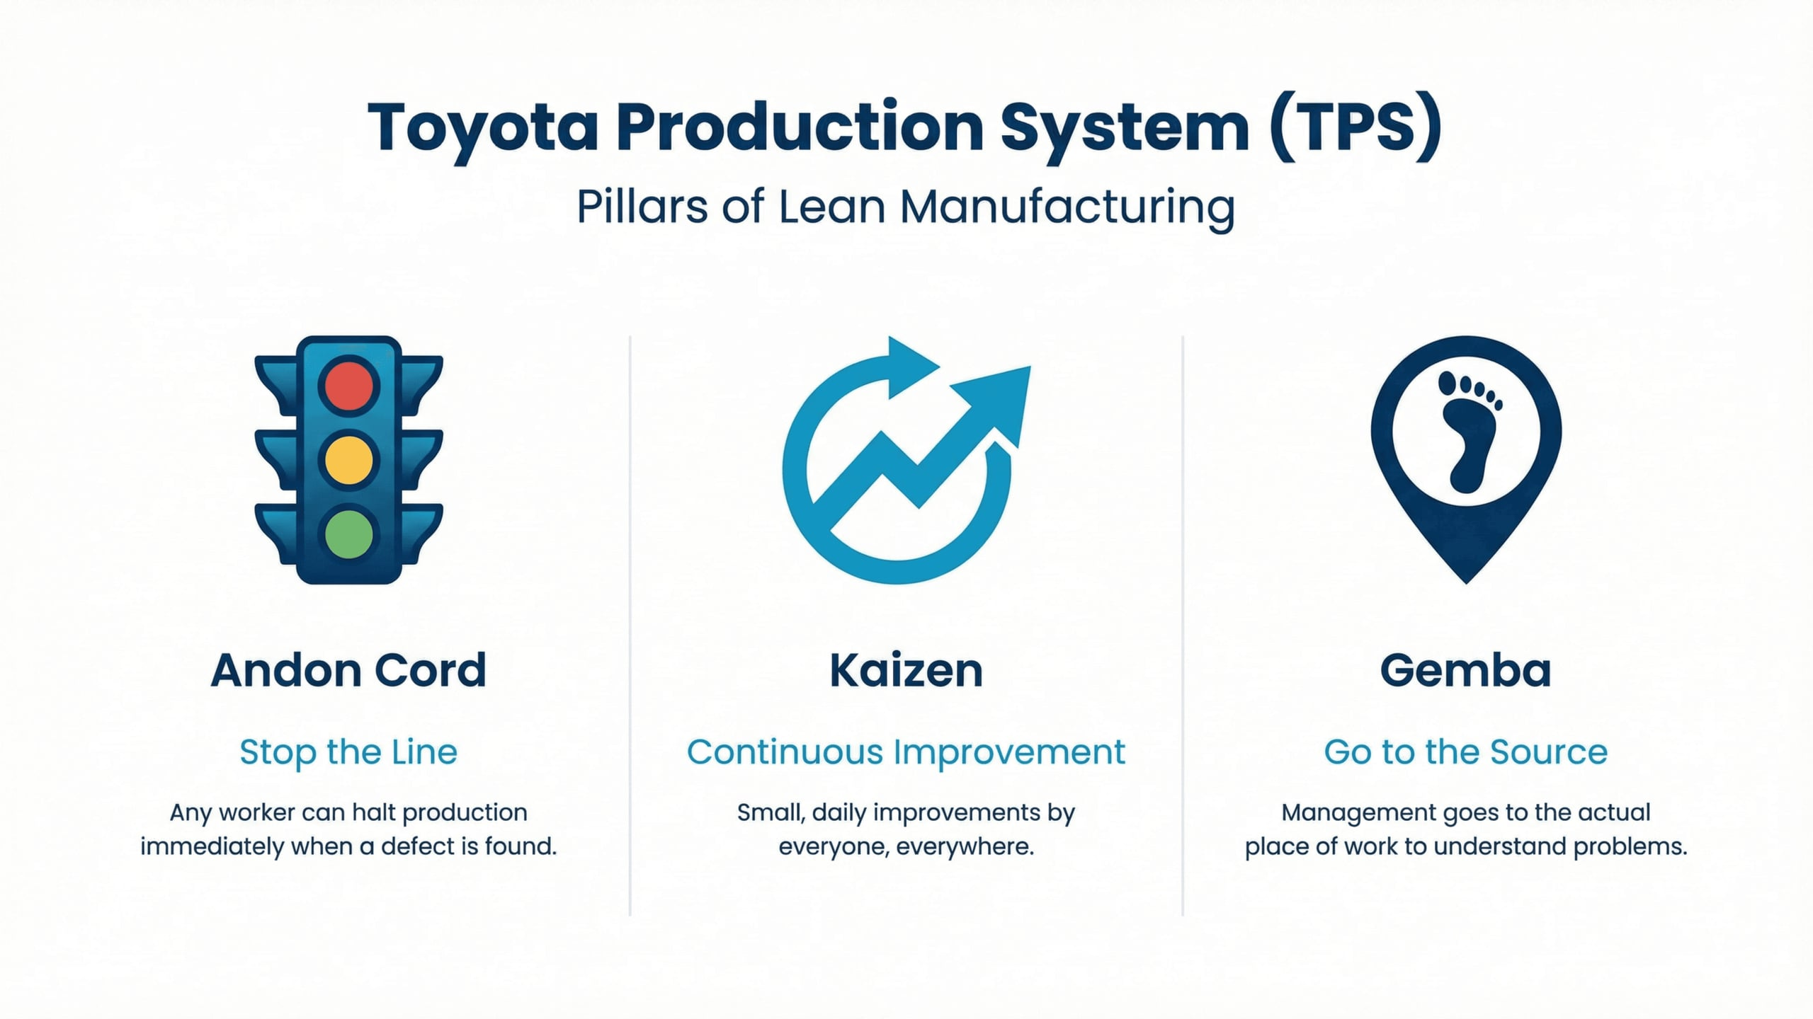
Lecture
05
Toyota Production System (TPS)
vv
1 - 26

Slide 27
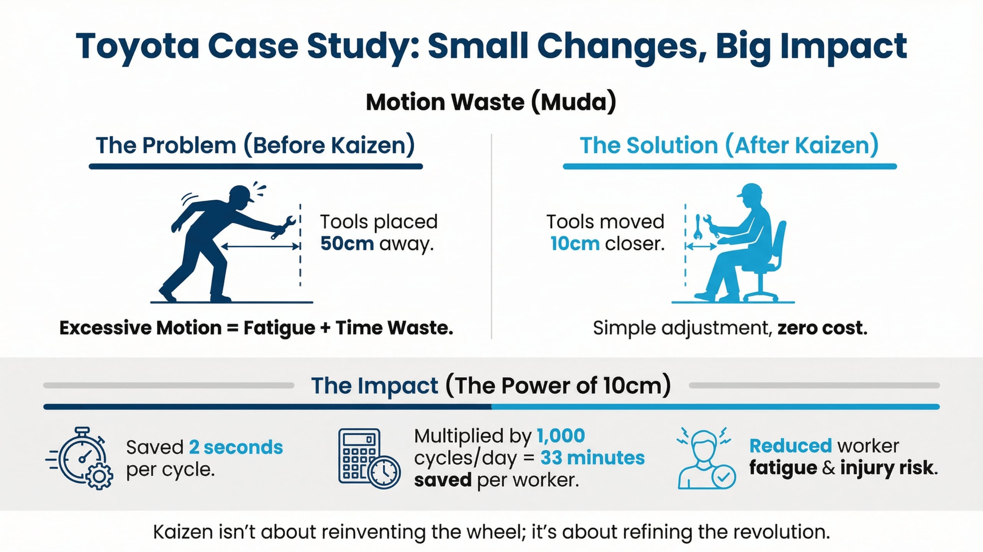
Lecture
05
Toyota Case Study
1 - 27

Slide 28
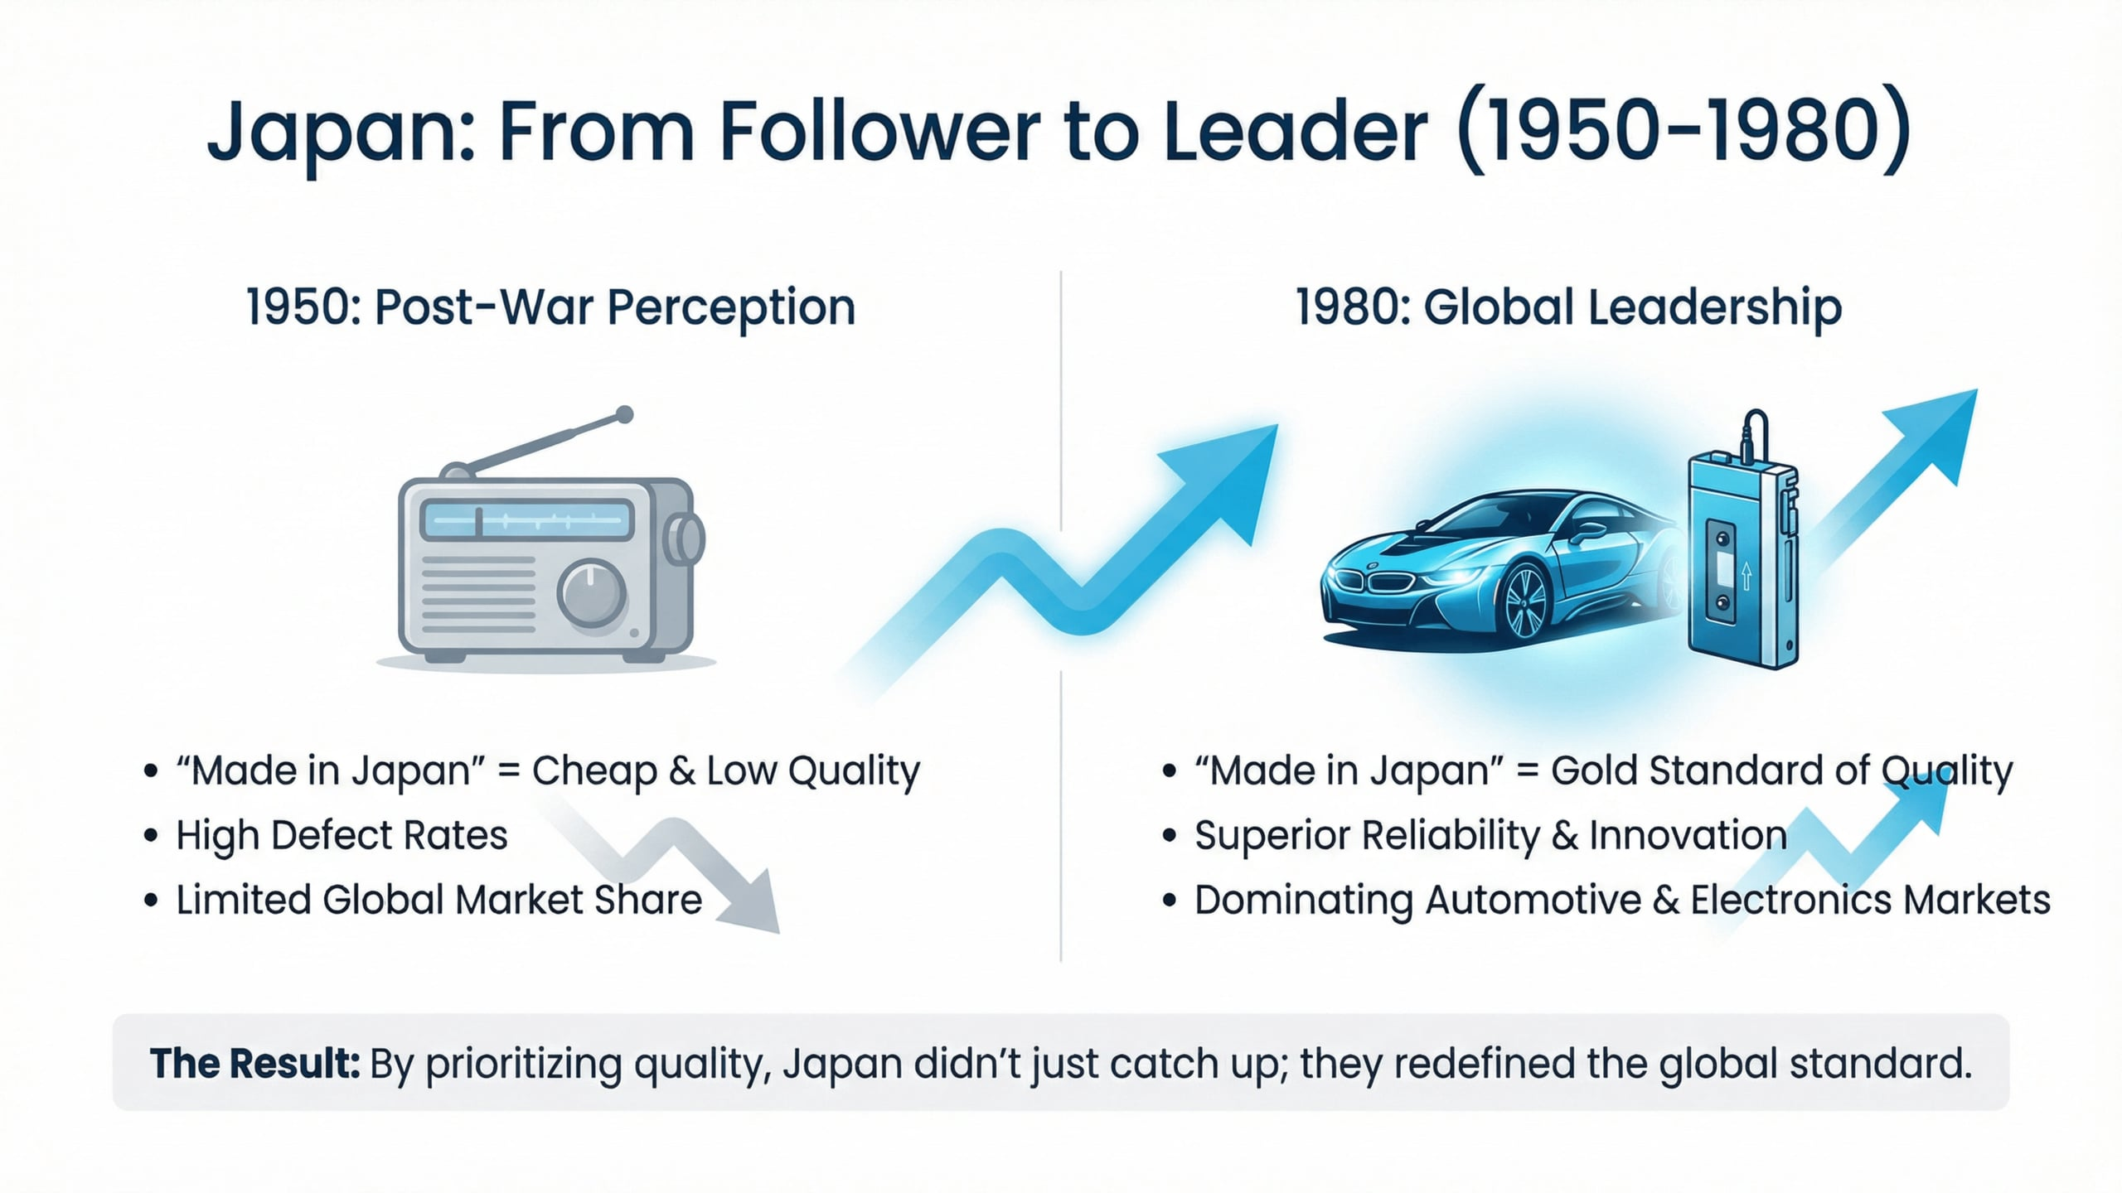
Lecture
05
Japan experience
1 - 28

Slide 29
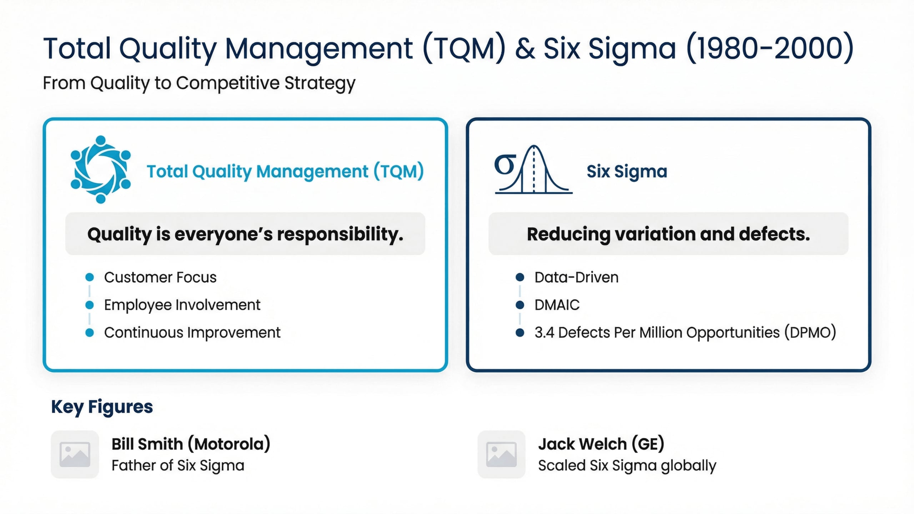
Lecture
05
Phase 6: Total Quality Management & Six Sigma
1 - 29

Slide 30
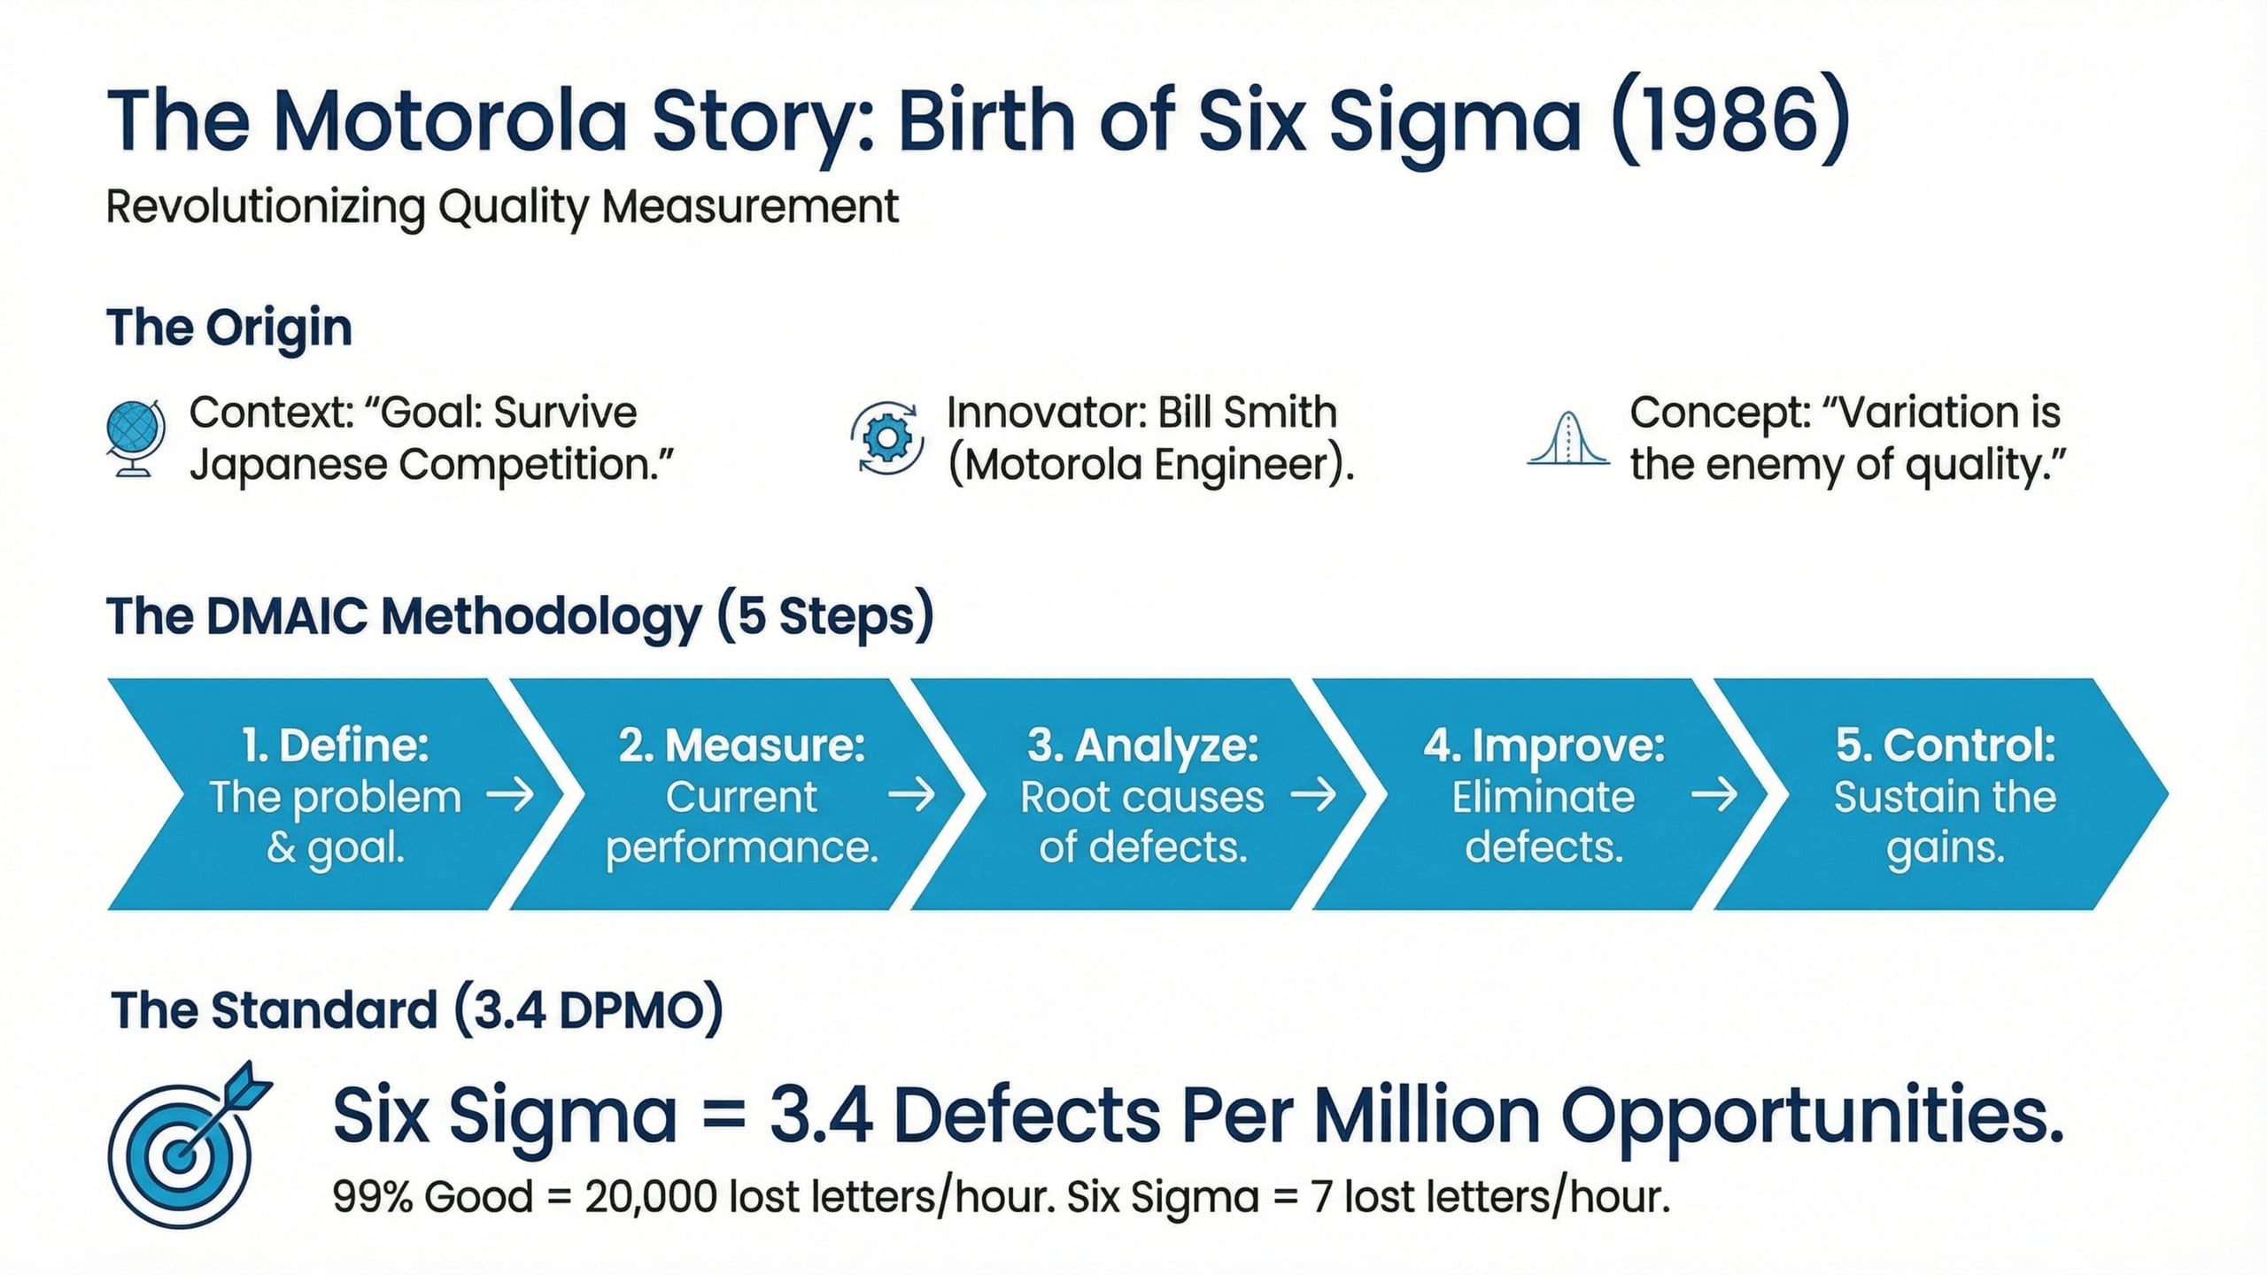
Lecture
05
The Motorola Story
1 - 30

Slide 31
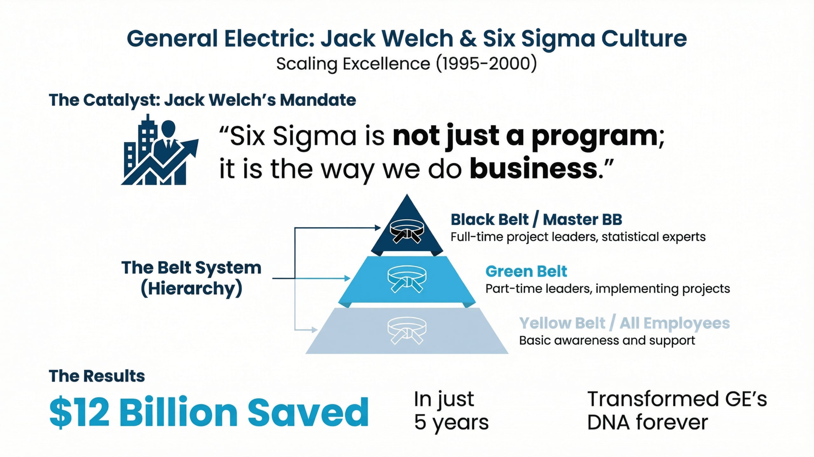
Lecture
05
General Electric Story
vv
1 - 31

Slide 32
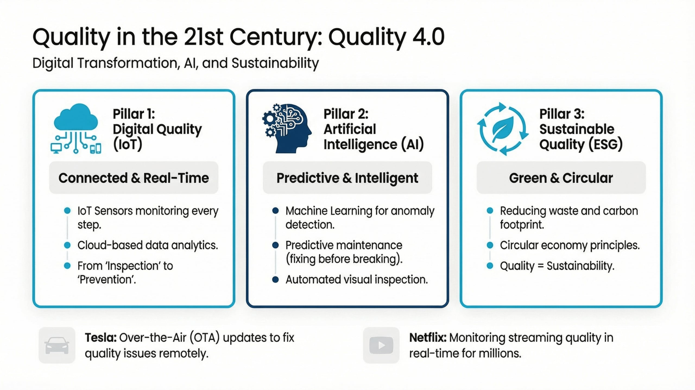
Lecture
05
Phase 7: Quality in the 21st century
vv
1 - 32

Slide 33
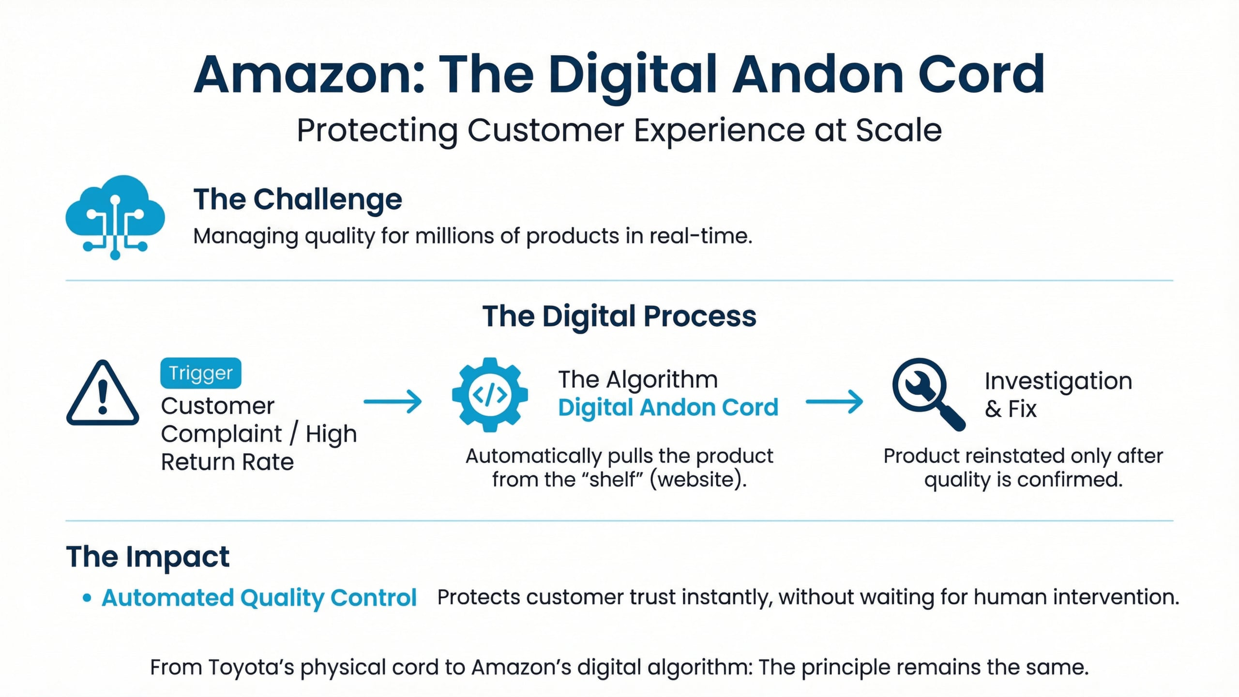
Lecture
05
The Amazon Story
vv
1 - 33

Slide 34
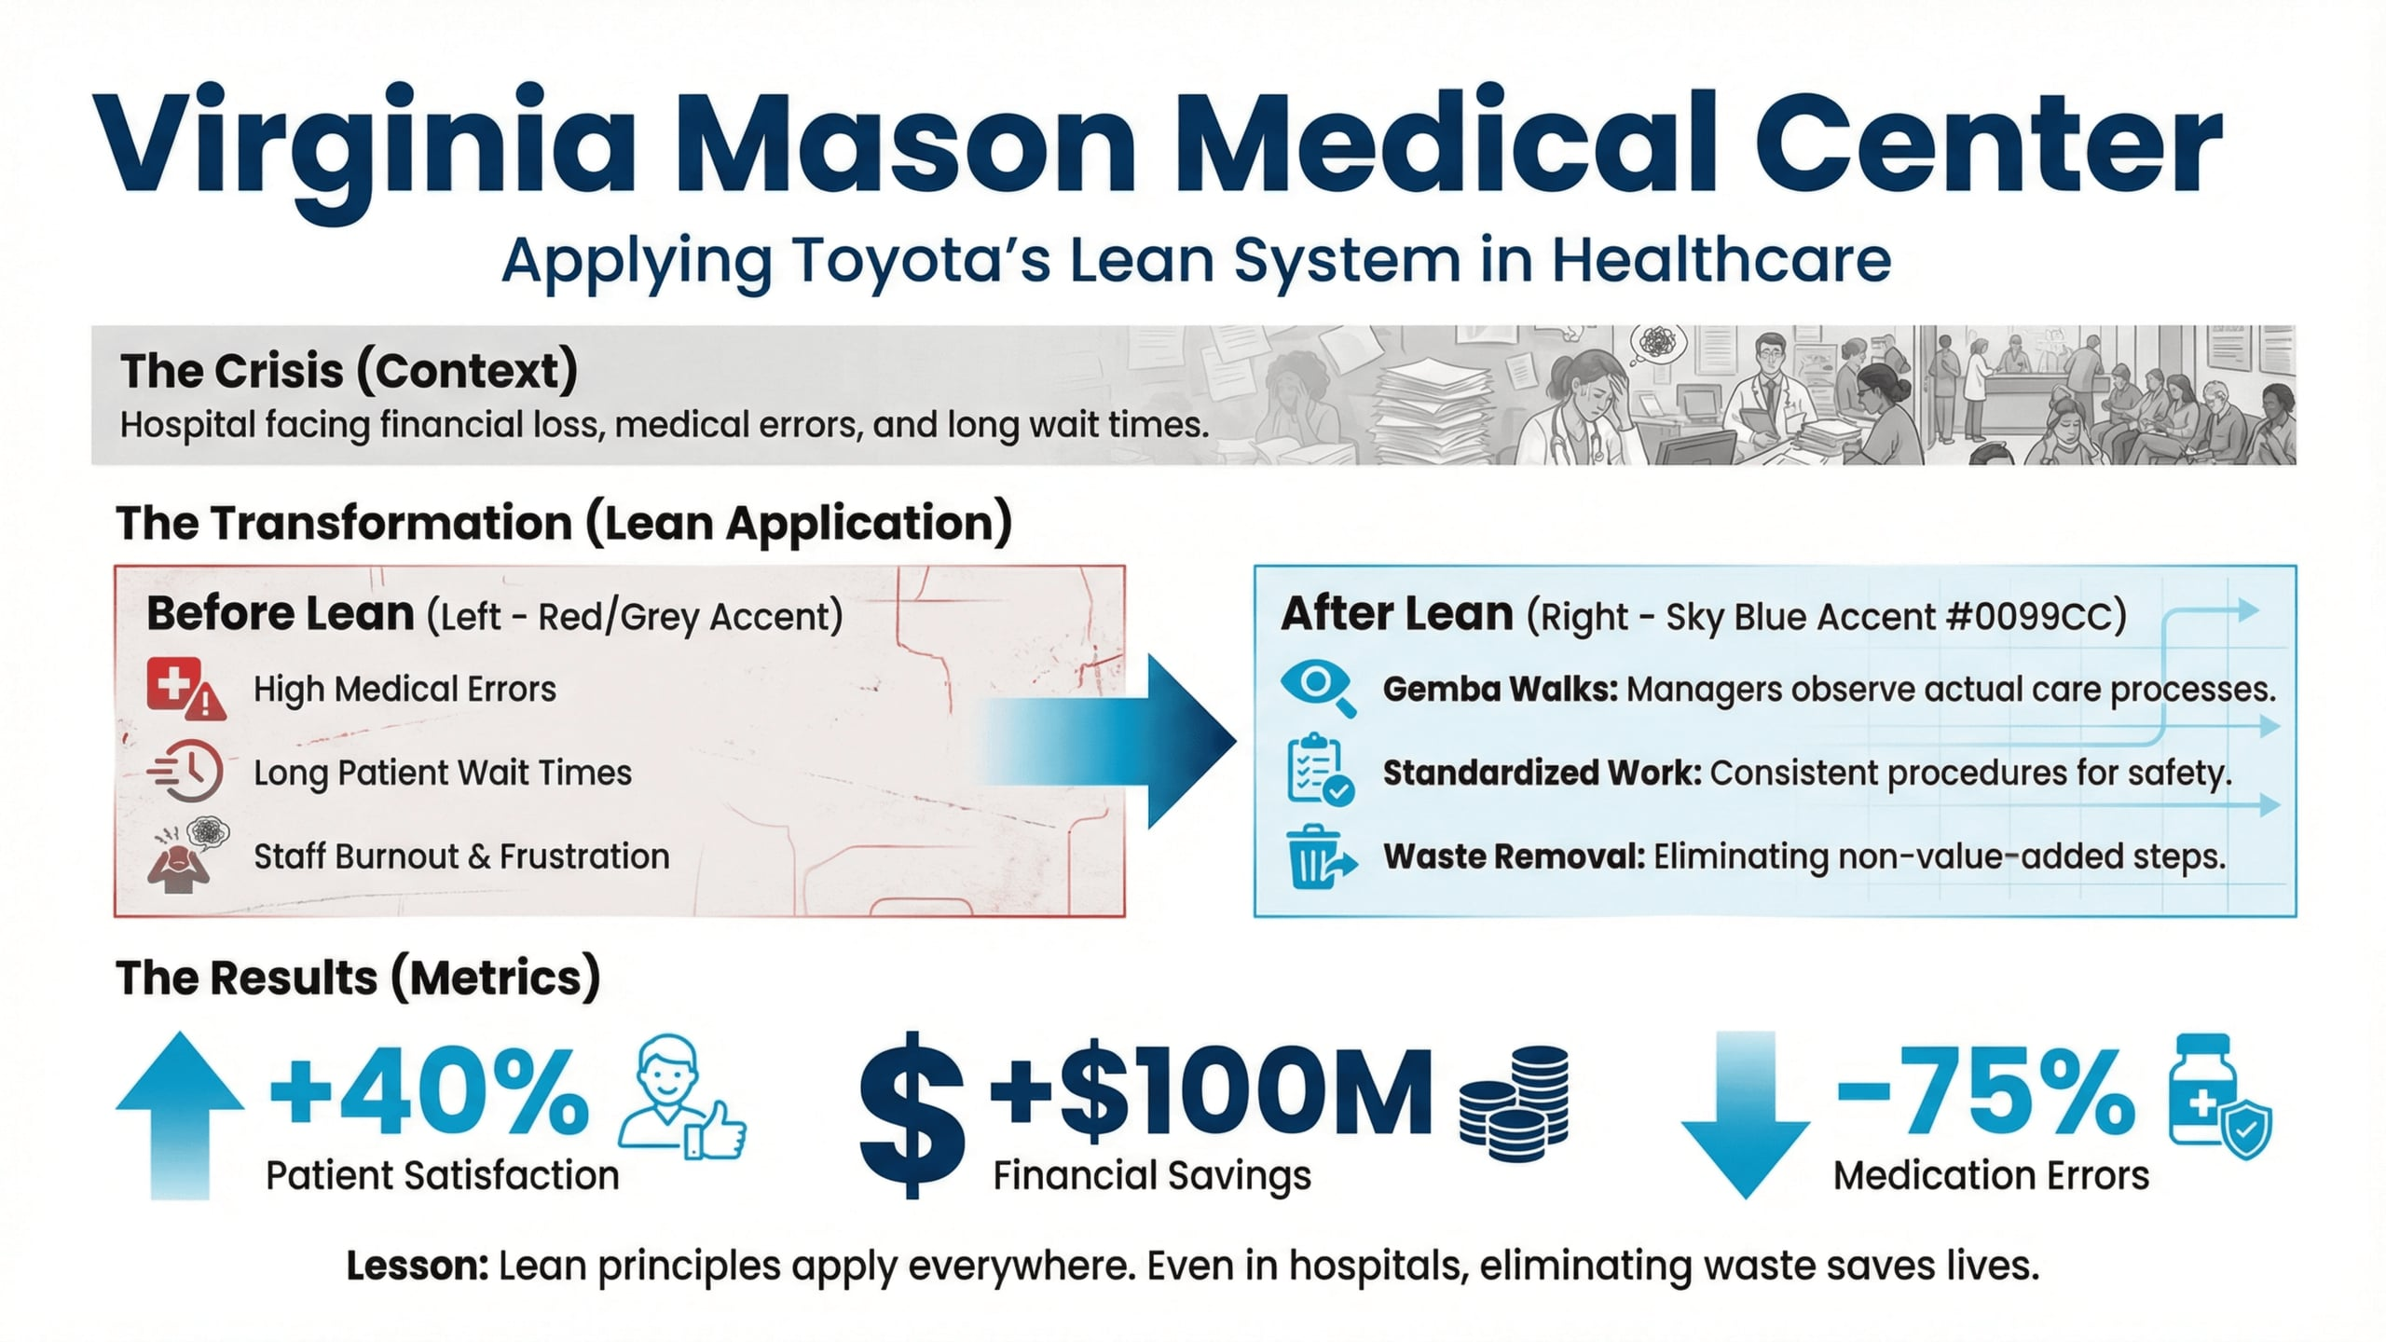
Lecture
05
Virginia Mason Medical Center
vv
1 - 34

Slide 35
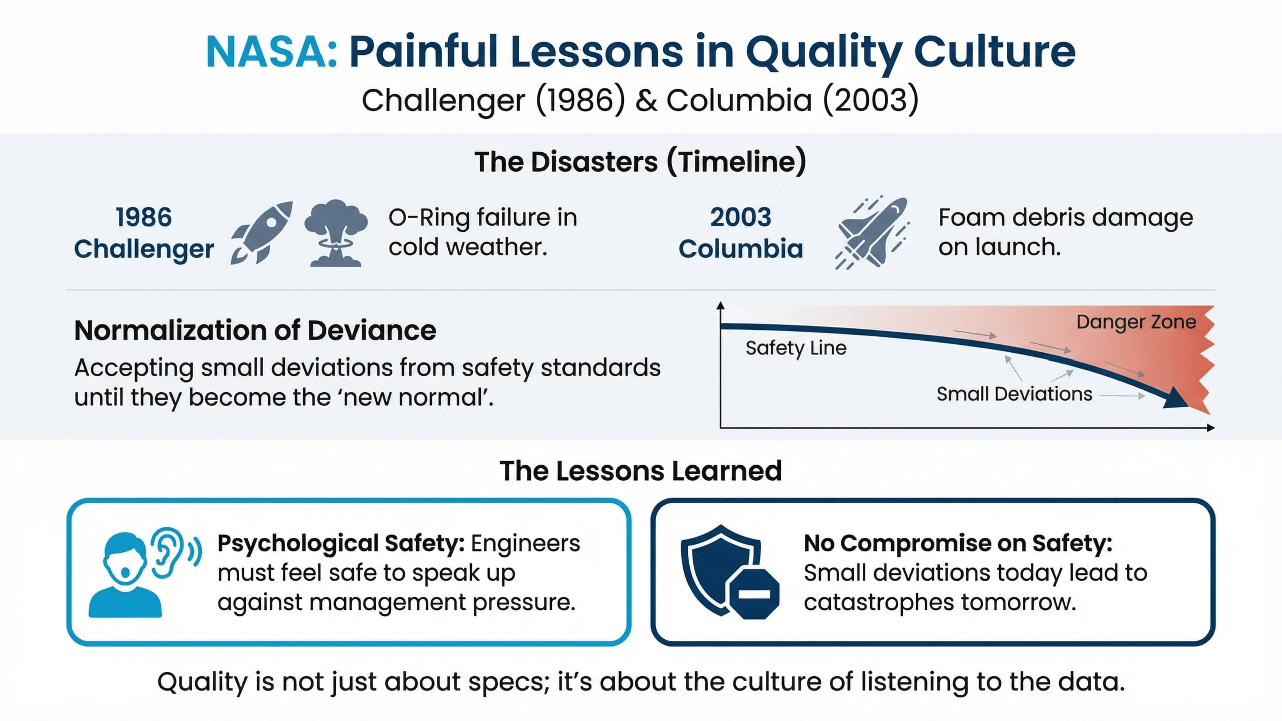
Lecture
05
NASA: The Disasters
1 - 35

Slide 36

Lecture
05
1 - 36

Slide 37
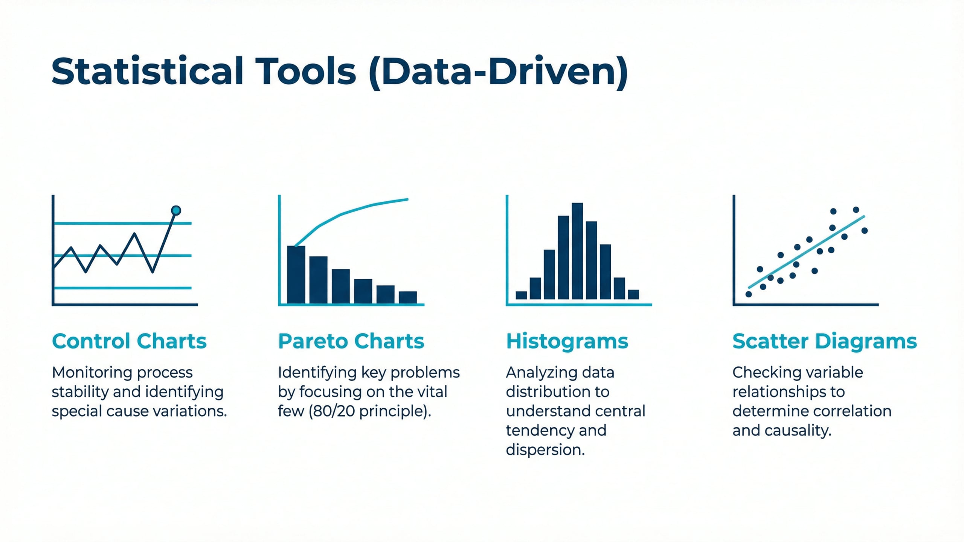
Lecture
05
Statistical Tools
1 - 37

Slide 38
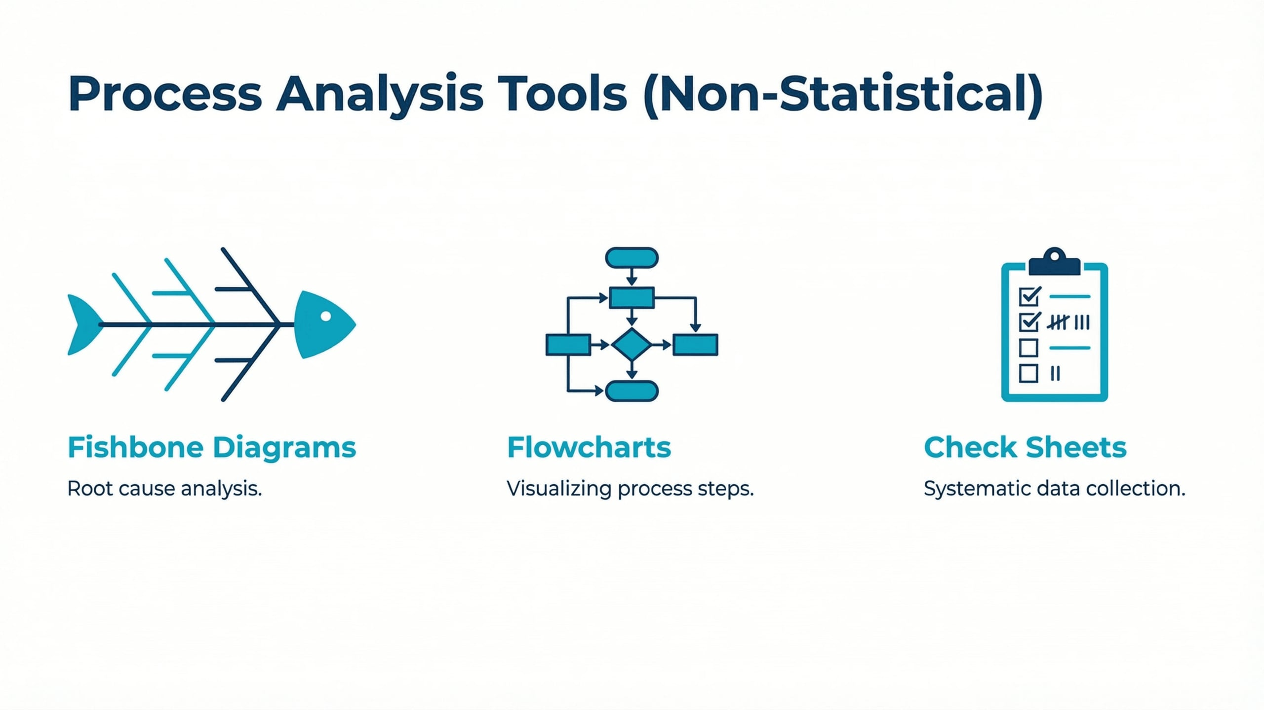
Lecture
05
Non-Statistical Tools
1 - 38

Slide 39
Lecture
05
Today's wisdom
Edwards Deming
"Don't settle for less. Always strive for the best."
Steve Jobs
1 - 39

Slide 40


Thank You

