Slide 1



Influence and Negotiation Skills
Negotiation Strategies
Lecture 8
College of Entrepreneurship and Innovation
Code ENT623
Prepared by
Dr. Bothaina Mahmoud Fouad

Slide 2

Our Learning Outcomes
The main points:
The negotiation Strategies
Difference of each strategy through asking ourselves ( how and when we can use these strategies ).
The Power of Persuasion
Case studies

Slide 3
Difference between Tactics and Strategies
While strategy is the action plan that takes you where you want to go, the tactics are the individual steps and actions that will get you there. In a business context, this means the specific actions teams take to implement the initiatives outlined in the strategy

Slide 4
Difference between Tactics and Strategies
In simple terms, a strategy is a comprehensive, long-term plan of action designed to achieve a specific goal, while tactics are the specific, short-term actions taken to execute that plan. Think of strategy as the "what" and "why," and tactics as the "how".
Strategy:
Long-term: Focuses on achieving broad, overarching goals.
Big picture: Considers the overall direction and roadmap for an organization or project.
Example: A company's strategy might be to become the market leader in a specific industry.
Tactics:
Short-term: Involves specific actions taken to implement the strategy.
Specific and actionable: Outlines the concrete steps needed to achieve the strategy's objectives.
Example: To achieve the market leadership strategy, the company might use tactics like developing innovative products, targeted marketing campaigns, or strategic partnership

Slide 5
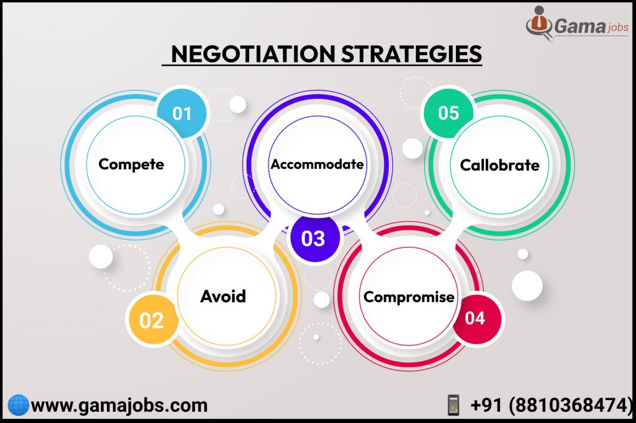
The Negotiation Strategies

Slide 6
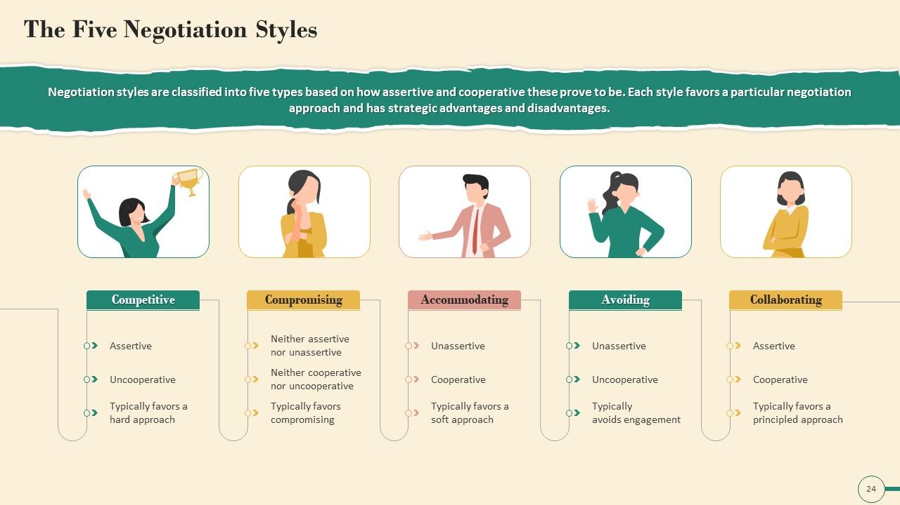
Looking at the Strategy Matrix, you will notice the varying negotiation styles.

Slide 7
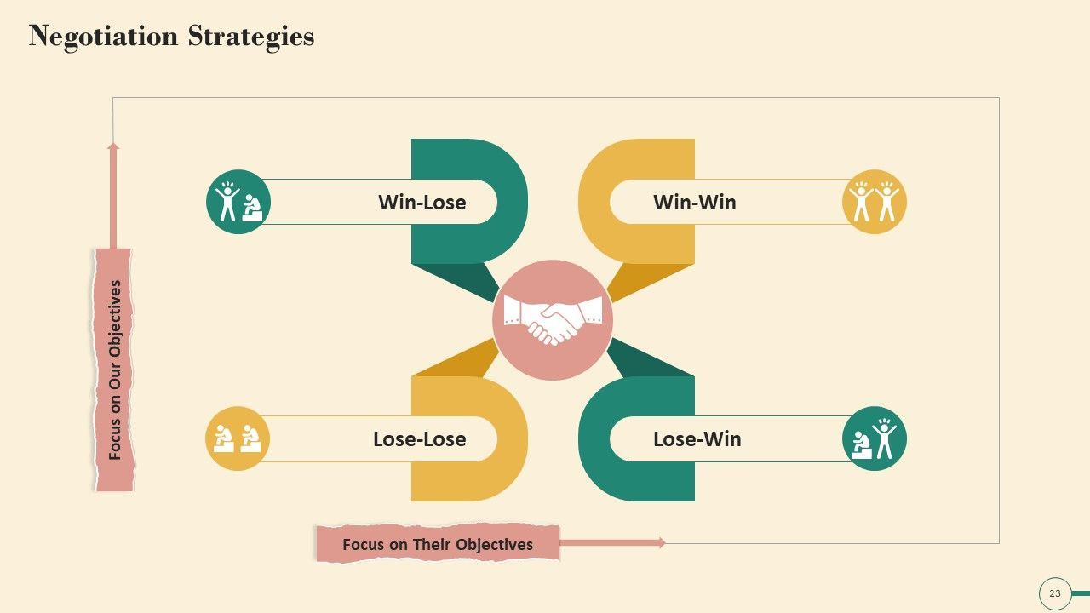
Negotiation Strategies

Slide 8
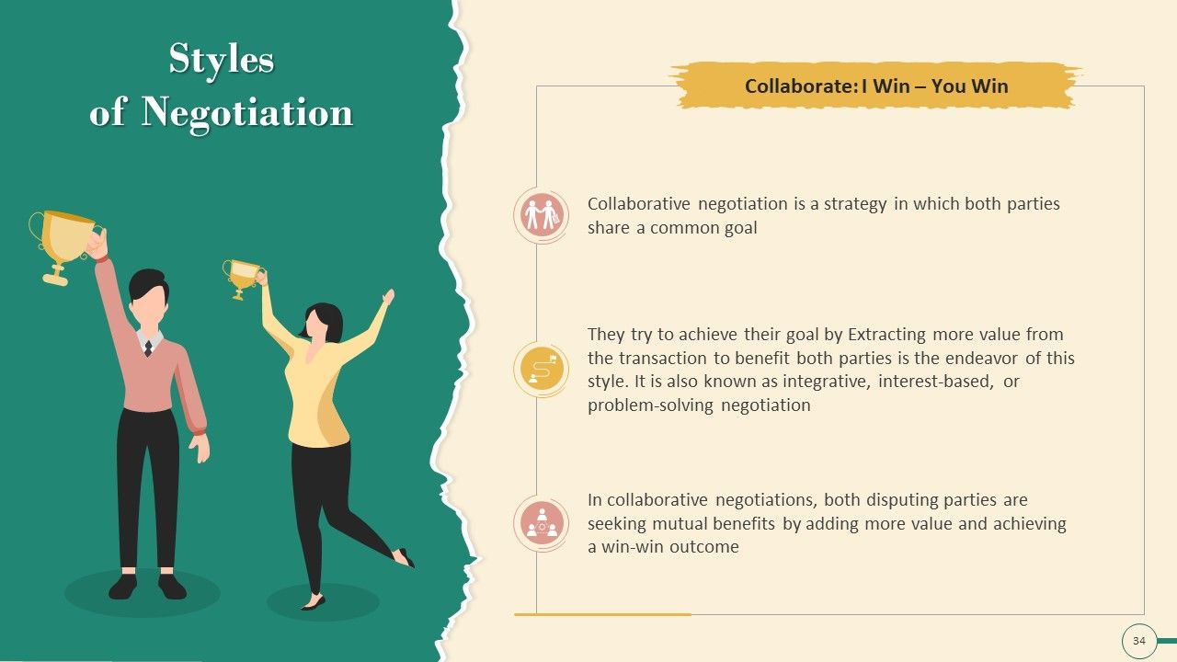
Definition:
Parties work together to find solutions that satisfy the interests of all involved.
Characteristics:
Collaborative, focuses on mutual benefits, and often involves creative problem-solving.
Examples:
Business partnerships,
labor negotiations, and conflict resolution.
Potential Benefits:
Stronger relationships, long-term cooperation, and more creative solutions.
01
Win- Win Strategy
(Integrative Bargaining)

Slide 9
A situation where both parties gain from a transaction or a deal, or where all possible outcomes are favorable.
The situation by which a cooperation, compromise or group participation leads to all participants benefiting
the result of a mutual-gains approach to negotiation in which parties work together to meet interests and maximize value creation.
when both sides are satisfied with their agreement.
01
Win- Win Strategy

Slide 10
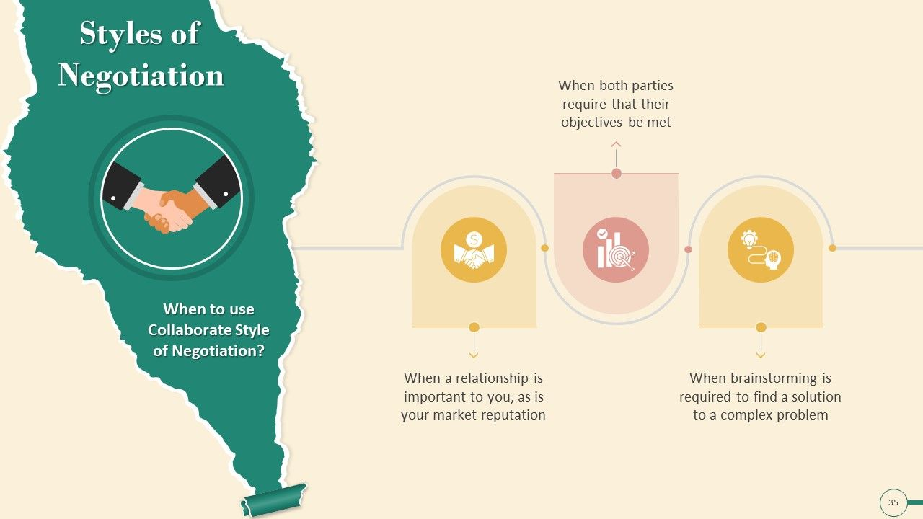
When we can use this style??

Slide 11
Tips for reaching a win-win situation
Start with defining a shared vision, of a desired future you want to achieve.
Focus on long-term mutual gain, and be ready to make short-term tactical changes in your plan if they help to achieve strategic success.
Think holistically, keep the big picture of the desired future in mind and always remember that there are not just one, but many ways to draw it.
See yourselves not as bargainers, but as creators and strategic design thinkers who design a better future jointly.
Be strategically flexible, Keep your mind open to emerging strategic opportunities when you face a major road block in negotiations. Be ready to adapt your strategies accordingly to achieve a Win-Win solution
Stay calm, it's helpful to stay calm and make sure your actions work toward a win for both sides. And to take a moment to breathe and collect your thoughts before responding to a proposed solution you find less than desirable.
Remain positive, Though it's not always certain that you can get everything you want, remaining positive can remind you that there's often still a resolution that can benefit the both of you. A positive attitude can also prime the atmosphere for the negotiations, helping the entire process take on a more positive tone.
Be respectful, Try to keep in mind that the other side of a negotiation is trying to get what they think is fair. Be respectful of other people's time, opinions and requests to help negotiations run smoothly.

Slide 12
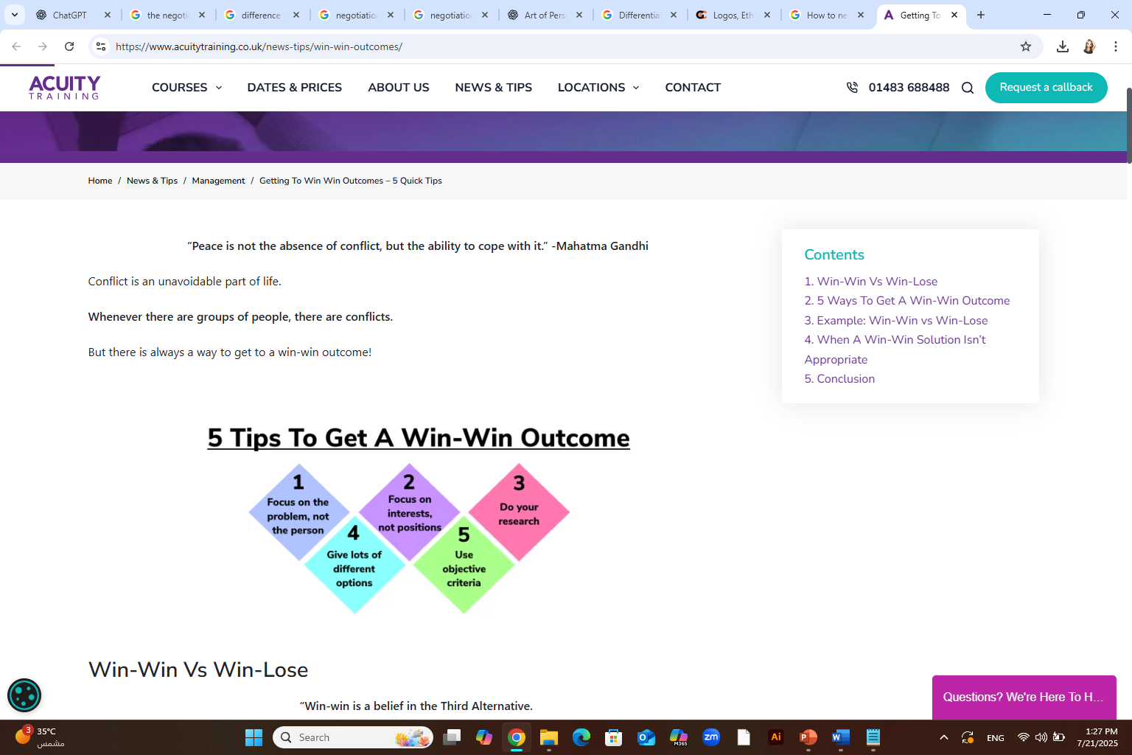
How to negotiate a win-win situation
Remember the other person's goals: When negotiating with someone, it's helpful to remember what the other person might want out of this situation.
Evaluate your expectations: Since a win-win resolution means that both sides think the outcome is beneficial, it's important to make sure that what you expect from the other party is fair to them.
Create mutually beneficial opportunities: If the negotiations don't seem to include a way of reaching a win-win situation, it's sometimes possible to create a new situation that does.
Remain objective: During negotiations, it's best to keep a focus on the objective facts of that specific situation instead of the potential outcome.
Determine your best alternative: Instead of focusing on your most desirable outcome, it's helpful to determine which alternative outcome might have benefits for you.
Work together toward a common goal: It's sometimes helpful to work together with the other party to determine which outcomes you both want.
Be honest about any potential issues: In negotiations like these, it's helpful to remain honest about the things that conflict with your desired goal. This lets both parties either work around those potential conflicts or resolve the issues themselves.

Slide 13
Scenario: Freelance Graphic Designer and a Small Business Owner
Context: A small business wants to hire a freelance graphic designer to create branding materials (logo, business cards, and social media graphics). The business has a limited budget, and the designer wants fair compensation for quality work.

Slide 14
Remember the other person's goals
  Designer considers: “The business owner wants a strong brand presence without going over budget.”
  Business owner considers: “The designer needs to earn fairly for their time and skill.”
2. Evaluate your expectations
  Designer: “I usually charge $1,000 for this package, but given their situation, I can simplify the project to meet them halfway.”
  Business owner: “I was hoping to pay $600. Maybe I can stretch to $800 if we phase the project.”
3. Create mutually beneficial opportunities
  They agree: “Let’s do the logo and business cards now for $700, and revisit the social media graphics next month. This helps both financially and workload-wise.”
4. Remain objective
  They focus on deliverables, timelines, and the value of good design, rather than emotions or assumptions like “You’re undervaluing me” or “You’re charging too much.”

Slide 15
5. Determine your best alternative
  Designer’s BATNA: “If this doesn’t work, I could take a smaller gig this week.”
  Business owner’s BATNA: “I could try a DIY logo maker, but it won’t have the same impact.”
6. Work together toward a common goal
  Both parties discuss their goals and realize: “We both want a polished brand that helps grow the business—if this succeeds, we can collaborate again.”
7. Be honest about any potential issues
  Designer says: “I can’t deliver high-quality results if I have to rush it—can we extend the deadline by two days?”
  Owner says: “I’m concerned about the upfront cost—can we split the payment?”

Slide 16
Win – Win case study
Company A is a large manufacturer of electronics products, and Company B is a small retailer specializing in selling these products to consumers. Both companies recognize the potential for collaboration to increase their profits and market reach.
Objective: The objective of this collaboration is to create a win-win situation where both Company A and Company B can achieve their business goals through mutual cooperation.

Slide 17
Actions
Identifying Complementary Strengths: Both companies identified their respective strengths and weaknesses. Company A excelled in manufacturing and had a vast production capacity, while Company B had a strong local market presence and knowledge of consumer preferences.
Resource Sharing: To create a win-win situation, both companies agreed to share resources. Company A offered a discount on bulk purchases to Company B, enabling the retailer to access products at a lower cost. In return, Company B agreed to provide valuable market insights and feedback on product performance.
Marketing Collaboration: Company A and Company B collaborated in marketing efforts. Company B utilized its local market knowledge and customer relationships to promote Company A's products effectively. This resulted in increased sales for Company A and a boost to Company B's revenue through increased customer traffic.
Customer Support Collaboration: Company B provided pre and post-sales customer support on behalf of Company A. This arrangement helped both companies significantly. Company B expanded its service offerings, attracting more customers, and Company A reduced its operational costs by outsourcing customer support.

Slide 18
Results
Increased Sales and Profits: The collaboration resulted in increased sales for both companies. Company A's products gained wider visibility through the retailer's marketing efforts, leading to a surge in demand. Company B saw an increase in revenue due to access to discounted products and increased foot traffic.
Market Expansion: Through collaboration, Company A was able to penetrate new markets, leveraging Company B's established distribution channels. This resulted in increased product exposure and improved accessibility for customers.
Improved Efficiency: The collaboration allowed Company A to focus on its core competency of manufacturing, while Company B handled customer support and marketing. This specialization improved operational efficiency for both companies, ultimately leading to cost savings and improved overall performance.
This case study demonstrates how a win-win situation can be achieved through collaboration and resource sharing. By identifying complementary strengths and aligning their objectives, Company A and Company B were able to benefit from each other's capabilities, resulting in increased sales, market expansion, and improved efficiency. Such win-win partnerships build sustainable relationships and contribute to the long-term growth and success of businesses involved.
Conclusion

Slide 19
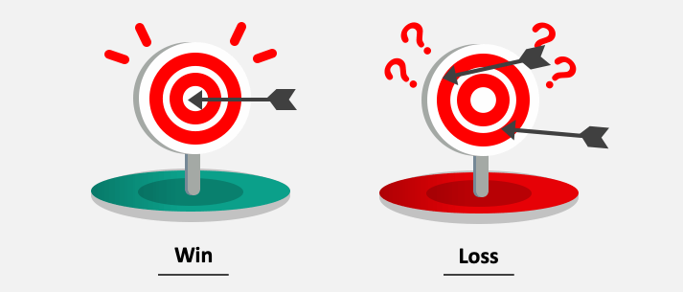
Definition
refers to a distributive negotiation where one negotiator’s gain the other negotiator’s loss. Both negotiators are typically competing to take away or claim the most value from their negotiation.
The win-lose negotiation assumes a fixed amount of value (zero-sum game) — if one side gains, the other loses.
This term refers to a distributive negotiation whereby one party’s gain is another party’s loss.
Both parties are competing to get the most value from the negotiation
with Win-Lose, you are looking to claim as much of the existing value as possible.
Also called the ‘fixed-pie’ scenario.
02
Win- Lose Strategy

Slide 20
Characteristics:
Competitive or adversarial.
Short-term focus.
Often involves hard bargaining or manipulation.
One party gets more at the expense of the other.
Examples:
A buyer insists on a very low price, forcing the seller to accept minimal profit.
Legal settlements where one party wins the case, and the other loses completely.
Potential Downsides:
Can damage relationships.
Often leads to resentment or future conflict.
Limited opportunities for creative solutions.
02
Win- Lose Strategy

Slide 21
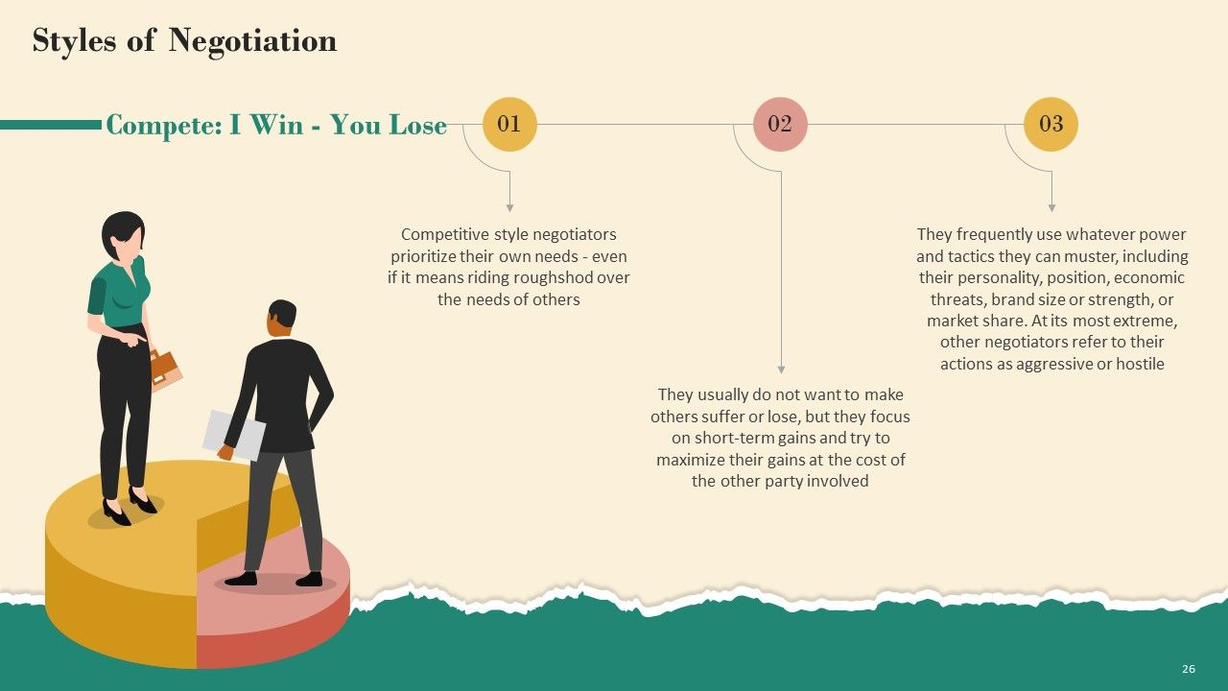
When we can use this style??

Slide 22
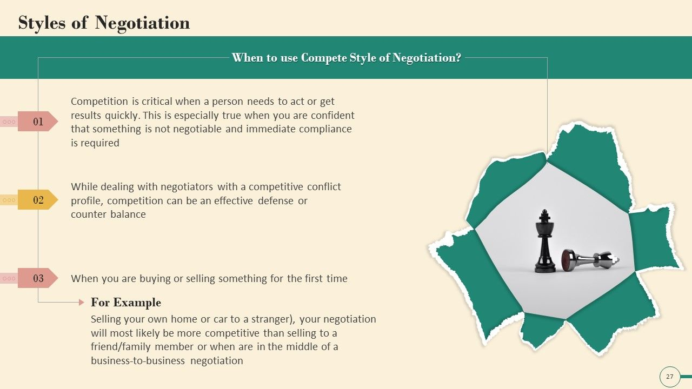
When we can use this style??

Slide 23
Win – Lose case study
the negotiation between a company and its labor union during contract renewal.
Let's say Company X, a manufacturing firm, is negotiating a new contract with its labor union representing the workers.
The workers are demanding higher wages and improved working conditions, while the company wants to keep labor costs low to remain competitive in the market.
In this situation, if the labor union is successful in negotiating higher wages and better working conditions, the workers will be considered the winners. They will enjoy improved pay and working conditions, potentially leading to higher job satisfaction and productivity.
However, if the company is unable to meet the union's demands, they will be considered the losers. They may have to cut costs in other areas, reduce labor force, or face strikes and disruptions in operations. This could negatively impact the profitability and competitiveness of the company.
Ultimately, this negotiation illustrates a win-lose situation as the outcome favors one side (the workers or the company) at the expense of the other.
Conclusion

Slide 24
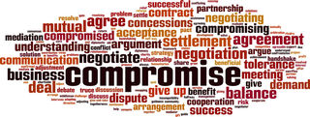
Definition:
Both parties give up part of their demands to reach an acceptable middle ground.
Or both parties give up something that they want in order to get something else they want more.
Characteristics:
Often used under time pressure.
Seen as “fair,” but might not be the best outcome for either side.
Faster than integrative negotiation, but possibly less creative.
Examples:
Negotiating a project deadline that is halfway between two proposed dates.
Settling a lawsuit for half the claimed damages.
Potential Benefits:
Can resolve conflict quickly.
Everyone walks away with something.
03
Compromise Strategy

Slide 25
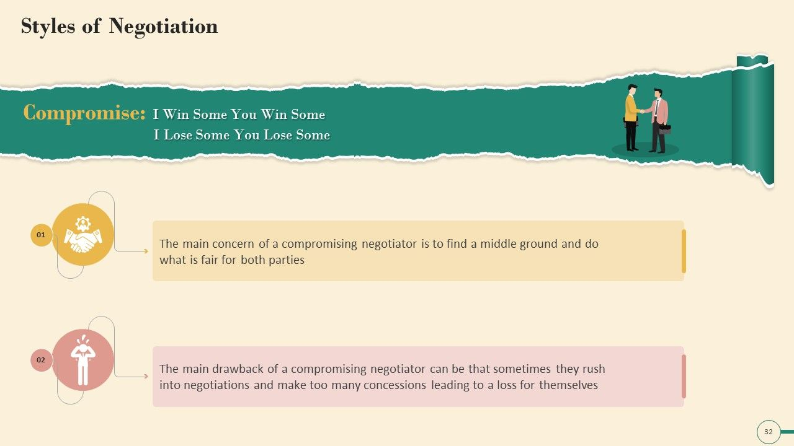
When we can use this style??

Slide 26
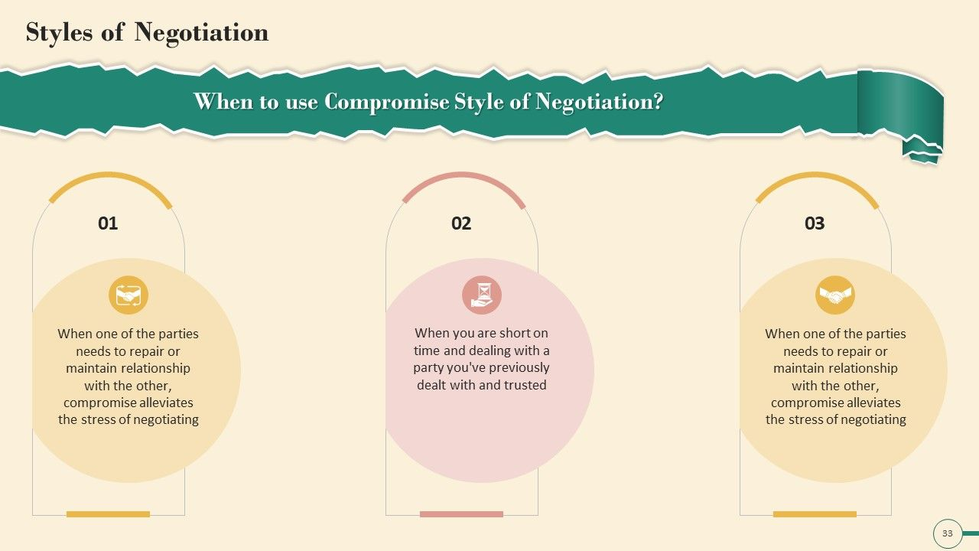
When we can use this style??

Slide 27
Compromise case study
Joy and Antony want to buy a house that is on the market for 200000$.
However, they don’t want to pay that much, so they make an offer of 160000$.
Bob the seller doesn't want to go that low, but does want to sell the house soon, so he offers to sell for 180000$.
Joy and Antony accept the deal and the house is sold.
In this case, Joy and Antony paid 20000$ more than they wanted to and Bob sold for 20000$ less, but the house was exchanged, which was the main goal of both parties

Slide 28
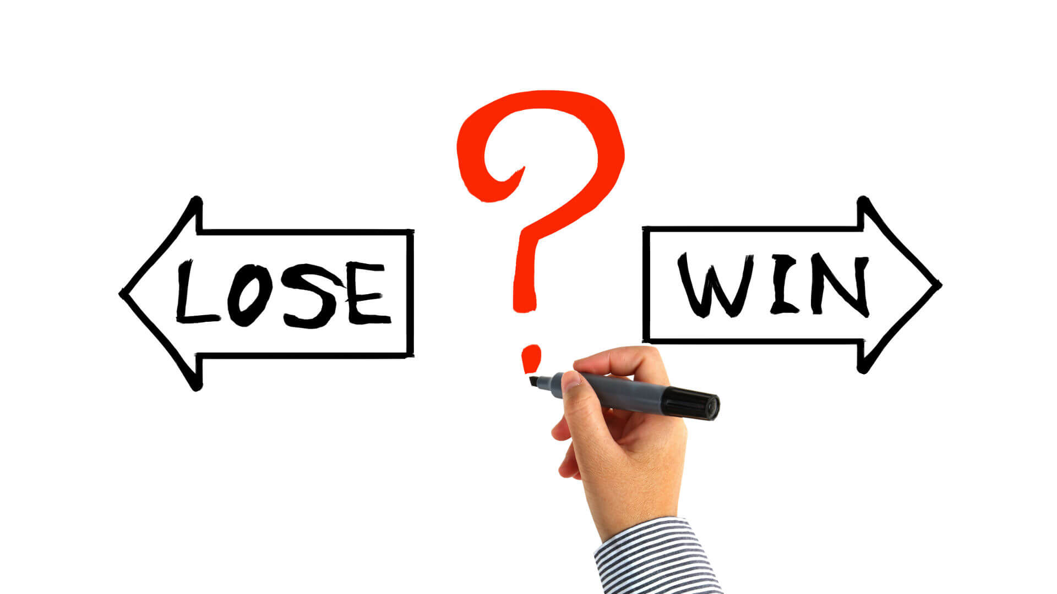
Definition:
One or both parties choose to avoid or delay the negotiation altogether.
this a strategy where one party gives in to the wishes or demands of another. They're being cooperative but not assertive. This may appear to be a gracious way to give in when one figures out s/he has been wrong about an argument.
04
Lose- Win Strategy

Slide 29
Characteristics:
Passive approach.
Often due to fear of conflict or lack of power.
May lead to unresolved issues.
Examples:
An employee avoids asking for a raise despite dissatisfaction.
Two departments refuse to collaborate, resulting in inefficiencies.
Potential Drawbacks:
Problems persist or worsen.
Missed opportunities for resolution or growth.
04
Lose- Win Strategy

Slide 30
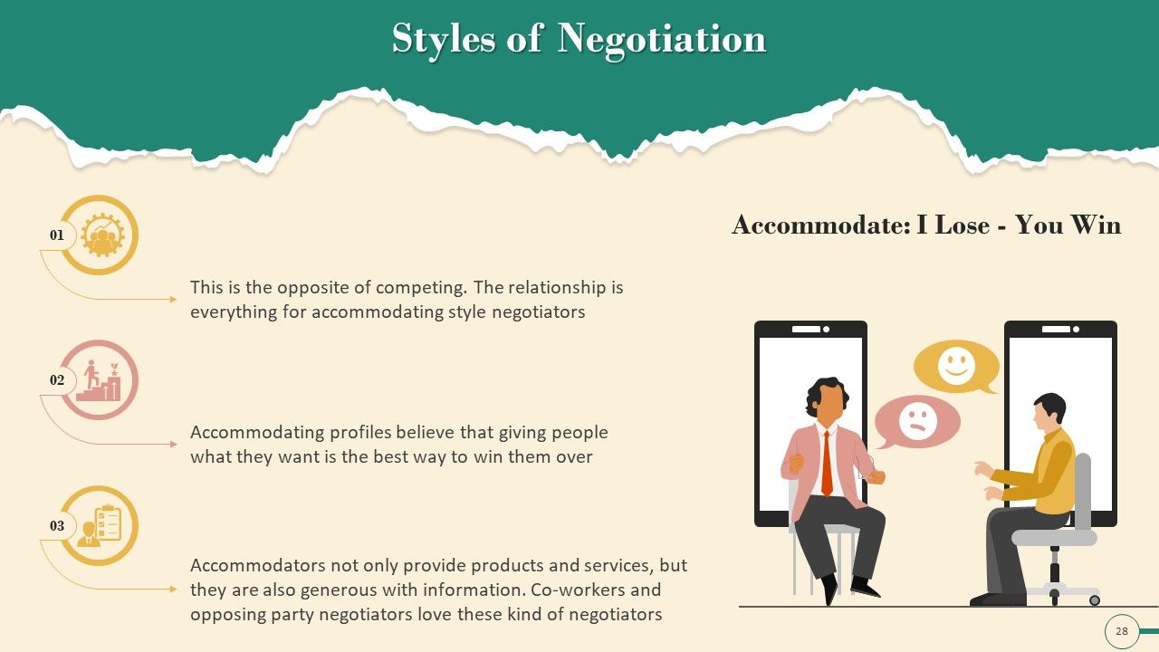
When we can use this style??

Slide 31
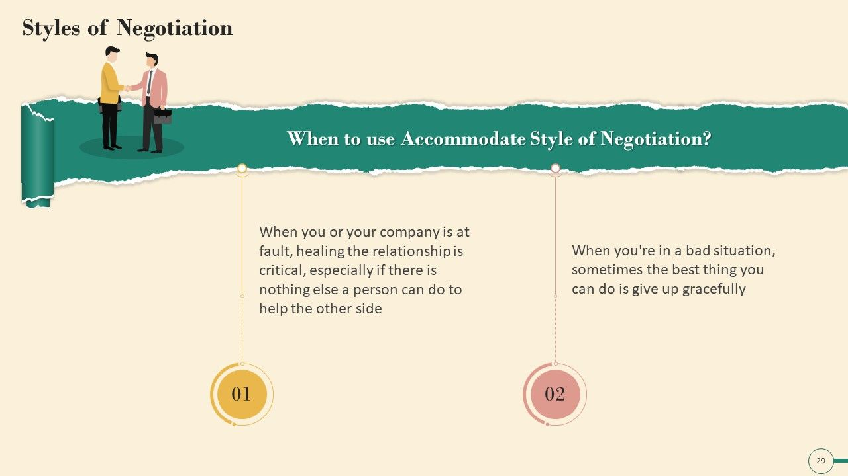
When we can use this style??

Slide 32
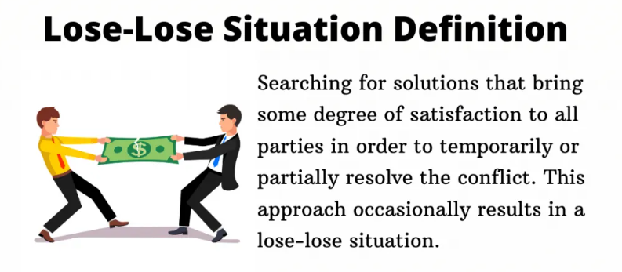
Definition:
A negotiation where both parties end up worse off, often due to stubbornness, miscommunication, or unwillingness to compromise.
Is called too no win situation, is one where a person has choices, but no choice leads to a net gain
05
Lose- Lose Strategy

Slide 33
Characteristics:
  Often emotional or defensive.
  Driven by a desire to “not let the other win.”
  Results in suboptimal outcomes.
Examples:
  Two companies go to court instead of settling, resulting in huge legal fees for both.
  Labor strike where both the employer and employees suffer financial losses.
Potential Causes:
  Ego or pride.
  Poor communication.
  Misaligned goals.
05
Lose- Lose Strategy

Slide 34
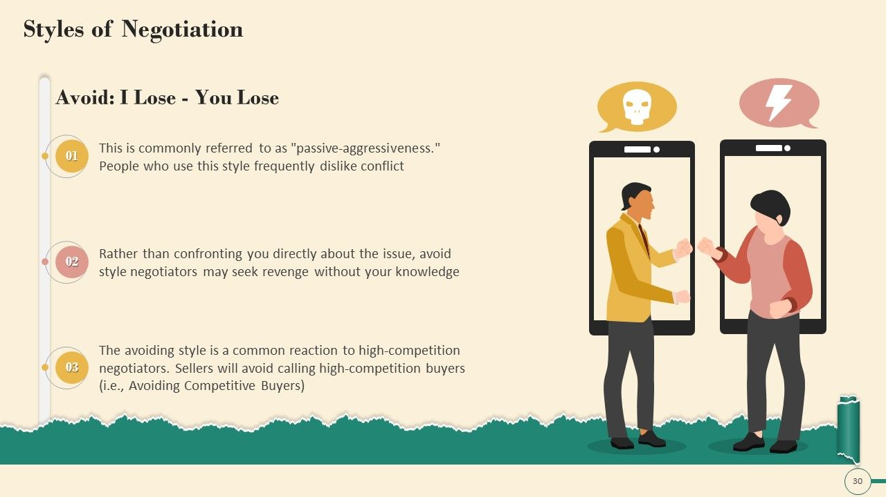
When we can use this style??

Slide 35
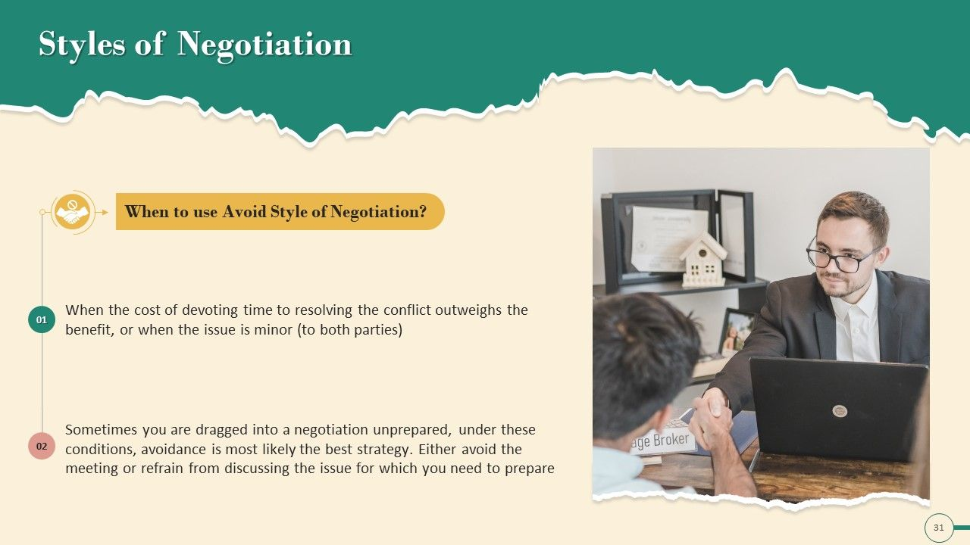
When we can use this style??

Slide 36
Lose – Lose case study
For example, if a company finds a dangerous fault in one of its products, they can either issue a product recall and take some reputational damage, or allow the product to harm people: the company is in a no-win situation.

Slide 37
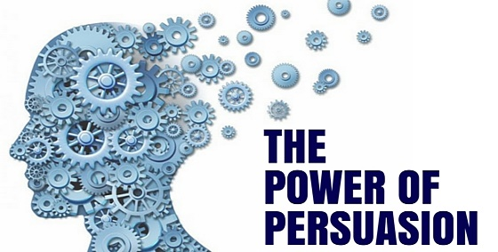
The Power of Persuasion

Slide 38
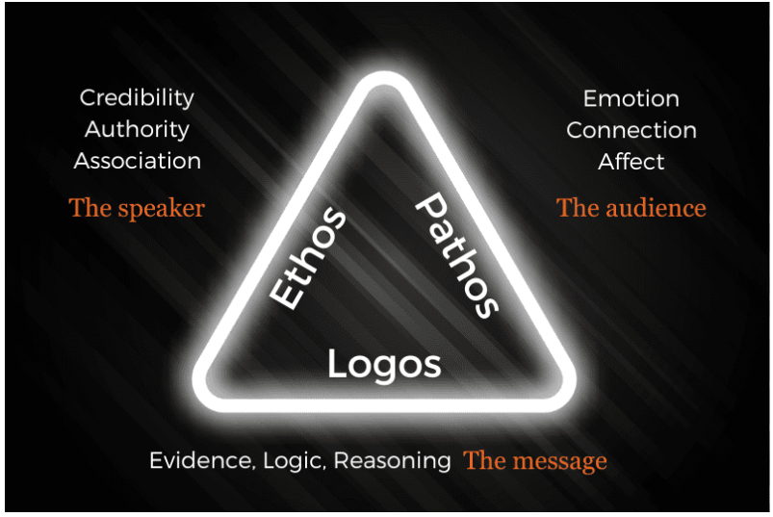
The Power of Persuasion
Ethos, pathos, and logos are three persuasive appeals used to influence an audience. Ethos focuses on establishing the speaker's credibility and trustworthiness, pathos uses emotional appeals to connect with the audience, and logos relies on logical arguments and evidence to persuade

Slide 39
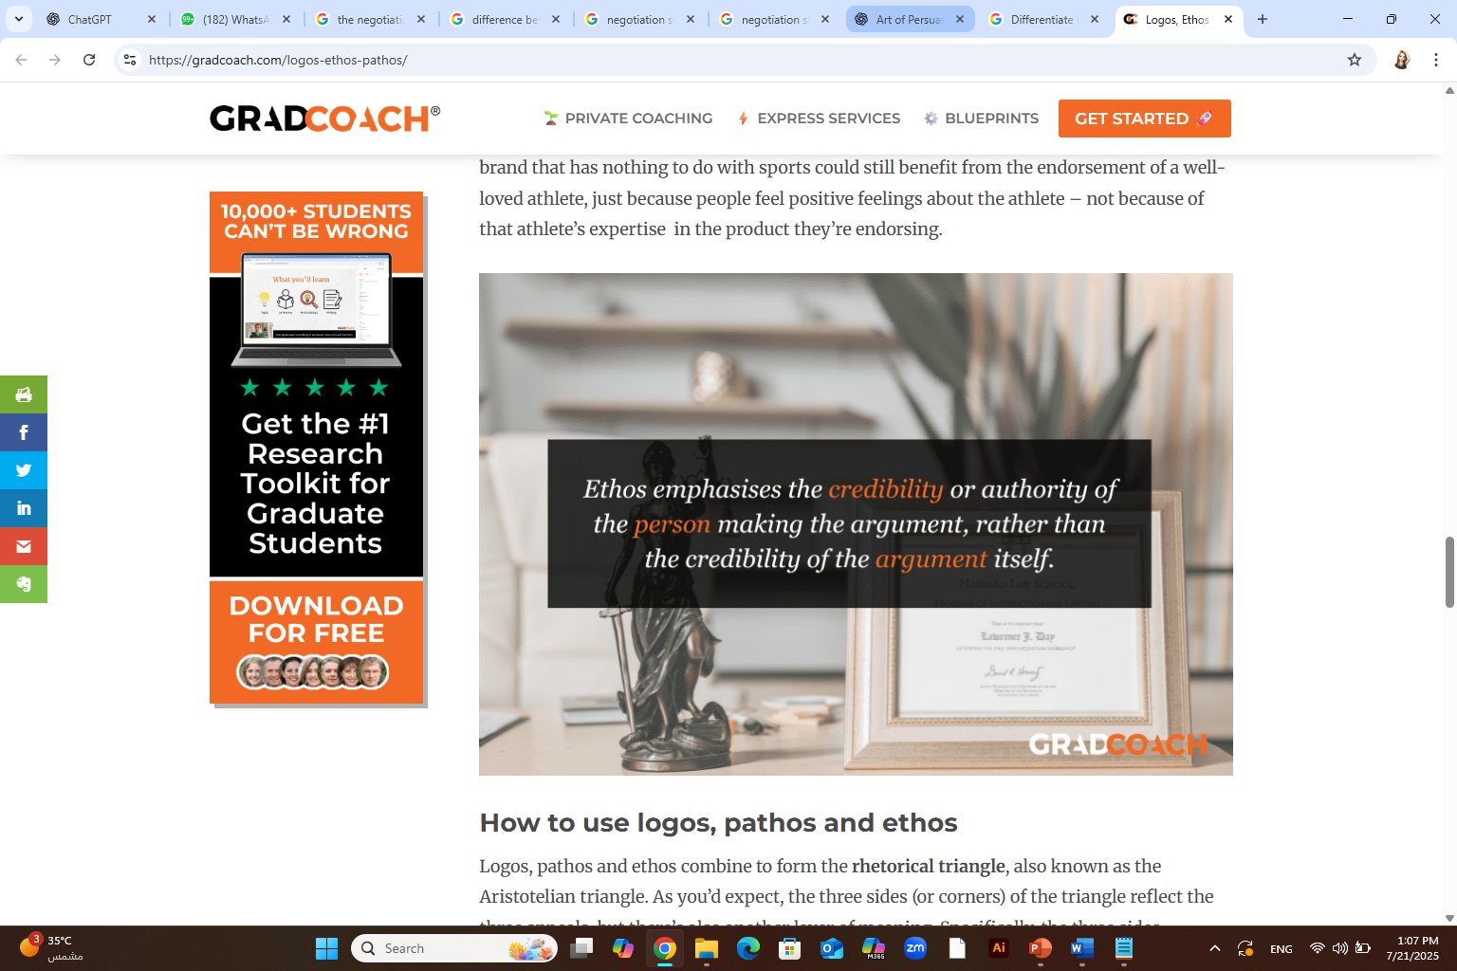
The three classic modes of persuasion
1. Ethos — Building Credibility
Definition: Appeal based on the character, credibility, or authority of the speaker or writer.
Goal: Make the audience trust you.
How it works: When you demonstrate expertise, integrity, or goodwill, people are more likely to believe and follow you.
Examples:
“As a doctor with 20 years of experience…”
“Our organization has won multiple safety awards.”
Speaking clearly, dressing professionally, and citing reliable sources.
Best used when: You're trying to gain trust or establish authority on a topic.

Slide 40
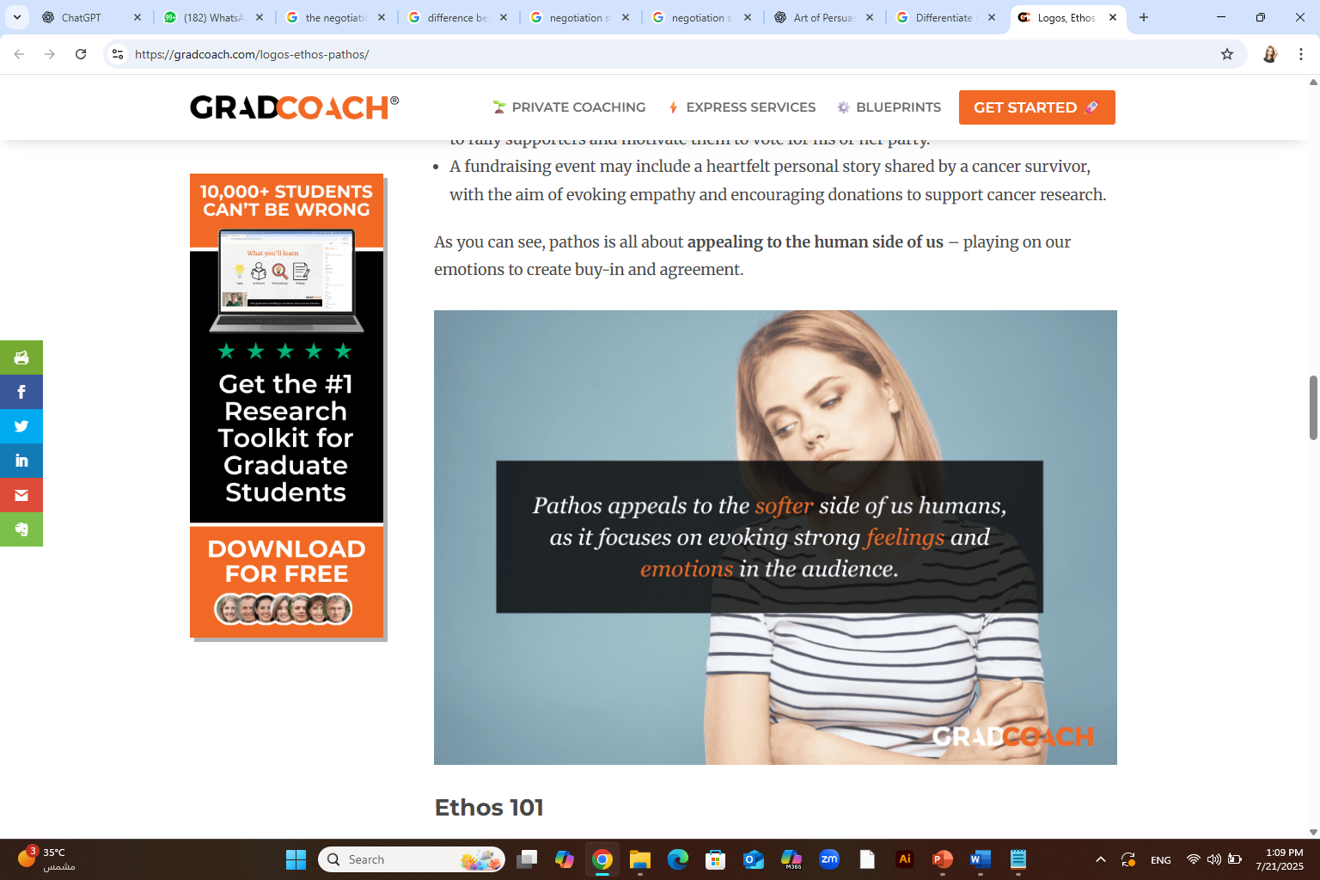
The three classic modes of persuasion
2. Pathos — Emotional Appeal
Definition: Appeal to the emotions, values, or desires of the audience.
Goal: Make the audience feel something—sympathy, fear, anger, joy—that leads them to act.
How it works: By tapping into feelings or personal stories, you create a connection that logic alone may not achieve.
Examples:
“Imagine a child going to bed hungry tonight.”
Using music, vivid imagery, or emotionally charged language.
Showing before/after effects of a problem.
Best used when: You need to motivate action or inspire empathy.

Slide 41
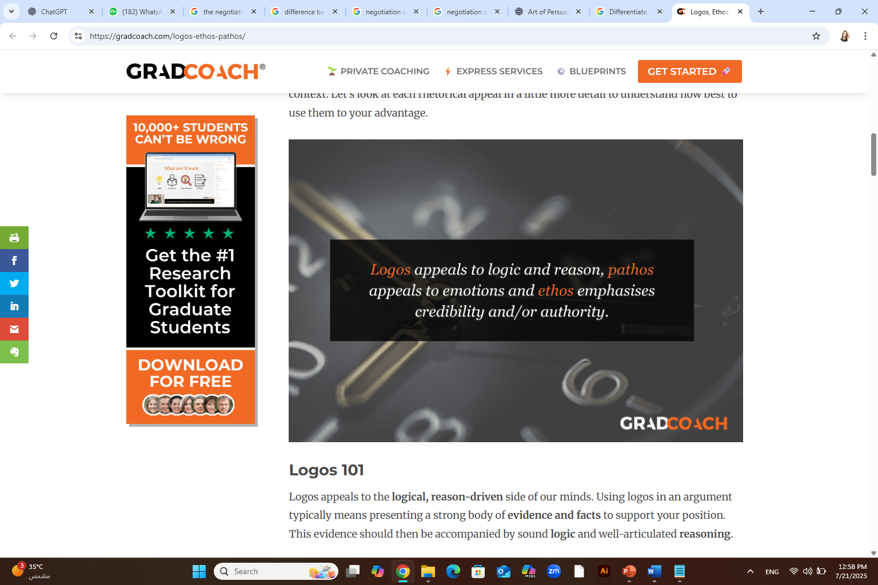
The three classic modes of persuasion
3. Logos — Logical Argument
Definition: Appeal to reason, facts, data, and logic.
Goal: Convince the audience through rationality.
How it works: Presenting clear evidence, sound reasoning, and a structured argument makes your case hard to deny.
Examples:
“Studies show a 40% increase in productivity with this method.”
Using statistics, graphs, step-by-step reasoning.
Making comparisons or citing historical facts.

Slide 42
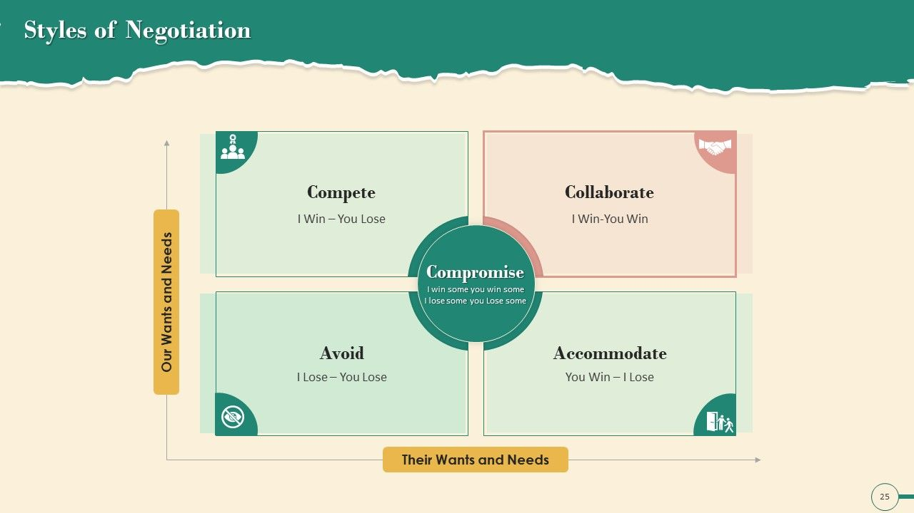
Looking at the Strategy Matrix, you will notice the varying negotiation styles.

Slide 43
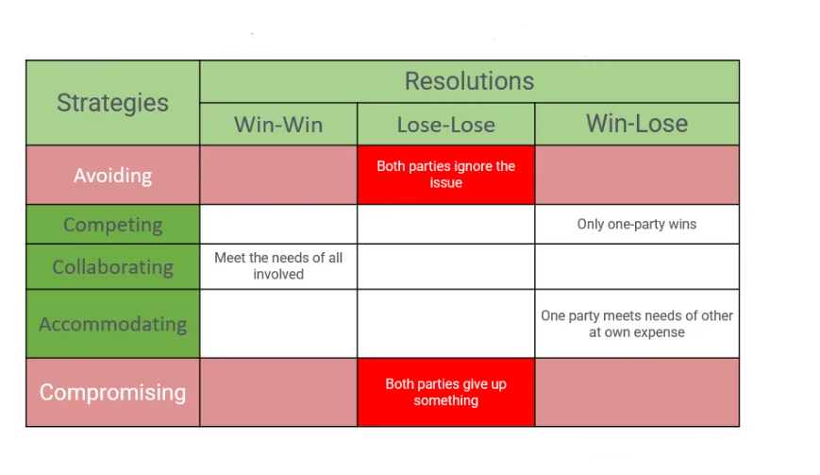
Looking at the Strategy Matrix, you will notice the varying negotiation styles.

Slide 44



Thank You

