Slide 1

MAT 112
Math by Python

Slide 2
Lecture
10
Lecture Objectives
Study how to download python
Learn how to run different codes with Python for factorization
Learn how to run different codes with Python for graphing functions
Learn how to run different codes with Python for solving limits
Learn how to run different codes with Python for differential
Learn how to run different codes with Python for Integration

Slide 3
Lecture
10
Lecture Objectives
1- Download Python (Anaconda) – Use Jupyter Notebook.
2- Python for factorization
3- Python for graphing functions
4- Python for solving limits
5- Python for differential
6- Python for Integration

Slide 4
Lecture
10
Ways to get the program
1- Go to the technical engineer to set up the program called Anaconda.
2- Use Jupyter ONLINE.
OR
Solve all the problems manually.

Slide 5

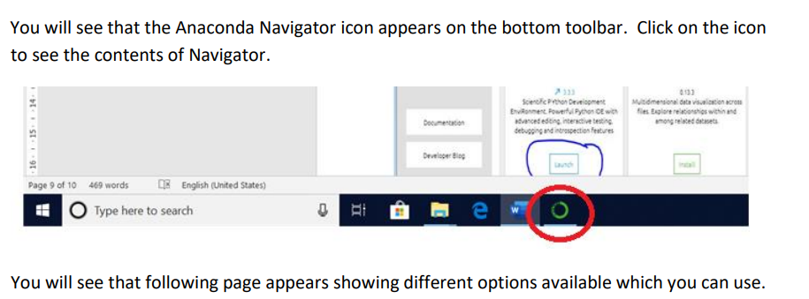
Lecture
10
How to open the program ?

Slide 6
Lecture
10
How to open the program ?

Slide 7
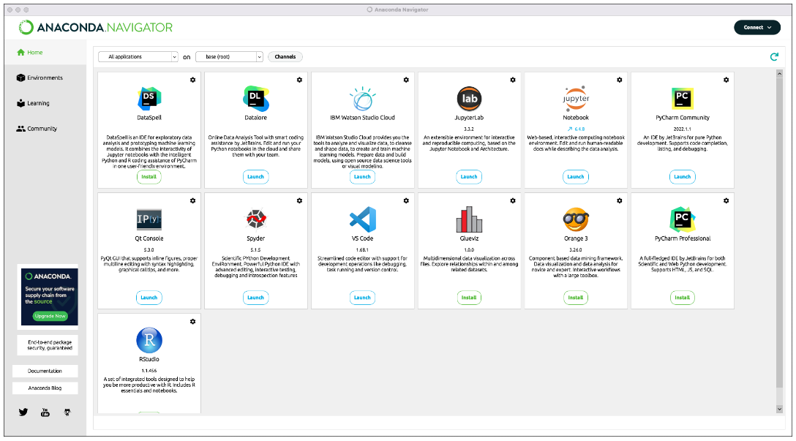
Lecture
10
How to open the program ?

Slide 8
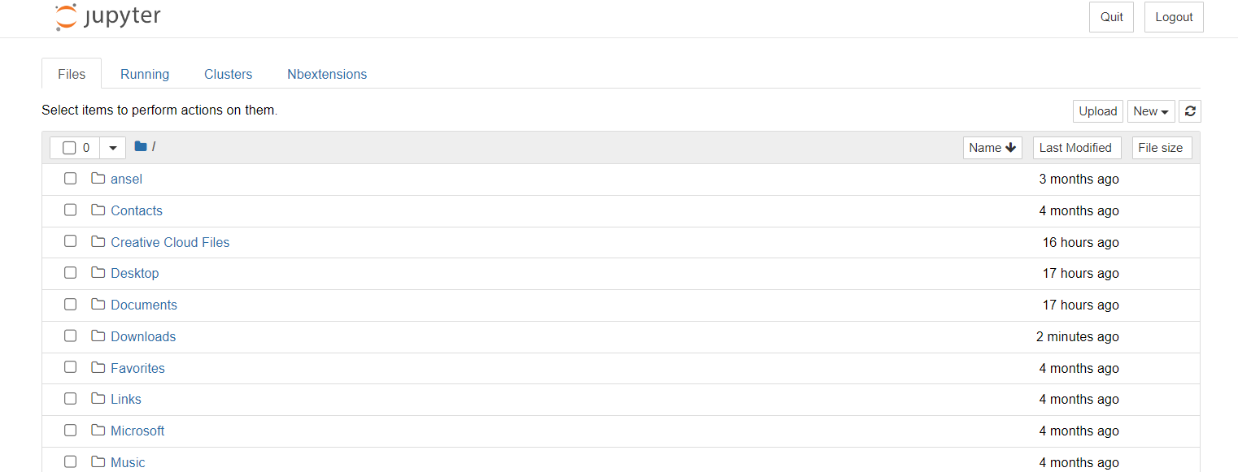
Lecture
10
Jupyter Interface

Slide 9
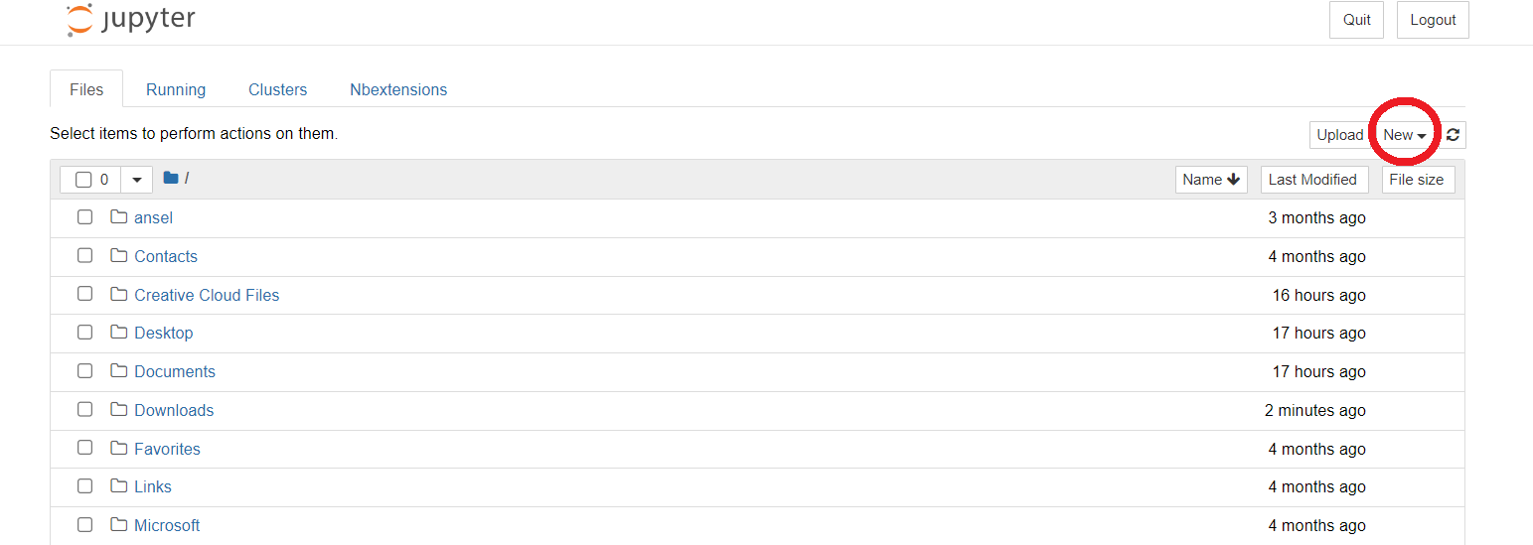
Lecture
10
Open new file in Jupyter

Slide 10
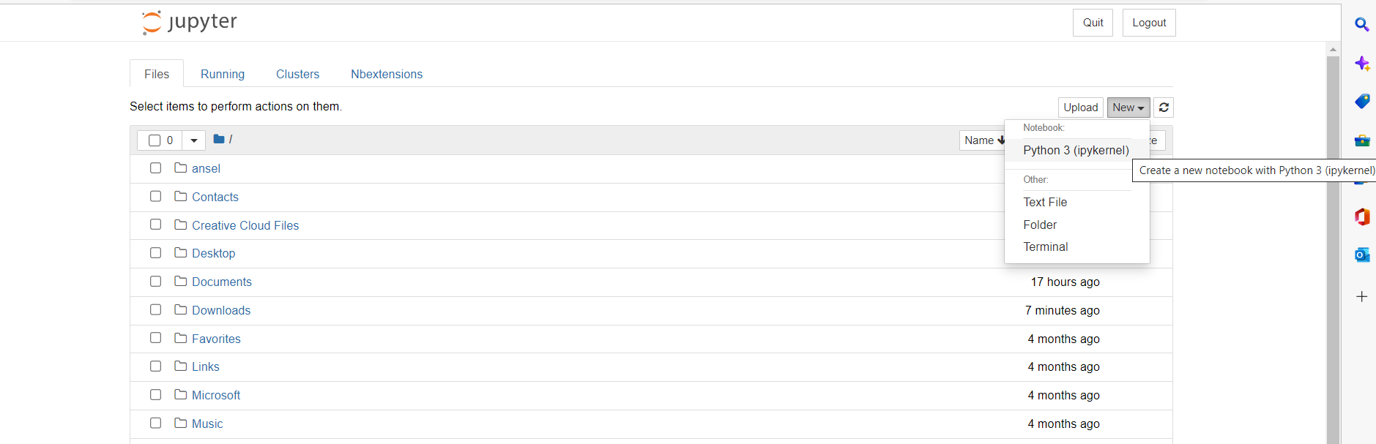
Lecture
10
Open new file in Jupyter

Slide 11
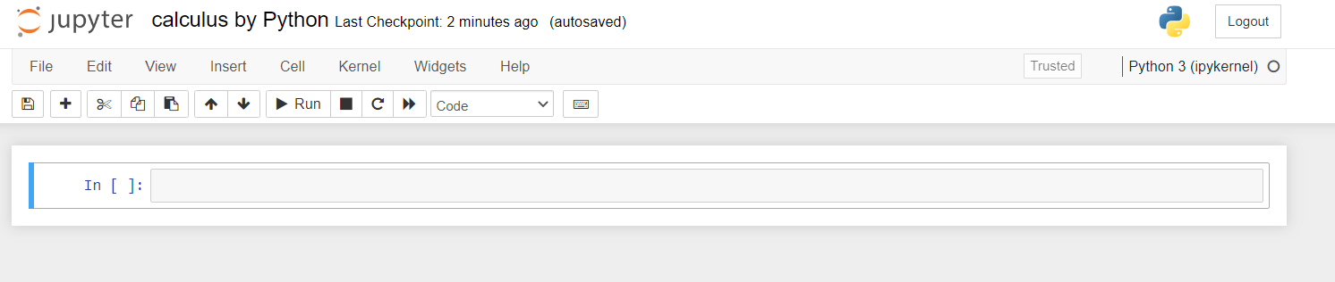
Lecture
10
New Notebook

Slide 12
Lecture
10
New Notebook

Slide 13
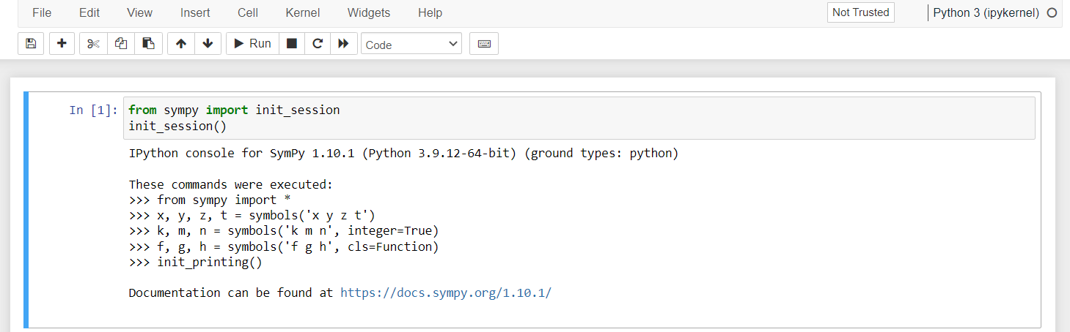
Lecture
10
Sympy Package

Slide 14
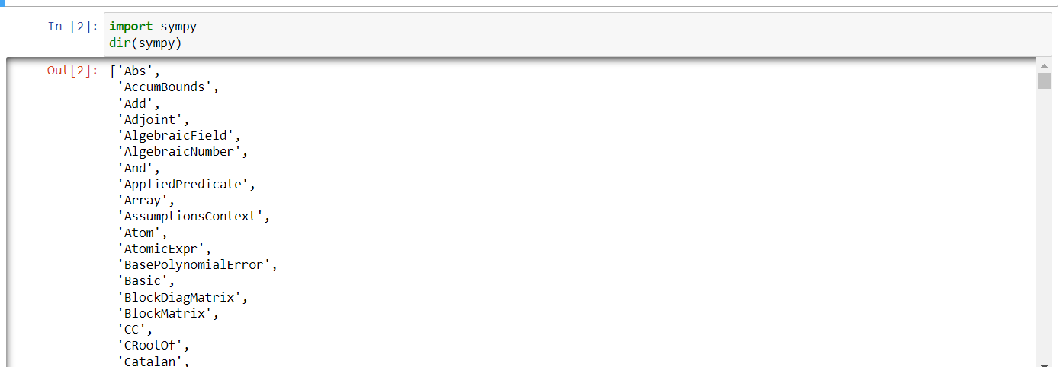
Lecture
10
Sympy Package

Slide 15
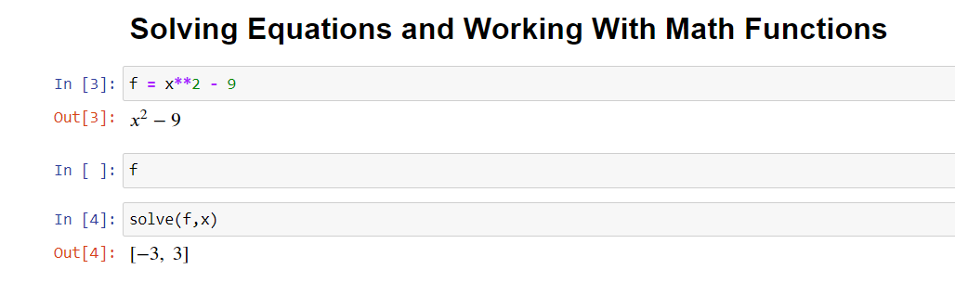
Lecture
10
Solving Equation

Slide 16
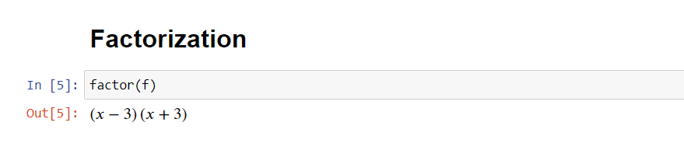
Lecture
10
Factorization by Python

Slide 17

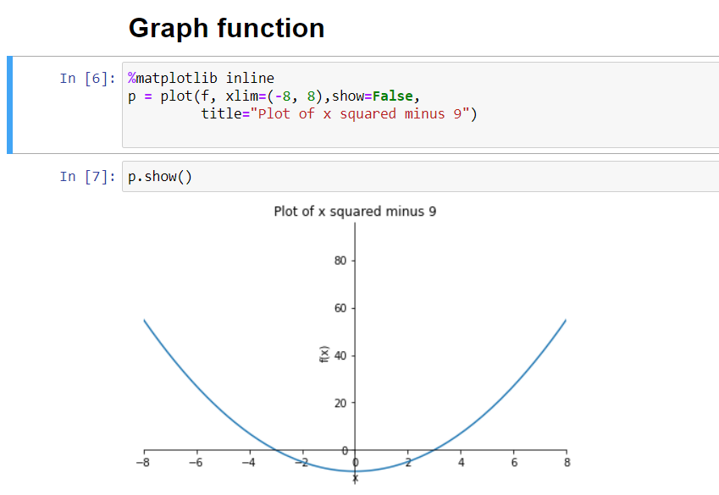
Lecture
10
Graph function

Slide 18
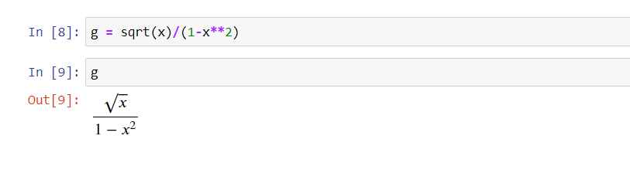
Lecture
10
Writing Root

Slide 19
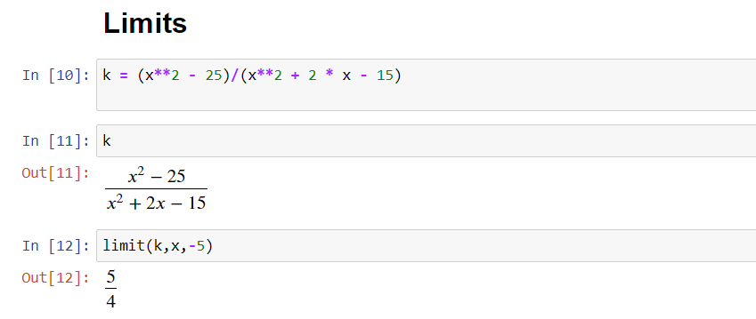
Lecture
10
Limits by Python

Slide 20
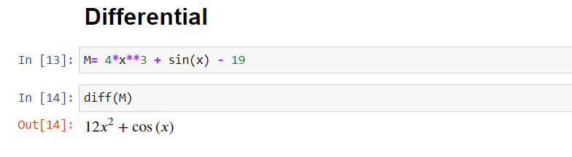
Lecture
10
Python for differential

Slide 21
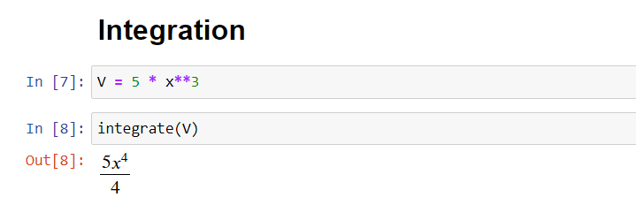
Lecture
10
Integration by Python

Slide 22
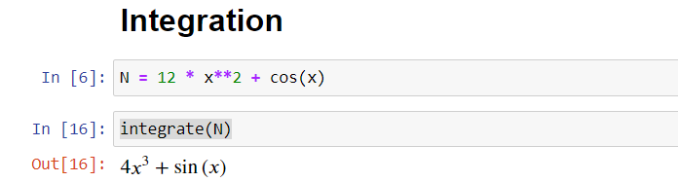
Lecture
10
Integration by Python

Slide 23

Lecture
10
Lecture Summary
1- Download Python
2- Python for factorization factor(f)
3- Python for graphing functions plot(f)
4- Python for solving limits limit(f,x,3)
5- Python for differential diff(f)
6- Python for Integration integrate(f)

