Slide 1



Operational & Strategic Risk Management
PMG630
Lecture 8
Prepared by
Dr. Nael Zabel
www.midocean.ae

Slide 2
Introduction
RISK Treatment IN Managing Operational Risks:
Risk treatment (including risk mitigation) is a general term to indicate modifying a system or its elements for the purpose of affecting particular risk events. Risk treatment follows the identification and description of risks, the latter also termed as risk assessment.

Slide 3
1. WHY RISK TREATMENT IS PERFORMED?
Risk treatment is performed or considered for implementation when particular risks are deemed important enough that actions need to be taken. Importance is usually based on the chances of occurrence, the consequences if the risk events happen, and other factors such as ethical and legal reasons.

Slide 4
2. WHAT ARE THE OBJECTIVES OF RISK TREATMENT
The general objectives in risk treatments are (a) reduction in the chances of occurrence of the risk events and (b) reduction in the consequences if the risk events occur.

Slide 5
3. HOW ARE CHANCES OF OCCURRENCE REDUCED?
Reducing the chance of occurrence, also known as prevention, involves preventing the causal chain of events (or causalities) to develop or progress. Part of risk analysis is establishing the causal chain of events that eventually lead to a particular risk event under consideration, such as those embodied in Failure Mode and Effects Analysis (FMEA), Hazard and Operability Analysis (HAZOP), and Cause and Consequences Analysis (CCA) as discussed in Chapter 3.

Slide 6
3. HOW ARE CHANCES OF OCCURRENCE REDUCED?
Each discernable segment in the causal chain of events may serve as an opportunity to terminate the progression of the risk event, hence reducing the chance of its eventual occurrence.

Slide 7
HOW ARE UNDESIRED CONSEQUENCES
REDUCED IF THE RISK EVENTS OCCUR?
Once a risk event occurs, the accrual of the consequences may be spread out over a time period rather than an instantaneous الفوري
accrual. The general objective is to slow down the accrual of the consequences and to eventually stop it as soon as possible. This is also known as risk mitigation.

Slide 8
Fundamental Strategies Of Risk Treatment
In risk treatment, there are various strategies for (1) reducing chances of occurrence, (2) reducing consequences if they do occur, or (3) both. Detection and control are the typical strategies to reduce the chances of occurrence and are often applied in anticipation of a risk event, while recovery plans address the reduction of consequences after risk events have occurred.

Slide 9
Fundamental Strategies Of Risk Treatment
As an example, consider the risk event of a fire that may result in injury, death, or damage to property and, in an industrial setting, may include the disruption of operation. To make risk treatment more concrete, as an example, consider an industrial fire scenario in which the causalities may follow the sequence shown in Table 4.1.

Slide 10
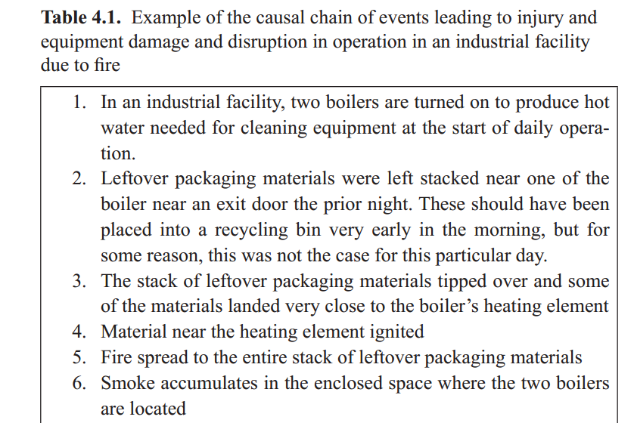

Slide 11
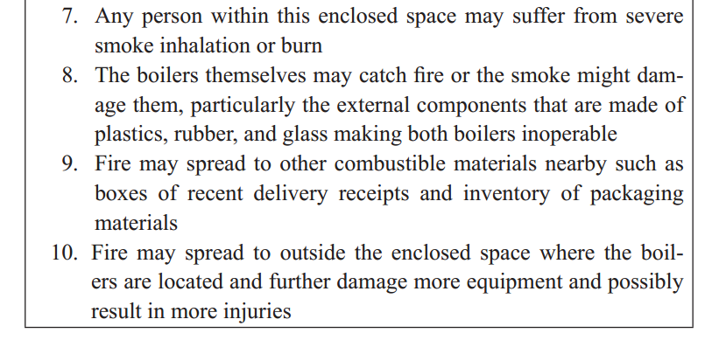

Slide 12
DETECTION
Detection pertainsتتعلق to the capability to obtain information on the presence or absence of a particular event or phenomenon, especially of events causing, and precursory السلائفto the risk events of interest (the risk event of interest is from here on termed as the target risk event).Early and accurate detection of the causal chain of events provides opportunities to prevent or control succeeding events to happen, essentially breaking the causal chain of events that lead to the target risk event and further progression of the sequence of events and accrual of consequences.

Slide 13
CONTROL
Once the causal chain of events or the target risk events are detected, the opportunity is now presented to control them if at all possible. Control may be in the form of slowing down or totally stopping the progression of the causal chain of events. Some common forms of risk control strategies are separation and suppression قمع .

Slide 14
CONTROL
Separation pertains to the practice of increasing the spatial مكانيdistance or providing barriers between hazards and the remainder of the system. In a householdالمنزليه or an industrial setting, evacuation is a form of separation by providing adequate distance between the fire and humans (and other valuable movable assets).

Slide 15
CONTROL
In an industrial setting, such as that described in Table 4.1, the adequate distance between combustible materials and the boiler could have been implemented by having a material-free zone around the boiler and could have prevented progression of the causal chain of events.

Slide 16
RECOVERY PLANNING
Recovery planning pertains to the development of a plan of actions in anticipation of the target risk events to primarily assure the continuity of operation, as well as to reduce further accrual of undesirable consequences. These plans are also known as emergency response plans, disaster recovery plans, and may itself include detection and control, as well as risk transfer. Parts of these plans may require actions both before and after the occurrence of risk events.

Slide 17
Fundamental Steps in risk Treatment
For convenience, the 1 + 6 general guiding questions in risk management (RM) in Table 2.1 are repeated here.
0th What should go right?
1st What can go wrong?
2nd What are the causes and consequences?
3rd What is the likelihood of occurrence?
4th What can be done to detect, control, and manage them?
5th What are the alternatives?
6th What are the effects beyond this particular time?

Slide 18
Fundamental Steps in risk Treatment
As described in Chapter 2, the 1st, 2nd, and 3rd questions are those usually associated with risk assessment process culminating in some form of analysis, not just about particular target risk event but also a comparison among other risk events.
On the other hand, the 4th, 5th, and 6th questions are those usually associated with RM wherein actions on how to use resources for affecting risks are rationalized and justified.

Slide 19
Fundamental Steps in risk Treatment
To a great degree, the steps in designing plans on how to treat risks follows these 1 + 6 questions in parallel and can be summarized in the following four steps.
1. Identification of treatment options
2. Development of an action plan
3. Approval of an action plan
4. Implementation of the action plan

Slide 20
IDENTIFICATION OF TREATMENT OPTIONS
In the first step—identification of treatment options—we need to choose which risk events will be targeted based on their importance and identify appropriate detection and control strategies based on the causal chain of events. The following guiding questions may facilitate identification of treatment options.

Slide 21
IDENTIFICATION OF TREATMENT OPTIONS
Which risk event(s) needs to be treated? After obtaining answers to
the 1st, 2nd, and 3rd guiding questions in RM, the risk analysts can now
compare the relative importance of various risk events and effectively
establish prioritization among these risks as needing treatment. The prioritization may be based on the combination of the chances of occurrence and degree of consequence.

Slide 22
IDENTIFICATION OF TREATMENT OPTIONS
Oftentimes, a risk matrix similar to that in Figure 4.1 is used to compare among risk events and facilitate their ranking or prioritization. A risk event with a high chance of occurrence and high degree of consequence may be deemed of high priority, such as those that may fall in Zone A of Figure 4.1.

Slide 23
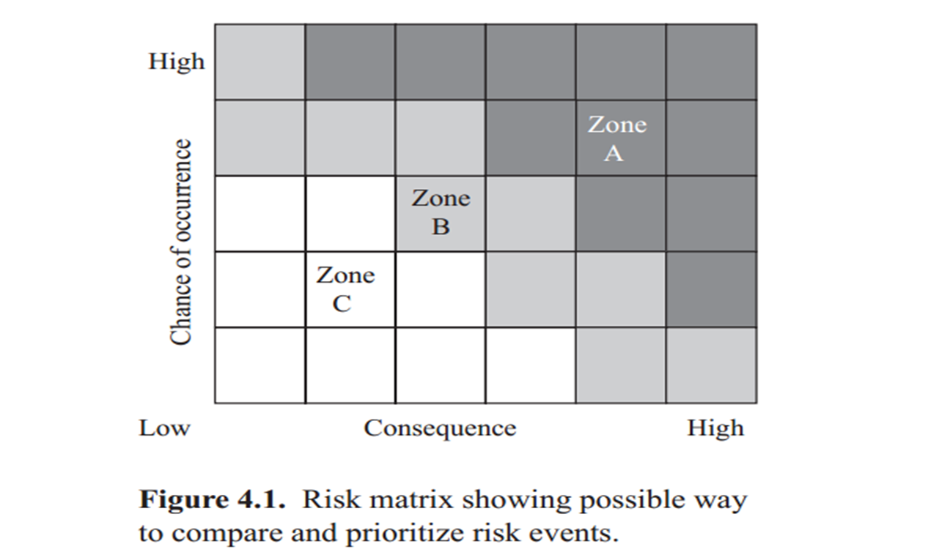
Risk Matrix

Slide 24
Risk Matrix
Risk events with lower chances of occurrence and lower degree of consequence may be of the lowest priority and may fall in Zones B and C. Using a risk matrix similar to that in Figure 4.1 may be appropriate in cases where the consequences of risk events can be expressed in similar measures, such as a monetary unit.

Slide 25
Risk Prioritization
However, there may be cases where expressing consequences in the same measure may not be possible or acceptable, such as in the case of some risk events resulting in injury and some resulting in equipment damage. Another way to compare and prioritize risk events may be based on categories rather than a matrix such as those shown in Table 4.2.

Slide 26
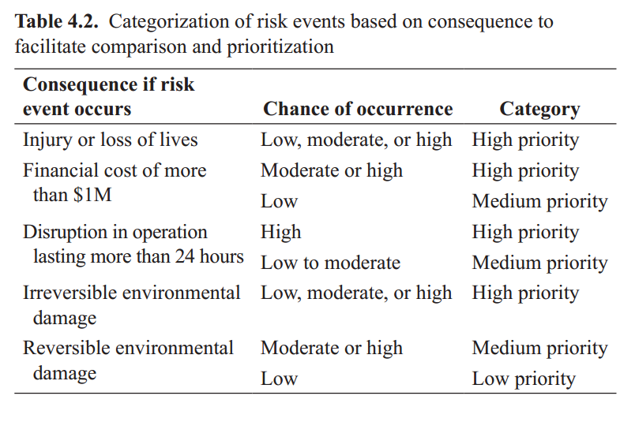

Slide 27
Risk Prioritization
Categorization allows the analyst to distinguish among types of consequences based on criteria relevant to a particular system without the need to express them using the same measure. For example, a system that greatly values the environment may have a distinct criterion معيار متميز
for risk events that may result in environmental damage. Nonetheless, such categorization of risk events would still be based on some assessment of the chance of occurrence coupled with the consequence if they occur.

Slide 28
Risk Detection amenability
Which segments in the causal chain of events can be detected? Certain segments in the causal chain of events may be more amenable قابله
to detection than other segments based on the mechanics of the phenomena, available technology for detections, and other factors (e.g., ethical and legal factors).

Slide 29
Risk Detection amenability
Which segments of the causal chain of events can be controlled and how? In the same way that segments in the causal chain of events may be more amenable than others to detection, some of these segments may be more amenable to control than others.

Slide 30
Post Risk Occurrence
If the risk event happens, how can the system recover quickly? Import-ant functions in the operation of the system are identified for the purpose of analyzing whether any of them can be duplicated or dispersed. This applies not only to equipment and information as illustrated in Table 4.1 but also to personnel through cross-trainings. Finally, options to purchase insurance products and services also need to be considered based on economic and legal factors.

Slide 31
DEVELOPMENT OF ACTION PLAN
In the second step—development of an action plan—we need to generate combinations of particular risk treatments that will be effective for a particular system and target risk event and the accountable party. Which risk treatment strategies will work well together? Risk treatment strategies are not mutually exclusiveيستبعد كل منهما الآخر
and effective action plans that are usually made up of combination of strategies, albeit in various degrees.

Slide 32
DEVELOPMENT OF ACTION PLAN
Who will be accountable for implementing the plan? Upon determination of risk treatment strategies, the parties (individuals, job descriptions, teams, or organizations) that will be most reasonably held accountable for their implementation are identified.

Slide 33
APPROVAL OF THE ACTION PLAN
In the third step—approval of the action plan—we need to obtain the approval of the action plan from the management and from responsible parties.
How much will this cost? From the management’s perspective, there will most likely be a need to economically rationalize the choice of risk treatment strategies based on the benefit that the system will get from such plan compared to the cost of implementation.

Slide 34
APPROVAL OF THE ACTION PLAN
Who will lead the implementation? Management commitment is also needed to coordinate among the various responsible parties and assure that required resources for implementation are made available. From the perspective of the parties responsible for the various treatment strategies, their commitment based on motivation and incentives are needed for long-term effectiveness of the plan.

Slide 35
APPROVAL OF THE ACTION PLAN
A single party—individual or team—is usually assigned the accountability of assuring the plan is implemented. This party responsible for the overall plan is usually labeled as the risk manager, safety officer, or other similar job title.

Slide 36
References
Resources:
Operational Risk Management
C. Ariel Pinto
Luna Mylene Magpili
Raed M. Jaradat

