Slide 1


Advancing Ophthalmic Diagnostics with AI: A Deep Learning Framework for early Detection of Retinal Diseases from OCT Data
Student Name: Sirin Hejazi
AI902
Final Project
Supervisor: Dr. Khaled Eskaf

Slide 2


Agenda
Introduction
Objective
Problem statement
Methodology and Implementation
Results
Conclusions
www.midocean.ae

Slide 3
Introduction
Introduction:
This research aims to design, develop, and evaluate a deep learning-based diagnostic system for the automated classification of retinal diseases from OCT images, integrating clinical usability with high predictive performance.
Objective:
To achieve this aim, the study pursues the following specific objectives:
To preprocess and augment a publicly available OCT image dataset to enhance model robustness and generalizability.
To develop and train multiple CNN architectures, including custom networks and transfer learning model (VGG16, ResNet50, DenseNet121)
To evaluate and compare model performance using comprehensive metrics including accuracy, precision, recall, F1-score, and area under the ROC curve (AUC).
To select the optimal model based on diagnostic accuracy, computational efficiency, and explain ability.
To deploy the selected model within a functional web-based application for real-time clinical demonstration.
www.midocean.ae

Slide 4
Problem statement
Despite the diagnostic precision offered by OCT imaging, its clinical application faces significant limitations:
Dependence on specialist expertise, leading to diagnostic delays
High inter-observer variability in image interpretation
Risk of oversight or misdiagnosis, particularly in early-stage disease
Limited accessibility in underserved regions due to a shortage of trained ophthalmologists
Increasing diagnostic workloads amid growing prevalence of retinal diseases
These challenges underscore the need for an automated, reliable, and efficient AI-assisted diagnostic system capable of providing consistent, rapid, and accurate classification of retinal conditions from OCT images.
www.midocean.ae

Slide 5
يتم استعراضها بشكل سريع جدا اثناء المناقشه
Literature Review
Author(s), Year | Contribution | Limitation | Relevance
Kermany et al. (2018) | Pioneering transfer learning for OCT; established benchmark dataset | Focused on accuracy; limited robustness and explain ability | Provides foundational dataset; highlights need for balanced evaluation
Li et al. (2020) | High performance (97.3%) with ResNet50 ensemble | Limited external validation; no dataset bias consideration | Validates ResNet50 for OCT classification
Du et al. (2024) | Foundation model with improved interpretability | Focused on specific features; limited clinical deployment focus | Emphasizes importance of model transparency
Khan et al. (2021) | Systematic review highlighting dataset imbalances and biases | Identified problem without technical solution | Informs need to address class imbalance and bias
www.midocean.ae

Slide 6
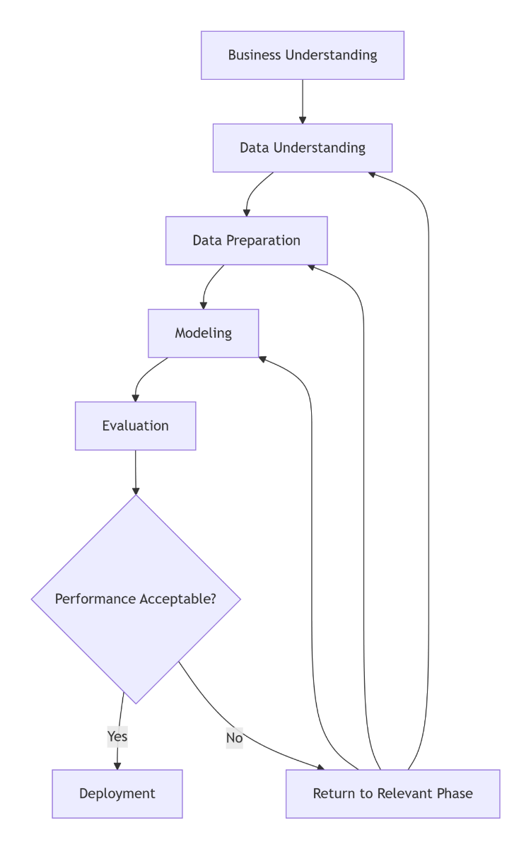
Methodology and Implementation
CRISP-DM Methodology Framework
CRISP-DM Methodology Framework
Phase 1: Business Understanding
Phase 2: Data Understanding
Phase 3: Data Preparation
Phase 4: Modeling
Phase 5: Evaluation
www.midocean.ae

Slide 7
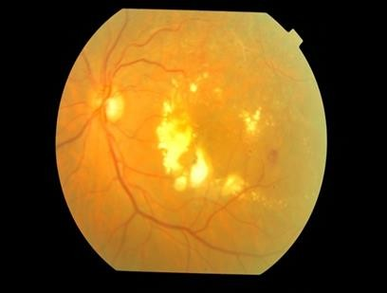
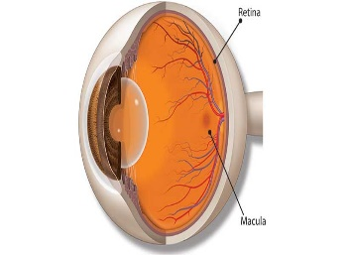
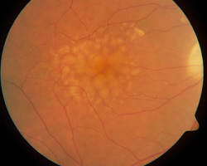
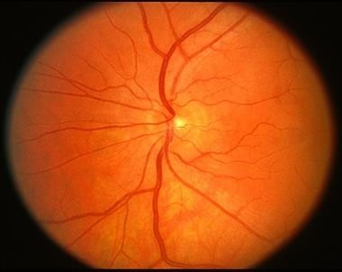
1- Business Understanding
The primary objective is to develop a deep learning-based system that can automatically classify OCT B-scans into four diagnostic categories:
Normal: Healthy retinal structure
Choroidal Neovascularization (CNV): Characteristic of wet AMD
Diabetic Macular Edema (DME): Retinal thickening with intraretinal fluid
Drusen: Sub-RPE deposits indicative of early AMD
Figure 2: Diabetic macular edema
Figure 3: CNV
Figure 4: Dursun
Figure 5: Normal eye
www.midocean.ae

Slide 8
2- Data Understanding
The dataset was partitioned into training, validation, and test subsets using a 70/15/15 split. After processing, the training set contained 83,484 images, the validation set 32 images, and the test set 968 images. A preliminary inspection revealed a severe class imbalance: the NORMAL category dominated the training portion, while the validation set—unexpectedly small at only 32 samples—proved insufficient for reliable hyperparameter tuning. Consequently, during subsequent experiments, the validation set was enlarged by reallocating a balanced 15 % of the original training data, and the reported test set of 968 images was retained as the final independent evaluation set. Sample images from each class (NORMAL, CNV, DME, DRUSEN) were displayed in a 5×5 grid to confirm correct loading, orientation, and the presence of characteristic pathological features before model training.
Class | Number of Images | Percentage | Image Dimensions | Format
CNV | 37,206 | 44.0% | 496×512–768×496 | JPEG
NORMAL | 25,774 | 30.5% | 496×512–768×496 | JPEG
DME | 11,598 | 13.7% | 496×512–768×496 | JPEG
DRUSEN | 8,617 | 10.2% | 496×512–768×496 | JPEG
www.midocean.ae

Slide 9
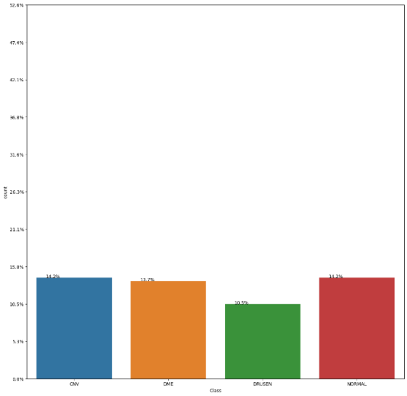
3- Data Preparation
To improve the robustness of the classification model and reduce the risk of overfitting, image augmentation techniques were applied to artificially increase dataset size and variability. Augmentation produces new image variations from the original OCT scans, enabling the model to generalize better to unseen data and enhancing recognition of different retinal abnormalities.
Augmentation Technique | Purpose
Random cropping | Enhances feature learning by showing only partial regions of the retina
Horizontal & vertical flip | Allows the model to learn disease patterns independent of orientation
Rotation | Strengthens invariance to angle differences in OCT scans
Elastic deformation | Simulates natural retinal distortion or tissue variation
Grid distortion | Introduces warping to challenge the model to adapt
Hue/Saturation adjustments | Increases tolerance to light and colour intensity variation
www.midocean.ae

Slide 10
4- Modeling
Five architectures were selected for comparative analysis:
Model Architectures and Rationale
Model | Depth | Parameters | Rationale
3-Layer CNN | 3 conv layers | ~50K | Baseline lightweight model
7-Layer CNN | 7 conv layers | ~500K | Medium complexity custom CNN
VGG16 | 16 layers | 138M | Standard transfer learning baseline
ResNet50 | 50 layers | 25M | Deep network with residual connections
DenseNet121 | 121 layers | 8M | Parameter-efficient dense connections
www.midocean.ae

Slide 11
Evaluation
A comprehensive evaluation framework was established:
A subset of 100 images was reviewed by two board-certified ophthalmologists. Model predictions were compared against:
Expert Consensus: Agreement between both ophthalmologists
Clinical Ground Truth: Original diagnosis from medical records
Model Performance: Sensitivity/Specificity against expert labels
www.midocean.ae

Slide 12
Deployment
Design the architecture of the OCT system, including how it will capture, store, and analyze retinal images. Create the user interface design to ensure ease of use for medical professionals.
A comprehensive OCT dataset was analyzed, cleaned, and augmented to address class imbalance and increase model generalization capability. Multiple convolutional neural architectures—including custom CNNs and transfer learning models—were designed, trained, and configured with appropriate optimization strategies. Evaluation metrics and clinical validation plans were defined to ensure that model performance aligns with real diagnostic expectations rather than solely statistical benchmarks.
Frontend: HTML, CSS, JAVASCRIPT
Backend: Paython flask API
Model: desenet121
The system is POV
www.midocean.ae
Notes:
GRU and NNA

Slide 13
Results
Key Findings:
DenseNet121 achieved the highest overall performance with 96% accuracy and 97% AUC-ROC, demonstrating superior feature reuse and parameter efficiency.
7-layer CNN outperformed VGG16 despite being a custom architecture, indicating that domain-specific design can surpass general-purpose transfer learning in certain cases.
ResNet50 showed balanced performance across all metrics, making it a reliable choice for clinical applications.
Model | Accuracy | Precision | Recall | F1-Score | AUC-ROC
3-layer CNN | 0.89 | 0.88 | 0.87 | 0.87 | 0.92
7-layer CNN | 0.95 | 0.94 | 0.93 | 0.93 | 0.96
VGG16 | 0.91 | 0.90 | 0.89 | 0.89 | 0.93
ResNet50 | 0.94 | 0.93 | 0.92 | 0.92 | 0.95
DenseNet121 | 0.96 | 0.95 | 0.94 | 0.94 | 0.97
www.midocean.ae

Slide 14
Thank You

