Slide 1



Introduction to Influence & Negotiation skills, Part 1
Lec.1
ENT623
College of Entrepreneurship and Innovation
Prepared by
Dr. Bothaina Mahmoud Fouad

Slide 2

Share some defining and key concepts of negotiation and influencing
Highlight some different between negotiation and influencing skills
Have awareness about the importance of these skills.
Learning Outcomes of the Lecture

Slide 3

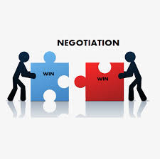
Everyone negotiates on a daily basis (Samina & Vinta, 2010, p. 26)

Slide 4
At work;
employees in organisations negotiate and influence vertically & horizontally with colleagues, partners, customers, clients and internal teams.
Personal lives;
Who makes dinner, who drinks/drives, holiday destinations…
Negotiation and Influencing are skills, not a profession we can learn it through experience and training.
Vital personally and for organizations

Slide 5
Chapter
Negotiation skills & Influencing Skills
02
Influence and negotiation skills are crucial for success in both personal and professional life.
Influence involves persuasion and shaping others' perspectives, while negotiation focuses on reaching mutually satisfactory agreements through communication and compromise.

Slide 6
Chapter
02
Mastering these skills helps individuals build strong relationships, resolve conflicts effectively, and achieve desired outcomes in various contexts.

Slide 7
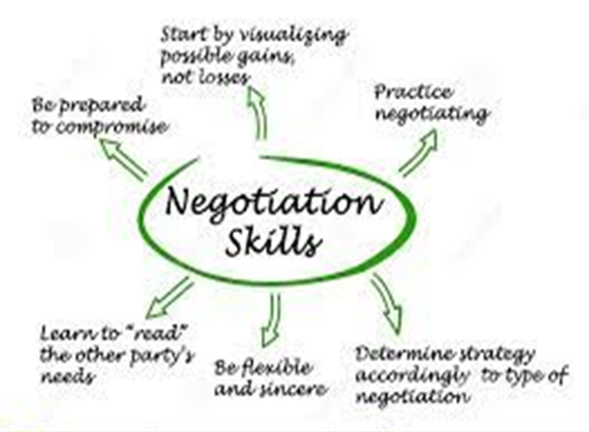
Negotiation skills
are inherent qualities that help two or more parties agree to a common logical solution.
Other definition:
is a process of communication in which the parties aim to send a message to the other side and influence each other.

Slide 8
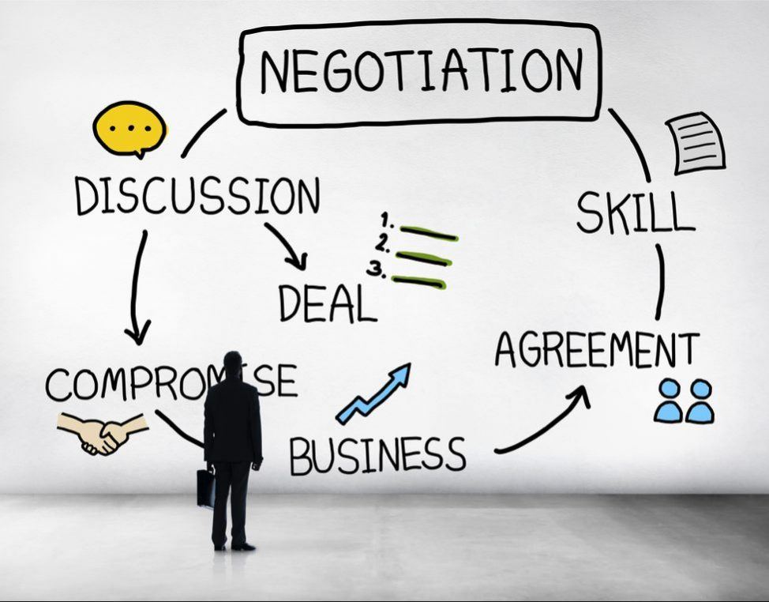
Negotiation skills
Negotiation is a discussion to settle disputes and reach agreements between two or more sides. Negotiation is a “give and take” process resulting in a compromise where each side makes a concession for the benefit of everyone involved.

Slide 9
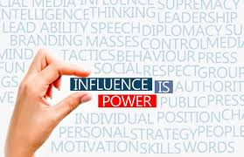
Influencing skills
Influencing skills are your abilities to encourage and persuade others to adopt your ideas.
The skill to influence others can be beneficial for leaders to motivate people and make their teams more productive.

Slide 10
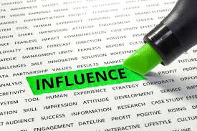
Influencing skills
Influencing skills, also known as persuasion or interpersonal influence, are the abilities to encourage and motivate others to adopt your ideas or support your goals. These skills are crucial for effective leadership, team collaboration, and positive workplace relationships. They involve understanding and influencing others' perspectives, attitudes, and behaviors without resorting to coercion or manipulation
according to Dale Carnegie Training. These skills are crucial for leaders, sales professionals, and anyone who needs to motivate others in various settings

Slide 11
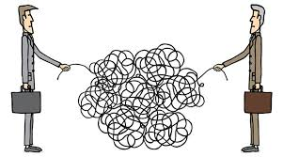
The importance of Influencing and Negotiation
NEGOTIATING involves being able to discuss and reach a mutually satisfactory agreement. INFLUENCING encompasses both of these.
These skills are important in many jobs, especially areas such as marketing, sales, advertising and buying, but are also valuable in everyday life.

Slide 12
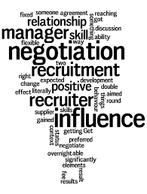
What is the relationship between influence and negotiation?
Influence and negotiation are related as influence can be a tool within negotiation to shape perceptions, preferences, and decisions during the negotiation process. However, negotiation is a broader process of reaching a mutual agreement, while influence is about having an effect on another's actions or opinions

Slide 13

How important a skill is negotiation??
Negotiation Is the pre- eminent form of decision making in personal and professional life
William Ury
one of the world's best-known experts on negotiation and mediation
co-founder of Harvard's Program on Negotiation

Slide 14
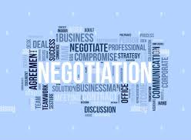
Be Careful
A negotiator without influence has limited power—influence is how you guide the other party toward your desired outcome.

Slide 15
Common elements of Negotiation and Influencing
More than one party is involved
Both parties have shared interests (they are therefore committed to an extent) but there are also opposed interests
The parties are prepared to be flexible
communication, active listening
understanding interests and positions, building relationships, and managing emotions
Participants have the ability and authority to make decisions

Slide 16
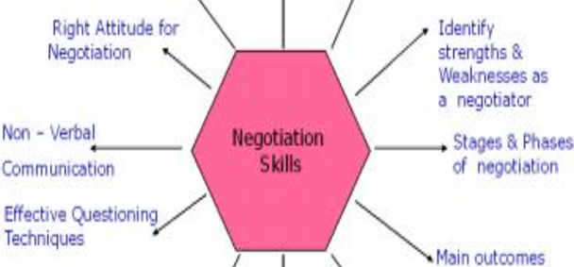
Chapter
01
Negotiating Skills

Slide 17
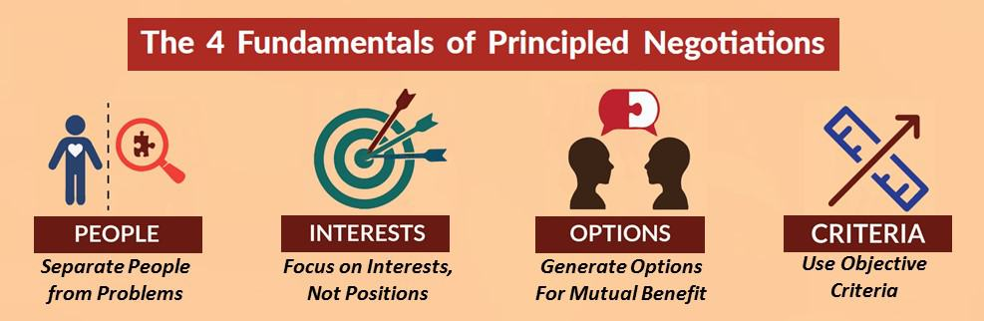

Slide 18
What is the role of the negotiator
A negotiator is a person who either comes to an agreement with someone else, or one who helps other people reach such an agreement.
When two people cannot see eye to eye, it's time to bring in a negotiator. When two businesses are merging, they can use the help of a negotiator to work out details of the plan.

Slide 19
Interests
Judgments about the future
Risk tolerance
Time preferences
Differences between negotiators

Slide 20
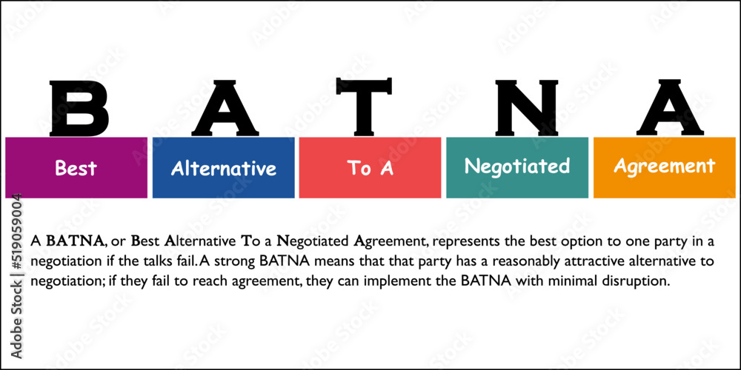

Slide 21
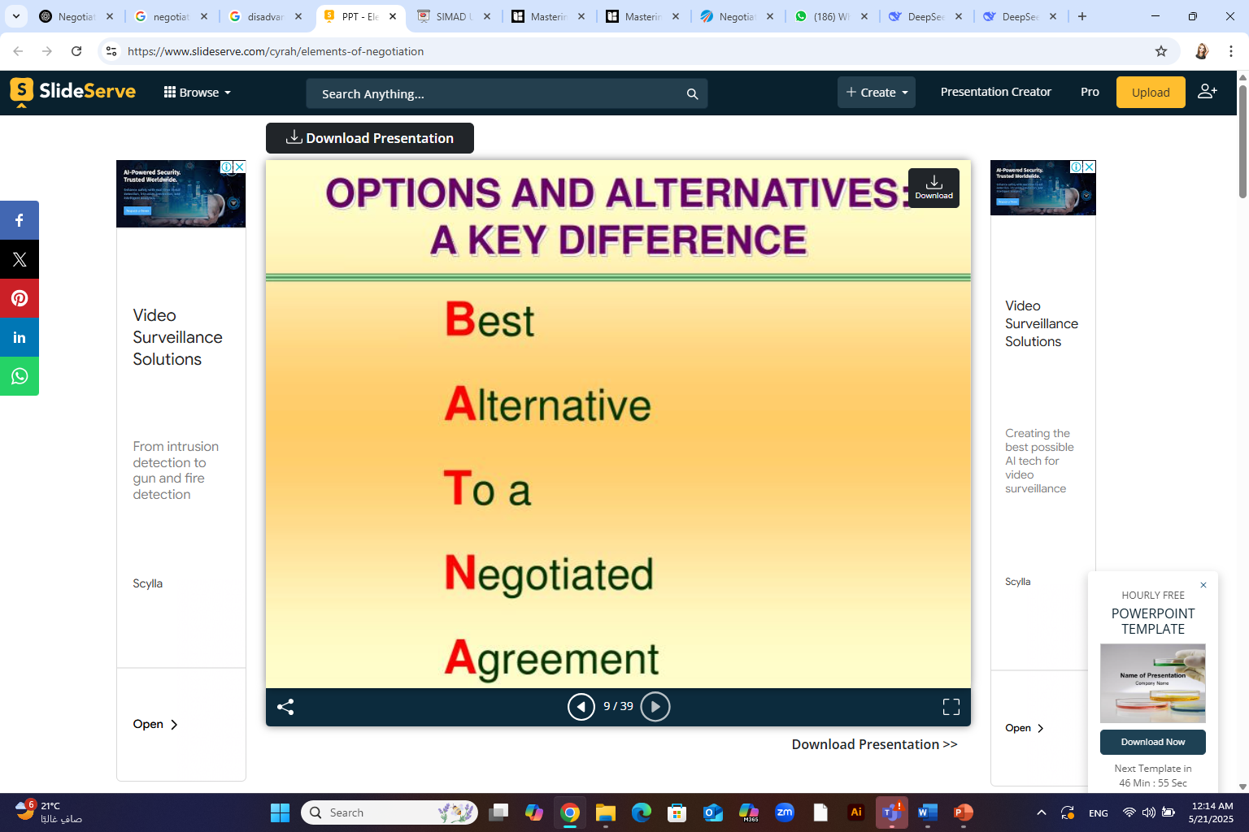
What is the meaning of ( BATNA ) in negotiation
BATNA stands for Best Alternative To a Negotiated Agreement. It's a term used in negotiation, referring to the best course of action you would take if you cannot reach an agreement with the other party. Essentially, it's your "Plan B" or fallback option.

Slide 22
BATNA: The alternative you have if the negotiation fails and you can't agree with the other party.
Example: If you're buying a car and can't agree with the dealership on the price, your BATNA might be to go to another dealership.

Slide 23
Why many people avoid even fear negotiation??
Because they may lack the simple skills, techniques, and experience to prepare and succeed at negotiation

Slide 24
Reasons of avoiding some people from negotiation
Fear of Failure and Rejection
Fear of being assertive or aggressive, which can damage relationships and hinder the negotiation process.
Feeling underprepared or lacking the necessary skills can also contribute to the fear of negotiating.
A lack of confidence in one's ability to negotiate effectively can make the process feel overwhelming and daunting.
Fear of losing or giving up something valuable in a negotiation. and Lack of Control
In some cultures, direct negotiation may be considered impolite or aggressive, while in others, it's seen as a necessary part of business and personal interactions.

Slide 25
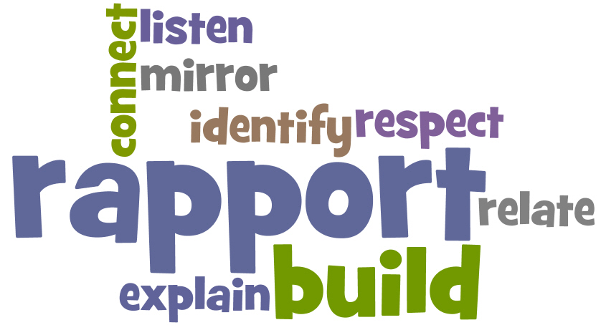
  ‘Always get to know the other party. Never negotiate with a stranger.’

Slide 26
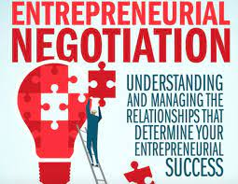
the importance of negotiation in entrepreneurship?
Negotiating effectively can give clients, employees and employers a positive impression rooted in respect. By dealing with problems fairly, forming strong bonds with clients and securing mutually beneficial deals, more people will want to work with you because of your ability and value your insights.

Slide 27
Important aspects of negotiations
Is everywhere
Is a process
Entails a relationships
Various ways with their own risks and rewards
To do or not do something has value for us

Slide 28
Effective negotiation hinges on several key aspects such as:
Preparation is Key
Building Rapport and Trust
Focus on Interests, Not Positions
Adaptability and Flexibility
Effective Communication

Slide 29
Effective negotiation hinges on several key aspects such as:
1. Preparation is Key:
Define your goals and objectives: Clearly articulate what you hope to achieve in the negotiation.
Research and gather information: Understand the other party's perspective, their potential needs, and any relevant background information.
Consider your BATNA (Best Alternative to a Negotiated Agreement): Know your fallback position if an agreement isn't reached.
Identify your interests and needs: Go beyond just your stated position and understand the underlying reasons for your requests

Slide 30
Effective negotiation hinges on several key aspects such as:
2. Building Rapport and Trust:
Establish a positive relationship: Create a collaborative and respectful environment where you can openly communicate and build trust.
Practice active listening: Pay attention to the other party's perspective and concerns, showing that you value their input.
Use effective communication techniques: Clearly articulate your points, ask clarifying questions, and actively listen to the other party

Slide 31
Effective negotiation hinges on several key aspects such as:
3. Focus on Interests, Not Positions:
Move beyond surface-level demands: Try to understand the underlying reasons behind the other party's positions.
Explore common ground and shared interests: Look for areas where both parties can benefit from a mutually agreeable outcome.
Generate creative solutions: Brainstorm different options that address the needs of all parties involved.

Slide 32
Effective negotiation hinges on several key aspects such as:
4. Adaptability and Flexibility:
Be open to new ideas: Be willing to explore different approaches and be flexible in your thinking.
Recognize the importance of compromises: Negotiations often involve making concessions to reach a mutually acceptable agreement.
Stay adaptable throughout the process: Be prepared to adjust your strategy as the negotiation unfolds and new information emerges.

Slide 33
Effective negotiation hinges on several key aspects such as:
5. Effective Communication:
Communicate clearly and concisely: Use language that is easily understood and avoid jargon or technical terms that could be confusing.
Express your needs and concerns clearly: Don't be afraid to articulate your position and expectations.
Use both verbal and nonverbal cues effectively: Pay attention to your body language and the other party's nonverbal cues to ensure clear communication

Slide 34
Some Basic assumptions we need to keep in mind
We can try to negotiate everything
Negotiation is a skill
Negotiation is not a magic pill
There is no “ best “ way to negotiate
It depends on strategy and implementation

Slide 35
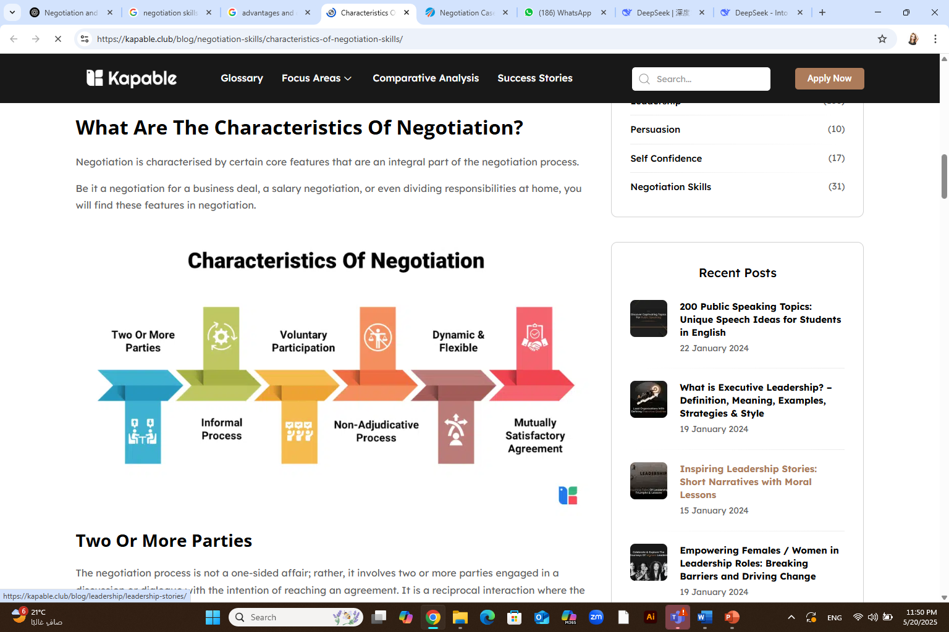
Characteristics of Negotiation

Slide 36
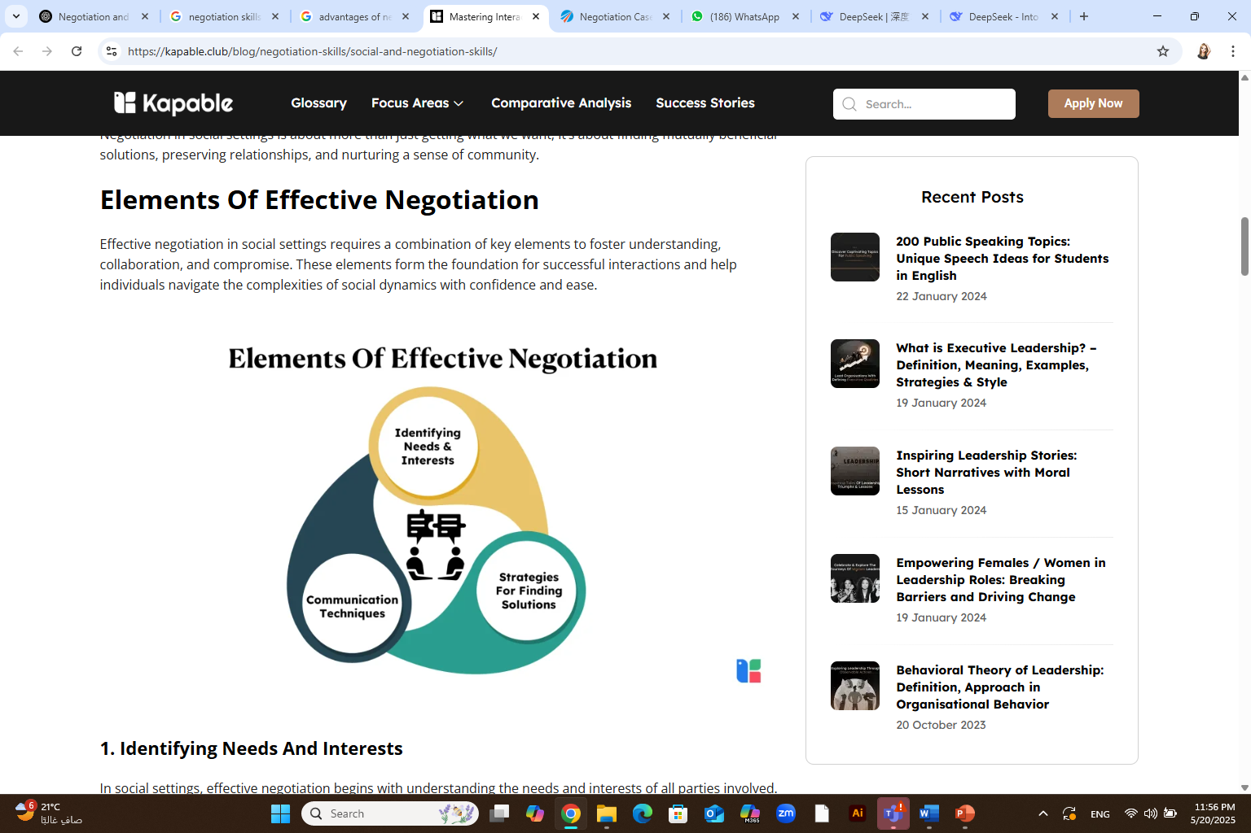
https://kapable.club/blog/negotiation-skills/social-and-negotiation-skills/

Slide 37
The common elements in negotiation situations
In any negotiation, common elements include parties with differing needs or desires, a process of interaction, and the possibility of reaching a mutually acceptable agreement.
Parties with Conflicting Needs
Interaction and Communication
Exploration of Options
Skill Development
Relationship Building
Emotional Intelligence
Two or more parties
Independence
Ability of decision making
Common goals
flexibility

Slide 38
Basic types of negotiation ( 3Ds)
Deal Making
Purchase of something ( new home, new car…etc)
Decision Making
Parties in a zoning case
Dispute resolution
Litigation over property rights
While the three have subtle differences, all are forms of negotiations

Slide 39
One of the most important tips to be effective negotiators
Before you first meet parties with whom you are negotiating, take time to gather pertinent information.
Focus on all dimensions: people, problem, and process — for your side and the other side. (See the chart “Preparing for the 3 Dimensions,” below, for details.)
Preparation for the 3 Dimensions
https://www.fm-magazine.com/news/2022/oct/negotiation-skills-finance-leaders.html

Slide 40
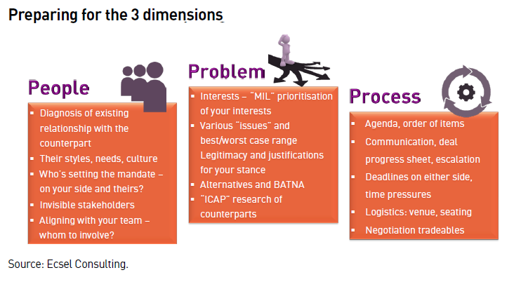
Preparation for the 3 Dimensions
In negotiation, focusing on all dimensions (people, problem, and process) is crucial for effective outcomes. This means understanding the dynamics of the individuals involved, the specific issues being negotiated, and the overall process of reaching an agreement. The PPP model of negotiation is a conceptual tool that helps negotiators understand, prepare for, and conduct negotiations by addressing these three levels
https://www.fm-magazine.com/news/2022/oct/negotiation-skills-finance-leaders.html

Slide 41
Preparation for the 3 Dimensions
People: This dimension focuses on the individuals involved in the negotiation, including their personalities, motivations, and power dynamics. Understanding the other party's perspective, including their goals, needs, and underlying interests, is essential for building trust and finding common ground.
Problem: This dimension refers to the specific issues or problems being negotiated, including their content, complexity, and the potential for creative solutions.
Process: This dimension focuses on the structure and flow of the negotiation, including the agenda, communication methods, decision-making rules, and overall approach to resolving the problem. A well-defined process can help manage time, address disagreements, and ultimately facilitate a more productive outcome.
https://www.fm-magazine.com/news/2022/oct/negotiation-skills-finance-leaders/

Slide 42
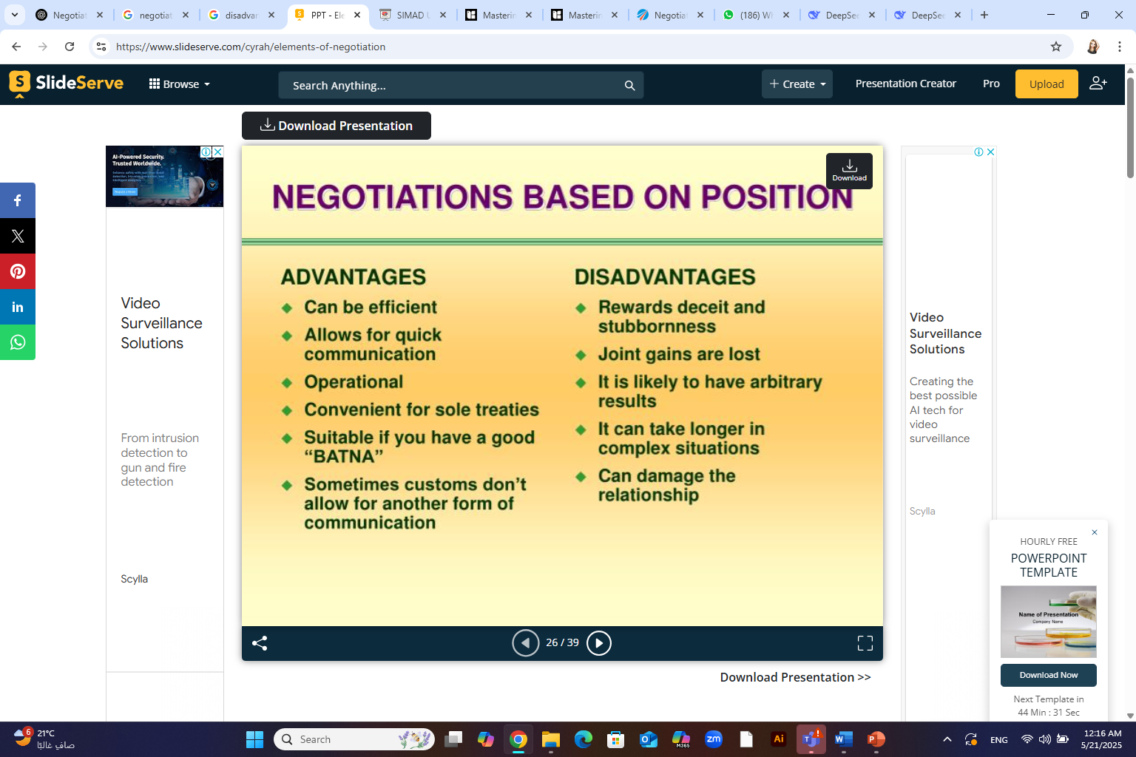
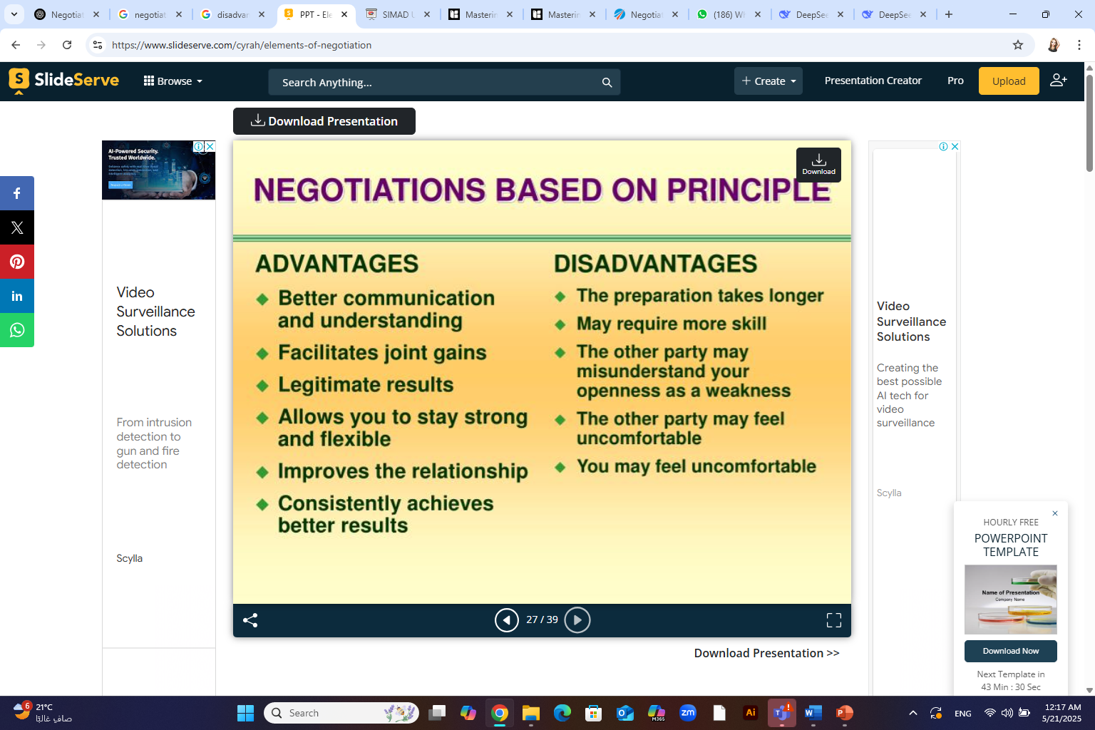
Advantages Vs. Disadvantages of Negotiation

Slide 43
Advantages of Negotiation
Finding mutually beneficial solutions
Negotiation can help parties find solutions that benefit everyone involved, leading to more harmonious relationships and improved outcomes
Enhancing communication skills
Through negotiation, individuals can improve their communication skills, including active listening, persuasion, and conflict resolution.
Resolving conflicts:
Negotiation can help resolve disputes by finding common ground and reducing tension between parties.
Successful negotiation can establish strong relationships built on trust, respect, and mutual understanding.
Building relationships
https://www.risely.me/understanding-persuasion-and-negotiation/

Slide 44
Disadvantages of Negotiation
Time-consuming
Negotiation can be a time-consuming process, as it requires both parties to communicate effectively, listen to each other, and find common ground.
Risk of failure
Negotiation can fail if parties cannot find common ground or if one party is unwilling to compromise, leading to a breakdown in communication and further conflicts.
Power imbalance
Negotiation can be unfair if one party holds more power than the other, leading to an unequal outcome that favors the stronger party.
Negotiation can be emotionally stressful, especially if parties have a history of conflict or if the negotiation involves high-stakes decisions
Emotional stress
https://www.risely.me/understanding-persuasion-and-negotiation/

Slide 45
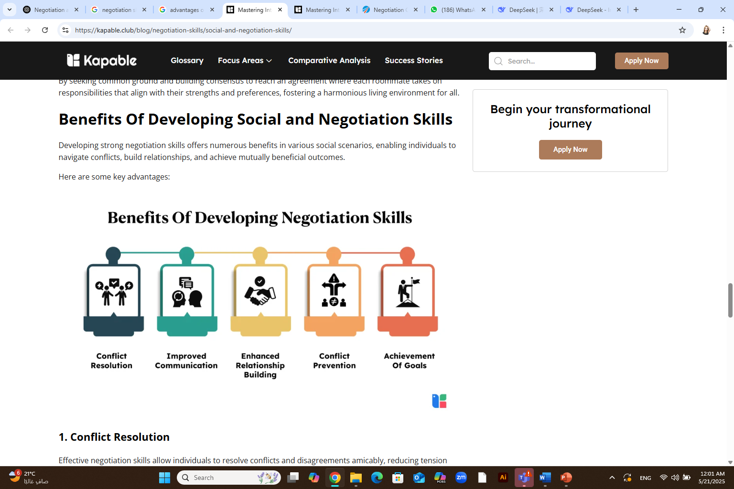

Slide 46
Case Study and role model

Slide 47
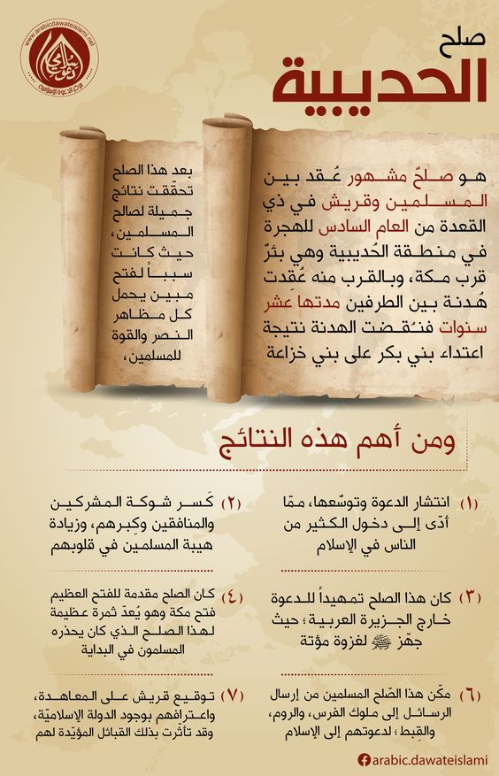
صلح الحديبية
صلح الحديبية عهد واتفاق، تم بين المسلمين وقريش في ذي القعدة من السنة السادسة للهجرة قرب موضع يقال له الحديبية قبيل مكة. ففي ذلك العام رأى رسول الله - صلى الله عليه وسلم - في منامه أنه يدخل هو وأصحابه المسجد الحرام، وأنهم يطوفون بالبيت، فأخبر رسول الله - صلى الله عليه وسلم - أصحابه بذلك، ففرحوا فرحا شديدا، فرؤيا الأنبياء حق، وقد اشتد بهم الحنين إلى تأدية النسك والطواف بالكعبة ودخول مكة، موطنهم الأول ومسقط رأسهم .
أشهر عملية تفاوض في التاريخ

Slide 48
خرج النبي ـ صلى الله عليه وسلم ـ ومعه زوجه أم سلمة في ألف وأربعمائة مسلم، متجهين إلى مكة لقضاء أول عمرة لهم بعد الهجرة، وحملوا معهم السلاح توقعا لشر قريش، فلما وصل إلى ذي الحليفة أهل مُحْرما هو ومن معه، وبعث النبي ـ صلى الله عليه وسلم ـ بُسر بن سفيان إلى مكة ليأتيه بأخبار قريش وردود أفعالهم. وحين وصل المسلمون إلى عسفان(مكان بين مكة والمدينة)، جاءهم بسر بأخبار استعدادات قريش لصد ومنع المسلمين من دخول مكة.
فاستشار النبي ـ صلى الله عليه وسلم ـ أصحابه ، فأشار أبو بكر ـ رضي الله عنه ـ بالتوجه إلى مكة لأداء العمرة والطواف بالبيت، وقال: ( فمن صدنا عنه قاتلناه، فقال ـ صلى الله عليه وسلم ـ : امضوا على اسم الله ) ( البخاري ).
وصلى الرسول ـ صلى الله عليه وسلم ـ بأصحابه في عسفان صلاة الخوف، ثم سلك بهم طريقا وعرة، متجنبا الاصطدام بخالد بن الوليد ـ وكان لا زال على الشرك ـ حيث خرج من مكة بجنود ليمنع النبي ـ صلى الله عليه وسلم ـ من دخولها.. فمضى النبي ـ صلى الله عليه وسلم ـ ومعه أصحابه باتجاه مكة حتى إذا اقتربوا من الحديبية بركت ناقته، فقالوا: خلأت القصواء(امتنعت عن المشي)؟، فقال ـ صلى الله عليه وسلم ـ: ( ما خلأت القصواء وما ذلك لها بخلق، ولكن حبسها حابس الفيل ) ثم قال ـ صلى الله عليه وسلم : ( والذي نفسي بيده، لا يسألونني خطة يعظمون فيها حرمات الله إلا أعطيتهم إياها ) ( البخاري )
أشهر عملية تفاوض في التاريخ

Slide 49
فلما نزل الرسول ـ صلى الله عليه وسلم ـ بالحديبية أرسل عثمان ـ رضي الله عنه ـ إلى قريش وقال له: أخبرهم أنا لم نأت لقتال، وإنما جئنا عماراً، وادعهم إلى الإسلام، وأَمره أن يأتي رجالاً بمكة مؤمنين ونساء مؤمنات، فيبشرهم بالفتح، وأن الله عز وجل مظهر دينه بمكة..
فانطلق عثمان فمر على قريش، فقالوا: إلى أين؟، فقال : بعثني رسول الله ـ صلى الله عليه وسلم ـ أدعوكم إلى الله وإلى الإسلام، ويخبركم : أنه لم يأت لقتال ، وإنما جئنا عماراً..
ولكن عثمان احتبسته قريش فتأخر في الرجوع إلى المسلمين ، فخاف الرسول ـ صلى الله عليه وسلم ـ عليه، وخاصة بعد أن شاع أنه قد قتل، فدعا إلى البيعة، فتبادروا إليه، وهو تحت الشجرة ، فبايعوه على أن لا يفروا، وهذه هي بيعة الرضوان التي نزل فيها قول الله تعالى: { لَقَدْ رَضِيَ اللَّهُ عَنِ الْمُؤْمِنِينَ إِذْ يُبَايِعُونَكَ تَحْتَ الشَّجَرَةِ فَعَلِمَ مَا فِي قُلُوبِهِمْ فَأَنْزَلَ السَّكِينَةَ عَلَيْهِمْ وَأَثَابَهُمْ فَتْحاً قَرِيباً } (الفتح:18).
وأرسلت قريش عروة بن مسعود للتفاوض مع الرسول ـ صلى الله عليه وسلم ـ، ثم أرسلت سهيل بن عمرو لعقد الصلح ، فلما رآه النبي ـ صلى الله عليه وسلم ـ وسلم قال : قد سهل لكم أمركم، أراد القوم الصلح حين بعثوا هذا الرجل. فتكلم سهيل طويلاً ثم اتفقا على قواعد الصلح.
أشهر عملية تفاوض في التاريخ

Slide 50
وأسفرت المفاوضات عن اتفاق سُمِّيَ في التاريخ والسيرة صلحا، يقضي بأن تكون هناك هدنة بين الطرفين لمدة عشر سنوات، وأن يرجع المسلمون إلى المدينة هذا العام فلا يقضوا العمرة إلا العام القادم، وأن يرد محمد ـ صلى الله عليه وسلم ـ من يأتي إليه من قريش مسلما دون علم أهله، وألا ترد قريش من يأتيها مرتدا، وأن من أراد أن يدخل في عهد قريش دخل فيه، ومن أراد أن يدخل في عهد محمد ـ صلى الله عليه وسلم ـ من غير قريش دخل فيه.
وفي هذا الصلح المبارك ظهرت أهمية الشورى، ومكانة المرأة في الإسلام، وأهمية القدوة العملية في موقف واحد.
أشهر عملية تفاوض في التاريخ

Slide 51
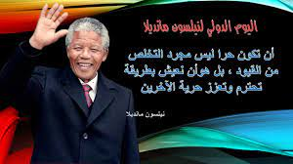
Nelson Mandela will certainly be remembered as one of the best negotiators in history. And the greatest negotiator of the twentieth century
Robert H. Mnookin
Harvard Law School professor and Program on Negotiation Chairman
In his Book “ Bargaining with the Devil, When to Negotiate, When to Fight ”

Slide 52

He was a man of peace.
He had a powerful presence and disarmed enemies with his smile.
He showed the world what forgiveness looks like.
He was positive, thinking about what could be.
He was a visionary and could see the big picture.
He was focused on goals and a mission beyond himself.
He had remarkable endurance.
He showed grit and determination.
He was humble.
He was full of hope, not hate.
He was patient.
Chapter
01
Qualities of Nelson Mandela as an Extraordinary Leader
https://www.skipprichard.com/11-leadership-qualities-of-nelson-mandela/

Slide 53
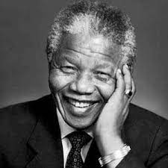
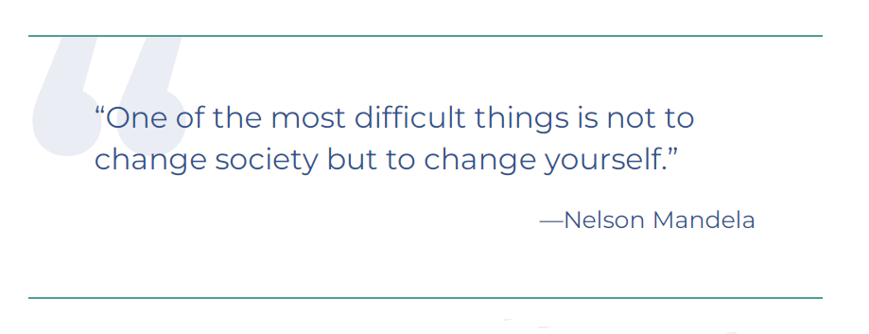
Chapter
01
"ليس أفضل من أن تكون ذلك القائد الذي يقف في الخلف ويضع الآخرين في المقدمة وقت الاحتفال بالانتصار، بينما تقفز لأول الصف وقت الخطر".

Slide 54



Thank You

