Slide 1


Financial Accounting
Prepared by Dr. Emad Zaher
Assistant Professor of Accounting
MGM611
Lecture (3)
Basic Financial Statements &Closing of Accounts

Slide 2
Learning outcomes
LO 1 Identify the income statement (Profit & loss).
LO 2 Explain the statement of changes in owner’s Equity.
LO 3 Describe the classified balance sheet(Statement of financial position).
LO 4 State the different types of Accounts & closing entries.
Prepared by Dr. Emad Zaher

Slide 3
The Four Basic Financial Statements
Financial Statements are prepared directly from the Trial Balance.
Companies prepare four financial statements:
Income Statement (Profit & loss statement) |  | Changes in owner’s Equity Statement |  | Statement of Financial Position (Balance Sheet) |  | Statement of Cash Flows
Period of time
Prepared by Dr. Emad Zaher
Period of time
Point in time
Period of time

Slide 4
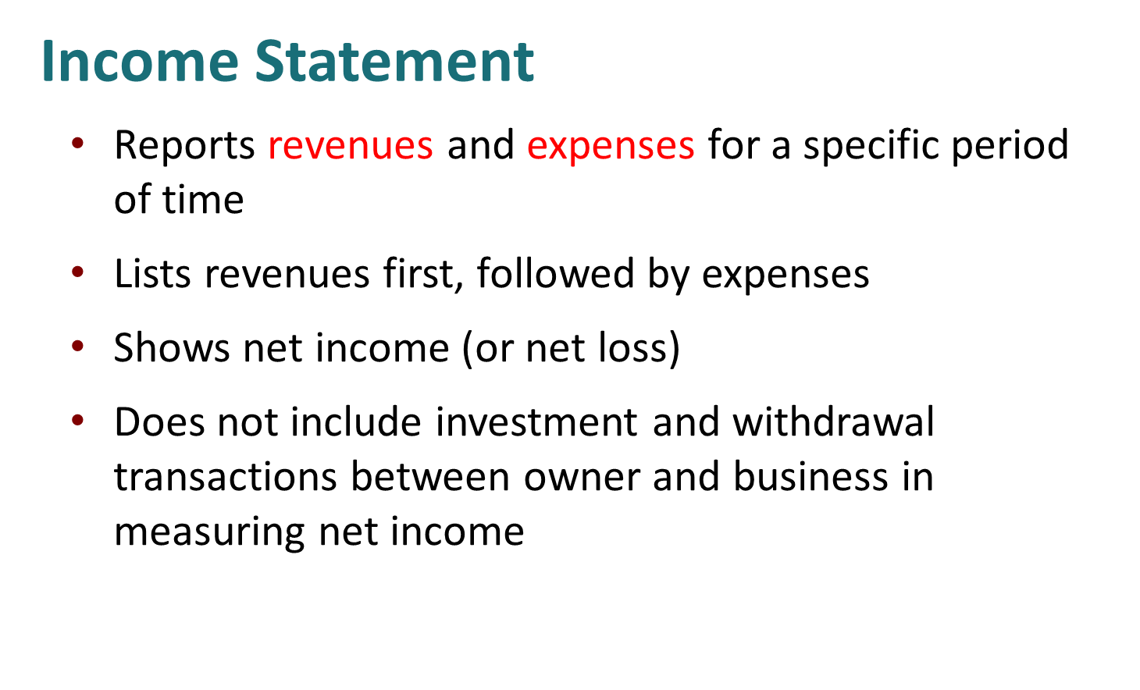
Prepared by Dr. Emad Zaher

Slide 5
Business Name…. Single-Step income statement for the year ended Dec. 31, 2022
Revenues :
Sales Revenue | ×
Service Revenue | ×
Fees Earned | ×
Commission Revenue | ×
Consulting revenue | ×
Dividends Revenue | ×
Rental revenue | ×
Total Revenues | ××
Expenses:
Salary expenses | (×)
Wages expenses | (×)
Rent expenses | (×)
Utility expense | (×)
Repair expense
Insurance expense | (×)
Interest expense | (×)
Depreciation expense | (×)
Advertising expense | (×)
Supplies expense | (×)
Total expenses | (××)
Net income | ××
Prepared by Dr. Emad Zaher

Slide 6
Revenues and expenses determine if a net income or net loss occurs as follows:
Revenues > Expenses: Net Income(Profit).
Revenues < Expenses: Net Income (loss).
Prepared by Dr. Emad Zaher

Slide 7
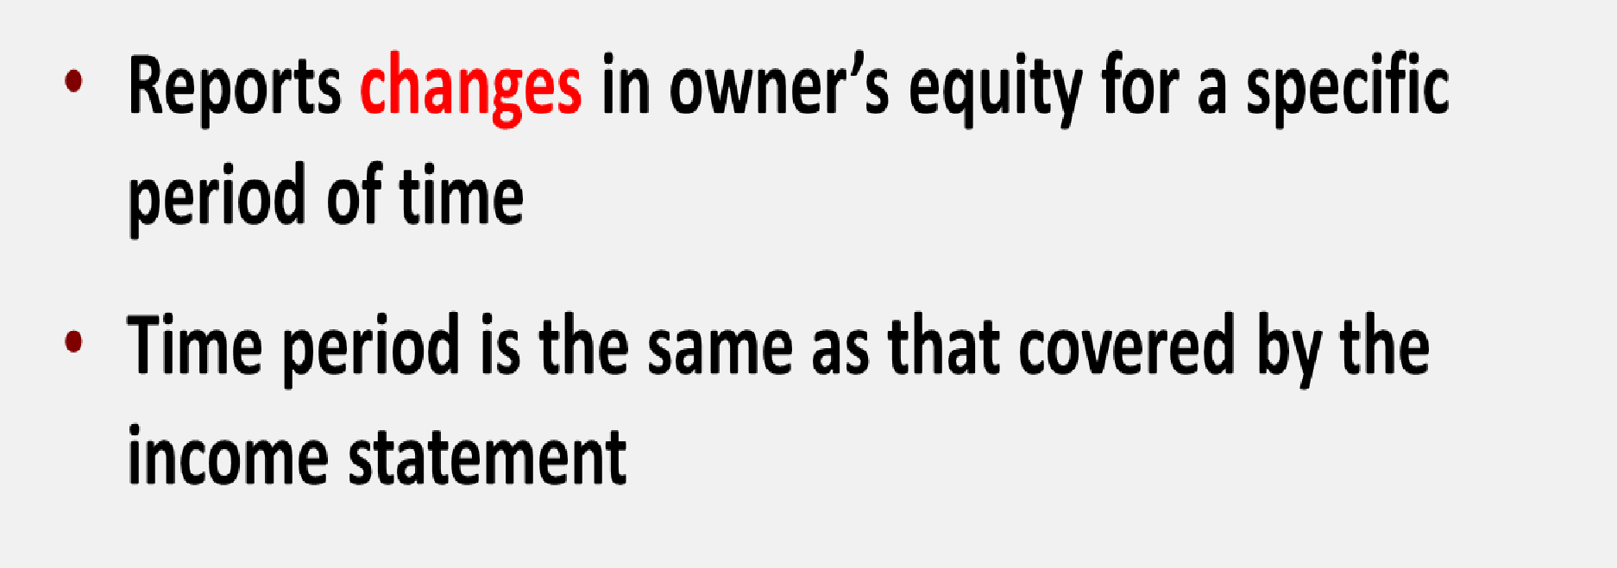
Changes in Owner’s Equity Statement
Prepared by Dr. Emad Zaher

Slide 8
Business Name…. Changes in Owner’s equity statement For the year ended Dec 31.2024
Beginning Capital | ×
Add (+) | +
Additional Investment | ×
Net income (Profit) ….from the income statement | ×
Less (-) | (×)
Drawings (Withdrawals)
Net income (Loss) …. from the income statement
Ending Capital | ××
Prepared by Dr. Emad Zaher

Slide 9
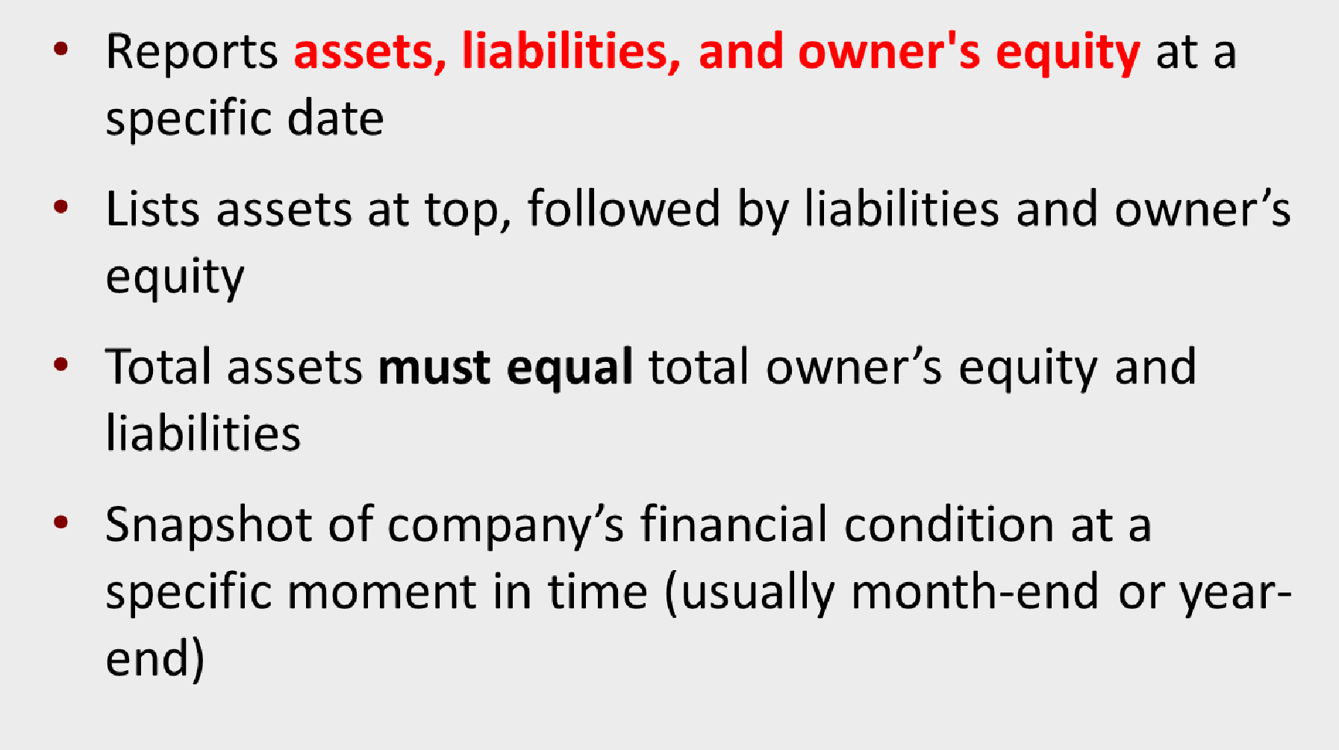
Statement of Financial Position (Balance sheet)

Slide 10

At the year ended Dec 31.2024
Assets | xx xx xx xx xx xx
Current assets Cash Short-term investment Account receivable Notes receivable Inventories Prepaid expenses Total current assets |  | xx
Property, plant, and equipment (Fixed Assets) |  | xx
Land Building ( - ) Accumulated Depreciation Equipment ( - ) Accumulated Depreciation Machinery ( - ) Accumulated Depreciation Furniture ( - ) Accumulated Depreciation | xx xx xx xx xx
Total property, plant, and equipment |  | xx
Intangible assets | xx
Goodwill | xx
Copyright | xx
Trademark | Xx
Total intangible assets |  | xx
Total assets | xx
Liabilities & owner's equity
Liabilities | xx xx Xx | xx
Current liabilities |  | xx
Notes payable Account payable Unearned revenue Total current liabilities |  | xx
 | xx xx
Long term liabilities Mortgage payable Bank loan payable Total long-term liabilities |  | xx
Total liabilities |  | xx
Owner's equity Capital …..From the changes in owner’s equity statement |  | xx
Total liabilities & owner's equity |  | xx
Prepared by Dr. Emad Zaher
www.midocean.ae

Slide 11
Example (1)
Mohamed Emad has the following Activities during the year:
Service revenue $52800- Rent expense $4800 - wages expense $33080 - advertising expense $5400- utilities expense $3600 - Mohamed withdrawals
$2800- Cash $6200- Accounts receivable $3000-supplies $400- Accounts payable $1800 - Mohamed beginning capital $8680
Required
Prepare the income statement.
Prepare the statement of owner's equity.
Prepare the balance sheet for Mohamed Emad proprietorship.
land 4000-
Prepared by Dr. Emad Zaher

Slide 12




Mohamed Emad Balance Sheet
At the year ended Dec 31.2022
Mohamed Emad Single-Step income statement for the year ended Dec. 31, 2022
Revenues :
Service Revenue | 52800
Expenses:
Rent expenses | (4800)
Wages expenses | (33080)
Advertising expense | (5400)
Utility expense | (3600)
Total expenses | (46880)
Net income | 5920
Assets
6200
3000
400
Current assets:
Cash Accounts receivable Supplies
9600
4000
Fixed Assets
Land
Total Assets
Liabilities and owner's’s equity
Short term liabilities
Accounts Payable
Long term liabilities
Loans (If found)
Owner's equity
Capital
4000
13600
Mohamed Emad Owner’s equity statement
For the year ended Dec 31.2022
1800
Beginning Capital
Add (+)
Additional Investment Net income (Profit) Less (-)
Drawings (Withdrawals)
8680
+
0
5920
11800
(2800)
Total liabilities and Owner's equity
13600
Ending Capital
11800
Prepared by Dr. Emad Zaher

Slide 13
Example(2)
Given the following trial balance:
FastForward Trial Balance
December 31, 2011
 | Debits | Credits
Cash | $ 4,350
Accounts receivable |  | -
Supplies | 9,720
Prepaid Insurance | 2,400
Equipment | 26,000
Accounts payable |  | $ 6,200
Unearned consulting revenue |  | 3,000
C. Taylor, Capital |  | 30,000
Owner's Withdrawals Consulting revenue | 200 | 5,800
Rental revenue |  | 300
Salaries expense | 1,400
Rent expense | 1,000
Utilities expense 230
Instructions
Prepare the income statement.
Prepare the statement of owner's equity.
Prepare the statement of
financial position.
Total
$ 45,300 $ 45,300

Slide 14
FASTFORWARD Income Statement For the Month Ended December 31, 2011
Revenues:
Consulting revenue | $ 5,800
Rental revenue | 300
Total revenues |  | $ 6,100
Expenses:
Rent expense | 1,000
Salaries expense | 1,400
Utilities expense | 230
Total expenses |  | 2,630
Net income |  | $ 3,470

Slide 15


STATEMENT OF OWNER'S EQUITY
FASTFORWARD Statement of Owner's Equity For the Month Ended December 31, 2011
C. Taylor, Capital 12/1/11 | $ -
Net income for December | 3,470
Plus: Investments by Owner | 30,000
 | 33,470
Less: Owner Withdrawals | 200
C. Taylor, Capital, 12/31/11 | $ 33,270
Connections
FASTFORWARD Income Statement For the Month Ended December 31, 2011
Revenues:
Consulting revenue | $ 5,800
Rental revenue | 300
Total revenues |  | $ 6,100
Expenses:
Rent expense | 1,000
Salaries expense | 1,400
Utilities expense | 230
Total expenses |  | 2,630
Net income |  | $ 3,470

Slide 16

BALANCE SHEET
FASTFORWARD
Statement of Owner's Equity
FASTFORWARD
Balance Sheet
For the Month Ended December 31, 2011
C. Taylor, Capital 12/1/11 | $ | -
Net income for December | 3,470
Plus: Investments by Owner | 30,000
 | 33,470
Less: Owner Withdrawals | 200
C. Taylor, Capital, 12/31/11 | $ | 33,270
December 31, 2011 Assets
Cash Supplies
Prepaid insurance Equipment
Total assets
Liabilities Accounts payable Unearned revenue Total liabilities
Equity
$
4,350
9,720
2,400
26,000
$
42,470
$
6,200
3,000
Connections
9,200
C. Taylor, Capital Total equity
Total liabilities and equity
$ 33,270
33,270
$ 42,470

Slide 17
Example(3)
Given the following trial balance:
Account title | Dr | Cr
Cash | 100,000
Accounts receivable | 30,000
Building | 90,000
Accumulated Depreciation -Building |  | 20,000
Equipment | 350,000
Accumulated Depreciation -Equipment |  | 50,000
Notes payable |  | 60,000
Accounts Payable |  | 90,000
Zaher ,Capital |  | 280,000
Zaher , Withdrawals | 30,000
Service revenue |  | 140,000
Salaries expense | 20,000
Insurance expense | 8,000
Advertising expense | 9,000
Rent expense | 3,000
Total | 640,000 | 640,000
Instructions
Prepare the income statement.
Prepare the statement of owner's equity.
Prepare the statement of
financial position.

Slide 18
income statement
for the year ended Dec. 31, 2022
Balance Sheet At the year ended Dec 31.2022
Assets
Fixed assets (Non-Current Assets) :
Building | 90,000
(-) Accumulated Depreciation | ( 20,000) | 70,000
Equipment | 350,000
(-) Accumulated Depreciation | (50,000)
Current Assets |  | 300,000
Cash |  | 100,000
Accounts receivable |  | 30,000
Total Assets |  | 500,000
Liabilities and stockholder’s equity
Short term liabilities
Accounts payable |  | 90,000
Notes payable |  | 60,000
Long term liabilities
Loans (If found)
Owner's equity
Capital |  | 350,000
Total liabilities and Owner's equity |  | 500,000
Revenues :
Service Revenue Expenses: Salaries Expense
Insurance expenses
Advertising Expense Rent expense
140000
(20000)
(8000)
(9000)
(3000)
Total expenses
(40000)
Net income (Profit)
100,000
Owner’s equity statement For the year ended Dec 31.2022
Beginning Capital | 280,000
Add (+) | +
Additional Investment | Zero
Net income (Profit) | 100,000
Less (-)
Drawings (Withdrawals) | (30,000)
Ending Capital | 350,000
Prepared by Dr. Emad Zaher

Slide 19
DO IT! Financial Statement Items
Presented below is selected information related to Li Fashions at December 31, 2020. Li reports financial information monthly.
Equipment | HK$10,000 | Utilities Expense | HK$4,000
Cash | 8,000 | Accounts Receivable | 9,000
Service Revenue | 36,000 | Salaries and Wages Expense | 7,000
Rent Expense | 11,000 | Notes Payable | 16,500
Accounts Payable | 2,000 | Owner’s Drawings | 5,000
a. Determine the total assets at December 31, 2020.
b. Determine the net income reported for December 2020.
c. Determine the owner’s equity at December 31, 2020.

Slide 20
Multiple Choice Questions

Slide 21
1. The following items are taken from the financial statements of the Postal Service for the year ending December 31, 2014:
Accounts payable | $ 18,000
Accounts receivable | 11,000
Accumulated depreciation – equipment | 28,000
Advertising expense | 21,000
Cash | 15,000
Owner’s capital (1/1/14) | 102,000
Owner’s drawings | 14,000
Depreciation expense | 12,000
Insurance expense | 3,000
Note payable, due 6/30/15 | 70,000
Prepaid insurance (12-month policy) | 6,000
Rent expense | 17,000
Salaries and wages expense | 32,000
Service revenue | 133,000
Supplies | 4,000
Supplies expense | 6,000
Equipment | 210,000
What is the company’s net income for the year ending December 31, 2014?
a. $12,000
b. $28,000
c. $42,000
d. $133,000

Slide 22
income statement for the year ended Dec. 31, 2014
Revenues :
Service Revenue | 133000
Expenses:
Advertising Expense | (21000)
Depreciation expenses | (12000)
Insurance Expense | (3000)
Rent expense | (17000)
Salaries & wages expense | (32000)
Supplies expense | (6000)
Total Expenses | (91000)
Net income (Profit) | 42000
The correct Answer is
c
Prepared by Dr. Emad Zaher

Slide 23
2. Misra Company compiled the following financial information as of December 31, 2023:
Revenues $340,000
Owner’s Capital (1/1/23)140,000
Equipment | 80,000
Expenses | 250,000
Cash | 90,000
Owner’s Drawings | 20,000
Supplies | 10,000
Accounts payable | 40,000
Accounts receivable | 70,000
Misra’s owner’s equity on December 31, 2023 is
a. $90,000.
b. $140,000.
c. $210,000.
d. $250,000.

Slide 24
income statement for the year ended Dec. 31, 2023
Revenues : | 340,000
Less (-) | (-)
Expenses | 250000
Net income (Profit) | 90,000
Owner’s equity statement For the year ended Dec 31.2023
Beginning Owner’s Capital | 140,000
Add (+) | +
Additional Investment | Zero
Net income (Profit) | 90,000
Less (-)
Drawings (Withdrawals) | (20,000)
Ending Owner’s Capital | 210,000
The correct Answer is
c

Slide 25
3.The following items are taken from the financial statements of the Postal
Service for the year ending December 31, 2014:
Accounts payable | $ 18,000
Accounts receivable | 11,000
Accumulated depreciation – equipment | 28,000
Advertising expense | 21,000
Cash | 15,000
Owner’s capital (1/1/14) | 102,000
Owner’s drawings | 14,000
Depreciation expense | 12,000
Insurance expense | 3,000
Note payable, due 6/30/15 | 70,000
Prepaid insurance (12-month policy) | 6,000
Rent expense | 17,000
Salaries and wages expense | 32,000
Service revenue | 133,000
Supplies | 4,000
Supplies expense | 6,000
Equipment | 210,000
Total current assets = Accounts receivable 11,000+ Cash 15,000+
Prepaid insurance 6000+ Supplies 4000
= $36000
The correct Answer is
B
What are total current assets at December 31, 2014?
a. $26,000
b. $36,000
c. $32,000
d. $42,000

Slide 26
4.The following information is for Bright Eyes Auto Supplies:
Bright Eyes Auto Supplies Balance Sheet
December 31, 2014
Total current liabilities
=
Accounts payable 130,000+
Salaries&Wages payable 50,000+
= $180,000
Cash | $ 40,000 | Accounts Payable
Prepaid Insurance | 80,000 | Salaries and Wa
Accounts Receivable | 100,000 | Mortgage P
Inventory | 140,000 | Total Li
Land Held for Investment | 180,000
Land | 250,000
Building $200,000
Less Accumulated Depreciation
Trademark Total Assets
(60,000) 14
The correct Answer is
c
The total do
a. $50, b.

Slide 27
5 .The income statement for the year 2023 of Nour Emad Co. contains the following information:
Revenues $70,000
Expenses:
Salaries and Wages Expense $45,000
Rent Expense Advertising Expense Supplies Expense Utilities Expense Insurance Expense
Total expenses
Net income (loss)
12,000
10,000
6,000
2,500
2,000
77,500
$ (7,500)
At January 1, 2023, Nour reported owner’s equity of $50,000. Owner drawings for the year totalled $10,000. At December 31, 2023, the company will report owner’s equity of
a. $17,500.
b. $32,500.
c. $40,000.
d. $42,500.

Slide 28
Owner’s equity statement For the year ended Dec 31.2023
Beginning Owner’s Capital | 50,000
Add (+) | +
Additional Investment | Zero
Net income (loss) | (7500)
Less (-)
Drawings (Withdrawals) | (10,000)
Ending Owner’s Capital | 32,500
The correct Answer is
b

Slide 29
6. The income statement and balance sheet columns of Iron and Wine Company's worksheet reflect the following totals:
Income Statement Balance Sheet
Dr.
$72,000
Cr.
$44,000
Dr.
$60,000
Cr.
$88,000
Totals
The net income (or loss) for the period is
a. $28,000 loss.
$28,000 income.
$24,000 income.
not determinable.
The correct Answer is
a

Slide 30
7.Misra Company compiled the following financial information as of December 31, 2014:
Revenues $340,000 Owner’s Capital (1/1/14)140,000
Total Assets= Equipment 80,000+ Cash 90,000+Supplies 10,000+ Accounts
receivable 70,000
= $250,000
Equipment | 80,000
Expenses | 250,000
Cash | 90,000
Owner’s Drawings | 20,000
Supplies | 10,000
Accounts payable | 40,000
Accounts receivable | 70,000
Misra’s assets on December 31, 2014 are
a. $180,000.
b. $250,000.
c. $360,000. d $490,000.
The correct Answer is
b

Slide 31
8.As of December 31, 2014, Calexico Company has assets of $42,000 and owner's equity of
$20,000. What are the liabilities for Calexico Company as of December 31, 2014?
a. $22,000.
b. $20,000.
c. $42,000.
d. $62,000.
Net income results when
  Assets > Liabilities.
  Revenues = Expenses.
  Revenues > Expenses.
  Revenues < Expenses.
The correct Answer is a
The correct Answer is c
Owner's capital at the end of the period is equal to
  owner's capital at the beginning of the period plus net income minus liabilities.
  owner's capital at the beginning of the period plus net income minus drawings.
c. net income.
d. assets plus liabilities.
The correct Answer is b

Slide 32
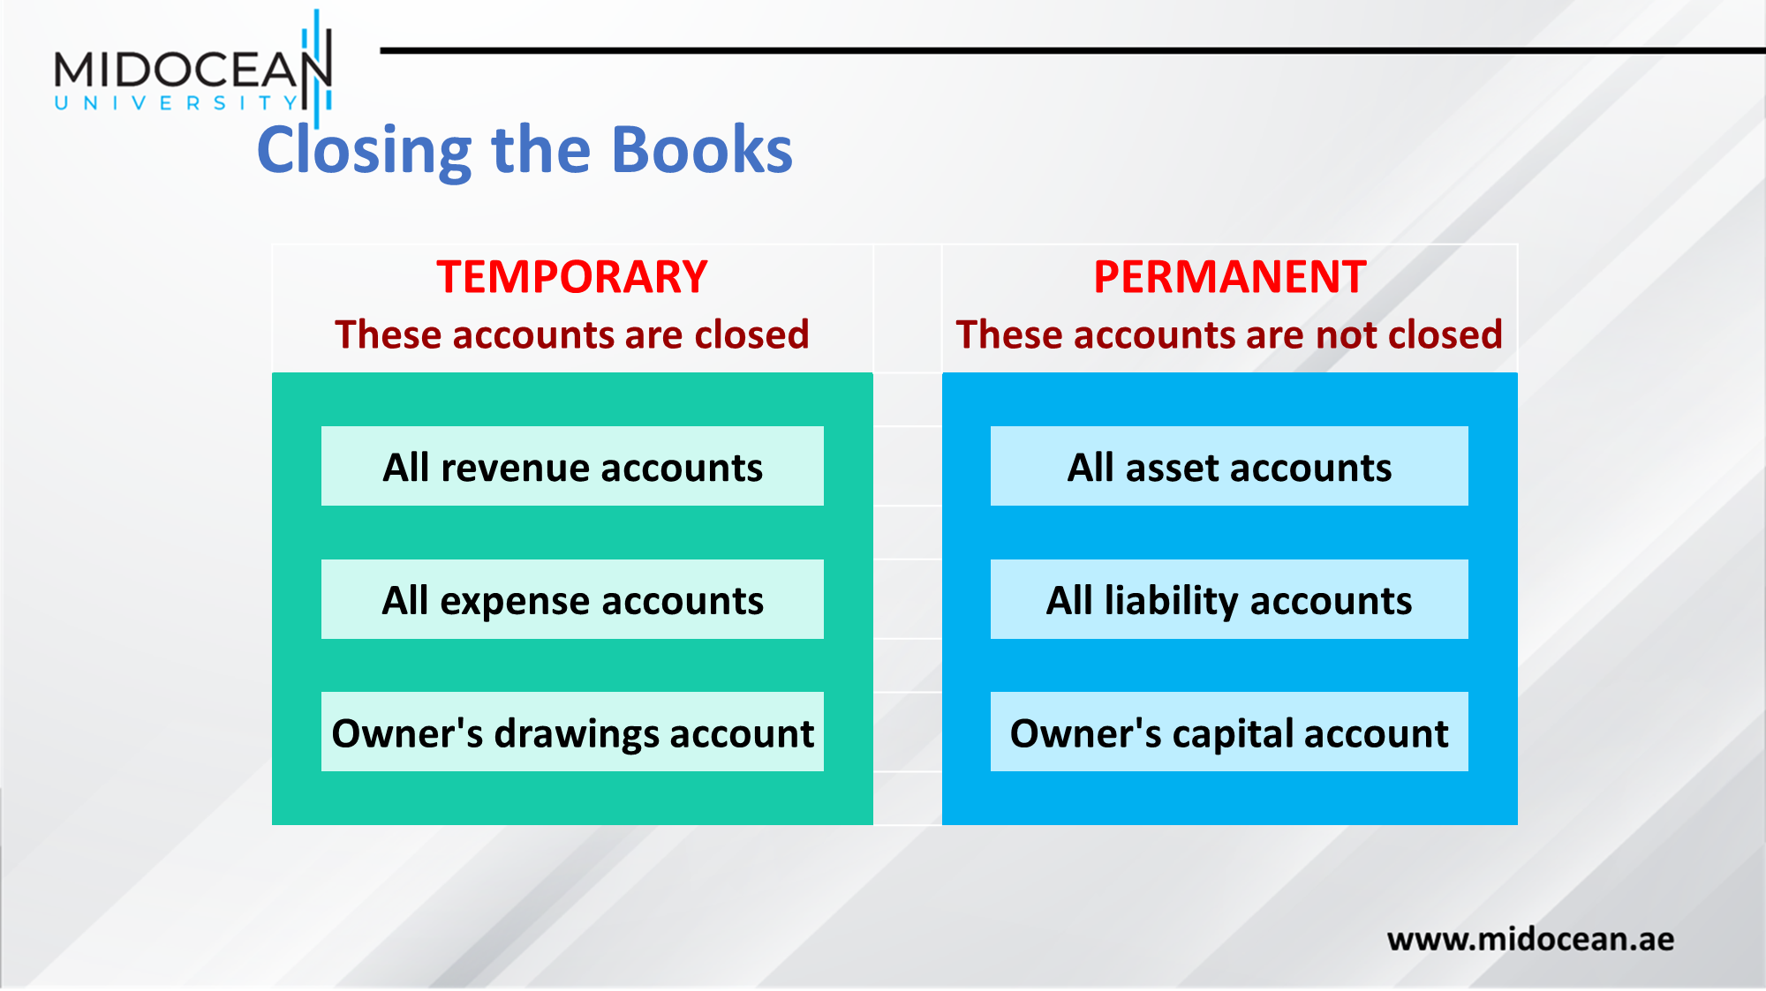

Slide 33
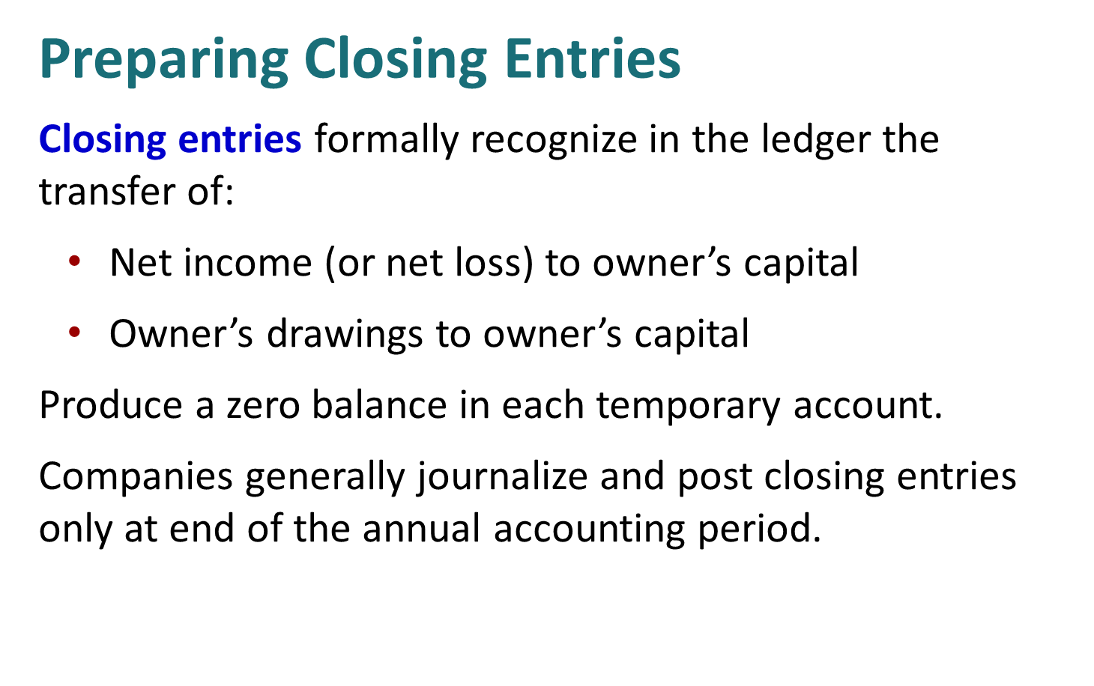

Slide 34
Preparing Closing Entries
Expenses
Income Summary
Revenues
2
1
3
Key:
Close Revenues to Income Summary.
Close Expenses to Income Summary.
Close Income Summary to Owner’s Capital.
Close Owner’s Drawings to Owner’s Capital.
Owner’s Drawings
Owner’s Capital
4

Slide 35
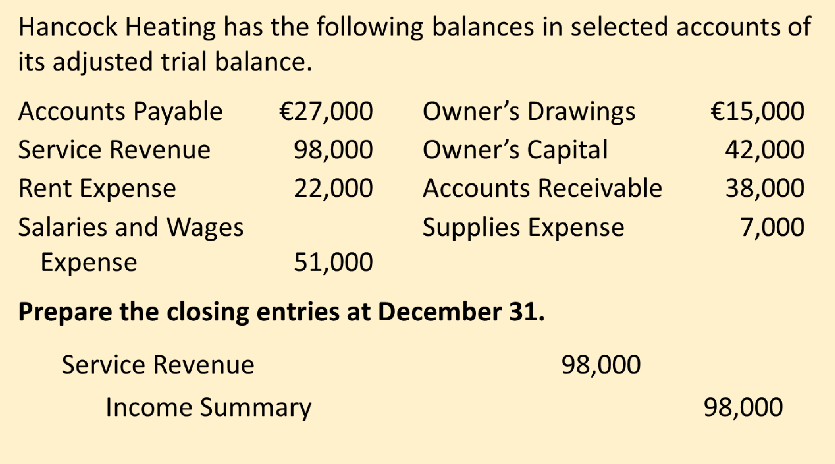
Example (1) Closing Entries

Slide 36
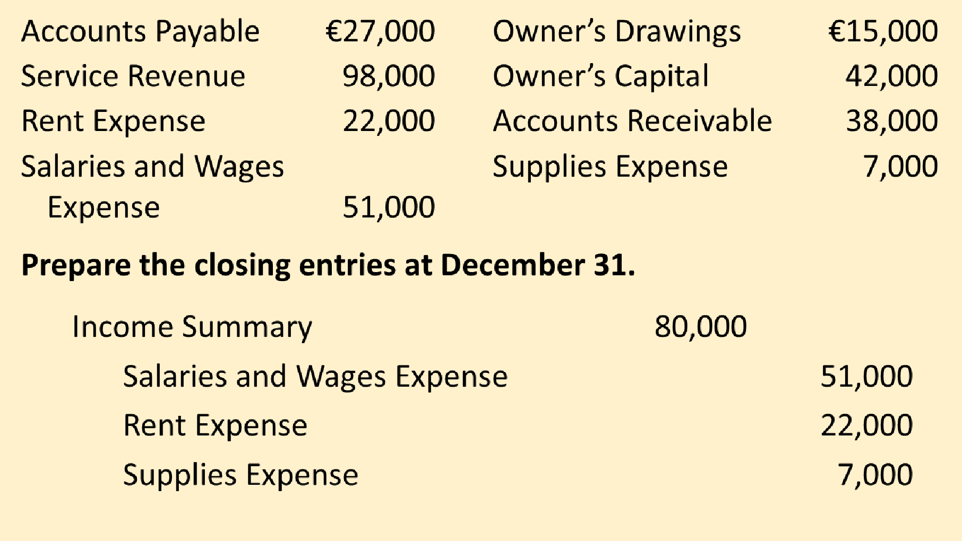

Slide 37
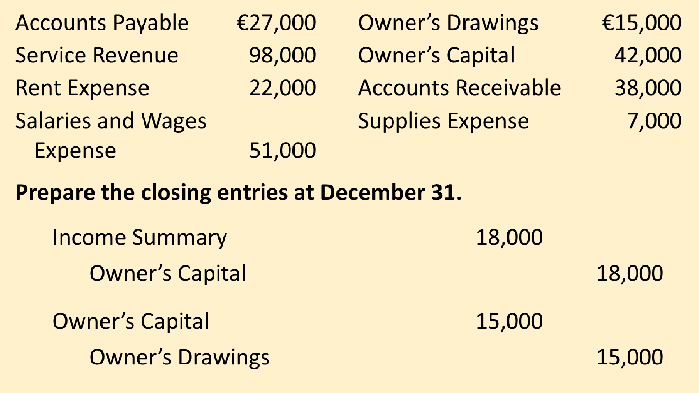

Slide 38
Example (
Yazici Advertising ₂₎ Adjusted Trial Balance October 31, 2020
 | Debit | Credit
Cash | ₺15,200
Accounts Receivable | 200
Supplies | 1,000
Prepaid Insurance | 550
Equipment | 5,000
Accumulated Depreciation—Equipment |  | ₺ 40
Notes Payable |  | 5,000
Accounts Payable |  | 2,500
Interest Payable |  | 50
Unearned Revenue |  | 800
Salaries and Wages Payable |  | 1,200
Owner’s Capital |  | 10,000
Owner’s Drawings | 500
Service Revenue |  | 10,600
Salaries and Wages Expense | 5,200
Supplies Expense | 1,500
Rent Expense | 900
Insurance Expense | 50
Interest Expense | 50
Depreciation Expense | 40
 | ₺30,190 | ₺30,190
Required:
Prepare the closing entries

Slide 39
Closing Entries
Date | Account Titles and Explanations |  | Debit | Credit
2020 Oct. 31 | Service Revenue |  | 10,600
 | Income Summary |  |  | 10,600
 | (To close revenue account)
31 | Income Summary |  | 7,740
 | Supplies Expense |  |  | 1,500
 | Depreciation Expense |  |  | 40
 | Insurance Expense |  |  | 50
 | Salaries and Wages Expense |  |  | 5,200
 | Rent Expense |  |  | 900
 | Interest Expense |  |  | 50
 | (To close expense accounts)

Slide 40
Multiple Choice Questions

Slide 41
The closing entry process consists of closing
  all asset and liability accounts.
  out the owner's capital account.
  all permanent accounts.
  all temporary accounts.
The correct Answer is d
In preparing closing entries
  each revenue account will be credited.
  each expense account will be credited.
  the owner's capital account will be debited if there
is net income for the period.
  the owner's drawings account will be debited.
The correct Answer is b
In order to close the owner's drawings account, the
  income summary account should be debited.
  income summary account should be credited.
  owner's capital account should be credited.
  owner's capital account should be debited.
The correct Answer is d

Slide 42
4.The income statement for the month of June, 2014 of Camera Enterprises contains the following information:
Revenues | $7,000
Expenses:
Salaries and Wages Expense | $3,000
Rent Expense | 1,500
Advertising Expense | 800
Supplies Expense | 300
Insurance Expense | 100
Total expenses | 5,700
Net income | $1,300
The correct Answer is d
The entry to close the revenue account includes a
debit to Income Summary for $1,300.
credit to Income Summary for $1,300.
debit to Income Summary for $7,000.
credit to Income Summary for $7,000.

Slide 43
76. The income statement for the month of June, 2014 of Camera
Obscura Enterprises contains the following information:
Revenues | $7,000
Expenses:
Salaries and Wages Expense | $3,000
Rent Expense | 1,500
Advertising Expense | 800
Supplies Expense | 300
Insurance Expense | 100
The correct Answer is b
Total expenses 5,700
Net income $1,300
The entry to close the expense accounts includes a
debit to Income Summary for $1,300.
credit to Rent Expense for $1,500.
credit to Income Summary for $5,700.
debit to Salaries and Wages Expense for $3,000.

Slide 44




Thank You

