Slide 1

Risk Management
Prepared by Dr. Dalia Hosni
Lecture5
MGM 510
Risk Management

Slide 2

Lecture 5
Plan Risk Responses
Risk Response Strategy is an action plan on what you will do a Risk on your project.
The main risk response strategies for threats are Mitigate, Avoid, Transfer, Actively Accept, Passively Accept, and Escalate a Risk.

Slide 3

Lecture 5
Plan Risk Responses
Quick Quiz: Look at the next table and see if you can quickly identify what type of risk response strategy is being employed in
each situation:

Slide 4
Lecture 5
Plan Risk Responses
Response Strategy? | Risk Description
 | There is a risk your lead architect may leave the project before her job is completed. As a result you cross-trained one of the developers to handle lead architect responsibility
 | The database for your software project is expected to run into multiple terabytes. After consulting with the infrastructure team you discover there are terabytes of available storage in the data center that can be secured at a much lower cost than purchasing new equipment.
 | An out-of-state vendor on your project has expressed concerns about meeting delivery due dates. You engage a local vendor that can easily meet the delivery dates without issue.
 | Staffing up for customer service on your project will take too long and be too expensive. You identify a vendor that will exceed your customer service requirements and will pay penalties if their service falls below stated quality levels.
mitigate
exploit
Avoid
transfer,

Slide 5
Lecture 5
Risk Register Updates
The risk register is completed at this point and can include:
تحديد المخاطر ووصفها
Identified risks and descriptions
Triggers
Response strategy
Specific actions taken if risk occurs
المحفزات
إستراتيجية الإستجابة
إتخاذ إجراءات محدده في حالة حدوث مخاطر

Slide 6
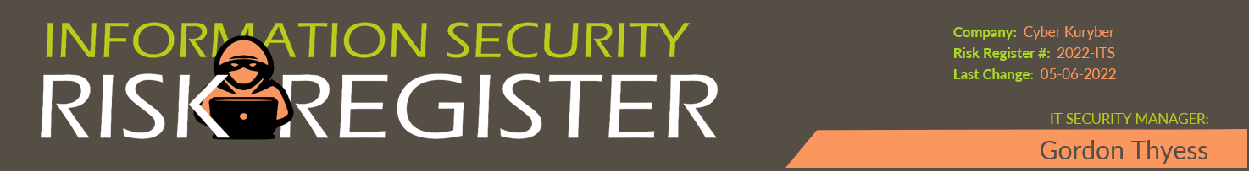
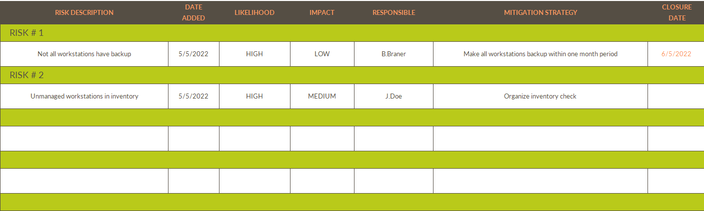
Lecture 5
Risk Register Updates Sample
محطات العمل غير المدارة في المخزون

Slide 7
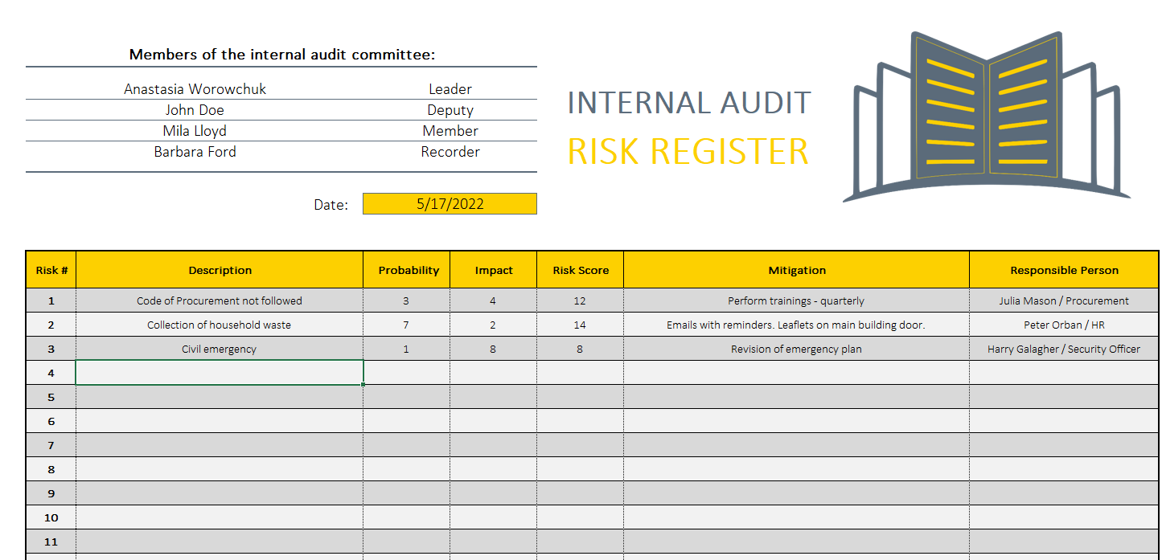
Lecture 5
Risk Register Updates Sample

Slide 8
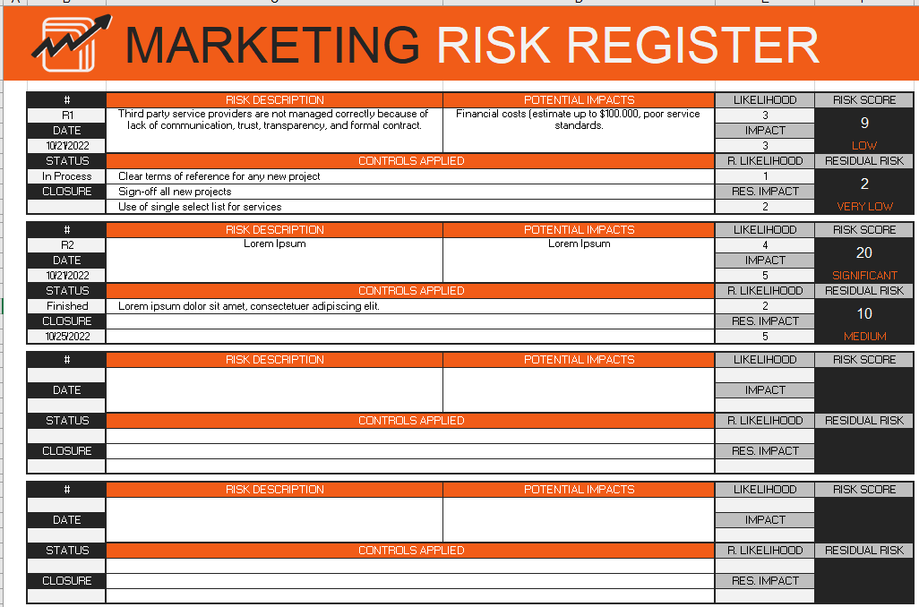
Lecture 5
Risk Register Updates Sample

Slide 9
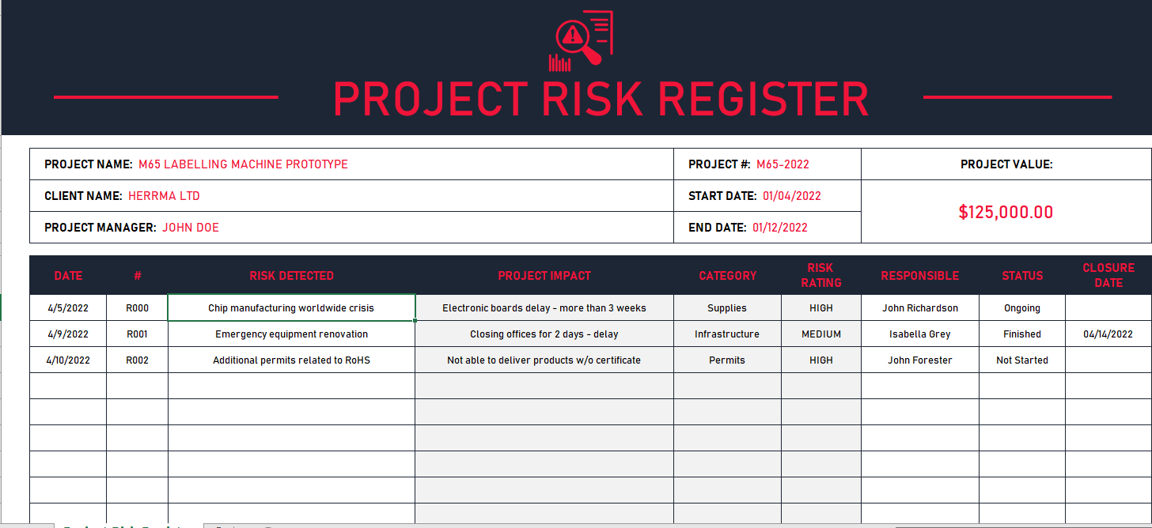
Lecture 5
Risk Register Updates Sample

Slide 10
Lecture 5
Here are the most important elements to include in your risk register template
Risk Category
Here, you categorize the risks you come up with. Some common categories include time, resources, environmental, scope, and cost. Using categories allows you to think of the likeliest risks which may occur and group them together for your reference.

Slide 11
Lecture 5
Here are the most important elements to include in your risk register template
Risk Description
This refers to a short description of each of the risks. It’s important to include this so anyone else who reads your project risk register template knows what each risk is all about.

Slide 12
Lecture 5
Here are the most important elements to include in your risk register template
Risk ID
This refers to a unique ID number you use to identify and to keep track of the information in your template. Assigning Risk IDs allows you to find them easily when the situation arises.

Slide 13
Lecture 5
Here are the most important elements to include in your risk register template
Project Impact
For this, you provide a short description of how the risk might impact the project. Including this description allows you to determine which are the most urgent risks to deal with them several occur at the same time.

Slide 14
Lecture 5
Here are the most important elements to include in your risk register template
Likelihood
Come up with an estimation of the probability or likelihood that each of the risks would occur and become an issue. You can use qualitative estimations but if you have enough information, quantitative estimations work well too.

Slide 15
Lecture 5
Here are the most important elements to include in your risk register template
Consequence
This refers to the potential impact or consequence of a particular risk if it becomes a reality. Including this information allows you and everyone else on your team to know how severe the risks are and how to deal with them

Slide 16
Lecture 5
Here are the most important elements to include in your risk register template
Risk Rank
This is the level or the magnitude of each of the risks. You can come up with the ranking by combining the consequence and the likelihood of each risk.
Risk = Likelihood X Severity X Detection
الإحتمالية
الشدة
الكشف

Slide 17
Lecture 5
Here are the most important elements to include in your risk register template
Risk Trigger
It’s also important to indicate the triggers that would signal that you need to start implementing your contingency plans. This makes it easier for you to know exactly when you must deal with the risk.

Slide 18
Lecture 5
Here are the most important elements to include in your risk register template
Prevention Plan
This refers to an action plan as part of your risk tracker that you create in order to prevent the occurrence of risks. It’s always better to prevent issues from arising rather than having to deal with them.

Slide 19
Lecture 5
Here are the most important elements to include in your risk register template
Contingency Plan
Even despite all your prevention efforts, some risks might still occur. In such cases, you must have a different action plan which you would use to address these risks when they occur. That way, your project won’t have to get delayed because you don’t have a plan.

Slide 20
Lecture 5
Here are the most important elements to include in your risk register template
Risk Owner
This refers to the person you assign to manage the risk when it occurs. Make sure that each risk owner knows about the contingency plans you’ve created so they know exactly what to do.

Slide 21
Lecture 5
Here are the most important elements to include in your risk register template
Residual Risk
This refers to the risk which remains even after you’ve dealt with it. In such a case, you can assign the level of risk as “Low.”

Slide 22

Lecture 5
What is a risk register?
A risk register is a document that is used as a risk management tool to identify potential setbacks within a project. This process aims to collectively identify, analyze, and solve risks before they become problems. While usually centered around projects, other circumstances where risk management is helpful include product launches and manufacturing.

Slide 23
Lecture 5
When should you use a risk register?
There are many instances when a risk register comes in handy. Ideally, it should be used—or available for use when needed—for every project. It can be used for both small and large projects, though your risk log may look different depending on the scope and complexity of your initiative.

Slide 24
Lecture 5
When should you use a risk register?
While a small project may only include basic information about the risk such as likelihood, priority, and solutions, a more complicated project may require around 10 different document fields.

Slide 25
Lecture 5
When should you use a risk register?
Some risk scenarios ranked by priority could include:
Low priority: Risks such as lack of communication and scheduling errors can leave projects open to scope creep and missed deliverables.
Medium priority: Risks such as unplanned or additional work can cause teams to struggle with productivity and create unclear objectives.
High priority: Risks such as data security and theft can leave your company open to revenue loss and should be prioritized.

Slide 26
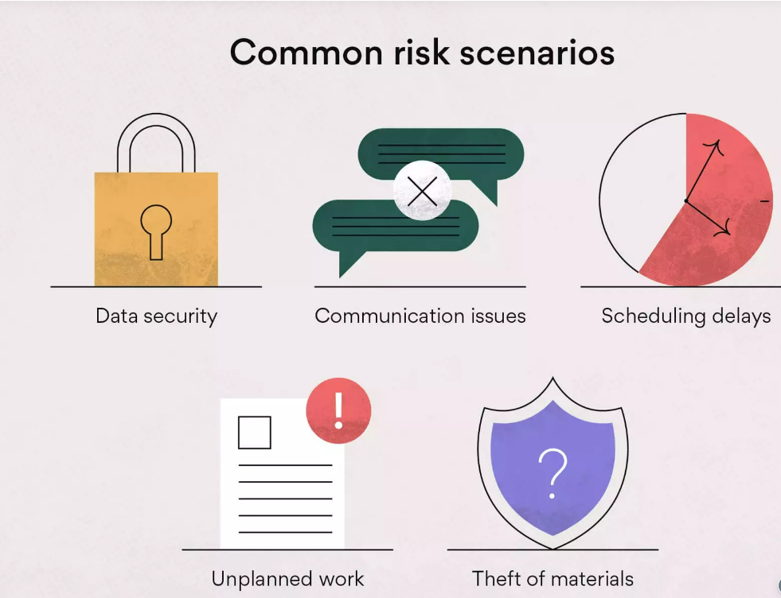
Lecture 5
Common risk scenarios

Slide 27

Lecture 5
Common risk scenarios
Multiple risks could arise during a new project. Anything from data security to unplanned work can risk projects going over budget and scope. Nobody wants to imagine the consequences of missed due dates, which is why it’s important to identify potential risks before they happen.
It’s a good idea to include common risk categories in your risk register log so you’re prepared when they occur.

Slide 28
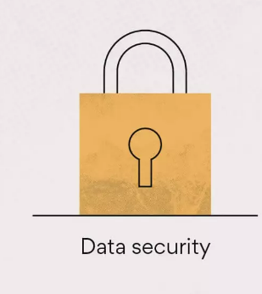
Lecture 5
Common risk scenarios
Data security
If you’re working on projects that could affect data security, it’s extremely important to track and mitigate potential risks. Unmanaged risks could result in:
Data security is a top risk and should be prioritized accordingly in order to prevent long-term security issues.
Information being stolen: Without proper mitigation, your business could become vulnerable to private information being stolen. This is especially harmful if it’s customer information being stolen.
Credit card fraud: This is dangerous for a number of reasons, but could result in a loss of revenue and potentially require legal action.

Slide 29
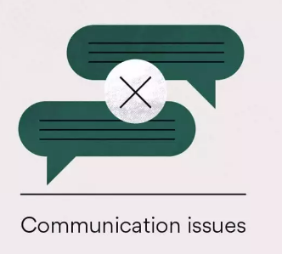
Lecture 5
Common risk scenarios
Communication issues
Communication issues can arise no matter the size of your project and team. While a risk register can help identify where communication areas live, it can be helpful to also implement work management software to streamline communication at work.
Here are some risks that could arise from lack of communication:

Slide 30
Lecture 5
Common risk scenarios
Here are some risks that could arise from lack of communication:
Project inconsistencies: Without proper communication, inconsistencies in deliverables can cause confusion.
Missed deadlines: No one wants to miss a deadline but without clear communication, your team may not be aware of due dates for deliverables.
Creating a proper communication plan can also help prevent risks from surfacing in the first place

Slide 31
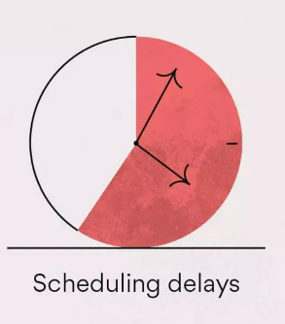
Lecture 5
Common risk scenarios
If scheduling errors and delays go unnoticed, they can become a big problem when deadlines are missed. Tools such as timelines and team calendar software can help prevent scheduling errors in the first place.
Project scheduling delays could result in:
Rushed deliverables: There’s nothing worse than a project that hasn’t been properly executed, which can cause goals to be missed and work to appear sloppy.
Confusion: Teams can become overwhelmed and confused without a proper schedule in place.
Implementing a schedule can help keep deliverables on track for both daily tasks and one-off projects

Slide 32
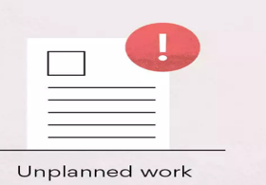
Lecture 5
Common risk scenarios
Unplanned work
We’ve all been in a situation where a project goes over scope. It’s a common risk that can be fairly easy to mitigate if tracked properly. Catching unplanned work early on allows you to properly delegate it to the project lead.

Slide 33
Lecture 5
Common risk scenarios
Without a proper risk register, you could experience:
Missed deliverables: If work slips through the cracks, you may be at risk of missing a deadline altogether.
Employee burnout: Overscheduling your team members with unplanned work can create tension and even cause overwork and burnout. That’s why it’s important to scope projects correctly.
If you do run into issues with unplanned work, implementing a change control process can help communicate additional work to your team members.

Slide 34
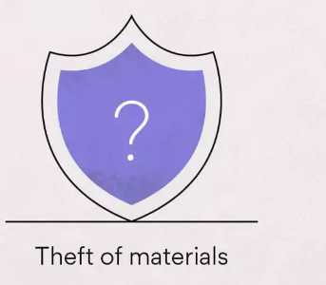
Lecture 5
Common risk scenarios
Theft of materials
While hopefully uncommon, businesses that have a large inventory of products could run the risk of theft or reporting errors. By tracking inventory consistently and frequently, you can catch risks early on to determine the cause.

Slide 35
Lecture 5
Common risk scenarios
Theft can leave your business open to:
Loss of revenue: Whether products are being stolen or there are errors in reporting, theft will have a negative impact on revenue.
Uncertainty: When theft happens, employee and business uncertainty can cause internal stress.
Misuse of time: Along with theft of tangible goods, there’s a risk of time theft. In a remote working environment, it can be more difficult to track where your team is spending their time.

