Slide 1


Prepared by Dr. Mahitab ELrafii
Research Methods (RSC 701)
Lecture 6

Slide 2



Research Methods (RSC 701)
Lecture 6
Prepared by
Dr. Mahitab ELrafii

Slide 3

Lecture
Lecture Content
6
Hypotheses

Slide 4

The Content of lecture 6 Includes the following:
What is Hypothesis?
What is a Research Hypothesis?
Characteristics of a Good Research Hypothesis
How to Formulate an Effective Research Hypothesis
Research Hypothesis Examples of Independent and Dependent Variables:
Importance of a Testable Hypothesis
Lecture
6

Slide 5
What is Hypothesis?
What is Hypothesis?
Simply put, a hypothesis is a research question that also includes the predicted or expected result of the research. Without a hypothesis, there can be no basis for a scientific or research experiment. As such, it is critical that you carefully construct your hypothesis by being deliberate and thorough, even before you set pen to paper .

Slide 6
What is Hypothesis?
What is Hypothesis?
Unless your hypothesis is clearly and carefully constructed, any flaw can have an adverse, and even grave, effect on the quality of your experiment and its subsequent results. A hypothesis is a fact-based guess or prediction that has not been proven. It is an essential step of the scientific method. The hypothesis of a study is a drive for experimentation to either prove the hypothesis or dispute it.

Slide 7
What is Hypothesis?
Hypothesis is an assumption, or an idea proposed for the sake of argument so that it can be tested. It is a precise, testable statement of what the researchers predict will be outcome of the study. Hypothesis usually involves proposing a relationship between two variables: the independent variable (what the researchers change) and the dependent variable (what the research measures)

Slide 8
What is a Research Hypothesis?
Research hypothesis is a statement that introduces a research question and proposes an expected result. It is an integral part of the scientific method that forms the basis of scientific experiments. Therefore, you need to be careful and thorough when building your research hypothesis.

Slide 9
What is a Research Hypothesis?
A minor flaw in the construction of your hypothesis could have an adverse effect on your experiment. In research, there is a convention that the hypothesis is written in two forms, the null hypothesis, and the alternative hypothesis (called the experimental hypothesis when the method of investigation is an experiment).

Slide 10
Research Question vs Hypothesis
It’s easy to confuse research questions with hypotheses, and vice versa. While they’re both critical to the Scientific Method, they have very specific differences. Primarily, a research question, just like a hypothesis, is focused and concise. But a hypothesis includes a prediction based on the proposed research, and is designed to forecast the relationship of and between two (or more) variables. Research questions are open-ended, and invite debate and discussion, while hypotheses are closed, e.g. “The relationship between A and B will be C.”

Slide 11
Research Question vs Hypothesis
A hypothesis is generally used if your research topic is fairly well established, and you are relatively certain about the relationship between the variables that will be presented in your research. Since a hypothesis is ideally suited for experimental studies, it will, by its very existence, affect the design of your experiment.

Slide 12
Research Question vs Hypothesis
The research question is typically used for new topics that have not yet been researched extensively. Here, the relationship between different variables is less known. There is no prediction made, but there may be variables explored. The research question can be casual in nature, simply trying to understand if a relationship even exists, descriptive or comparative.

Slide 13
Characteristics of a Good Research Hypothesis
Essential Characteristics of a Good Research Hypothesis
As the hypothesis is specific, there is a testable prediction about what you expect to happen in a study. You may consider drawing hypothesis from previously published research based on the theory.
A good research hypothesis involves more effort than just a guess. In particular, your hypothesis may begin with a question that could be further explored through background research.

Slide 14
Characteristics of a Good Research Hypothesis
To help you formulate a promising research hypothesis, you should ask yourself the following questions:
Is the language clear and focused?
What is the relationship between your hypothesis and your research topic?
Is your hypothesis testable? If yes, then how?
What are the possible explanations that you might want to explore?
Does your hypothesis include both an independent and dependent variable?

Slide 15
Characteristics of a Good Research Hypothesis
To help you formulate a promising research hypothesis, you should ask yourself the following questions:
Does your research predict the relationship and outcome?
Is your research simple and concise (avoids wordiness)?
Is it clear with no ambiguity or assumptions about the readers’ knowledge
Is your research observable and testable results?
Is it relevant and specific to the research question or problem?

Slide 16
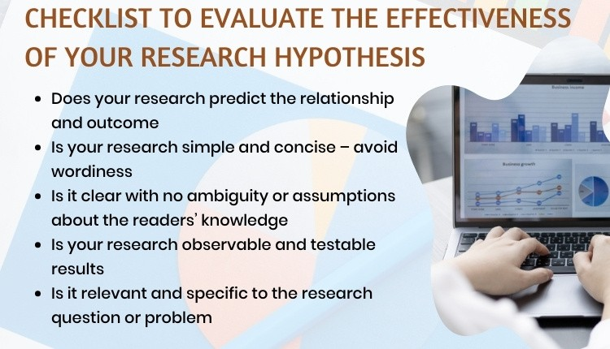
Characteristics of a Good Research Hypothesis

Slide 17
Characteristics of a Good Research Hypothesis
The questions listed above can be used as a checklist to make sure your hypothesis is based on a solid foundation. Furthermore, it can help you identify weaknesses in your hypothesis and revise it if necessary.

Slide 18
Characteristics that make a hypothesis weak
Characteristics that make a hypothesis weak include:
Unclear variables
Unoriginality
Too general
Too specific
Too vague
Untestable

Slide 19
Characteristics that make a hypothesis weak
A weak hypothesis leads to weak research and methods. The goal of a paper is to prove or disprove a hypothesis - or to prove or disprove a null hypothesis. If the hypothesis is not a dependent variable of what is being studied, the paper’s methods should come into question.

Slide 20
Characteristics that make a hypothesis weak
A strong hypothesis is essential to the scientific method. A hypothesis states an assumed relationship between at least two variables and the experiment then proves or disproves that relationship with statistical significance.

Slide 21
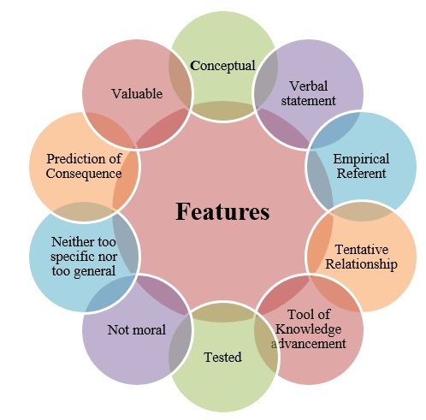
Features od hypothesis

Slide 22
Steps to develop and write a hypothesis
Steps to develop and write a hypothesis
1. Collect as much literature about a topic or problem as you can.
2. Examine the literature and identify possible causes of the problem or knowledge gaps to be filled.
3. Begin with a specific research problem.
4. Identify the variables.

Slide 23
How to Write Hypothesis in Research
Writing an effective hypothesis starts before you even begin to type. Like any task, preparation is key, so you start first by conducting research yourself, and reading all you can about the topic that you plan to research. From there, you’ll gain the knowledge you need to understand where your focus within the topic will lie.

Slide 24
How to Write Hypothesis in Research
Remember that a hypothesis is a prediction of the relationship that exists between two or more variables. Your job is to write a hypothesis, and design the research, to “prove” whether or not your prediction is correct. A common pitfall is to use judgments that are subjective and inappropriate for the construction of a hypothesis. It’s important to keep the focus and language of your hypothesis objective.

Slide 25
How to Write Hypothesis in Research
An effective hypothesis in research is clearly and concisely written, and any terms or definitions clarified and defined. Specific language must also be used to avoid any generalities or assumptions.
Use the following points as a checklist to evaluate the effectiveness of your research hypothesis:
Predicts the relationship and outcome
Simple and concise – avoid wordiness
Clear with no ambiguity or assumptions about the readers’ knowledge
Observable and testable results
Relevant and specific to the research question or problem

Slide 26
How to Formulate an Effective Research Hypothesis
A testable hypothesis is not a simple statement. It is rather an intricate statement that needs to offer a clear introduction to a scientific experiment, its intentions, and the possible outcomes. However, there are some important things to consider when building a compelling hypothesis.
1. State the problem that you are trying to solve.
Make sure that the hypothesis clearly defines the topic and the focus of the experiment.
2. Try to write the hypothesis as an if-then statement.
Follow this template: If a specific action is taken, then a certain outcome is expected.

Slide 27
How to Formulate an Effective Research Hypothesis
3. Define the variables
Independent variables are the ones that are manipulated, controlled, or changed. Independent variables are isolated from other factors of the study.
Dependent variables, as the name suggests are dependent on other factors of the study. They are influenced by the change in independent variable.
4. Scrutinize the hypothesis

Slide 28
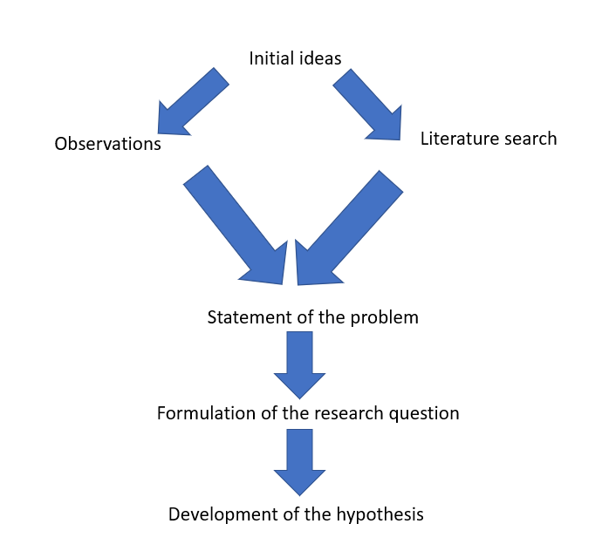
How to Formulate an Effective Research Hypothesis

Slide 29
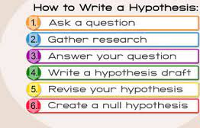
How to Formulate an Effective Research Hypothesis

Slide 30
Categories of Research Hypothesis
Research hypothesis can be classified into seven categories as stated below:
1. Simple Hypothesis
It predicts the relationship between a single dependent variable and a single independent variable.
2. Complex Hypothesis
It predicts the relationship between two or more independent and dependent variables.

Slide 31
Categories of Research Hypothesis
Research hypothesis can be classified into seven categories as stated below:
3. Directional Hypothesis
It specifies the expected direction to be followed to determine the relationship between variables and is derived from theory. Furthermore, it implies the researcher’s intellectual commitment to a particular outcome.
4. Non-directional Hypothesis
It does not predict the exact direction or nature of the relationship between the two variables. The non-directional hypothesis is used when there is no theory involved or when findings contradict previous research.

Slide 32
Categories of Research Hypothesis
5. Associative and Causal Hypothesis
The associative hypothesis defines interdependency between variables. A change in one variable results in the change of the other variable. On the other hand, the causal hypothesis proposes an effect on the dependent due to manipulation of the independent variable.
6. Null Hypothesis
Null hypothesis states a negative statement to support the researcher’s findings that there is no relationship between two variables. There will be no changes in the dependent variable due the manipulation of the independent variable. Furthermore, it states results are due to chance and are not significant in terms of supporting the idea being investigated.

Slide 33
Categories of Research Hypothesis
7. Alternative Hypothesis
It states that there is a relationship between the two variables of the study and that the results are significant to the research topic. An experimental hypothesis predicts what changes will take place in the dependent variable when the independent variable is manipulated. Also, it states that the results are not due to chance and that they are significant in terms of supporting the theory being investigated.

Slide 34
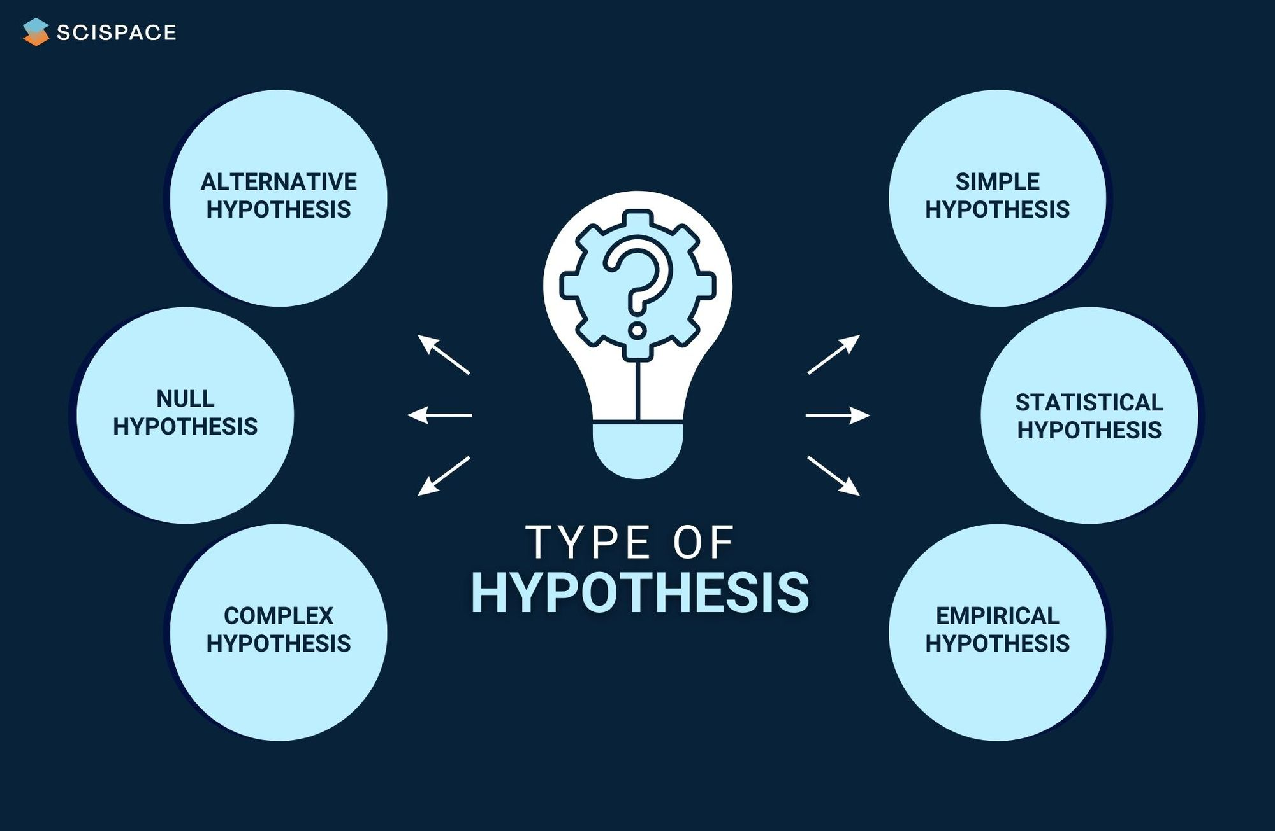
Categories of Research Hypothesis

Slide 35
Research Hypothesis Examples
Research Hypothesis Examples of Independent and Dependent Variables:
Research Hypothesis Example 1
The greater number of coal plants in a region (independent variable) increases water pollution (dependent variable).
If you change the independent variable (building more coal factories), it will change the dependent variable (amount of water pollution).

Slide 36
Research Hypothesis
The validity of your experiment and its results rely on a robust testable hypothesis. Developing a strong testable hypothesis has few advantages, it compels us to think intensely and specifically about the outcomes of a study.
Consequently, it enables us to understand the implication of the question and the different variables involved in the study .

Slide 37
Research Hypothesis
Furthermore, it helps us to make precise predictions based on prior research. Hence, forming a hypothesis would be of great value to the research. Here are some good examples of testable hypotheses.
More importantly, you need to build a robust testable research hypothesis. A testable hypothesis is a hypothesis that can be proved or disproved as a result of application.

Slide 38
Importance of a Testable Hypothesis
To devise and perform an experiment using scientific method, you need to make sure that your hypothesis is testable. To be considered testable, some essential criteria must be met:
There must be a possibility to prove that the hypothesis is true.
There must be a possibility to prove that the hypothesis is false.
The results of the hypothesis must be reproducible.
Without these criteria, the hypothesis and the results will be vague. As a result, the experiment will not prove or disprove anything significant.

Slide 39
Hypotheses and conclusions
When writing the conclusion for your research, you will state whether the hypothesis was correct or not, followed by an explanation of the results of the research. Remember that a hypothesis does not have to be correct. The objective is to determine whether your prediction was right or wrong. The negation of a hypothesis is an important finding too!

Slide 40
Summary
Ensure the following aspects for your hypothesis:
The hypothesis must be clear and directional.
The hypothesis must be falsifiable (can be supported or refuted) and testable.
The results of the hypothesis must be reproducible.

Slide 41



Thank You

