Slide 1

Social Media Management (DGM 721)
Prepared by
Dr. Mahitab ELrafii
Lecture No.7
Social Media Management (DGM721)

Slide 2

Sources of Knowledge
Social media management
Dr. Mahitab ELrafii
E-Recruitment

Slide 3
Content of lecture
The Content of lecture 7Includes the following:
1.What is E-recruitment?
2. What are the advantages of E-recruitment?
3. What are the disadvantages of E-recruitment?
4. Methods of E-Recruitment
5. How does e-recruiting work?
6. Changing requirements in e-recruiting.
7. How do you build an E-Recruitment strategy?

Slide 4

What is E-recruitment?
The electronic recruitment process of finding, assessing, and recruiting employees is known as e-recruitment.
This process connects organizations with potential employees through the use of technology, and it has changed how employers and employees interact. Employers can use e-recruitment to post job openings and search resumes electronically, and employees can use it to submit applications and resumes electronically, search job postings, and receive job alerts.

Slide 5
What are the advantages of E-recruitment?
Employers can reach a bigger number of potential employees by using electronic recruitment.
Companies can build their own e-recruitment stages in-house, use e-recruitment HR software, or use recruiting firms that include e-recruitment in their services.
Using online stages and HR software, e-recruitment is the automated process of identifying, attracting, screening, and hiring candidates.
Businesses can use this internet recruitment strategy to develop an online presence and communicate with candidates.

Slide 6

1. Cost-Effective:
Work costs in recruiting are generally high in terms of advertising, travel expenses, outside recruiter fees etc.
As a result, the employing process generally takes up an excessive amount of time and its expense could be minimized by switching to e-recruitment, which permits you to post free employment opportunities on multiple social stages just by one tick.

Slide 7
2. Quicker process:
The hiring process could be shortened simply by clicking a few catches to screen, filter, and sort candidates' information and CV. E-recruitment streamlines the process of welcoming or rejecting candidates one by one and inserting candidates' information physically is not, at this point needed.

Slide 8

3. Customized filtration:
E-recruitment allows filtering requirements to help recruiters to track down the ideal candidates with competencies that match the work position.
Therefore, the filtration apparatuses provided by e-recruitment systems speed up the process of arranging the candidates as indicated by experience, education, competencies, and a lot more criteria.

Slide 9

4. Flexible:
The E-recruitment process is easy to get adapted to. Thus, it is easy to use and provides a stage where all the HR managers could follow the hiring process and their funnel smoothly. Moreover, the cloud-based feature permits the employer to have a CV database stored in one place making it easier to refer or come back to in future.

Slide 10
What are the disadvantages of E-recruitment?
1. Tech problems:
Some candidates may not be confident enough with the security of an online application. There's always the possibility that the application system may operate slowly or lose information during the submission process.

Slide 11
2. Fraudulent applicants:
A few applications may be phony to get data about the company or hiring official. At the same time, spammers may utilize the data presented online to advance a help or item to your company. On the off chance that you part with an excessive number of subtleties in your promotion, vindictive programmers can even utilize the data to possibly access your company's IT frameworks.

Slide 12

3. Less effective:
Not all e-recruitment administrations offer an inside and out investigation of your posting; consequently, it tends to be difficult to sort out the thing is and isn't working and how to advance your advertisement. Obviously, this is a typical issue in disconnected recruitment.

Slide 13

4. Misunderstandings:
Speaking with planned representatives through a screen can prompt confounded messages or wrong suspicions. In any case, conversing with somebody face to face can explain what an individual resembles as a first impression while likewise keeping up with clear correspondence with each other.

Slide 14
5. Diverse audience:
Since e-recruitment creates countless applicants each day, organizations ought to be more cautious when utilizing this. Scouts should guarantee proficiency consistently and try not to tap unfit candidates, just as candidates who live excessively far from the workplace.

Slide 15

Methods of E-Recruitment
Types of Online Recruitment Methods:
More and more people these days use the internet to search for work and find out more about companies before job interviews. By having a strong presence on the internet and using online recruitment methods, businesses can have access to a large pool of candidates and seamlessly manage their recruitment process.

Slide 16
The most common types of online recruiting methods include:
Sourcing potential candidates on professional social media platforms.
Using an applicant tracking system (ATS).
Interviewing candidates online via video conferencing software.
Using online testing via surveys and questionnaires.
Creating job boards to advertise job offerings.

Slide 17

Sourcing and Attracting Potential Candidates:
Sourcing is the process of searching for qualified job candidates for a current or pending position in the company. In order to recruit candidates efficiently, it becomes important to know where the pool of interested candidates lies.
Which is why, using social media for sourcing and attracting potential candidates is one of the most common methods used for online recruitment. Social media is an effective tool for building employer brands and hiring potential candidates. Platforms like Facebook, LinkedIn, Instagram have been commonly visited sites for finding, tracking and recruiting candidates online.

Slide 18
Using Applicant Tracking System:
An Applicant Tracking System is a software that uses an algorithm to sort out resumes of the potential candidates and simplify the process of recruitment for the hiring HR managers.
When a lot of candidates apply for a job opening, this software helps to segregate under qualified resumes and qualified resumes during the hiring process. So, this enables the recruiters to see the resumes that are filtered and as per their criteria asked in the job profile. Thus, an Applicant Tracking System is a useful method for E- recruitment.

Slide 19
Interviewing Candidates Online:
Thanks to the internet, it is not mandatory to have job interviews in a physical space anymore. By using free interview video tools like Skype, Google meet, Zoom etc., HR managers can recruit the qualified candidates by interviewing them online. Nowadays, most of the companies use an automated online interviewing system where the candidates are asked questions and are given a certain time limit for thinking and speaking the answers. This is also the reason why this method of E- recruitment has become very common in the corporate world.

Slide 20
Using Job Boards:
Job boards are the websites used by the recruiters for advertising job offerings specifically. On the contrary, Job seekers can use job boards to search for new job opportunities in their area and profession. Some job boards use applicant tracking systems to help streamline the application process while in others, individual job postings redirect interested candidates to company websites to complete the application process. For example, sites like Glassdoor and Indeed allow candidates to post their resumes for the recruiters to find them.

Slide 21
Why e-recruiting?
The modern job search takes place almost exclusively online with the help of common search algorithms. Potential candidates prefer to search for jobs quickly, efficiently and almost exclusively via smartphone and tablet. By using digital e-recruiting, companies are adapting to the current demands of young talent, making it possible to apply quickly and efficiently with just a few clicks.

Slide 22
The use of e-recruiting also pays off for companies in terms of processes and cost optimization. It streamlines administrative work, increases reach and visibility, saves money and effectively supports them in recruiting.

Slide 23
How does e-recruiting work?
With e-recruiting, job advertisements are placed on suitable online job platforms aimed at the desired target groups. The application is sent to the potential employer either by e-mail or - even better - by document upload using the dedicated platform. This makes the application process barrier-free, time-saving and altogether much more attractive to applicants.

Slide 24
When an application is submitted the applicant tracking system (ATS), or similar e-recruiting software, centrally collects the applications sent in, confirms their receipt, creates applicant profiles, and significantly simplifies the evaluation of the applications.
Unsuitable candidates can usually be sent an automatic rejection email with just a few clicks after the suitable candidate selection.

Slide 25
Common channels of digital recruiting
Some of the most common channels for e-recruiting are:
The career page on the company's own website.
Online job boards such as Indeed or LinkedIn.
Job search engines like Google for Jobs.
Social media such as Facebook.
Apps for smartphones and tablets (mobile recruiting).
Ideally, all the above-mentioned channels are served simultaneously in order to achieve the highest possible reach.

Slide 26
Changing requirements in e-recruiting
With the digitalization of the application process, there are also new requirements for writing job advertisements and communicating with applicants.
Instead of presenting the company and its achievements in a distanced 'you' tone, the modern job ad focuses on giving talents the opportunity to 'feel' their way into everyday work in a company.

Slide 27
In addition, the job advertisement must be kept gender-neutral and should be oriented towards the interests of the applicant target group, similar to a good marketing text.

Slide 28
For more valuable information, important must-dos in the hiring process and useful tips on how companies can increase their hiring success, visit our Knowledge Hub.

Slide 29
What are the benefits of E-Recruitment?
E-Recruitment is a process of finding and hiring employees through the use of technology.
This can include job boards, online applications, and social media.
E-Recruitment can save time and money for both the employer and the employee.
It is also a more efficient way to connect with potential employees.

Slide 30
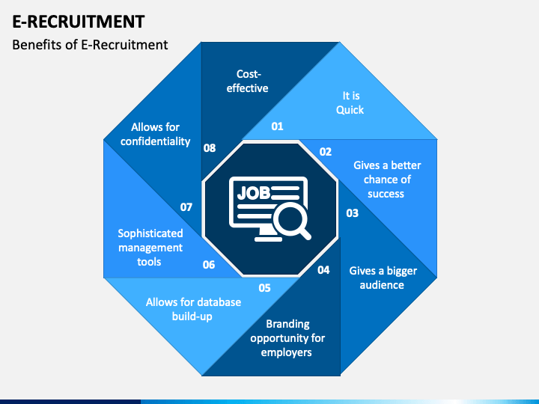
What are the benefits of E-Recruitment?

Slide 31
Who uses E-Recruitment?
E-recruitment is a process that allows organizations to post job openings and collect applications electronically.
It is used by human resources professionals to screen candidates and fill job openings.
E-recruitment can also be used to manage employee onboarding and training.

Slide 32
How do you build an E-Recruitment strategy?
An e-recruitment strategy is the process of planning and executing the recruitment process using electronic means.
The aim of an e-recruitment strategy is to improve the efficiency and effectiveness of the recruitment process.

Slide 33
There are a number of steps that you can take to build an e-recruitment strategy:
1. Establish your recruitment needs The first step in creating an e-recruitment strategy is to establish your recruitment needs. What positions do you need to fill? What skills and experience are required for these positions? What is the deadline for filling these positions? Once you have established your recruitment needs, you can begin to identify the best ways to recruit candidates using electronic means.

Slide 34
2. Identify the best methods for recruiting candidates There are a number of ways to recruit candidates using electronic means.
You can post job advertisements on job boards and search engines, and you can also use social media to attract candidates.
You can also use email to contact potential candidates.
You should also consider using video interviews to screen candidates.

Slide 35
3.Create a recruitment website A recruitment website is a website that is dedicated to the recruitment process. It can be used to post job advertisements, view resumes, and conduct video interviews.
A recruitment website can be a valuable tool in attracting candidates to your organization.

Slide 36
4.Use social media to recruit candidates Social media can be a powerful tool for recruiting candidates.
You can use social media to post job advertisements, collect resumes, and conduct video interviews.
You can also use social media to attract candidates to your organization.

Slide 37
5.Use email to contact potential candidates Email can be a powerful tool for recruiting candidates.
You can use email to contact potential candidates and invite them to apply for a job.
You can also use email to contact candidates who have applied for a job.

Slide 38
6.Conduct video interviews Video interviews can be a powerful tool for assessing candidates.
You can use video interviews to screen candidates for a job.
You can also use video interviews to assess the candidates' skills and experience.

Slide 39
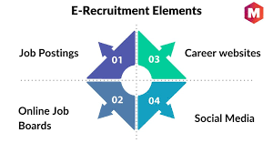

Slide 40
Thank you

