Slide 1


English Language 2
Orientation show
Lect. Samara Jasim
Everyone Smart University
2023

Slide 2





Who Am I?
Samara Jasim
  Lecturer in Teaching English as a Foreign Language Field / Methods of Teaching;
    Thesis: “Evaluation of Using English Discourse Markers by Undergraduate Students”.
    M.A. from Tikrit University, Iraq, 2017
    B.A. from Tikrit University, Iraq, 2013
  Educational Consultant in British International Schools; and
  Sworn Translator
  How to contact me
    via email at samara@esu.ac.ae
    via Moodle messages
  Office hours
  Online Meetings (Sunday at 6:30 PM)
English Language 2, Samara Jasim

Slide 3

The Course Details
English Language 2
English Language 2, Samara Jasim

Slide 4
Main Objectives of the Course
This course aims to:
Develop basic skills to deal with people in business situations;
Increase their knowledge of key business concepts worldwide;
Write and read basic business emails;
Expand vocabulary related to general business situations; and
Develop confidence to deal with people and basic issues in the business world;
English Language 2, Samara Jasim

Slide 5


Learning Resources:
Credit Hours:
3 credit hours.
  Required Textbook:
  Market Leader, Course Book, Pre-Intermediate, by Pearson
  Market Leader, Practice Book, Pre-Intermediate, by Pearson
  Essential References:
1. A Dictionary
English Language 2, Samara Jasim

Slide 6
What This Course is about?
  Market Leader is a multi-level business English course for businesspeople and students of business English. It has been developed in association with the Financial Times, one of the leading sources of business information in the world. It consists of 12 units based on topics of great interest to everyone involved in international business.
English Language 2, Samara Jasim

Slide 7
Course Content
  Lecture Structure:
Course Unit | No.of. Weeks | Contact Hours
Unit 1: Careers | 2nd | 5
Unit 2: Companies | 3rd | 5
Unit 3: Selling | 4th | 5
Unit 4: Great Ideas | 5th | 5
Unit 5: Stress | 6th | 5
Unit 6: Entertaining | 7th | 5
Unit 7: New Business | 8th | 5
Unit 8: Marketing | 9th | 5
Unit 9: Planning | 10th | 5
Unit 10: Managing People | 11th | 5
English Language 2, Samara Jasim

Slide 8
Assessment Tools:
  Multiple Choice, T&F, Matching, Arranging, Audio Questions
  80% marks
    10 weekly quizzes (open on Saturdays, at 22:00 ksa and close next Saturday at 21:00 ksa)
    The duration of each quiz is (24 minutes only = 3 minutes for each question)
    8 Marks for each of short exam.
    8 questions
  20% Final Examination
English Language 2, Samara Jasim

Slide 9
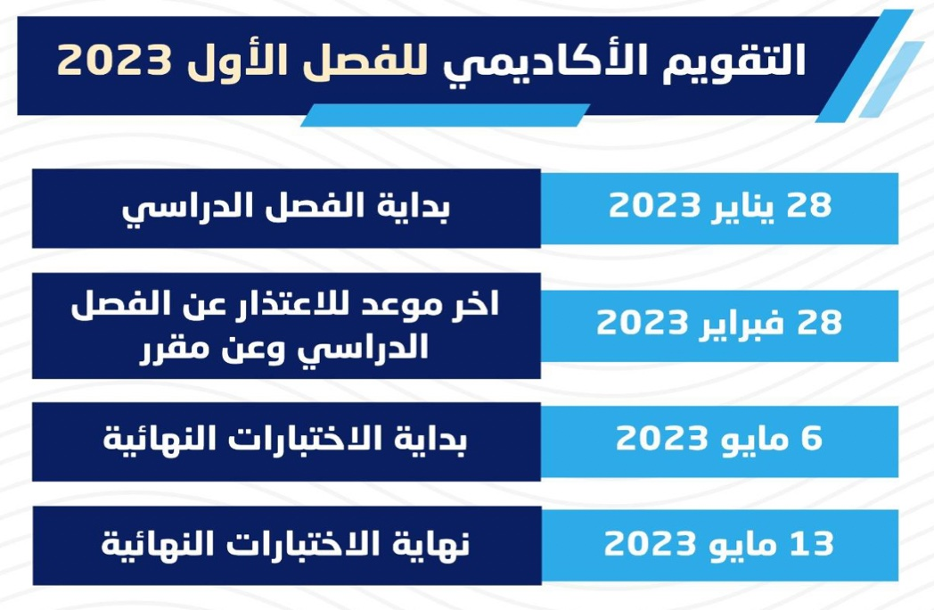
Academic Calendar
English Language 2, Samara Jasim

Slide 10

Academic Calendar
English Language 2, Samara Jasim

Slide 11
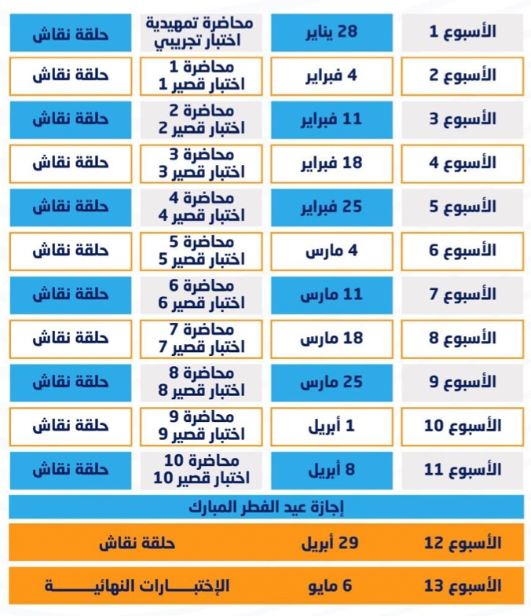
Academic Calendar
English Language 2, Samara Jasim

Slide 12

English Language 2, Samara Jasim

