Slide 1

Risk Management
Prepared by Dr. Nael Zabel
Lecture 2
MGM 510
Risk Management

Slide 2

Lecture 2
Topics to Cover in Week 2
Principals Iso 31000: 2018.
Impact of risk on organizations.
  Level of risk
  Impact of hazard risks
  Attachment of risks
  Risk and reward
  Attitudes to risk
  Risk and triggers

Slide 3
Lecture 1
3 Pilers of Iso31:2018

Slide 4
Lecture 2
Principals
a) Integrated
Risk management is an integral part of all organizational activities.
b) Structured and comprehensive
A structured and comprehensive approach to risk management contributes to consistent and comparable results.

Slide 5
Lecture 2
Principals
c) Customized
The risk management framework and process are customized and proportionate to the organization’s external and internal context related to its objectives.

Slide 6
Lecture 2
Principals
d) Inclusive
Appropriate and timely involvement of stakeholders enables their knowledge, views and perceptions to be considered. This results in improved awareness and informed risk management.

Slide 7
Lecture 2
Principals
e) Dynamic
Risks can emerge, change or disappear as an organization’s external and internal context changes. Risk management anticipates, detects, acknowledges and responds to those changes and events in an appropriate and timely manner.

Slide 8
Lecture 2
Principals
f) Best available information
The inputs to risk management are based on historical and current information, as well as on future expectations.

Slide 9
Lecture 2
Principals
g) Human and cultural factors
Human behaviour and culture significantly influence all aspects of risk management at each level and stage.

Slide 10
Lecture 2
Principals
d) Inclusive
Appropriate and timely involvement of stakeholders enables their knowledge, views and perceptions to be considered. This results in improved awareness and informed risk management.

Slide 11
Lecture 2
Principals
h) Continual improvement
Risk management is continually improved through learning and experience.

Slide 12
Lecture 2
Impact of risk on organizations
Level of risk
Impact of hazard risks
Attachment of risks
Risk and reward
Attitudes to risk
Risk and triggers

Slide 13
Lecture 2
Four Areas of Improvement by RM
●● Strategy, because the risks associated with different strategic options.
●● Tactics, because consideration will have been given to selection of the tactics

Slide 14
Lecture 2
Four Areas of Improvement by RM
●● Operations, because events that can cause disruption.
●● Compliance will be enhanced because the risks associated with failure to
achieve compliance with statutory and customer obligations will be recognized.

Slide 15
Lecture 2
Level of risk
This level of risk should be compared with the risk attitude and risk appetite of the organization for risks of that type.
The risk appetite will sometimes be described as
a set of risk criteria.

Slide 16
Lecture 2
Impact of hazard risks
Hazard risk management is concerned with issues such as health and safety at work, fire prevention, avoiding damage to property and the consequences of defective products.
Hazard risks can cause disruption to normal operations, as well as resulting in increased costs and poor publicity associated with disruptive events.

Slide 17
Lecture 2
Attachment of risks
Most standard definitions of risk refer to risks as being attached to corporate objectives.
key components of the existing nature and future enhancement of the business model and can relate to operations, tactics and corporate strategy, as well as
compliance activities.

Slide 18
Lecture 2
Risk and reward
When an organization puts value at risk in this way, it should do so with the full knowledge of the risk exposure and it should be satisfied that the risk exposure is within the appetite of the organization.

Slide 19
Lecture 2
Attitudes to Risk
Different organizations will have different attitudes to risk. Some organizations may be considered to be risk averse, whilst others will be risk aggressive.

Slide 20

Lecture 2
RISK ATTITUDE
  Risk Attitude A chosen mental disposition towards uncertainty, adopted explicitly or implicitly by individuals and groups, driven by perception, and evidenced by observable behavior.
Risk Seeker/Taker Risk Neutral Risk Averter/Adverse

Slide 21
Lecture 2
RISK ATTITUDE
  Risk appetite, which is the degree of uncertainty an entity is willing to take on in anticipation of a reward.
  Risk tolerance, which is the degree, amount, or volume of risk that an organization or individual will withstand.
  Risk threshold, which refers to measures along the level of uncertainty or the level of impact at which a stakeholder may have a specific interest. Below that risk threshold, the organization will accept the risk. Above that risk threshold, the organization will not tolerate the risk.

Slide 22
Lecture 2
RISK ATTITUDE
  Risk appetite, which is the degree of uncertainty an entity is willing to take on in anticipation of a reward.
  Risk tolerance, which is the degree, amount, or volume of risk that an organization or individual will withstand.
  Risk threshold, which refers to measures along the level of uncertainty or the level of impact at which a stakeholder may have a specific interest. Below that risk threshold, the organization will accept the risk. Above that risk threshold, the organization will not tolerate the risk.

Slide 23
Lecture 2
RISK ATTITUDE
Risk
Appetite
High Level Identification
Take High Risk
Low
Measurable
Risk
Tolerance
Define a Degree of Tolerance
Take Risk up to 100,000 $
High
Measurable
Risk
threshold
Measures the Level of Uncertainty or Impact
Take Risk up to 100,000 $ and 50% Probability

Slide 24
Lecture 2
Risk and triggers
A risk trigger is a condition or other event that will cause a risk to take place. Risk triggers for a given risk are identified during the risk analysis.
Understanding risk triggers helps a person develop a more efficient risk response.

Slide 25
Lecture 2
Risk and triggers
Risk is sometimes defined as uncertainty of outcomes.
As the construction work proceeds, more information will be available about the nature of the conditions.
This information may be positive news that the ground is stronger than expected and less foundation work is required.

Slide 26
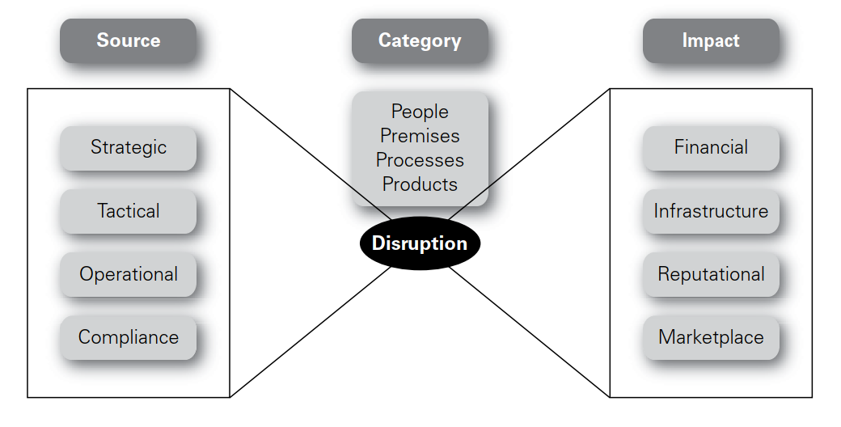
Lecture 2
Disruptive events and the bow-tie

