Slide 1


Project Management Technologies
PMG 312
Prepared by Dr. Majid Saad
Lec.4 -Ch.3 Power and politics

Slide 2



Project Management Technologies
PMG 312
Lecture 4
Ch.3 Power and politics
Prepared by
Dr. Prepared by Dr. Majid Saad

Slide 3
Lecture outline
Introduction
Root cause of power and politics
Organizational structures.
Centralized organization structure
Functional organization structure
Projectized organization structure
Matrix organization structure
Virtual organization structure
Composite organization structure
Summary

Slide 4
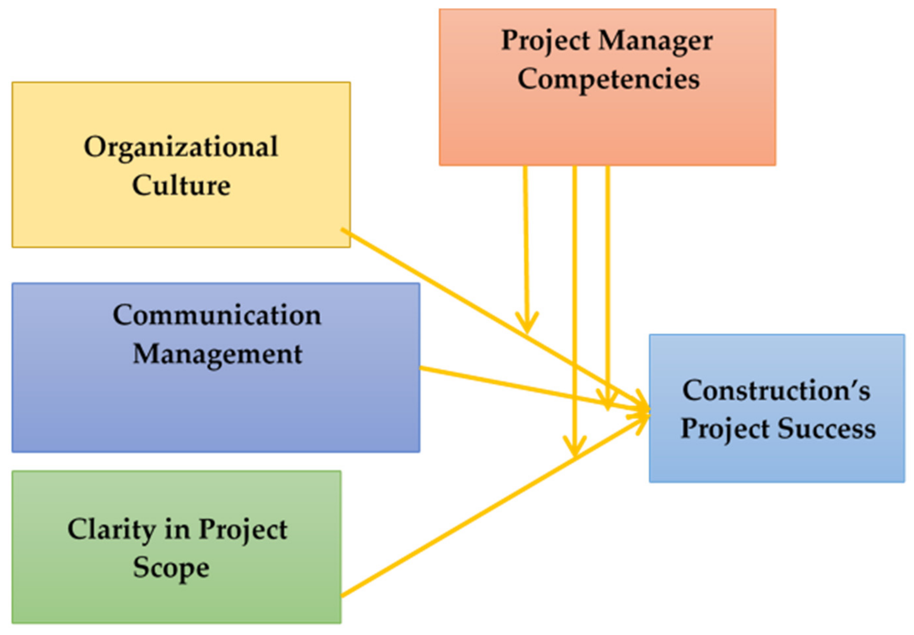
Introduction
Look at power and politics and how it plays out in different organizational structures.
This all relates to the internal support environment for the project and the general maturity of the organization.

Slide 5
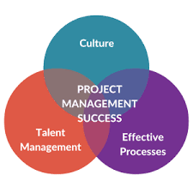
Introduction
An organization’s culture can contribute to a project’s success or failure and that is why it is important to understand the positives and negatives of different organizational structures, so the power and politics can be minimized as much as possible

Slide 6

Root cause of power and politics
Projects are natural breeding grounds for conflict resulting in ineffective human behavior, which must be dealt with effectively for the overall success and health of a project.
Every organization, regardless of being small or large, has politics due to power struggles.
Every project will also have unique power struggles due to changing parameters of the project resources, environment, or goals and deliverable.

Slide 7
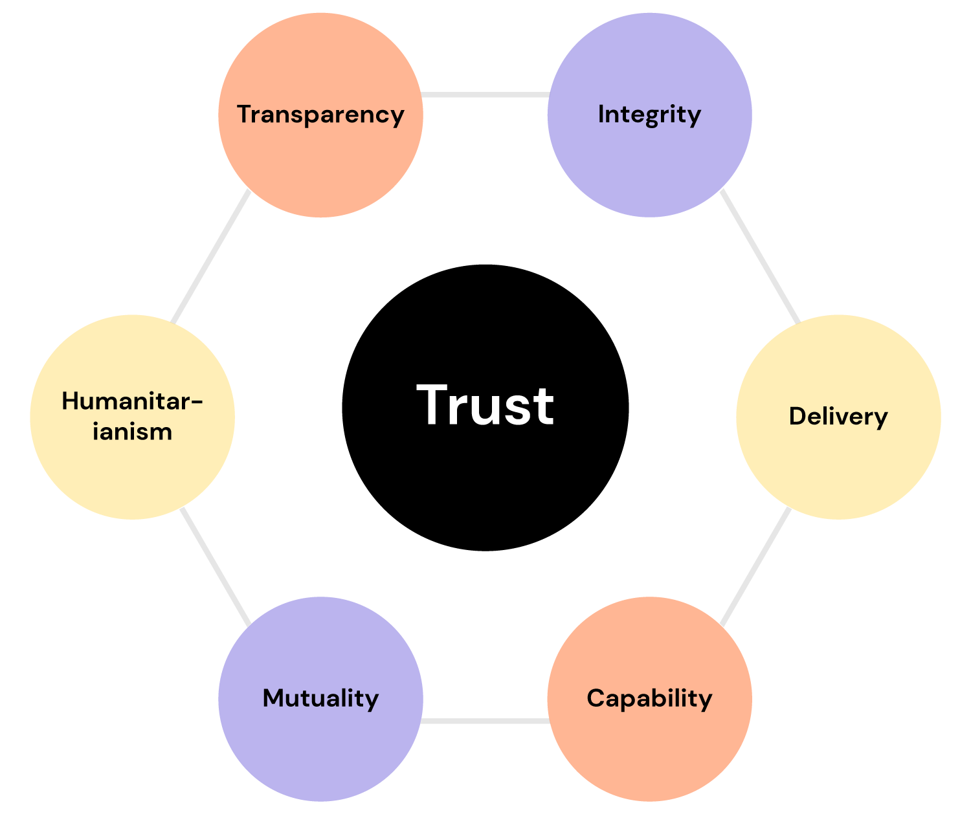
Root cause of power and politics
Politics can be in terms of which projects the senior management support and are committed to bringing to fruition ثمار.
Trust between the stakeholders and project team is a powerful asset as it can foster loyalty from key stakeholders and result in a positive project environment .

Slide 8
Root cause of power and politics
It is necessary to identify and manage stakeholders to help in selling and continuing to sell the project throughout the life of the project.
Another important aspect of the project is assembling the right team of individuals.
These struggles root from resources being in limited supply

Slide 9

Root cause of power and politics
What types of resources are limited?
What types of resources are limited?
For many organizations, it comes down to:
labor resources
Monetary resources
Facility (space) resources, and equipment resources.

Slide 10
labor resources
Case:
If you are a manager and your boss asks you to spare two labor resources as in two employees for 1 year to work on a special project, who is going to be chosen?
Will the two star performers
or
Two low performers be chosen?

Slide 11

labor resources
1st Scenario:
If you choose your two star performers, your boss may be very grateful as it will allow the special project to more likely succeed.
However, if your office is without the star performers, will your office dynamics change so much that you are left with a dysfunctional group of employees that will leave you having to pick up the slack contributing to even more work hours a week.

Slide 12

labor resources
2nd Scenario:
If you choose your two low performers, is your boss going to be back in your office a month from now saying that those workers are not suitable for the special project requiring you to still let go of your star performers?

Slide 13

labor resources
These are the types of decision-making going on inside the head of every lead, manager, and executive in the work environment.
So, did you make a decision regarding which employees to send to the special project?
Maybe you decide to compromise and send just one star performer and one average performer so that your boss will be successful while your office is not too terribly interrupted.

Slide 14

labor resources
Now, as a manager, it is also your responsibility to help with the career development of your employees.
So, if this special project has high visibility for the employees that are sent, then maybe both star performers are deserving of that opportunity making the decision that much more complicated.

Slide 15

Monetary resources
There is not an organization out there with unlimited money to spend on the organization.
So, executives spend time planning which efforts or projects their company should be investing in that will grow the company’s profits.

Slide 16

Monetary resources
Different channels of communication go up and down the organization as employees may ask their leads for monetary resources for different reasons such as the need for upgraded equipment.
In return, the leads then ask managers for funding for the employee’s needs, resulting in managers asking their bosses up through to executives for funding.

Slide 17

Monetary resources
Unfortunately, every department or office is experiencing the phenomenon of having needs that require funding.
Different employees, leads, managers, and executives continuously have to make decisions on the best way to use the limited amount of funding.

Slide 18

Monetary resources
Sometimes the choices made regarding how to spend the funds have to do with what is best for a company but often choices are made due to politics in terms of making decisions based on other agendas.
Sometimes a business unit creates a need for a specific project for their own value and does not think enough about the organizational-level goals.
These hidden or sometimes obvious agendas have more to do with returning favors to other individuals to keep conflicts to a minimum.

Slide 19

Monetary resources
However, this is never the recommended approach to leadership and management.
Managers might feel the pressure to provide funding for one project over another based on perhaps the PM having performed a favor to the manager in the past or promised favors in the near future.

Slide 20

Monetary resources
Decisions on how to use the limited amount of funding should be based on which projects or needs are best in alignment with an organization, but in reality, this is true only a portion of the time

Slide 21
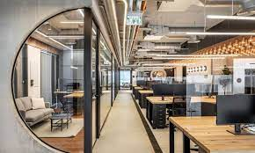
Space or Equipment resources
Other resources high in demand are equipment or even space.
Depending on the organization, there may even be specific rules or guidelines distributed on how much space one level manager gets for their office versus another manager.
Even conflicts over which department gets the better conference room to conduct a workshop occur as again the amount of needs in an organization are unlimited, whereas the resources to fulfill those needs are limited.

Slide 22

Space or Equipment resources
As for equipment, this can be anything from professors at a university all wanting specific classroom space because one classroom may have computer stations for students and other classrooms just desks.
Or, it could be different product managers all needing some of the same factory equipment to produce their product line
Yet, as there are only 24 hours in each day, not everyone’s needs are met within the time that best fits their needs.

Slide 23
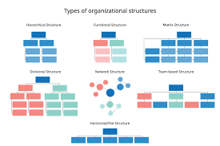
Organizational structures
What Is an Organizational Structure?
An organizational structure is a system that outlines how certain activities are directed in order to achieve the goals of an organization.
These activities can include rules, roles, authorities and responsibilities.
The organizational structure also determines how information flows between levels within the company.

Slide 24
Organizational structures
Having an organizational structure in place allows companies to remain efficient and focused.
Six different types of organizational structures that include centralized, functional, projectized, matrix, virtual, and composite.
Each structure has distinct characteristics.
There are benefits and challenges in existence for each of these structures as well

Slide 25
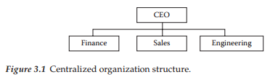
1- Centralized organization structure
Is set up by different departments that may overlap according to their functions.
A centralized organization structure has a very clear way of exercising control over project selection.
This occurs because all project requests are submitted to the manager of a group for approval, including identifying the project team members to work on the project.

Slide 26
1- Centralized organization structure
The Centralized organizational structure is formally designed and the orders come from one manager, which is described as Mechanistic/ Standardized structure

Slide 27
1- Centralized organization structure
In this organization, there is typically one set of management procedures and reporting systems for all projects within the entire organization regarding project planning documents, risk management, change management, conflict resolution, and so on.

Slide 28
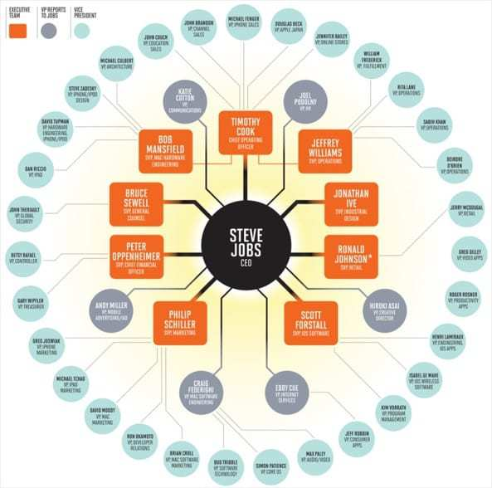
1- Example of Centralized organization structure
Apple is an example of a type of centralized organization. Many employees of Apple have spoken out over the years and said that Steve Jobs used to have a look at every project and every initiative before a go ahead was given. Below is an image depicting the centralized nature at Apple during Steve Jobs' tenure as the CEO.

Slide 29
Benefits of Centralized organization structure
Large benefit to the company because these procedures and reporting systems should technically be more perfected in comparison to each PM creating their own procedure and reporting system.
It is easier for higher-level managers to see the health of the organization as a whole and where weak spots may occur because of the standardization in procedures and reporting systems.
Managers can compare apples with apples since the company has standardized procedures and reporting systems (Benchmark)

Slide 30
Benefits of Centralized organization structure
Another benefit within the centralized organization structure is that working relationships tend to be more established.
This is due to people on a team already know how to successfully work with each other and managers already know the strengths and weaknesses of different team members.
PMs and the project teams can easily be held responsible and accountable for the success of a project.
Therefore, clear authority increases pressure for people to honor their commitments since performance appraisals, for instance, are conducted in the same organization where the work is being accomplished.

Slide 31
Challenges of Centralized Organization Structures
It can also be difficult to manage peaks and valleys فترات الذروات والانخفاضات in staff workloads. Project needs do not match the availability of team members in that there could be too much or too little work at any one time since project team members all come out of just one department.
Since there is a smaller pool of labor resources to tap into, there may be a lack of specific skills among the group, making it difficult to staff a project team or rather causing skill gaps within the project team.

Slide 32
Challenges of Centralized Organization Structures
Potentially, there could be slow response times to project requests since there will be internal politics regarding which projects get approved.
People who know each other may not feel comfortable challenging the status quo. Therefore, if there are not a set of fresh eyes, it can be negative since processes and politics that may remain may be ineffective.

Slide 33
Challenges of Centralized Organization Structures
People who know each other may not feel comfortable challenging the status quo. Therefore, if there are not a set of fresh eyes, it can be negative since processes and politics that may remain may be ineffective.
This can cause problems with the need to pull from another division of the company in hopes of having a labor resource that is a valuable team member and proficient in the skill needed.
Benefits and challenges exist within every structure. Companies organize themselves based on which organization fits their company the best.

Slide 34
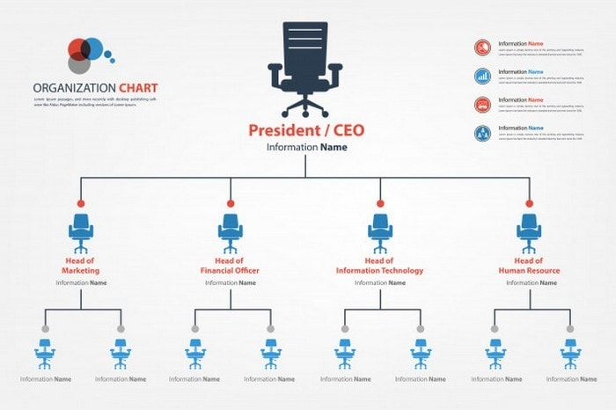
2. Functional organization structure

Slide 35
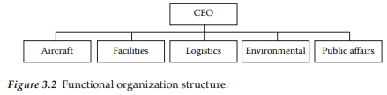
2. Functional organization structure
Is set up according to major business functions such as aircraft, facilities, logistics, environment, or public affairs.
Therefore, the different divisions are formed based on the main functions of the company, and employees have one clear supervisor

Slide 36
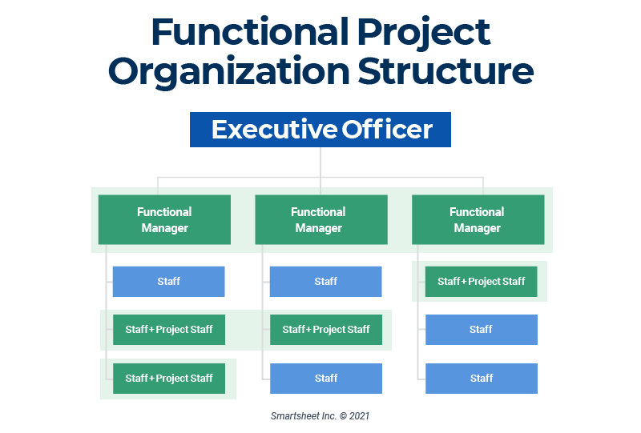
Benefits of Functional organization structure
People in a specialty unit have an in-depth understanding of the functional area for which they belong because all of their work revolves around that function such as aircraft-related projects.

Slide 37
Benefits of Functional organization structure
Do not have to compete with one another to get the support of their specialty groups because only one group is familiar with aircraft and that eliminates competition within the same organization.
Functional groups are often very adept at technical problem-solving within the group because all of their projects are related and thus expertise is acquired by the group.

Slide 38
The challenges of the functional organization structure
The challenges of the functional organization structure are, in many respects, the benefits of a centralized organization in reverse.
To begin with, each functional unit, since each unit acts almost independent of each other, most likely has different work procedures and reporting systems.

Slide 39
The challenges of the functional organization structure
Therefore, the organization experiences inconsistent procedures and reporting processes.
This results in higher-level management not being able to compare apples with apples when assessing the health of the organization as it will be more difficult to compare one functional unit to another since all the documentation and system output will be different.

Slide 40
The challenges of the functional organization structure
If the management cannot easily identify strengths and weaknesses within the company, it could be more difficult for a functional unit manager to convince the upper management to make major investments in equipment and facilities that are needed to support a unit’s technical work.

Slide 41
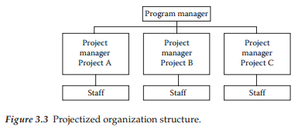
3. Projectized organization structure
The projectized organization structure is a project organization that has PMs with full authority where employees actually report to the PM
There is also staff to support the PM.

Slide 42
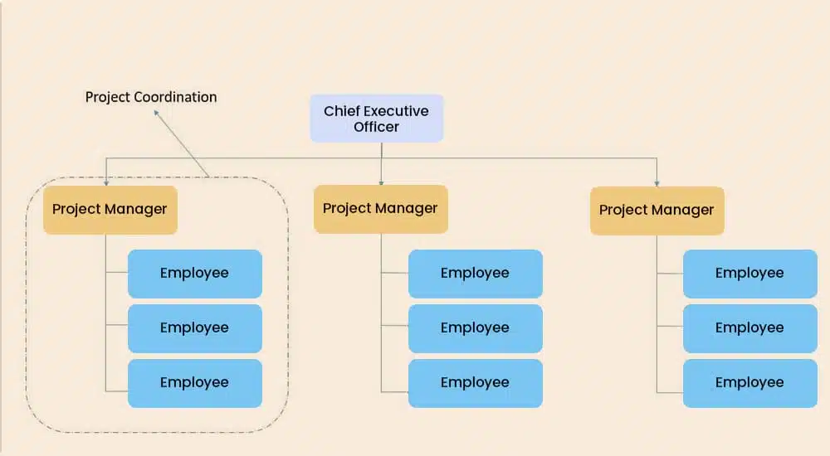
3. Projectized organization structure
Team members are loyal to the project goal.
Team members report directly to project managers; the line of authority is clear. Communication is fast because of a single authority.
project managers can make quick decisions and complete the project faster.
Team members become more flexible when working on different projects.
Team members are encouraged to learn from others’ experiences and share their own.

Slide 43
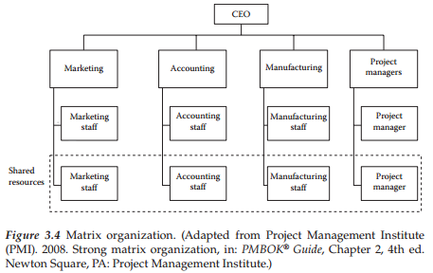
4. Matrix organization structure
This structures involve projects that pull employees from various functional units trying to capitalize on the benefits of both centralized and functional structures.
The matrix organization structure can be considered as a weak, balanced, or strong matrix.
The matrix is a combination of functional, centralized, and/or projectized organizations as displayed in Figure 3.4.

Slide 44
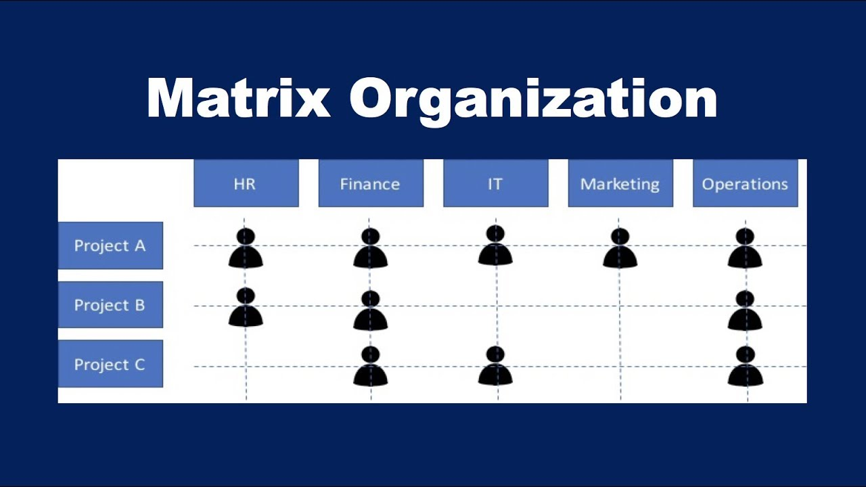
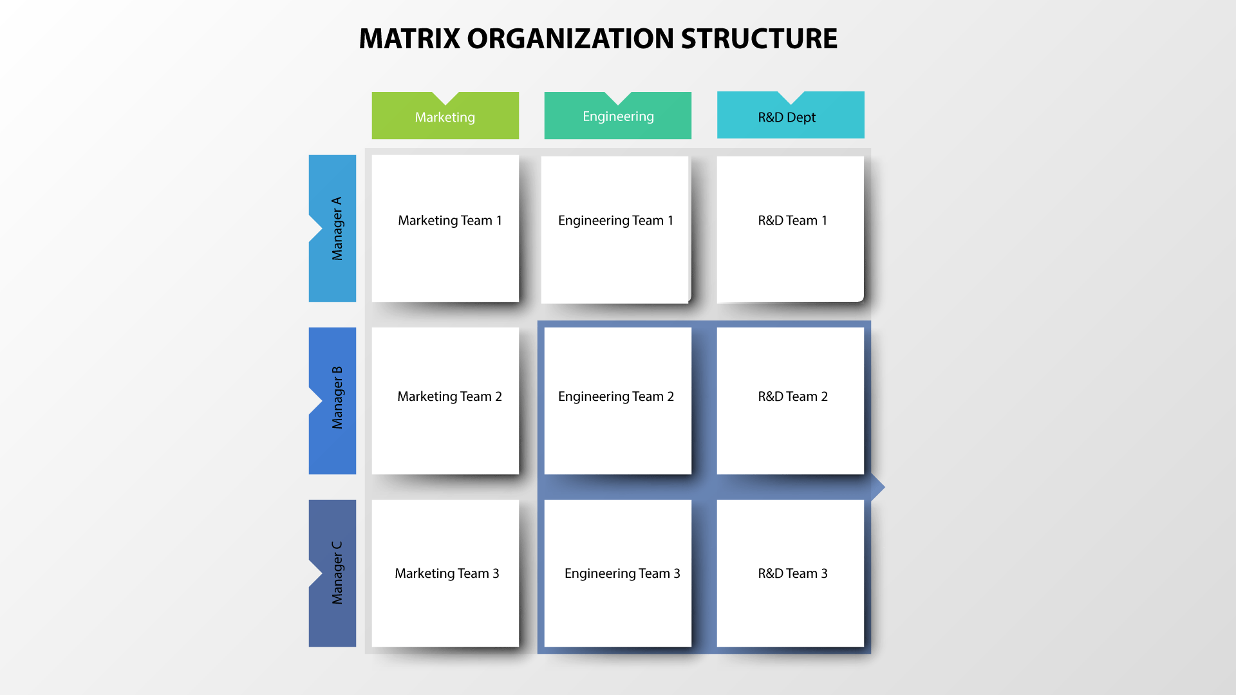

Slide 45
4. Matrix organization structure
The stronger the matrix, the more it resembles a projectized organization where PMs have administrative staff with a significant amount of authority.
The weaker the matrix, the more it resembles a functional organization where the PM has little authority and no administrative staff.
The balanced matrix provides the PM with a greater degree of authority than the weak matrix but still not full authority as found in a strong matrix.

Slide 46
Benefits of Matrix organization structure
A large benefit of the matrix organization structure is that teams can be assembled rapidly since there is a larger resource pool to tap into and the organization as a whole already has employees with different expertise.
Scarce expertise can be applied to different projects as needed and therefore the organization as a whole can justify maintaining a full-time employee with a certain expertise because this employee can be used for small amounts of work on multiple projects.
The project cost is lessened since a full-time dedicated resource for one particular project is not necessary since the costs are then shared among multiple projects.

Slide 47


Challenges of Matrix organization structure
Team members often respond to two different managers.
One manager is the PM assigning the work to be accomplished and the other one is the employee’s supervisor responsible for performance appraisals and leave requests.

Slide 48
Challenges of Matrix organization structure
If the two managers do not communicate, it could cause issues such as:
An employee being approved to be on leave during a critical part of the project
The employee doing great work but not being rewarded on their performance appraisal since it is work being accomplished that does not serve the employee’s manager.

Slide 49
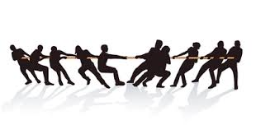
Challenges of Matrix organization structure
In this environment, the PM has a weakened power of control over their team since the supervisors have more ultimate power over the employee than the PM..

Slide 50

Challenges of Matrix organization structure
The PM has also to deal with multiple supervisors as any one team may be comprised of different employees each with different supervisors.
This aspect of the matrix organization structure is difficult.

Slide 51

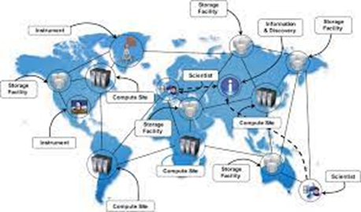
5. Virtual organization structure
The virtual organization can take on any of the structures previously. Virtual teams consist of groups of people with a shared goal who work together without necessarily any physical interaction
Since technology has identified many ways for individuals to communicate at a distance, companies that operate virtually can operate just like any other organization.

Slide 52
Benefits of Virtual organization structure
Makes more sense in its existence where multiple projects are being worked, especially if you are a PM.
Costs can be lower when physical facilities are not needed to house employees.
Team members being geographically dispersed and interacting at different times.
Best for individuals within an organization that are self-managing and not in need of much supervision.
Best for a team that communicates to a manager who serves the role of more of a facilitator.
Organizations with off-site employees requiring expertise found in multiple locations around the globe have no choice but to conduct themselves virtually.

Slide 53
Challenges of Virtual organization structure
Challenges within the virtual organizational structure exist with working with colleagues who are not collocated, causing greater potential for miscommunication.
Difficulty in trust building is difficult enough with teams that are collocated versus a distributed work team.
Communication can greatly suffer when there is no frequent face-to-face communication.

Slide 54
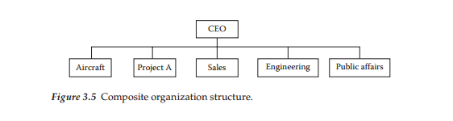
6. Composite organization structure
The composite organization may be referred to as the hybrid organization that has units resembling centralized, functional, projectized, and virtual and/or matrix organization structures.
This organizational structure was developed to meet or customize the structure to the particular needs of a company.

Slide 55
Benefits of Composite organization structure
The main benefit that exists is the same as in the centralized organization structure because of standardization throughout the organization regarding processes and reporting systems.

Slide 56
Challenges of Composite organization structure
Challenges within this organizational structure tend to be in the area of increased conflict within and between projects because of duplication of effort and overlapping authority.
Many managers have issue with regard to the performance appraisal and leave requests residing with one manager where one or more additional managers are responsible for assigning work tasks.
Typically, large and global companies tend to be matrix organization structures, which include the composite organization structure.
The more mature a company tends to be, the more likely it is to be of a matrix or composite organization structure.

Slide 57
Summary
For many organizations, power and politics occur due to labor resources, monetary resources, facility (space) resources, and equipment resources.
Every organizational culture is different, but regardless of the culture, every project in order to be successful needs support from the organization so that the organizational structure is supportive and not restrictive to the PM.
In conclusion, different organizational structures serve different needs, so companies will select which structure or combination of structure best fits their needs.

Slide 58
Summary
Depending on the structure in place, different power struggles and politics will occur. However, even though different structures have different types of power struggles and politics, no structure is without these issues.
Six different types of organizational structures were addressed that included centralized organization structures, functional organization structures, projectized organization structure, matrix organization structure, virtual organizational structure, and composite organization systems.
Every structure has distinct characteristics, each with benefits and challenges.

Slide 59



Thank You

