Slide 1

Supply chain Management
Lecture-2
PMG 660
Supply Chain Performance: Achieving Strategic Fit and Scope

Slide 2

Learning Objectives
After reading this chapter, you will be able to:
1. Explain why achieving strategic fit is critical to a company's overall success.
2. Describe how a company achieves strategic fit between its supply chain strategy and its competitive strategy
3. Discuss the importance of expanding the scope of strategic fit across the supply chain.

Slide 3
Competitive and supply chain strategies
A company's competitive strategy defines, relative to its competitors, the set of customer needs that it seeks to satisfy through its products and services.
For example, Wal-Mart aims to provide high availability of a variety of products of reasonable quality at low prices.
Most products sold at Wal-Mart are commonplace (everything from home appliances to clothing) and can be purchased elsewhere.

Slide 4
Competitive and supply chain strategies
What Wal-Mart provides is a low price and product availability.
McMaster-Carr sells maintenance, repair, and operations (MRO) products.
It offers more than 400,000 different products through both a catalog and a Web site.

Slide 5
Its competitive strategy is built around providing the customer with convenience, availability, and responsiveness.
With this focus on responsiveness, McMaster does not compete based on low price. Clearly, the competitive strategy at Wal-Mart is different from that at McMaster.

Slide 6
Competitive and supply chain strategies
We can also contrast Dell, with its build-to-order model, with a firm like Gateway selling eMachines PCs through retailers.
Dell has stressed customization and variety at a reasonable cost, with customers having to wait approximately one week to get their product.
In contrast, a customer can walk into a computer retailer, be helped by a salesperson, and leave the same day with an eMachines computer. The amount of variety and customization available at the retailer, however, is limited.

Slide 7
Competitive and supply chain strategies
In each case, the competitive strategy is defined based on how the customer prioritizes product cost, delivery time, variety, and quality.
A McMaster-Carr customer places greater emphasis on product variety and response time than on cost.
A Wal-Mart customer, in contrast, places greater emphasis on cost.
A Dell customer, purchasing online, places great emphasis on product variety and customization.
A gateway customer purchase eMachines PC at is most concerned with price, fast response time, and help in product selection

Slide 8
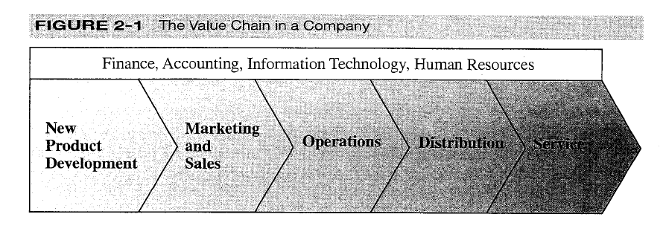
Competitive and supply chain strategies
To see the relationship between competitive and supply chain strategies, we start with the value chain for a typical organization, as shown in Figure 2-1. below.

Slide 9
Achieving strategic fit
the idea that for any company to be successful, its supply chain strategy and competitive strategy must fit together. Strategic fit means that both the competitive and supply chain strategies have aligned goals.
It refers to consistency between the customer priorities that the competitive strategy hopes to satisfy and the supply chain capabilities that the supply chain strategy aims to build. The issue of achieving strategic fit is a key consideration during the supply chain strategy or design phase.

Slide 10
Achieving strategic fit
All processes and functions that are part of a company's value chain contribute to its success or failure.
These processes and functions do not operate in isolation; no one process or function can ensure the chain's success.
Failure at any one process or function, however, may lead to failure of the overall chain.

Slide 11
Achieving strategic fit
company's success or failure is thus closely linked to the following keys:
The competitive strategy and all functional strategies must fit together to form a coordinated overall strategy.
Each functional strategy must support other functional strategies and help a firm reach its competitive strategy goal.
3. The different functions in a company must appropriately structure their processes and resources to be able to execute these strategies successfully.
4. The design of the overall supply chain and the role of each stage must be aligned to support the supply chain strategy.

Slide 12
Achieving strategic fit
A company may fail either because of a lack of strategic fit
or because its overall supply chain design, processes, and resources do not provide the capabilities to support the desired strategic fit.
In thinking of the major tasks of a chief executive officer (CEO), there are few greater than the job of aligning the supply chain design and all of the core functional strategies with the overall competitive strategy to achieve strategic fit.

Slide 13
Achieving strategic fit
If this alignment is not achieved, conflicts arise between different functional goals within the firm, or between the goals of different supply chain stages.
Such conflicts result in different functions within the firm and stages across the supply chain targeting different customer priorities.
This conflict within the firm or across the supply chain leads to conflicts during supply chain operation.

Slide 14
Achieving strategic fit
Consider, for example, a situation in which marketing is publicizing a company's ability to provide a large variety of products very quickly; simultaneously, distribution is targeting the lowest cost means of transportation.
In this situation, it is very likely that distribution will delay orders so it can get better transportation economies by grouping orders together or using inexpensive but slow modes of transportation.

Slide 15
Achieving strategic fit
This action conflicts with marketing's stated goal of providing variety quickly.
Similarly, consider a scenario where a retailer has decided to provide a high level of variety while carrying low levels of inventory but has selected suppliers and carriers based on their low price and not their responsiveness.
In this case, the retailer is likely to end up with unhappy customers because of poor product availability.

Slide 16
How is strategic fit achieved?
What does a company need to do to achieve that all-important strategic fit between the supply chain and competitive strategies?
A competitive strategy will specify, either explicitly or implicitly, one or more customer segments that a company hopes to satisfy.
a company must ensure that its supply chain capabilities support its ability to satisfy the targeted customer segments.

Slide 17
How is strategic fit achieved?
There are three basic steps to achieving this strategic fit, which we outline here and then discuss in more detail:
Understanding the Customer and Supply Chain Uncertainty:
First, a company must understand the customer needs for each targeted segment and the uncertainty the supply chain faces in satisfying these needs.

Slide 18
How is strategic fit achieved?
These needs help the company define the desired cost and service requirements.
The supply chain uncertainty helps the company identify the extent of the unpredictability of demand, disruption, and delay that the supply chain must be prepared for.

Slide 19
How is strategic fit achieved?
2. Understanding the Supply Chain Capabilities: There are many types of supply chains, each of which is designed to perform different tasks well. A company must understand what its supply chain is designed to do well.
3. Achieving Strategic Fit: If a mismatch exists between what the supply chain does particularly well and the desired customer needs, the company will either need to restructure the supply chain to support the competitive strategy or alter its competitive strategy.

Slide 20
Expanding strategic scope
A key issue relating to strategic fit is the scope, in terms of supply chain stages, across which the strategic fit applies.
Scope of strategic fit refers to the functions within the firm and stages across the supply chain that devise an integrated strategy with a shared objective.
At one extreme, every operation within each functional area devises its own independent strategy with the objective of optimizing its individual performance.

Slide 21
Expanding strategic scope
In this case the scope of strategic fit is restricted to an operation in a functional area within a stage of the supply chain.
At the opposite extreme, all functional areas across all stages of the supply chain devise strategy jointly with a common objective of maximizing supply chain profit.
In this case the scope of strategic fit extends to the entire supply chain.

Slide 22
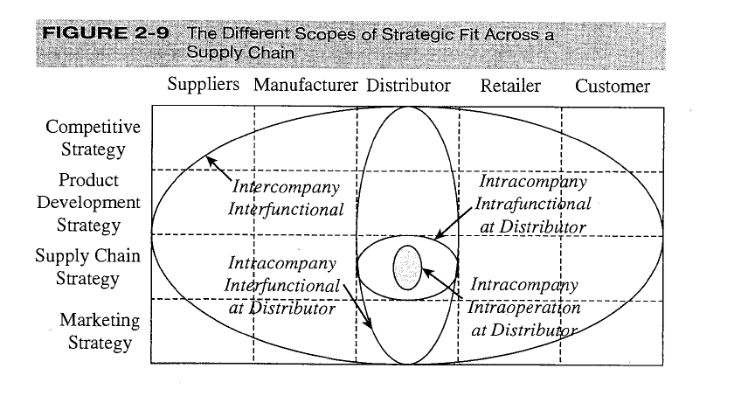

Slide 23
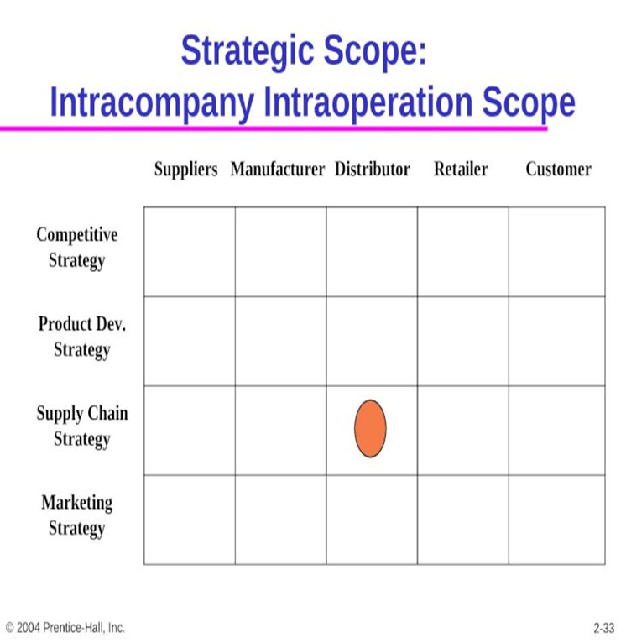
Intra company intra operation scope: the minimize local cost view
This is referred to as intracompany intra operation scope. Here, each operation within each stage of the supply chain devises strategy independently.
The most limited scope over which strategic fit is considered is one operation within a functional area within a company.
The smallest ellipse represents the scope of strategic fit at the distributor in this instance

Slide 24
Intra company intra operation scope: the minimize local cost view
In such a setting, the resulting collection of strategies will most likely not come close to maximizing supply chain profit, because different functions and operations have conflicting local objectives.
This limited scope was the dominant practice during the 1950s and 1960s, when each operation within each stage of the supply chain attempted to minimize its own costs.

Slide 25
Intra company intra operation scope: the minimize local cost view
The key point here is that the transportation decision was made independent of other functions within the firm and the rest of the supply chain.
In this case, the scope of strategic fit is restricted to a portion (transportation) of the distributor stage within the supply chain..

Slide 26
Intra company intra functional scope: the minimize functional cost view
Given that many operations together form each function within a firm, managers recognized the weakness of the intra company intra operation scope.
Supply chain operations include manufacturing, warehousing, and transportation, among others.

Slide 27
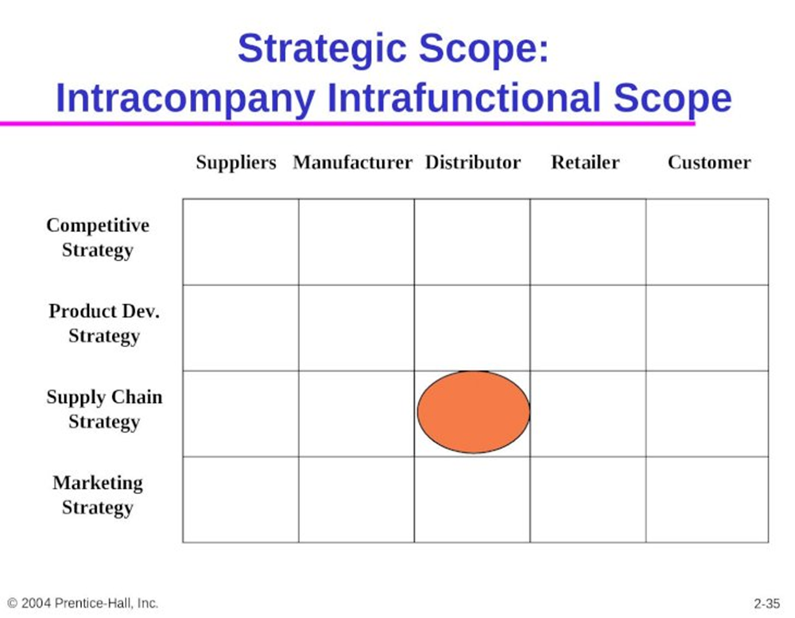
Intra company intra functional scope: the minimize functional cost view
With the intra company intra functional scope, the strategic fit is expanded to include all operations within a function.
In this case, the warehousing manager no longer minimizes warehousing costs while the transportation manager independently minimizes transportation costs.
By working together and developing a joint strategy, the two minimize the total functional cost.

Slide 28
Intracompany interfunctional scope: the maximize company profit view
The key weakness of the intra company intra functional view is that different functions may have conflicting objectives.
Over time, companies became aware of this weakness as they saw, for example, marketing and sales focusing on revenue generation, and manufacturing and distribution focusing on cost reduction.
Actions the two functions took were often in conflict, hurting the firm's overall performance.

Slide 29
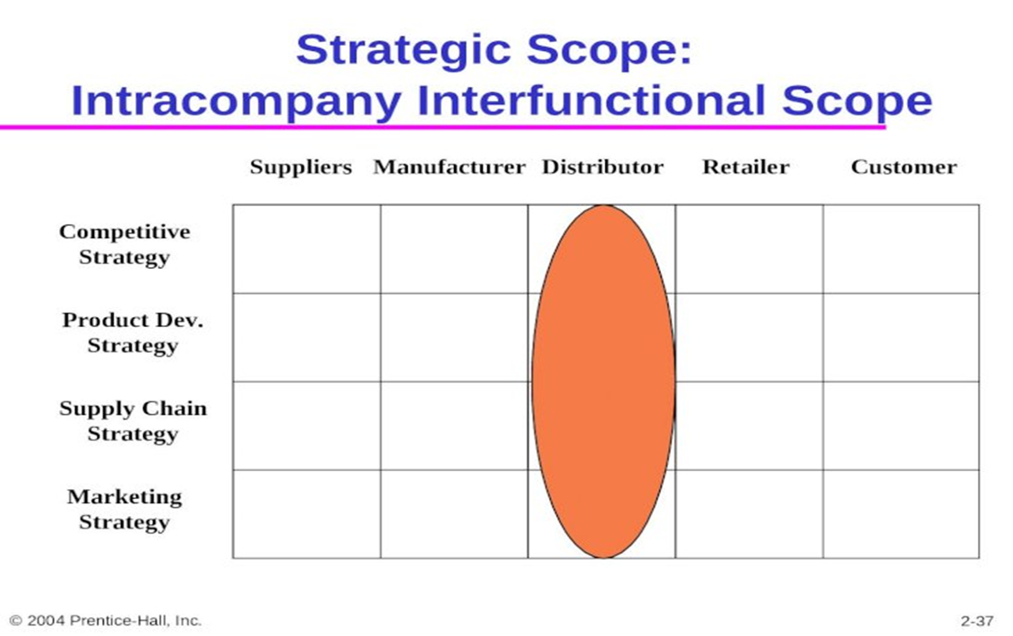
Intracompany interfunctional scope: the maximize company profit view
Companies realized the importance of expanding the scope of strategic fit across all functions within the firm.
With the intracompany interfunctional scope, the goal is to maximize company profit.
To achieve this goal, all functional strategies are developed to support both each other and the competitive strategy.

Slide 30
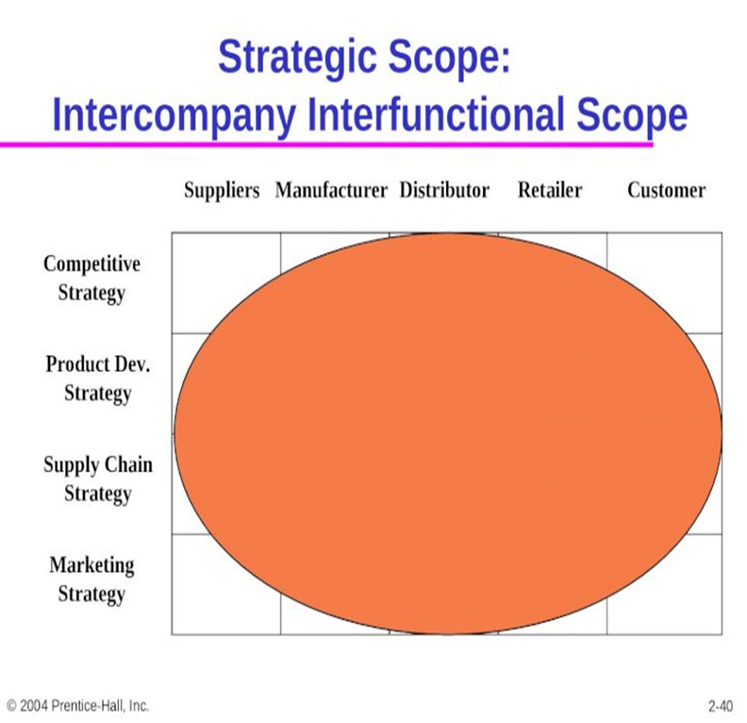
Intercompany interfunctional scope: the maximize supply chain surplus view
The intracompany interfunctional scope of strategic fit has two major weaknesses.
First, it leads to each stage of the supply chain trying to maximize its own profits, which does not necessarily result in the maximization of supply chain surplus.
Supply chain surplus is maximized only when all supply" chain stages coordinate strategy together.

Slide 31
Agile intercompany interfunctional scope
Up to this point, we have discussed strategic fit in a static context; that is, the players in a supply chain and the customer needs do not change over time.
In reality, the situation is much more dynamic. Product life cycles are getting shorter and companies must satisfy the changing needs of individual customers.

Slide 32
Agile intercompany interfunctional scope
A company may have to partner with many different firms, depending on the product being produced and the customer being served.
The strategy and operations at firms must be agile enough to maintain strategic fit in a changing environment.

Slide 33
Agile intercompany interfunctional scope
Agile intercompany scope refers to a firm's ability to achieve strategic fit when partnering with supply chain stages that change over time.
Firms must think in terms of supply chains consisting of many players at each stage. For example, a manufacturer may interface with a different set of suppliers and distributors depending on the product being produced and the customer being served.

Slide 34
Agile intercompany interfunctional scope
Furthermore, as customer needs vary over time, firms must have the ability to become part of new supply chains while ensuring strategic fit.
This level of agility becomes more important as the competitive environment becomes more dynamic.

Slide 35
Reference
Supply chain management
Strategy, Planning, and Operation
By: Sunil Chopra,
>eter Meind!.-3rd ed.
Chapter 2

