Slide 1


Project Governance
Prepared by Dr. Fayez Jrad
PMG 424
Lecture 10

Slide 2



Project Governance
Lecture 10
PMG 424
Governance of Projects
Prepared by
Dr. Fayez Jrad
www.midocean.ae

Slide 3
Chapter
Learning Outcomes
10
Clarifying the different perspectives of project governance.
Discussing the role of the steering group as the governance institution of projects.
Understanding the different views of projects.
Explaining project control as related to the achievement of the project plan.
Highlighting the main capabilities of project managers.
www.midocean.ae

Slide 4
The Aim of Project Governance
Project governance aims at the consistent and predictable delivery of the project’s planned contribution to the portfolio – and thereby to the achievement of the corporate strategic objectives – within the framework of corporate governance.
Project governance provides risk minimization, transparency, division of ownership and control at the project level.
www.midocean.ae

Slide 5
Approaches of Project Governance
Governance frameworks are developed from different approaches; either a top-down or a bottom-up approach.
Top-down approaches are developed from an outcome perspective and represent the Flexible Economist and Versatile Artist paradigm.
Bottom-up approaches take a control perspective and represent the Conformist and Agile Pragmatist paradigm.
www.midocean.ae

Slide 6
Perspectives of Project Governance
This distinction has implications for the depth to which governance is carried out by the institutions governing projects.
An outcome perspective provides flexibility in project execution if the governance institution (the steering group) feels that the intended outcome can be achieved.
A control perspective calls for more upfront planning and estimation, strict control procedures and contingency plans.
www.midocean.ae

Slide 7
The Steering Group
Although the steering group may Not be the only governing institution of projects, it is the one that carries the most authority when it comes to project execution.
The steering group has full responsibility for project success; it owns the business case and is accountable to top management for achieving project objectives.
www.midocean.ae

Slide 8
Steering Group Authority
Steering group members have managerial authority to assign or withdraw resources (for example, financial) from the project.
They also have authority to accept or decline proposed changes to the project and decide on whether the project has accomplished its objectives or not.
www.midocean.ae

Slide 9
Steering Group Responsibility
Steering groups constitute the linkage between the permanent and temporary organizations.
Their main responsibility is to ensure effective coordination of governance mechanisms between the project and its parent organization.
www.midocean.ae

Slide 10
Steering Group Responsibility
The steering group, and by association the sponsor, looks at the interface between the permanent and temporary organizations from two opposite perspectives:
The perspective of the parent organization towards its project.
The perspective of the project towards its parent organization.
www.midocean.ae

Slide 11
Steering Group Responsibility
The perspective of the parent organization towards its project.
This perspective is related to project governance and includes defining the goals, means and ends of the project.
It reviews the project based on its contribution to and link with the parent organization.
www.midocean.ae

Slide 12
Steering Group Responsibility
The perspective of the project towards its parent organization.
This perspective is related to project support and includes provision of resources and decisions.
It includes formal decisions like sign-off on milestones and formal authorization by the parent organization for the project to continue.
www.midocean.ae

Slide 13
Level of Project Governance
Depending on its specific situation, a project may have a higher or lower need for governance - typically, high governance is indicated:
where project failure would lead to very severe consequences;
when the project is mission critical;
when the parent organization works in rapidly changing markets;
where corporate governance requires a strong focus on a particular project;
the project must be realigned to a new strategy.
www.midocean.ae

Slide 14
Level of Project Support
Depending on its specific situation, a project may have a higher or lower need for support - typically, high support is indicated for projects that:
lack resources and other support from the parent organization;
incur resistance from within the parent organization to accept the project or its outcome;
have inexperienced project management.
www.midocean.ae

Slide 15
Steering Group Governance Roles and Tasks
The governance roles and tasks of the steering group include:
establishing the governance infrastructure;
setting the project goals;
provision of the means to achieve those goals; and
control of progress.
www.midocean.ae

Slide 16
Establishing the Governance Infrastructure
The steering group sets up the governance infrastructure by defining and communicating to all related parts of the organization, upwards and downwards:
the project governance processes.
the means of controlling projects.
the roles, responsibilities and approval authorities.
The infrastructure must link to corporate governance and cross organizational procedures, corporate policies, existing standards and processes (paradigm).
www.midocean.ae

Slide 17
Setting Project Goals
When setting the goals for a project, the steering group defines:
The desired business benefits.
The project deliverables, including the products or services.
The project success criteria with measures and tolerances.
The steering group also agrees on the project management process required to achieve these goals with the project manager.
www.midocean.ae

Slide 18
Providing the Means To Achieve Project Goals
When providing the means to achieve the project goals, the steering group performs governance and support roles in parallel.
The governance role is carried out through provision of various resources according to the latest project plan.
The support role includes activities to anchor the project within the organization.
www.midocean.ae

Slide 19
Providing The Means To Achieve Project Goals
Types of resources
The types of resources provided can include, but are not limited to:
people and skill sets;
budgets;
training and consulting;
technical and communication infrastructures.
www.midocean.ae

Slide 20
Providing The Means To Achieve Project Goals
Types of support
The type of support provided can include, but are not limited to:
working on removing obstacles;
reducing risks from the relationship between parent organization and project;
linking project and organizational success factors;
mitigating the impact of resource shortages on project results or business benefits.
www.midocean.ae

Slide 21
Controlling the Progress
The progress control roles address both the details of the project, project context and environment.
The following are continuously monitored and adjusted when appropriate:
project progress;
achieved results;
critical success factors;
stakeholder interest.
www.midocean.ae

Slide 22
Controlling the Progress
Formal measurement of the previous aspects is set up, consisting of quality indicators, milestone and other achievements and general plan adherence.
These measures are formally evaluated, quantified wherever possible and become input for performance assessments and project forecasts.
From a broader perspective, the progress control role of the steering group includes preventing scope creep and managing contingency reserves.
www.midocean.ae

Slide 23
Steering Group Meetings
These meetings are initiated at the start of the project.
They are typically held more frequently in the first few phases and last few phases of a project, when they might be held weekly or, on high profile projects, even more frequently.
During the other project phases, they will usually be held monthly and at agreed-to decision points, such as stage gate reviews.
www.midocean.ae

Slide 24
Project Governance and Project View
There are two main project views that have implications on how projects are governed:
The transaction to be performed, which is the project as an object consisting of contract, process, method and outcome (process).
The agency performing the transaction, which is the project as an object consisting of the project manager and the team (people).
www.midocean.ae

Slide 25
Project Governance As A Transaction
Decisions on how to govern the project as a transaction are made based on keeping the costs of governance to a minimum - these are the costs of:
Adaptiveness: the costs of aligning the interests of the various parties involved in the contract.
Contract governance: the costs of governing contract execution, including the costs of monitoring, control, meetings and reviews.
Contract administration: the costs of developing and agreeing on contract contents.
www.midocean.ae

Slide 26
Minimizing Project Cost Decisions
There are several factors considered when deciding on how best to minimize project costs; these are:
The uniqueness of the product (asset specificity).
The risk of the endeavor (uncertainty).
The extent to which the endeavor is one-time or repeatable (frequency).
Within the transaction view, these three factors are seen as the space within which the project process is governed.
www.midocean.ae

Slide 27
Project Contract Development
Through their governance role of setting goals, steering groups carry out the work of contract administration.
A contract is a promise or set of promises between parties, which enforced by the law.
It is an instrument for balancing and distributing risks between contract partners, impacting the management of the risks for which each partner is responsible.
www.midocean.ae

Slide 28
Types of Project Contracts
This affects the governance structure itself and the depth of project implementation:
Fixed price contracts tend to lower governance efforts as the risk is on the side of the supplier and the price is fixed for the buyer.
Re-measurement contracts involve more governance efforts as the sponsor or steering group must ensure that their money is spent wisely.
Alliance contracts involve the greatest amount of governance as the relationship between buyer and seller is often complex and ambiguous.
www.midocean.ae

Slide 29
Governance of Project Contracts
As part of their work in governance of the contract, the steering group and the project manager must agree how to:
Make adaptations to the contract to meet any unforeseen circumstances.
Identify when such circumstances require a contract modification.
Decide on the type of project management methodology to be applied.
www.midocean.ae

Slide 30
Types of Project Management Methodologies
Project management methodologies can be grouped into:
Predictive methodologies,
Convergent methodologies, and
Emergent methodologies.
www.midocean.ae

Slide 31
Predictive Methodologies
This type of methodology represents the traditional project management such as waterfall.
These methodologies are sequential in nature, thus require complete planning of the project before, or very shortly after, the productive work begins.
This type of methodology is used in low-risk industries (construction), and often use fixed price/fixed date contracts.
www.midocean.ae
www.midocean.ae

Slide 32
Convergent Methodologies
This type of methodology uses little upfront planning with a moderate level of detail such as the dynamic systems development methods (DSDM).
It supports projects where the details of the deliverables cannot be clearly defined at the start.
This type of methodology is used in moderate-risk industries (manufacturing), and often use fixed price with variable fees/variable date contracts.
www.midocean.ae

Slide 33
Emergent Methodologies
These methodologies allow for the incremental building of project deliverables such as Scrum or Agile.
The advantage in such methodologies is that benefits are gradually delivered.
The sponsor and steering group are required to have an in-depth understanding of project requirements and priorities.
This type of methodology is used in high-risk industries (IT), and often use variable price/variable date contracts.
www.midocean.ae

Slide 34
Choice of Project Management Methodology
The choice of project management methodology depends on project type and the nature of the project deliverable.
The methodology chosen impacts the governance of the project, as it defines both:
The relationship between project manager and steering group.
The type of information exchanged during steering group and other governance and project meetings.
www.midocean.ae

Slide 35
Achieving Project Goals
The steering group provides the means for contract adoption by the various parties.
From a contracting perspective, this includes the contractual incentives for delivering the project and aligning the objectives of the various stakeholders.
From a governance perspective, this includes provision of facilities, resources, decisions and budgets to enable the project team to do its work.
From a support perspective, this includes adopting the project by the parent organization.
www.midocean.ae

Slide 36
Assessing Project Goals
The final task of the steering group is defining the mechanism for assessing how well the completed project met its objectives (progress control).
The steering group performs contract governance through assessing compliance with the contract by reviewing the level of achievement against the project plan.
This is done through formal reviews at predetermined points in the project process, normally at the end of phases, or the implementation of major deliverables.
www.midocean.ae

Slide 37
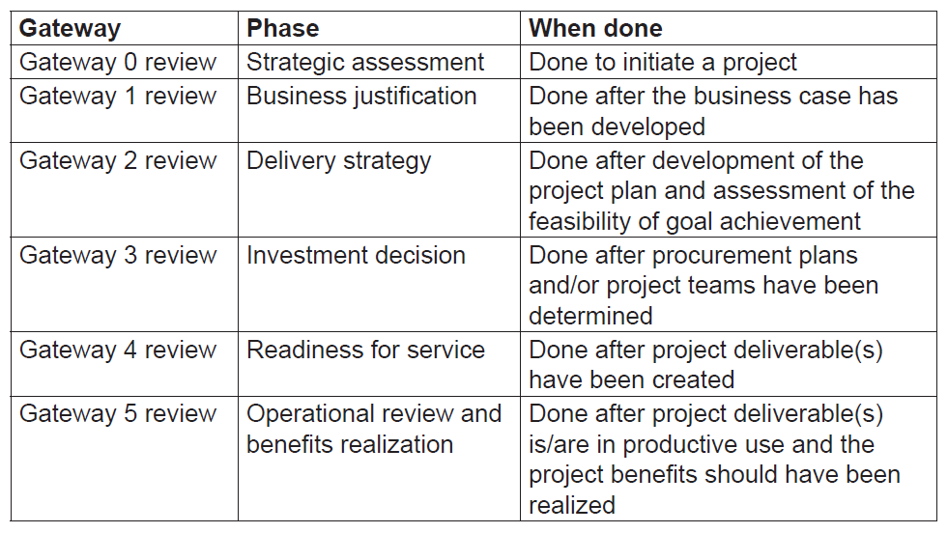
OGC Gateway Review Recommendations
www.midocean.ae

Slide 38
Governance of the Project As An Agency
Beside process and contract there is the human part of the project which also needs to be governed.
For the project to be viable, it must align to the business, the parent and the project organizations.
www.midocean.ae

Slide 39
Alignment to Business
Alignment of the project to the company’s business is done through the strategic alignment, and through the project organization as part of the parent organization business.
Project-based organizations organize their governance processes differently based on whether their clients are small or large and whether the projects for these clients are small or large.
www.midocean.ae

Slide 40
Alignment of Parent and Project Organizations
This is done through governance of the link between the functional structure and the project structure.
There are three perspectives the permanent organization has towards the project:
An agency for change.
An agency for resource utilization.
An agency for managing risk.
Each of these links may lead to potential conflicts.
www.midocean.ae

Slide 41
A Project As An Agency For Change
Projects and their teams are put in place to establish a beneficial change, which may be unfavorable by the traditional, functional organization.
The best way to manage this area of potential conflict is to ensure the careful preparation of the parent organization for the upcoming change, preferably supported by an appropriate incentive system.
www.midocean.ae

Slide 42
A Project As An Agency For Resource Utilization
In project-based organizations the permanent organization assigns their resources to projects, which results in productive use of those resources.
This may bring up a major conflict of interests between the functional manager and the project manager.
This conflict of interests is best governed by a farsighted and multidimensional incentive system.
www.midocean.ae

Slide 43
A Project As An Agency For Managing Risk
The project form of organization is currently the best way of minimizing the risk in executing unique, transient and novel endeavors.
The perspective of the project as an agency for managing risk has the least potential for conflict.
www.midocean.ae

Slide 44
The Project Manager
There is no one size fits all when it comes to project managers.
Successful project managers need managerial competences that allow them to guide a team towards defined objectives.
The type of these competences depends on the project size, industry and complexity.
www.midocean.ae

Slide 45
Project Manager Competencies
Project managers working on large and/or complex projects must have:
Project management knowledge and experience (methodologies).
Business area(s) related knowledge (benefits).
Engagement and communication (team members and project clients).
Leadership capabilities (doing the right things).
Intellectual, emotional and managerial capabilities (people and process).
Creativity and risk management (uncertainty).
Conscientiousness and self-awareness (reasonableness).
www.midocean.ae

Slide 46
Choosing an Appropriate Project Manager
Steering groups should evaluate the specific leadership needs for each project and match project types with appropriate project managers.
A good project manager may Not have the necessary competencies from the outset; these can be developed during the project.
www.midocean.ae

Slide 47
Conclusions
Top-down project governance approaches are developed from an outcome perspective and represent the Flexible Economist and Versatile Artist paradigm.
Bottom-up project governance approaches take a control perspective and represent the Conformist and Agile Pragmatist paradigm.
www.midocean.ae

Slide 48
Conclusions
An outcome perspective of project governance provides flexibility in project execution if the governance institution feels that the outcome can be achieved.
A control perspective of project governance calls for more upfront planning and estimation, strict control procedures and contingency plans.
www.midocean.ae

Slide 49
Conclusions
Although the steering group may Not be the only governing institution of projects, it is the one that carries the most authority when it comes to project execution.
The steering group has full responsibility for project success; it owns the business case and is accountable to top management for achieving project objectives.
www.midocean.ae

Slide 50
Conclusions
The steering group governance tasks include setting the governance infrastructure; defining project goals; providing the means to achieve goals; and controlling progress.
The steering group sets up the governance infrastructure by defining and communicating to all related parts of the organization, upwards and downwards
www.midocean.ae

Slide 51
Conclusions
Successful project managers need managerial competences that allow them to guide a team towards defined objectives.
The type of project managers competences must be aligned with the project size, industry and complexity.
www.midocean.ae

Slide 52
Task 1
Find two projects, one is developed from an outcome perspective and the other from a control perspective, and try to figure out the implications of both perspective on how these projects are governed?
www.midocean.ae

Slide 53
Task 2
Explore two successful projects within different sectors (construction, IT), and try to identify the differences between project manager competencies that have led both projects to their favourable performance?
www.midocean.ae

Slide 54

Reference
www.midocean.ae

Slide 55



Thank You

