Slide 1

Sentiment Analysis for Mobile App Reviews:
A Comparative Study
Prepared By:
Name: Sultan Khalaf Alotaibi ID No: 222000226
Name: Abdel Hafez Adeeb Alassar ID No: 251002398
Supervised By: Dr. Wesam Ahmed

Slide 2
Agenda
Introduction and Background
Contribution
Related Work
Methodology
Hardware and Software
Results and Analysis
Conclusion and Future Work
References

Slide 3
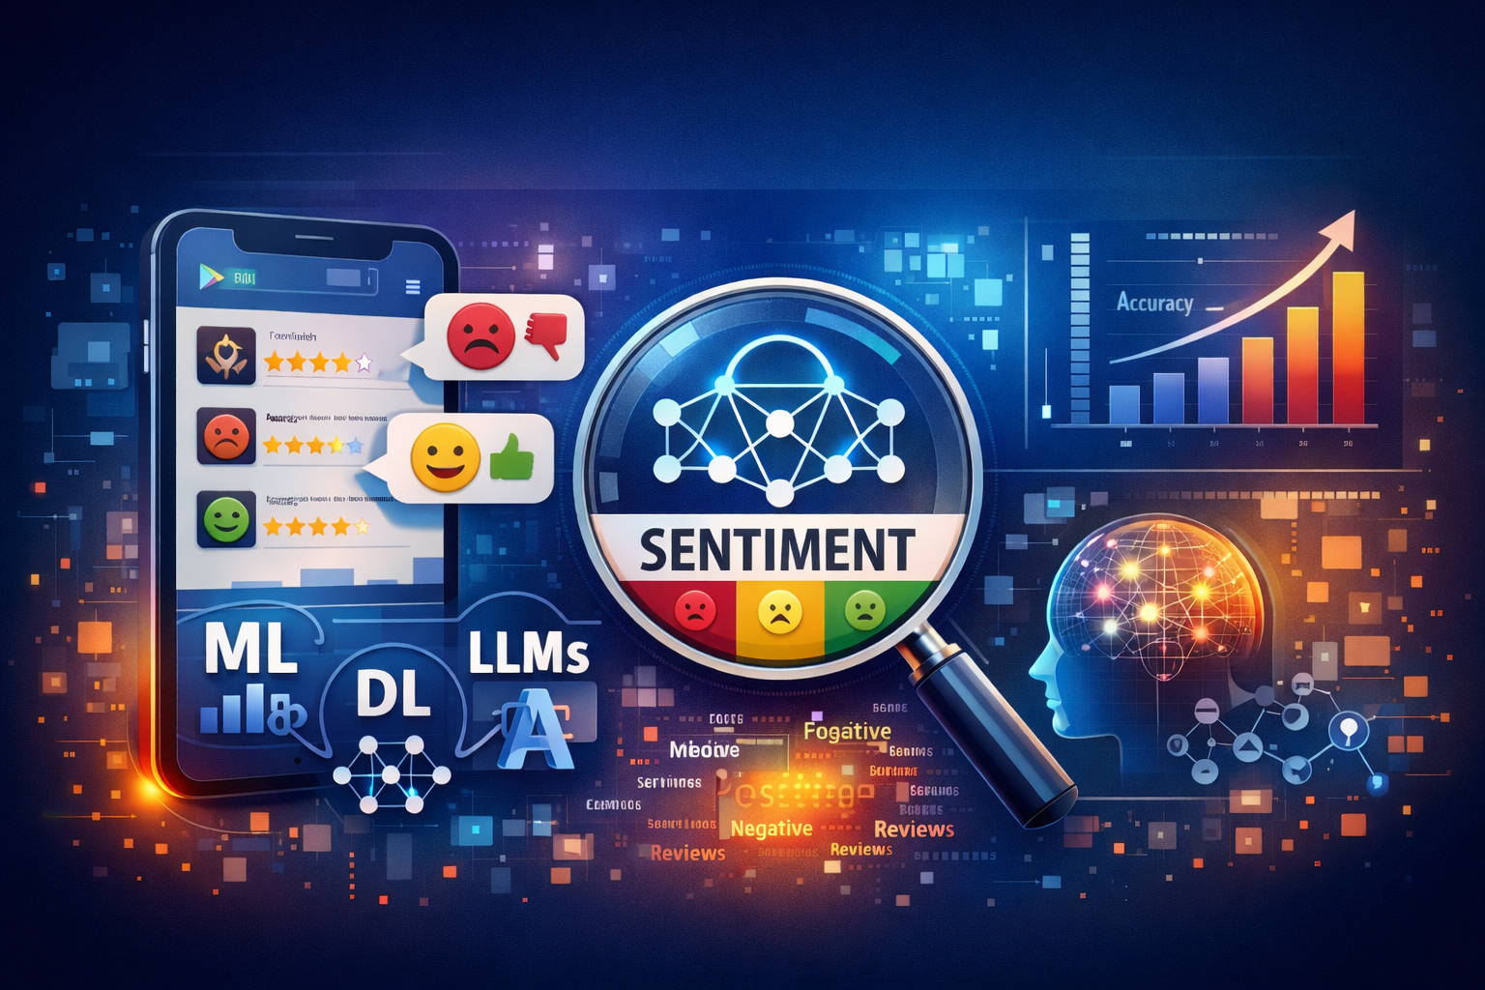
Introduction And Background
With mobile application growth, user reviews are crucial for product improvement. This project uses sentiment analysis to classify Mobile Legends reviews and extract insights. It compares machine learning, deep learning, and LLM-based models to find the most effective method for enhancing user experience.

Slide 4
Introduction And Background
Problem Statement: Effectively analyzing large-scale, unstructured mobile app reviews is a persistent challenge.
Objective: To evaluate and compare ML, DL, and transformer-based models for sentiment analysis of mobile app reviews.
Challenges: Analyzing large-scale, noisy app reviews and selecting the most effective sentiment analysis model remain key challenges.

Slide 5
Contribution
This study presents a comprehensive comparative analysis of Machine Learning (ML), Deep Learning (DL), and Large Language Model (LLM) approaches for mobile sentiment analysis. By evaluating traditional ML classifiers alongside DL architectures, and modern LLMs such as Roberta-Base, the research identifies the relative strengths and limitations of each approach.
Developed a robust preprocessing pipeline to handle noisy and inconsistent app review data.
Delivered best practices and actionable insights to improve user experience in mobile apps like Mobile Legends.

Slide 6
Related Work
Study | Model | Dataset | Key Findings | Limitations/Gaps
Jannah et al. [3] | SVM, Naive Bayes | Synthetic Shopee beauty product reviews | SVM achieved 86.14% accuracy; Naive Bayes 85.53%; TF-IDF + lemmatization effective | Synthetic dataset limits generalizability; no error analysis or feature importance; neutral class not fully addressed
Amirkhalili & Wong [13] | LSTM, Naive Bayes | 2,025 mobile banking reviews (Canada) | LSTM: 82%, NB: 77%; LSTM captures subtle sentiment patterns better | Small dataset; region-specific; no per-class metrics; no transformer benchmark
Ranjan & Mishra [15] | LSTM + GloVe embeddings | Google Apps reviews + Student App Reviews (SAR) | Accuracy: 95.2%, F1-score: 88; LSTM + embeddings outperforms traditional ML models | No transformer comparison; generalization to other apps/domains not evaluated
Nkhata et al. [19] | Hybrid: BERT + BiLSTM; data augmentation (SMOTE, NLPAUG) | IMDb (binary), SST-5 (five-level) datasets | IMDb: 97.67% accuracy; SST-5: 59.48% accuracy; better than standard BERT | Focused on movies, not app reviews; neutral/ambivalent sentiment not handled
Nugroho et al. [23] | Fine-tuned BERT (multilingual + Indonesian) with score-based and lexicon-based labeling | Google Play Store reviews of top 10 Indonesian apps | Indonesian BERT: 84% accuracy (lexicon-based) | No multilingual expansion; comparison with RoBERTa/DeBERTa missing; noisy/informal text not fully addressed

Slide 7
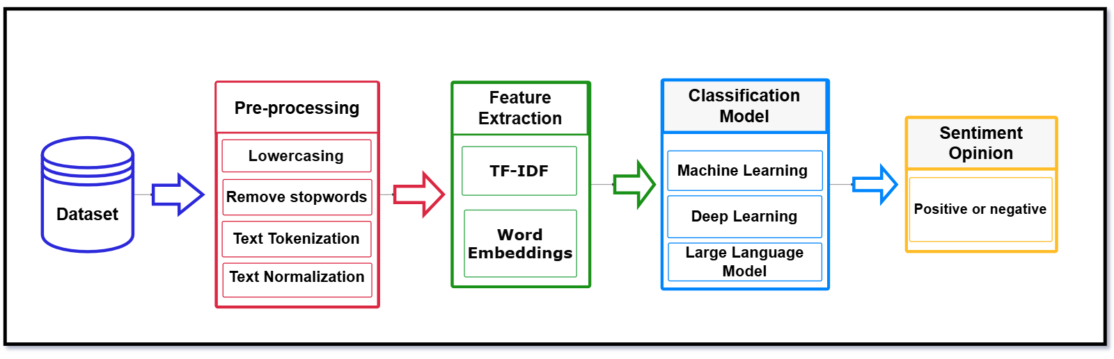
Methodology
Proposed Framework

Slide 8
Methodology
Dataset Information: Dataset Source: https://www.kaggle.com/datasets/abiyyurasyiq/mobile-legends-google-play-reviews Mobile Legends Google Play Reviews Scraped from Google Play Store for the mobile game Mobile Legends: Bang Bang
Columns Included: Review ID: Unique identifier for each review Username: Display name of the reviewer Content: The actual review text Score: Rating given by the user (1 to 5 stars) thumbsUpCount: Number of likes the review received At: Timestamp of the review
Key Details: Total Rows: 52,000 reviews Time Range: February - June 2025 Number of Columns: 6

Slide 9
Hardware and Software
Hardware: Computing Environment: Google Colab
Software: Python Libraries: Pandas, NumPy Data Visualization: Matplotlib, Seaborn NLP Tools: NLTK, Text Blob, SpaCy Machine Learning: Scikit-learn Deep learning: TensorFlow

Slide 10
Results and Analysis
Machine Learning Models Configuration and Evaluation
Performance Metrics of ML Models
Model | Precision | Recall | F1-Score | Accuracy
Logistic Regression | 0.89 | 0.89 | 0.89 | 0.89
SVM (Optimized) | 0.90 | 0.89 | 0.89 | 0.89
LightGBM | 0.89 | 0.89 | 0.89 | 0.89
Naïve Bayes | 0.89 | 0.88 | 0.88 | 0.88
Random Forest | 0.88 | 0.88 | 0.88 | 0.88
Models Parameters
Model | Data Split | Text Representation | Key Settings
SVM (LinearSVC) | 80 / 20 | TF-IDF | C = 0.1, loss = squared hinge
Logistic Regression | 80 / 20 | TF-IDF (10k, 1–2 grams) | C = 1.0, penalty = 12
Random Forest | 80 / 20 | TF-IDF (15k, 1–2 grams) | Trees = 200, depth = None
LightGBM | 80 / 20 | TF-IDF (15k, 1–2 grams) | Trees = 500, lr = 0.05, leaves = 64
Naïve Bayes | 80 / 20 | TF-IDF (Word + Char) | alpha = 1.0

Slide 11
Results and Analysis
Deep Learning Models Configuration and Evaluation
Performance results of Deep Learning Models
Model | Precision | Recall | F1-Score | Accuracy
BiGRU + Attention | 0.8798 | 0.8793 | 0.8780 | 0.8792
CNN + BiGRU Hybrid | 0.8779 | 0.8779 | 0.8779 | 0.8778
Models Parameters
Model | Data Split | Embedding | Input Length | Architecture (Short) | Training Setup
BiGRU + Attention | 80 / 20 | GloVe-100d (frozen) | 120 | BiGRU(64) + Attention + Dense + Dropout | Adam, epochs=12, batch=64, early stop=2
CNN + BiGRU Hybrid | 80 / 20 | GloVe-100d (freeze → fine-tune) | 120 | CNN (kernels 3,5,7) + BiGRU(64) + Global Pooling + Dense | AdamW, lr=2e-4→1e-4, epochs=15+5, early stop=3

Slide 12
Results and Analysis
Large Language Models: Fine-Tuning Setup and Evaluation
Performance results of Transformer-Based Models
Model | Precision | Recall | F1-Score | Accuracy
Distilbert-Base-Uncased | 0.9019 | 0.9014 | 0.9012 | 0.9013
DEBERTA-V3-BASE | 0.9179 | 0.9164 | 0.9162 | 0.9164
Roberta-Base | 0.9038 | 0.9038 | 0.9038 | 0.9037
Electra-Large-Discriminator | 0.8990 | 0.8989 | 0.8988 | 0.8988
Models Parameters
Model | Data Split | Max Length | Learning Rate | Epochs | Key Regularization / Tricks
DistilBERT-base | 80 / 20 | 128 | 1.00E-05 | 3 | Dropout=0.20, Label smoothing=0.10, Early stopping=2
DeBERTa-v3-base | 80 / 20 | 256 | 1.00E-05 | 7 | Dropout=0.30, Label smoothing=0.15, Weight decay=0.18
RoBERTa-base | 80 / 20 | 256 | 8.00E-06 | 8 | Dropout=0.25, Label smoothing=0.12, Gradient checkpointing
ELECTRA-base | 80 / 20 | 256 | 1.50E-05 | 8 | Dropout=0.30, Weight decay=0.15, Early stopping=2

Slide 13
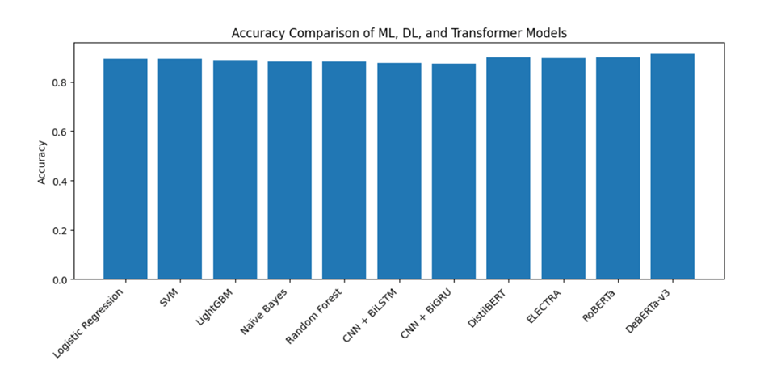
Results and Analysis
Performance Comparison Across ML, DL, and Transformer Models
Traditional ML models (Logistic Regression, SVM, Random Forest, LightGBM, Naïve Bayes) achieve strong baseline performance using TF-IDF features.
Deep Learning models (BiGRU-based and CNN–BiGRU hybrid) provide moderate improvement by leveraging dense word embeddings.
Transformer-based LLMs consistently outperform ML and DL models due to their contextual representation learning.
DeBERTa-v3 achieves the highest accuracy, demonstrating the effectiveness of disentangled attention and advanced pretraining.

Slide 14
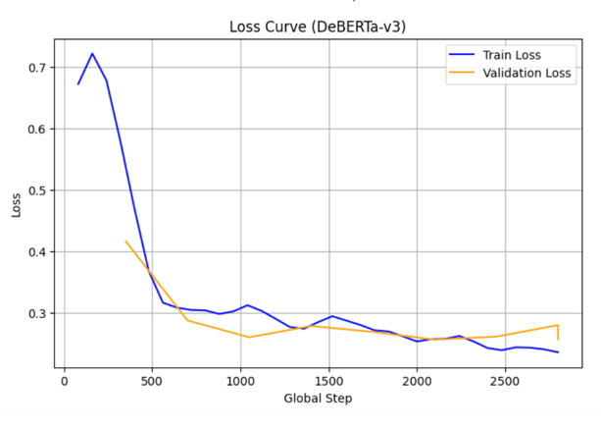
The model with the Best score
Results and Analysis
The DeBERTa-v3 model reached a maximum test accuracy of 0.9164, which is the best performance obtained in this study shown in Figure. Its decoupled attention mechanism and strengthened context encoding remarkably increased classification performance.

Slide 15
CONCLUSION AND FUTURE WORK
Conclusion:
In conclusion, models built on transformers excel at sentiment classification because they grasp context and meaning deeply.
Future work:
Looking ahead, research can push sentiment analysis further by focusing on aspect-based and multilingual techniques, as well as making models more efficient and easier to understand.

Slide 16
References
[1] Maroof, A., Wasi, S., Jami, S. I., & Siddiqui, M. S. (2024). Aspect-based sentiment analysis for the service industry. IEEE Access, 12, 109702–109713.
[2] Adiningtyas, H., & Auliani, A. S. (2024). Sentiment analysis for mobile banking service quality measurement. Procedia Computer Science, 234, 40–50.
[3] Jannah, N. Z. B., & Kusnawi, K. (2024). Comparison of Naïve Bayes and SVM in sentiment analysis of product reviews on marketplaces. Sinkron: Jurnal dan Penelitian Teknik Informatika, 8(2), 727–733.
[4] Juliane, C. (2021, November). Implementation of naive bayes algorithm on sentiment analysis application. In 2nd International Seminar of Science and Applied Technology (ISSAT 2021) (pp. 193-200). Atlantis Press.
[5] Azeraf, E., Monfrini, E., & Pieczynski, W. (2021). Improving usual Naive Bayes classifier performances with Neural Naive Bayes based models. arXiv preprint arXiv:2111.07307.
[6] Sumantiawan, D. I., Suseno, J. E., & Syafei, W. A. (2023). Sentiment analysis of customer reviews using Support Vector Machine and SMOTE-Tomek Links for identifying customer satisfaction. Jurnal Sistem Informasi Bisnis, 13(1), 1–9.
[7] Wirawan, A., & Cahyono, H. D. (2023). Easy data augmentation in sentiment analysis of cyberbullying. In Proceedings of the 6th International Conference on Information and Communications Technology (ICOIACT), Yogyakarta, Indonesia (pp. 443–447).
[8] Özmen, C. G., & Gündüz, S. (2025). Comparison of machine learning models for sentiment analysis of big Turkish web-based data. Applied Sciences, 15(5), 2297.
[9] Danyal, M., Khan, S., Khan, M., Ghaffar, M., Khan, B., & Arshad, M. (2023). Sentiment analysis based on performance of linear support vector machine and multinomial Naïve Bayes using movie reviews with baseline techniques. Journal on Big Data, 5, 1.

Slide 17
References
[10] Khan, T. A., Sadiq, R., Shahid, Z., Alam, M. M., & Su'ud, M. M. (2024). Sentiment analysis using support vector machine and random forest. Journal of Informatics and Web Engineering, 3(1), 67–75.
[11] Ahammad, S., Sinthia, S. A., Ahmed, M., Hossain, M., Asif, N. A. A., & Ikram, N. A. (2024). Deep learning-based sentiment analysis of user generated reviews of various AI powered mobile applications. In Proceedings of the 2024 International Conference on Inventive Computation Technologies (ICICT) (pp. 505–512).
[12] Samanmali, P. H. C., & Rupasingha, R. A. H. M. (2024). Sentiment analysis on Google Play Store app users' reviews based on deep learning approach. Multimedia Tools and Applications, 83(36), 84425–84453.
[13] Amirkhalili, Y., & Wong, H. Y. (2025). Banking on feedback: Text analysis of mobile banking iOS and Google app reviews. arXiv preprint arXiv:2503.11861.
[14] Zaman, N., Goldberg, D. M., Qiao, Z., & Abrahams, A. S. (2025). More than meets the eye: Feature concerns and suggestions in mobile XR app reviews. Decision Support Systems, 114475.
[15] Ranjan, S., & Mishra, S. (2022). Perceiving university students' opinions from Google app reviews. Concurrency and Computation: Practice and Experience, 34(10), e6800.
[16] Basri, N. F., & Utami, E. (2025). Application of Word2Vec and LSTM models in sentiment analysis of Mobile Legends user reviews. Sistemasi: Jurnal Sistem Informasi, 14(2), 856–871.
[17] Eser, G., & Sahin, C. (2024). Sentiment analysis and rating prediction for app reviews using transformer-based models.

Slide 18
References
[18] Motger, Q., Miaschi, A., Dell'Orletta, F., Franch, X., & Marco, J. (2024). T-FREX: A transformer-based feature extraction method from mobile app reviews. In Proceedings of the 2024 IEEE International Conference on Software Analysis, Evolution and Reengineering (SANER) (pp. 227–238).
[19] Nkhata, G., Gauch, S., Anjum, U., & Zhan, J. (2025). Fine-tuning BERT with Bidirectional LSTM for fine-grained movie reviews sentiment analysis. arXiv preprint arXiv:2502.20682.
[20] Chi, D., Huang, T., Jia, Z., & Zhang, S. (2025). Research on sentiment analysis of hotel review text based on BERT-TCN-BiLSTM-attention model. Array, 25, 100378.
[21] Ullah, W., Zhang, Z., & Stefanidis, K. (2023). Sentiment analysis of mobile apps using BERT. In Proceedings of the International Conference on Industrial, Engineering and Other Applications of Applied Intelligent Systems (pp. 66–78). Cham, Switzerland: Springer Nature.
[22] Lee, M. A., Park, Y. J., Na, J. Y., & Sohn, C. B. (2023). Implementation of review sentiment analysis application using KoBERT, KoGPT-2, and KoBART optimized hyperparameters. Journal of Digital Contents Society, 24(11), 2831–2840.
[23] Nugroho, K. S., Sukmadewa, A. Y., Wuswilahaken, D. W. H., Bachtiar, F. A., & Yudistira, N. (2021). BERT fine-tuning for sentiment analysis on Indonesian mobile apps reviews. In Proceedings of the 6th International Conference on Sustainable Information Engineering and Technology (pp. 258–264).

Slide 19
Thank you

