Slide 1



Operating System Overview
Lecture 5
HCIA-Security
Prepared by
Dr. Abdelrhman Ahmed

Slide 2
Chapter
Foreword
05
• An operating system (OS) is a platform that manages computer hardware and software resources. It is required for the normal operation of a computer. During the development of personal computers (PCs), there have been many different operating systems - the most commonly used include DOS, Windows, Linux, Unix (Mac), and OS/2.
• This course describes the Windows and Linux operating systems.

Slide 3
Chapter
Objectives
05
• Upon completion of this course, you will be able to:
□ Describe the main functions of an operating system.
□ Describe features of the Windows operating system.
□ Describe the development history of the Linux operating system.

Slide 4
Chapter
05
Definition
• An operating system:
□ is an interface between users and computers
□ manages all hardware resources and controls the execution of software
□ improves the human-machine interaction interface
□ is a (system) software program

Slide 5
Chapter
05
Main Function - Processor Management
• The main task of processor management is to allocate, control, and manage processor resources. In a multiprogramming environment, a process is the basic unit for the allocation and running of processor resources. Therefore, processor management can be included in process management.
Processor management includes:
□ Process control
□ Process synchronization
□ Process communication
□ Process scheduling

Slide 6
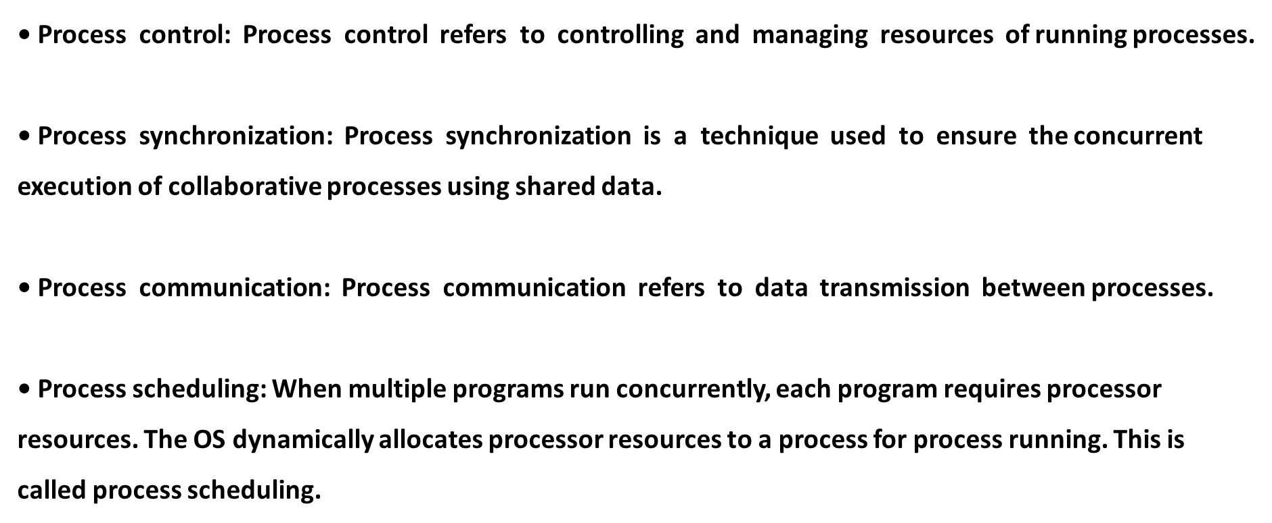
Chapter
05
Main Function - Processor Management

Slide 7
Chapter
05
Main Function - Memory Management
• The main task of memory management is to allocate memory resources to programs and manage these resources. Memory management facilitates memory usage and logical expansion. Therefore, memory management should provide:
□ Memory allocation
□ Memory protection
□ Memory expansion

Slide 8
Chapter
05
Main Function - Memory Management
Main Function - Memory Management
• Memory allocation: Memory allocation refers to the process of allocating memory during process execution.
• Memory protection: Before memory is allocated, the OS must be protected from the impact of the user processes, and the running user process must be protected from being affected by other user processes.
• Memory expansion: The execution of large or multiple programs may require more memory than the system supports or has installed. Therefore, memory management needs to support memory expansion.

Slide 9
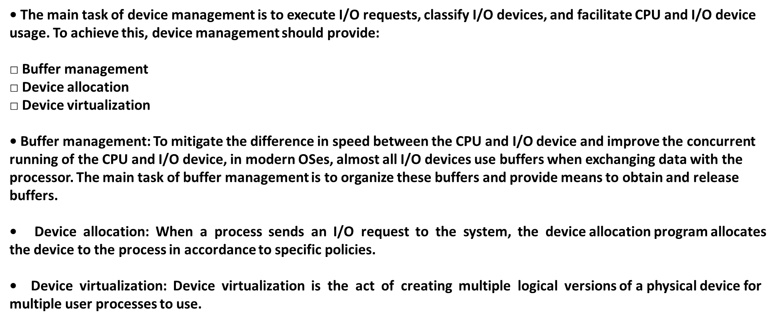
Chapter
05
Main Function - Device Management

Slide 10
Chapter
05
Main Function - File Management
• In modern computer systems, programs and data are stored as files.
• The main task of file management is to manage user and system files. File management facilitates file usage and security. To achieve this, file management should provide functions such as file storage space management, file read and write management, directory management, and file sharing and protection.

Slide 11
Chapter
05
Main Function - Job Management
• The main task of job management is to provide a stable environment suitable for users to effectively organize their workflows. Job management should provide:
□ Task and interface management
□ Human-machine interaction
□ Graphical interfaces
□ Language control

Slide 12
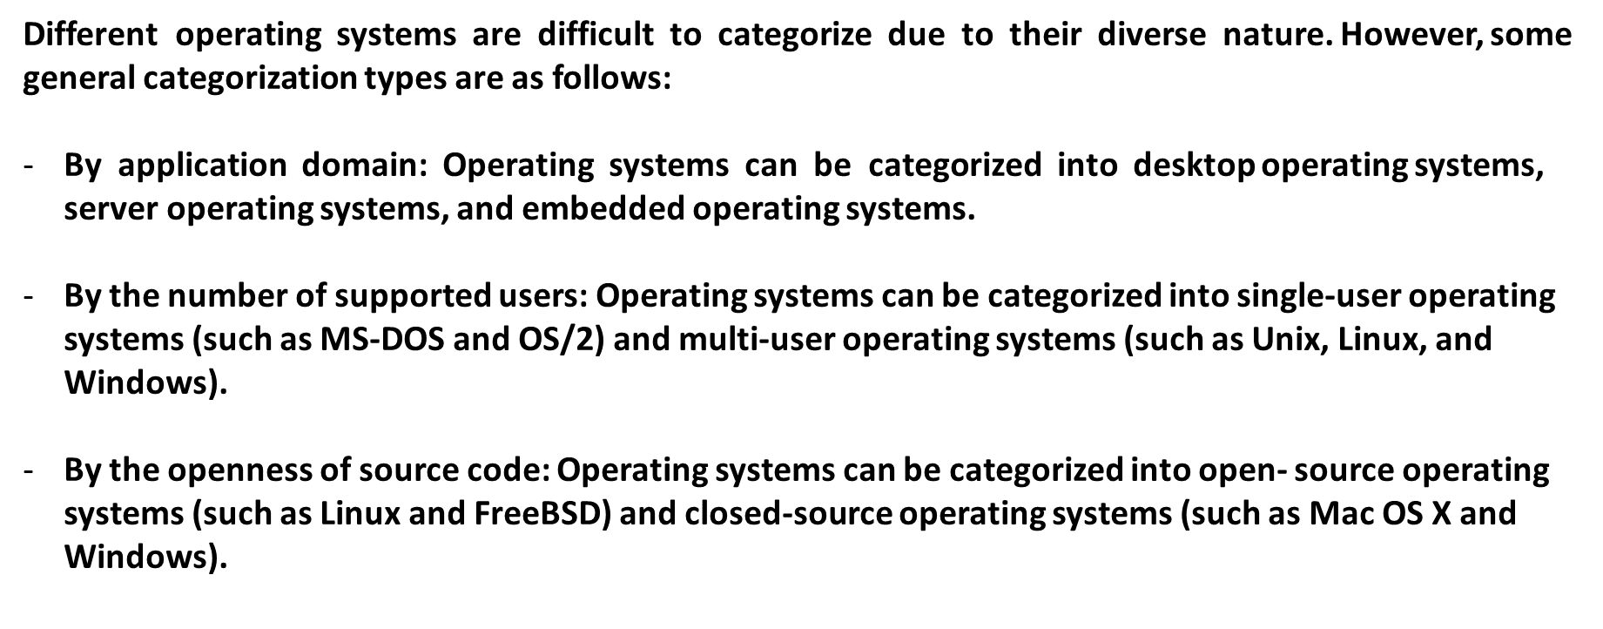
Chapter
Operating System Categorization
05

Slide 13
Chapter
05
Origin of Windows
• In 1985, Microsoft officially released the first-generation window-based multitasking system—Windows 1.0. Due to the hardware limitation at that time, Windows 1.0 did not draw the expected social attention and did not play its advantages. However, the launch of the operating system indicated that PCs entered the era of GUI. In GUI operating systems, most operation objects are represented by icons, which are intuitive and user-friendly and can better meet actual needs of some users.

Slide 14
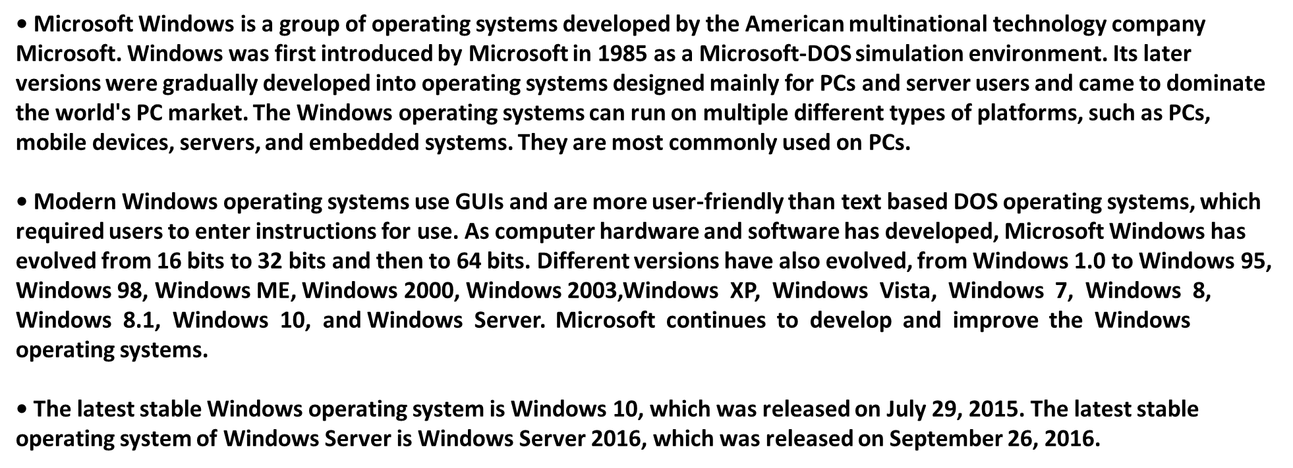
Chapter
05
Overview of Windows

Slide 15
Chapter
05
System arch. Of windows

Slide 16
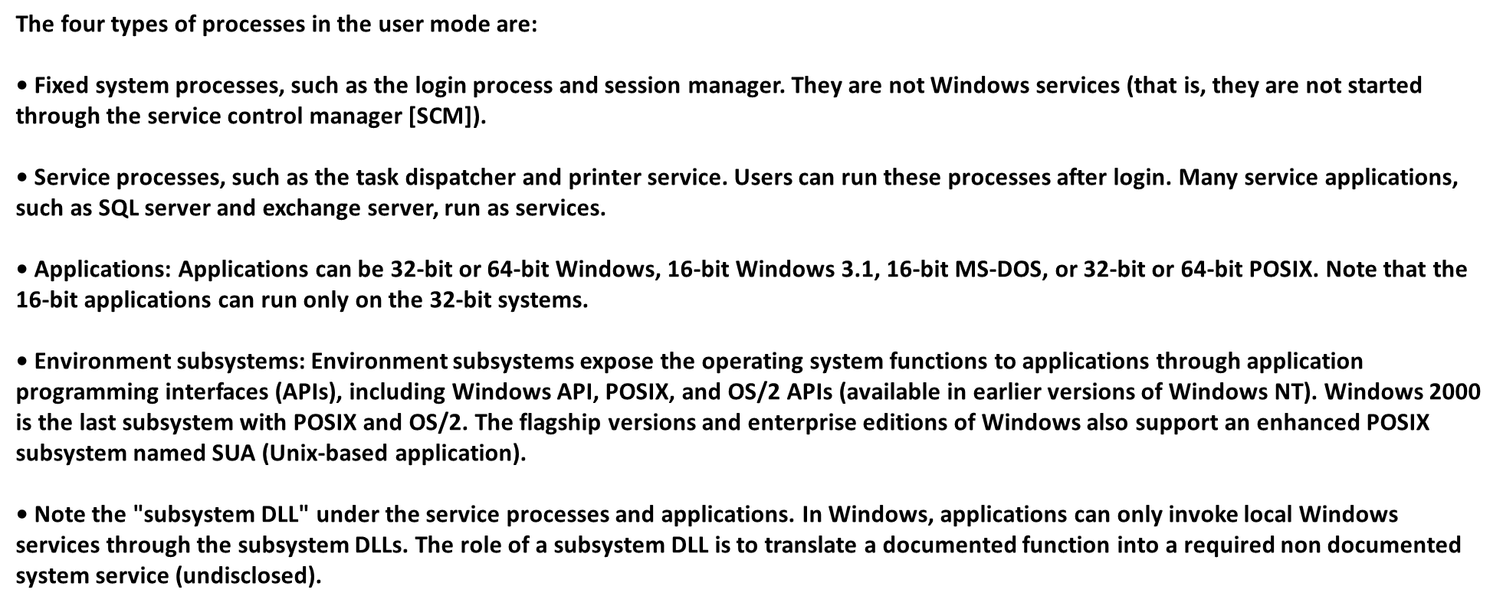
Chapter
05
System arch. Of windows

Slide 17
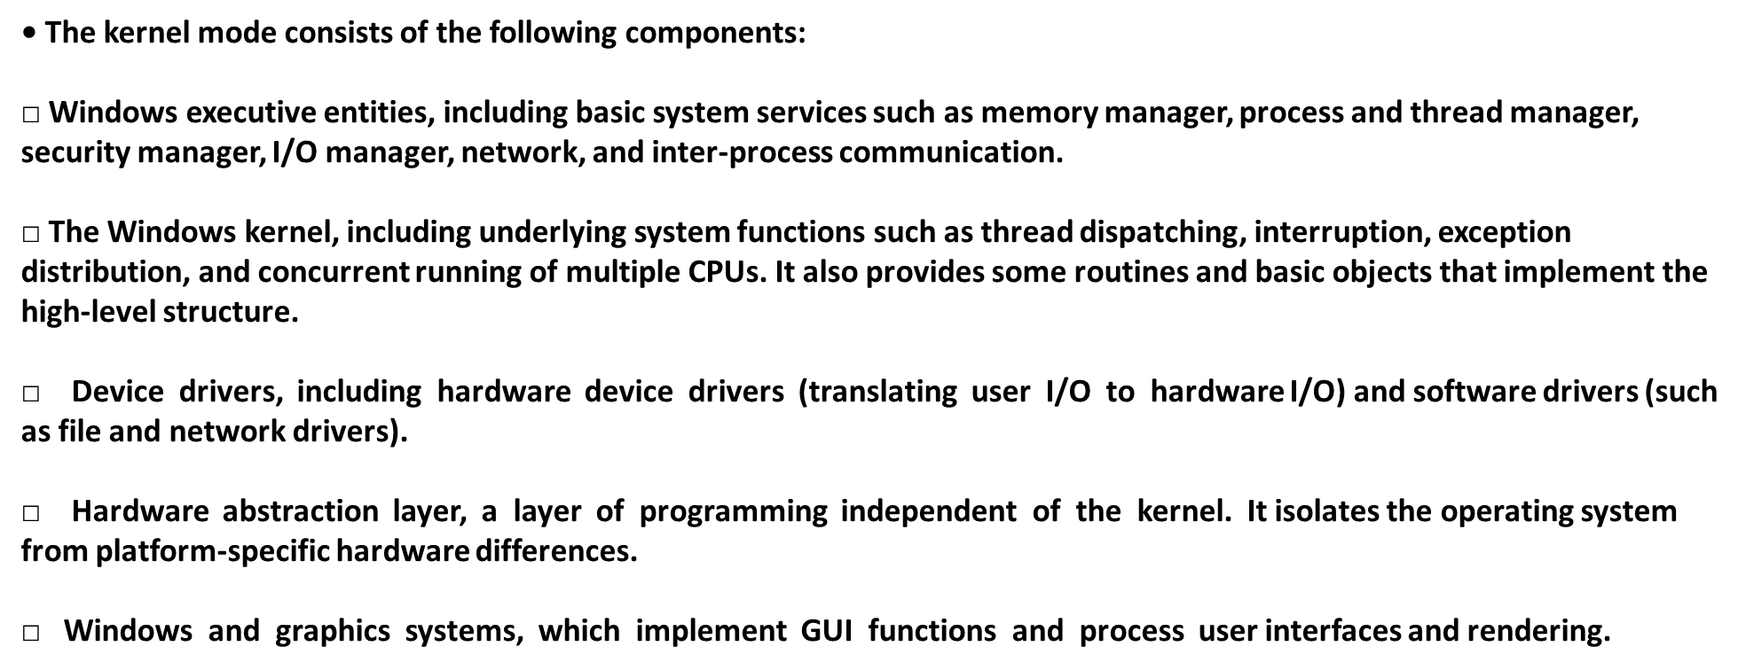
Chapter
05
System arch. Of windows

Slide 18
Chapter
05
Windows Family

Slide 19
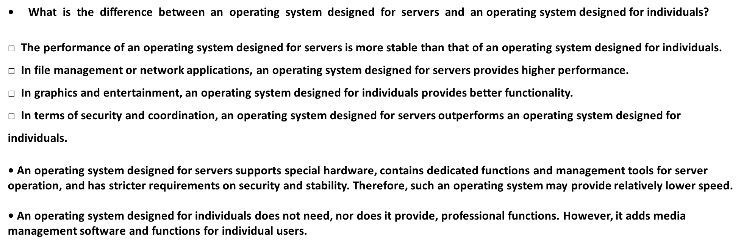
Chapter
05
Windows Family

Slide 20
Chapter
05
Features of Windows
• Intuitive and efficient object-oriented GUIs that are easy to learn and use
• The most widely used and most compatible operating system worldwide
• Unified, friendly, and neat Uls
• Various device-independent graphical operations
• Multi-user and multitasking

Slide 21
Chapter
05
Application of Windows

Slide 22
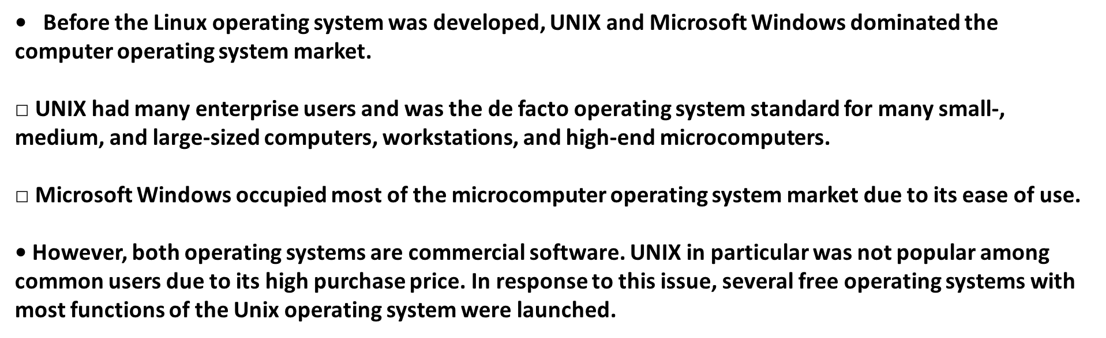
Chapter
05
History of Linux (1)
History of Linux (1)

Slide 23
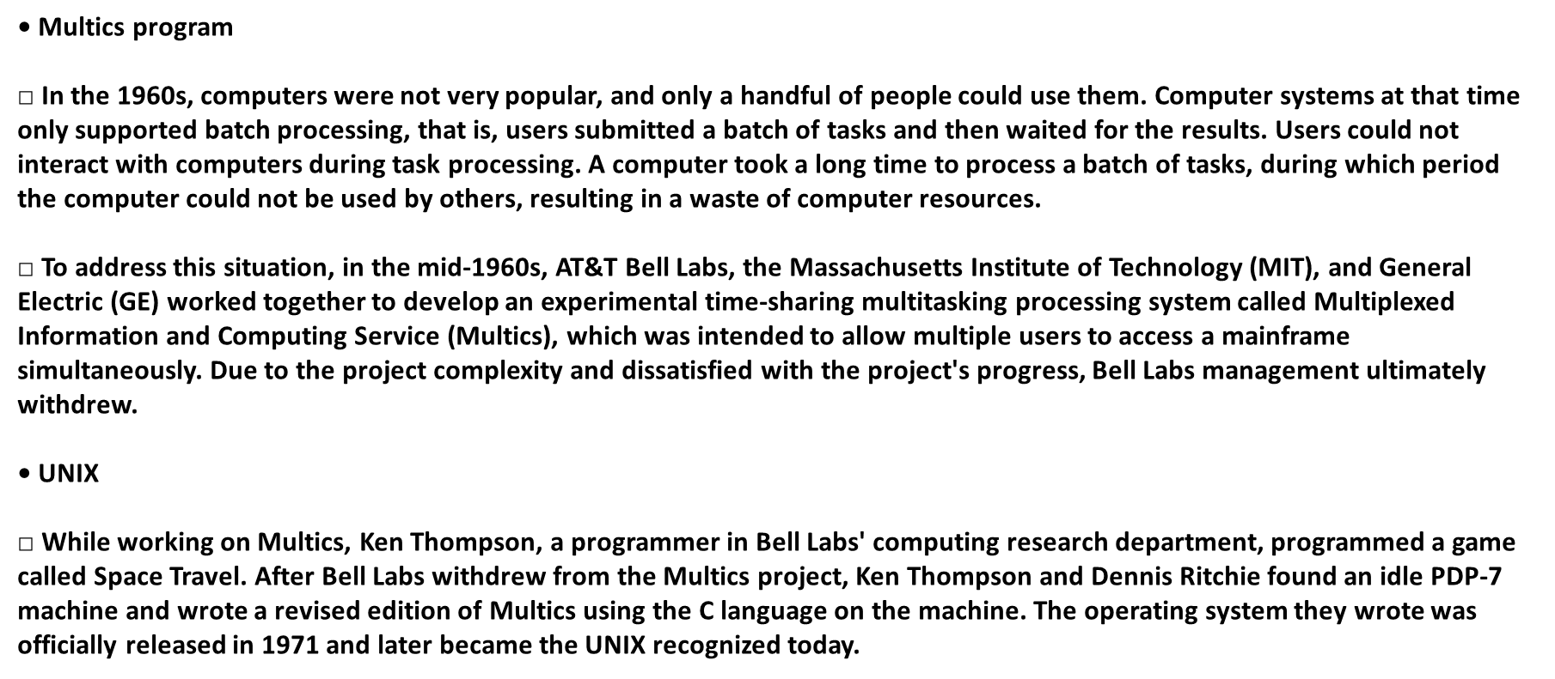
Chapter
05
History of Linux (1)

Slide 24
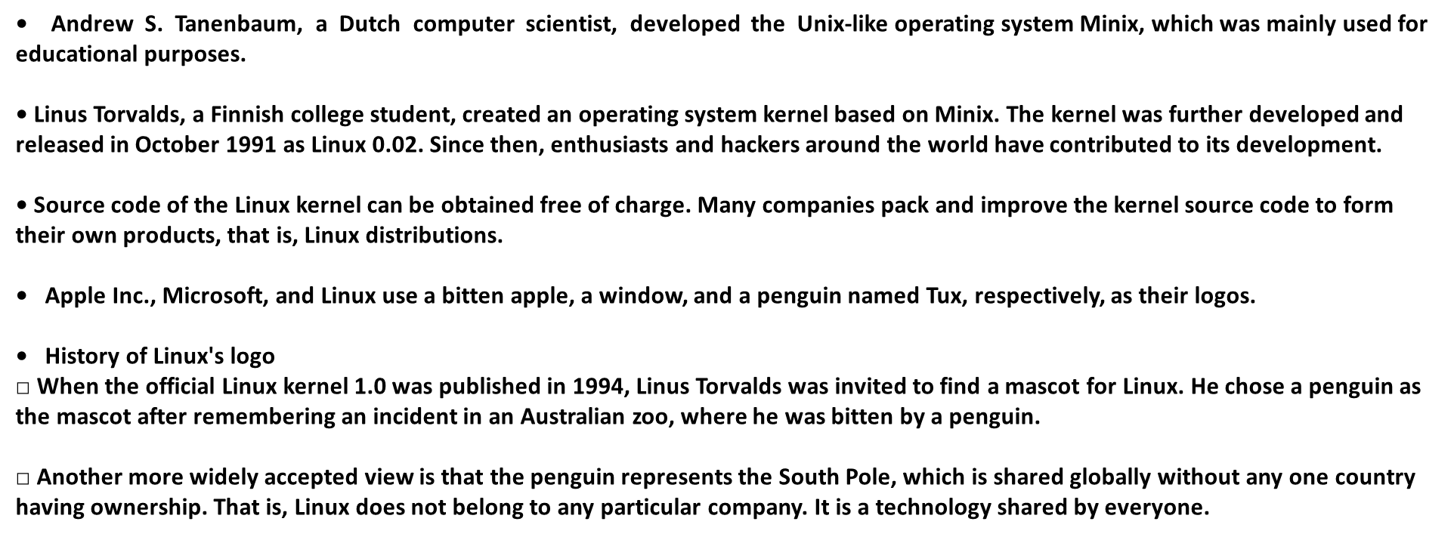
Chapter
05
History of Linux (2)

Slide 25
Chapter
05
System Architecture of Linux

Slide 26
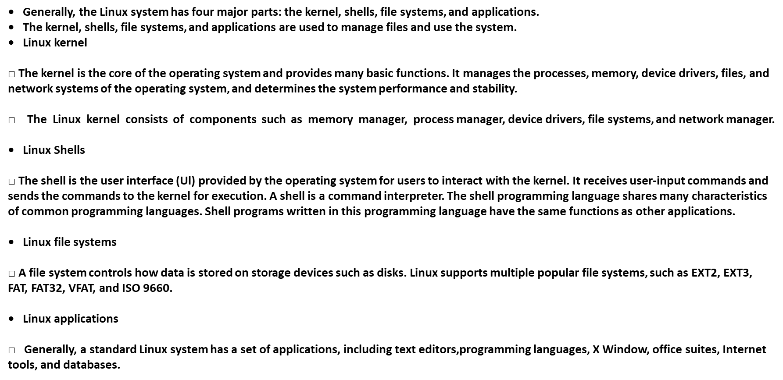
Chapter
05
System Architecture of Linux

Slide 27
Chapter
05
Common Linux Operating Systems
• Linux has two defining features:
□ Everything is a file.
□ Each software program has a defined purpose.
• The first feature means that, in Linux, the Linux kernel regards everything (including commands, hardware and software devices, operating systems, and processes) as a file of a specific type with its own features. Linux is based on Unix, which is largely because they share this basic idea.

Slide 28
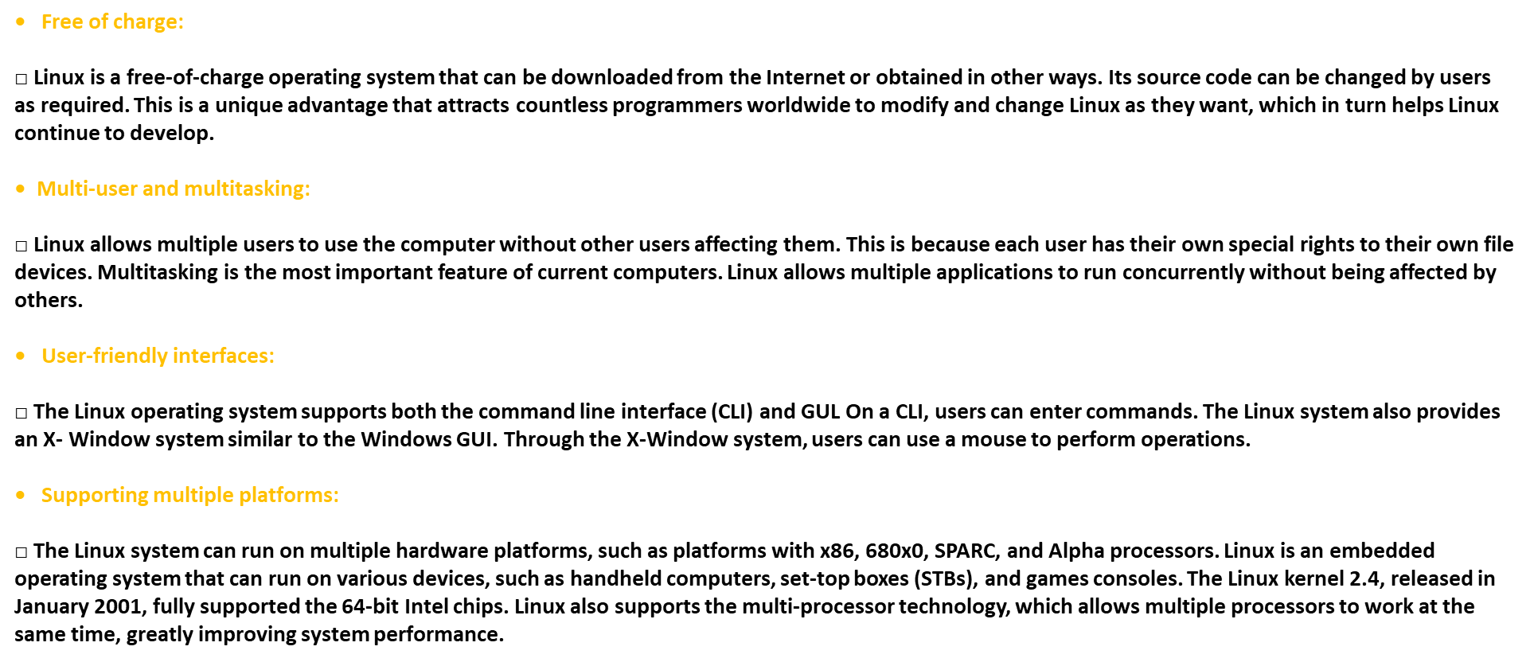
Chapter
05
Main Features of Linux

Slide 29
Chapter
05
Application of Linux

Slide 30
Chapter
Comparison Between Windows and Linux
05

Slide 31



Thank You

