Slide 1


Risk Management
MGM 510
Prepared by
Dr. Hamed Almahadin
Lecture 9

Slide 2



Ch#9
Risk Analysis and Evaluation
www.midocean.ae

Slide 3

Chapter
Topics to Cover in Week 9
9
Risk Application of a risk matrix
Inherent and current level of risk
As low as reasonably practicable (ALARP)
Risk Significance
Opportunity Assessment
Riskiness index
Upside in strategy
Upside in projects
Upside in operations
www.midocean.ae

Slide 4
Chapter
Application of a Risk Matrix
9
The use of a risk matrix is a very simple way of demonstrating the level of risk that a particular event represents to an organization.
A risk matrix is normally used to represent the residual or current level of risk.
This can also be referred to as the net risk.
www.midocean.ae

Slide 5
Chapter
Application of a Risk Matrix
9
When the risk matrix is used to illustrate the current level of risk, the vertical axis will normally be labelled as impact.
However, the risk matrix can also be used to represent gross or inherent level of risk, which is the level of risk before controls are applied.
www.midocean.ae

Slide 6
Chapter
Application of a Risk Matrix
9
When the risk matrix is used to illustrate the inherent level of risk, the vertical axis may sometimes be labelled magnitude.
www.midocean.ae

Slide 7
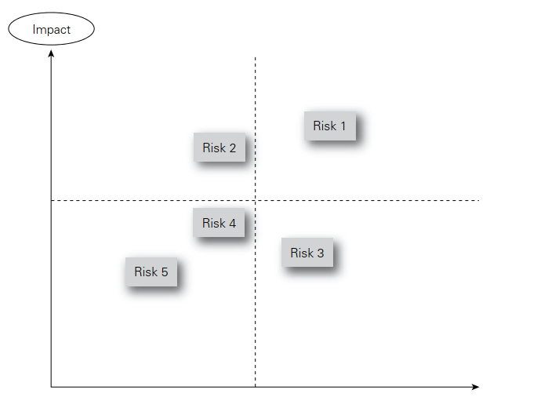
Chapter
Application of a Risk Matrix
9
www.midocean.ae

Slide 8
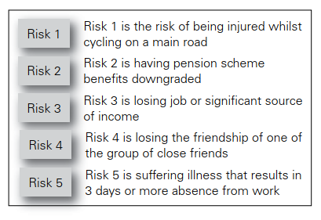
Chapter
Application of a Risk Matrix
9
www.midocean.ae

Slide 9
Chapter
Inherent and Current Level of Risk
9
Many risk management practitioners assess risk at its current (also referred to as residual) level.
However, internal auditors prefer to undertake an assessment of the risk at its inherent level.
www.midocean.ae

Slide 10
Chapter
Inherent and Current Level of Risk
9
There are advantages in considering the inherent level of a risk when undertaking a risk assessment.
Considering the inherent level will enable the effect of individual control measures to be identified.
www.midocean.ae

Slide 11
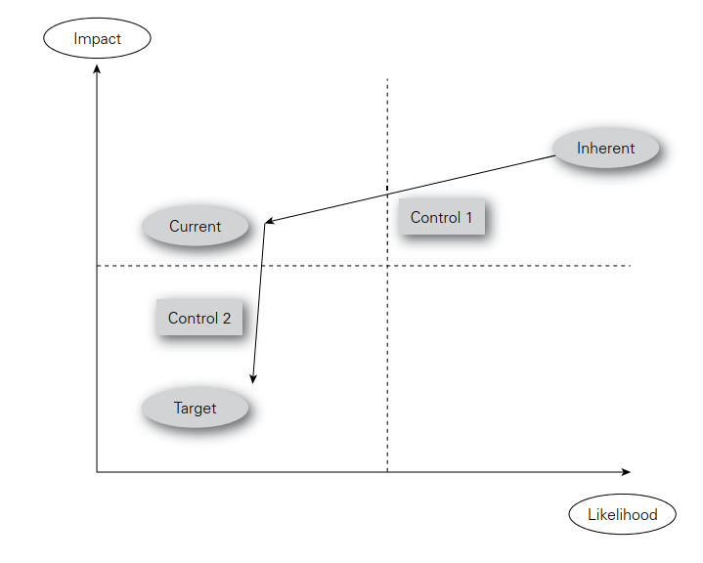
Chapter
Inherent and Current Level of Risk
9
www.midocean.ae

Slide 12
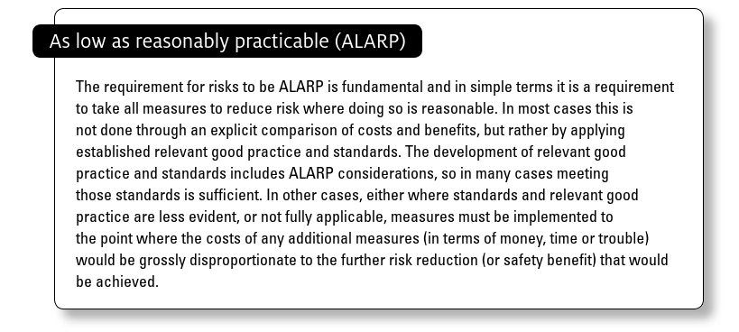
Chapter
As low as reasonably practicable (ALARP)
9
www.midocean.ae

Slide 13
Chapter
Risk Significance
9
When undertaking a risk assessment, it is quite common to identify a hundred or more risks that could impact the objective, core process or key dependency that is being considered.
www.midocean.ae

Slide 14
Chapter
Risk Significance
9
This is an unmanageable number of risks and so a method is required to reduce the number that will be considered to be priority issues for management.
In order for an organization to concentrate on significant risks, a test for risk significance is required.
www.midocean.ae

Slide 15
Chapter
Risk Significance
9
For risks that will have a financial or commercial impact, the benchmark test is likely to be based on monetary value.
For risks that could disrupt the infrastructure or routine operations of the organization, a benchmark test based on the impact, cost and duration of disruption is appropriate.
www.midocean.ae

Slide 16
Chapter
Risk Significance
9
For reputational risks, the most likely benchmark will be based on the adverse publicity that would result if the risk materializes.
This may vary according to the nature of the risk and whether it is a financial or non-financial one.
www.midocean.ae

Slide 17
Chapter
Opportunity Assessment
9
Successfully embracing business opportunities is more likely to be achieved if the organization undertakes opportunity assessments.
Many consultancy firms undertake a detailed evaluation of each new business prospect.
www.midocean.ae

Slide 18
Chapter
Opportunity Assessment
9
The organization will look at the new prospect and evaluate the scope for a profitable partnership, opportunities to earn extra income and the reputational benefits that might arise from having that potential client as a customer.
www.midocean.ae

Slide 19
Chapter
Opportunity Assessment
9
Opportunity assessment can be undertaken in relation to new business ventures, as well as new clients.
This opportunity evaluation is designed to identify the additional business opportunities that could arise from winning that client business.
www.midocean.ae

Slide 20
Chapter
Opportunity Assessment
9
The evaluation will also look at the potential disadvantages of successfully acquiring the client prospect.
When undertaking such an opportunity assessment, there has to be the possibility that the organization will advise the client prospect that they do not wish to tender for the business.
www.midocean.ae

Slide 21
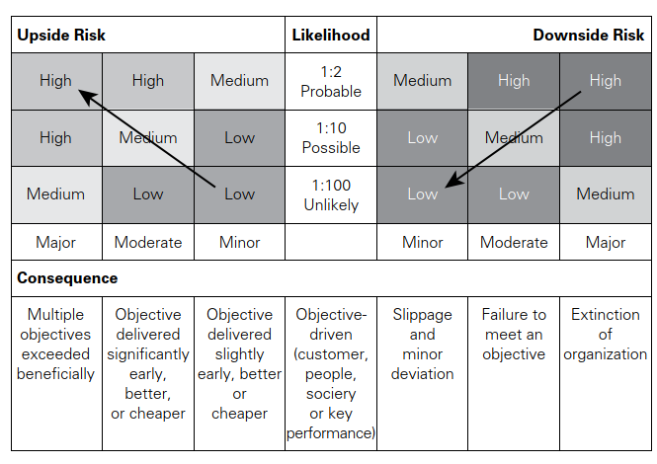
Chapter
Opportunity Assessment
9
www.midocean.ae

Slide 22
Chapter
Riskiness Index
9
The risk profile of an organization can be represented in many ways.
The most common method used is to prepare a risk register that contains details of the significant risks that it faces.
www.midocean.ae

Slide 23
Chapter
Riskiness Index
9
However, a disadvantage of the risk register is that it is usually a qualitative evaluation of individual risks.
Organizations need to develop a means of measuring, evaluating and quantifying the total risk exposure of the organization.
www.midocean.ae

Slide 24
Chapter
Riskiness Index
9
One of the features of the enterprise risk management approach is to develop a consolidated view of the risk exposure of the organization.
www.midocean.ae

Slide 25
Chapter
Riskiness Index
9
The approach based on calculating the total risk exposure of an organization is similar to the approach taken to the measurement and quantification of risk in operational risk management.
www.midocean.ae

Slide 26
Chapter
Riskiness Index
9
This section introduces the idea of a ‘riskiness index’. The idea is to present a semi-quantitative approach that takes a snapshot of the overall level of risk embedded in the organization.
www.midocean.ae

Slide 27
Chapter
Riskiness Index
9
The overall level of risk will take account of the strategy currently being followed by the organization, the projects that are in progress, and the nature of the routine operations being undertaken.
www.midocean.ae

Slide 28
Chapter
Riskiness Index
9
This approach can offer an opportunity to benchmark risk management performance and track changes over time.
www.midocean.ae

Slide 29
Chapter
Riskiness Index
9
Table 14.2 presents a set of questions that can be used to develop a riskiness index for an organization.
The table uses the structure of the FIRM risk scorecard as a means of categorizing risks.
www.midocean.ae

Slide 30
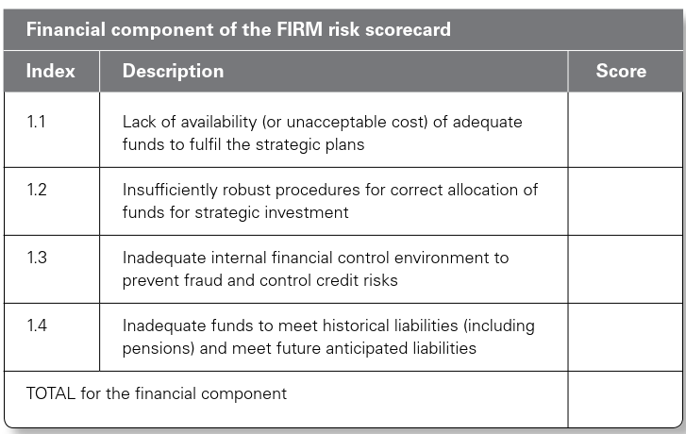
Chapter
Riskiness Index
9
www.midocean.ae

Slide 31
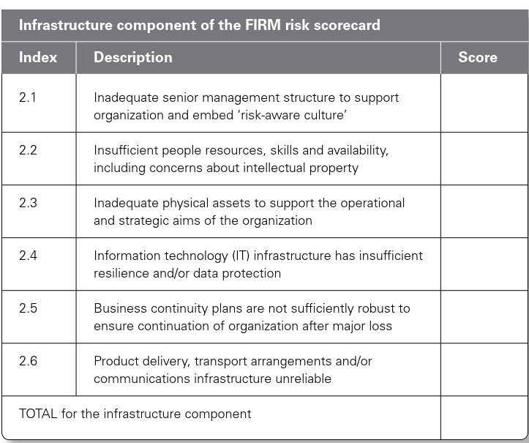
Chapter
Riskiness Index
9
www.midocean.ae

Slide 32
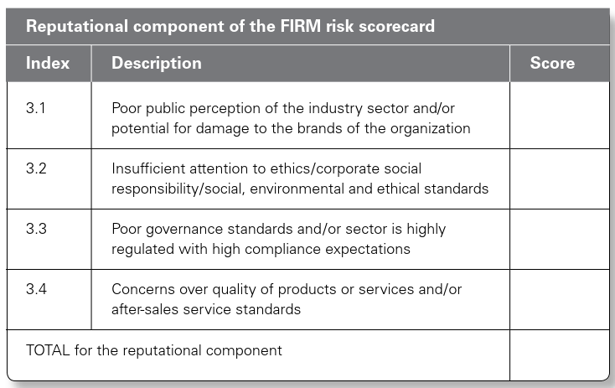
Chapter
Riskiness Index
9
www.midocean.ae

Slide 33
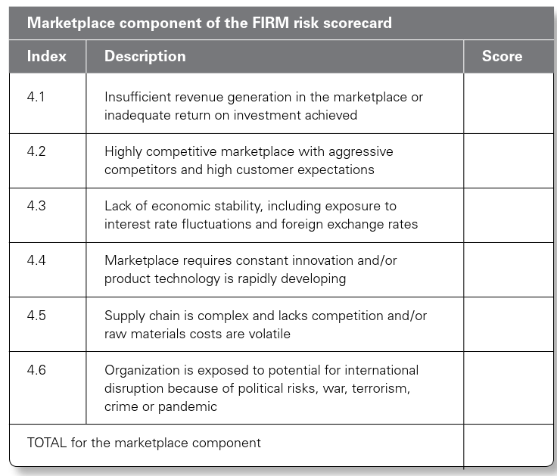
Chapter
Riskiness Index
9
www.midocean.ae

Slide 34
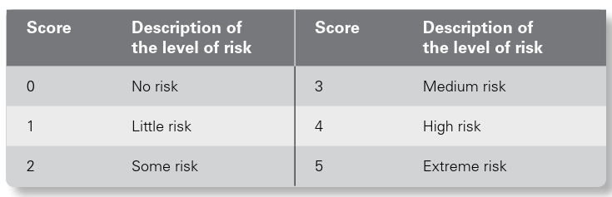
Chapter
Table 14.2: Riskiness Index
9
www.midocean.ae

Slide 35
Chapter
Upside in Strategy
9
Organizations will have a mission statement, together with a set of corporate objectives and an understanding of the expectations of the different stakeholders in the organization.
www.midocean.ae

Slide 36
Chapter
Upside in Strategy
9
The board of the organization then needs to develop an effective and efficient strategy that will deliver exactly what is expected in terms of the mission, objectives and expectations.
www.midocean.ae

Slide 37
Chapter
Upside in Strategy
9
In order to make correct strategic decisions, the board of the organization will need access to risk information.
A risk assessment of the proposed strategy, together with a risk assessment of any viable alternative strategies, should be undertaken.
www.midocean.ae

Slide 38
Chapter
Upside in Strategy
9
The availability of this risk assessment information will ensure that the strategic decisions are more likely to be correct.
www.midocean.ae

Slide 39
Chapter
Upside in Projects
9
It is essential that every organization adopts the correct core processes.
A core process may be considered as the collection of activities that deliver a specific stakeholder expectation.
www.midocean.ae

Slide 40
Chapter
Upside in Projects
9
This is the meaning of core process that is allocated by business process re-engineering (BPR) practitioners.
There is a difference between a process being efficient and effective.
www.midocean.ae

Slide 41
Chapter
Upside in Projects
9
An efficient process means that there is no disruption and no excess cost.
However, the process may be the incorrect one for cost-effectively delivering the requirements.
www.midocean.ae

Slide 42
Chapter
Upside in Projects
9
Where processes need to be improved, a project will normally be undertaken, and change achieved.
In circumstances where a series of projects are required, this is often referred to as a program of work.
www.midocean.ae

Slide 43
Chapter
Upside in Projects
9
When a project, or program of work, is implemented by an organization, the desire will normally be to improve the effectiveness and/or efficiency of core processes.
www.midocean.ae

Slide 44
Chapter
Upside in Projects
9
It is a fundamental requirement for organizations that they have effective and efficient operations.
Efficient operations should make best use of the resources of the organization and should operate without unplanned disruption.
www.midocean.ae

Slide 45
Chapter
Upside in Projects
9
Undertaking efficient operations that use minimum resources and produce maximum output will deliver the greatest benefit to the organization.
www.midocean.ae

Slide 46
Chapter
Upside in Projects
9
Operations also need to be effective in that they represent the best way of conducting the operations.
For example, it is possible to have an efficient journey by car or bus across a busy city.
www.midocean.ae

Slide 47
Chapter
Upside in Projects
9
However, the effective way to travel in many large cities is by means of the metro or underground system.
www.midocean.ae

Slide 48




Thank You

