Slide 1


Entrepreneurial
New Ventures
Prepared by Dr. Sarah Chahine
ENT 634
Unique Marketing Issues
Lecture 9

Slide 2


Entrepreneurial
New Ventures
Lecture 9
ENT 634
Unique Marketing Issues
Prepared by
Dr. Sarah Chahine
www.midocean.ae

Slide 3

Chapter
Introduction
11
In this chapter, we focus on the marketing challenges that are most pressing for young entrepreneurial firms. The reason for doing this is that marketing is an essential component of a start-up firm’s success.
www.midocean.ae

Slide 4

Chapter
Selecting a Market and Establishing a Position
11
To succeed, a new firm must know who its customers are and how to reach them. A firm uses a three-step process to determine who its customers are:
Segmenting the market
Selecting a target market
Crafting a unique positioning strategy
www.midocean.ae

Slide 5
Chapter
Selecting a Market and Establishing a Position
11
Segmenting the Market:
The first step in selecting a target market is to study the industry in which the firm intends to compete and determine the different potential target markets in that industry. This process is called market segmentation.
Market segmentation is important because a new firm typically has only enough resources to target one market segment, at least initially.
www.midocean.ae

Slide 6
Chapter
Selecting a Market and Establishing a Position
11
Segmenting the Market:
Markets can be segmented in many ways, such as by geography (city, state, country), demographic variables (age, gender, family size, income), psychographic variables (personality, lifestyle, values), behavioral variables (benefits sought, product usage rates, brand loyalty), and product type (varies by product).
  For example, the computer industry can be segmented by product type (i.e., handheld computers, tablet computers, laptops, PCs, work stations, minicomputers, mainframes, and super computers) or customers served (i.e., individuals, businesses, schools, and government).
www.midocean.ae

Slide 7
Chapter
Selecting a Market and Establishing a Position
11
Segmenting the Market:
Sometimes a firm segments its market on more than one dimension to drill down to a specific market segment that the firm thinks it is uniquely capable of serving.
To test whether you have segmented your market successfully, consider these requirements for successful market segmentation:
  Homogeneity of needs and wants appears within the segment.
  The segment should be distinct enough so that its members can be easily identified.
  It should be possible to determine the size of the segment.
  The segment should be large enough for the firm to earn profits.
www.midocean.ae

Slide 8
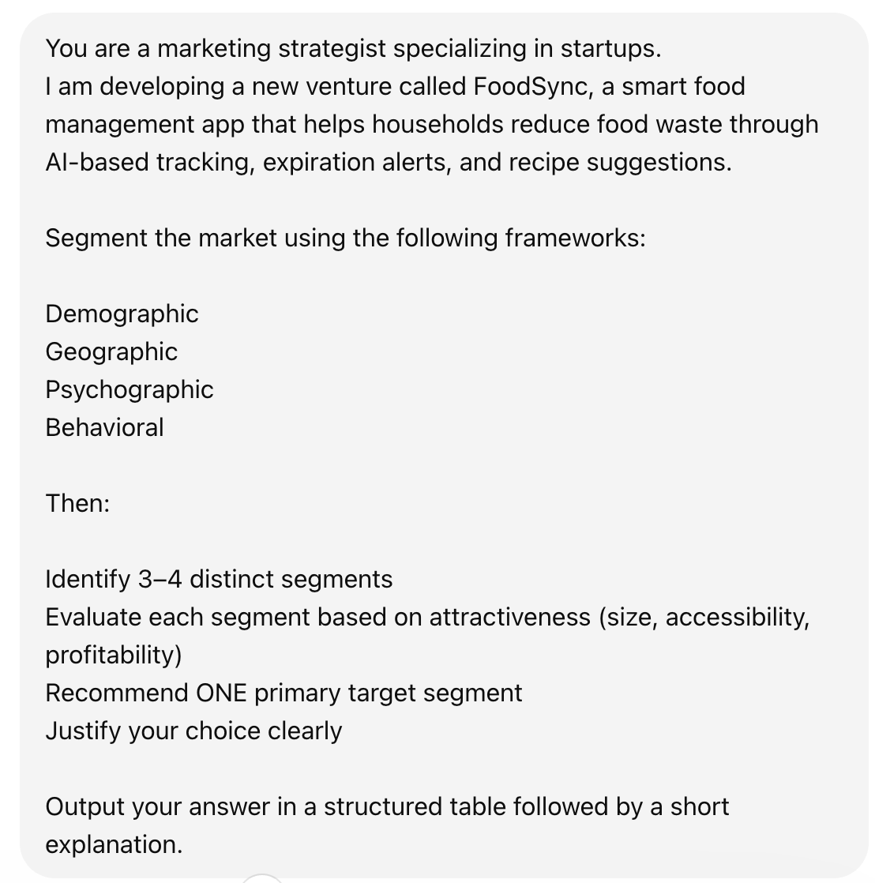
Chapter
Selecting a Market and Establishing a Position
11
You are a marketing strategist specializing in startups.
I am developing a new venture called FoodSync, a smart food management app that helps households reduce food waste through AI-based tracking, expiration alerts, and recipe suggestions.
Segment the market using the following frameworks:
Demographic
Geographic
Psychographic
Behavioral
Then:
Identify 3–4 distinct segments
Evaluate each segment based on attractiveness (size, accessibility, profitability)
Recommend ONE primary target segment
Justify your choice clearly
Output your answer in a structured table followed by a short explanation.
Segmenting the Market:
Can we use ChatGPT to help
in market segmentation? Definitely.
Example Prompt:
www.midocean.ae

Slide 9
Chapter
Selecting a Market and Establishing a Position
11
You are a marketing strategist specializing in startups.
I am developing a new venture called FoodSync, a smart food management app that helps households reduce Se waste through AI-based tracking, expiration alerts, and recipe suggestions.
Segment Segthe market using the following frameworks:
Demographic
Geographic
Psychographic
Behavioral
Then:
Identify 3–4 distinct segments
Evaluate each segment based on attractiveness (size, accessibility, profitability)
Recommend ONE primary target segment
Justify your choice clearly
Output your answer in a structured table followed by a short explanation.
Segmentation Type | Variables | Description for FoodSync
Demographic | Age, income, family size, occupation | Young professionals, families with children, middle-to-high income households, working parents
Geographic | Urban vs rural, country development level | Urban/semi-urban areas, developed & emerging markets with high food waste (e.g., Lebanon, UK, GCC)
Psychographic | Values, lifestyle, attitudes | Sustainability-conscious users, busy lifestyles, health-focused individuals, tech adopters
Behavioral | Usage habits, pain points, benefits sought | Frequent grocery shoppers, food wasters, users seeking convenience, meal planners, app-heavy users
Segmentation
Framework:
www.midocean.ae

Slide 10
Chapter
Selecting a Market and Establishing a Position
11
You are a marketing strategist specializing in startups.
I am developing a new venture called FoodSync, a smart food management app that helps households reduce Se waste through AI-based tracking, expiration alerts, and recipe suggestions.
Segment Segthe market using the following frameworks:
Demographic
Geographic
Psychographic
Behavioral
Then:
Identify 3–4 distinct segments
Evaluate each segment based on attractiveness (size, accessibility, profitability)
Recommend ONE primary target segment
Justify your choice clearly
Output your answer in a structured table followed by a short explanation.
Segment | Description | Key Needs | Attractiveness (Size / Accessibility / Profitability)
1. Busy Urban Families | Dual-income households with kids, limited time | Reduce food waste, simplify meal planning, save money | ⭐⭐⭐⭐ Large size, highly accessible via digital channels, strong willingness to pay
2. Young Professionals (Singles/Couples) | Ages 22–35, urban, tech-savvy | Convenience, quick recipes, organization | ⭐⭐⭐ Medium-large size, very accessible, moderate willingness to pay
3. Sustainability-Conscious Consumers | Eco-aware individuals prioritizing waste reduction | Environmental impact tracking, conscious consumption | ⭐⭐ Niche but growing, accessible via targeted messaging, moderate profitability
4. Budget-Conscious Households | Lower/middle income families focused on saving money | Minimize waste, stretch food budgets | ⭐⭐⭐ Large size, but lower willingness to pay (price-sensitive)
Identified Market Segments:
www.midocean.ae

Slide 11
Chapter
Selecting a Market and Establishing a Position
11
You are a marketing strategist specializing in startups.
I am developing a new venture called FoodSync, a smart food management app that helps households reduce Se waste through AI-based tracking, expiration alerts, and recipe suggestions.
Segment Segthe market using the following frameworks:
Demographic
Geographic
Psychographic
Behavioral
Then:
Identify 3–4 distinct segments
Evaluate each segment based on attractiveness (size, accessibility, profitability)
Recommend ONE primary target segment
Justify your choice clearly
Output your answer in a structured table followed by a short explanation.
Criteria | Evaluation
Primary Target Segment | Busy Urban Families
Why This Segment? | - Highest pain intensity (time + waste + decision fatigue)- Strong product-market fit (AI tracking + alerts + recipes directly solve their problems)- High willingness to pay for convenience- Easier to reach via digital platforms (Instagram, parenting communities, etc.)
Strategic Advantage | This segment benefits from all core features simultaneously, making adoption and retention more likely
Target Segment Recommendation:
www.midocean.ae

Slide 12
Chapter
Selecting a Market and Establishing a Position
11
Selecting a Target Market:
The market must be sufficiently attractive, and the firm must be able to serve it well. Typically, a firm (especially a start-up venture) doesn’t target an entire segment of a market because many market segments are too large to target successfully. Instead, most firms target a niche market within the segment.
A niche market is a place within a market segment that represents a narrow group of customers with similar interests.
By focusing on a clearly defined market, a firm can become an expert in that market and then be able to provide its customers with high levels of value and service.
www.midocean.ae

Slide 13
Chapter
Selecting a Market and Establishing a Position
11
Selecting a Target Market:
A firm’s choice of target markets must also be in sync with its business model and the backgrounds and skills of its founders and other employees.
A firm must also continually monitor the attractiveness of its target market.
  Societal preferences change, a fact that sometimes causes a target market to lose its attractiveness for a firm and the product or service it has to offer customers.
www.midocean.ae

Slide 14
Chapter
Selecting a Market and Establishing a Position
11
Crafting a Unique Marketing Position:
Position is concerned with how the firm is situated relative to competitors.
A firm’s market position is defined by its products or services. Determining which position in a market to occupy and in which to compete is a strategic call on the part of a company based on its mission, its overall approach to the marketplace, and its competitive landscape.
www.midocean.ae

Slide 15
Chapter
Selecting a Market and Establishing a Position
11
Crafting a Unique Marketing Position:
To support their positioning strategy, firms often develop a tagline.
A tagline is a catchy phrase that’s used consistently in a company’s literature, advertisements, stationery, and even invoices, and thus becomes associated with that company—to reinforce the position it has staked out in the market.
A concern that retail start-ups have is whether they’ll be able to compete successfully against big-box stores the ability of a start-up to compete effectively against a big-box store often boils down to positioning.
www.midocean.ae

Slide 16
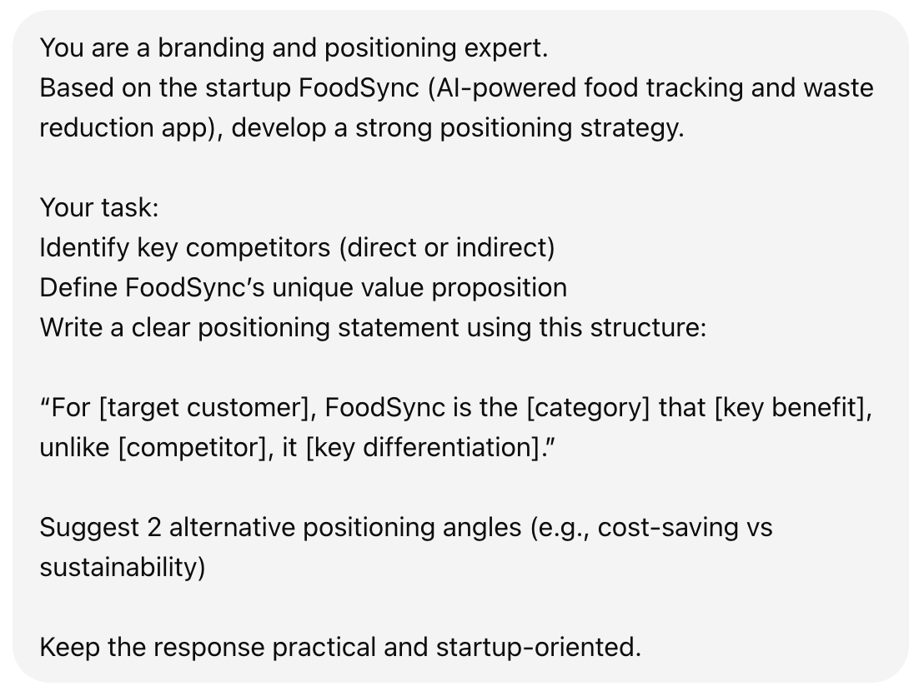
Chapter
Selecting a Market and Establishing a Position
11
Crafting a Unique Marketing Position:
ChatGPT prompt for a unique
positioning strategy:
www.midocean.ae

Slide 17
Chapter
Selecting a Market and Establishing a Position
11
Crafting a Unique Marketing Position:
Output:
Type | Competitors | What They Do | Gap / Weakness
Direct | NoWaste, Too Good To Go | Track food inventory / reduce waste | Limited AI intelligence, weak automation, fragmented experience
Indirect – Meal Planning | Mealime, Yummly | Suggest recipes & meal plans | Not connected to actual fridge inventory
Indirect – Grocery / Notes | AnyList, Google Keep | Lists & reminders | Manual input, no intelligence, no waste reduction focus
www.midocean.ae

Slide 18
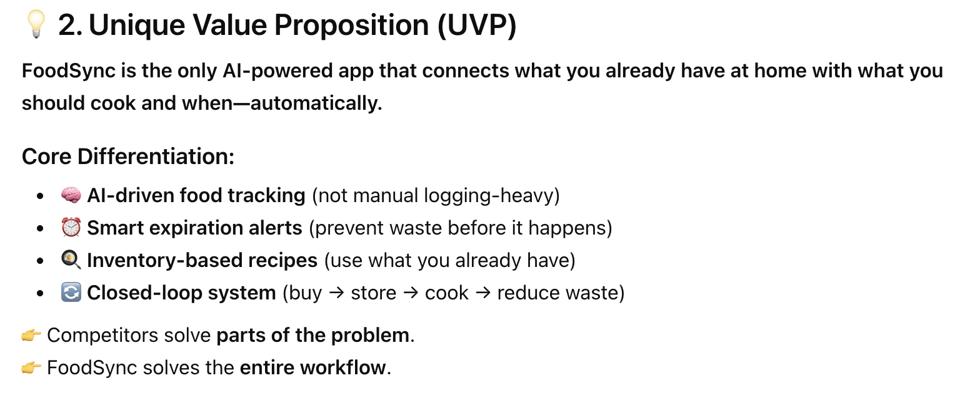
Chapter
Selecting a Market and Establishing a Position
11
Crafting a Unique Marketing Position:
Output:
www.midocean.ae

Slide 19
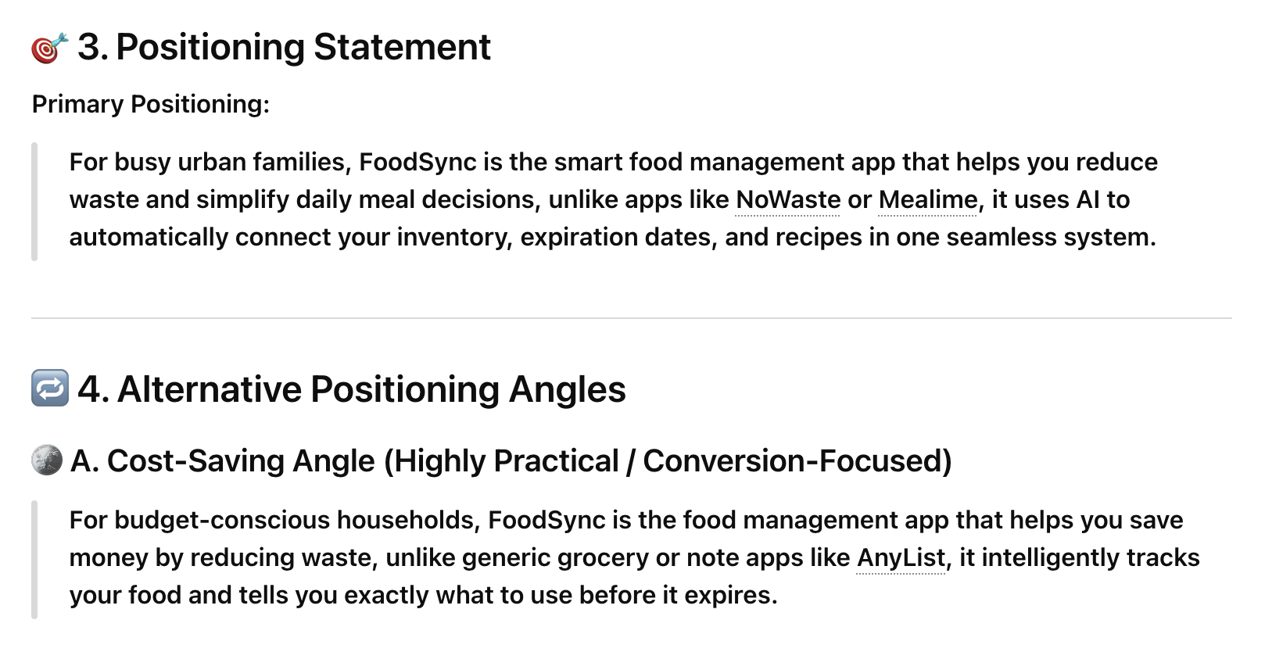
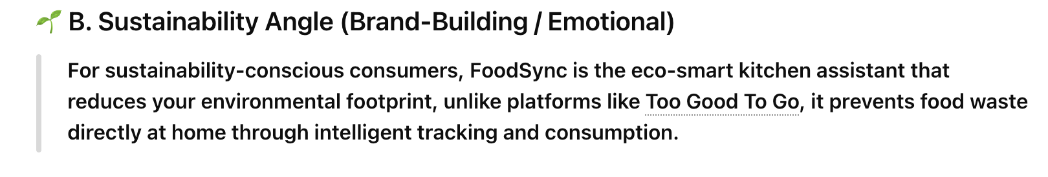
Chapter
Selecting a Market and Establishing a Position
11
www.midocean.ae

Slide 20
Chapter
Branding
11
A brand is the set of attributes—positive or negative—that people associate with a company. These attributes can be positive, such as trustworthy, innovative, dependable, or easy to deal with. Or they can be negative, such as cheap, unreliable, arrogant, or difficult to deal with. The customer loyalty a company creates through its brand is one of its most valuable assets.
Some companies monitor the integrity of their brands through brand management, which is a program used to protect the image and value of an organization’s brand in consumers’ minds.
www.midocean.ae

Slide 21
Chapter
Branding
11
Start-ups must build a brand from scratch; this process begins with selecting the company’s name.
One of the keys to effective branding is to create a strong personality for a firm, designed to appeal to the chosen target market.
  Southwest Airlines, for example, has created a brand that denotes fun. This is a good fit for its historical and current primary target market: people traveling for pleasure rather than business. Similarly, Starbucks have created a brand that denotes an experience framed around warmth and hospitality, encouraging people to linger and buy additional products.
www.midocean.ae

Slide 22
Chapter
Branding
11
So how does a new firm develop a brand? On a philosophical level, a firm must have meaning in its customers’ lives. It must create value—something for which customers are willing to pay.
On a more practical level, brands are built through a number of techniques, including advertising, public relations, sponsorships, social media, and good performance.
A firm’s name, logo, website design, Facebook page, Instagram account, and even its letterhead are part of its brand. It’s important for start-ups, particularly if they plan to sell to other businesses, to have a polished image immediately so that they have credibility when they approach their potential customers.
www.midocean.ae

Slide 23
Chapter
Branding
11
Most experts warn against placing an overreliance on advertising to build a firm’s brand. A more affordable approach is to rely on word of mouth and the media. Focusing too much on the features and benefits of their products is a common mistake entrepreneurs make when trying to gain attention from the media.
People a human interest story about why a firm was started or a story focused on something that’s distinctly unique about the start-up.
www.midocean.ae

Slide 24
Chapter
The 4Ps of Marketing for New Ventures
11
A firm’s marketing mix is the set of controllable, tactical marketing tools that it uses to produce the response it wants in the target market. Most marketers organize their marketing mix into four categories: product, price, promotion, and place (or distribution). For an obvious reason, these categories are commonly referred to as the 4Ps.
The way a firm sells and distributes its product dramatically affects its marketing program. This effect means that the first decision a firm has to make is its overall approach to selling its product or service.
www.midocean.ae

Slide 25
Chapter
The 4Ps of Marketing for New Ventures
11
Product
A firm’s product is the good or service it offers to its target market. Technically, a product is something that takes on physical form, such as an Apple iPhone, a bicycle, or a solar panel. A service is an activity or benefit that is intangible and does not take on a physical form, such as an airplane trip or advice from an attorney. But when discussing a firm’s marketing mix, both products and services are lumped together under the label “product.”
The most important attribute of a product is that it adds value in the mind of its target customers.
www.midocean.ae

Slide 26
Chapter
The 4Ps of Marketing for New Ventures
11
Product
An important distinction should be made between the core product and the actual product.
  The core product may be a CD that contains a tax preparation program.
  The actual product, which is what the customer buys, may have as many as five characteristics: a quality level, features, design, a brand name, and packaging.
Entrepreneurs must focus on the actual product that constitute the collection of benefits that the customer ultimately buys.
www.midocean.ae

Slide 27
Chapter
The 4Ps of Marketing for New Ventures
11
Product
A reference account is an early user of a firm’s product who is willing to give a testimonial regarding his or her experience with the product.
To obtain reference accounts, new firms must often offer their product to an initial group of customers for free or at a reduced price in exchange for their willingness to try the product and for their feedback.
www.midocean.ae

Slide 28
Chapter
The 4Ps of Marketing for New Ventures
11
Price
Price is an extremely important element of the marketing mix because it ultimately determines how much money a company can earn. The price a company charges for its products also sends a clear message to its target market.
Most entrepreneurs use one of two methods to set the price for their products: cost-based pricing or value-based pricing.
www.midocean.ae

Slide 29
Chapter
The 4Ps of Marketing for New Ventures
11
Price
In cost-based pricing, the list price is determined by adding a markup percentage to a product’s cost. The markup percentage may be standard for the industry or may be arbitrarily determined by the entrepreneur.
The advantage of this method is that it is straightforward, and it is relatively easy to justify the price of a good or service.
The disadvantage is that it is not always easy to estimate what the costs of a product will be. Once a price is set, it is difficult to raise it, even if a company’s costs increase in an unpredicted manner.
www.midocean.ae

Slide 30
Chapter
The 4Ps of Marketing for New Ventures
11
Price
In value-based pricing, the list price is determined by estimating what consumers are willing to pay for a product.
What a customer is willing to pay is determined by the perceived value of the product and by the number of choices available in the marketplace.
A company can work backwards by testing to see what its target market is willing to pay. A firm influences its customers’ perception of the value through positioning, branding, and the other elements of the marketing mix.
www.midocean.ae

Slide 31
Chapter
The 4Ps of Marketing for New Ventures
11
Price
Most experts also warn entrepreneurs to resist the temptation to charge a low price for their products in the hopes of capturing market share. This approach can win a sale but generates little profit.
In addition, most consumers make a price-quality attribution when looking at the price of a product. This means that consumers naturally assume that the higher-priced product is also the better-quality product.
www.midocean.ae

Slide 32
Chapter
The 4Ps of Marketing for New Ventures
11
Promotion
Promotion refers to the actions the firm takes to communicate the merits of its product to its target market. Ultimately, the goal is to persuade people to buy the product. There are a number of these actions, but most start-ups have limited resources, meaning that they must carefully study promotion activities before choosing the one or ones they’ll use.
www.midocean.ae

Slide 33
Chapter
The 4Ps of Marketing for New Ventures
11
Promotion
Advertising is making people aware of a product in hopes of persuading them to buy it. Advertising’s major goals are to:
  Raise customer awareness of a product
  Explain a product’s comparative features and benefits
  Create associations between a product and a certain lifestyle
These goals can be accomplished through a number of media including direct mail, magazines, newspapers, radio, the Internet, blogs, television, and billboard advertising. The most effective ads tend to be those that are memorable and support a product’s brand.
www.midocean.ae

Slide 34
Chapter
The 4Ps of Marketing for New Ventures
11
Promotion
One of the most cost-effective ways to increase the awareness of the products a company sells is through public relations.
Public relations refers to efforts to establish and maintain a company’s image with the public.
The major difference between public relations and advertising is that public relations is not paid for directly. The cost of public relations to a firm is the effort it expends to network with journalists, blog authors, and other people to try to interest them in saying or writing good things about the company and its products.
www.midocean.ae

Slide 35
Chapter
The 4Ps of Marketing for New Ventures
11
Promotion
Many start-ups emphasize public relations over advertising primarily because it’s cheaper and helps build the firm’s credibility.
A firm’s public relations effort can be oriented to telling the company’s story through a third party, such as a magazine or a newspaper.
www.midocean.ae

Slide 36
Chapter
The 4Ps of Marketing for New Ventures
11
Promotion
Use of social media consists primarily of blogging and establishing a presence and connecting with customers and others through social networking sites such as Facebook, X, Instagram, or Snapchat.
The idea behind blogs is that they familiarize people with a business and help build an emotional bond between a business and its customers.
The key to maintaining a successful blog is to keep it fresh and make it informative and fun. It should also engage its readers in the “industry” and “lifestyle” that a company promotes as much as a company’s products.
www.midocean.ae

Slide 37
Chapter
The 4Ps of Marketing for New Ventures
11
Promotion
Many start-ups also benefit from establishing a presence on social networking sites like Facebook, X, Instagram, and Pinterest.
Facebook has made itself more attractive to businesses since launching a family of social plug-ins in April 2010. Social plug-ins are tools that websites can use to provide their users with personalized and social experiences. Facebook’s most popular social plug-ins, which a website can install, include the Like button, the Share button, and the Comments box. These social plug-ins allow people to share their Facebook experiences with their friends on Facebook.
www.midocean.ae

Slide 38
Chapter
The 4Ps of Marketing for New Ventures
11
Place (or Distribution)
Place, or distribution, encompasses all the activities that move a firm’s product from its place of origin to the consumer.
A distribution channel is the route a product takes from the place it is made to the customer who is the end user.
The first choice a firm has to make regarding distribution is whether to sell its products directly to consumers or through intermediaries such as wholesalers or distributors.
Within most industries, both choices are available, so the decision typically depends on how a firm believes its target market wants to buy its product.
www.midocean.ae

Slide 39
Chapter
The 4Ps of Marketing for New Ventures
11
Place (or Distribution)
Many firms sell directly to customers. Being able to control the process of moving products from their place of origin to the end user instead of relying on third parties is a major advantage of direct selling.
The disadvantage of selling direct is that a firm has more of its capital tied up in fixed assets because it must own or rent retail outlets, must maintain a sales force, and/or must support an e-commerce website. It must also find its own buyers rather than have distributors that are constantly looking for new outlets for the firm’s products.
www.midocean.ae

Slide 40
Chapter
The 4Ps of Marketing for New Ventures
11
Place (or Distribution)
Firms selling through intermediaries typically pass off their products to wholesalers or distributors that place them in retail outlets to be sold. An advantage of this approach is that the firm does not need to own as much of the distribution channel.
The disadvantage of selling through intermediaries is that a firm loses a certain amount of control of its product.
www.midocean.ae

Slide 41
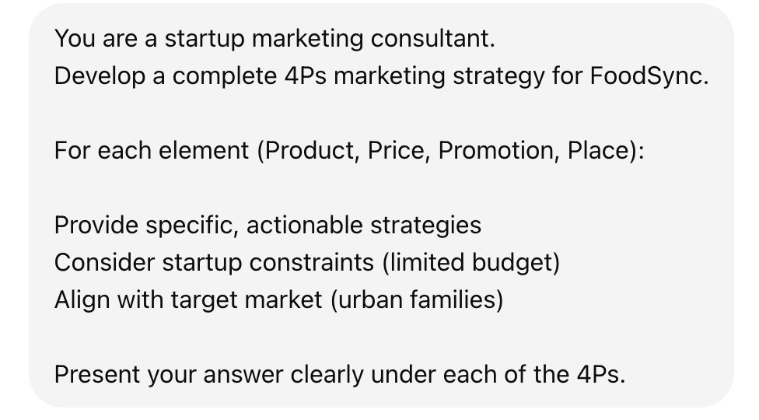
Chapter
The 4Ps of Marketing for New Ventures
11
Now let’s try this prompt for developing a complete 4Ps marketing strategy for FoodSync
www.midocean.ae

Slide 42


Thank You

