Slide 1



Introduction to Financing
Prepared by Dr. Sara Ahmed
Lecture 2

Slide 2



Equity Market and
Stock Valuation
Lecture 2
Prepared by
Dr. Sara Ahmed
www.midocean.ae

Slide 3

Topic
OUTLINE
02
1 Common Stock Valuation
Some Features of Common and Preferred Stocks
The Stock Markets
www.midocean.ae

Slide 4
Topic
Key Concepts and Skills
02
Understand how stock prices depend on future dividends and dividend growth
Be able to compute stock prices using the dividend growth model
www.midocean.ae

Slide 5
One Period Example
Suppose you are thinking of purchasing the stock of Moore Oil, Inc.
  You expect it to pay a $2 dividend in one year
  You believe you can sell the stock for $14 at that time.
  You require a return of 20% on investments of this risk
  What is the maximum you would be willing to pay?
www.midocean.ae

Slide 6
One Period Example
D₁ = $2 dividend expected in one year
R = 20%
P₁ = $14
CF₁ = $2 + $14 = $16
Compute the PV of the expected cash flows
www.midocean.ae

Slide 7
Two Period Example
What if you decide to hold the stock for two years?
  D₁ = $2.00 CF₁ = $2.00
  D₂ = $2.10
  P₂ = $14.70
  Now how much would you be willing to pay?
CF₂ = $2.10 + $14.70 = $16.80
www.midocean.ae

Slide 8
Three Period Example
What if you decide to hold the stock for three years?
  D₁ = $2.00 CF₁ = $2.00
  D₂ = $2.10 CF₂ = $2.10
  D₃ = $2.205
  P₃ = $15.435
  Now how much would you be willing to pay?
CF₃ = $2.205 + $15.435 = $17.640
www.midocean.ae

Slide 9
Developing The Model
You could continue to push back when you would sell the stock
You would find that the price of the stock is really just the present value of all expected future dividends
www.midocean.ae

Slide 10
Stock Value = PV of Dividends
^
D₁ D₂ D₃ D∞
P₀ =
+
+
+…+
(1+R)¹ (1+R)² (1+R)³ (1+R)∞
How can we estimate all future dividend payments?
www.midocean.ae

Slide 11
Estimating Dividends Special Cases
Constant dividend/Zero Growth
  Firm will pay a constant dividend forever
  Like preferred stock
  Price is computed using the perpetuity formula
Constant dividend growth
  Firm will increase the dividend by a constant percent every period
Supernormal growth
  Dividend growth is not consistent initially, but settles down to constant growth eventually
www.midocean.ae

Slide 12
Zero Growth
Dividends expected at regular intervals forever = perpetuity
  P₀ = D / R
Suppose stock is expected to pay a $0.50 dividend every quarter and the required return is 10% with quarterly compounding. What is the price?
www.midocean.ae

Slide 13
Constant Growth Stock
One whose dividends are expected to
grow forever at a constant rate, g.
D₁ = D₀(1+g)¹
D₂ = D₀(1+g)²
D_{t} = D_{t}(1+g)^{t}
D₀ = Dividend JUST PAID
D₁ – D_{t} = Expected dividends
www.midocean.ae

Slide 14
Projected Dividends
D₀ = $2.00 and constant g = 6%
D₁ = D₀(1+g) = 2(1.06) = $2.12
D₂ = D₁(1+g) = 2.12(1.06) = $2.2472
D₃ = D₂(1+g) = 2.2472(1.06) = $2.3820
www.midocean.ae
Notes:
11

Slide 15
Dividend Growth Model
^
D₀(1+g)
D₁
P₀ =
=
R - g
R - g
“Gordon Growth Model”
www.midocean.ae

Slide 16
DGM – Example 1
Suppose Big D, Inc. just paid a dividend of $.50. It is expected to increase its dividend by 2% per year. If the market requires a return of 15% on assets of this risk, how much should the stock be selling for?
D₀= $0.50
g = 2%
R = 15%
www.midocean.ae

Slide 17
DGM – Example 2
Suppose TB Pirates, Inc. is expected to pay a $2 dividend in one year. If the dividend is expected to grow at 5% per year and the required return is 20%, what is the price?
  D₁ = $2.00
  g = 5%
  r = 20%
www.midocean.ae

Slide 18
Stock Price Sensitivity to Dividend Growth, g
D₁ = $2; R = 20%
www.midocean.ae

Slide 19
Stock Price Sensitivity to Required Return, R
D₁ = $2; g = 5%
www.midocean.ae

Slide 20
Example 3
Gordon Growth Company - I
Gordon Growth Company is expected to pay a dividend of $4 next period and dividends are expected to grow at 6% per year. The required return is 16%.
What is the current price?
www.midocean.ae

Slide 21
Example 3
Gordon Growth Company - II
What is the price expected to be in year 4?
www.midocean.ae

Slide 22
Example 3
Gordon Growth Company - II
What is the implied return given the change in price during the four year period?
  50.50 = 40(1+return)⁴; return = 6%
  4 ,; 40 S.; 50.50 0; 0 /; %- = 6%
The price grows at the same rate as dividends
www.midocean.ae

Slide 23
Constant Growth Model Conditions
Dividend expected to grow at g forever
Stock price expected to grow at g forever
Expected dividend yield is constant
Expected capital gains yield is constant and equal to g
Expected total return, R, must be > g
Expected total return (R):
  = expected dividend yield (DY)
  + expected growth rate (g)
  = dividend yield + g
www.midocean.ae

Slide 24
Nonconstant Growth
Suppose a firm is expected to increase dividends by 20% in one year and by 15% in two years. After that dividends will increase at a rate of 5% per year indefinitely. If the last dividend was $1 and the required return is 20%, what is the price of the stock?
Remember that we have to find the PV of all expected future dividends.
www.midocean.ae

Slide 25
Nonconstant Growth – Solution
Compute the dividends until growth levels off
  D₁ = 1(1.2) = $1.20
  D₂ = 1.20(1.15) = $1.38
  D₃ = 1.38(1.05) = $1.449
Find the expected future price at the beginning of the constant growth period:
  P₂ = D₃ / (R – g) = 1.449 / (.2 - .05) = 9.66
Find the present value of the expected future cash flows
  P₀ = 1.20 / (1.2) + (1.38 + 9.66) / (1.2)² = 8.67
www.midocean.ae

Slide 26
Nonconstant + Constant growth
Basic PV of all Future Dividends Formula
Dividend Growth Model
www.midocean.ae
Notes:
6

Slide 27
Nonconstant + Constant growth
www.midocean.ae
Notes:
6

Slide 28
Nonconstant growth followed by constant growth:
0
r_{s}=20%
1
2
3
g = 20%
g = 15%
g = 5%
D₀ = 1.00 1.20 1.38 1.449
1.0000
0.9583
^
$1.449
6.7083
P₂ =
= $9.66
0.20 – 0.05
8.6667 = P₀
www.midocean.ae
Notes:
18

Slide 29
Quick Quiz: Part 1
What is the value of a stock that is expected to pay a constant dividend of $2 per year if the required return is 15%?
What if the company starts increasing dividends by 3% per year beginning with the next dividend? The required return remains at 15%.
www.midocean.ae

Slide 30
Using the DGM to Find R
Start with the DGM:
Rearrange and solve for R:
www.midocean.ae

Slide 31
Finding the Required Return Example
A firm’s stock is selling for $10.50. They just paid a $1 dividend and dividends are expected to grow at 5% per year.
What is the required return?
www.midocean.ae

Slide 32
Finding the Required Return Example
P₀ = $10.50.
D₀ = $1
g = 5% per year.
What is the required return?
www.midocean.ae

Slide 33
Finding the Required Return Example
P₀ = $10.50
D₀ = $1
g = 5% per year
What is the dividend yield?
  1(1.05) / 10.50 = 10%
What is the capital gains yield?
  g =5%
Dividend Capital Gains
Yield Yield
www.midocean.ae

Slide 34
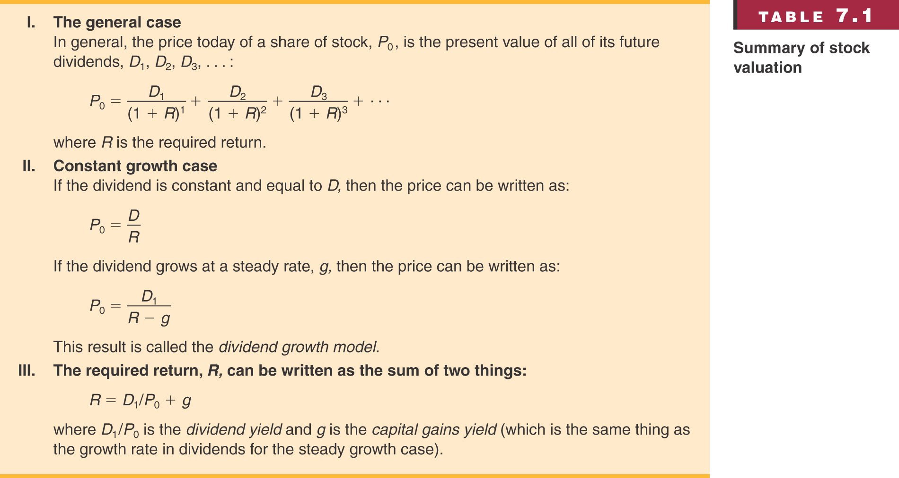
Table 1
www.midocean.ae

Slide 35
Features of Common Stock
Voting Rights
  Stockholders elect directors
Return to Quick Quiz
www.midocean.ae

Slide 36
Features of Common Stock
Other Rights
  Share proportionally in declared dividends
  Share proportionally in remaining assets during liquidation
  Preemptive right
    Right of first refusal to buy new stock issue to maintain proportional ownership if desired
Return to Quick Quiz
www.midocean.ae

Slide 37
Dividend Characteristics
Dividends are not a liability of the firm until declared by the Board of Directors
  A firm cannot go bankrupt for not declaring dividends
Dividends and Taxes
  Dividends are not tax deductible for firm
  Taxed as ordinary income for individuals
  Dividends received by corporations have a minimum 70% exclusion from taxable income
www.midocean.ae

Slide 38
Features of Preferred Stock
Dividends
  Must be paid before dividends can be paid to common stockholders
  Not a liability of the firm
  Can be deferred indefinitely
  Most preferred dividends are cumulative
    Missed preferred dividends have to be paid before common dividends can be paid
Preferred stock generally does not carry voting rights
Return to Quick Quiz
www.midocean.ae

Slide 39
The Stock Markets
Primary vs. Secondary Markets
  Primary = new-issue market
  Secondary = existing shares traded among investors
Dealers vs. Brokers
  Dealer: Maintains an inventor
  Ready to buy or sell at any time
  Think “Used car dealer”
  Broker: Brings buyers and sellers together
  Think “Real estate broker”
www.midocean.ae

Slide 40
Work the Web
Not only are stock price quotes readily available online. Some online trading sites display their “order book” or “limit order book” live online.
Batstrading is one of these.
Follow the link and see current buy and sell orders for Microsoft (MSFT).
www.midocean.ae

Slide 41
Quick Quiz: Part 2
You observe a stock price of $18.75. You expect a dividend growth rate of 5% and the most recent dividend was $1.50. What is the required return?
www.midocean.ae

Slide 42
Quick Quiz: Part 2
What are some of the major characteristics of common stock?
What are some of the major characteristics of preferred stock?
www.midocean.ae

Slide 43


Thank You

