Slide 1

Text Mining, Sentiment Analysis, and Social Analytics
Prepared by Dr. Mohamed Sleem
Subject code : FNT 631
Data Analysis
Lecture 11

Slide 2



Text Mining, Sentiment Analysis, and Social Analytics
Lecture 11
Subject code : FNT 631
Data Analysis
Prepared by
Dr. Mohamed Sleem
www.midocean.km

Slide 3
Answer Review Questions
Explain the role of Association Rule Mining in marketing and sales promotion?
Answer:
Association Rule Mining is a technique used to discover significant relationships between items in large datasets. In marketing and sales promotion, it helps analyze customer behavior and identify products that are frequently bought together. For example, if a rule shows that customers who buy "Bagels" often also buy "Potato Chips," a store can use this information to boost sales by placing these items near each other or offering discounts on "Potato Chips" when "Bagels" are purchased. This targeted promotion can increase overall sales and enhance the customer shopping experience.

Slide 4
Answer Review Questions
Describe the benefits and limitations of using clustering in market segmentation.
Answer:
Benefits:
  - Targeted Marketing: Tailored strategies for each segment, leading to effective campaigns.
  - Customer Understanding: Insights into different groups for better service.
  - Resource Allocation: Efficient focus on high-potential segments.
  Limitations:
  - Data Quality: Depends on accurate data.
  - Dynamic Markets: Changing preferences can make clusters less relevant.
  - Computational Complexity: Intensive and time-consuming for large datasets.

Slide 5
Answer Review Questions
How does data preprocessing improve the quality of data mining results? Provide examples of data preprocessing tasks
Answer:
Data preprocessing enhances data mining by ensuring data is clean, accurate, and well-formatted. Key tasks include:
Data Cleaning:
  Handling Missing Values: Fill missing values using techniques like mean imputation.
  Removing Noisy Data: Smooth data to remove errors or outliers.
  Correcting Inconsistent Data: Ensure consistency in data formats and coding.
Data Transformation:
  Normalization: Scale data to a standard range (e.g., 0 to 1).
  Aggregation: Summarize data to reduce volume (e.g., daily to monthly sales data).
Data Reduction:
  Sampling: Select a representative subset to reduce processing time.
  Dimensionality Reduction: Use techniques like PCA to reduce variables while retaining essential information.

Slide 6
Learning Objectives
Describe text mining and understand the need for text mining
Differentiate among text analytics, text mining and data mining
Understand the different application areas for text mining
Know the process of carrying out a text mining project
Appreciate the different methods to introduce structure to text-based data
Describe sentiment analysis
Develop familiarity with popular applications of sentiment analysis
Learn the common methods for sentiment analysis
Become familiar with speech analytics as it relates to sentiment analysis
Learn three facets of Web analytics—content, structure, and usage mining
Know social analytics including social media and social network analyses

Slide 7
Text Analytics and Text Mining (1 of 2)
Text Analytics versus Text Mining
Text Analytics =
  Information Retrieval +
  Information Extraction +
  Data Mining +
  Web Mining
or simply
  Text Analytics = Information Retrieval + Text Mining

Slide 8
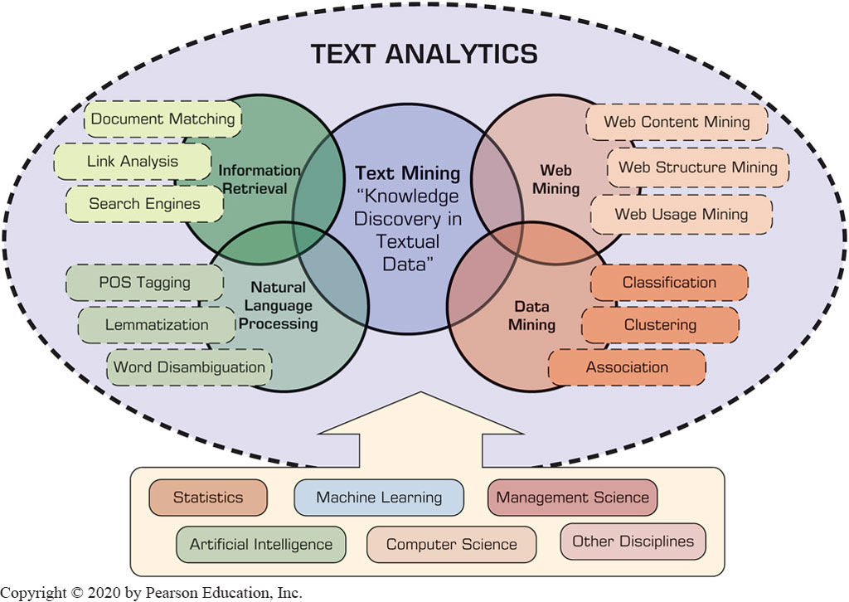
Text Analytics and Text Mining (2 of 2)
Figure Text Analytics, Related Application Areas, and Enabling Disciplines.

Slide 9
Text Mining Concepts
85-90 percent of all corporate data is in some kind of unstructured form (e.g., text)
Unstructured corporate data is doubling in size every 18 months
Tapping into these information sources is not an option, but a need to stay competitive
Answer: text mining
  A semi-automated process of extracting knowledge from unstructured data sources
  a.k.a. text data mining or knowledge discovery in textual databases

Slide 10
Data Mining versus Text Mining
Both seek for novel and useful patterns
Both are semi-automated processes
Difference is the nature of the data:
  Structured versus unstructured data
  Structured data: in databases
  Unstructured data: Word documents, P D F files, text excerpts, X M L files, and so on
To perform text mining – first, impose structure to the data, then mine the structured data.

Slide 11
Text Mining Concepts (2 of 2)
Benefits of text mining are obvious especially in text-rich data environments
  e.g., law (court orders), academic research (research articles), finance (quarterly reports), medicine (discharge summaries), biology (molecular interactions), technology (patent files), marketing (customer comments), etc.
Electronic communization records (e.g., Email)
  Spam filtering
  Email prioritization and categorization
  Automatic response generation

Slide 12
Text Mining Application Area
Information extraction
Topic tracking
Summarization
Categorization
Clustering
Concept linking
Question answering

Slide 13
Text Mining Terminology (1 of 2)
Unstructured or semistructured data
Corpus (and corpora)
Terms
Concepts
Stemming
Stop words (and include words)
Synonyms (and polysemes)
Tokenizing

Slide 14
Text Mining Terminology (2 of 2)
Term dictionary
Word frequency
Part-of-speech tagging
Morphology
Term-by-document matrix
  Occurrence matrix
Singular value decomposition
  Latent semantic indexing

Slide 15
Natural Language Processing (N L P) (1 of 4)
Structuring a collection of text
  Old approach: bag-of-words
  New approach: natural language processing
N L P is …
  a very important concept in text mining
  a subfield of artificial intelligence and computational linguistics
  the studies of "understanding" the natural human language
Syntax- versus semantics-based text mining

Slide 16
Natural Language Processing (N L P) (2 of 4)
What is “Understanding” ?
  Human understands, what about computers?
  Natural language is vague, context driven
  True understanding requires extensive knowledge of a topic
  Can/will computers ever understand natural language the same/accurate way we do?

Slide 17
Natural Language Processing (N L P) (3 of 4)
Challenges in N L P
  Part-of-speech tagging
  Text segmentation
  Word sense disambiguation
  Syntax ambiguity
  Imperfect or irregular input
  Speech acts
Dream of A I community
  to have algorithms that are capable of automatically reading and obtaining knowledge from text

Slide 18
N L P Task Categories
Question answering
Automatic summarization
Natural language generation & understanding
Machine translation
Foreign language reading & writing
Speech recognition
Text proofing, optical character recognition
Optical character recognition

Slide 19
Text Mining Applications (1 of 2)
Marketing applications
  Enables better C R M
Security applications
  E C H E L O N, O A S I S
  Deception detection (…example coming up)
Medicine and biology
  Literature-based gene identification (…)
Academic applications
  Research stream analysis

Slide 20
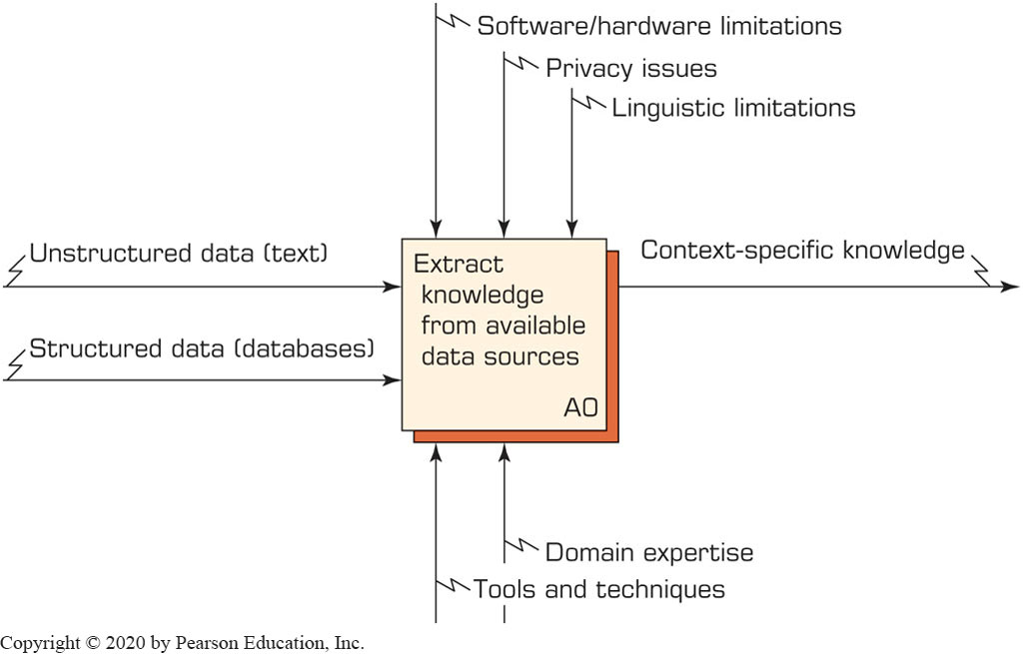
Text Mining Process (1 of 7)
A Context Diagram for Text Mining Process

Slide 21
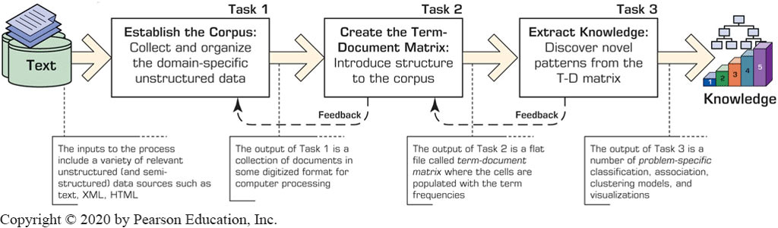
Text Mining Process (2 of 7)
Figure 7.6 The Three-Step/Task Text Mining Process.

Slide 22
Sentiment Analysis
Sentiment → belief, view, opinion, and conviction
Sentiment analysis is trying to answer the question “What do people feel about a certain topic?”
By analyzing data related to opinions of many using a variety of automated tools
Used in variety of domains, but it application in C R M are especially noteworthy (which related to customers/consumers’ opinions)

Slide 23
Sentiment Analysis Applications
Voice of the customer (V O C)
Voice of the Market (V O M)
Voice of the Employee (V O E)
Brand Management
Financial Markets
Politics
Government Intelligence
… others

Slide 24
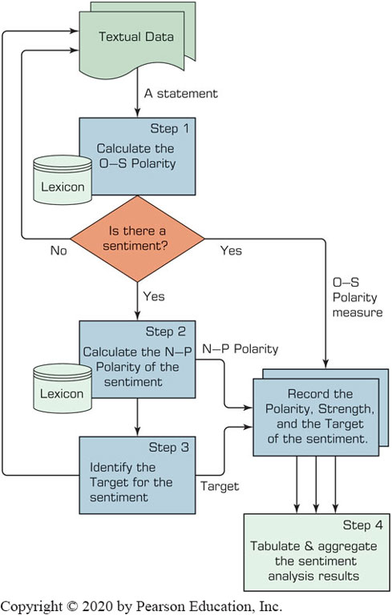
Sentiment Analysis Process (1 of 3)

Slide 25
Web Mining Overview
Web is the largest repository of data
Data is in H T M L, X M L, text format
Challenges (of processing Web data)
  The Web is too big for effective data mining
  The Web is too complex
  The Web is too dynamic
  The Web is not specific to a domain
  The Web has everything
Opportunities and challenges are great!

Slide 26
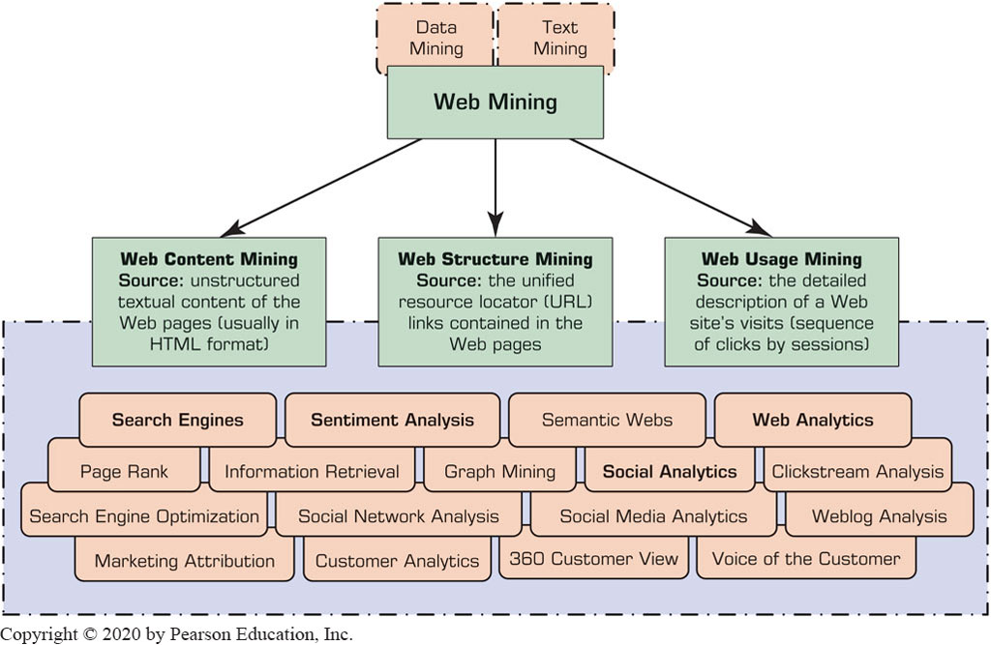
Web Mining
Web mining (or Web data mining) is the process of discovering intrinsic relationships from Web data (textual, linkage, or usage)

Slide 27
Search Engines
Google, Bing, Yahoo, …
For what reason do you use search engines?
Search engine is a software program that searches for documents (Internet sites or files) based on the keywords (individual words, multi-word terms, or a complete sentence) that users have provided that have to do with the subject of their inquiry
They are the workhorses of the Internet

Slide 28
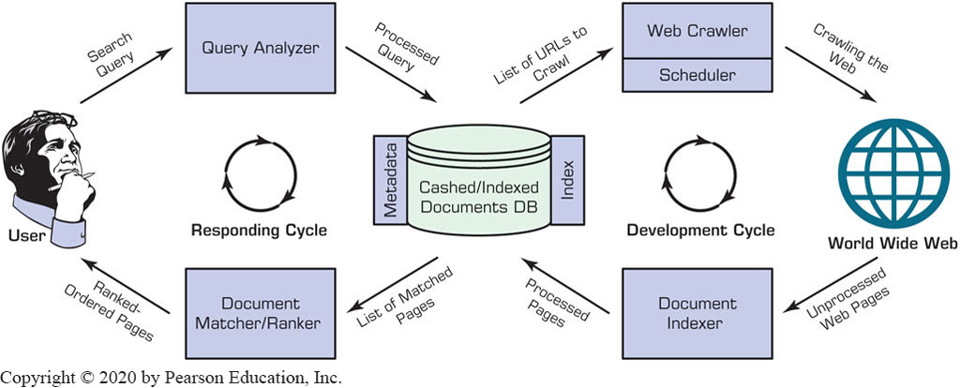
Structure of a Typical Internet Search Engine

Slide 29
Search Engine Optimization
It is the intentional activity of affecting the visibility of an e-commerce site or a Web site in a search engine’s natural (unpaid or organic) search results
Part of an Internet marketing strategy
Based on knowing how a Search Engine works
  Content, H T M L, keywords, external links, …
Indexing based on …
  Webmaster submission of U R L
  Proactively and continuously crawling the Web

Slide 30
Top 15 Most Popular Search Engines
(by eBizM B A, August 2016)
Rank | Name | Estimated Unique Monthly Visitors
1 | Google | 1,600,000,000
2 | Bing | 400,000,000
3 | Yahoo! Search | 300,000,000
4 | Ask | 245,000,000
5 | AOL Search | 125,000,000
6 | Wow | 100,000,000
7 | WebCrawler | 65,000,000
8 | MyWebSearch | 60,000,000
9 | Infospace | 24,000,000
10 | Info | 13,500,000
11 | DuckDuckGo | 11,000,000
12 | Contenko | 10,500,000
13 | Dogpile | 7,500,000
14 | Alhea | 4,000,000
15 | ixQuick | 1,000,000

Slide 31
Web Analytics Metrics (1 of 3)
Web site usability
  How were the visitors using my Web site?
Traffic sources
  Where did they come from?
Visitor profiles
  What do my visitors look like?
Conversion statistics
  What does it all mean for the business?

Slide 32
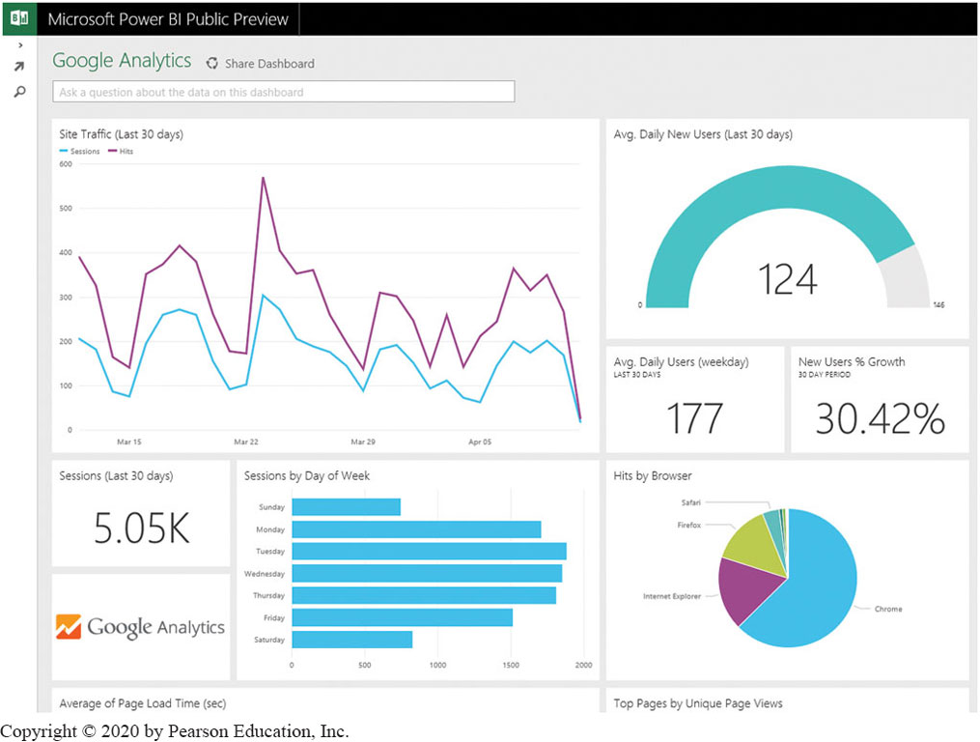
A Sample Web Analytics Dashboard

Slide 33
Social Analytics Social Network Analysis (1 of 2)
Social Network - social structure composed of individuals link to each other
Analysis of social dynamics
Interdisciplinary field
  Social psychology
  Sociology
  Statistics
  Graph theory

Slide 34
Social Analytics Social Network Analysis (2 of 2)
Social Networks help study relationships between individuals, groups, organizations, societies
  Self organizing
  Emergent
  Complex
Typical social network types
  Communication networks, community networks, criminal networks, innovation networks, …

Slide 35
Social Media Definitions and Concepts
Enabling technologies of social interactions among people
Relies on enabling technologies of Web 2.0
Takes on many different forms
  Internet forums, Web logs, social blogs, microblogging, wikis, social networks, podcasts, pictures, video, and product reviews
Different types of social media
  Based on media research and social process

Slide 36
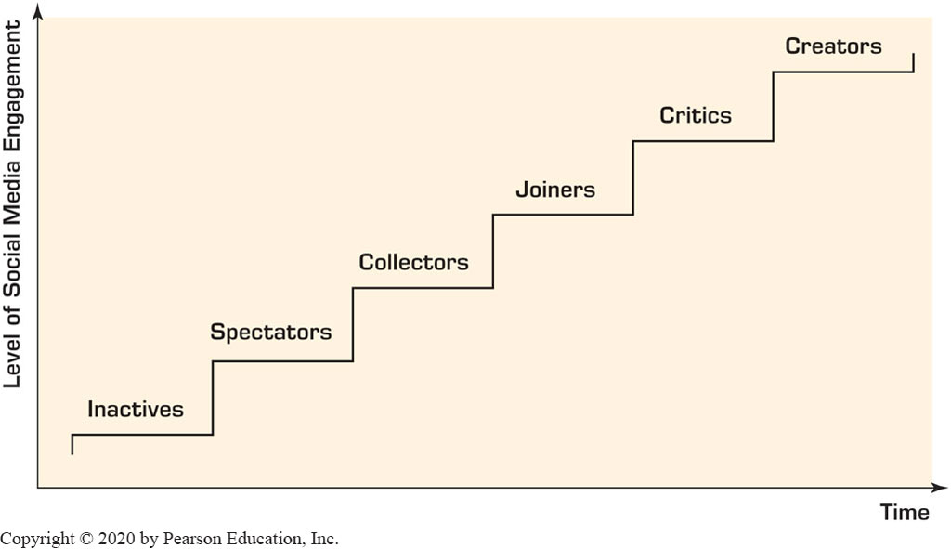
How Do People Use Social Media?
Different engagement levels

Slide 37
Social Media Analytics
It is the systematic and scientific ways to consume the vast amount of content created by Web-based social media outlets, tools, and techniques for the betterment of an organization’s competitiveness
Tools to measure social media impact:
  Descriptive analytics
  Social network analysis
  Advanced analytics

Slide 38
Best Practices in Social Media Analytics
Think of measurement as a guidance system, not a rating system
Track the elusive sentiment
Continuously improve the accuracy of text analysis
Look at the ripple effect
Look beyond the brand
Identify your most powerful influencers
Look closely at the accuracy of your analytic tool
Incorporate social media intelligence into planning

Slide 39
Review Questions:
What is the primary difference between text mining and data mining?
How does sentiment analysis benefit Customer Relationship Management (CRM)?
What are the main challenges associated with Natural Language Processing (NLP) in text mining?

Slide 40



Thank You

