Slide 1
Lecture 9: the First Apple (PFS)
The HPMQS and the new processes for ending the project execution phase .
“The transformation from the Readiness-deliverables into the Accepted-deliverables with effectively project value added (PVA)”

Slide 2




Welcome to the professional quality track
We did have the most efficient, complained Readiness-deliverables

Slide 3
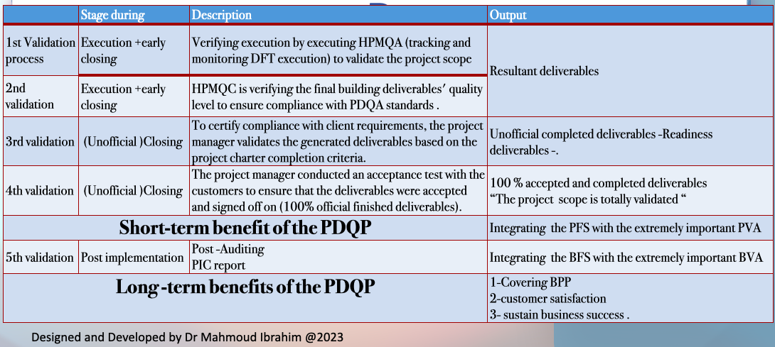

Slide 4
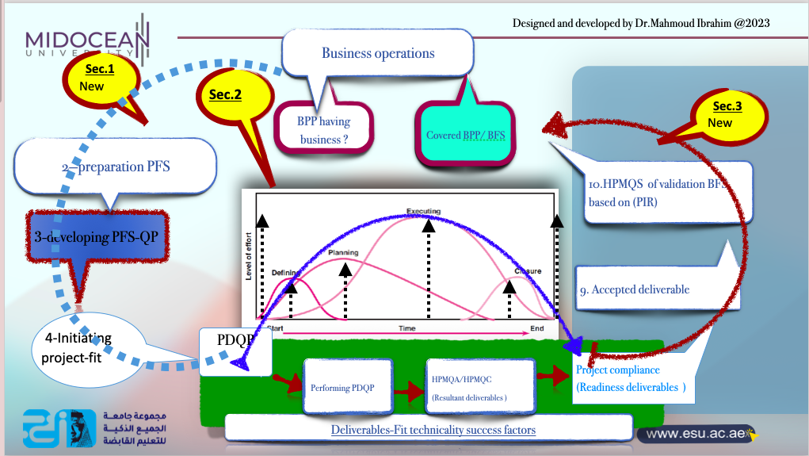

Slide 5

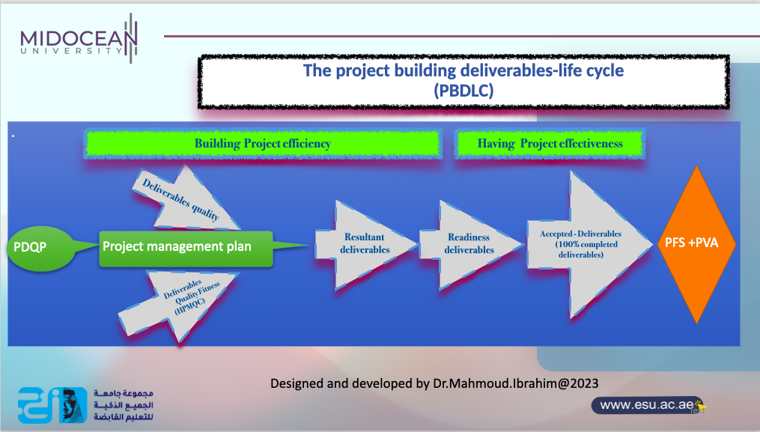

Slide 6
The Accepted-deliverables
They are the complained Readiness-deliverables that are transformed effectively through the acceptance test into the Accepted-deliverables, which are signed off by the customers and handed over after the phase review is conducted successfully

Slide 7

Lecture outline
1st section content :
Introduction and the relationship between the Accepted deliverables and GCOQ
2nd section content :
conducting the acceptance plan
3rd section content :
The closing levels of the accepted deliverables

Slide 8

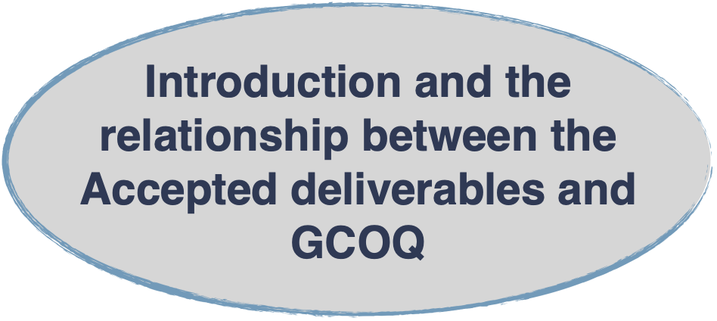

Slide 9
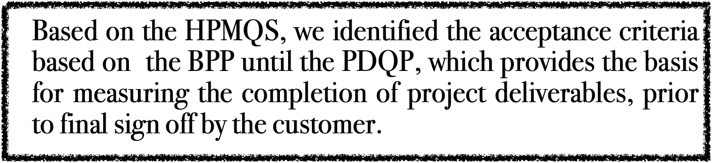
Acceptance plan
To answer this questions HPMQC wi th the project manager and the customers are applying the acceptance plan which is “the process of reviewing deliverables within the project and gaining the customer's acceptance for each deliverable produced that they are 100% complete.”

Slide 10
The lecture target is
the fourth validation question : Is your readiness deliverables accepted or not ?
Here the “Resultant deliverables” should pass the acceptance criteria of the acceptance test process
If the answer is yes , so we do have not only accepted signed off deliverables but also 100 %completed DF
So finally we have got the big (PFS) s

Slide 11
Why do we need the acceptance test ?
1-To ensure that your customer is satisfied with the deliverables produced by your project, you need to implement an Acceptance Management Process.
2-This process allows the customer to sign off on each deliverable in the project once it has been completed.
3-By allowing the customer to approve deliverables as 100% complete as you move through the project, you will substantially increase your chances of project success.

Slide 12
The aim of the acceptance process
1-To ensure that your customer is satisfied with the deliverables produced by your project, then you need to implement an Acceptance Management Process.
2-To increase your chances of gaining customer sign-off, you may wish to involve the customer in the acceptance testing process itself. This gives the customer additional confidence that the deliverables meet the acceptance criteria and that the testing methods used to determine the completion of each deliverable are comprehensive and effective.

Slide 13
The acceptance plan process
-This process allows the customer to sign off on each deliverable in the project once it has been completed. By allowing the customer to approve deliverables as 100% complete as you move through the project, you will substantially increase your chances of project success.
-Through a suite of Acceptance Tests, the Acceptance plan Process ensures that each deliverable produced by the project meets the acceptance criteria stated by the customer in the project's Acceptance Plan.
-The results of acceptance tests are documented on an Acceptance Form, which is presented to the customer along with the deliverable for final signoff.
-Only after the customer has approved the Acceptance Form is the deliverable considered 100% complete.
Throughout the execution process, the customer can monitor and control the acceptance of deliverables within the project by reviewing an up-to-date Acceptance Register.
The acceptance process is terminated only when the execution phase is complete.

Slide 14
Te acceptance plan and the COQ

Slide 15


The cost of managing the defects and errors
(COQ)
COPQ
Failures Costs
(Nonconformity costs)
Working on product effectiveness
COGQ
(Conformity costs)
Work on the process efficient
Internal failures
External failures
Prevention costs
Appraisal costs

Slide 16
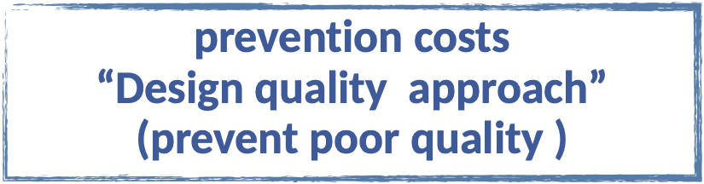

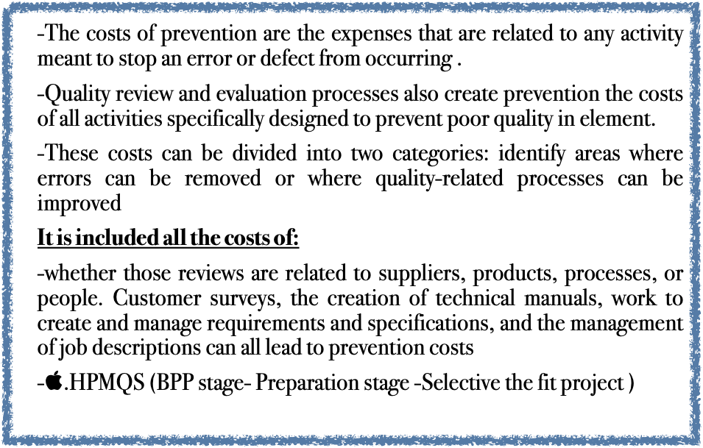
Preventive cost or External Failures
External failures usually occur after products or services have been delivered, which means they are directly associated with customer dissatisfaction. External failures might include revenue losses associated with a reduction in sales because of the quality of products, services, systems, or information. Other types of external losses include expenses associated with repairs, returns, or rework associated with a customer complaint; expenses associated with warranties; or loss of revenue or sales because of customer ill will or bad word-of-mouth.

Slide 17

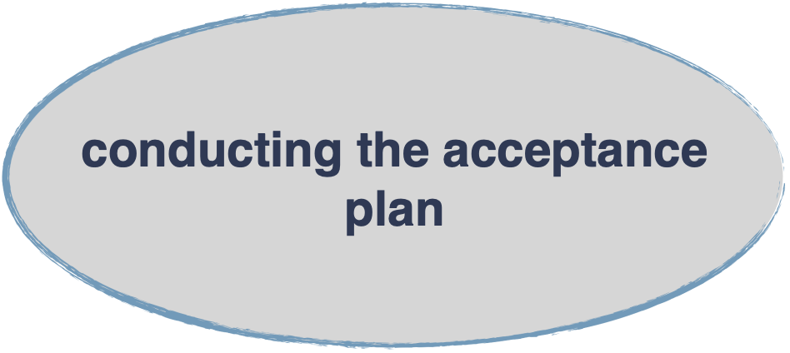

Slide 18
1-Schedule Acceptance Test
2-Complete Acceptance Test
3-Complete Acceptance Form
4-Request Acceptance Form Approval
2- Perform Acceptance Test

Slide 19

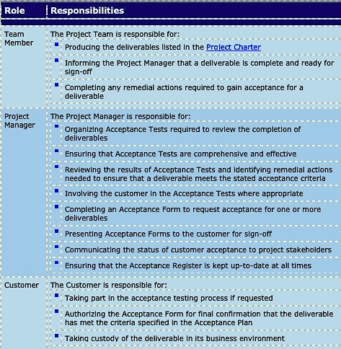
Acceptance plan Roles

Slide 20
1-conducting Acceptance Test
-If the Project Manager concurs with the team member that the deliverable is complete, then he will review schedule an Acceptance Test.
-He might decide to perform the test immediately or, depending on the size and complexity of the deliverable, he might wait until other related deliverables are complete and test the entire group of deliverables simultaneously.
-In any case, rather than waiting until the end of the Execution phase, we will perform Acceptance Tests as soon after completion of the deliverable as possible, to give us time to rectify any issues that arise.

Slide 21
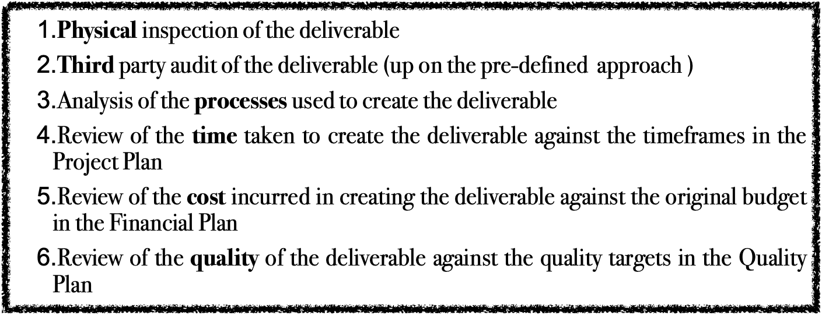
2-Analyzing the results of the tested deliverables
Acceptance Tests are carried out to determine whether the deliverables meet the acceptance criteria stated within the Acceptance Plan. To this end, we have a variety of testing methods at our disposal to determine a deliverable's completion status, including a:

Slide 22
3-the customer assess the results and decided
After analyzing the deliverable and the results of the Acceptance Test provided by the Project Manager, the customer can decided :
Share by their own at Acceptance Test to ensure that the deliverable is actually 100% complete
Request further information about the testing activities and results
Refuse to approve the deliverable and raise a formal issue with the Project Manager
Approve the deliverable as 100% complete by endorsing the Acceptance Form

Slide 23
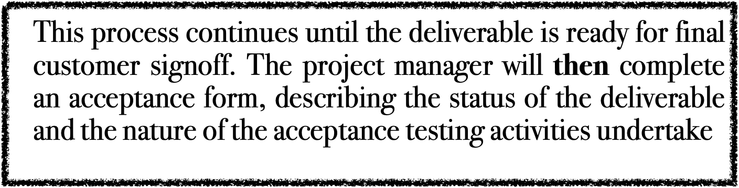
4-additional work 0r retested may required
After the Acceptance Test has been undertaken, any additional work required to meet the acceptance criteria will be undertaken and the deliverable will be re-tested to ensure that it has achieved the required quality level and customer requirements .

Slide 24

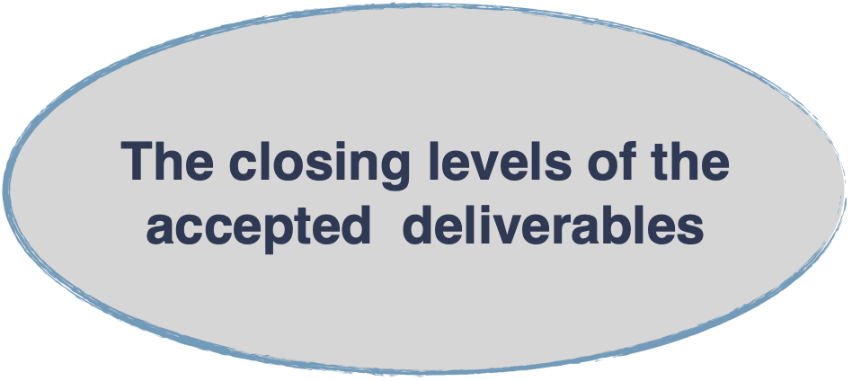

Slide 25
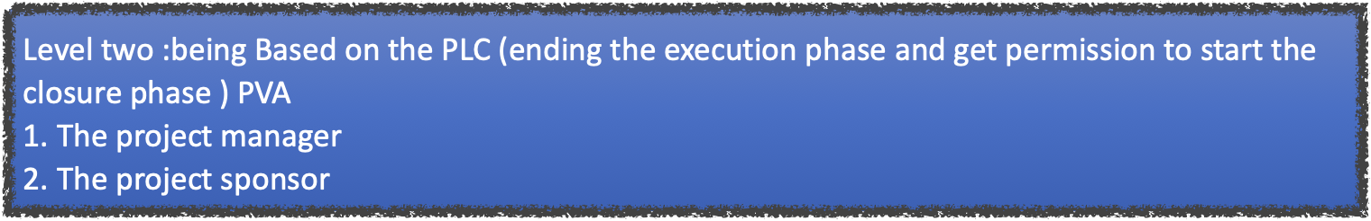
Level one : having the effective project
Based on t he accepted deliverables by the following to start the hand over process and start producing the PFS on the business level :
The project manager
The customer
The HPMQS (having the PVA)
3-closing Acceptance process of the readiness Deliverable levels

Slide 26

.
  Official approved accepted deliverables
with an effective project
Applying on the business level
(post phase )
CustomerLevel
PFS
Signed off
Project level
with PVA
Phase review
Project closure phase
(Ending PLC )
doc.
Designed and developed by DrMahmoud.Ibrahim @2023

Slide 27
1. Complete the Acceptance Form provided by the project manager
2. Review the AF by the customers.
3: Acceptance Form Approved by the Customers
4: Confirming the acceptance test validation by HPMQS
First level: Having the PVA

Slide 28

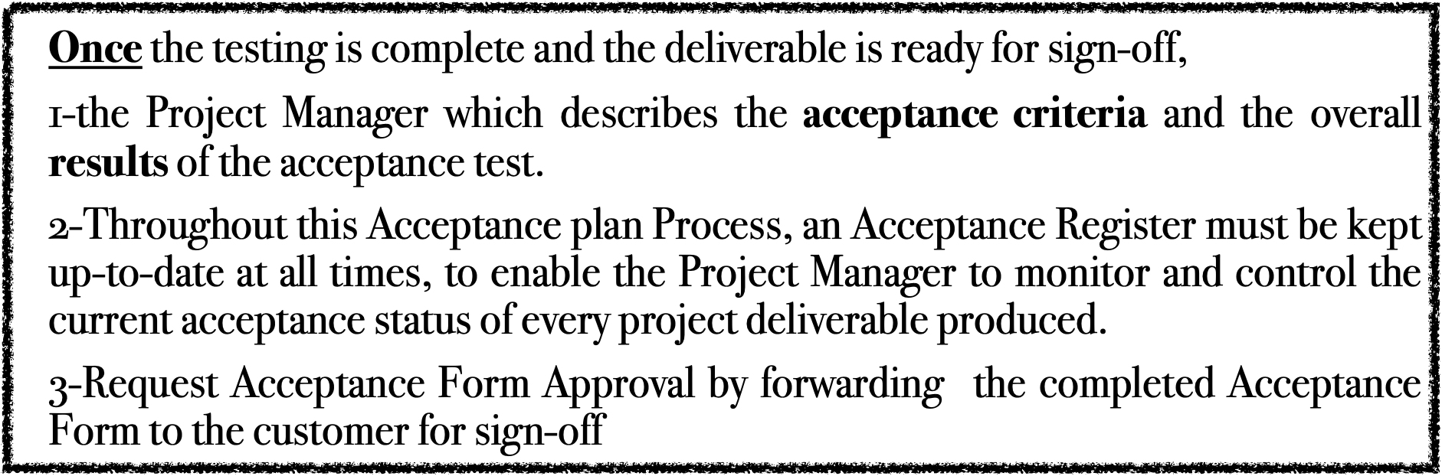

Slide 29
2- Review Acceptance Form by the customer
Upon receipt of the completed Acceptance Form, the customer will undertake their own analysis to decide whether or not to sign off the deliverable as 100% complete. The depth of the analysis will likely depend on whether the customer:
Has full confidence in the Project Manager's ability to produce deliverables that meet their requirements
Has taken part in the Acceptance Testing process and viewed each deliverable personally
Has received a documented set of Acceptance Test results proving that the deliverable is complete and meets their requirements as stated in the Acceptance Plan

Slide 30


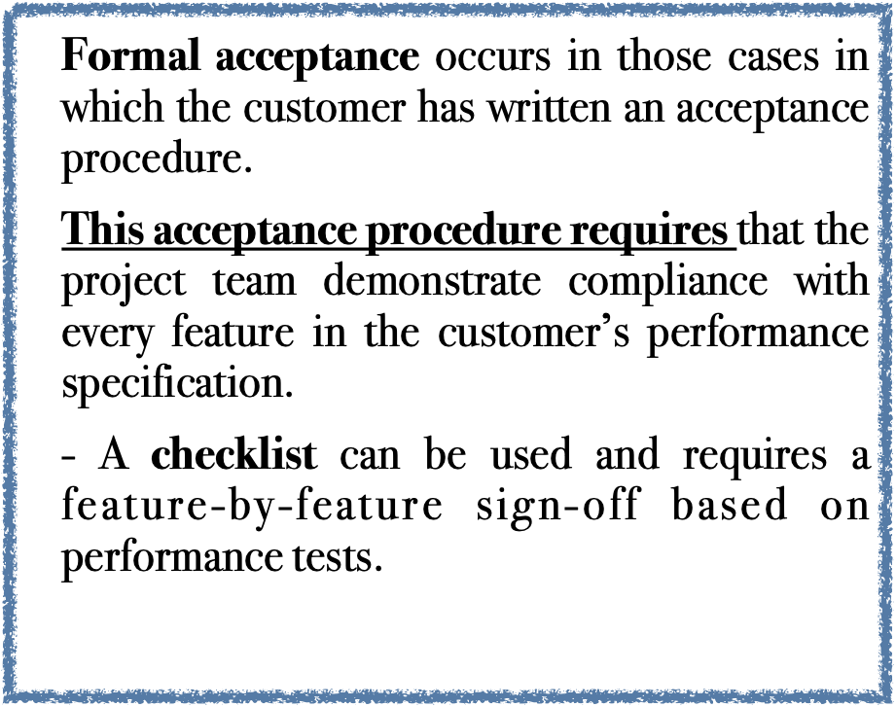
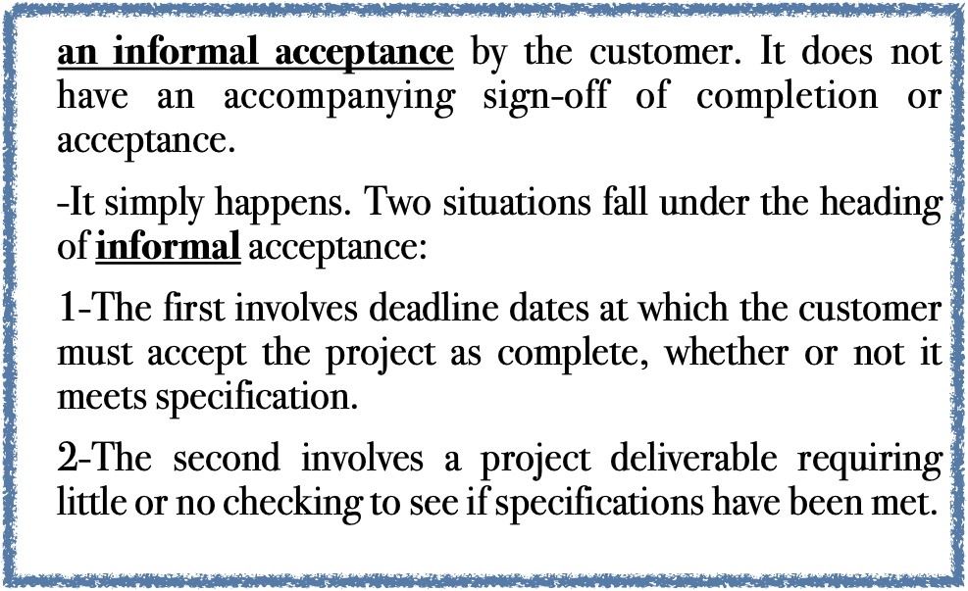
3- Acceptance Form Approved :
With all your deliverables signed off on by the customer, you are almost ready to close the project.

Slide 31
4: The validation of the acceptance test of the HPMQS to have the PVA
Confirm the Completion Acceptance Test
Confirming that the criteria and resources outlined in the acceptance plan are still relevant and appropriate for the review.
Confirming the Scheduling the review with the customer.
Undertaking the review with the customer.
Confirm the Documentation of the results to present to the customer.

Slide 32
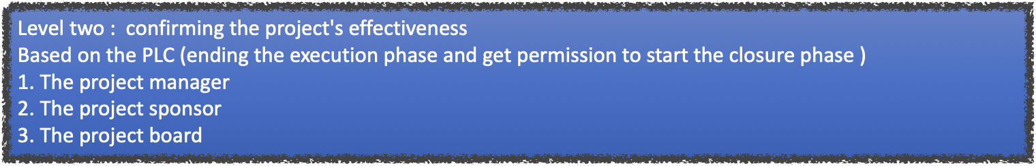
The PVA
means that it has received official approval from the project board to proceed to the closure phase with full customer acceptance and satisfaction.
Second level: confirming the PVA

Slide 33

the deliverables being marked as complete in the Project Plan,phase review should be conducted

Slide 34
1-Conducting Perform Phase Review.
1. With all your deliverables signed off on by the customer, you are almost ready to close the project.
-But first, a phase review is undertaken to ensure that all of the required activities in the execution phase have been completed and the project is ready to proceed to the closure phase.
2. The project manager leads the completion of the phase review to ensure that the assessment is completed fairly and the result is accurately documented.

Slide 35
2-Complete Phase Review Form
1-The results of the Phase review are collated by the Project Administrator and bound into a single documentation set.
2-The Project Manager will then summarize the results of the review, by completing a Phase Review Form.
3-Once completed, this form should be forwarded to the Project Sponsor for consideration by the Project Board.

Slide 36
3—Seek Approval to Proceed
1-The Project Manager will present the Phase Review Form at a board meeting held specifically to discuss the current status of the project and decide if it is ready to close.
2-At this meeting, the Project Manager will present:
The original project vision, objectives, scope and deliverables
The deliverables completed by the project to date
The accomplished quality criteria and the actual results
Any remaining issues or carryover work required
The acceptance test results and the customers feed back

Slide 37
4-The Project Board will assess this information
The Project Board will assess this information and reach one of the following conclusions:
Approve the project to proceed to the next phase of the project: Project Closure
Request that additional activities are taken within the existing project phase
Delay, transfer or close the project

Slide 38
5: The acceptance deliverables are officially handed over
To ensure the PVA's success, the project manager preferred to begin handing over the officially accepted deliverables at the end of the execution phase or at the beginning of the closure phase after receiving official approval based on the results of the phase reviewed.

Slide 39
Output
Having the PFS plus PVA as follows :
1- the official accepted deliverable from the customers
2- official 100%completed deliverable from the project decision makers and full marked at the Project plan
3- official validated accepted deliverables from the HPMQS .

Slide 40


