Slide 1


Slide 2


Slide 3
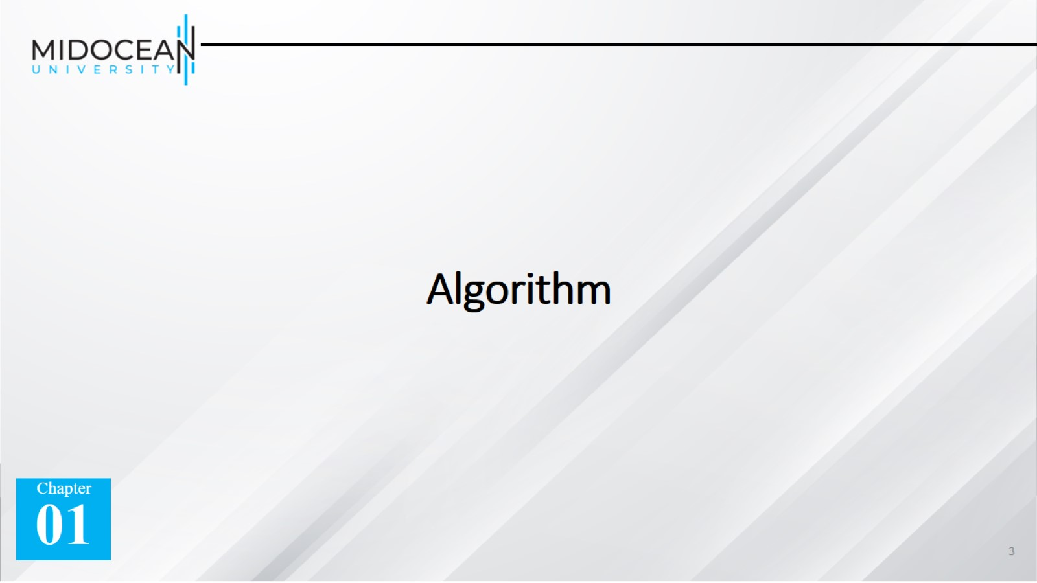
Algorithm

Slide 4


Slide 5
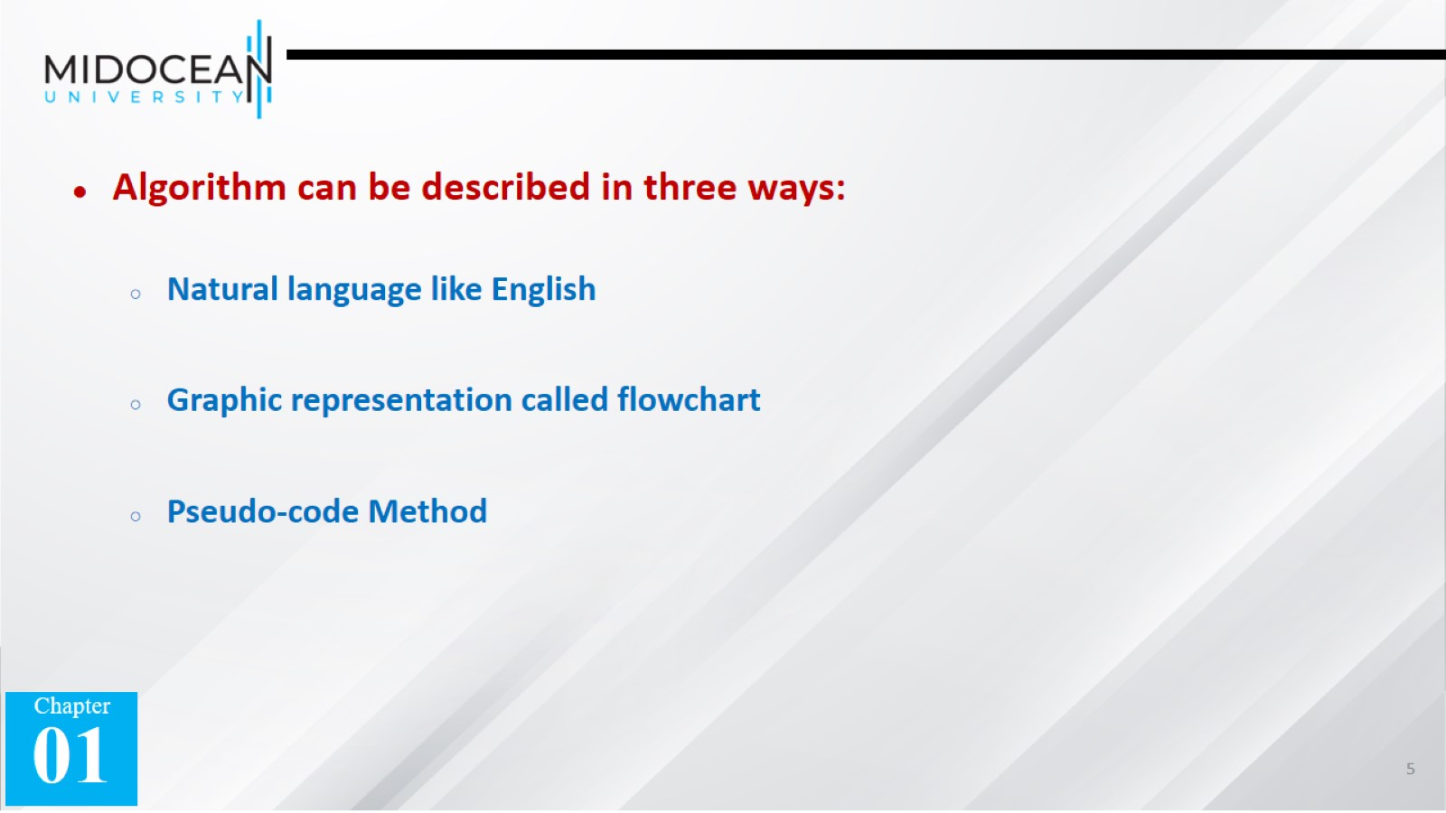

Slide 6
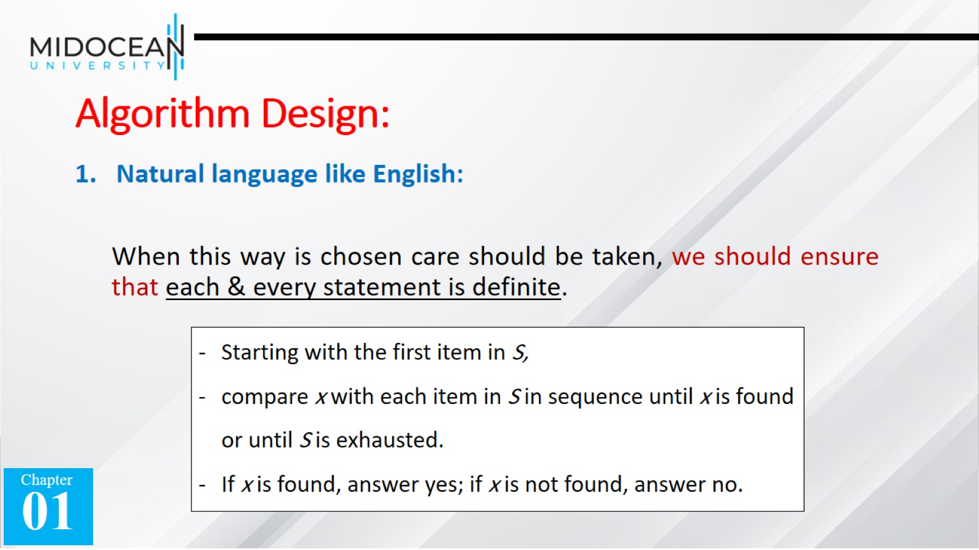
Algorithm Design:

Slide 7
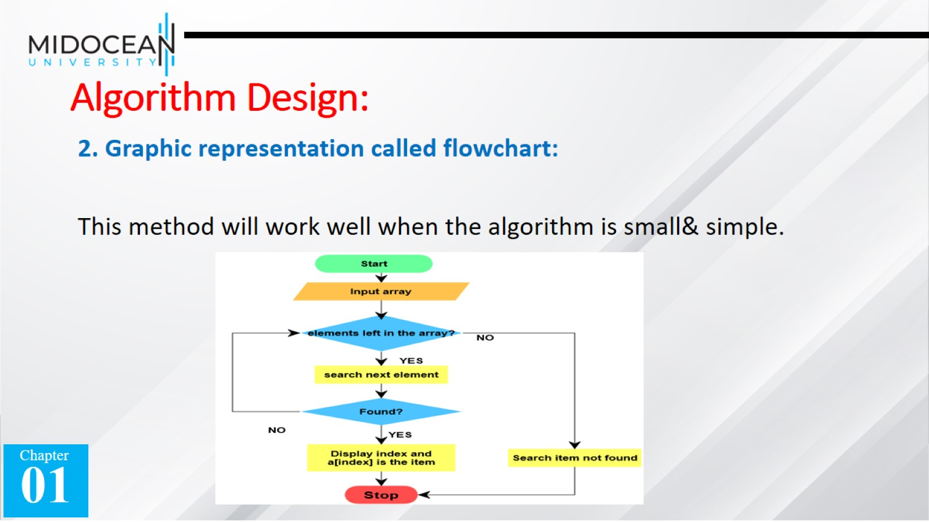
Algorithm Design:

Slide 8
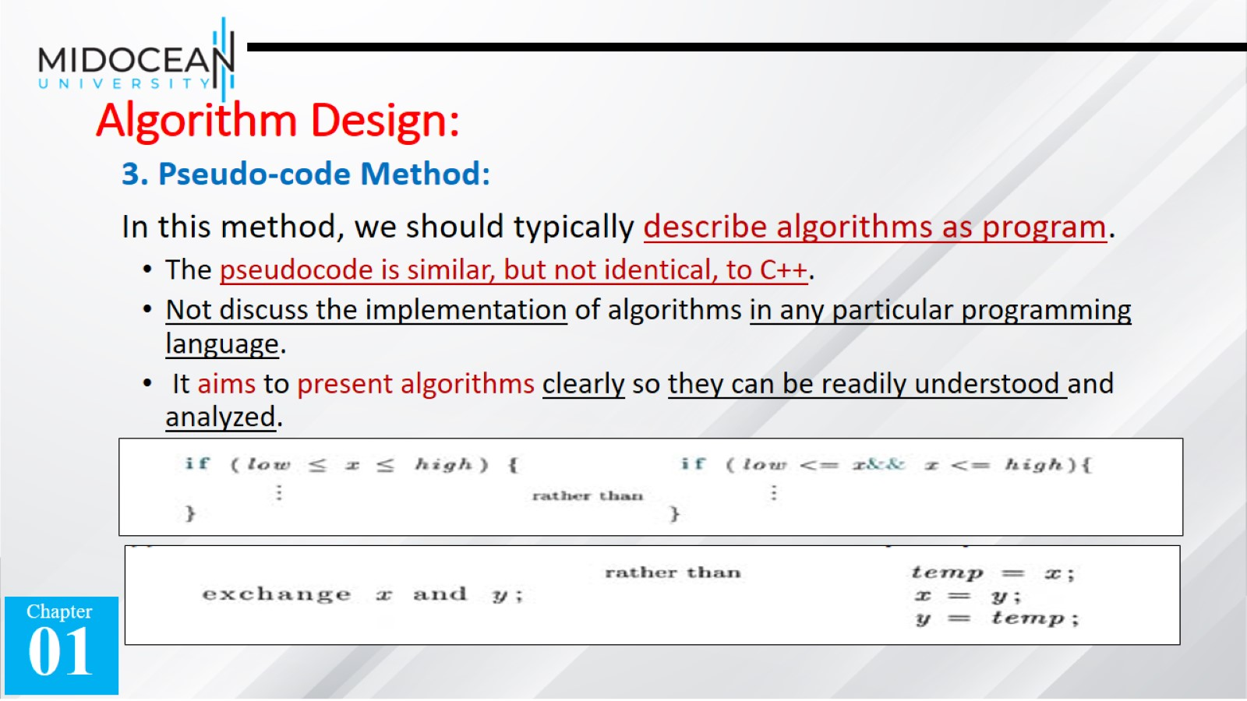
Algorithm Design:

Slide 9
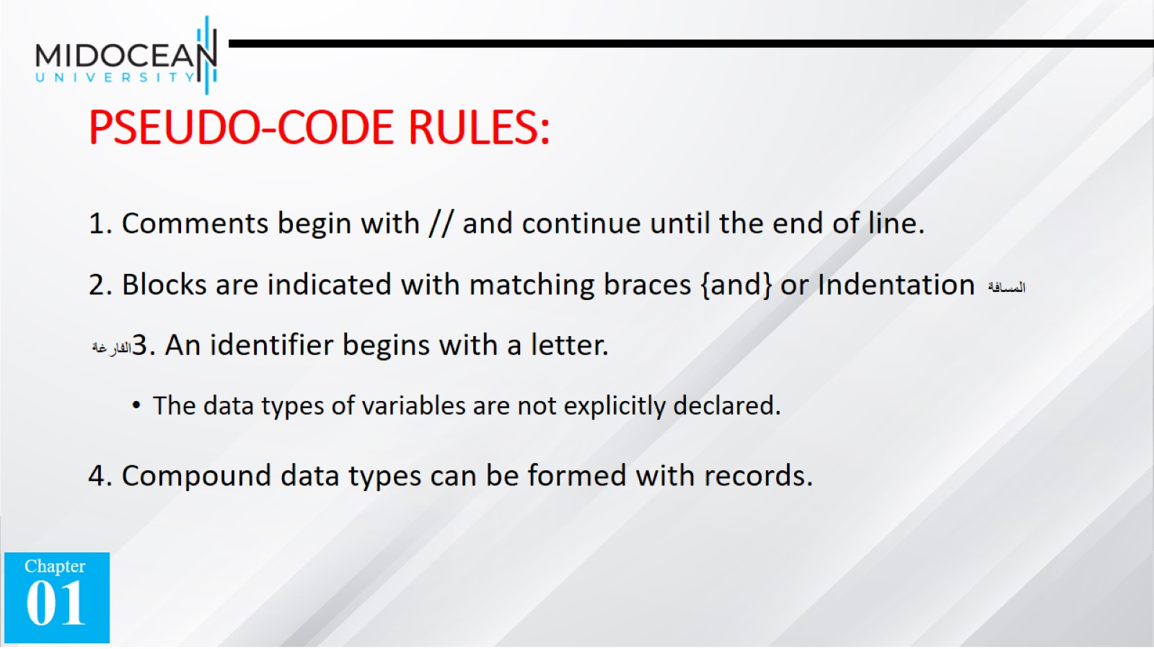
PSEUDO-CODE RULES:

Slide 10
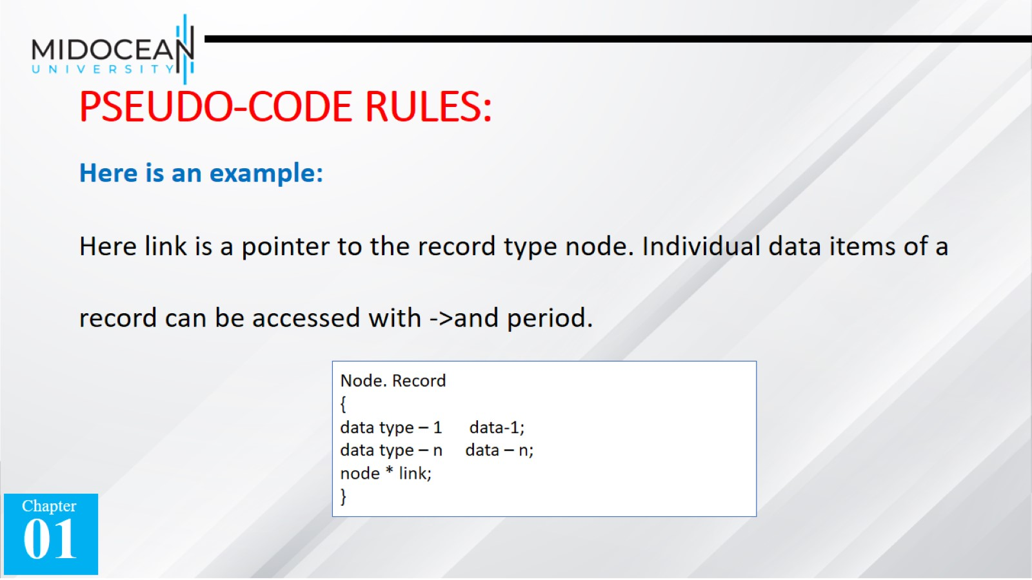
PSEUDO-CODE RULES:

Slide 11
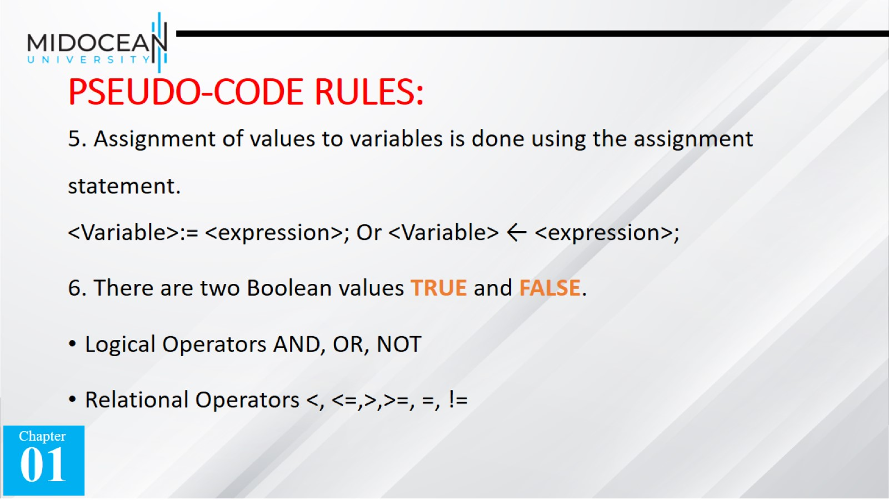
PSEUDO-CODE RULES:

Slide 12
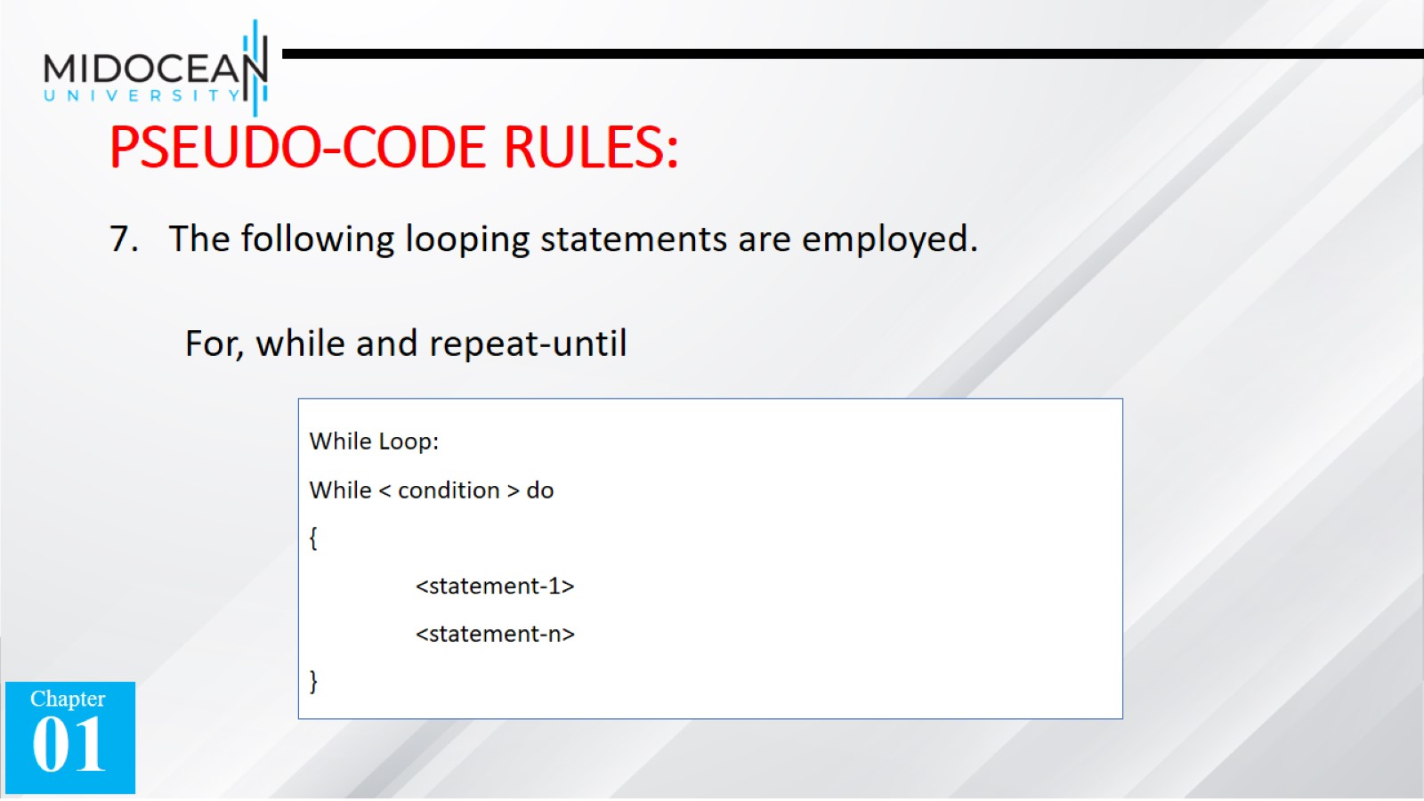
PSEUDO-CODE RULES:

Slide 13
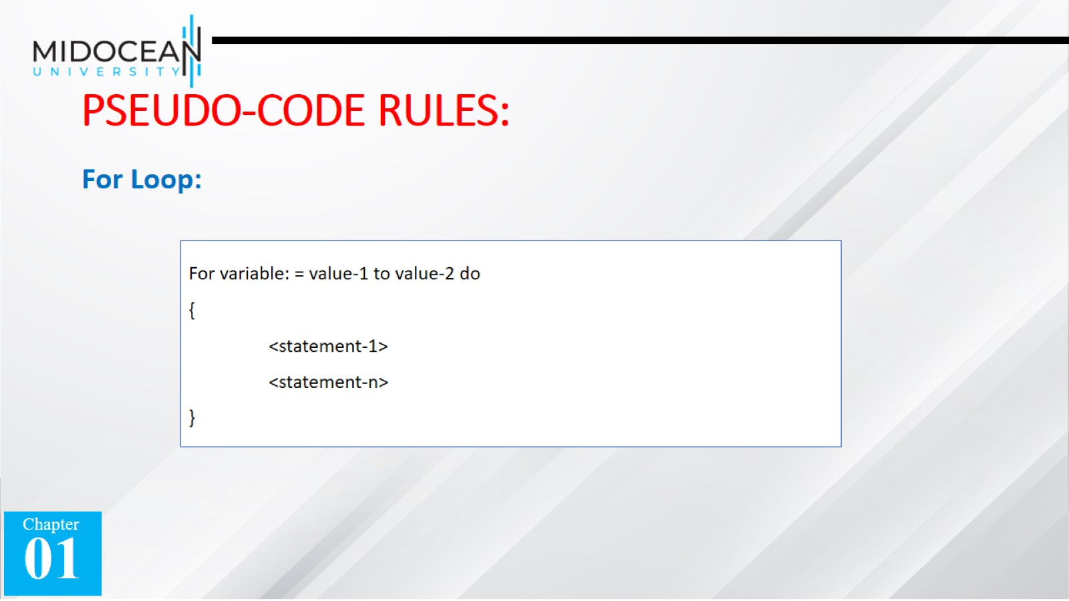
PSEUDO-CODE RULES:

Slide 14
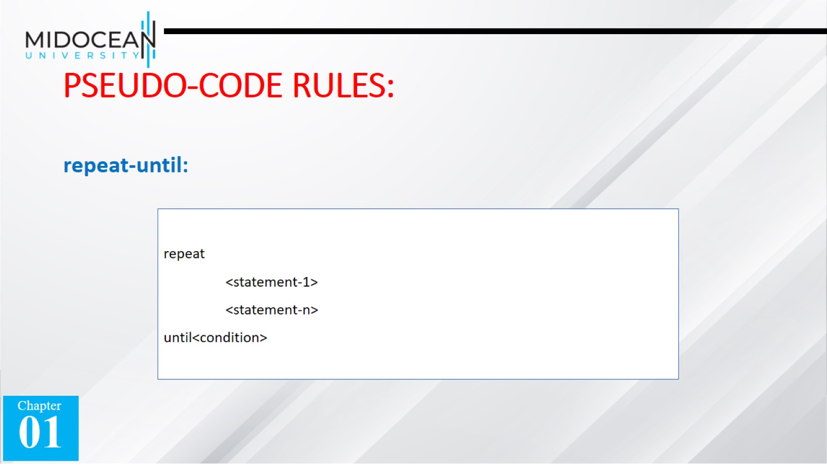
PSEUDO-CODE RULES:

Slide 15
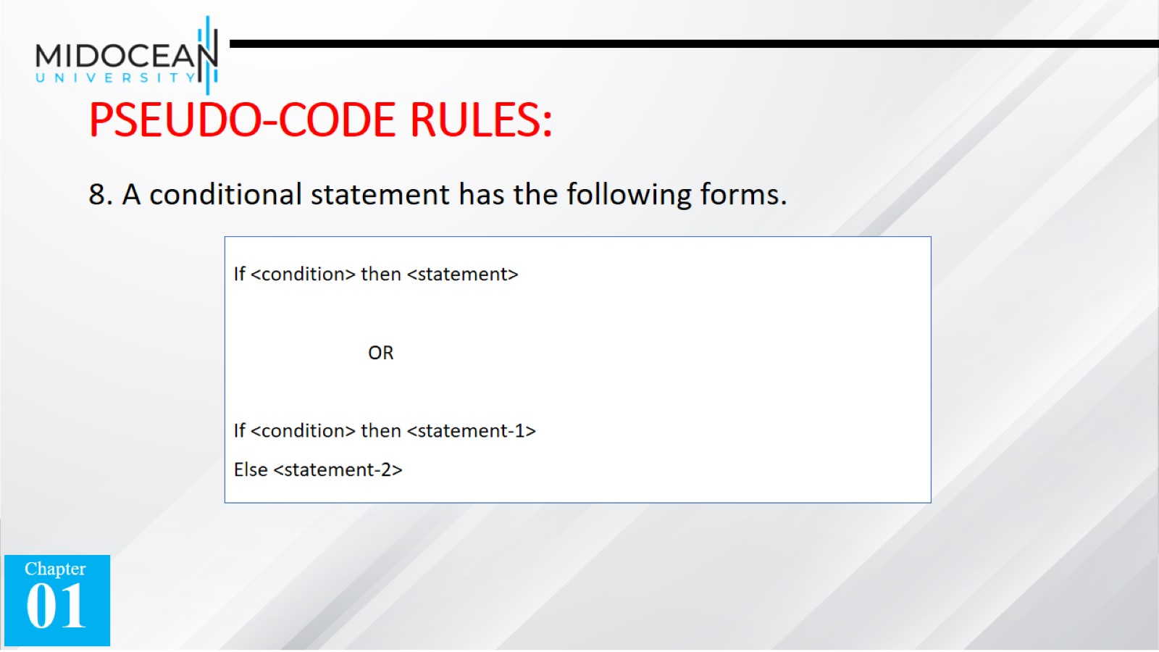
PSEUDO-CODE RULES:

Slide 16
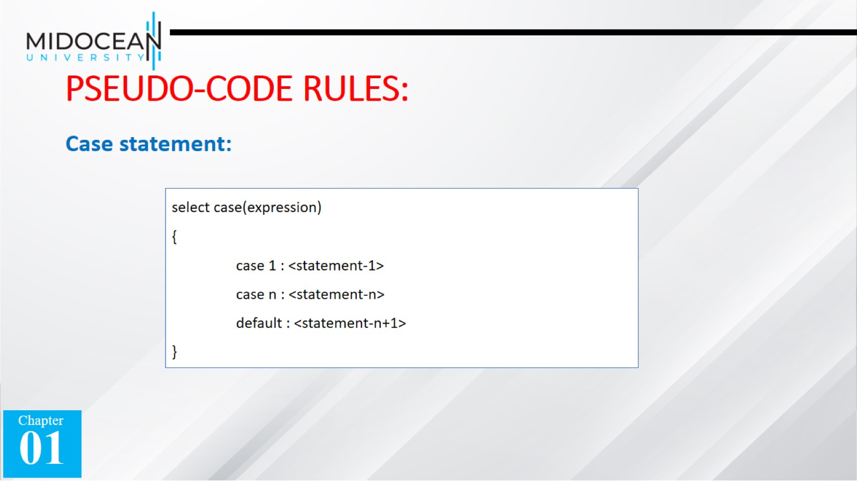
PSEUDO-CODE RULES:

Slide 17
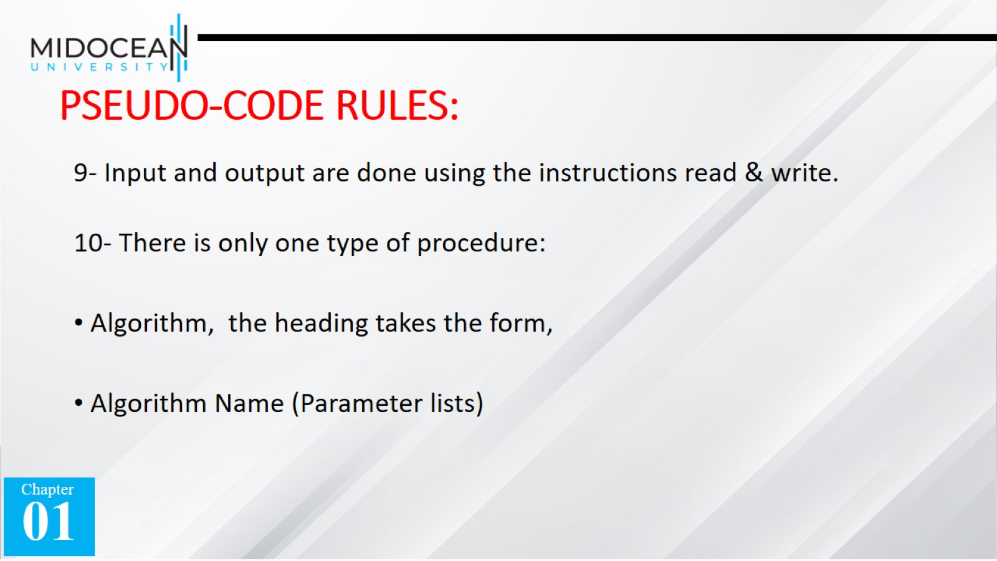
PSEUDO-CODE RULES:

Slide 18
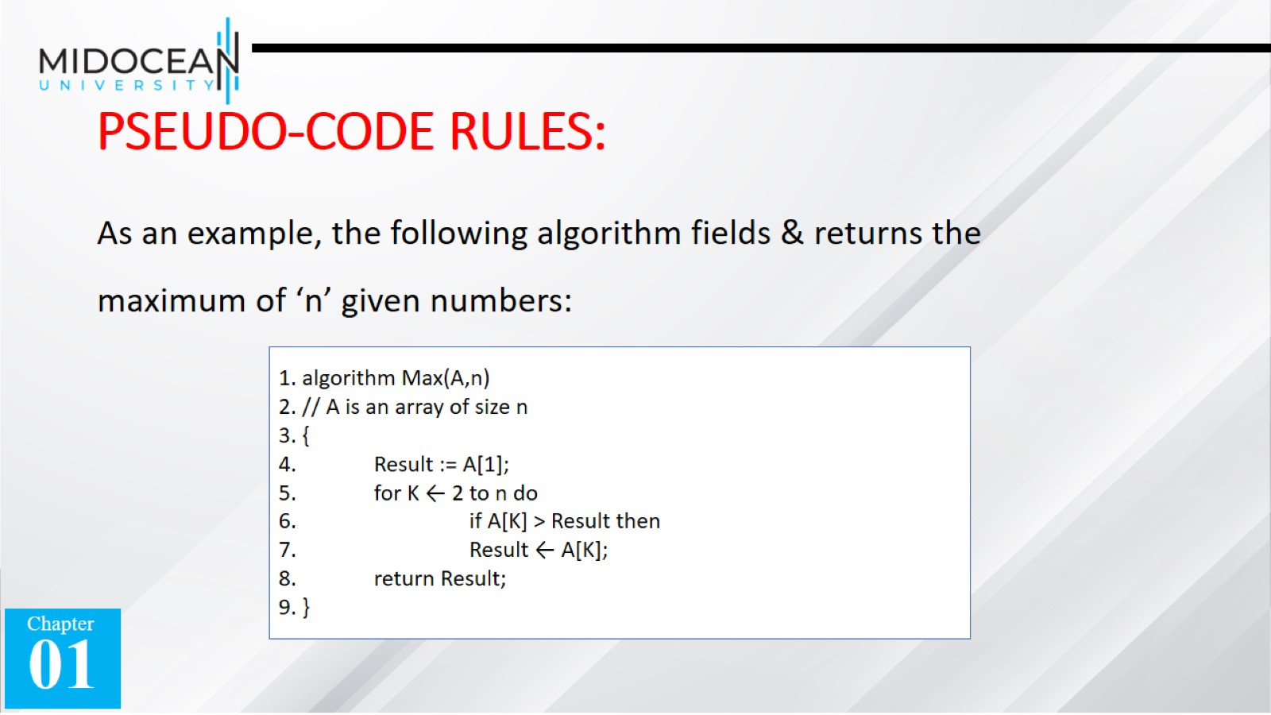
PSEUDO-CODE RULES:

Slide 19


Slide 20
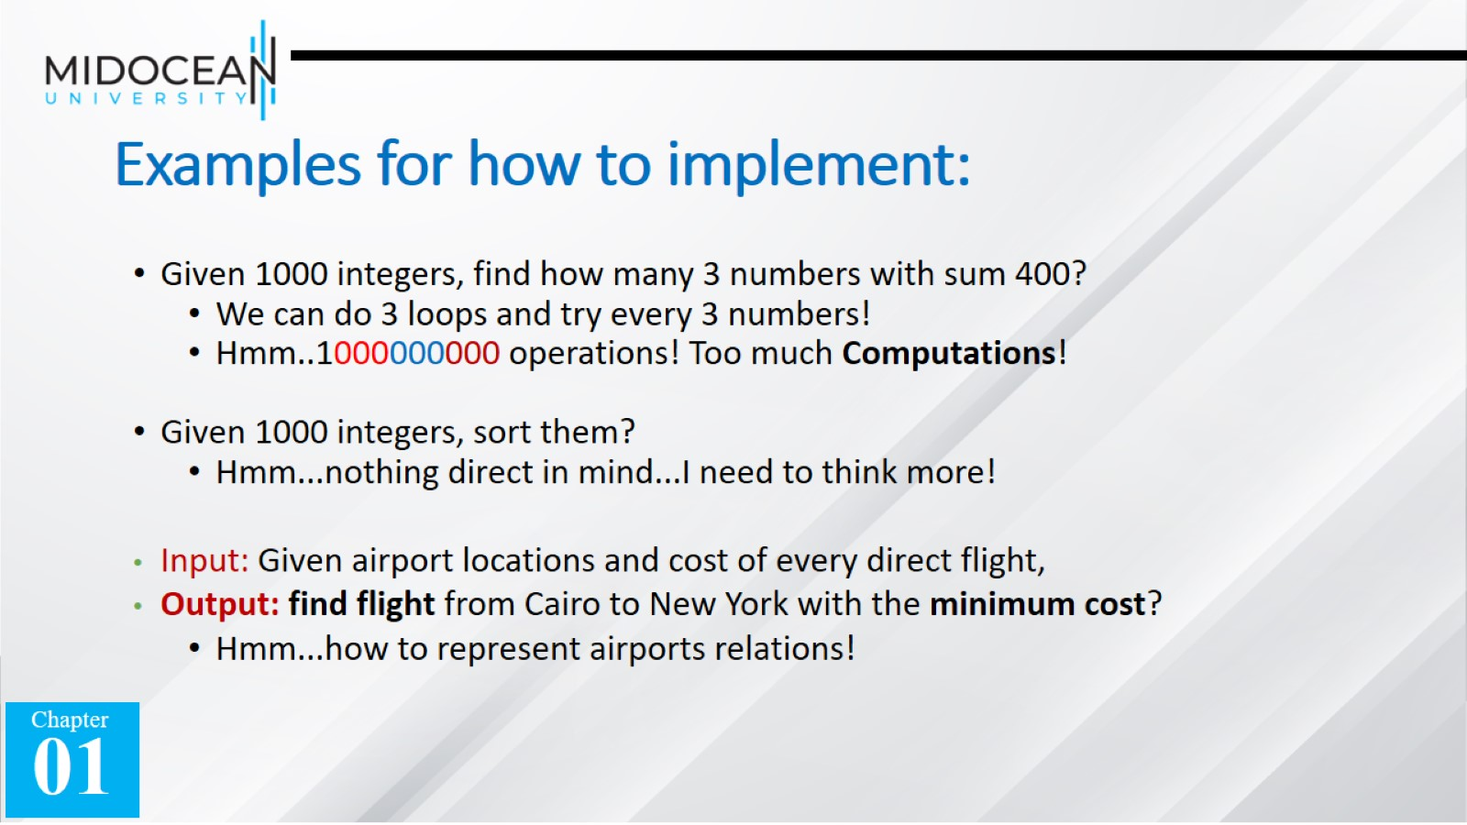
Examples for how to implement:

Slide 21
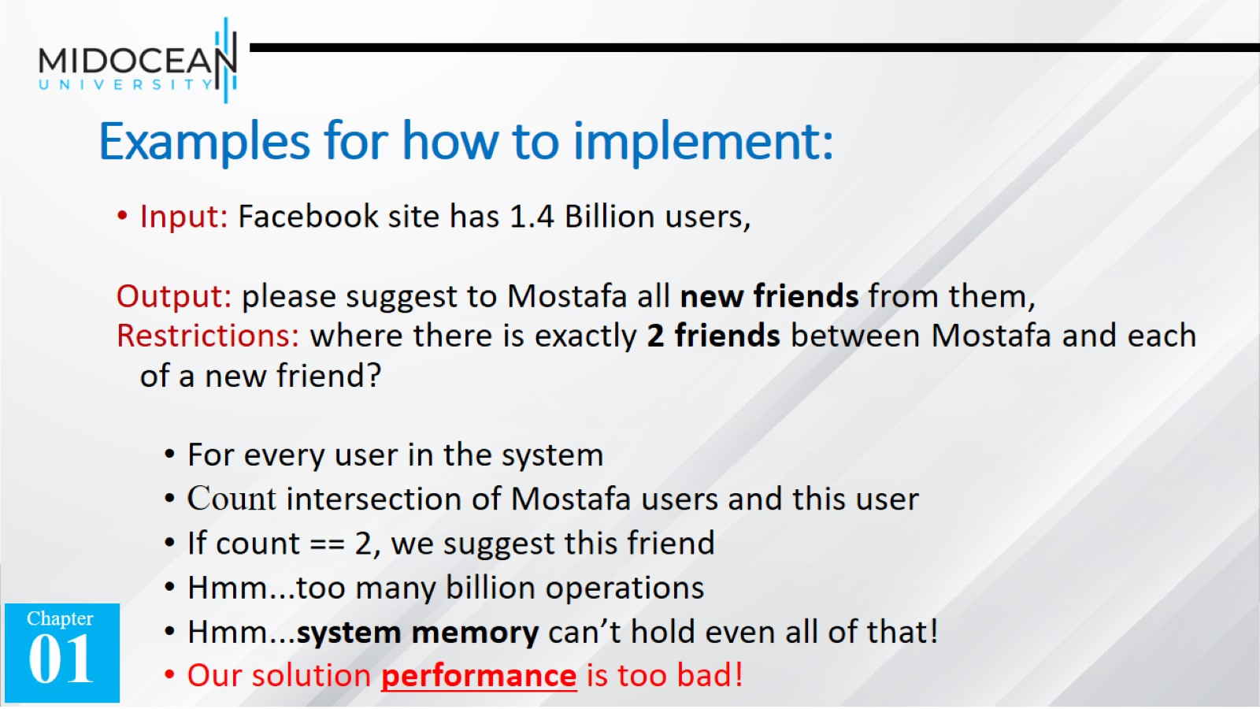
Examples for how to implement:

Slide 22
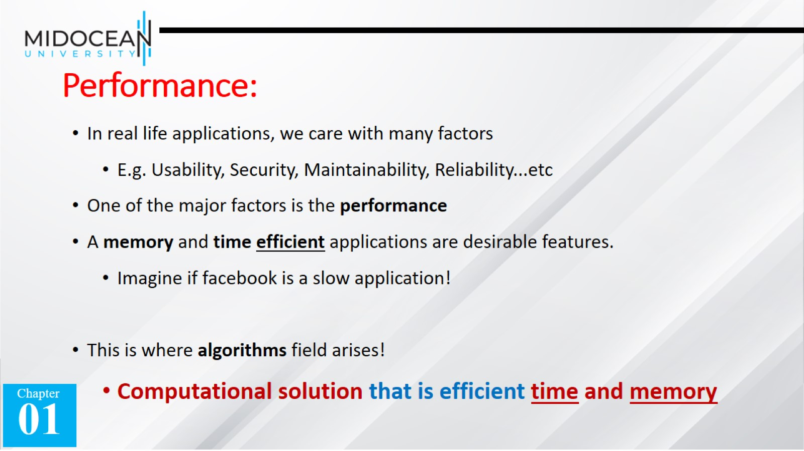
Performance:

Slide 23
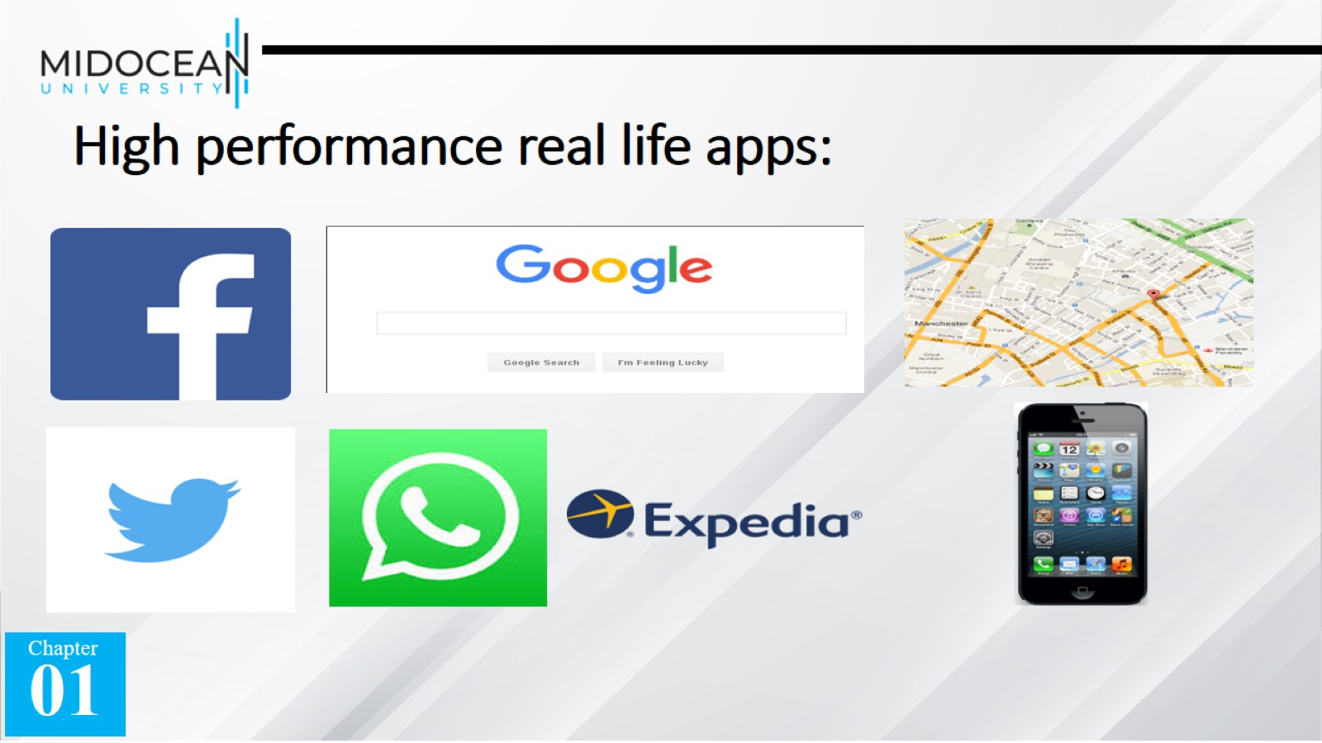
High performance real life apps:

Slide 24
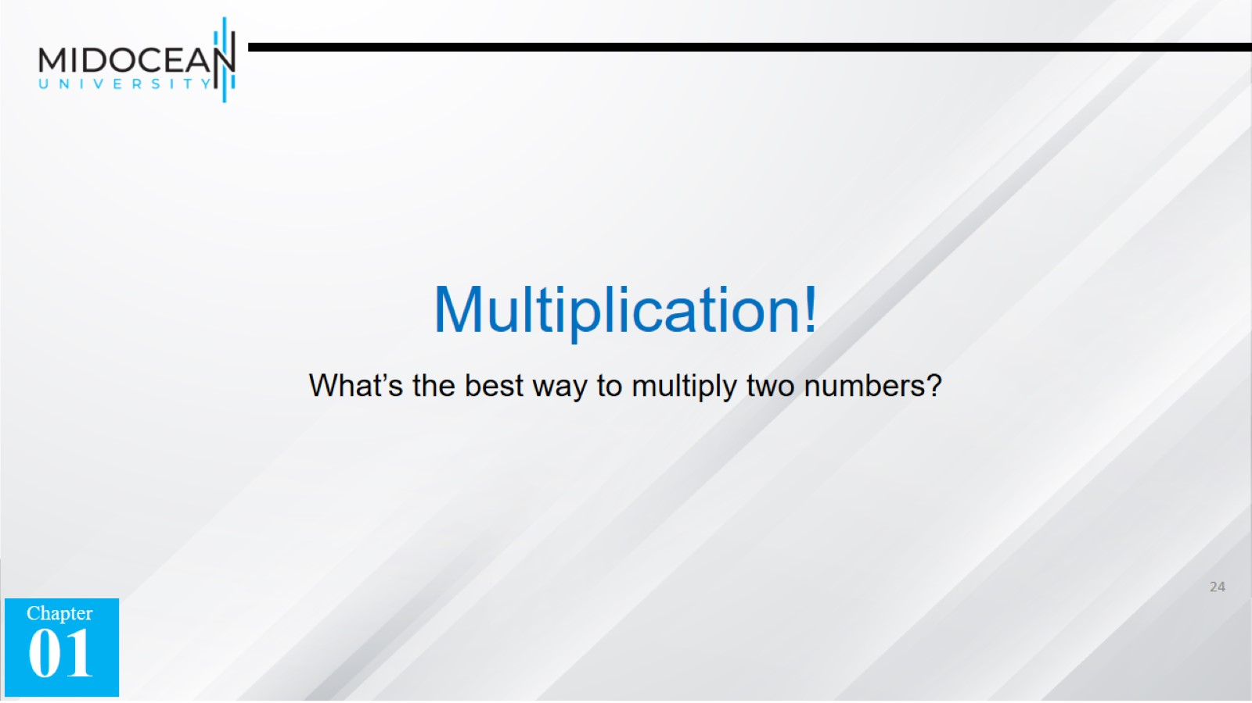
Multiplication!

Slide 25
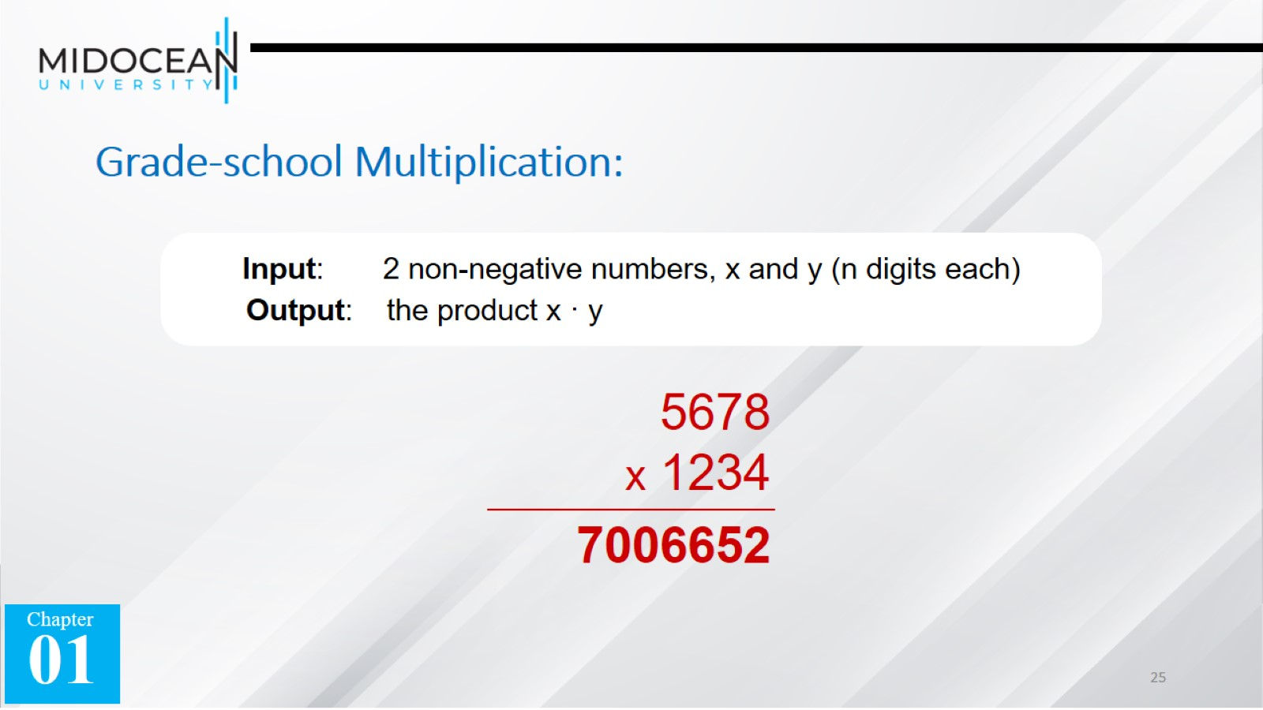
Grade-school Multiplication:

Slide 26
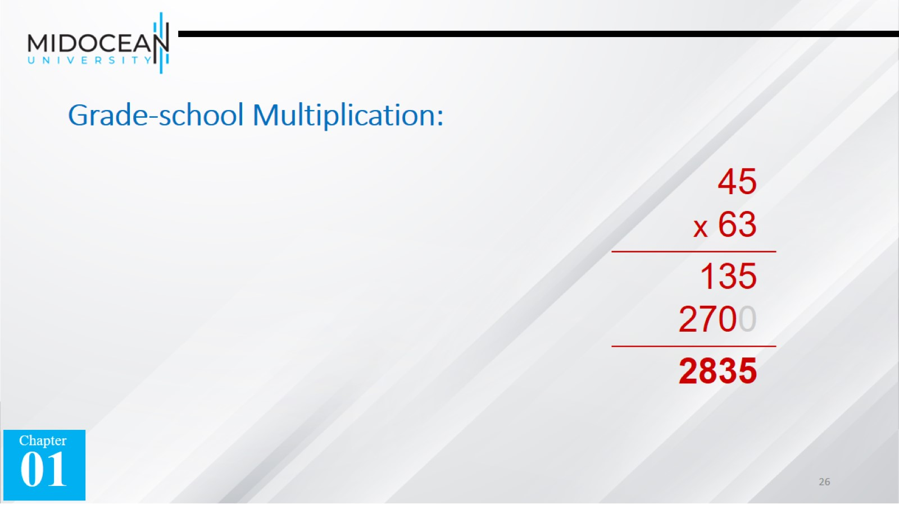
Grade-school Multiplication:

Slide 27
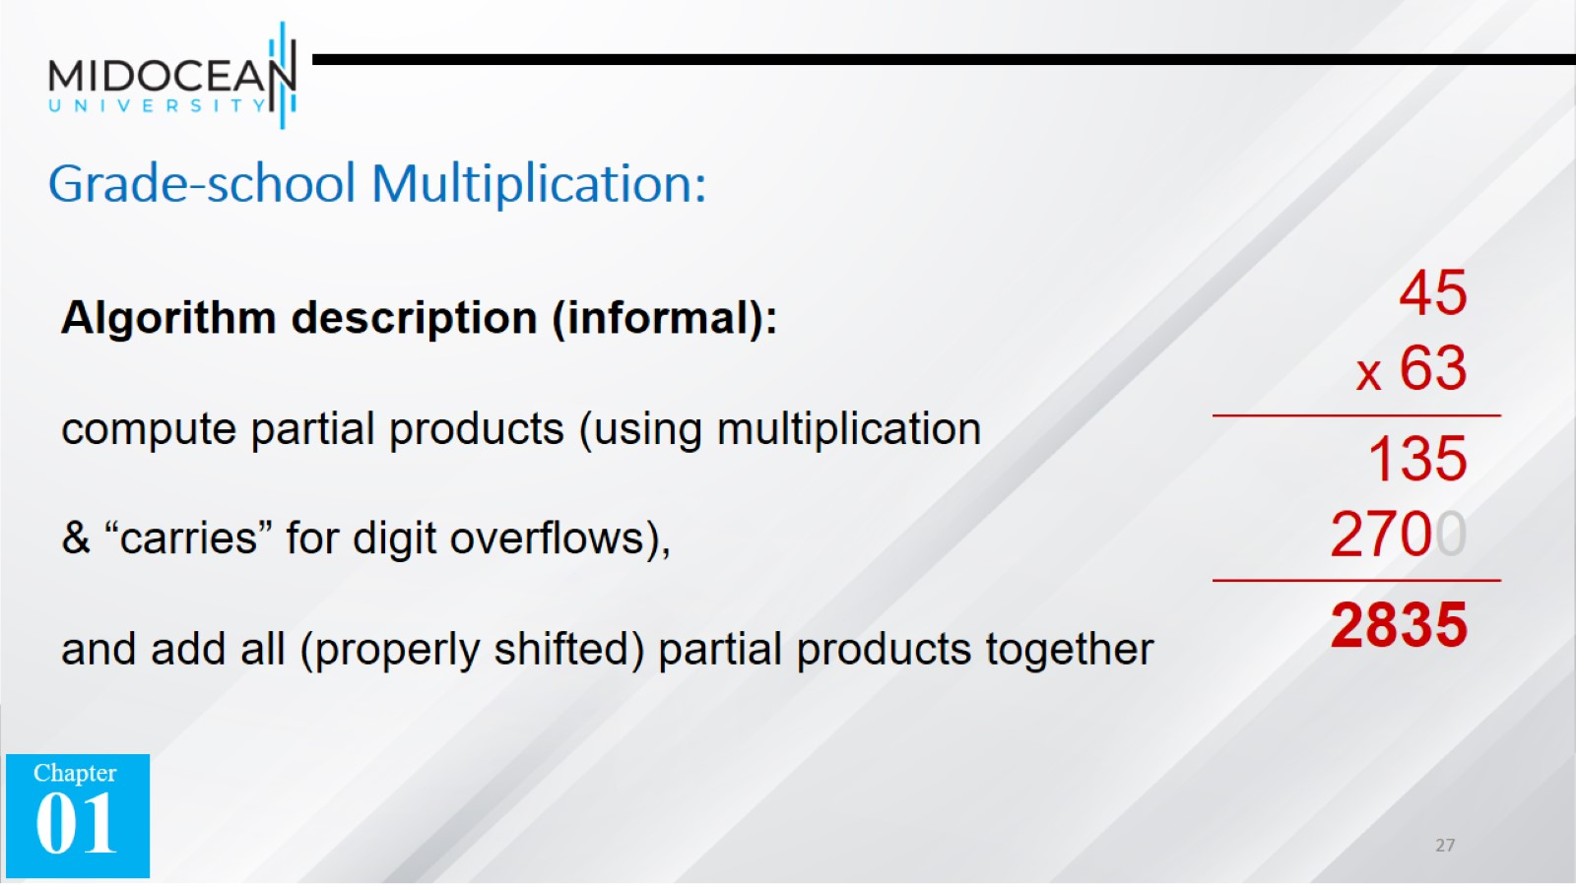
Grade-school Multiplication:

Slide 28
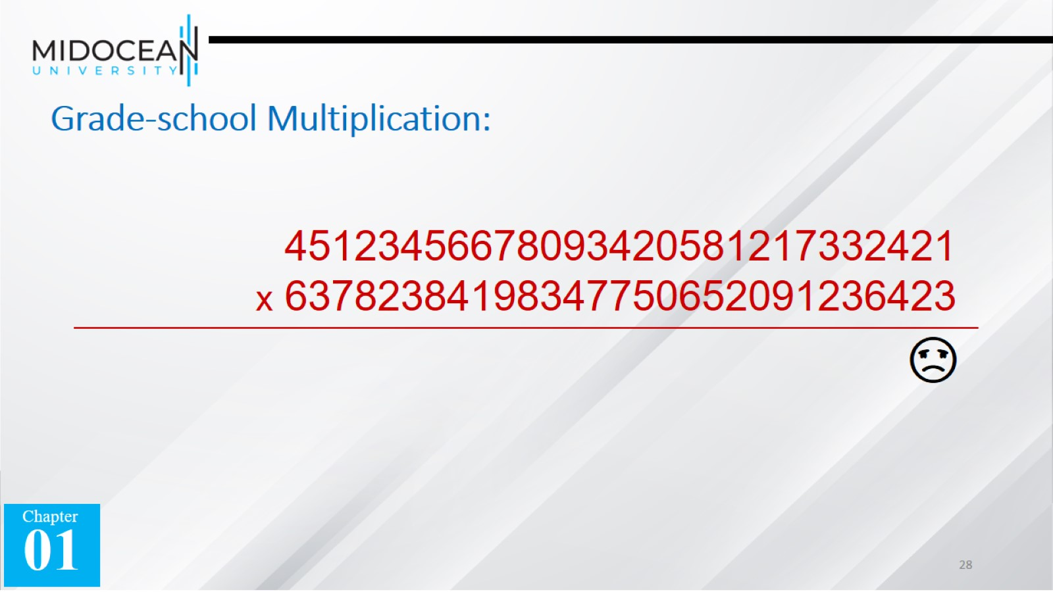
Grade-school Multiplication:

Slide 29
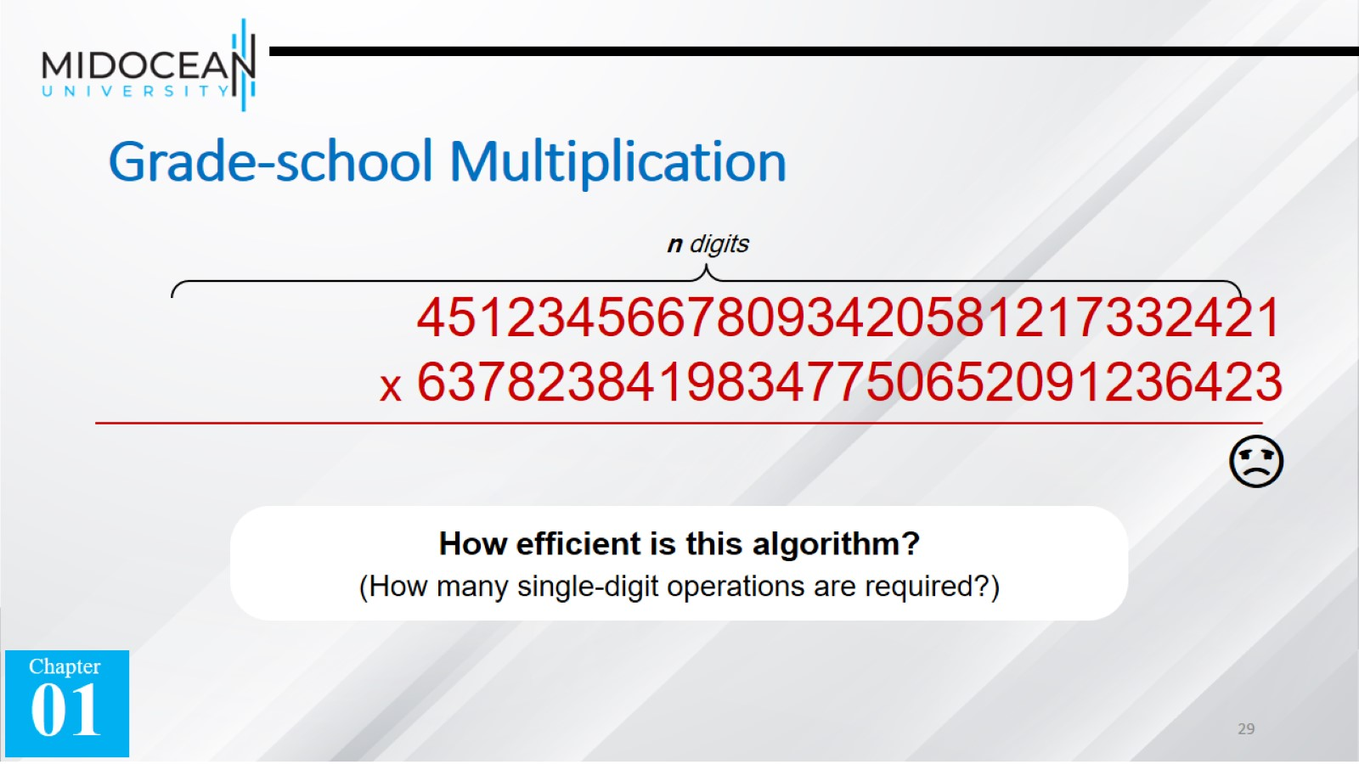
Grade-school Multiplication

Slide 30
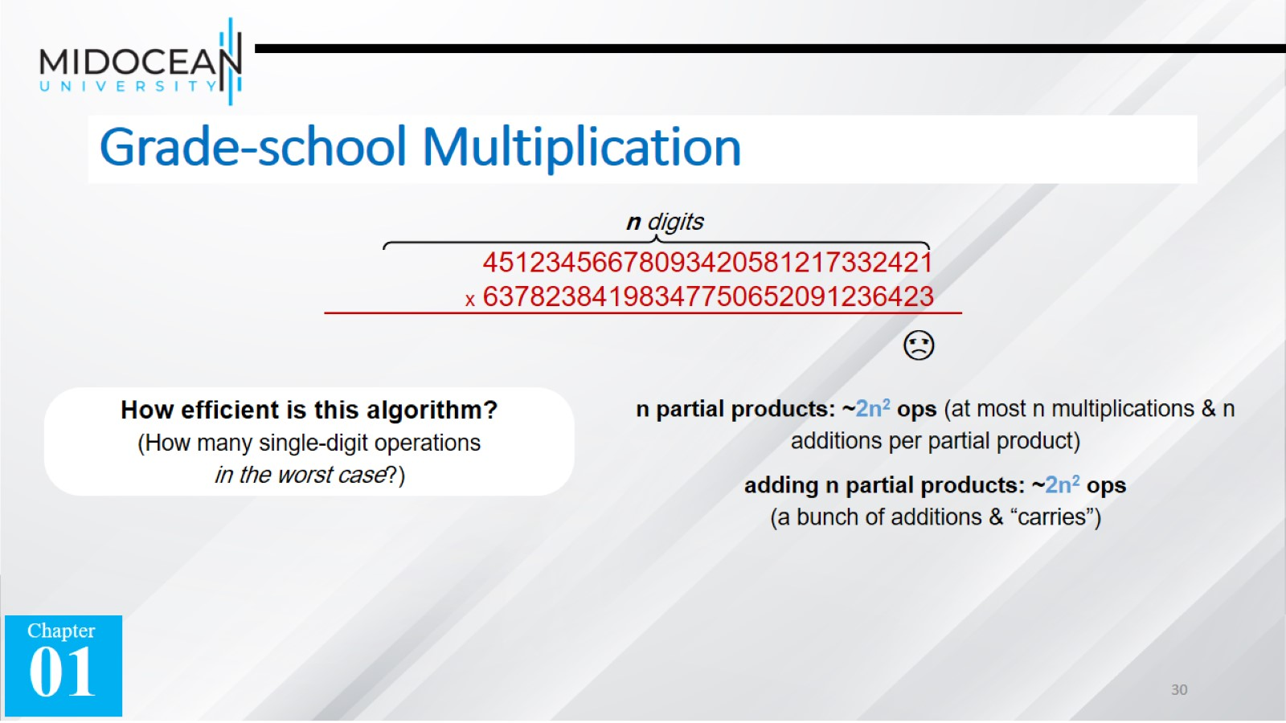
Grade-school Multiplication

Slide 31
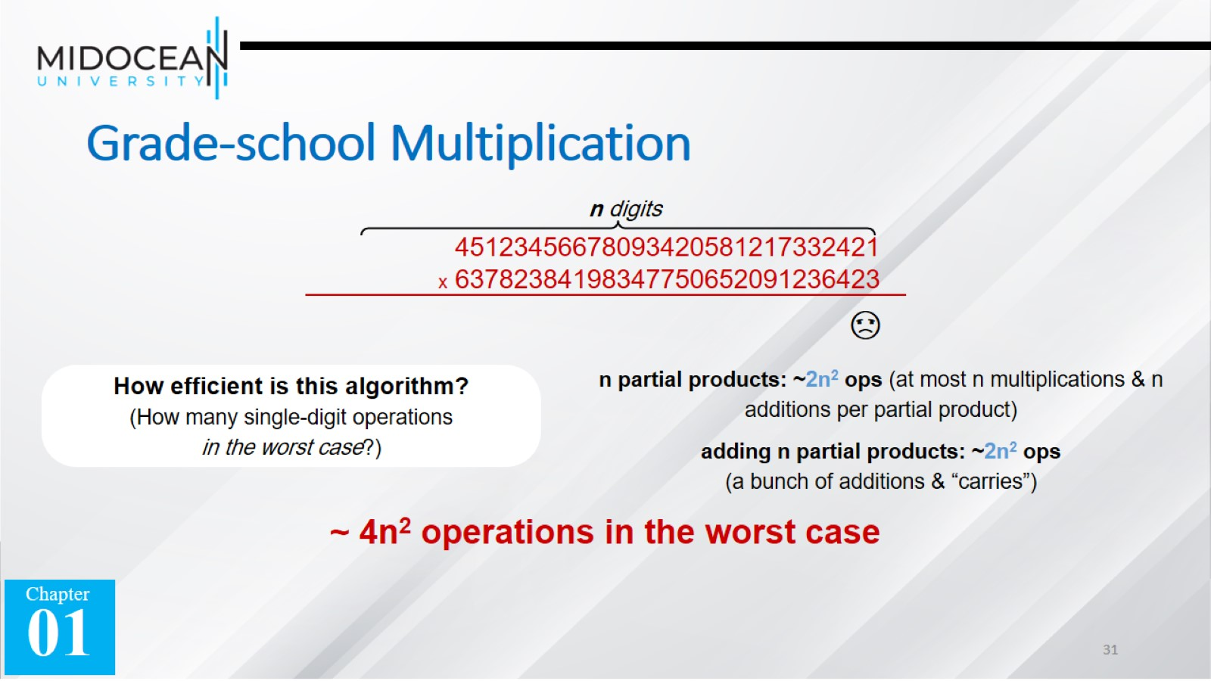
Grade-school Multiplication

Slide 32
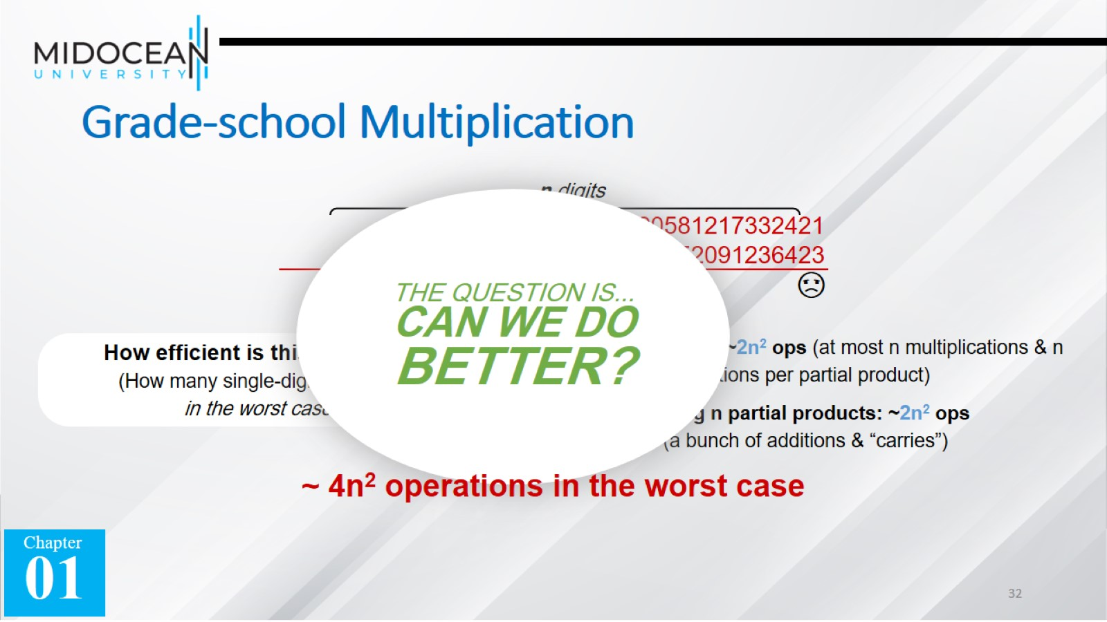
Grade-school Multiplication

Slide 33


Slide 34
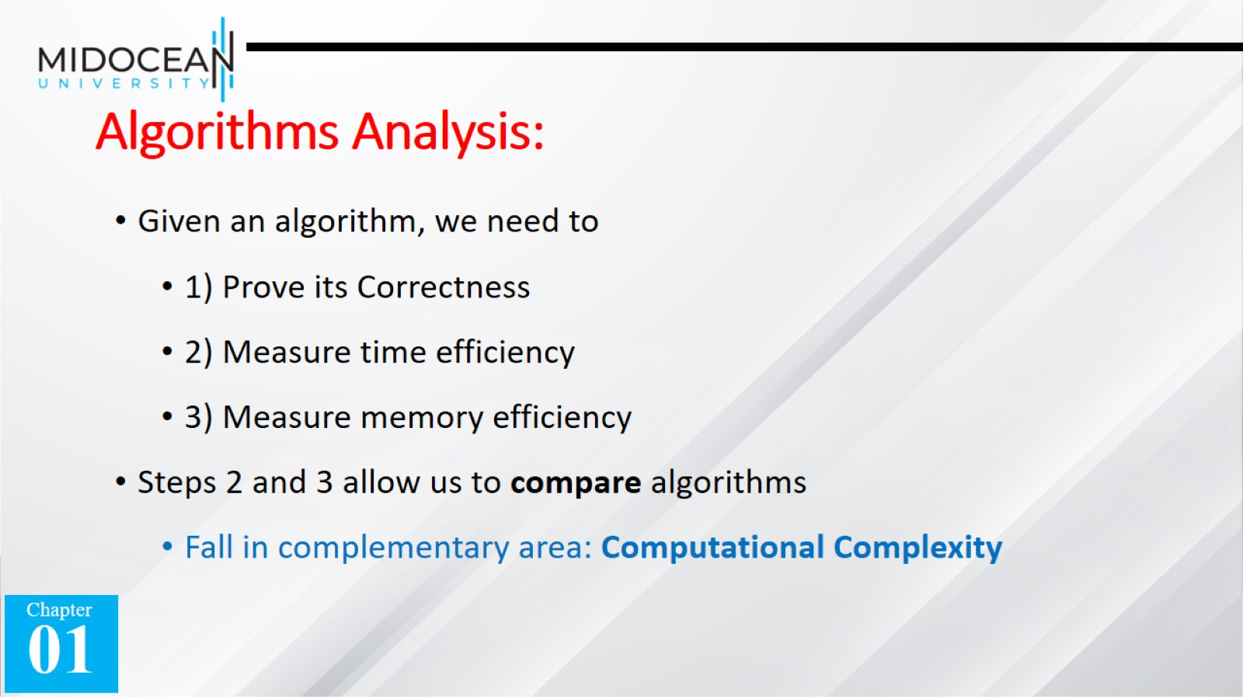
Algorithms Analysis:

Slide 35
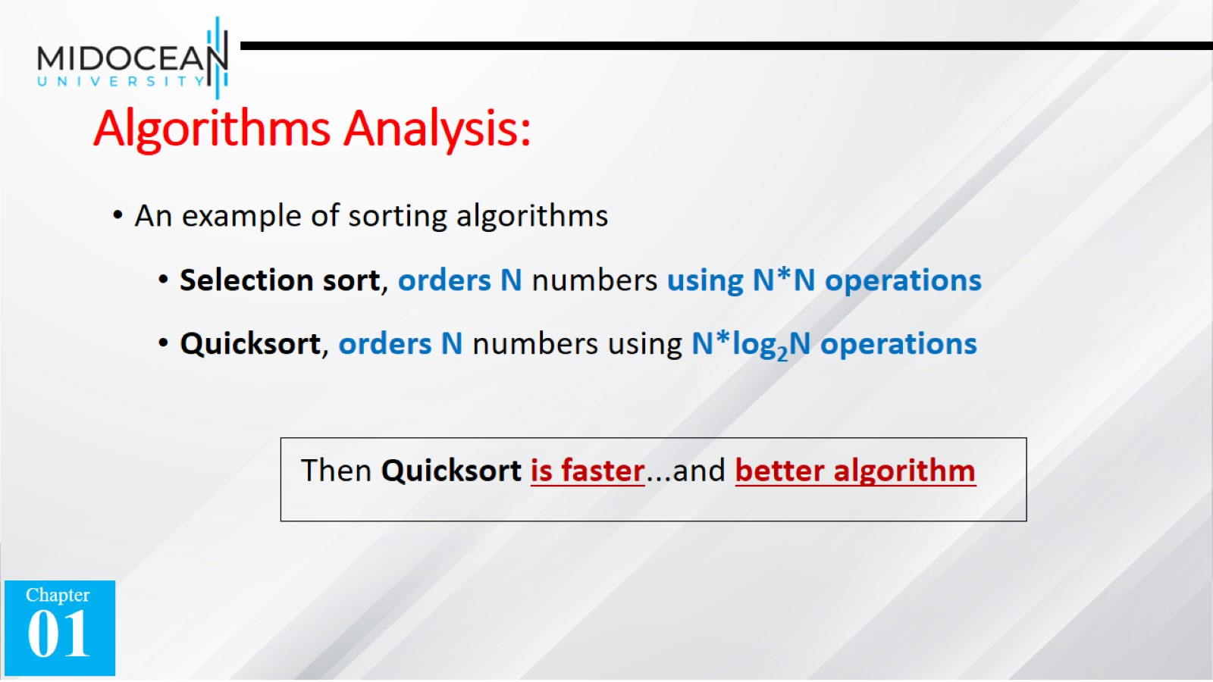
Algorithms Analysis:

Slide 36
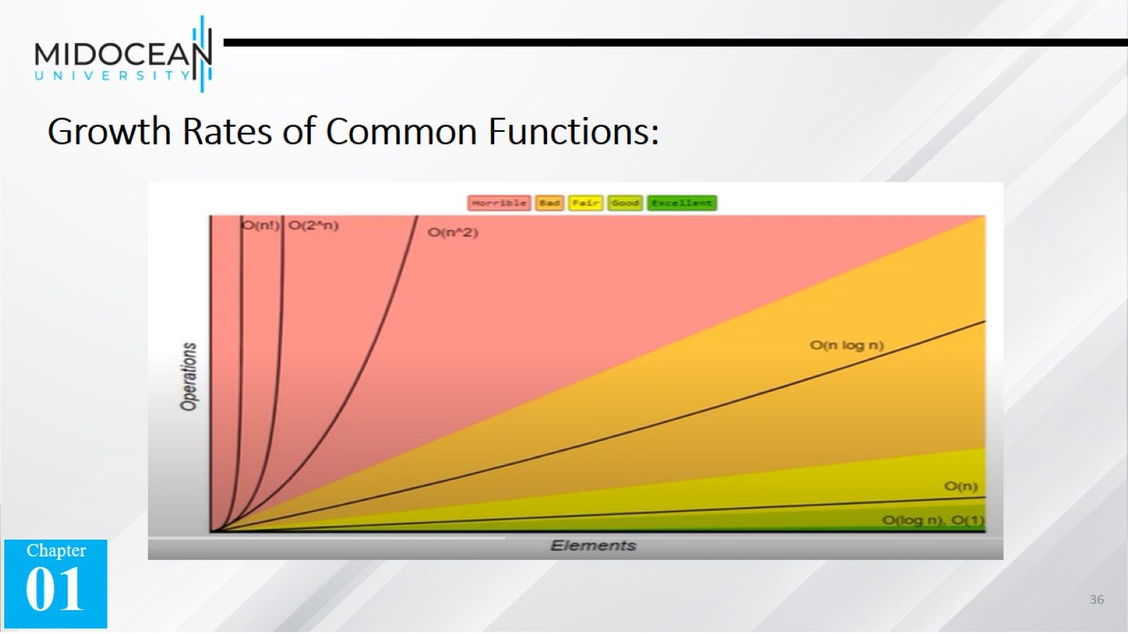
Growth Rates of Common Functions:

Slide 37
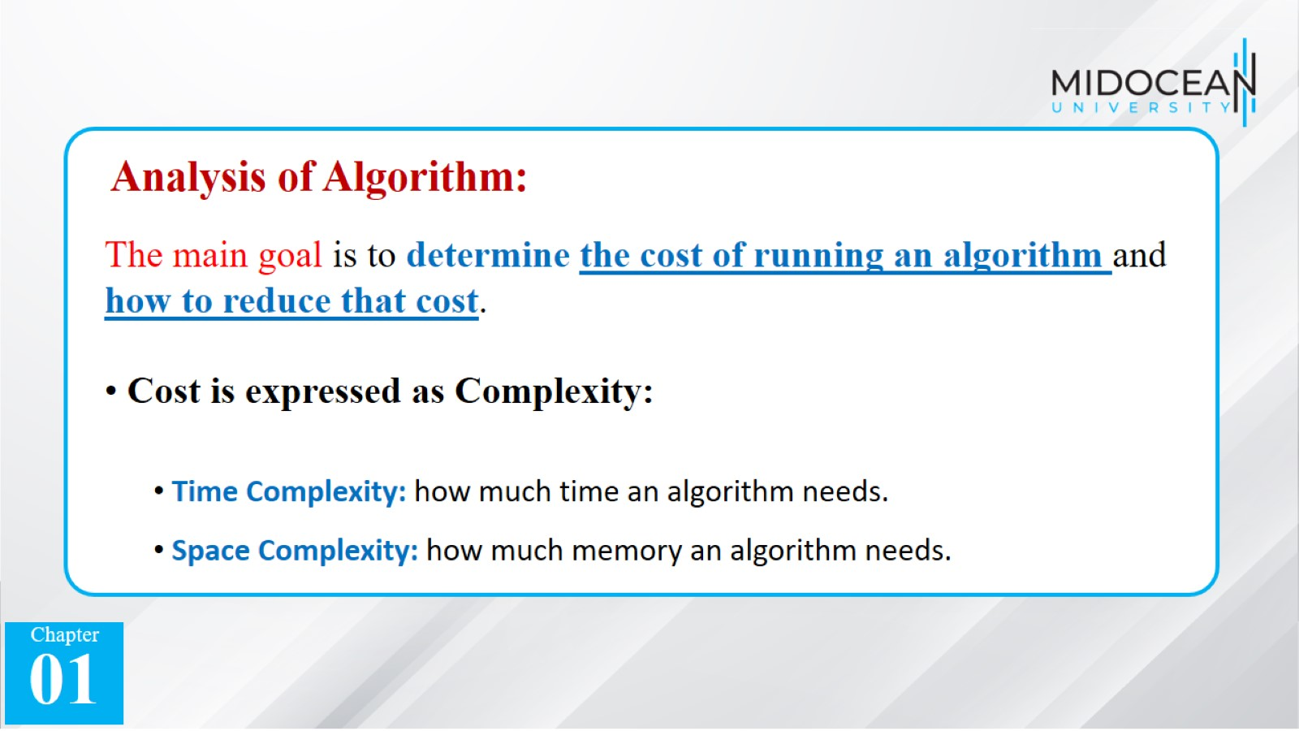

Slide 38
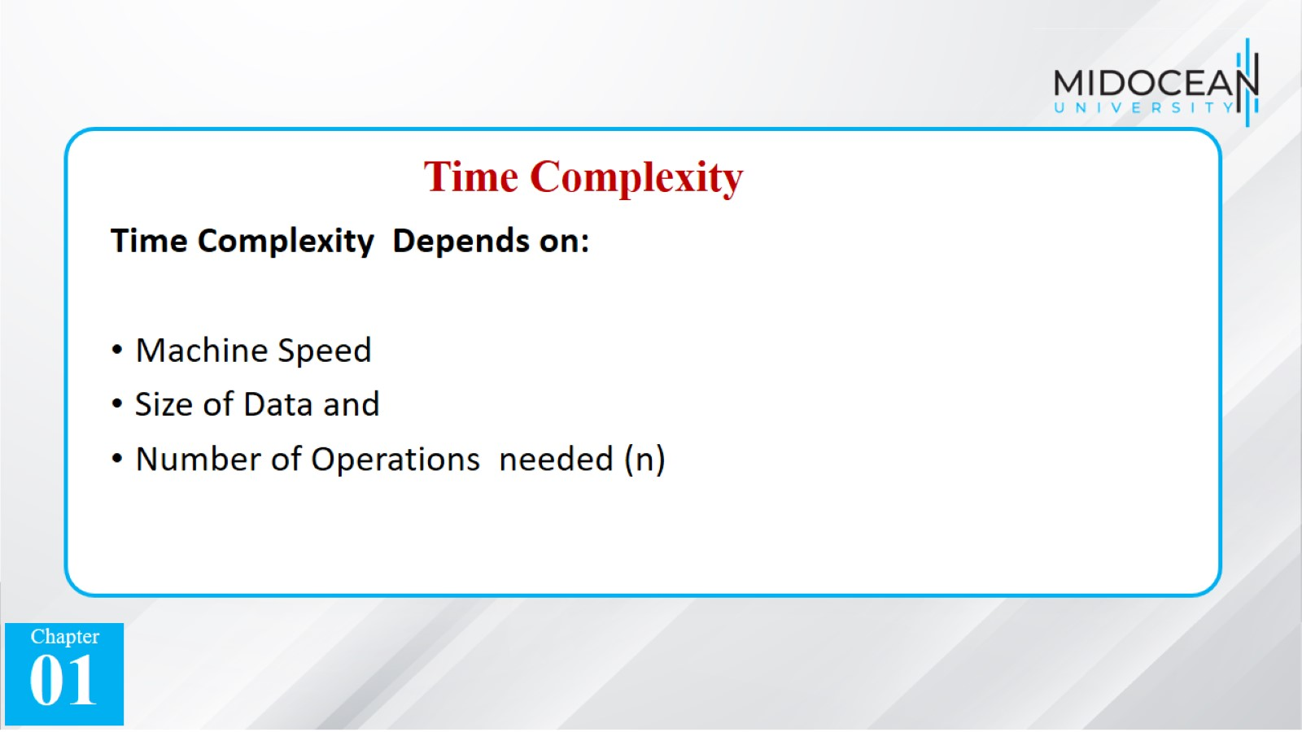

Slide 39
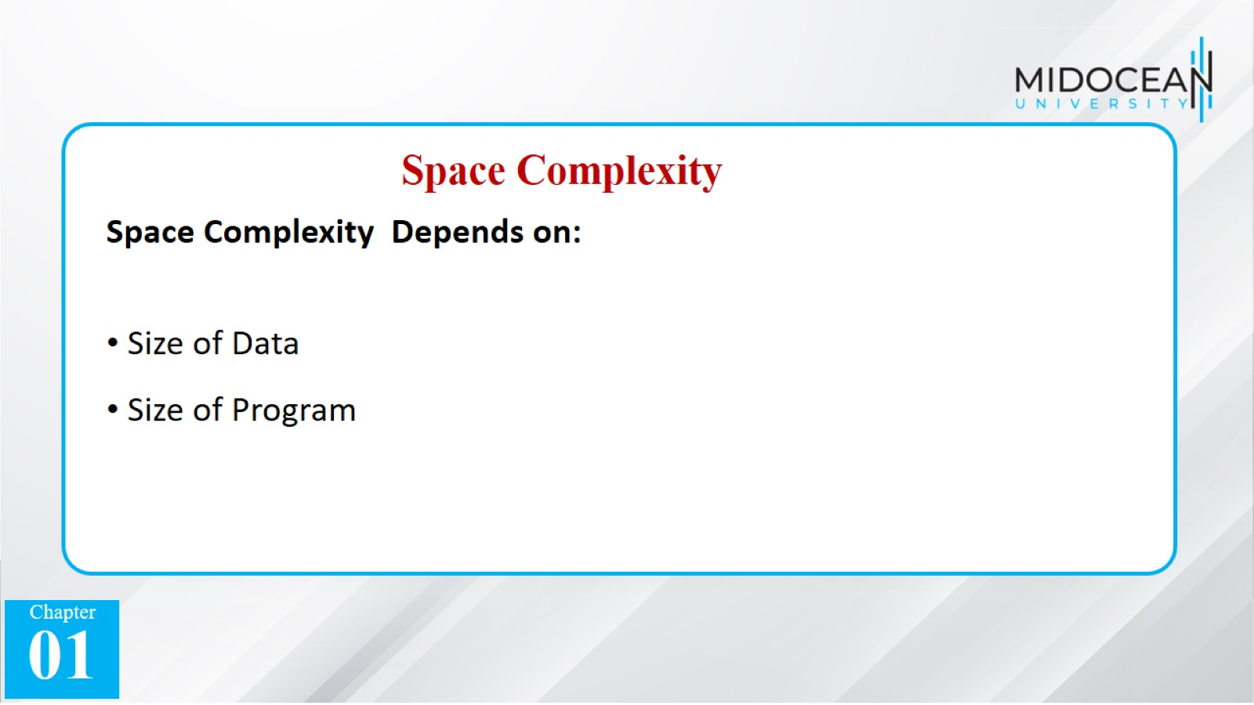

Slide 40
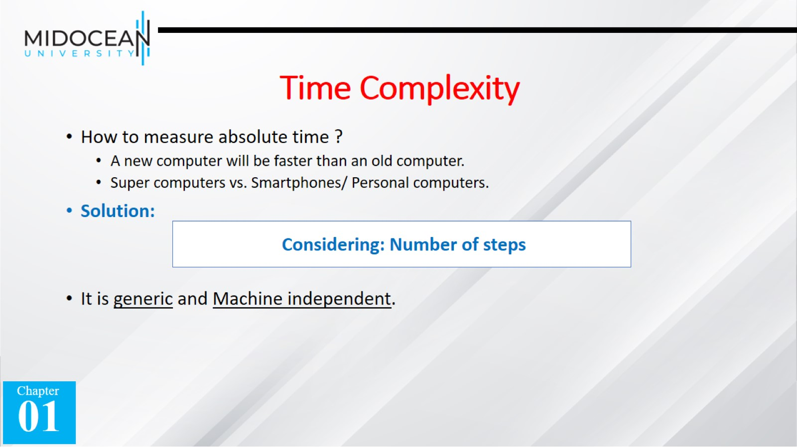
Time Complexity

Slide 41
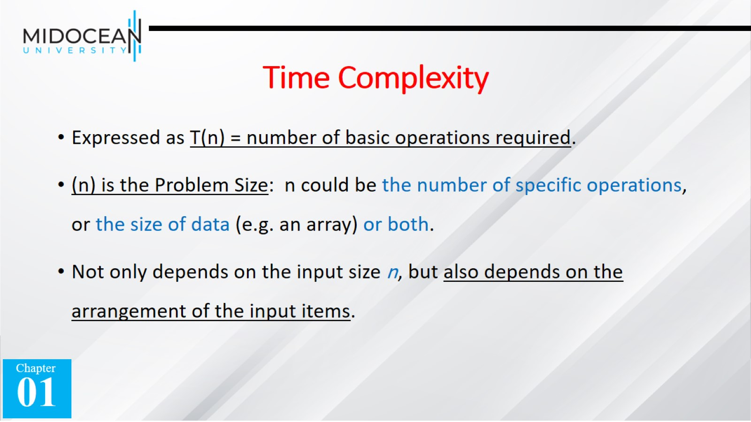
Time Complexity

Slide 42
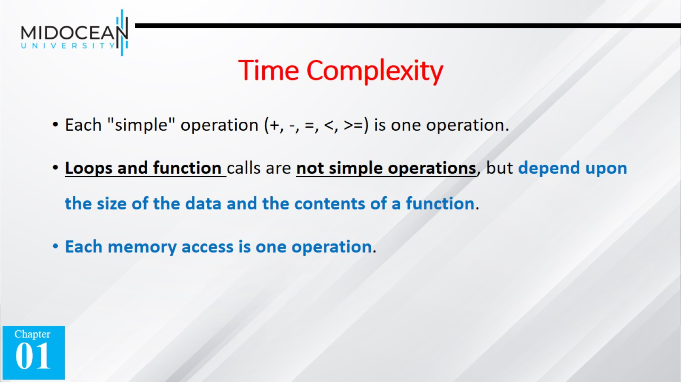
Time Complexity

Slide 43


