Slide 1


System Administration (2)
IT401
Prepared by
Dr. Ahmed El-Douh
Lecture 9

Slide 2



System Administration 2
Lecture 9
IT401
System Log Architecture
Prepared by
Dr. Ahmed El-Douh

Slide 3
Objectives
Upon completion of this lecture, you will be able to:
  ▪ Understand the System Log Architecture and the purpose of system logging.
  ▪ Analyze Syslog data to identify system and network events.
  ▪ Locate and view log files on the system.
  ▪ Configure remote logging for centralized log management.
www.midocean.ae

Slide 4
Chapter
Outlines
09
System Logging
Analyze a Syslog
Finding Log
Configuring a remote logging solution
Testing Environment
Firewall
www.midocean.ae

Slide 5


System Log Architecture
www.midocean.ae

Slide 6
System Log Architecture
System Logging
Processes and the operating system kernel need to record events that occur.
These logs are useful for auditing the system and troubleshooting issues.
By convention, log files are stored in /var/log. Linux uses a standard logging system based on the Syslog protocol.
Many programs use this logging system to record events and organize them into log files.
In Red Hat Enterprise Linux, syslog messages are handled by two services: systemd-journald and rsyslog.
www.midocean.ae

Slide 7
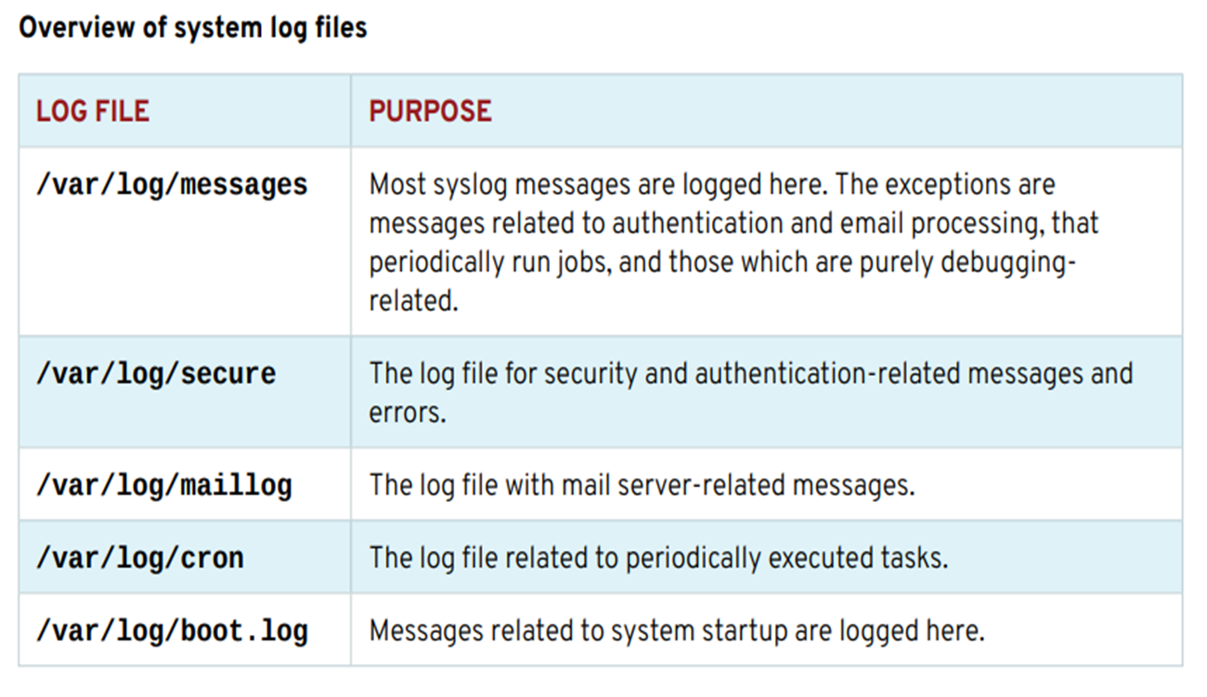
System Log Architecture
The rsyslog service then sorts the syslog messages by type (or facility) and priority and writes them to persistent files in the /var/log directory.
The /var/log directory holds various system- and service-specific log files maintained by rsyslog:
www.midocean.ae

Slide 8
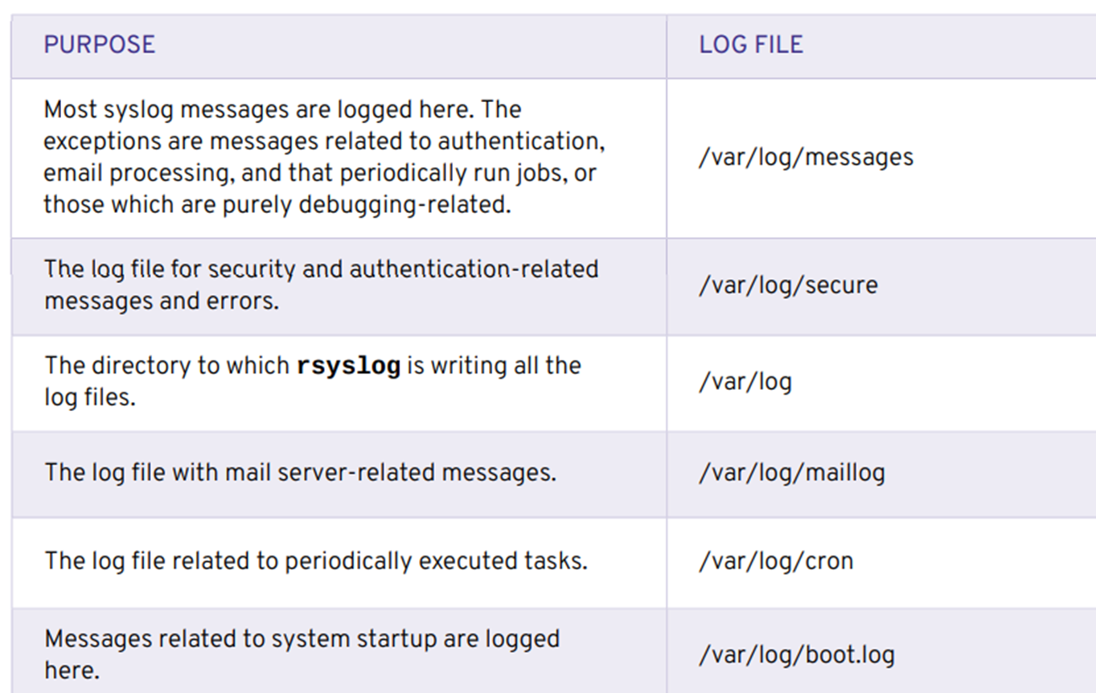
System Log Architecture
www.midocean.ae

Slide 9
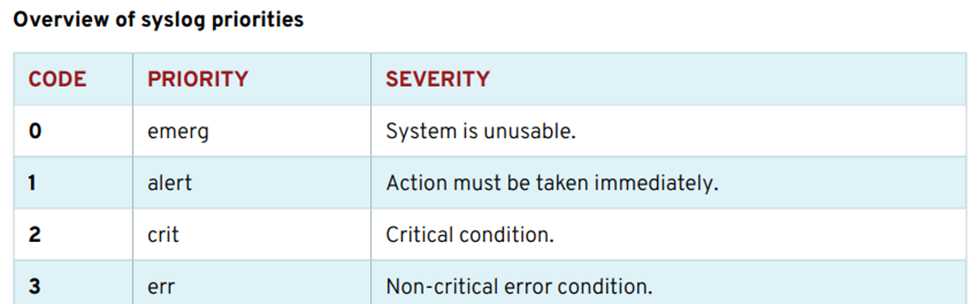
System Log Architecture
SYSLOG FILES
Many programs use the syslog protocol to log events to the system. Each log message is categorized by a facility (the type of message) and a priority (the severity of the message).
The facilities which are available are documented by the rsyslog.conf(5) man page. The eight priorities are also standardized and ranked as follows:
www.midocean.ae

Slide 10
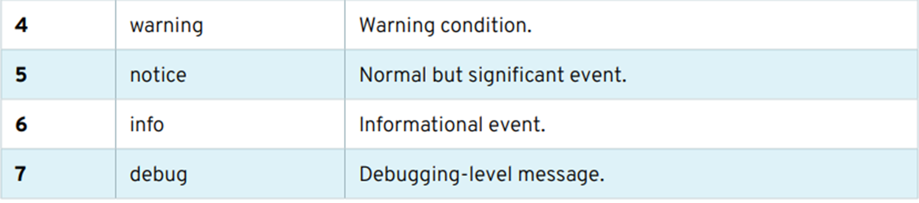
System Log Architecture
The rsyslogd service uses the facility and priority of log messages to determine how to handle them.
This is configured by the file /etc/rsyslog.conf and by *.conf files in /etc/ rsyslog.d. Programs and administrators can change rsyslogd configuration in a way that will not be overwritten by updates to rsyslog by putting customized files with a .conf suffix in the / etc/rsyslog.d directory.
www.midocean.ae

Slide 11
System Log Architecture
The #### RULES ####
section of /etc/rsyslog.conf contains directives that define where log messages are saved.
The left side of each line indicates the facility and severity of the log message the directive matches.
The rsyslog.conf file can contain the character * as a wild card in the facility and severity field, where it either stands for all facilities or all severities.
The right side of each line indicates what file to save the log message in.
Log messages are normally saved in files in the /var/log directory.
A message handled by rsyslog can appear in multiple different log files.
www.midocean.ae

Slide 12
System Log Architecture
To prevent that, the severity field can be set to none, which means that none of the messages directed to this facility are added to the specified log file.
Instead of logging syslog messages to a file, they can be printed to the terminals of all logged-in users.
In the default rsyslog.conf file, this is done for all messages that have "emerg" priority.
SAMPLE RULES SECTION OF rsyslog.conf
www.midocean.ae

Slide 13
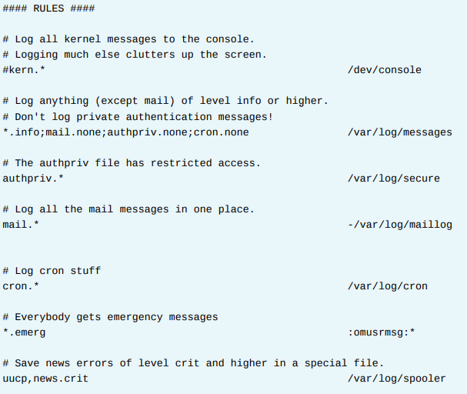
www.midocean.ae

Slide 14
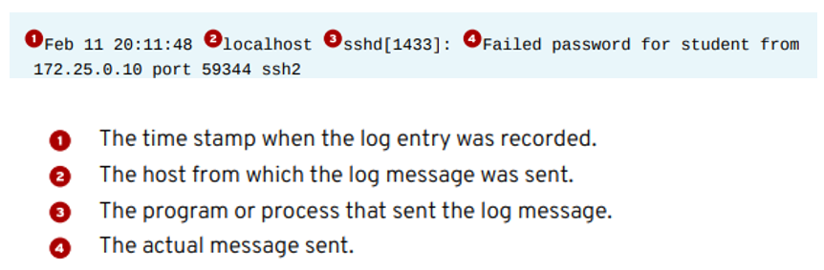
System Log Architecture
ANALYZE A SYSLOG ENTRY
The system logs written by rsyslog start with the oldest message on top and the newest message at the end of the log file.
All log entries in log files managed by rsyslog are recorded in a standard format.
The following example will explain the anatomy of a log file message in the /var/ log/secure log file:
www.midocean.ae

Slide 15
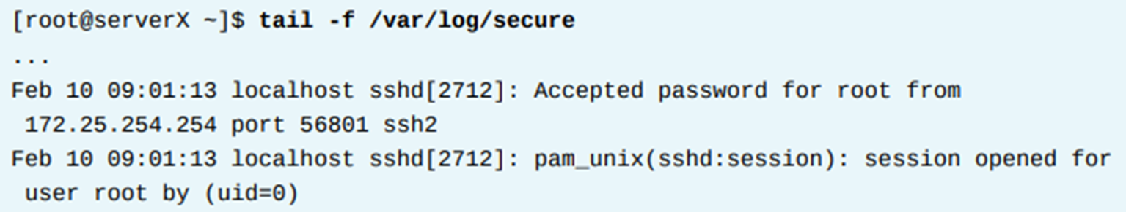
System Log Architecture
MONITOR A LOG FILE WITH tail
It is especially helpful for reproducing problems and issues to monitor one or more log files for events.
The tail -f /path/to/file command outputs the last 10 lines of the file specified and continues to output new lines as they get written to the monitored file.
To monitor for failed login attempts on one terminal, run ssh as user root while a user tries to log in to the serverX machine:
www.midocean.ae

Slide 16


System Log Architecture
FINDING LOG ENTRIES, you will reconfigure rsyslog to write specific messages to a new log file.
OUTCOMES The rsyslog service writes all messages with priority debug to the /var/log/messagesdebug log file for temporary troubleshooting purposes.
Configure rsyslog on serverX to log all messages with severity debug, or higher, for any service into a newly created log file /var/log/messages-debug by adding the rsyslog configuration file /etc/rsyslog.d/debug.conf. Verify that a generated debug log message with the logger command arrives in the /var/log/messages-debug log file.
  Change the rsyslog configuration to log all messages with severity debug to /var/log/messages-debug on serverX by adding the /etc/rsyslog.d/ debug.conf file.
  Restart the rsyslog serviceon server.
www.midocean.ae

Slide 17



System Log Architecture
Generate a debug log message with the logger command and verify that the message gets logged to the log file /var/log/messages-debug with the tail command on serverX.
  Monitor the /var/log/messages-debug with the tail command on serverX.
  On a separate terminal window, use the logger command to generate a debug message on serverX.
www.midocean.ae

Slide 18
System Log Architecture
Configuring a remote logging solution
To ensure that logs from various machines in your environment are recorded centrally on a logging server, you can configure the Rsyslog application to record logs that fit specific criteria from the client system to the server.
  The Rsyslog logging service
The Rsyslog application, in combination with the systemd-journald service, provides local and remote logging support in Red Hat Enterprise Linux.
The rsyslogd daemon continuously reads syslog messages received by the systemd-journald service from the Journal. rsyslogd then filters and processes these syslog events and records them to rsyslog log files or forwards them to other services according to its configuration.
www.midocean.ae

Slide 19
System Log Architecture
The rsyslogd daemon also provides extended filtering, encryption protected relaying of messages, input and output modules, and support for transportation using the TCP and UDP protocols.
In /etc/rsyslog.conf, which is the main configuration file for rsyslog, you can specify the rules according to which rsyslogd handles the messages.
Generally, you can classify messages by their source and topic (facility) and urgency (priority) and then assign an action that should be performed when a message fits these criteria.
In /etc/rsyslog.conf, you can also see a list of log files maintained by rsyslogd. Most log files are located in the /var/log/ directory. Some applications, such as httpd and samba, store their log files in a subdirectory within /var/log/.
www.midocean.ae

Slide 20
How to Set Up Remote Logging on Linux Using Rsyslog
Logs are a critical component of any software or operating system. Logs usually record user’s actions, system events, network activity and so much more, depending on what they are intended for. One of the most widely used logging systems on Linux systems is rsyslog.
Rsyslog is a powerful, secure and high-performance log processing system which accepts data from different types of source (systems/applications) and outputs it into multiple formats.
It has evolved from a regular syslog daemon to a fully-featured, enterprise level logging system. It is designed in a client/server model, therefore it can be configured as a client and/or as a central logging server for other servers, network devices, and remote applications.
www.midocean.ae

Slide 21
System Log Architecture
Testing Environment
For the purpose of this guide, we will use the following hosts:
Server: 192.168.241.140
Client: 172.31.21.58
How to Install and Configure Rsyslog Server
Most Linux distributions come with the rsyslog package preinstalled.
In case it’s not installed, you can install it using your Linux package manager tool as shown.
www.midocean.ae

Slide 22
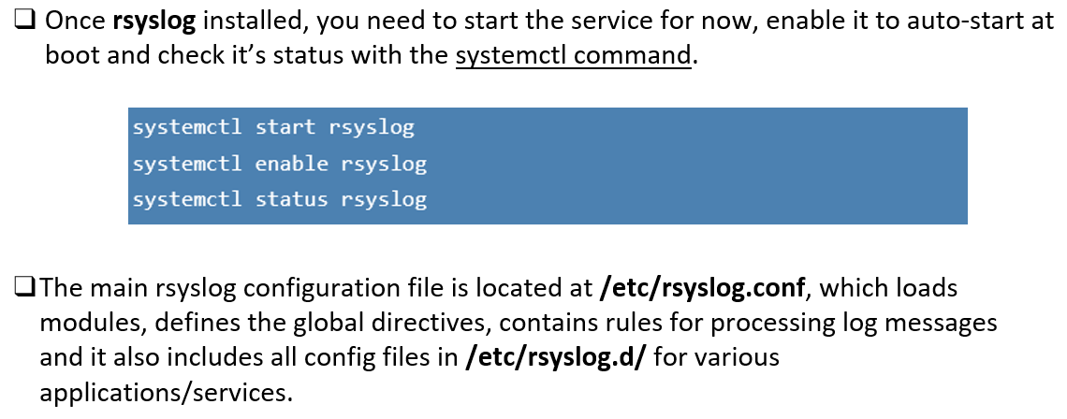
System Log Architecture
www.midocean.ae

Slide 23
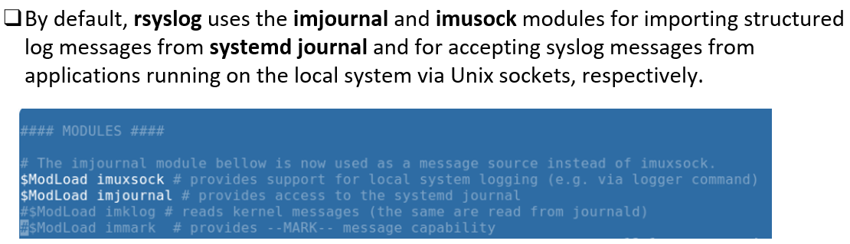
System Log Architecture
www.midocean.ae

Slide 24
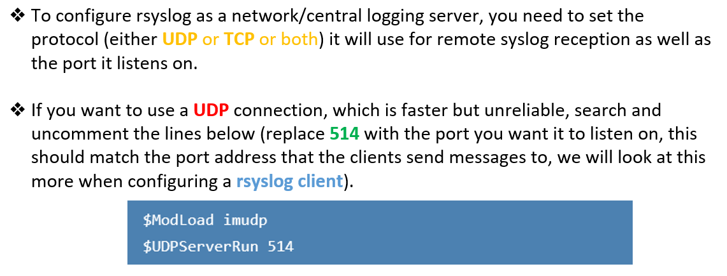
System Log Architecture
www.midocean.ae

Slide 25
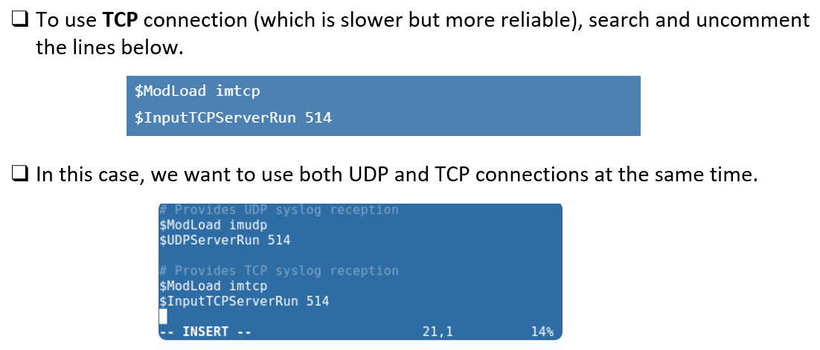
System Log Architecture
www.midocean.ae

Slide 26
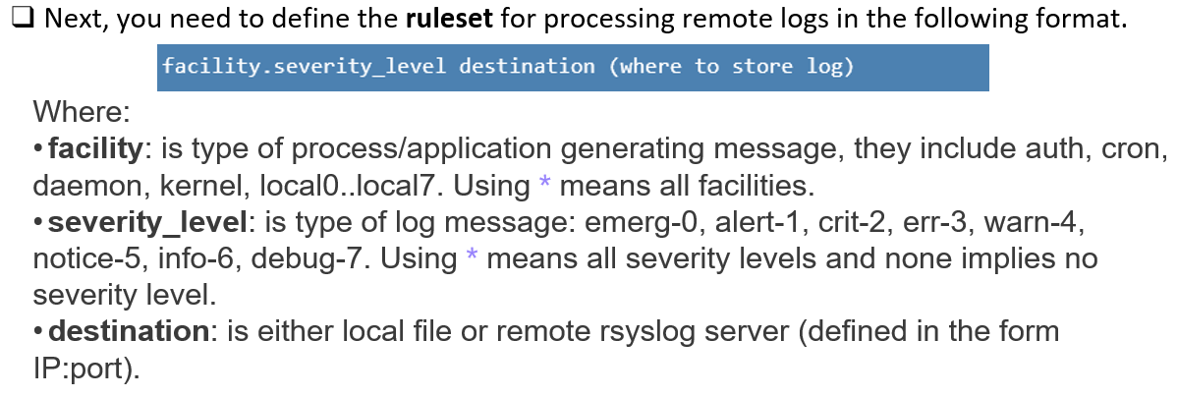
System Log Architecture
www.midocean.ae

Slide 27
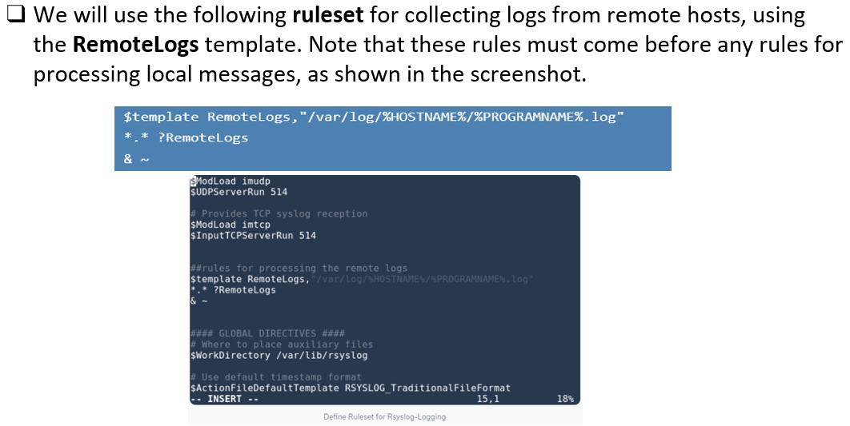
System Log Architecture
www.midocean.ae

Slide 28
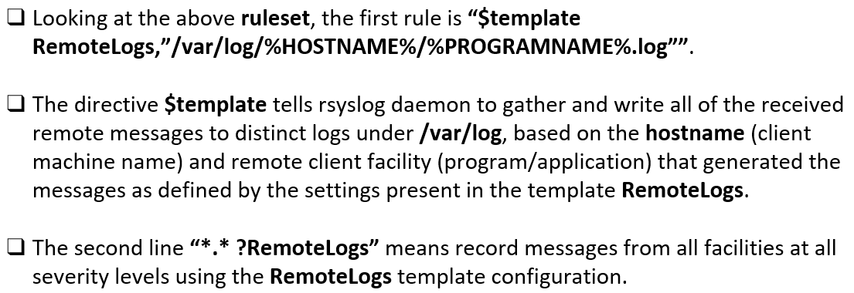
System Log Architecture
www.midocean.ae

Slide 29
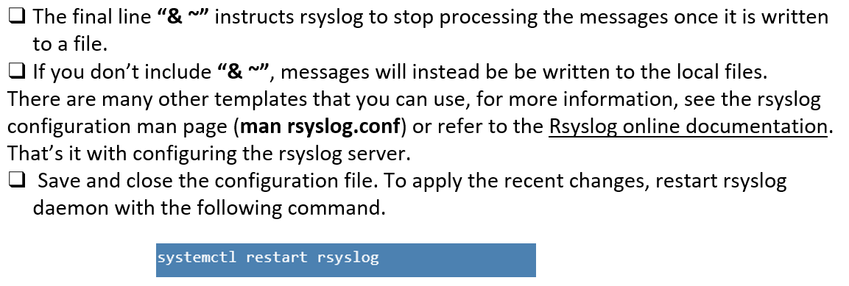
System Log Architecture
www.midocean.ae

Slide 30
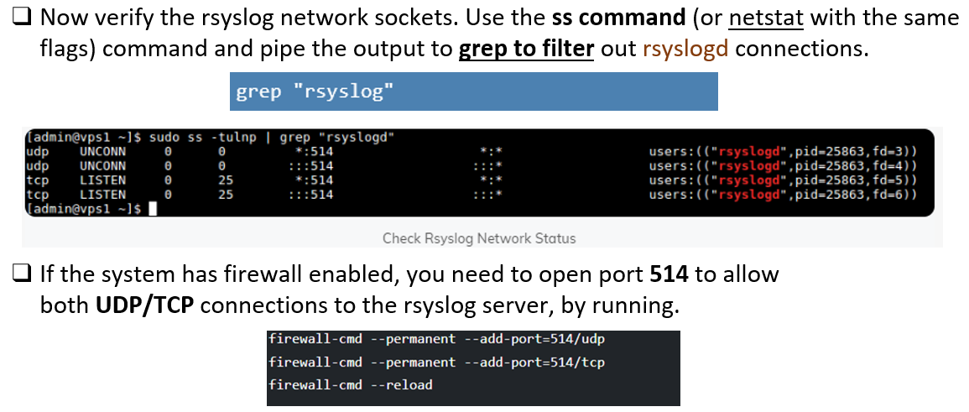
System Log Architecture
www.midocean.ae

Slide 31
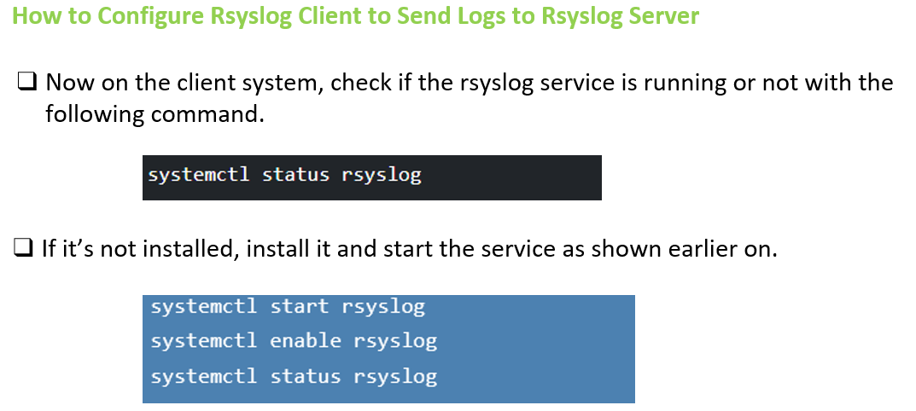
System Log Architecture
www.midocean.ae

Slide 32
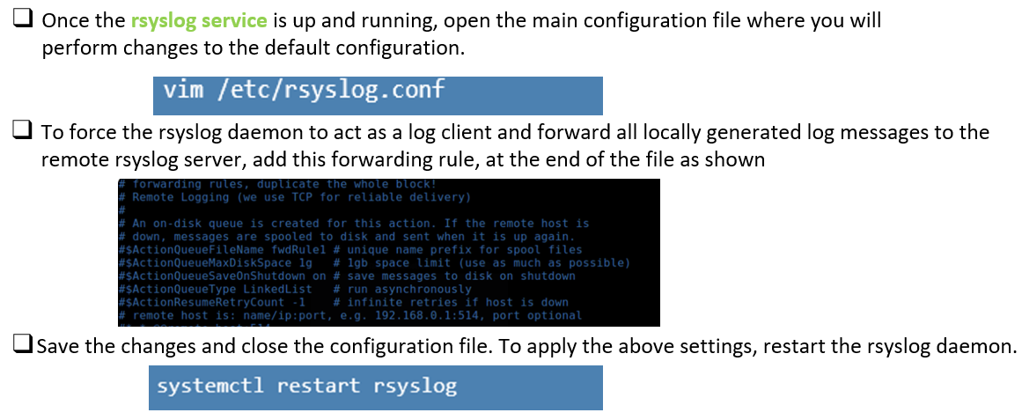
System Log Architecture
www.midocean.ae

Slide 33
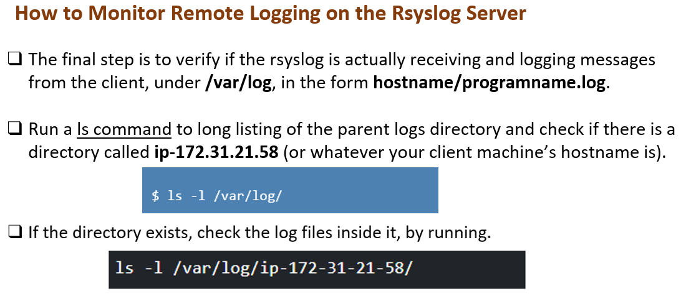
System Log Architecture
www.midocean.ae

Slide 34
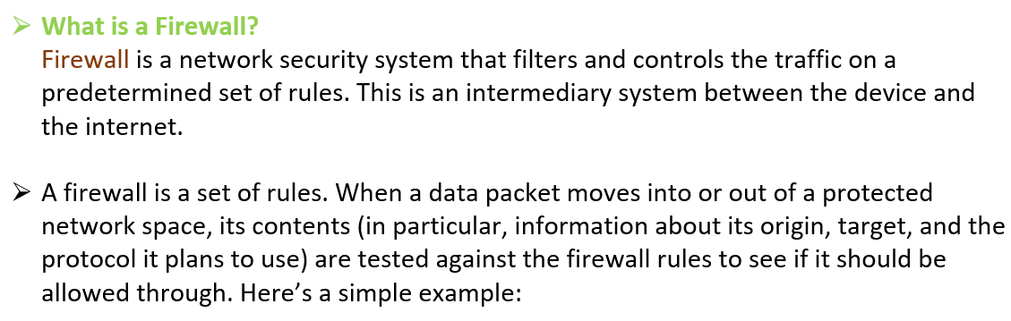
System Log Architecture
www.midocean.ae

Slide 35
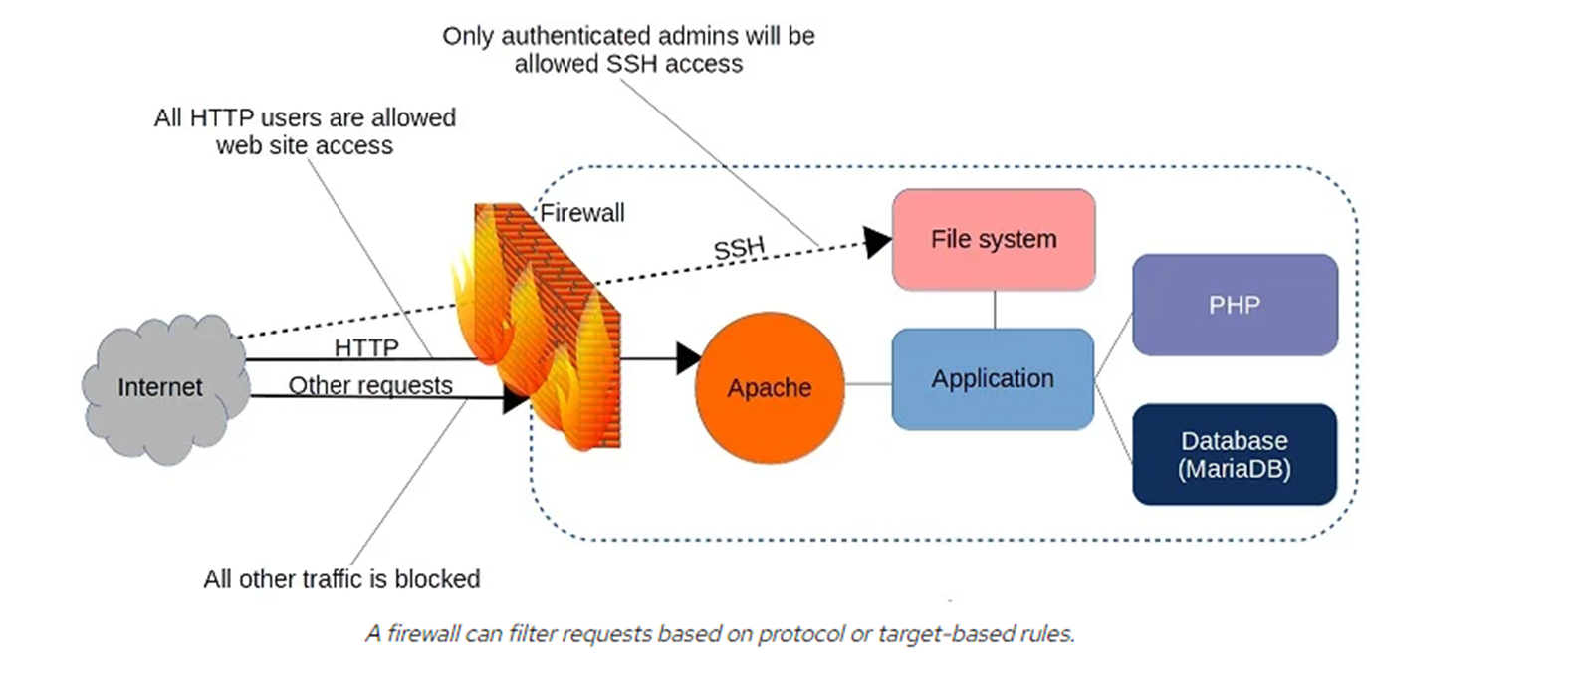
System Log Architecture
www.midocean.ae

Slide 36
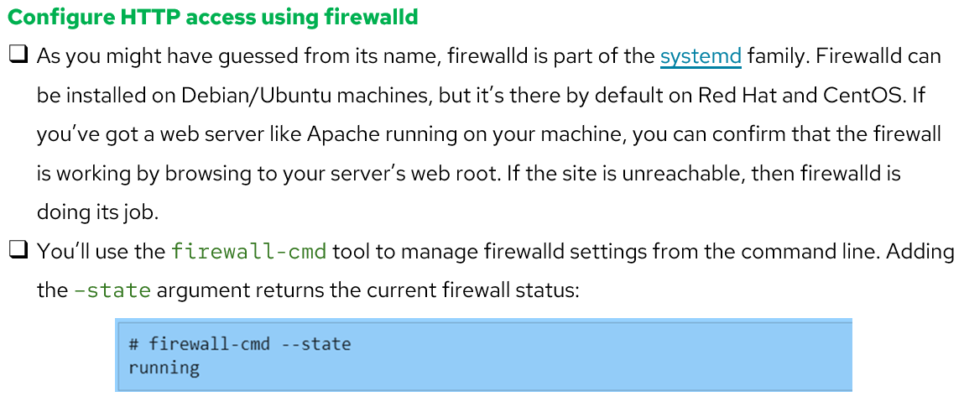
System Log Architecture
www.midocean.ae

Slide 37
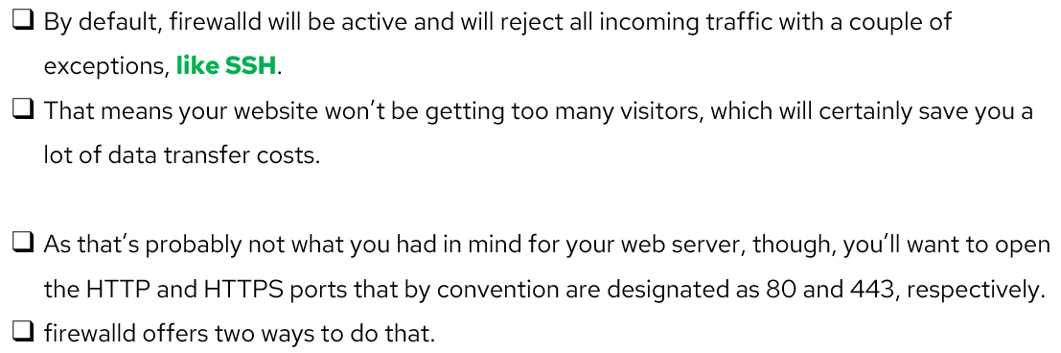
System Log Architecture
www.midocean.ae

Slide 38
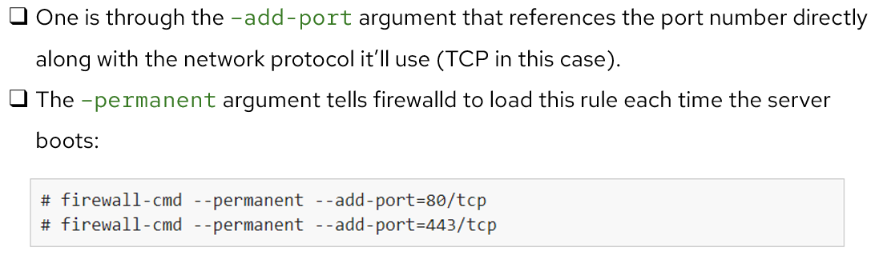
System Log Architecture
www.midocean.ae

Slide 39
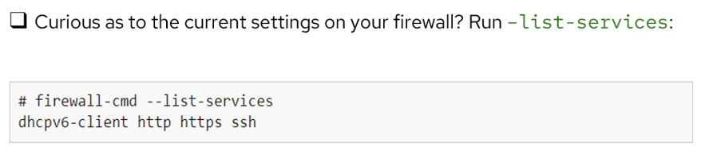

System Log Architecture
www.midocean.ae

Slide 40



Thank You

