Slide 1


Strategic and Operational
Management
Prepared by
Dr. Ahmad AL-Naimi
MGM 630 (part one)
Lecture 2

Slide 2



Strategic and
Operational Management
Lecture Two
MGM 630
Prepared by
Dr. Ahmad Al-NAIMI

Slide 3

Lecture
LECTURE OUTLINE
02
2.1 Vision, Mission, and Values (Vision, Mission, Values).
2.2 Strategic Leadership.
- What do Strategic Leaders do?
- How do You Become a Strategic Leader?
- Formulating Strategy across Levels
2.3 The Strategic Management Process.
- Top-Down Strategic Planning
- Scenario Planning
- Strategy as Planned Emergence: Top-Down and Bottom-Up
2–2

Slide 4
Lecture
LEARNING OBJECTIVES
02
1. Describe the roles of vision, mission, and values in the strategic management process.
2. Evaluate the strategic implications of product-oriented and customer oriented vision statements.
3. Explain why anchoring a firm in ethical core values is essential for long-term success.
4. Outline how managers become strategic leaders.
5. Describe the roles of corporate, business, and functional managers in strategy formulation and implementation.
6. Evaluate top-down strategic planning, scenario planning, and strategy as planned emergence.
2–3

Slide 5
Lecture
Leading The Strategy: The Manager's Role
02
2.1. Vision, Mission, and Values
An effective strategic management process lays the foundation for sustainable competitive advantage. Strategic leaders design a process to formulate and implement strategy. Strategic leadership pertains to executives’ use of power and influence to direct the activities of others when pursuing an organization’s goals.
The first step in this process is to define a firm’s vision, mission, and values.
2–5

Slide 6
Lecture
Leading The Strategy: The Manager's Role
02
To define these basic principles, strategic leaders can ask these questions:
■ Vision. What do we want to accomplish ultimately?
■ Mission. How do we accomplish our goals?
■ Values. What commitments do we make, and what guardrails do we put in place, to act both legally and ethically as we pursue our vision and mission?
2–6

Slide 7
Lecture
Leading The Strategy: The Manager's Role
02
- Vision
A vision captures an organization’s aspiration and spells out what it ultimately wants to accomplish. An effective vision pervades the organization with a sense of winning and motivates employees at all levels to aim for the same target, while leaving room for individual and team contributions.
2–7

Slide 8
Lecture
Leading The Strategy: The Manager's Role
02
- Mission
Building on the vision, organizations establish a mission, which describes what an organization actually does—that is, the products and services it plans to provide, and the markets in which it will compete. People sometimes use the terms vision and mission interchange ably, but in the strategy process they differ.
2–8

Slide 9
Lecture
Leading The Strategy: The Manager's Role
02
- Values
While many companies have powerful vision and mission statements, they are not enough. An organization’s values should also be clearly articulated in the strategy process. A core values statement matters because it provides touchstones for the employees to understand the company culture. It offers bedrock principles that employees at all levels can use to deal with complexity and to resolve conflict. Such statements can help provide the organization’s employees with a moral compass.
2–9

Slide 10
Lecture
Leading The Strategy: The Manager's Role
02
Do vision statements help firms gain and sustain competitive advantage? It depends. The effectiveness of vision statements differs based on type. Customer-oriented vision statements allow companies to adapt to changing environments. Product-oriented vision statements often constrain this ability. This is because customer-oriented vision statements focus employees to think about how best to solve a problem for a consumer.
2–10

Slide 11
Lecture
Leading The Strategy: The Manager's Role
02
Product-oriented vision statements. A product-oriented vision defines a business in terms of a good or service provided. Product-oriented visions tend to force managers to take a more myopic view of the competitive landscape.
Customer-oriented vision statements. A customer-oriented vision defines a business in terms of providing solutions to customer needs. For example, “We provide solutions to professional communication needs.” Companies with customer-oriented visions can more easily adapt to changing environments. Exhibit 2.2 provides additional examples of companies with customer-oriented vision statements.
2–11

Slide 12
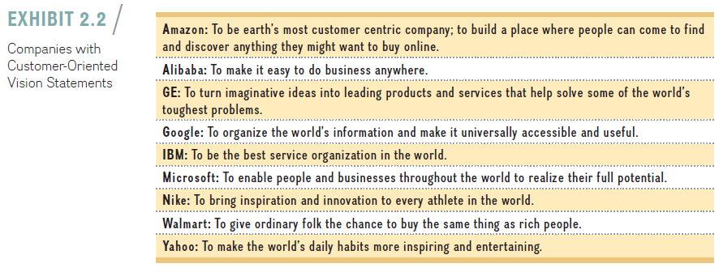
2–12

Slide 13
Lecture
Leading The Strategy: The Manager's Role
02
2.2 Strategic Leadership
Strategic leadership describes the executives’ successful use of power and influence to direct the activities of others when pursuing an organization’s goals. Executives whose vision and actions enable their organizations to achieve competitive advantage demonstrate strategic leadership. Marissa Mayer demonstrated strategic leadership in defining a new vision and mission for Yahoo. To put Yahoo’s new vision and mission into action, she worked to rejuvenate Yahoo’s bureaucratic culture and engaged in more open and frequent communication, with weekly FYI town-hall meetings where she and other executives pro-vide updates and field questions. All employees are expected to attend and encouraged to participate in the Q&A. Questions are submitted online during the week, and the employees vote which questions executives should respond to.
2–13

Slide 14
Lecture
Leading The Strategy: The Manager's Role
02
- What do strategic leaders do?
What do strategic leaders do that makes some strategic leaders more effective than others? In a recent study of more than 350 CEOs, strategy scholars found that they spend, on average, 67 percent of their time in meetings, 13 percent working alone, 7 percent on e-mail, 6 percent on phone calls, 5 percent on business meals, and 2 percent on public events such as ribbon-cutting for a new factory (see Exhibit 2.3).Other studies have also found that most managers prefer oral communication: CEOs spend most of their time “interacting—talking, cajoling, soothing, selling, listening, and nodding—with a wide array of parties inside and outside the organization.
2–14

Slide 15

Lecture
Leading The Strategy: The Manager's Role
02
2–15

Slide 16
Lecture
Leading The Strategy: The Manager's Role
02
Surprisingly given the advances in information technology, CEOs today spend most of their time in face-to-face meetings. They consider face-to-face meetings most effective in getting their message across and obtaining the information they need. Not only do meetings present data through presentations and verbal communications, but they also enable CEOs to pick up on rich nonverbal cues such as facial expressions, body language, and mood, that are not apparent to them if they use e-mail or Skype, for example.
2–16

Slide 17
Lecture
Leading The Strategy: The Manager's Role
02
- How do you become a strategic leader?
Is becoming an ethical and effective strategic leader innate? Can it be learned? According to the upper-echelons theory, organizational outcomes including strategic choices and performance levels reflect the values of the top management team. These are the individuals at the upper echelons, or levels, of an organization. The theory states that executives interpret situations through the lens of their unique perspectives, shaped by personal circumstances, values, and experiences.
2–17

Slide 18
Lecture
Leading The Strategy: The Manager's Role
02
Their leadership actions reflect characteristics of age, education, and career experiences, filtered through personal interpretations of the situations they face. The upper-echelons theory favors the idea that strong leadership is the result of both innate abilities and learning.
2–18

Slide 19
Lecture
Leading The Strategy: The Manager's Role
02
According to the Level-5 leadership pyramid, effective strategic leaders go through a natural progression of five levels. Each level builds upon the previous one; the manager can move on to the next level of leadership only when the current level has been mastered. On the left (in Exhibit 2.4) are the capabilities associated with each level. But not all companies are Fortune 500 behemoths. On the right we suggest that the model is valuable as well to the individual looking to develop the capacity for greater success.
2–19

Slide 20
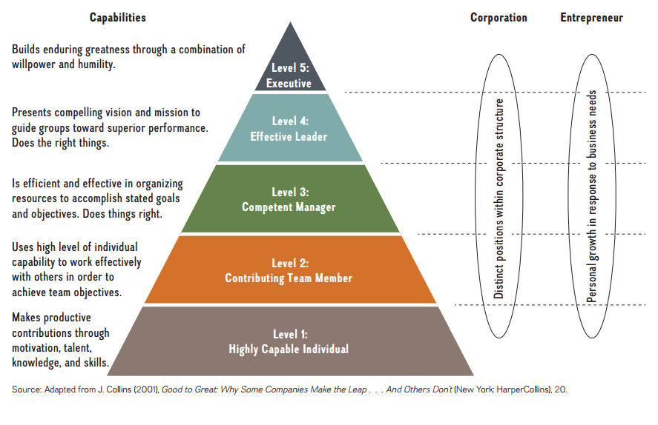
2–20

Slide 21
Lecture
Leading The Strategy: The Manager's Role
02
- Formulating strategy across levels:
Corporate, business, and functional managers
According to the upper-echelons theory, the top management team primarily determines a firm’s ability to gain and sustain a competitive advantage through the strategies they pursue. Given the importance of such strategies, we need to gain a deeper understanding of how they are formed.
2–21

Slide 22
Lecture
Leading The Strategy: The Manager's Role
02
Strategy formulation concerns the choice of strategy in terms of where and how to compete. In contrast, strategy implementation concerns the organization, coordination, and integration of how work gets done. In short, it concerns the execution of strategy. It is helpful to break down strategy formulation and implementation into three distinct areas— corporate, business, and functional.
2–22

Slide 23
Lecture
Leading The Strategy: The Manager's Role
02
■ Corporate strategy concerns questions relating to where to compete in terms of industry, markets, and geography.
■ Business strategy concerns the question of how to compete. Three generic business strategies are available: cost leadership, differentiation, or value innovation.
■ Functional strategy concerns the question of how to implement a chosen business strategy.
Exhibit 2.5 shows the three areas of strategy formulation.
2–23

Slide 24
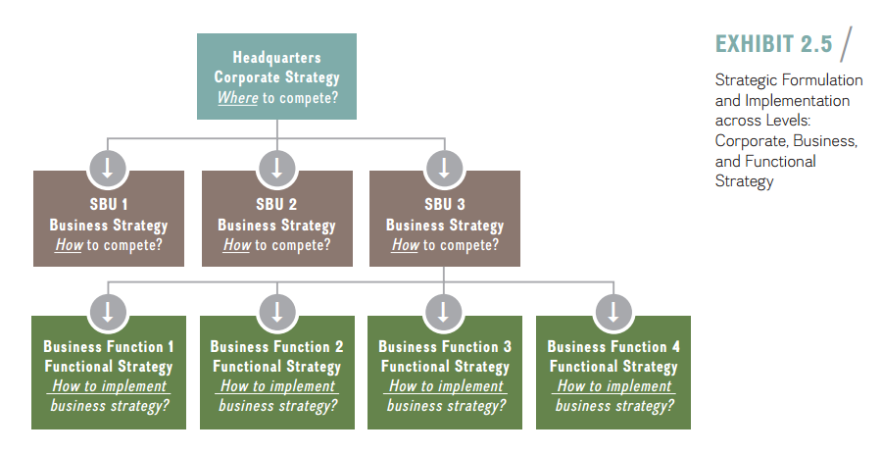
Lecture
Leading The Strategy: The Manager's Role
02
2–24

Slide 25
Lecture
Leading The Strategy: The Manager's Role
02
Although we generally speak of the firm in an abstract form, individual employees make strategic decisions—whether at the corporate, business, or functional level. Corporate executives at headquarters formulate corporate strategy. Corporate executives need to decide in which industries, markets, and geographies their companies should compete. They need to formulate a strategy that can create synergies across business units that may be quite different, and determine the boundaries of the firm by deciding whether to enter certain industries and markets and whether to sell certain divisions.
2–25

Slide 26
Lecture
Leading The Strategy: The Manager's Role
02
They are responsible for setting overarching strategic objectives and allocating scarce resources among different business divisions, monitoring performance, and making adjustments to the overall portfolio of businesses as needed. The objective of corporate-level strategy is to increase overall corporate value so that it is higher than the sum of the individual business units.
2–26

Slide 27
Lecture
Leading The Strategy: The Manager's Role
02
Business strategy occurs within strategic business units, or SBUs, the standalone divisions of a larger conglomerate, each with its own profit-and-loss responsibility. General managers in SBUs must answer business strategy questions relating to how to compete in order to achieve superior performance. Within the guidelines received from corporate headquarters, they formulate an appropriate generic business strategy, including cost leadership, differentiation, or value innovation, in their quest for competitive advantage.
2–27

Slide 28
Lecture
Leading The Strategy: The Manager's Role
02
Within each strategic business unit are various business functions:
accounting, finance, human resources, product development, operations, manufacturing, marketing, and customer service. Each functional manager is responsible for decisions and actions within a single functional area. These decisions aid in the implementation of the business-level strategy, made at the level above.
2–28

Slide 29
Lecture
Leading The Strategy: The Manager's Role
02
2.3 The Strategic Management Process
We have gained some insight into the corporate, business, and functional levels of strategy. Next, we turn to the process or method by which strategic leaders formulate and implement strategy. When strategizing for competitive advantage, managers rely on three approaches:
1. Strategic planning.
2. Scenario planning.
3. Strategy as planned emergence.
2–29

Slide 30
Lecture
Leading The Strategy: The Manager's Role
02
- Top-down strategic planning
The prosperous decades after World War II resulted in tremendous growth of corporations. As company executives needed a way to manage ever more complex firms more effectively, they began to use strategic planning. Top-down strategic planning, derived from military strategy, is a rational process through which executives attempt to program future success. In this approach, all strategic intelligence and decision-making responsibilities are concentrated in the office of the CEO. The CEO, much like a military general, leads the company strategically through competitive battles.
2–30

Slide 31
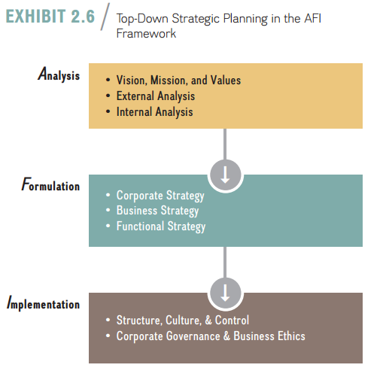
Lecture
Leading The Strategy: The Manager's Role
02
Exhibit 2.6 shows the three steps of analysis, formulation, and implementation in a traditional top-down strategic planning process. Strategic planners provide detailed analyses of internal and external data and apply it to all quantifiable areas: prices, costs, margins, market demand, head count, and production runs.
2–31

Slide 32
Lecture
Leading The Strategy: The Manager's Role
02
Top executives tie the allocation of the annual corporate budget to the strategic plan and monitor ongoing performance accordingly. Based on a careful analysis of these data, top managers reconfirm or adjust the company’s vision, mission, and values before formulating corporate, business, and functional strategies. Appropriate organizational structures and controls as well as governance mechanisms aid in effective implementation.
2–32

Slide 33
Lecture
Leading The Strategy: The Manager's Role
02
Top-down strategic planning more often rests on the assumption that we can predict the future from the past. The approach works reasonably well when the environment does not change much. One major shortcoming of the top-down strategic planning approach is that the formulation of strategy is separate from implementation, and thinking about strategy is separate from doing it. Information flows one way only: from the top down. Another short-coming of the strategic planning approach is that we simply cannot know the future. There is no data.
2–33

Slide 34
Lecture
Leading The Strategy: The Manager's Role
02
- Scenario planning
Given that the only constant is change, should managers even try to strategically plan for the future? The answer is yes—but they also need to expect that unpredictable events will happen. We can compare strategic planning in a fast-changing environment to a fire department operation. There is no way to know where and when the next emergency will arise, nor can we know its magnitude beforehand. Nonetheless, fire chiefs put contingency plans in place to address a wide range of emergencies along different dimensions.
2–34

Slide 35
Lecture
Leading The Strategy: The Manager's Role
02
In the same way, scenario planning asks those “what if” questions. Similar to top-down strategic planning, scenario planning also starts with a top-down approach to the strategy process. In addition, in scenario planning, top management envisions different scenarios, to anticipate plausible futures in order to derive strategic responses. For example, new laws might restrict carbon emissions or expand employee health care.
2–35

Slide 36
Lecture
Leading The Strategy: The Manager's Role
02
Demographic shifts may alter the ethnic diversity of a nation; changing tastes or economic conditions will affect consumer behavior. Technological advance may provide completely new products, processes, and services. How would any of these changes affect a firm, and how should it respond? Scenario planning takes place at both the corporate and business levels of strategy.
2–36

Slide 37
Lecture
Leading The Strategy: The Manager's Role
02
To model the scenario-planning approach, place the elements in the AFI strategy frame-work in a continuous feedback loop, where Analysis leads to Formulation to Implementation and back to Analysis. Exhibit 2.7 elaborates on this simple feedback loop to show the dynamic and iterative method of scenario planning.
2–37

Slide 38
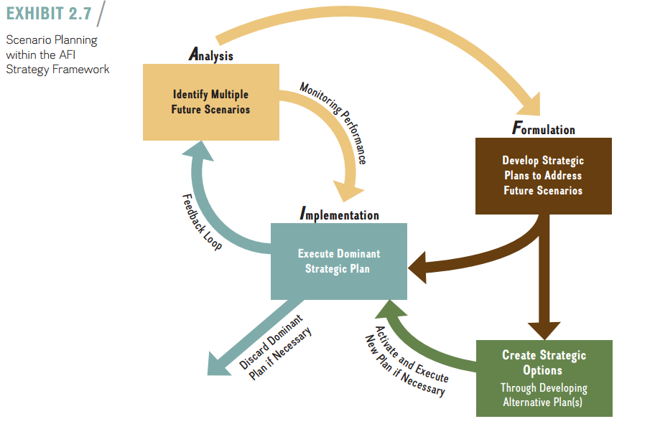
2–38

Slide 39
Lecture
Leading The Strategy: The Manager's Role
02
- Strategy as planned emergence: top-down and bottom-up
Critics of top-down and scenario planning argue that strategic planning is not the same as strategic thinking. In fact, they argue the strategic-planning processes are often too regimented and confining. As such, they lack the flexibility needed for quick and effective response. Managers engaged in a more formalized approach to the strategy process may also fall prey to an illusion of control, which describes a tendency by managers to overestimate their ability to control events.
2–39

Slide 40
Lecture
Leading The Strategy: The Manager's Role
02
Hard numbers in a strategic plan can convey a false sense of security. According to critics of strategic planning, to be successful, a strategy should be based on an inspiring vision and not on hard data alone. They advise that managers should focus on all types of information sources, including soft sources that can generate new insights, such as personal experience, deep domain expertise, or the insights of front-line employees. The important work, according to this viewpoint, is to synthesize all available input from different internal and external sources into an overall strategic vision. This vision in turn should then guide the firm’s strategy, as discussed earlier in this chapter.
2–40

Slide 41
Lecture
Leading The Strategy: The Manager's Role
02
According to this more holistic model, the strategy process also begins with a top-down strategic plan based on analysis of external and internal environments. This analysis completes the first stage of the AFI framework (see Exhibit 2.8). Top-level executives then design an intended strategy—the outcome of a rational and structured, top-down strategic plan. Exhibit 2.8 illustrates how parts of a firm’s intended strategy are likely to fall by the wayside because of unpredictable events and turn into unrealized strategy.
2–41

Slide 42
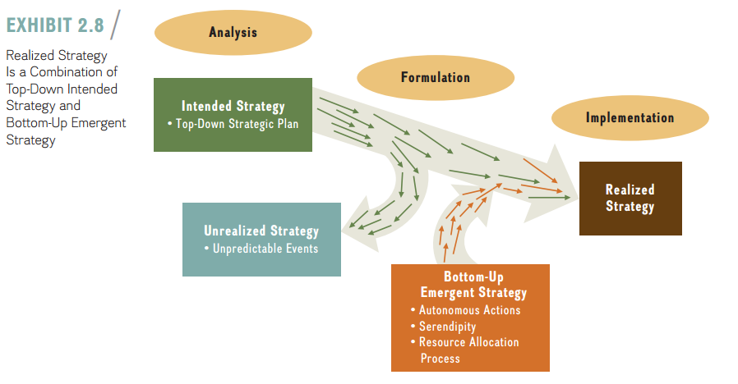
2–42

Slide 43
Lecture
Leading The Strategy: The Manager's Role
02
A firm’s realized strategy is generally formulated through a combination of its top-down strategic intentions and bottom-up emergent strategy. An emergent strategy describes any unplanned strategic initiative bubbling up from the bottom of the organization. If successful, emergent strategies have the potential to influence and shape a firm’s overall strategy.
2–43

Slide 44
Lecture
Leading The Strategy: The Manager's Role
02
The strategic initiative is a key feature in the strategy as a planned emergence model. A strategic initiative is any activity a firm pursues to explore and develop new products and processes, new markets, or new ventures. Strategic initiatives can come from anywhere. They could be the result of a response to external trends or come from internal sources. As such, strategic initiatives can be the result of top-down planning by executives, or they can also emerge through a bottom-up process.
2–44

Slide 45
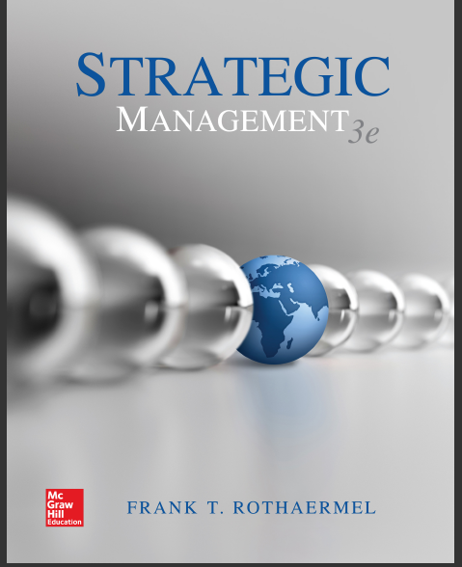
References
Strategic management, third edition, 2017 By Frank t. Rothaermel
Georgia Institute of Technology.
2–45

Slide 46


Thank You

