Slide 1



Digital Content Direction
Prepared by Dr. Sherihan Mohamed
DGM 733
Lecture 2

Slide 2




Lecture 2
Lecture 1 Conclusion:
Remember the last Lecture we talk about:
* Digital Content: A Closer Look
* Who Creates Digital Content?
* Content Creators.
* Web 2.0 and Convergence Culture

Slide 3

Digital Content: production media
Lecture 2

Slide 4

Lecture 2
Lecture Outlines:
* Digital Journalism: the line between ‘Producer’ and ‘Consumer’
* What is ‘Journalism’? Who Are ‘Journalists’?
* Digital Journalism: Key Features
* New Journalistic Identities
* Journalists on Social Media
* Conclusion
* References

Slide 5

Lecture 2
Digital Content Direction
Digital Journalism:
the line between ‘Producer’ and ‘Consumer’

Slide 6

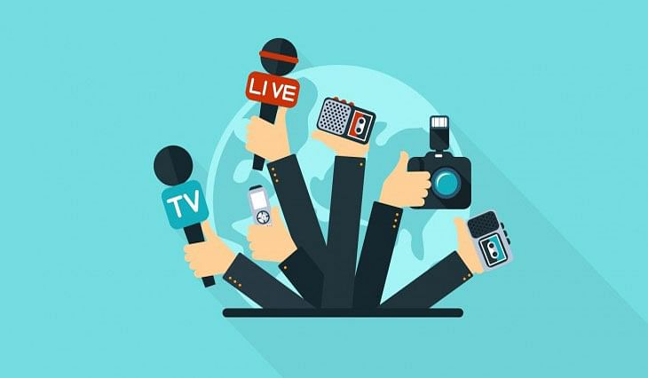
“Digital journalism” known as “online journalism” is a contemporary form of journalism where editorial content is distributed via the Internet as opposed to publishing via print or broadcast. What constitutes 'digital journalism' is debated by scholars.

Slide 7

However the primary product of journalism, which is news and features on current affairs, is presented solely or in combination as text, audio, video, or some interactive forms like newsgames, and disseminated through digital media technology.

Slide 8
⁽¹⁾Fewer barriers to entry, ⁽²⁾lowered distribution costs, and ⁽³⁾ diverse computer networking technologies have led to the widespread practice of digital journalism.
It has democratized the flow of information that was previously controlled by traditional media including newspapers, magazines, radio, and television.

Slide 9
Some have asserted that a greater degree of creativity can be exercised with digital journalism when compared to traditional journalism and traditional media.
The digital aspect may be central to the journalistic message and remains, to some extent, within the creative control of the writer, editor, and/or publisher.

Slide 10

Digital journalism allows for connection and discussion at levels that print does not offer on its own.
People can comment on articles and start discussion boards to discuss articles.

Slide 11

Before the Internet, spontaneous discussion between readers who had never met was impossible.
The process of discussing a news item is a big portion of what makes for digital journalism.
People add to the story and connect with other people who want to discuss the topic.

Slide 12

Digital journalism creates an opportunity for niche audiences, allowing people to have more options as to what to view and read.
Digital journalism opens up new ways of storytelling; through the technical components of the new medium, digital journalists can provide a variety of media, such as audio, video, and digital photography.

Slide 13

News consumers must become Web literate and use critical thinking to evaluate the credibility of sources.
Because it is possible for anyone to write articles and post them on the Internet, the definition of journalism is changing.

Slide 14
Because it is becoming increasingly simple for the average person to have an impact in the news world through tools like blogs and even comments on news stories on reputable news websites, it becomes increasingly difficult to sift through the massive amount of information coming in from the digital area of journalism.

Slide 15
The interaction between the writer and consumer is New, and this can be credited to digital journalism.
There are many ways to get personal thoughts on the Web. There are some disadvantages to this, however, the main one being factual information. There is a pressing need for accuracy in digital journalism, and until they find a way to press accuracy, they will still face some criticism.

Slide 16
Lecture 2
Digital Content Direction
What is ‘Journalism’?
Who Are ‘Journalists’?

Slide 17
Traditionally, journalism has undertaken one or more of the following functions:
* Fourth estate: Journalism functions as a fourth estate, keeping the other three estates (clergy, nobility and commoners) in check.
This model understands journalism as playing an influential and necessary role in holding the powerful to account.

Slide 18
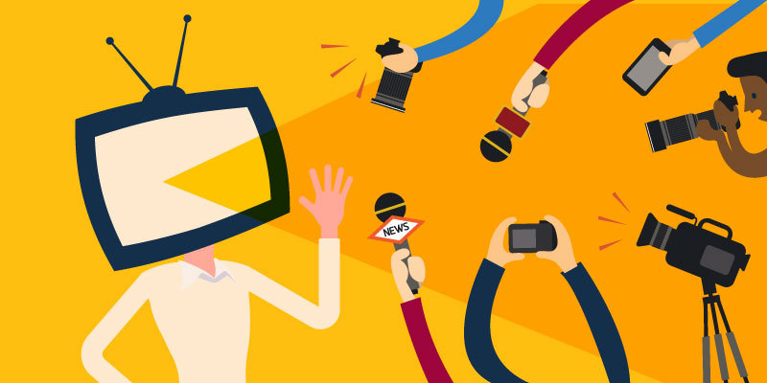
* Agenda setting: Journalism plays a crucial role in making any given issue the topic of public discussion and debate (or, putting it on the public agenda).
Journalism also plays a role in determining the terms in which this issue will be understood by members of the public.

Slide 19

*Source of entertainment: Journalism makes the reader laugh or cry, puts us at the edge of our seat and keeps us awake at night.
Journalism can perform two or more functions at the same time. For example, a piece of journalism can provide entertainment and keep the powerful in check.

Slide 20
Producers of journalism are known as ‘journalists’.
The understanding of journalism as a profession is linked to the conditions and requirements of “newswork”, training and education, the observance of certain ethics, the production of information, work routines and norms, the political economy of news organizations and press systems, legal frameworks, and normative expectations about the role of the press in democracy.

Slide 21
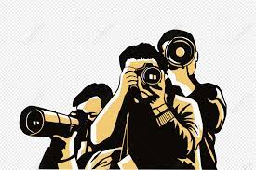
The professional journalist is commonly thought to be one who has trained to work in journalism, either through a cadetship, through studying journalism at university, or both.

Slide 22
The professional journalist has been thought to be committed to reporting the facts without fear or favour, taking no sides, and remaining uninvolved in, while remaining a keen observer of, political systems. In doing so, the professional journalist can contribute meaningfully to and help maintain, a healthy democracy.

Slide 23
Of course, the reality is messier. ‘Journalists were Never neutral and impartial, and they’re often embarrassingly ill equipped to detect ideological bias because they’re swimming in it, and because their professional survival often depends on pleasing their employers’. The notion of objectivity in news reportage has been subject to rigorous scholarly critique, and seems increasingly anachronistic in an era of hyper-partisan reportage.

Slide 24
Lecture 2
Digital Content Direction
Digital Journalism:
Key Features

Slide 25

‘Digital journalism’ is journalism that is produced wholly or predominantly online.
This encompasses the vast majority of journalism published today.
To illustrate that point, a 2018 Australian study reported:

Slide 26

*‘Since 2016, the number of heavy [Australian] news users – people accessing news more than once a day – has risen 15%.
* More than 80% of Australians access news at least once a day.
* 56% of Australians access news multiple times per day’

Slide 27
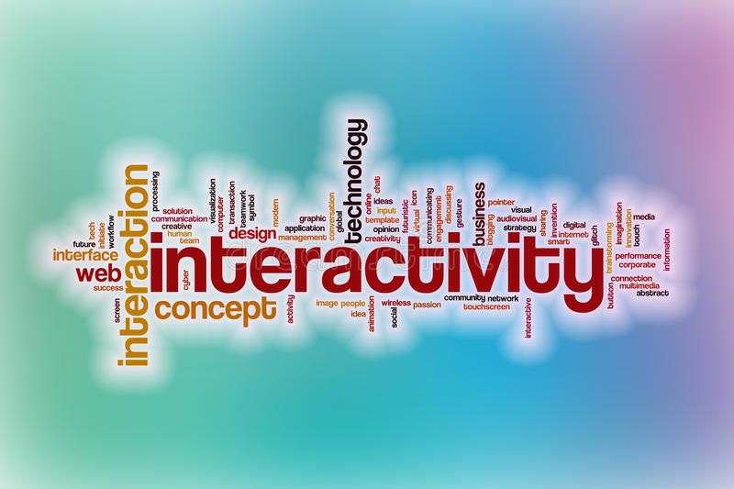
The following are some of the key features of digital journalism:
* Interactivity: This can range from data visualisations to below-the-line comments sections, in which the reader can interact with the journalist.
This also might include the reaching out to potential sources, by journalists and news organisation, via social media shout outs.

Slide 28

* Convergence: Once disparate media forms (e.g., TV, radio, and print) creating journalism that employs skills, technologies and forms from all three.
* Multiskilling: Digital journalists need to know how to write, but they also need to know how to make text work with audio, graphics, images and video.

Slide 29

* Social media fluency: Digital journalism is not restricted to legacy forms, formats and channels. Digital journalists, therefore, must be skilled in navigating and using social media as a research, engagement and publication tool.

Slide 30

* Embedded content: This can include videos, audio files, images, GIFs and memes embedded within text-based stories.
* Hyperlinking: For example, to evidence that will support or reinforce the points made in a piece of journalism.

Slide 31
* Clickbait: In the digital mediascape, clicks equals profit. So-called clickbait can range from sensationalistic headlines to content that aims only to generate clicks.
* Search Engine Optimisation (SEO): Use of keywords to be easily locatable by internet search engines.
* Algorithms: Artificial intelligence used to track the popularity of certain stories and even to write stories.

Slide 32
Lecture 2
Digital Content Direction
New Journalistic Identities

Slide 33

The stability of journalistic identity has been profoundly challenged by the digitisation of journalism and the concurrent the job losses experienced by journalists across the world in recent decades.

Slide 34
A 2018 study of journalists who had been laid off from newsrooms found that they ‘described their identity as weak or fading’.
The digitisation of newsrooms and the corresponding need to upskill have posed many challenges to the professional identities of journalists who commenced their careers during a time in which print media was dominant.

Slide 35

On the flipside, the digitalisation of journalism has led to a proliferation of new journalistic identities. Let’s look at two of these.

Slide 36
The first is the Citizen Journalist.
The term ‘citizen journalism’ has applied to individuals who have no formal journalistic training, and yet who (with the aid of digital technology tools such as the smartphone) report on current affairs, especially those which mainstream media outlets ignore or are unable to cover.

Slide 37
The question of whether citizen journalists can be regarded as ‘journalists’ has been the subject of controversy.
For example, in a 2017 study of journalistic identities, one journalist interviewee described citizen journalists as ‘people who have no experience and whose allegiance is to themselves and not journalism’.
Citizen journalists are not bound by codes of ethics, as professional journalists are; in many cases, they are not trained researchers, nor are they necessarily speaking from a position of interested indifference.

Slide 38
The second new journalistic identity is the Data Journalist.
Data journalism describes the application of data science to journalism.
In simple terms, data is information; data science is the curation and analysis of (digital) information in the search for, and creation of, useful knowledge.

Slide 39
The vast majority of information in the twenty-first century is stored digitally and in many cases is easily accessible and searchable, which allows for data to be combined, assessed, linked and processed in ways simply not possible in the pre-digital world.
This affords journalists the ability to extract insightful and revealing information from massive, and perhaps geographically or otherwise disparate and disconnected data sets, thereby lending greater credibility and evidential weight to their research.

Slide 40

Data journalists are increasingly being employed by media outlets, because they can give ‘newsrooms an “Investigative Edge” they wouldn’t have otherwise’.

Slide 41
Lecture 2
Digital Content Direction
Journalists on Social Media

Slide 42
Journalists Must Not Only use social media platforms to research and promote their work; They Must Also use these platforms to cultivate and promote their own personal brand.
Branding is most often discussed in relation to marketing, yet it remains an increasingly necessary exercise for content producers of all descriptions.
Personal branding is one of many examples of how the scope of journalistic identity has expanded in the digital era.

Slide 43
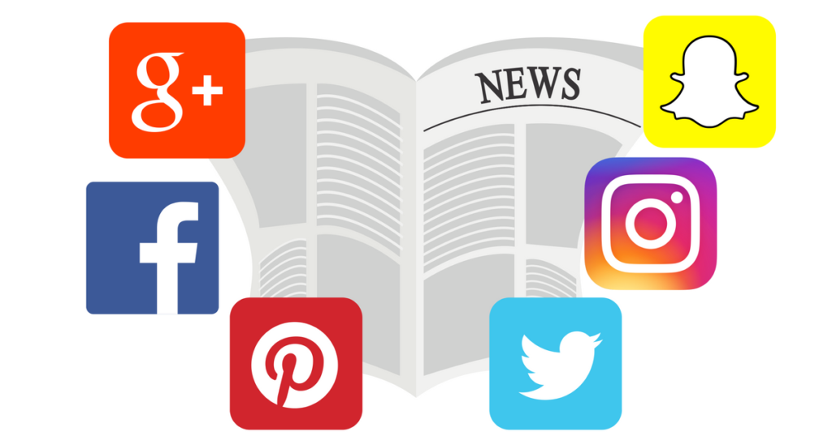
The journalist faces the following considerations when using social media to construct and/or enhance their personal brand:
*The platforms used. What are the affordances of each platform? Which platforms are the journalist’s readers likely to be using, and why? That last question reminds us of the importance of identifying and catering for your target audience.

Slide 44

* The kinds of content posted on that platform. It seems obvious that the journalist should promote their own work. Should they also promote the work of colleagues? Post material about their personal lives? Post about their political opinions and personal interests?

Slide 45

* How often the social media platforms will be updated. The contemporary journalist is a busy creature—who’s got the time to spend all day on Twitter? Yet, a failure to check in to social media can create the impression that the journalist doesn’t care about what those reading their work have to say—and this can mean a reduced number of followers.

Slide 46
* Tone, Will the tone be straight-faced? Satirical? Whimsical? A combination of the three? The tone of a journalist’s social media presence should be dictated by the tone of their journalism.
* Whether to engage with those who comment on posts. Social media is not the only place where journalists can interact with readers; this has also been a function of the below-the-line comments sections in online publications

Slide 47
It should go without saying that journalists should be wary of posting the following material to their professional social media pages:
# Material that could reflect poorly on their employers;
# Material that is unverified and/or factually dubious;
# Material that could be regarded as litigious in nature;
# Material that is ethically dubious and/or harmful.

Slide 48
Lecture 2
Lecture Outlines:
* Digital Journalism: the line between ‘Producer’ and ‘Consumer’
* What is ‘Journalism’? Who Are ‘Journalists’?
* Digital Journalism: Key Features
* New Journalistic Identities
* Journalists on Social Media

Slide 49


Lecture 2
Lecture References:
* Jenkins, H., Ford, S., & Green, J. (2013), Spreadable media: Creating value and meaning in a networked culture, New York University Press.
* Jay Daniel Thompson & John Weldon (2022), Content Production for Digital Media: An Introduction, Springer Nature Singapore.

Slide 50


Thank You

Slide 51

Digital Content
Direction
Lecture 2
DGM 733
Prepared by:
Dr. Sherihan Mohamed

