Slide 1


System Administration (2)
IT401
Prepared by
Dr. Ahmed El-Douh
Orientation Lecture

Slide 2



System Administration 2
Lecture 0
IT401
System Administration
Prepared by
Dr. Ahmed El-Douh

Slide 3

Who Am I ?
December 2024 - Current
Assistant Professor, Ashur University, Baghdad, Iraq
2023 - 2024
Lecturer, October 6 University, Egypt
• Google Scholar:
https://scholar.google.com.eg/citations?hl=en&user=eGZioxgAAAAJ
Ph.D.: Cyber Security - 2022
Huazhong University of Science and Technology
School of Cyber Science and Engineering, China
Awarded [ HUST University Outstanding Students Award 2022]
M.D.: Big Data - 2019
Cairo University
Faculty of Computers and Artificial Intelligence, Egypt

Slide 4
Course Description
This course provides a practical introduction to Linux system administration in enterprise environments. Students will learn core concepts such as system architecture, command-line usage, file and user management, networking, and security. The course emphasizes hands-on experience through real-world lab exercises.
www.midocean.ae

Slide 5
Course Learning Outcomes
After learning the course, the students should be able to:
  Describe Linux history, architecture, and system components.
  Install and configure Linux operating systems.
  Apply essential GNU/Linux commands and manage the file system hierarchy.
  Administer users, groups, processes, and system services.
  Configure networking and implement basic security measures.
  Develop shell scripts to automate administrative tasks.
  Analyze system performance and manage logs effectively.
www.midocean.ae

Slide 6
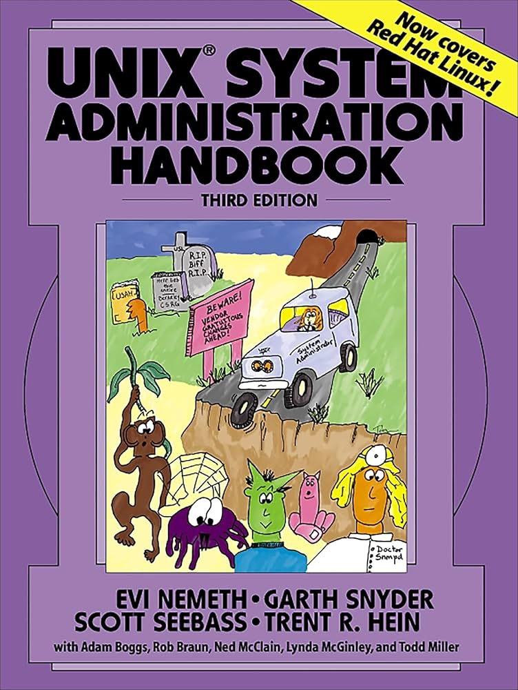
References
  Required Textbook:
  Title: "UNIX and Linux System Administration Handbook" (5th Edition)
  Author: Evi Nemeth, Garth Snyder, Trent R. Hein, and Ben Whaley
Red Hat System Administration 9 Training Material.
Note: The main material and reference for each course will be the Lecture notes and slides that the professor prepares. Textbook and other materials are additional resources.
www.midocean.ae

Slide 7

Course Plan
Week | Topics
1 | Orientation week
2 | Core Concepts in System Administration
3 | Introduction to Linux & System Architecture
4 | Access the command line & Manage files from the command line
5 | Get help in Red Hat Enterprise Linux & Create, view, and edit text files
6 | Manage local Users and Groups
7 | Control Access to Files
8 | Monitor and manage Linux processes & Control Services
9 | Configure and Secure SSH & Manage Networking
10 | Analyze and Store logs
11 | Install and Update Software
www.midocean.ae

Slide 8
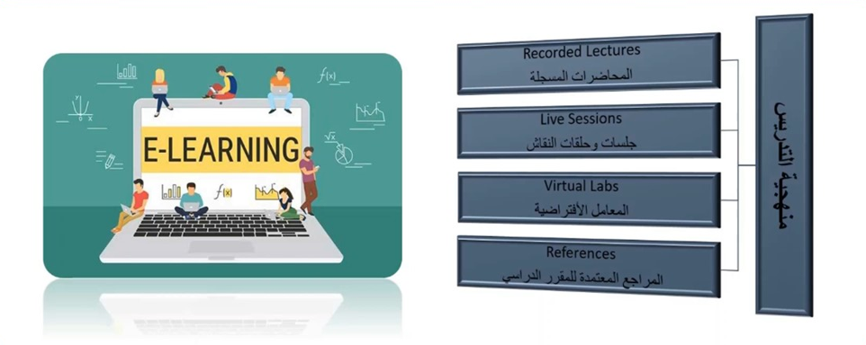
Teaching Methodology
www.midocean.ae

Slide 9
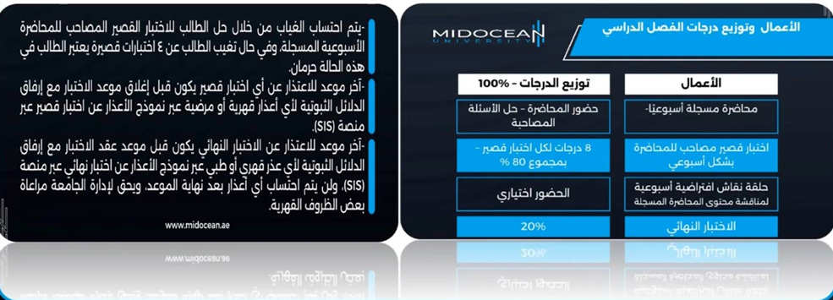
Study System
www.midocean.ae

Slide 10

Course Information - Evaluation
www.midocean.ae

Slide 11



Thank You

