Slide 1


Financial Accounting
Prepared by Dr. Emad Zaher
Assistant Professor of Accounting
MGM611
Lecture 2
Analyzing and Recording process

Slide 2

Learning outcomes
Chapter (1) Introduction to Financial Accounting
LO 1 Identify the Recording process in the general journal.
LO 2 Explain the Posting process to ledger accounts (T-Accounts).
LO 3 Describe the trial balance as a Main source of preparing the financial statements.

Slide 3





Step 2,3&4 Analyzing ,Recording& posting Process
Analyze each transaction and
event from source documents
Record relevant transactions
and events in a journal
Prepare and analyze the trial balance
Post journal information to ledger accounts

Slide 4

JOURNALIZING & POSTING TRANSACTIONS
Assets
= +
Liabilities Equity
T- Account
(Left side)
Debit
(Right side)
Credit
Step 1: Analyze transactions and source documents.
Step 2: Apply double-
entry accounting
ACCOUNT NAME: ACCOUNT No.
 | Date | Description | PR | Debit | Credit | Balance
GENERAL JOURNAL Page 123
 | Date |  | Description | Post. Ref. | Debit | Credit
Step 4: Post entry to ledger
Step 3: Record journal entry

Slide 5










= +
Double-Entry Accounting (Reminder)
Assets
Liabilities
Equity
ASSETS
LIABILITIES
EQUITIES
Debit
Credit
Debit
Credit
+ -
Debit Credit
+
- +
-
Normal
Normal
Normal

Slide 6
Journalizing Transactions
❶Transaction Date
❷Titles of Affected Accounts
Date
Description
Debit
Credit
2011
Dec.
1 Cash
30,000
C. Taylor, Capital
30,000
Investment by owner
Dec.
2 Supplies
2,500
Cash
2,500
Purchased supplies for cash
❹Transaction explanation
❸Dollar amount of debits
and credits

Slide 7

Posting Journal Entries
Enter the amount and description.

Slide 8
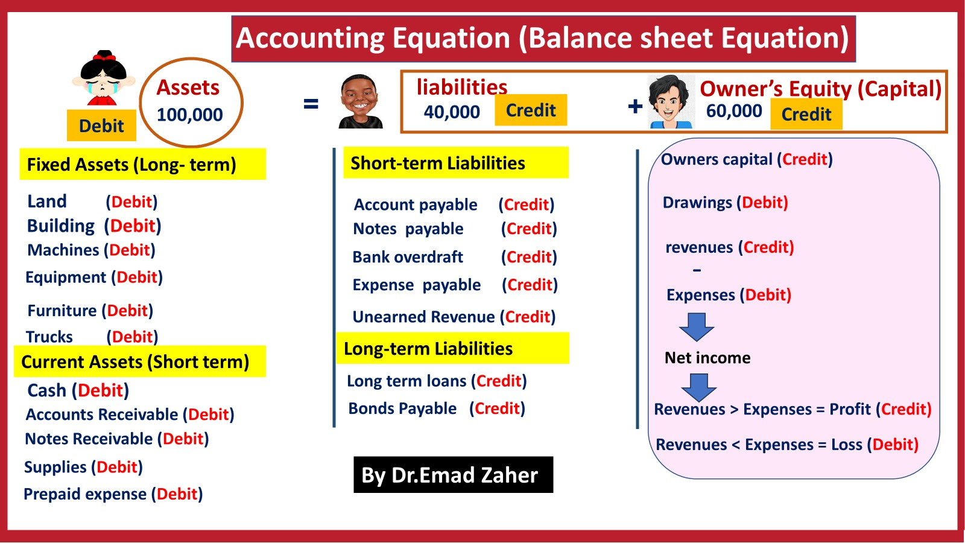
Kind Reminder

Slide 9
Analyzing Transactions
Transaction:
Owner invested $30,000 in FastForward on Dec. 1.
Analysis:
Assets | = Liabilities + | Equity
Cash 30,000 |  | Capital 30,000
Double entry:
Posting:
(1) | Cash C. Taylor, Capital | 101 | 30,000
 |  | 301 |  | 30,000
Cash
101
C. Taylor, Capital
301
301
(1)
30,000
(1) 30,000

Slide 10
Transaction:
FastForward purchases supplies by paying $2,500
cash.
Analysis:
Assets | = Liabilities + | Equity
Cash Supplies (2,500) 2,500 |  | Capital
Double entry:
(2) Supplies
Cash
126
101
2,500
2,500
Posting:
Supplies 126 |  |  | Cash |  |  |  | 101
(2) | 2,500 |  | (1) | 30,000 | (2) |  | 2,500

Slide 11
Transaction:
FastForward purchases equipment by paying $26,000
cash.
Analysis:
Assets | = Liabilities + | Equity
Cash Equipment (26,000) 26,000 |  | Capital
Double entry:
(3) Equipment
Cash
167
101
26,000
26,000
Posting:
Equipment
167
Cash |  |  |  | 101
(1) | 30,000 | (2) |  | 2,500
 |  | (3) |  | 26,000
(3)
26,000

Slide 12
Transaction:
FastForward purchases $7,100 of supplies on credit.
Analysis:
Assets | = Liabilities + Accounts Payable 7,100 | Equity
Supplies 7,100 |  | Capital
Double entry:
(4) Supplies
Accounts payable
126
201
7,100
7,100
Posting:
Supplies
126
Accounts Payable
201
(2)
(4)
2,500
7,100
(4) 7,100

Slide 13
Transaction:
FastForward provides consulting services and
immediately collects $4,200 cash.
Analysis:
Assets | = Liabilities + | Equity
Cash 4,200 |  | Revenue 4,200
Double entry:
(5) Cash
101
403
4,200
Consulting Revenue
4,200
Posting:
Consulting Revenue 403
Cash |  |  |  | 101
(1) | 30,000 | (2) |  | 2,500
(5) | 4,200 | (3) |  | 26,000
101
403
(5)
4,200

Slide 14
After processing its remaining transactions for December, FastForward’s Trial Balance is prepared.
FastForward Trial Balance
December 31, 2011
Debits
The trial balance lists all account balances in the general ledger. If the books are in balance, the total debits will equal the total credits.
Credits
Cash
$ 5700
Accounts receivable Supplies
-
9600
Equipment Accounts payable
26,000
$ 7100
C. Taylor, Capital
30,000
Consulting revenue
4200
Total
$ 41300 $ 41300

Slide 15
Another Example (Analyzing, recording& Posting)
Prepared by Dr. Emad Zaher

Slide 16
Posting
1. October 1: Shareholders invest ₺100,000 cash in an advertising venture to be known as Pioneer Advertising Agency Inc.
Oct. 1
Cash 100,000
Share Capital—Ordinary
100,000
Cash
Share Capital—Ordinary
Debit
Credit
Debit | Credit
 | 100,000
100,000

Slide 17
Posting
2. October 1: Pioneer purchases office equipment costing
₺50,000 by signing a 3-month, 12%, ₺50,000 note payable.
Oct. 1
Equipment
Notes payable
50,000
50,000
Equipment Debit
50,000
Notes Payable
Credit
Debit
Credit
50,000

Slide 18
Posting
3. October 2: Pioneer receives a ₺12,000 cash advance from KC, a client, for advertising services that are expected to be completed by December 31.
Oct. 2
Cash 12,000
Unearned Service Revenue
12,000
Cash
Unearned Service Revenue
Debit
Credit
Debit | Credit
 | 12,000
100,000
12,000

Slide 19
Posting
4. October 3: Pioneer pays ₺9,000 office rent, in cash, for
October.
ILLUSTRATION 3-12
Oct. 3
Rent Expense 9,000
Cash
9,000
Cash
Debit Credit
100,000 9,000
Rent Expense
Debit Credit
9,000
12,000

Slide 20
Posting
5. October 4: Pioneer pays ₺6,000 for a one-year insurance
policy that will expire next year on September 30.
Oct. 4
Prepaid Insurance 6,000
Cash
6,000
Cash
Prepaid Insurance Debit Credit
Debit | Credit
100,000 | 9,000
12,000 | 6,000
6,000
Prepared by Dr. Emad Zaher

Slide 21
Posting
6. October 5: Pioneer purchases, for ₺25,000 on account, an estimated 3-month supply of advertising materials from Aero Supply.
Oct. 5
Supplies 25,000
Accounts Payable
25,000
Supplies
Accounts Payable
Debit
Credit
Debit | Credit
 | 25,000
25,000
Prepared by Dr. Emad Zaher

Slide 22
Posting
7. October 9: Pioneer signs a contract with a local newspaper for advertising inserts (flyers) to be distributed starting the last Sunday in November. Pioneer will start work on the content of the flyers in November. Payment of ₺7,000 is due following delivery of the Sunday papers containing the flyers.
A business transaction has not occurred. There is only an agreement between Pioneer Advertising and the newspaper for the services to be provided in November. Therefore, no journal entry is necessary in October.
Prepared by Dr. Emad Zaher

Slide 23
Posting
8. October 20: Pioneer’s board of directors declares and pays
a ₺5,000 cash dividend to shareholders.
Oct. 20
Dividends 5,000
Cash
5,000
Cash
Dividends
Debit | Credit
100,000 | 9,000
12,000 | 6,000
Debit
Credit
5,000
5,000

Slide 24
Posting
9. October 26: Employees are paid every four weeks. The total payroll is ₺2,000 per day. The pay period ended on Friday, October 26, with salaries of ₺40,000 being paid.
Oct. 26
Salaries and Wages Expense 40,000 Cash
40,000
Cash
Salaries and Wages Expense Debit Credit
40,000
Debit | Credit
100,000 | 9,000
12,000 | 6,000
 | 5,000
40,000

Slide 25
10. October 31: Pioneer receives ₺28,000 in cash and bills Copa Company ₺72,000 for advertising services of
₺100,000 provided in October.
Oct. 31
Cash
Accounts Receivable
Service Revenue
28,000
72,000
100,000
Cash
Accounts Receivable Debit Credit
72,000
Service Revenue
Debit | Credit
100,000 | 9,000
12,000 | 6,000
28,000 | 5,000
 | 40,000
80,000
Debit | Credit
 | 100,000

Slide 26
Trial Balance
A Trial Balance
List of each account and its balance in the order in which they appear in the ledger.
Debit balances listed in the left column and credit balance in the right column.
Used to prove the mathematical equality of debit and credit balances.
Uncovers errors in journalizing and posting.

Slide 27
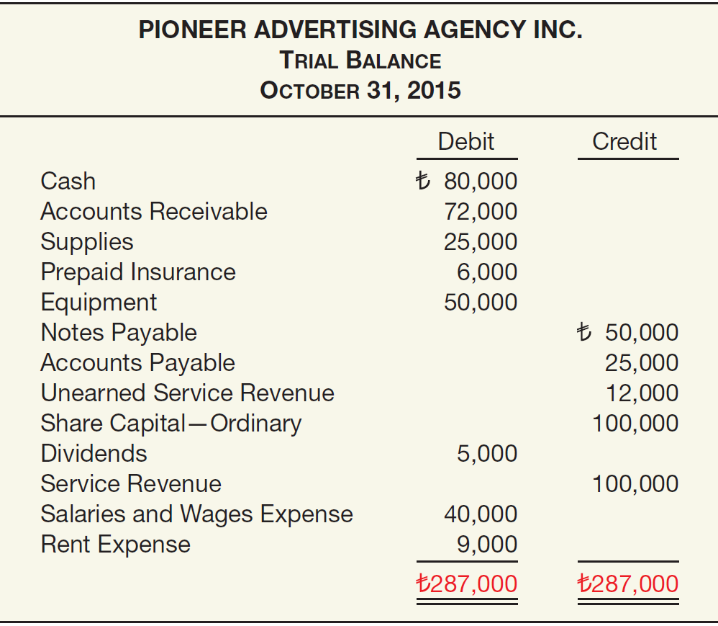
ILLUSTRATION 3-19

Slide 28
Additional Examples
Prepared by Dr. Emad Zaher

Slide 29
- Sept. 1 The owner deposited L.E 50000 in the bank account of the business.
Date | Account titles | Debit | Credit
Sept.1 | Cash Owner’s capital | 50000 | 50000

Slide 30
Sept. 4 Purchased supplies for L.E 3000 cash.
Date | Account titles | Debit | Credit
Sept.1 Sept.4 | Cash Owner’s capital | 50000 3000 | 50000 3000
 | Supplies Cash

Slide 31
- Sept. 7 Purchased equipment on account for L.E 8000.
Date | Account titles | Debit | Credit
Sept.1 Sept.4 Sept.7 | Cash Owner’s capital | 50000 3000 8000 | 50000 3000 8000
 | Supplies Cash
 | Equipment Accounts payable

Slide 32
- Sept. 11 Paid salaries for L.E 6000 Cash.
Date | Account titles | Debit | Credit
Sept. 1 Sept.4 Sept.7 Sept.11 | Cash Owner’s capital | 50000 3000 8000 6000 | 50000 3000 8000 6000
 | Supplies Cash
 | Equipment Accounts payable
 | Salaries expense Cash

Slide 33
- Sept. 15 Performed services for customer for L.E 2,500 on account.
Date | Account titles | Debit | Credit
Sept.1 Sept.4 Sept.7 Sept.11 Sept.15 | Cash Owner’s capital | 50000 3000 8000 6000 2500 | 50000 3000 8000 6000 2500
 | Supplies Cash
 | Equipment Accounts payable
 | Salaries expense Cash
 | Accounts receivable Service revenue

Slide 34
Date | Account titles | Debit | Credit
Sept.1 Sept.4 Sept.7 Sept.11 Sept.15 Sept.20 | Cash Owner’s capital | 50000 3000 8000 6000 2500 500 | 50000 3000 8000 6000 2500 500
 | Supplies Cash
 | Equipment Accounts payable
 | Salaries expense Cash
 | Accounts receivable Service revenue
 | Adv. expense Accounts payable
-Sept. 20 Received bill from ElAhram for the advertising
-of the opening of the
- company for L.E 500.

Slide 35
-Sept. 22 Received L.E 1000 cash from customers billed on Sept.15.
Date | Account titles | Debit | Credit
Sept.1 Sept.4 Sept.7 Sept.11 Sept.15 Sept.20 Sept.22 | Cash Owner’s capital | 50000 3000 8000 6000 2500 500 1000 | 50000 3000 8000 6000 2500 500 1000
 | Supplies Cash
 | Equipment Accounts payable
 | Salaries expense Cash
 | Accounts receivable Service revenue
 | Adv. expense Accounts payable
 | cash Accounts receivable

Slide 36
-Sept. 25 withdrew L.E 800 cash for personal use of owner.
Date | Account titles | Debit | Credit
Sept. 1 Sept.4 Sept.7 Sept.11 Sept.15 Sept.20 Sept.22 Sept.25 | Cash Owner’s capital | 50000 3000 8000 6000 2500 500 1000 800 | 50000 3000 8000 6000 2500 500 1000 800
 | Supplies Cash
 | Equipment Accounts payable
 | Salaries expense Cash
 | Accounts receivable Service revenue
 | Adv. expense Accounts payable
 | cash Accounts receivable
 | Drawings cash

Slide 37
- Sept. 30 Paid L.E 1500 for September rent for office space.
Date | Account titles | Debit | Credit
Sept. 1 Sept.4 Sept.7 Sept.11 Sept.15 Sept.20 Sept.22 | Cash Owner’s capital | 50000 3000 8000 6000 2500 500 1000 800 1500 | 50000 3000 8000 6000 2500 500 1000 800 1500
 | Supplies Cash
 | Equipment Accounts payable
 | Salaries expense Cash
 | Accounts receivable Service revenue
 | Adv. expense Accounts payable
 | cash Accounts receivable
Sept.25 | Drawings cash
Sept.30 | Rent expense cash

Slide 38










Trail balance
Cash ledger
Debit
50000
50.000 | 3.000
1.000 | 6.000
 | 800
 | 1500
51000 | 11.300
39700
Date
Account titles
Credit
Sept.1
Cash
Owner’s capital
Account | Debit | Credit
Cash Supplies Equipment Accounts receivable Accounts payable Owner’s capital Owner's drawings Revenues Salaries expense Advertising expense Rent expense | 39700 3000 8000 1500 800 6.000 500 1.500 | 8500 50.000 2500
 | 61000 | 61000
50000
Sept.4
Supplies
Cash
3000
8000
3000
Sept.7
Equipment
Accounts payable
Account receivable
8000
2500 | 1000
1500
_{Sept.11} Salaries expense
6000
Cash
6000
_{Sept.15} Accounts receivable
2500
Account payable
revenue
2500
 | 8000 500
 | 8500
Sept.20
Adv. expense Accounts payable
500
500
Sept.22
cash
1000
800
Accounts receivable
1000
800
1500
Sept.25
Drawings
cash
Sept.30
Rent expense
cash
1500

Slide 39
Net income = revenues - expenses = 2500 - ( 6000+ 500 + 1500) = - 5500 loss
Owner`s equity = capital + Net income -
Balance sheet
drawings
= 50.000
Account | Debit | Credit
Cash | 39700
Supplies | 3000
Equipment | 8000
Accounts receivable | 1500
Accounts payable |  | 8500
Owner’s capital Owner's drawings Revenues | 800 | 50.000 2500
Salaries expense | 6.000
Advertising expense | 500
Rent expense | 1.500
 | 61000 | 61000
+ ( - 5500 ) - 800
= 43700
Cash | 39.700
Supplies | 3.000
Equipment | 8.000
Accounts receivable | 1.500
Total Assets |  | 52200
Accounts payable | 8500
Owner’s capital | 43700
Total Liabilities |  | 52200
What did the Company shows as total credits on its trial balance?
A | 61000 LE | B | 52200 LE
C | 22,000 LE | D | 24,000 LE
What did the Company shows as total debit on its balance sheet ?
A | 61000 LE | B | 52200 LE
C | 22,000 LE | D | 24,000 LE

Slide 40
Choose the correct answer for each of the following
1- A debit to an asset account indicates :
A | an error | B | a credit was made to a liability account
C | a decrease in the asset | D | An increase in the assets
2-When the owner invests cash in the business:
A | Owner's capital is debited and Cash is credited. |  | B | Cash is debited and Dividends is credited
C | Cash is debited and owner's capital is credited. |  | D | None of the above
3-Accounts that normally have debit balances are:
A | assets, expenses, and revenues. |  | B | assets, expenses, and equity.
C | assets, liabilities, and owner’s drawing. |  | D | assets, owner’s drawing, and expenses.
C
Cash is debited and owner's capital is credited.
D
assets, owner’s drawing, and expenses.
Prepared by Dr. Emad Zaher

Slide 41
4- Assets normally show:
A | credit balances. | B | debit balance
C | debit and credit balance | D | debit or credit balances
B
debit balance
5- A credit is not the normal balance for which account listed below?
A | Capital account | B | Revenue account
C | Liability account | D | Owner’s Drawings account
6-Credits:
A | decrease both assets and liabilities | B | decrease Assets and increase Liabilities.
C | increase both assets and liabilities | D | increase assets and decrease liabilities
B
decrease assets and increase liabilities
Prepared by Dr. Emad Zaher

Slide 42
7- A debit is not the normal balance for which account listed below?
A | Owner’s Drawings | B | Cash
C | Accounts Receivable | D | Service Revenue
D
Service Revenue
8- An account consists of
A | one part | B | two parts
C | three parts | D | four parts
C
three parts
9- An account will have a credit balance if the
A | credits exceed the debits | B | first transaction entered was a credit.
C | debits exceed the credits | D | last transaction entered was a credit
A
credits exceed the debits
Prepared by Dr. Emad Zaher

Slide 43
10- An account consists of
A | a title, a debit balance, and a credit balance. | B | a title, a left side, and a debit balance.
C | a title, a debit side, and a credit side. | D | a title, a right side, and a debit balance.
C
a title, a debit side, and a credit side.
11- Which one of the following is not a part of an account?
A | Credit side | B | Trial balance
C | Debit side | D | Title
B
Trial balance
12- After transaction information has been recorded in the journal, it is transferred to the
A | trial balance. | B | income statement.
C | book of original entry | D |  | Ledger
D
Ledger
Prepared by Dr. Emad Zaher

Slide 44
6- The right side of an account
A | is the correct side. | B | reflects all transactions for the accounting period.
C | shows all the balances of the accounts in the system. | D | Is the credit side
D
Is the credit side
7-Posting
A | normally occurs before journalizing | B | transfers ledger transaction data to the journal
C | transfers journal entries to ledger accounts | D | Is an optional step in the recording process
C
transfers journal entries to ledger accounts
8- Which of the following is the correct sequence of steps in the recording process?
A | Posting, journalizing, analyzing | B | Journalizing, analyzing, posting
C | Analyzing, posting, journalizing | D | Analyzing, journalizing, posting
D
Analyzing, journalizing, posting
Prepared by Dr. Emad Zaher

Slide 45
9- ABC Company showed the following balances at the end of its first year:
Cash | 2,000 | Notes payable | 3,500
Prepaid insurance | 3,500 | Owner’s Capital | 1,500
Accounts receivable | 4,000 | Owner’s Drawings | 1,000
Accounts payable | 2,000 | Revenues | 16,000
 |  | Expenses | 12,500
What did the Company shows as total credits on its trial balance?
A | 7,000 LE | B | 23,000 LE
C | 22,000 LE | D | 24,000 LE
The credit balance
revenue + Capital + Notes payable + Accounts payable =
= 2000 + 3500 + 1500 + 16000 = 23000 LE
Prepared by Dr. Emad Zaher

Slide 46
3- Which of the following is not a correct form of the accounting equation?
Assets = Equities.
Assets = Liabilities + owner's equity.
Assets – Liabilities = owner's equity.
Assets + owner's equity = Liabilities
4- Owner's equity is best described by the following
Assets = Liabilities.
Liabilities + Assets.
Assets – Liabilities.
None of the above
5- The basic accounting equation may be expressed as
Assets = Equities.
Assets – Liabilities = Owner's Equity.
Assets = Liabilities + Owner's Equity.
All of these answer choices are correct
Prepared by Dr. Emad Zaher

Slide 47
(6) Liabilities of a company would not include
Notes payable.
Accounts payable.
Salaries and wages payable.
cash.
(7) Owner's equity is decreased by all of the following except
Owner's drawings.
Owner's withdrawals.
Expenses.
Owner's investments.
8- Sources of increases to owner's equity are
Additional investments by owners.
Purchases of merchandise.
Withdrawals by the owner.
Expenses.
Prepared by Dr. Emad Zaher

Slide 48
9- Owner's equity is decreased by
A. Liabilities.
B. Assets
C. Expenses.
D. Revenues.
10- Net income results when
A. Assets > Liabilities.
B. Revenues = Expenses.
C. Revenues > Expenses.
D. Revenues < Expenses
Prepared by Dr. Emad Zaher

Slide 49
11) A Balance sheet shows
Revenues, liabilities, and owner's equity.
Assets, liabilities, and owner's equity
Revenues, expenses, and drawings.
Expenses, drawings, and owner's equity
(12) A net loss will result during a time period when
Drawings exceed investments.
Expenses exceed revenues
Liabilities exceed assets.
Revenues exceed expenses.
13) On December 31,2019, ABC company has assets of L.E 200,000 and owner's equity of L.E 120,000. What are the liabilities for the company on December 31, 2019?
a. L.E 200,000. b. L.E 80,000. c. L.E 320,000. d. L.E 640,000
Prepared by Dr. Emad Zaher

Slide 50




Thank You

