Slide 1
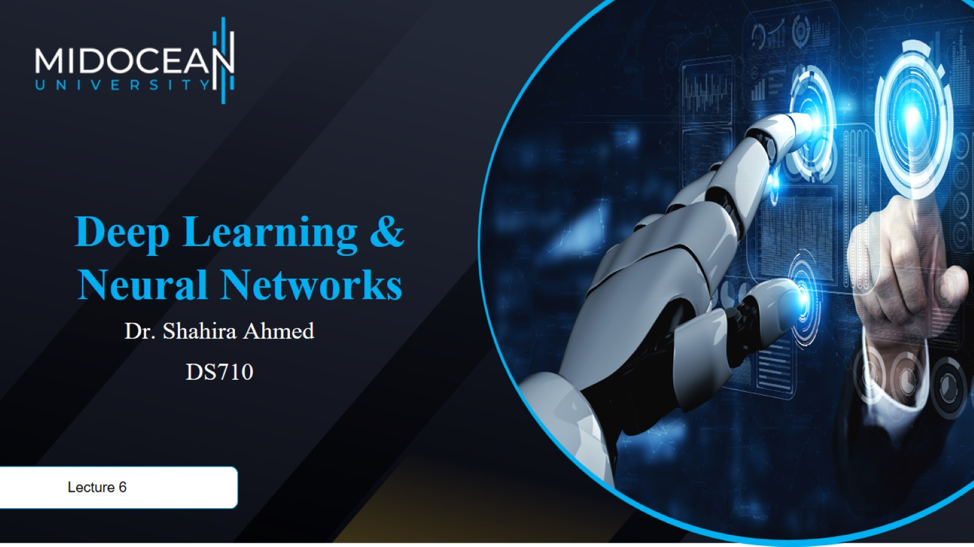

Slide 2


Slide 3
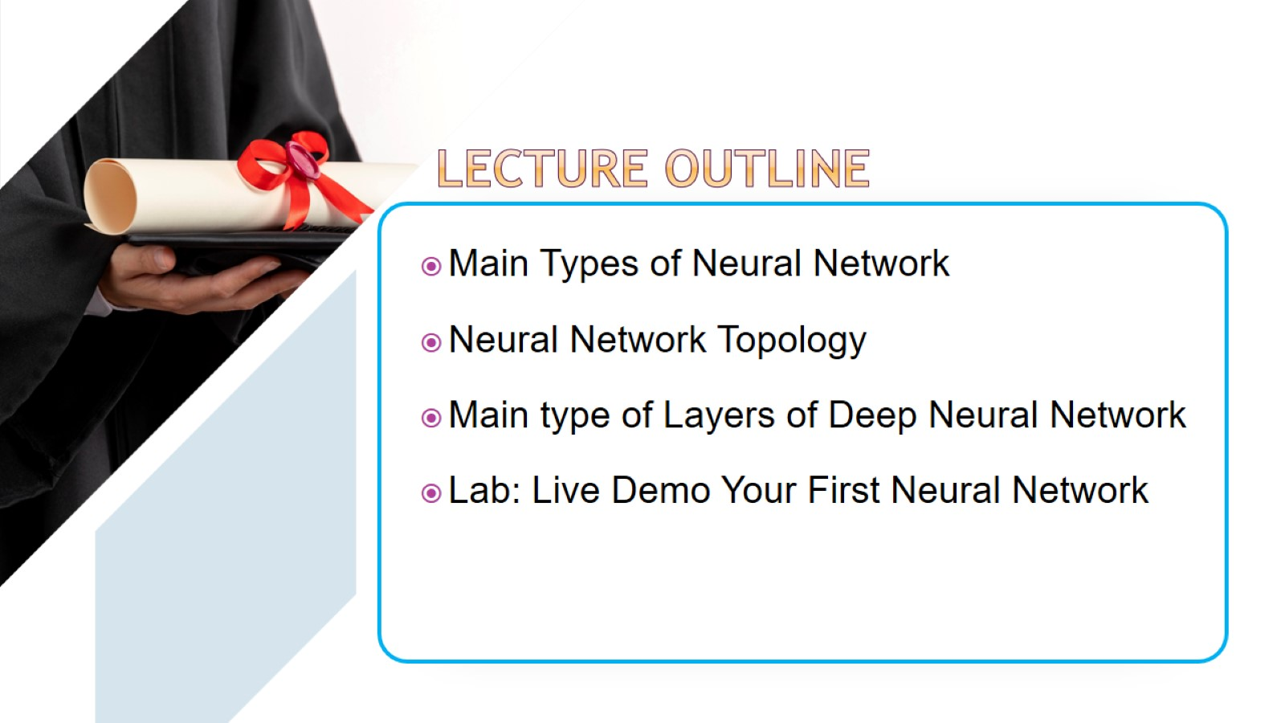

Slide 4
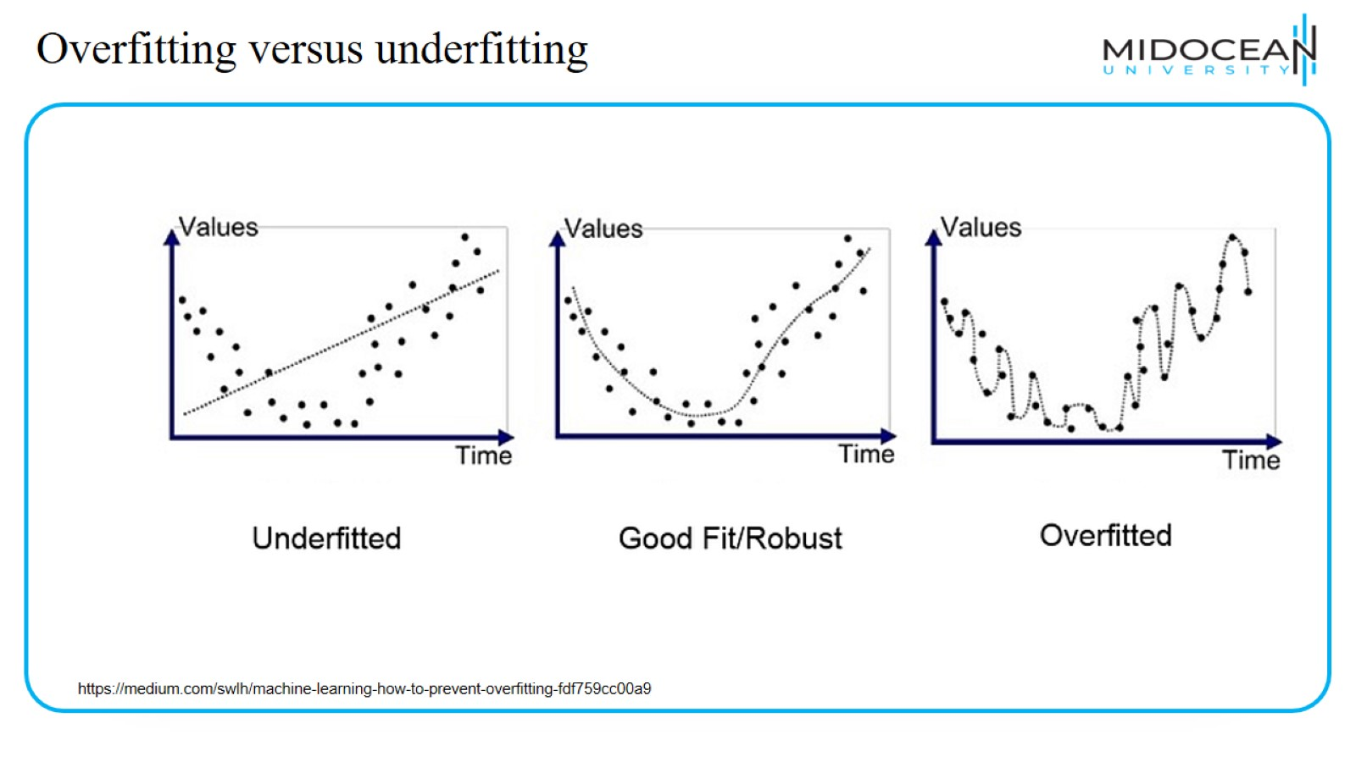
Overfitting versus underfitting

Slide 5
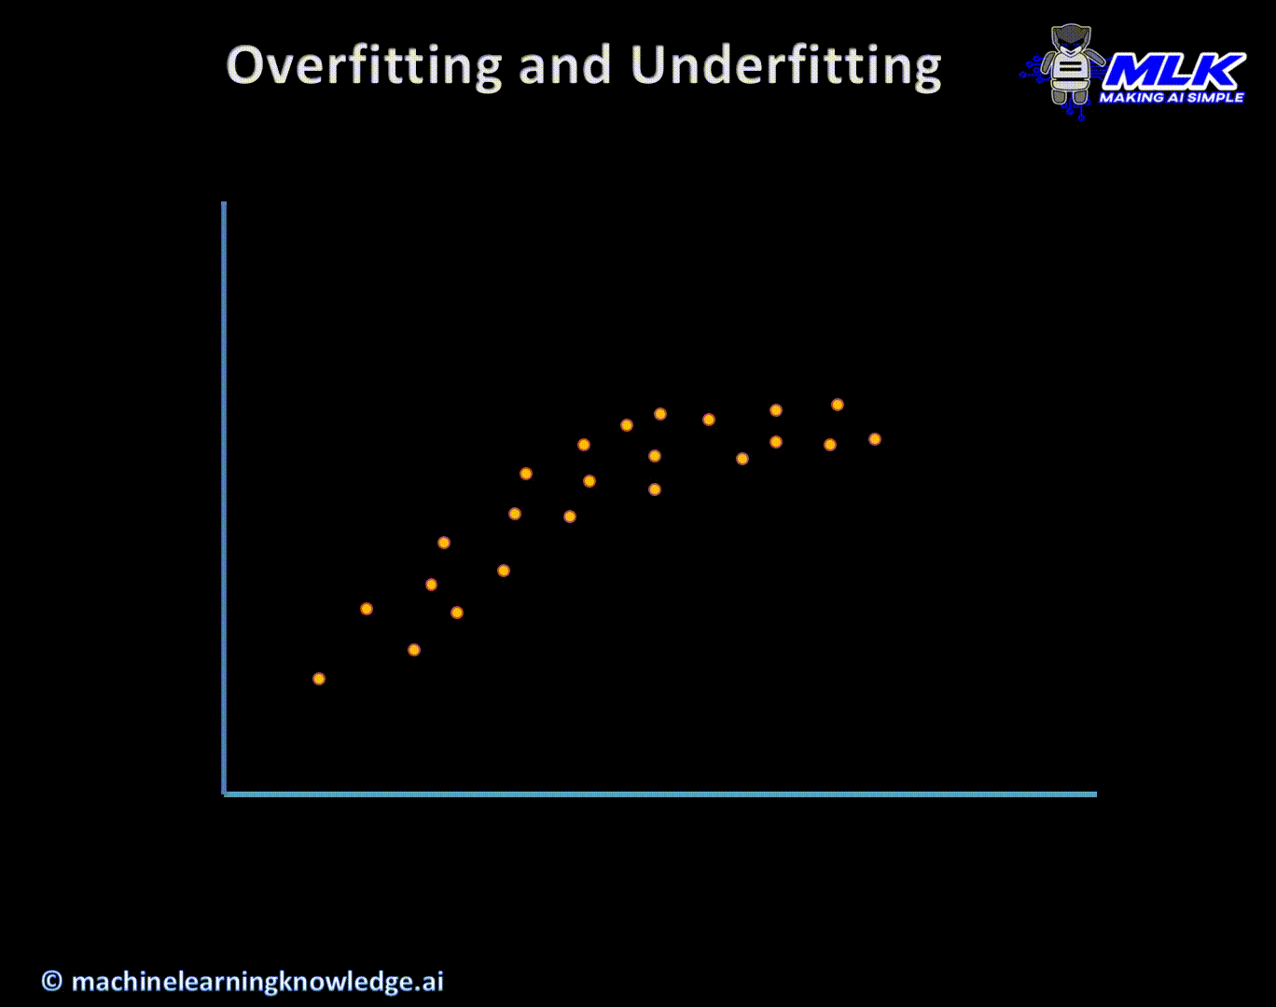
Overfitting versus underfitting
https://machinelearningknowledge.ai/overfitting-and-underfitting-in-machine-learning-animated-guide-for-beginners/

Slide 6
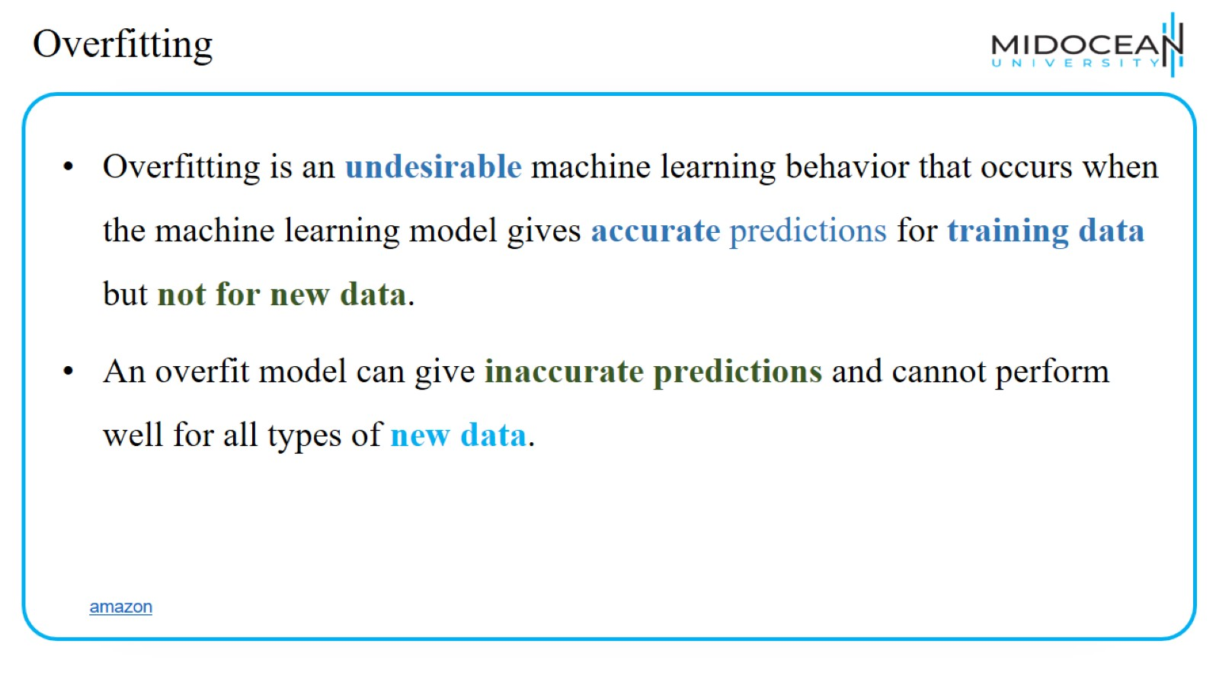
Overfitting

Slide 7
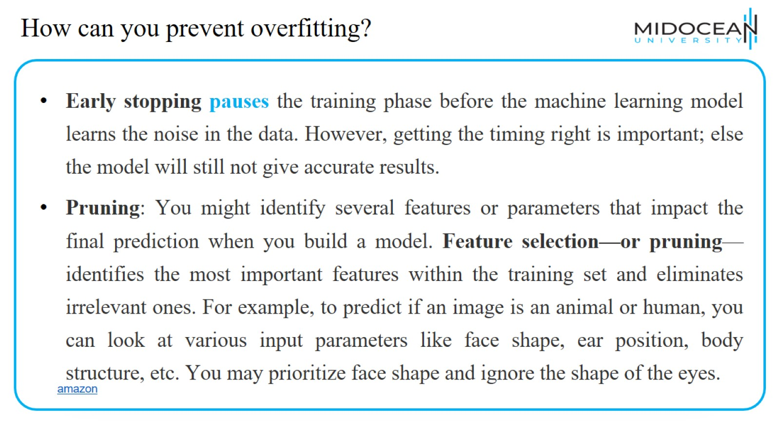
How can you prevent overfitting?

Slide 8
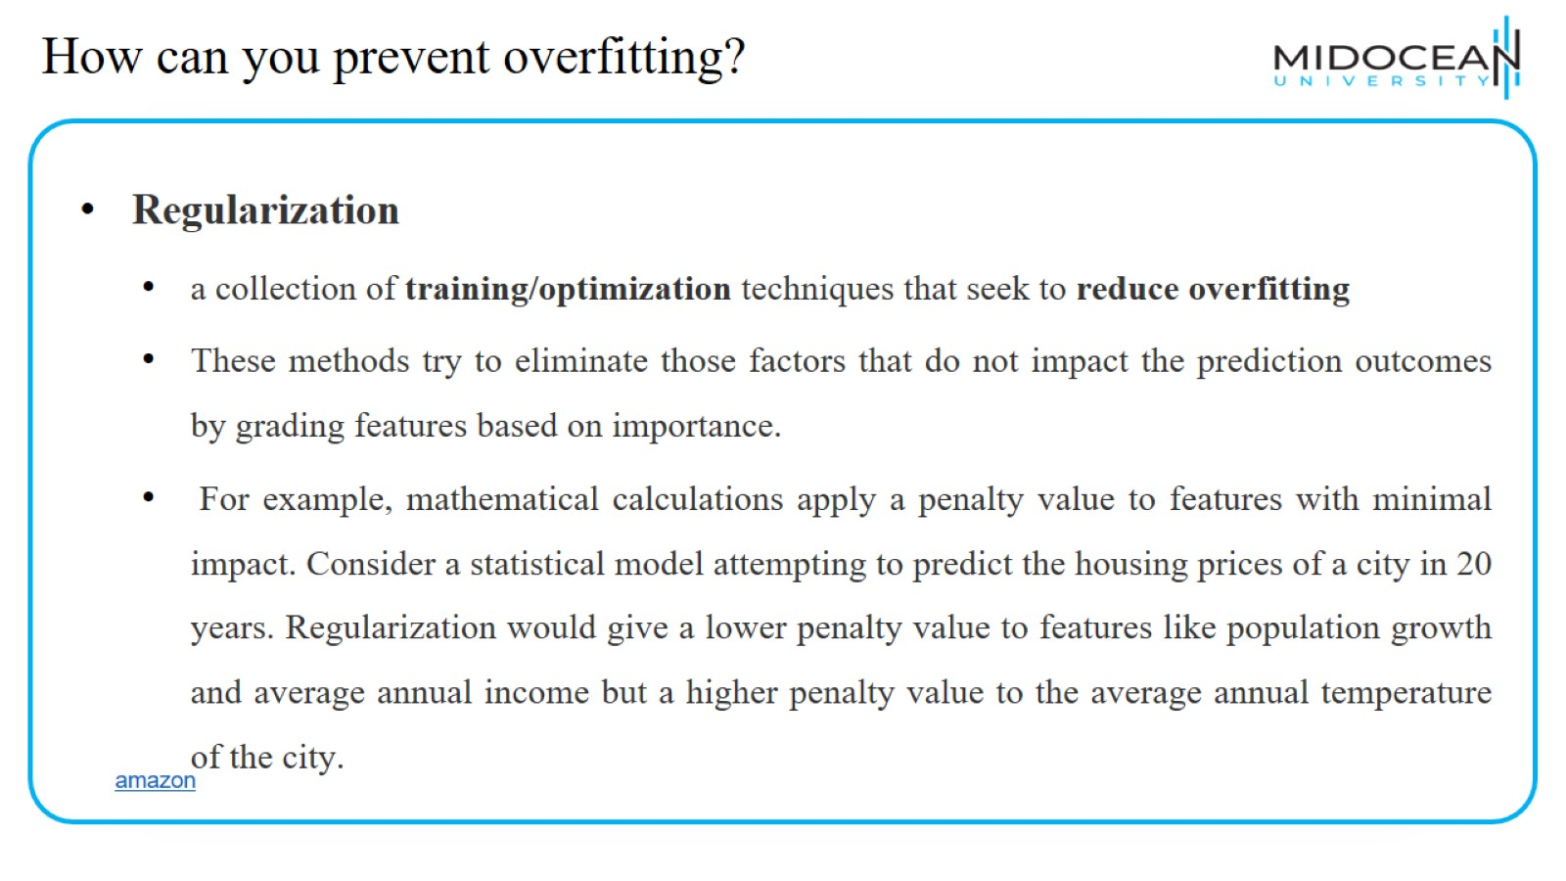
How can you prevent overfitting?

Slide 9
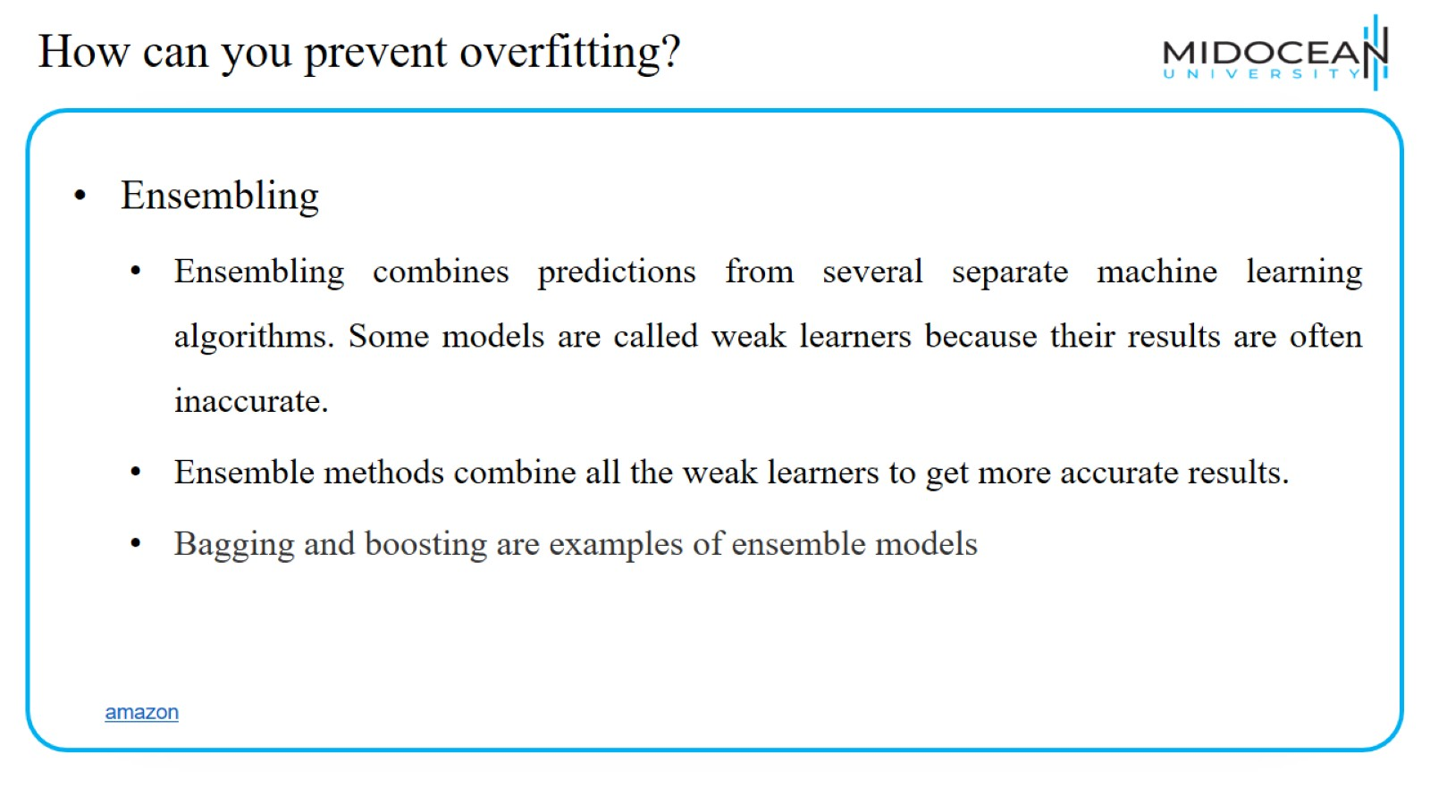
How can you prevent overfitting?

Slide 10
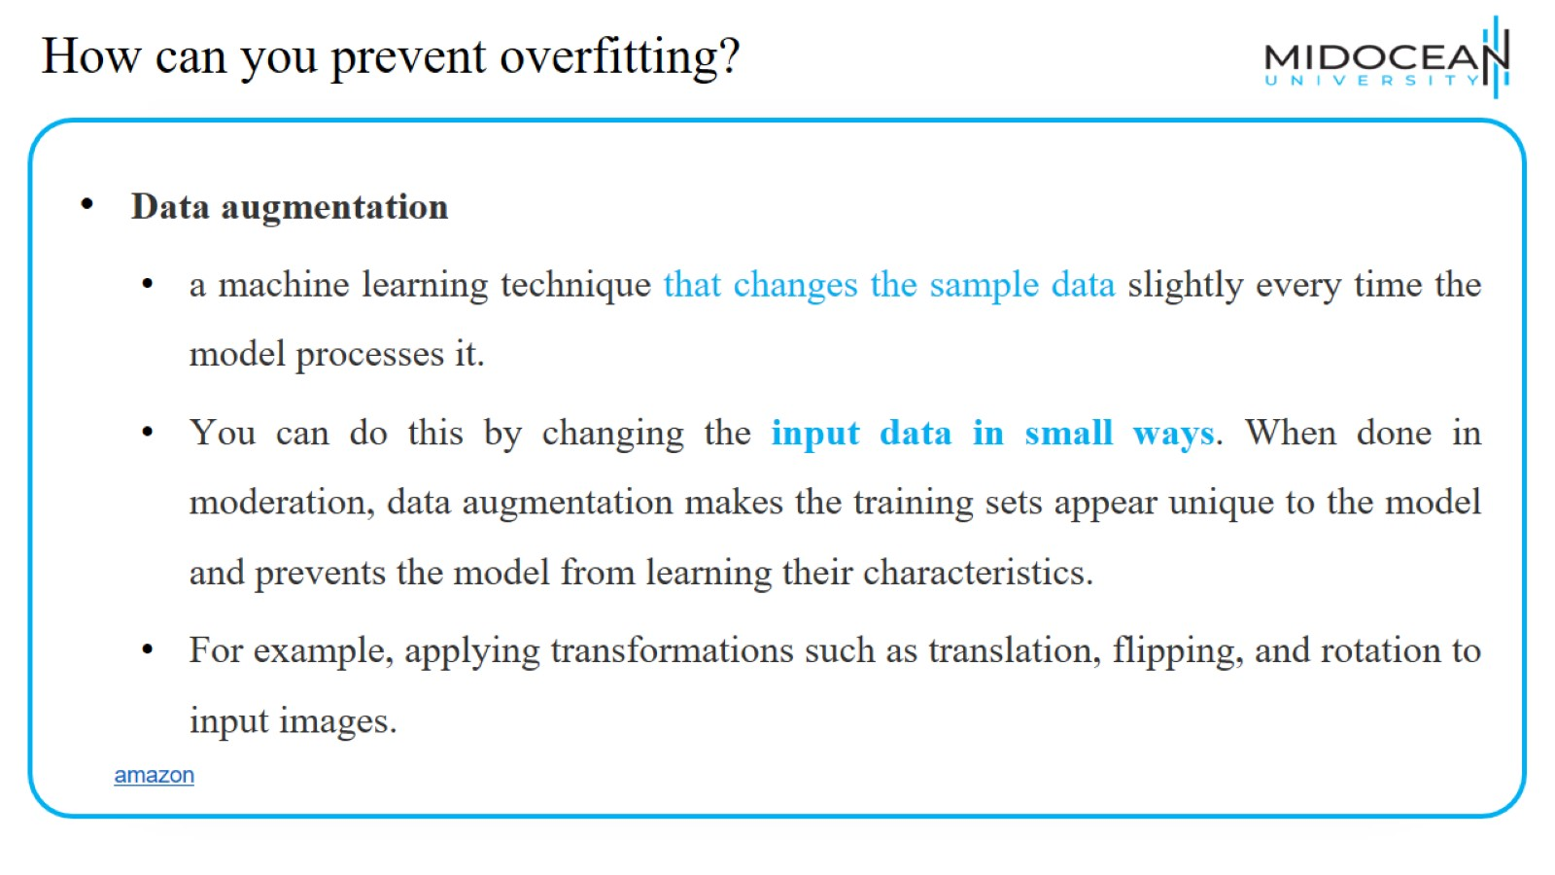
How can you prevent overfitting?

Slide 11
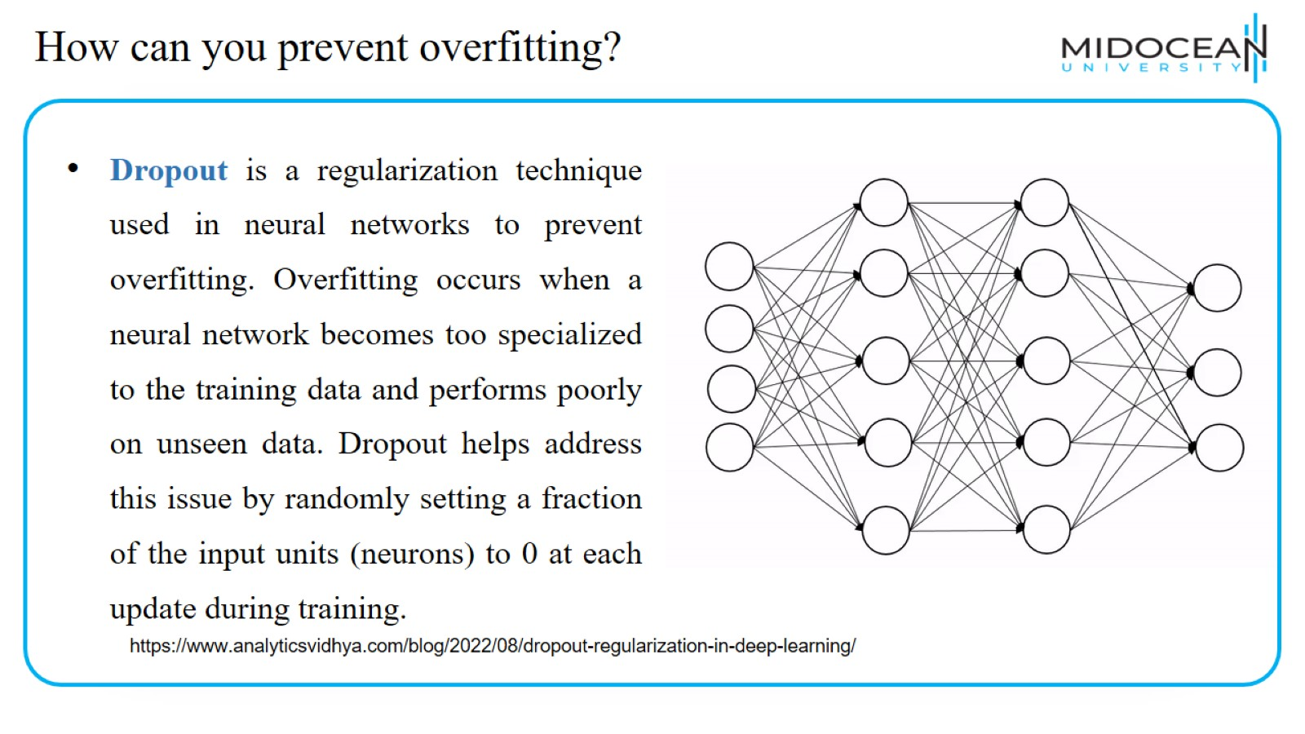
How can you prevent overfitting?

Slide 12
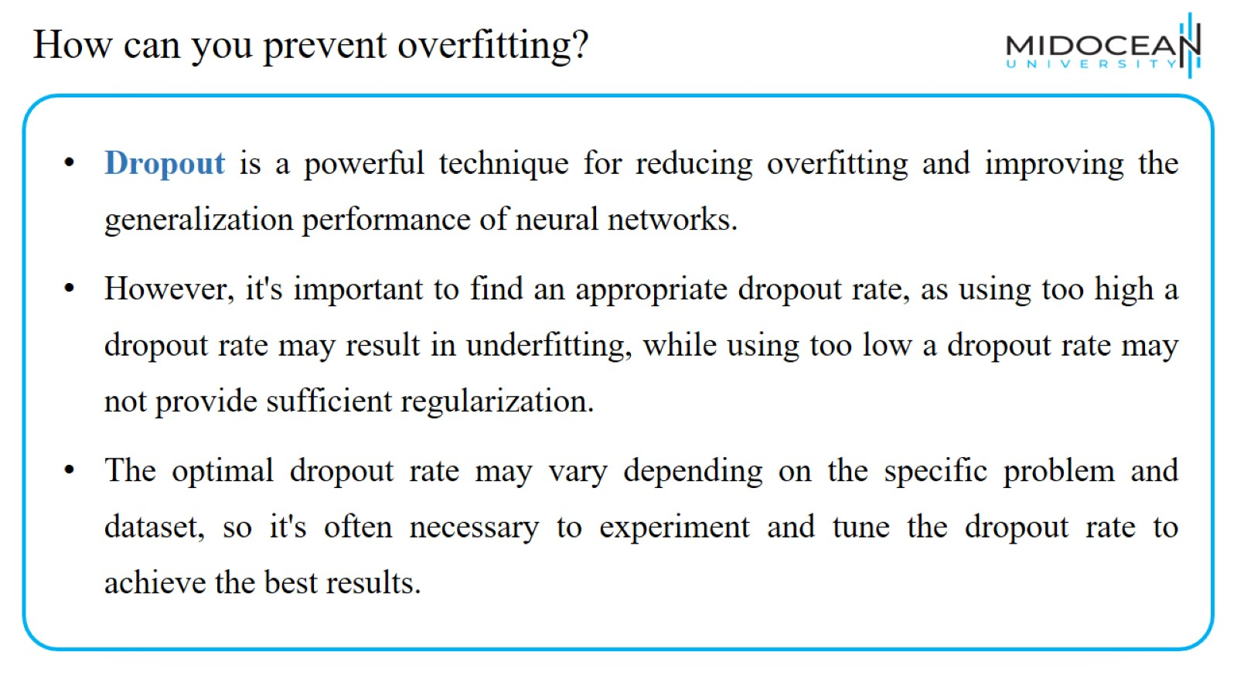
How can you prevent overfitting?

Slide 13
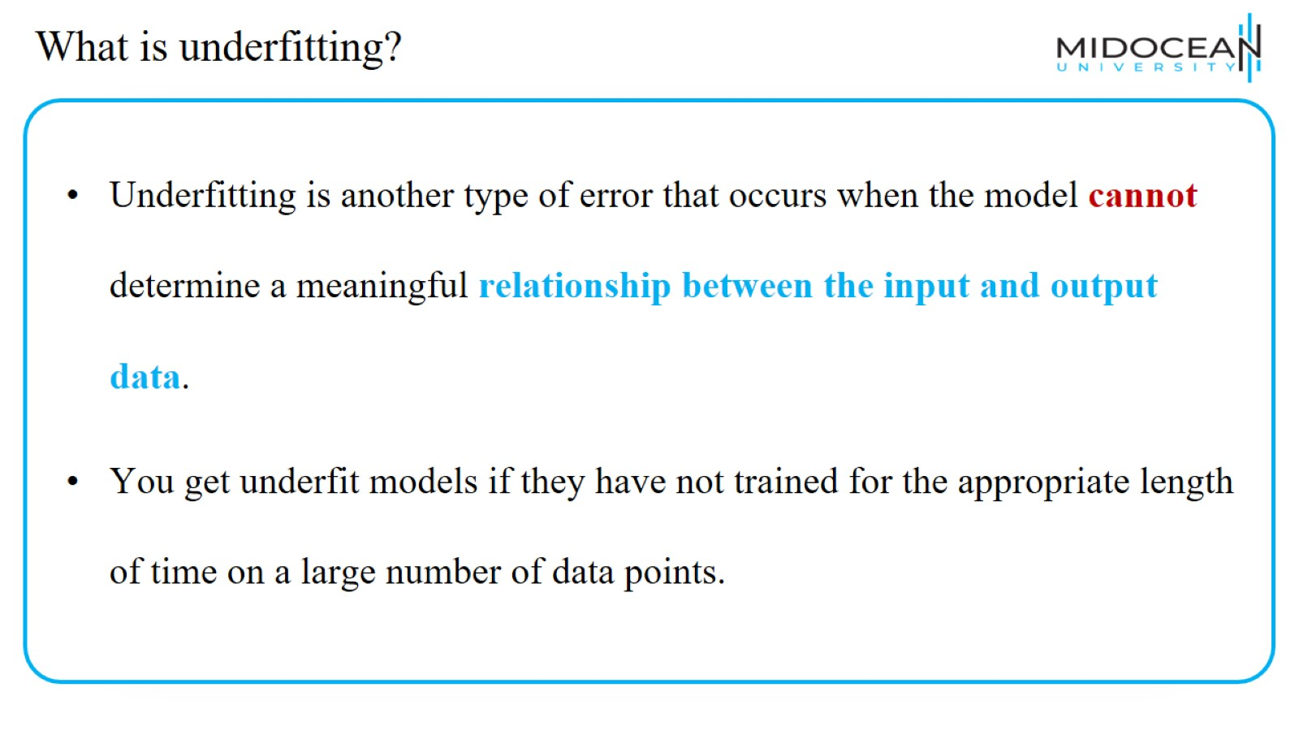
What is underfitting?

Slide 14
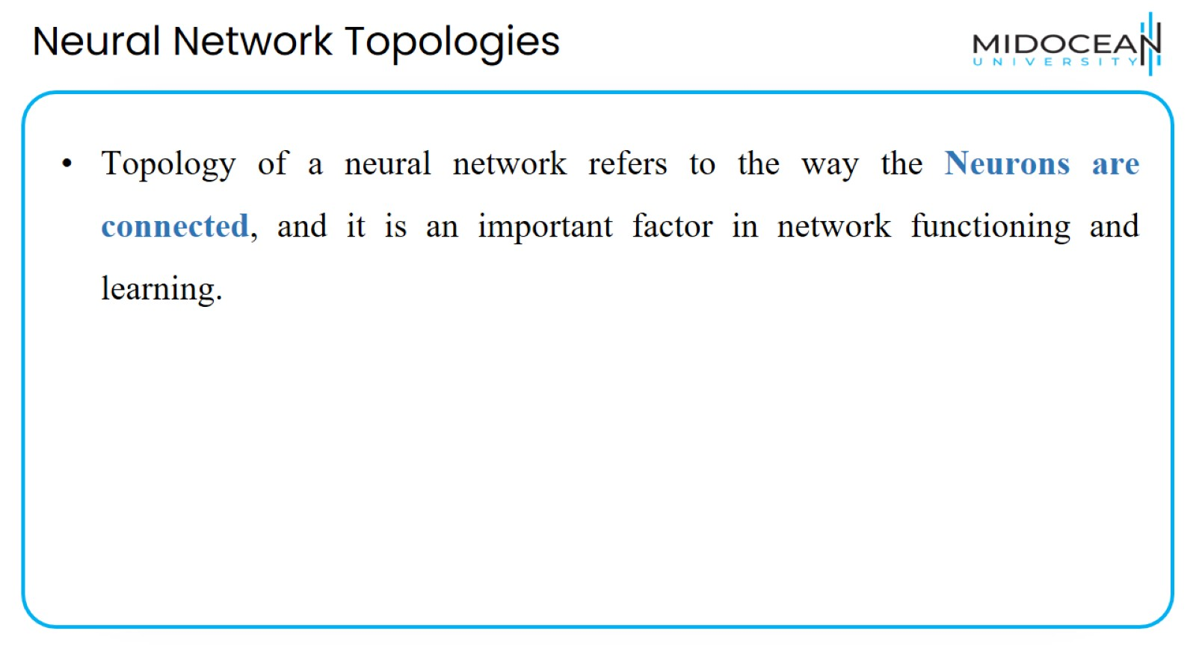
Neural Network Topologies

Slide 15
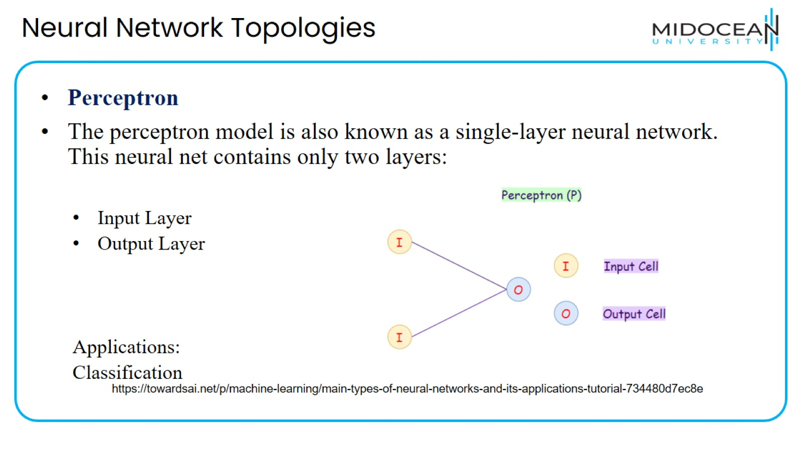
Neural Network Topologies

Slide 16
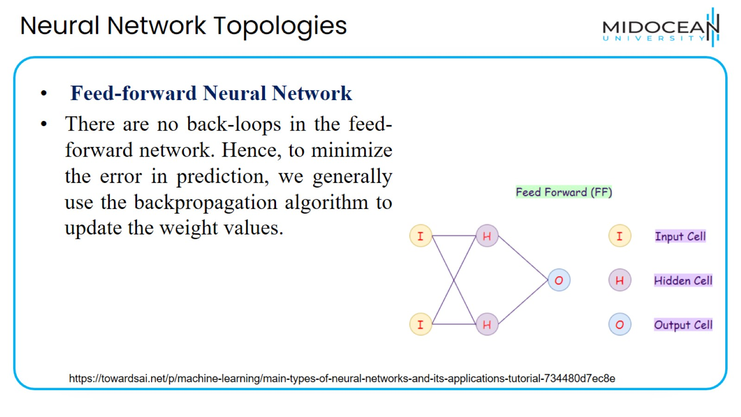
Neural Network Topologies

Slide 17
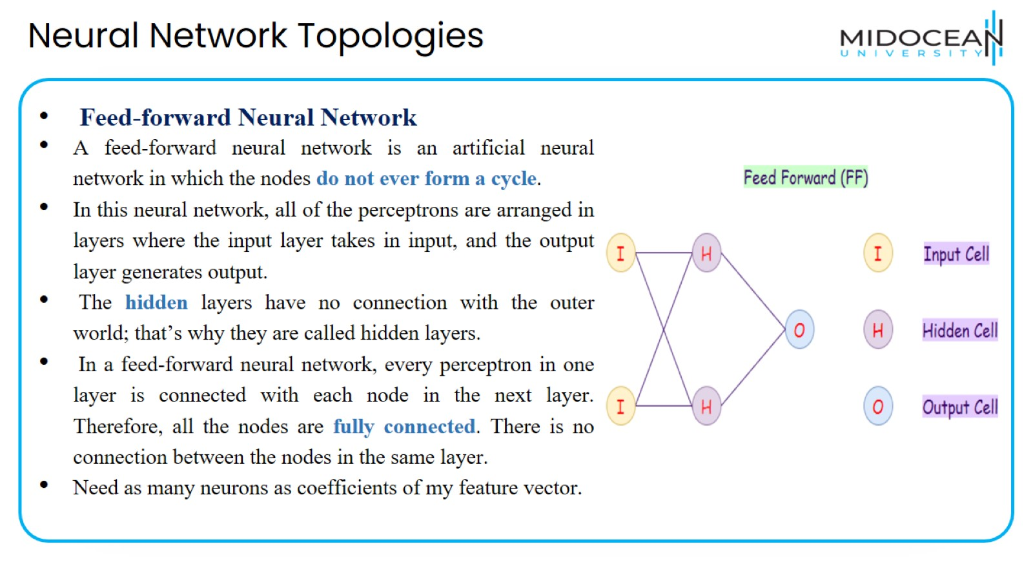
Neural Network Topologies

Slide 18
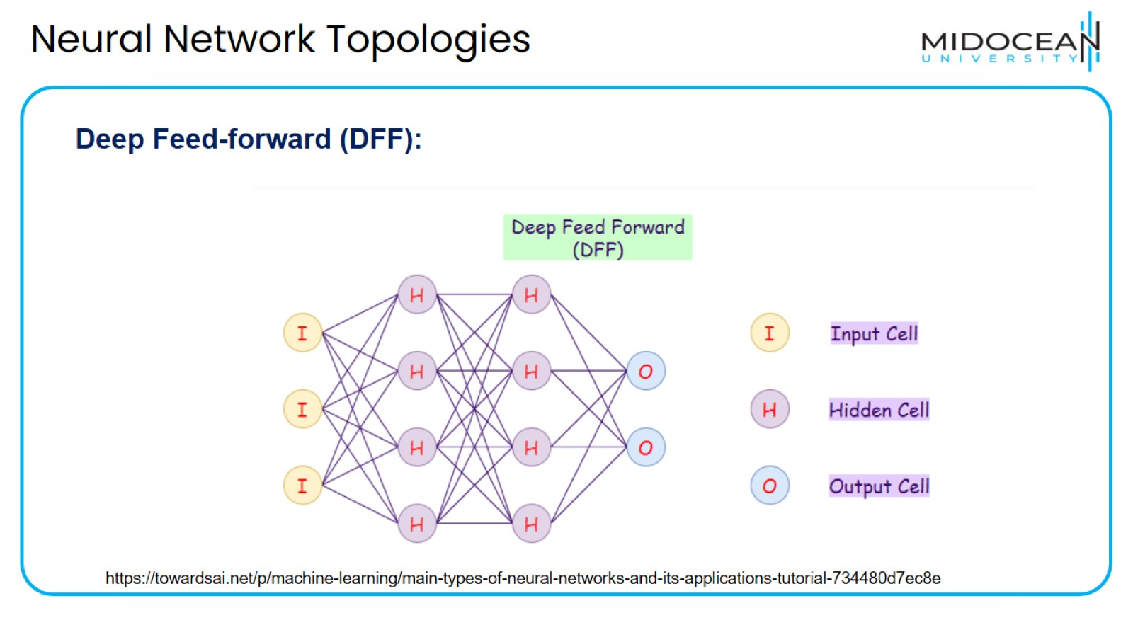
Neural Network Topologies

Slide 19
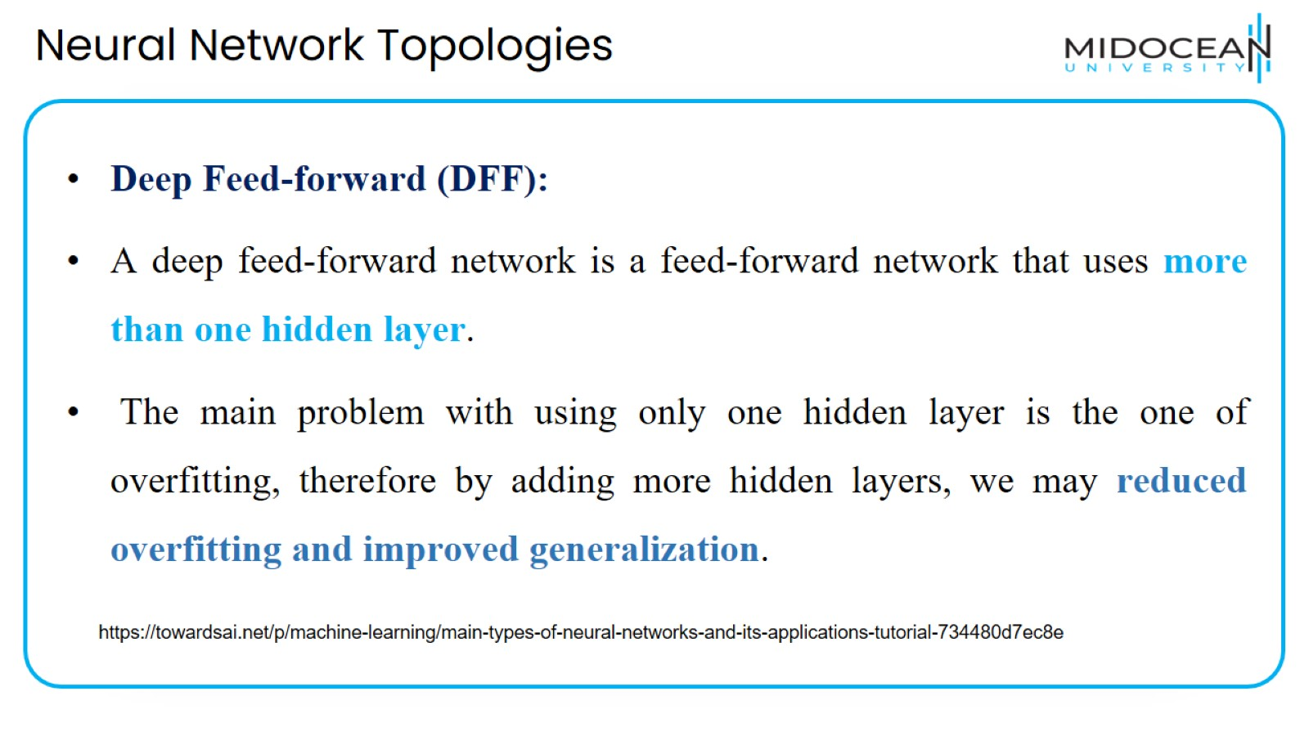
Neural Network Topologies

Slide 20
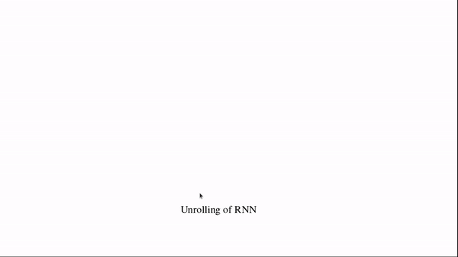
Neural Network Topologies
Recurrent Neural Network (RNN):
Recurrent neural networks (RNNs) are a variation to feed-forward (FF) networks. In this type, each of the neurons in hidden layers receives an input with a specific delay in time(cycle).
https://www.analyticsvidhya.com/blog/2021/06/a-visual-guide-to-recurrent-neural-networks/

Slide 21
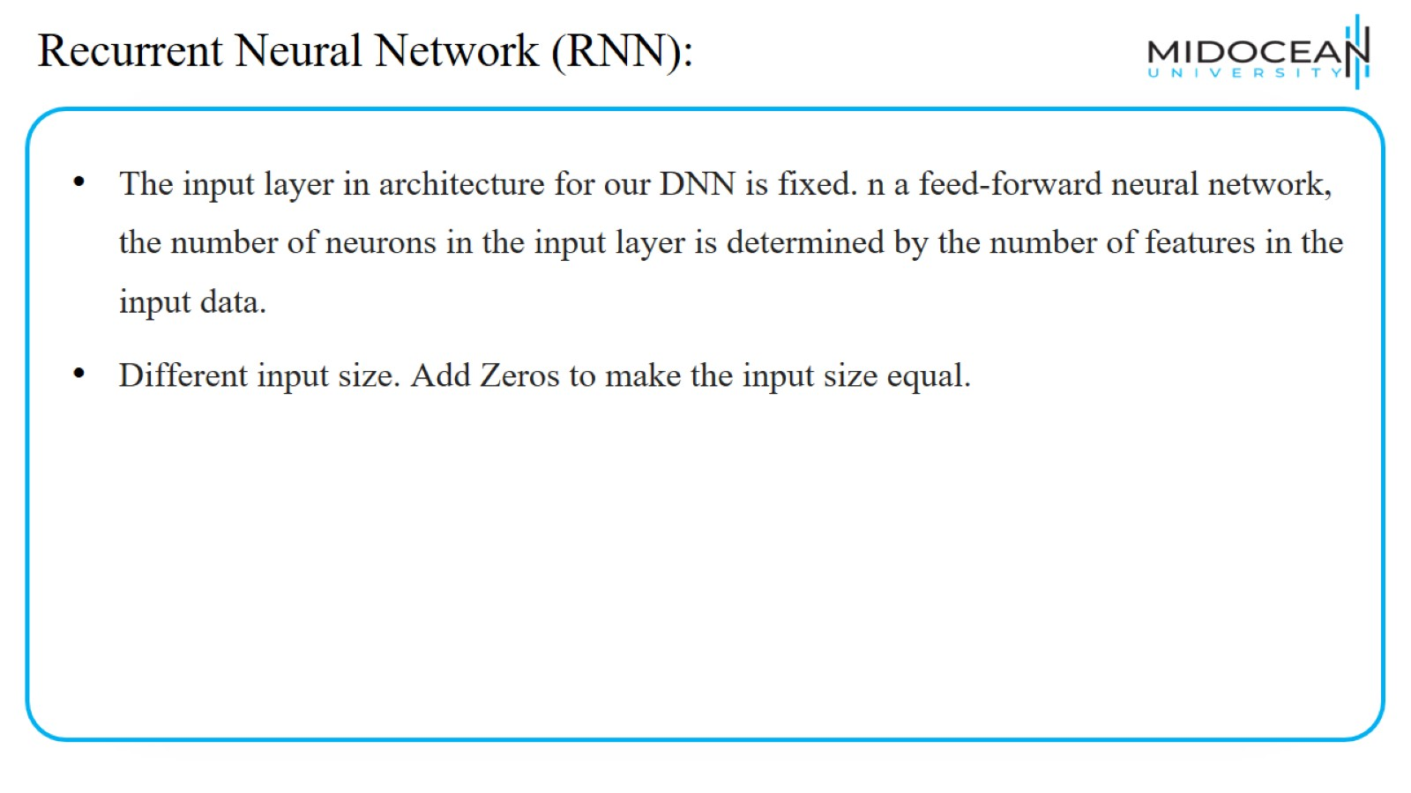
Recurrent Neural Network (RNN):

Slide 22
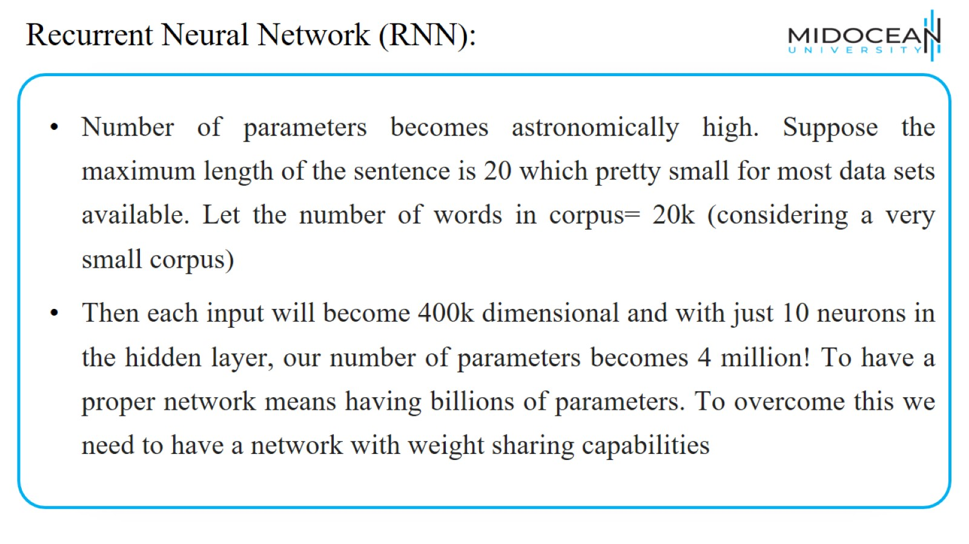
Recurrent Neural Network (RNN):

Slide 23
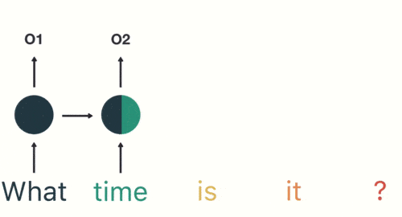
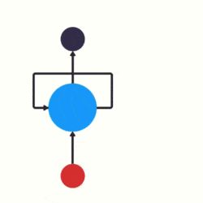
Recurrent Neural Network (RNN):
https://easyai.tech/en/ai-definition/rnn/

Slide 24
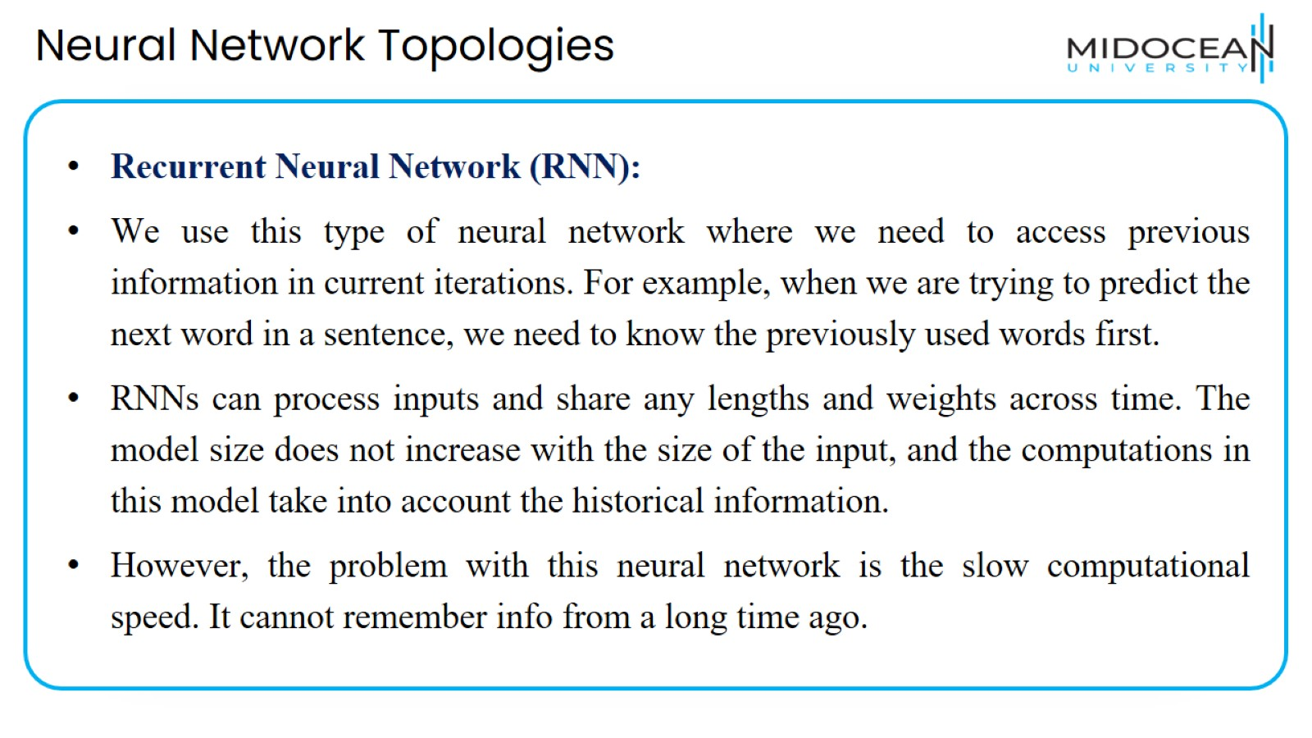
Neural Network Topologies

Slide 25
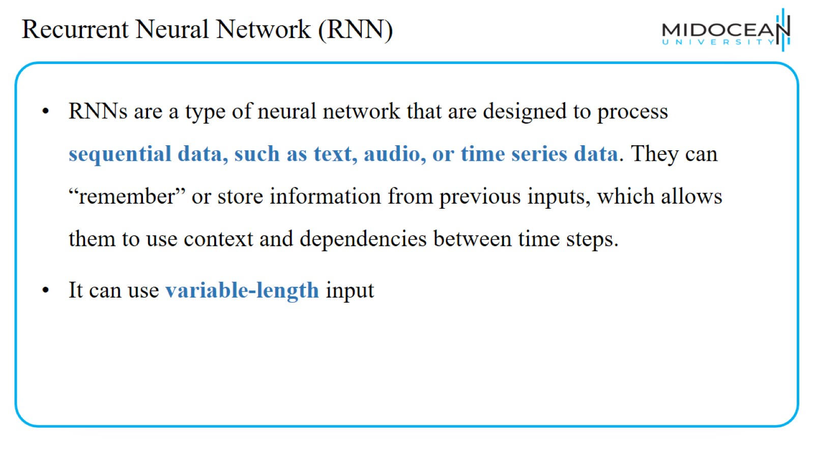
Recurrent Neural Network (RNN)

Slide 26
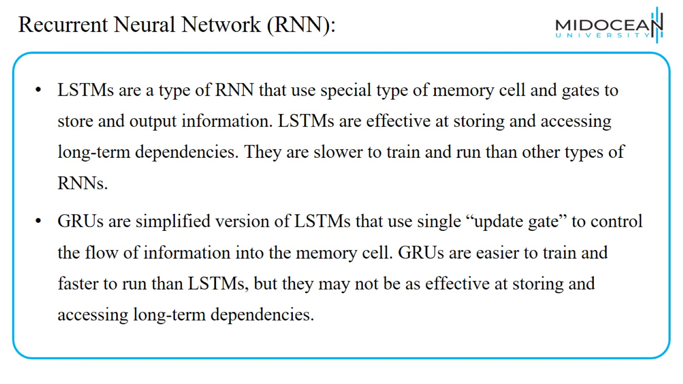
Recurrent Neural Network (RNN):

Slide 27
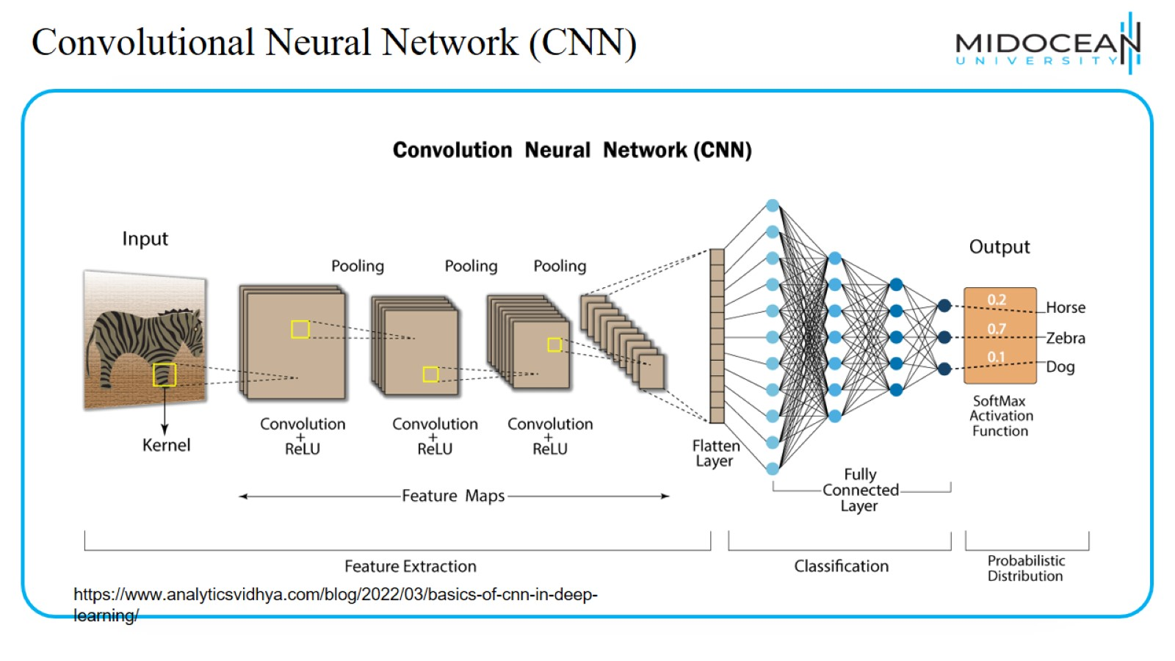
Convolutional Neural Network (CNN)

Slide 28
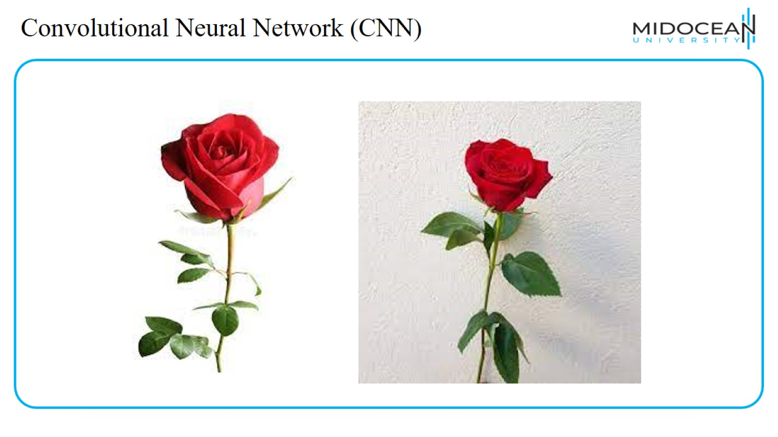
Convolutional Neural Network (CNN)

Slide 29
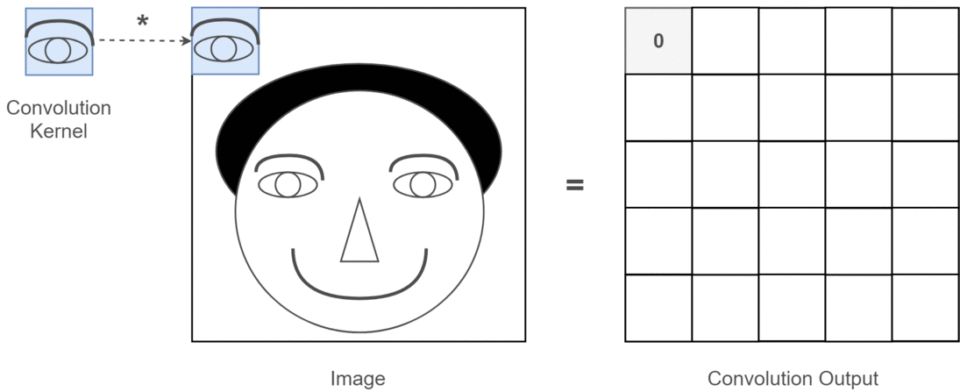
Convolutional Neural Network (CNN)
https://towardsdatascience.com/light-on-math-machine-learning-intuitive-guide-to-convolution-neural-networks-e3f054dd5daa

Slide 30
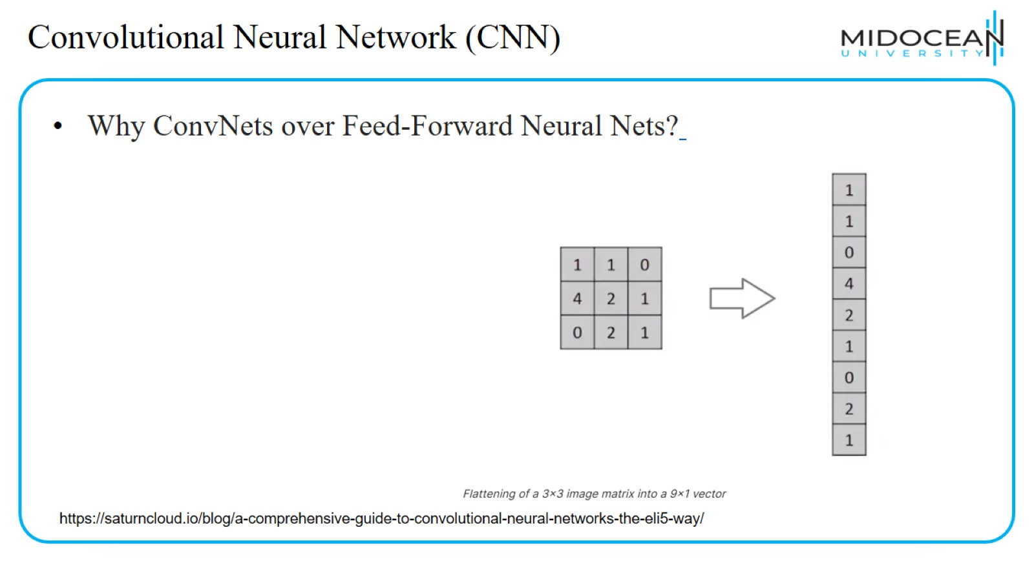
Convolutional Neural Network (CNN)

Slide 31
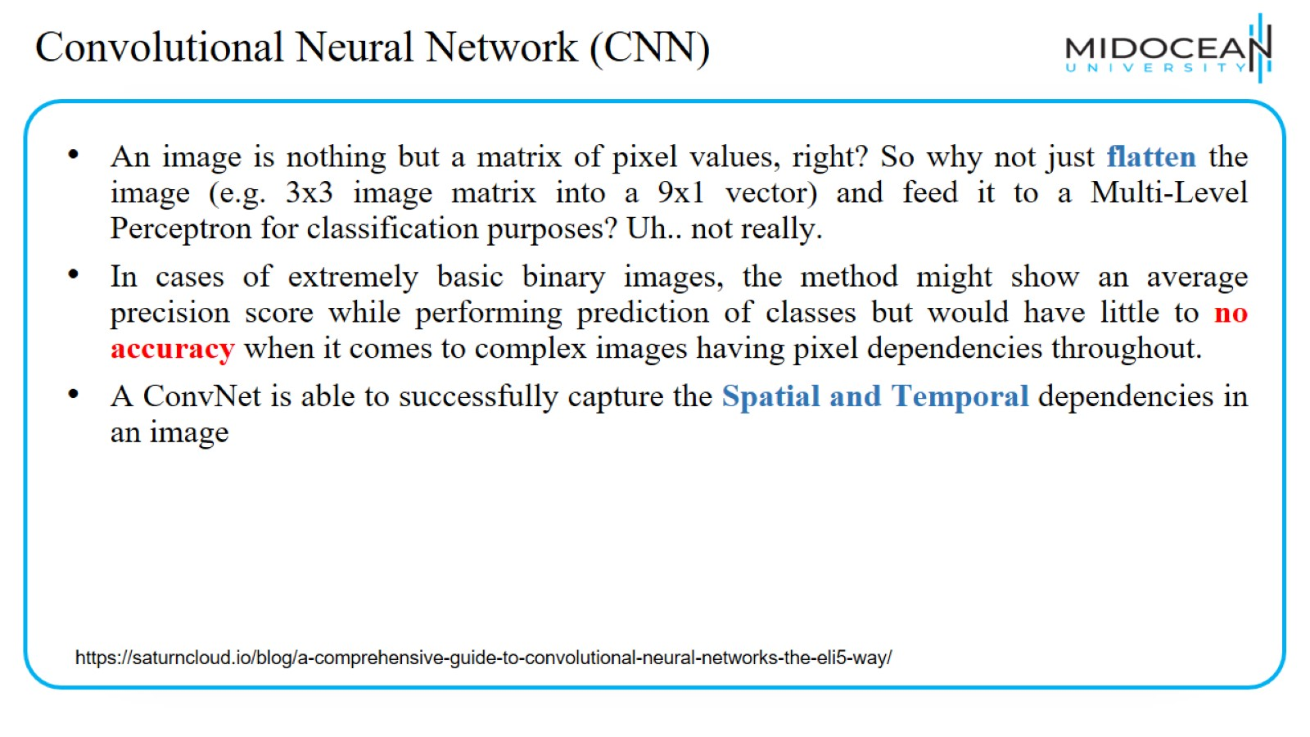
Convolutional Neural Network (CNN)

Slide 32
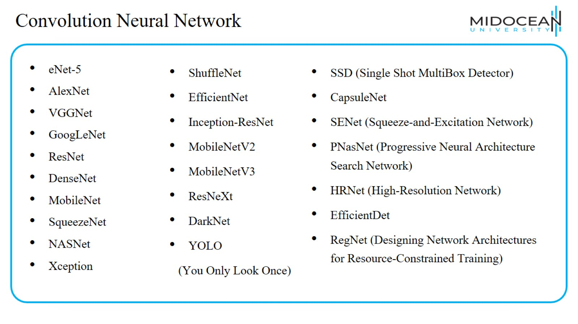
Convolution Neural Network

Slide 33
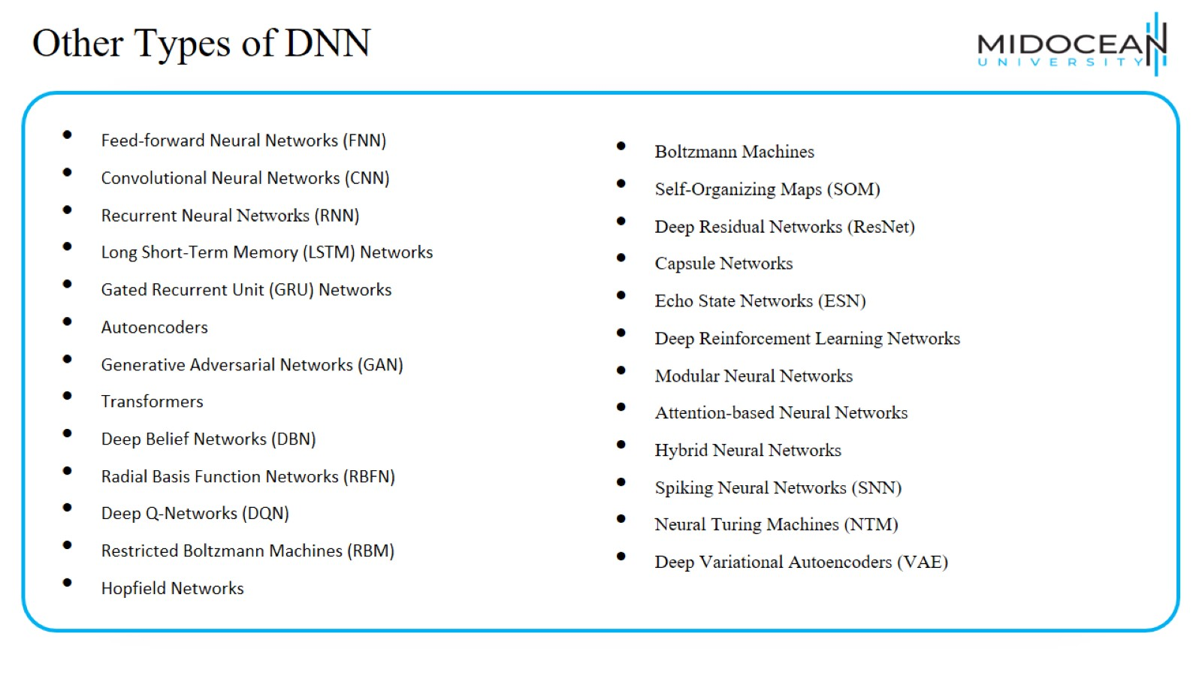
Other Types of DNN

Slide 34
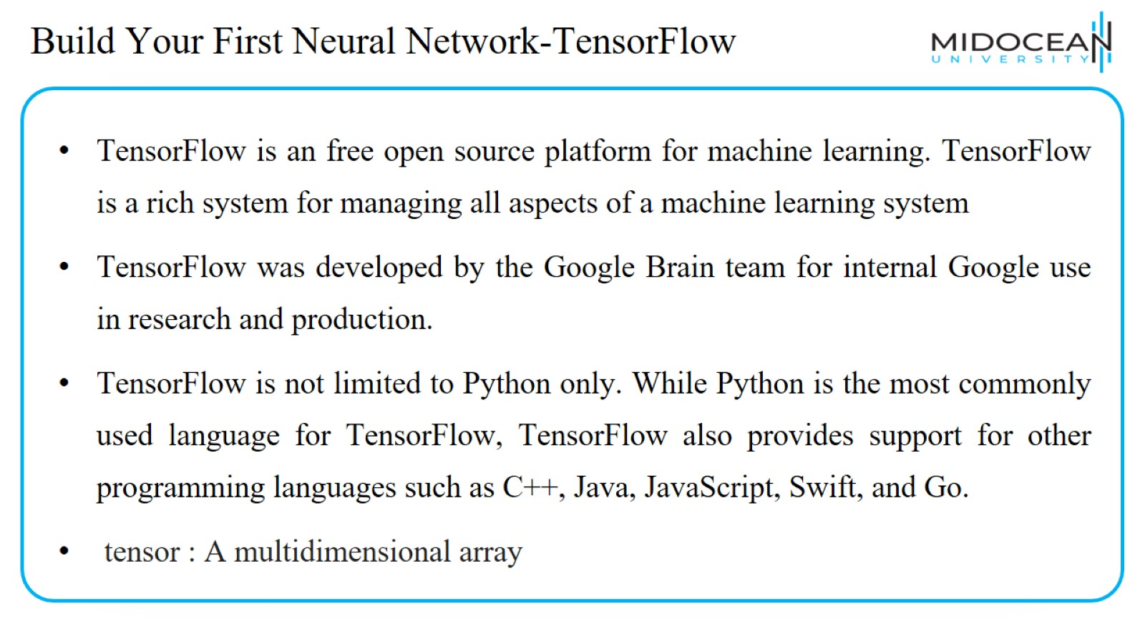
Build Your First Neural Network-TensorFlow

Slide 35
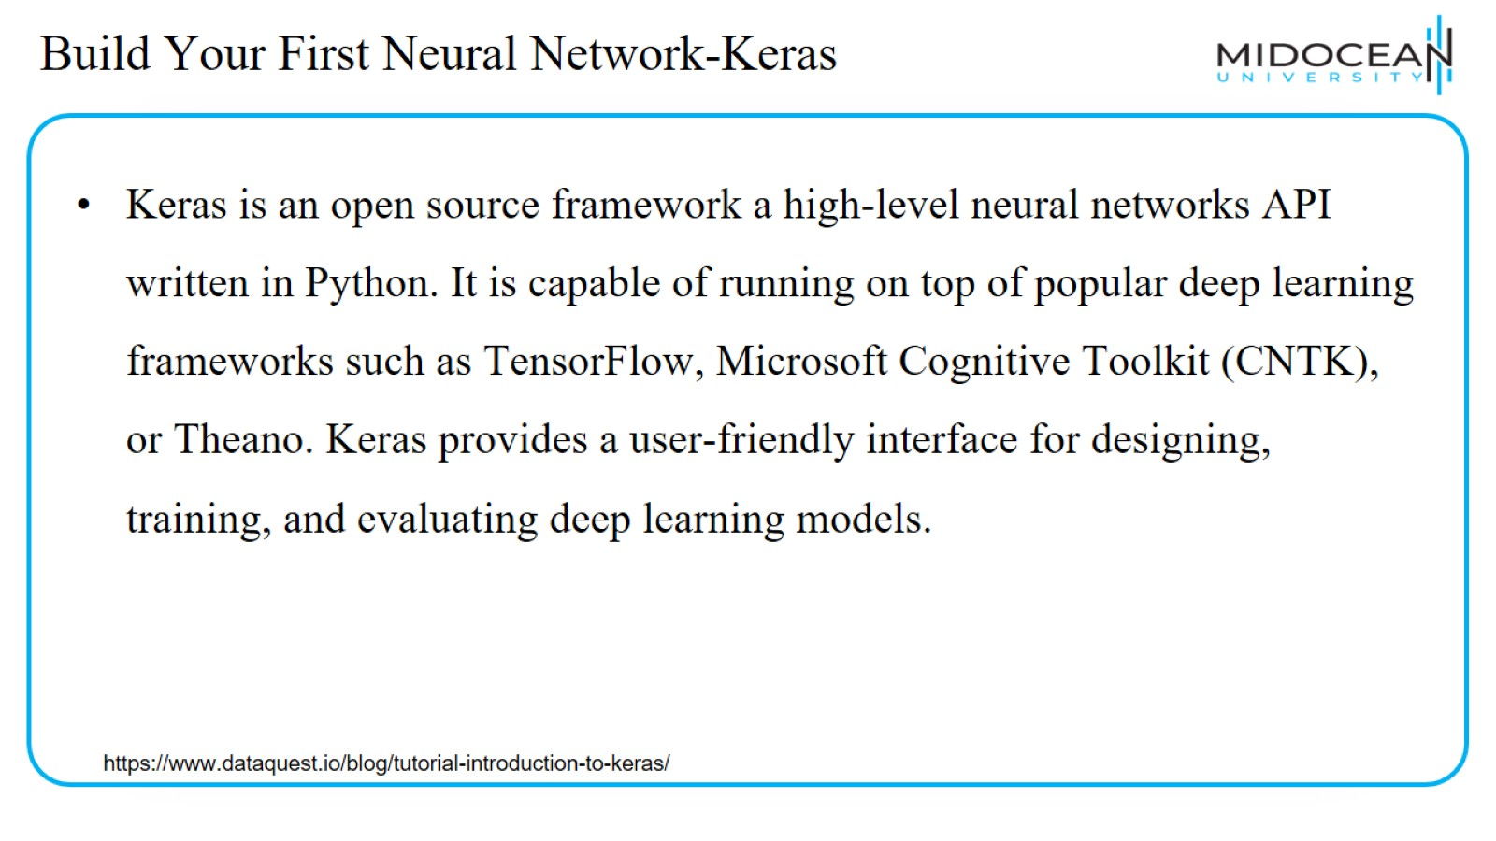
Build Your First Neural Network-Keras

Slide 36
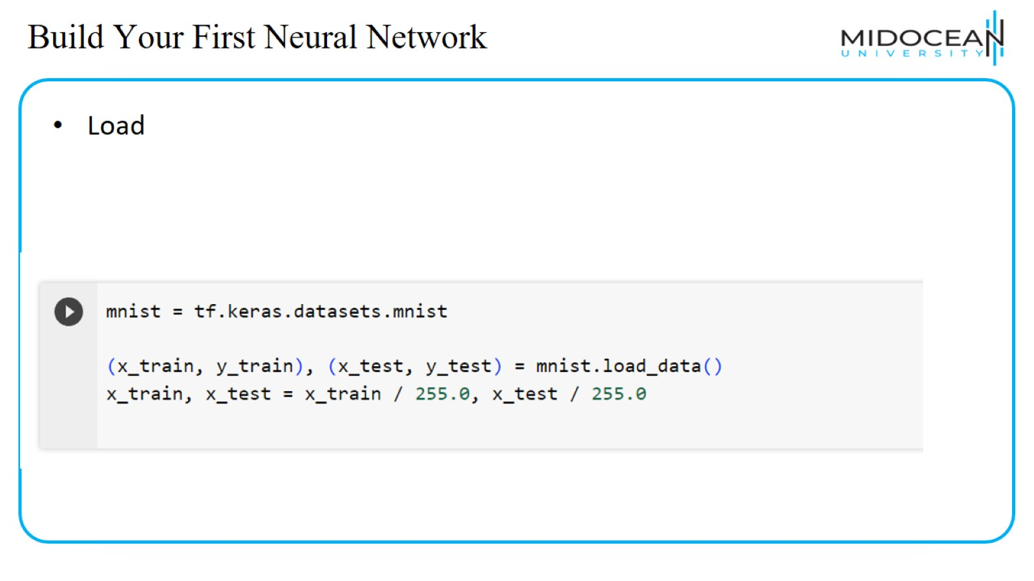
Build Your First Neural Network

Slide 37
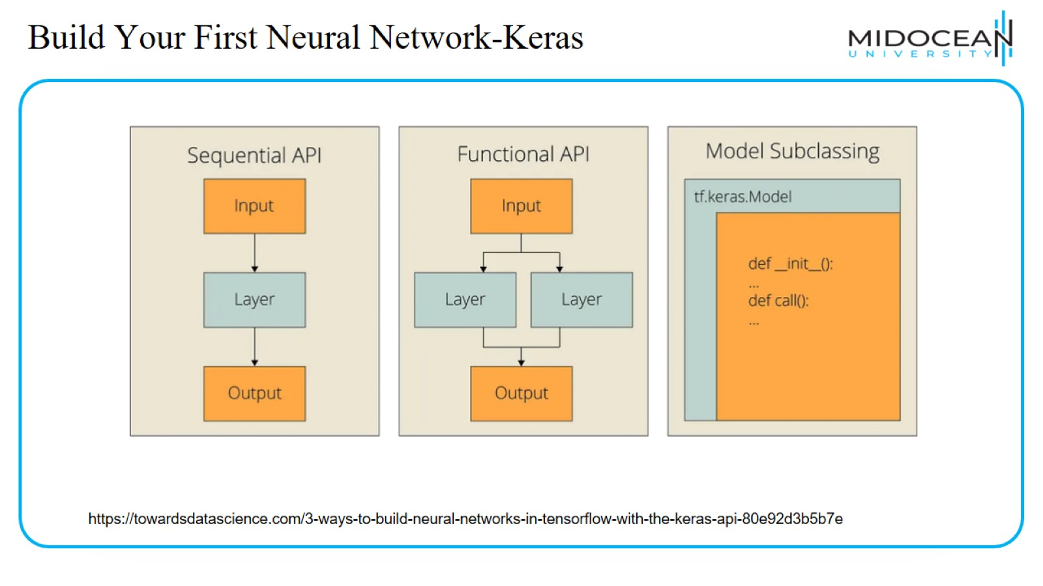
Build Your First Neural Network-Keras

Slide 38
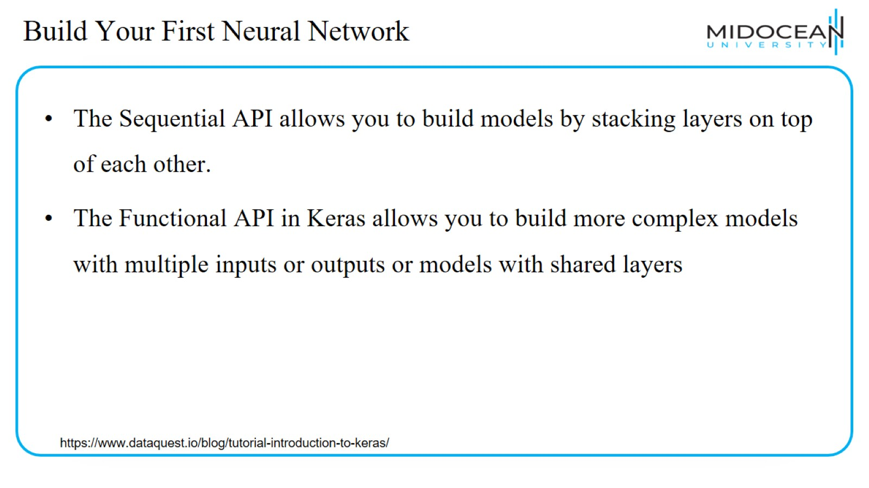
Build Your First Neural Network

Slide 39
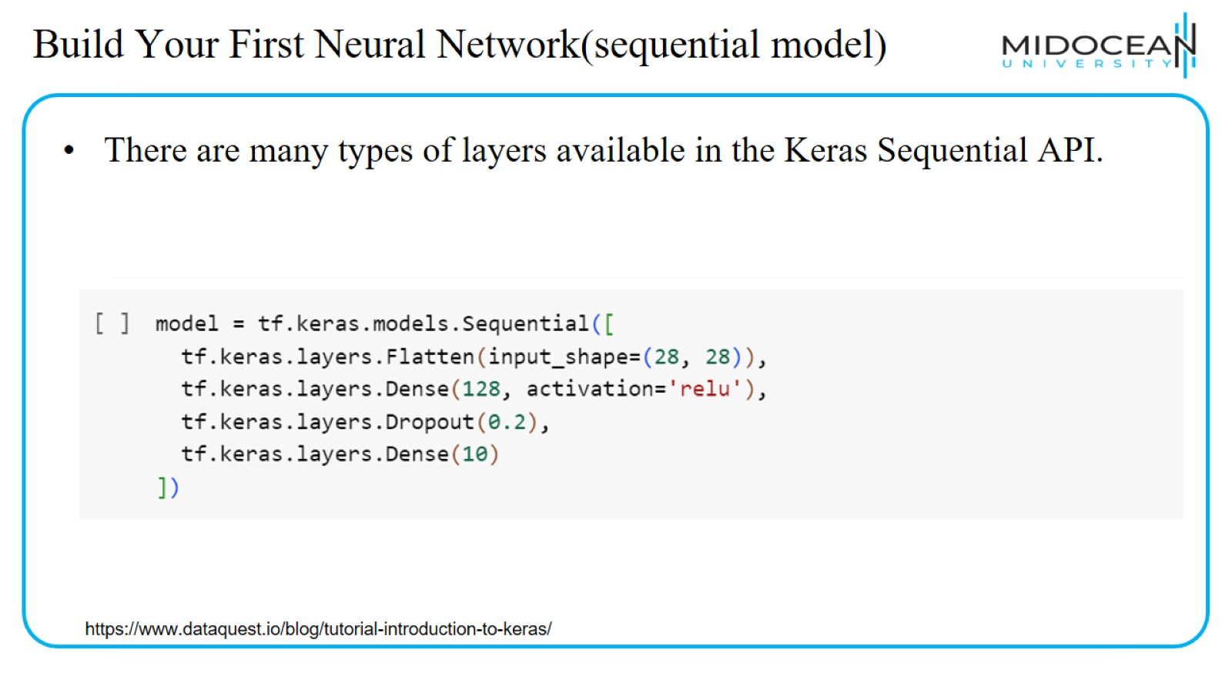
Build Your First Neural Network(sequential model)

Slide 40
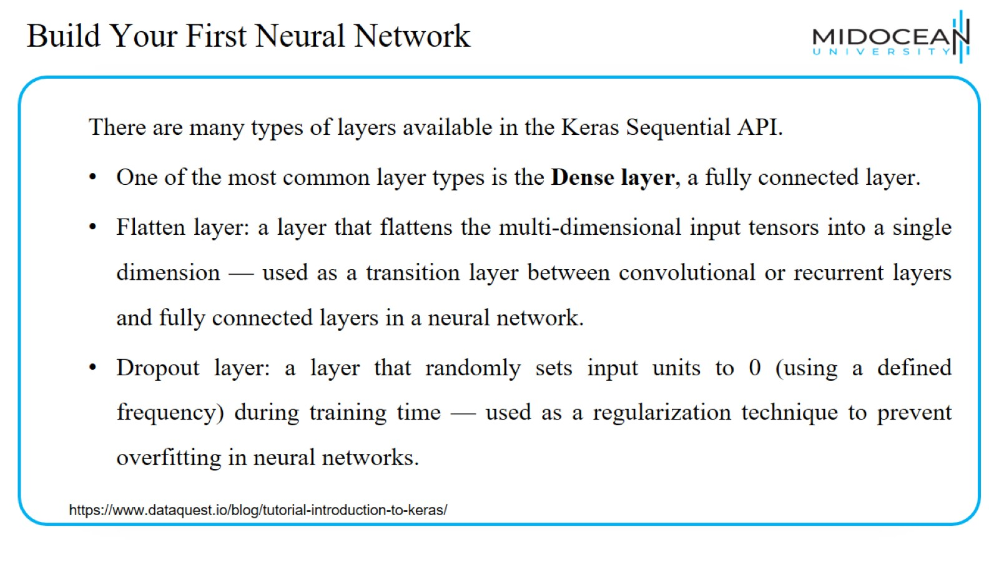
Build Your First Neural Network

Slide 41
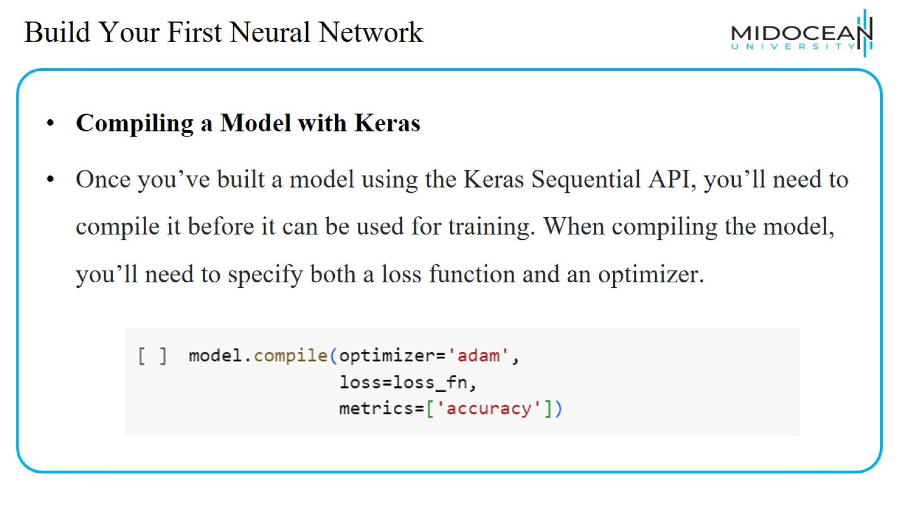
Build Your First Neural Network

Slide 42
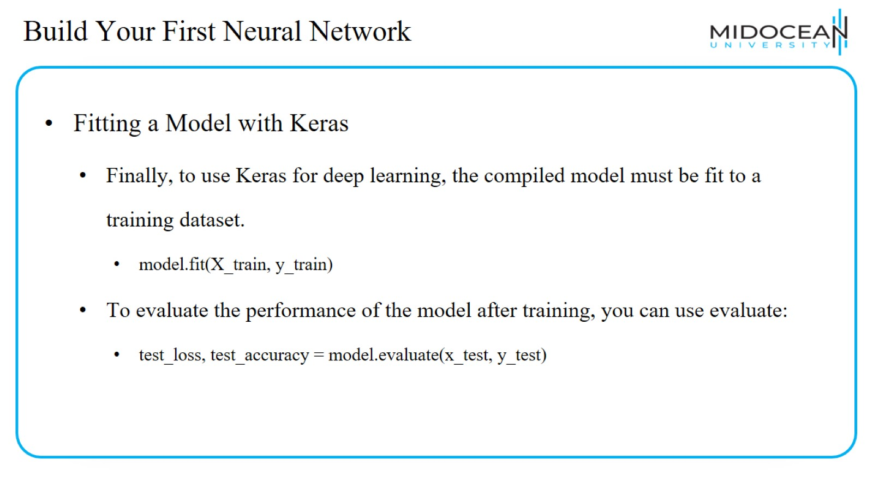
Build Your First Neural Network

Slide 43
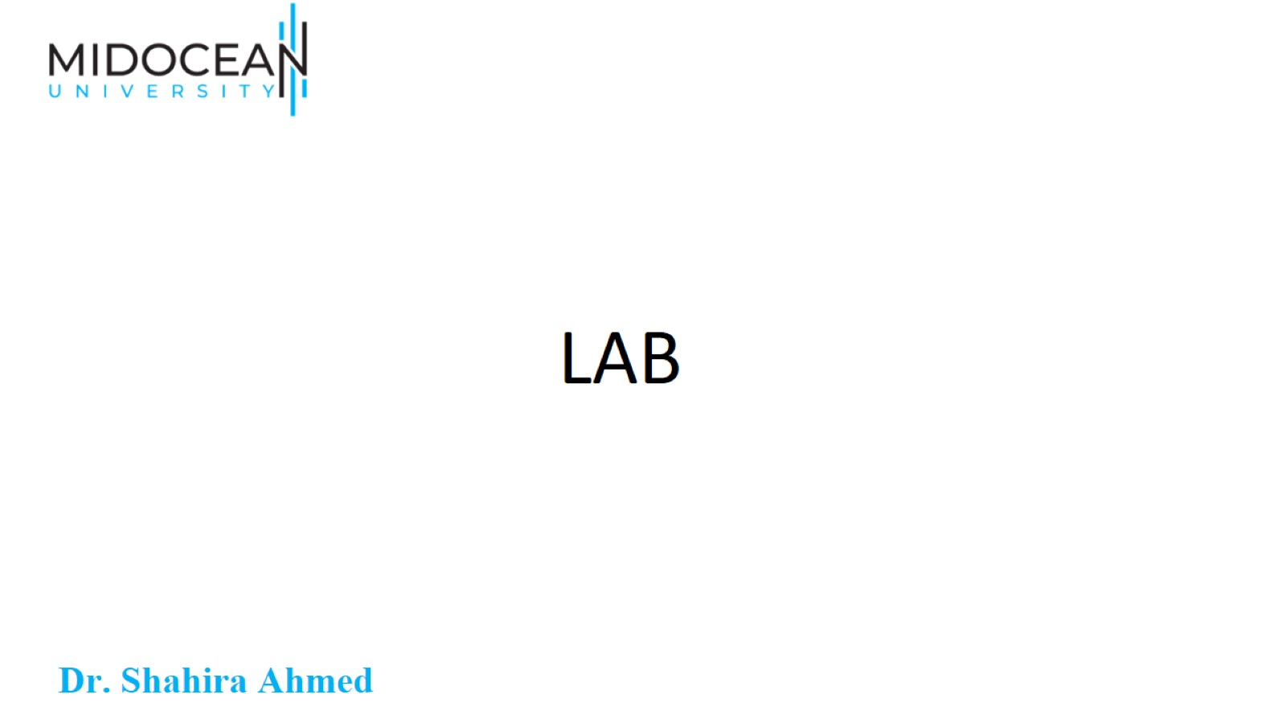
LAB

Slide 44
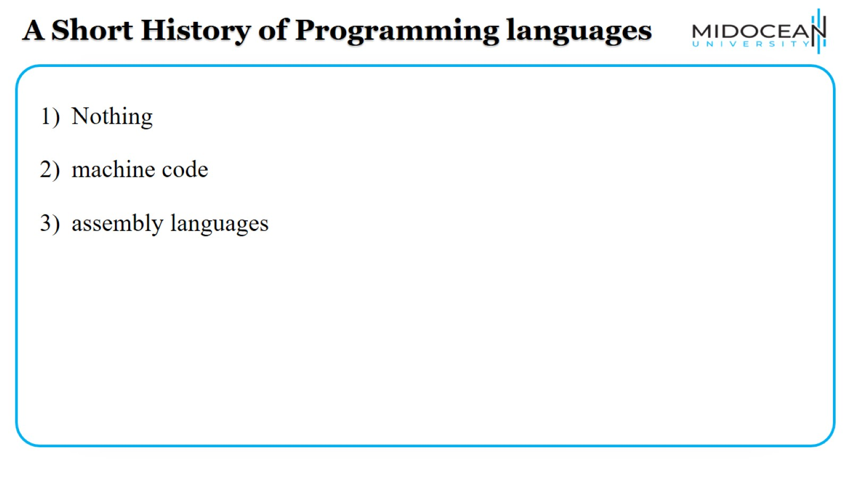
A Short History of Programming languages

Slide 45
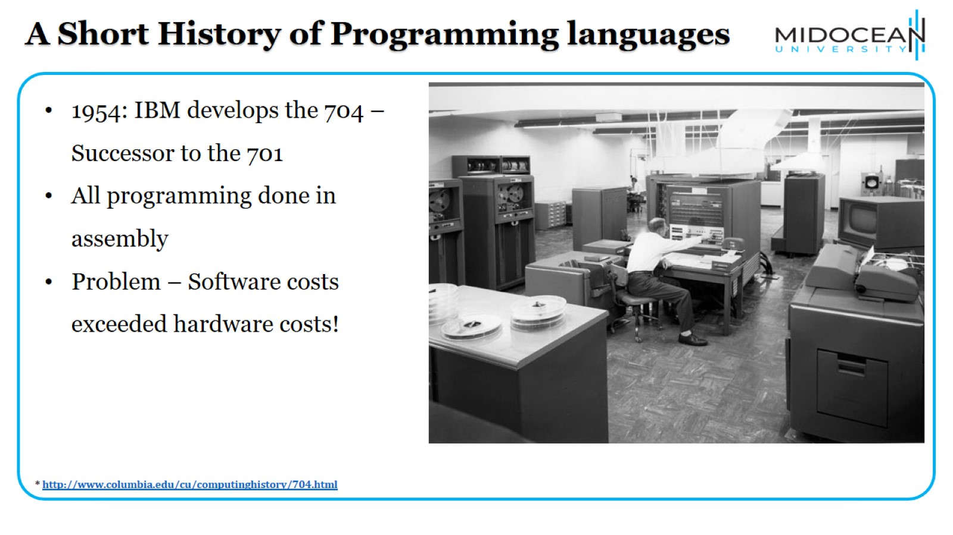
A Short History of Programming languages

Slide 46
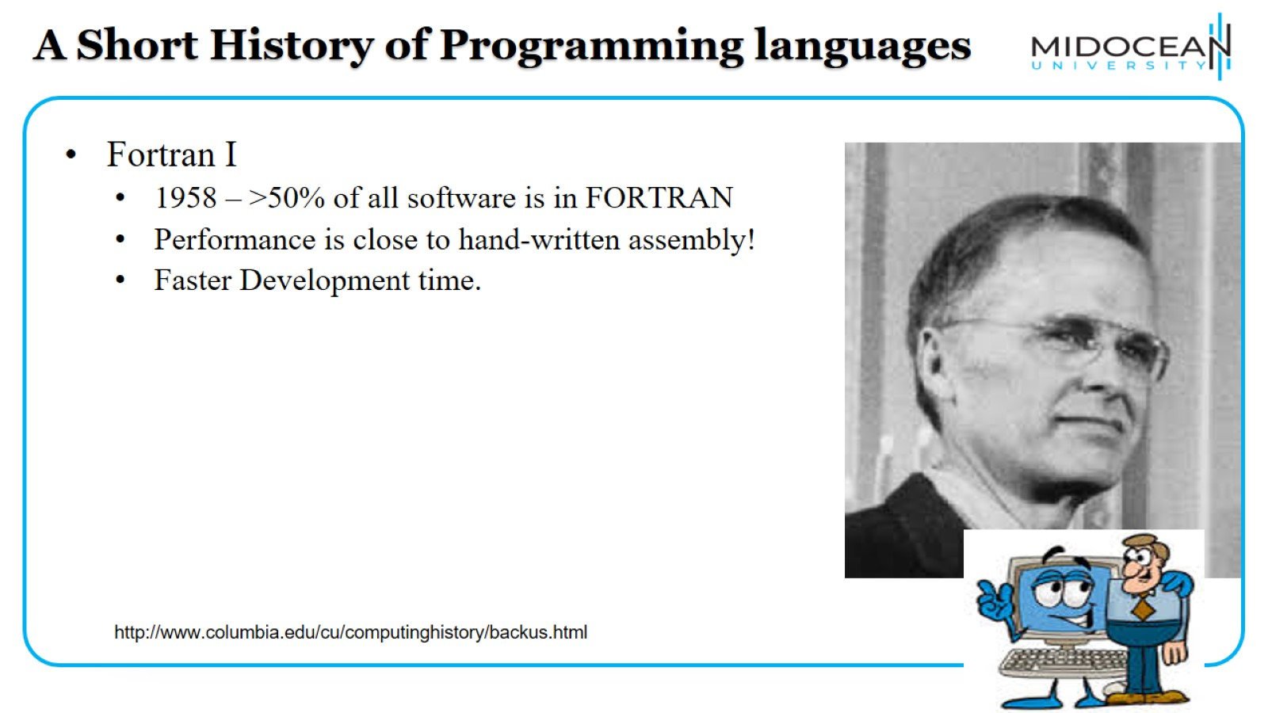
A Short History of Programming languages

Slide 47
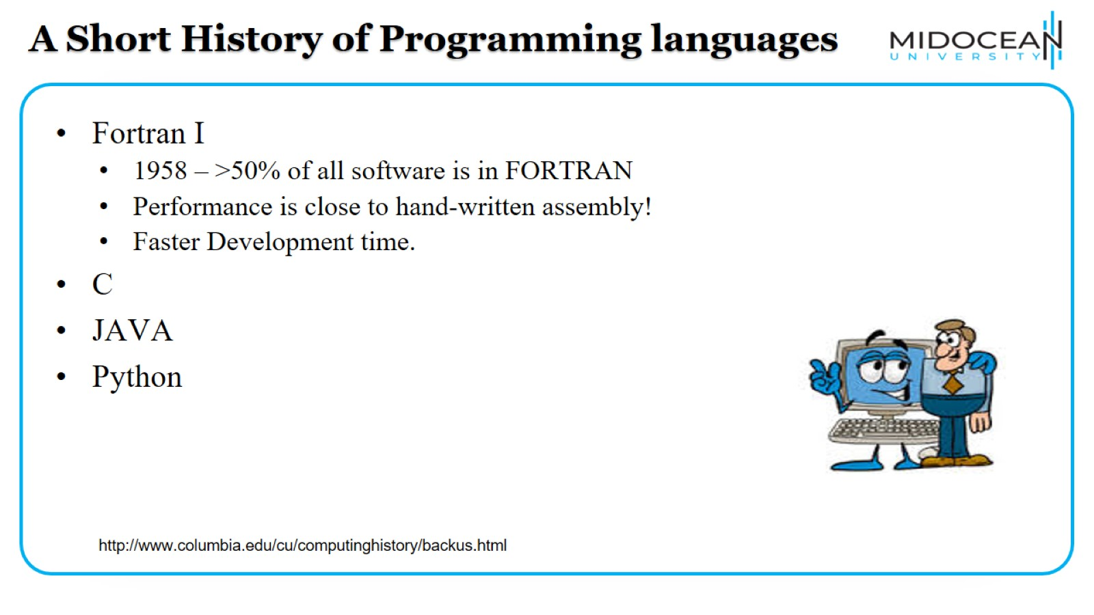
A Short History of Programming languages

Slide 48
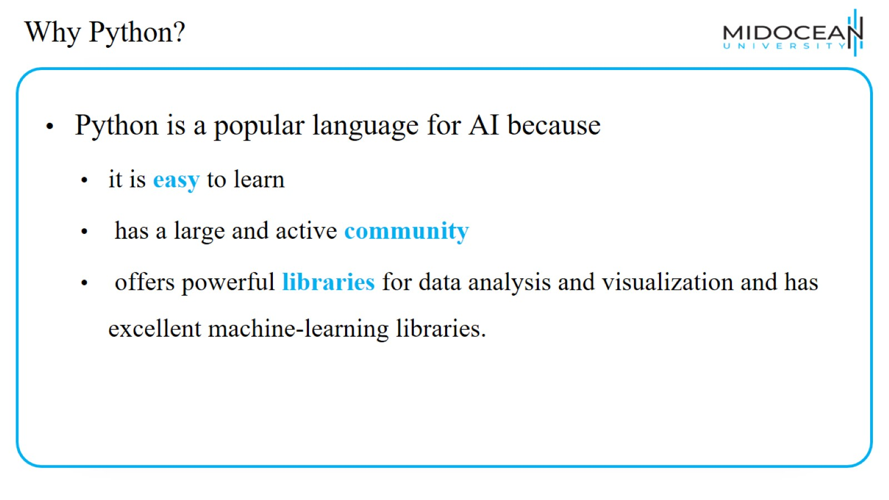
Why Python?

Slide 49
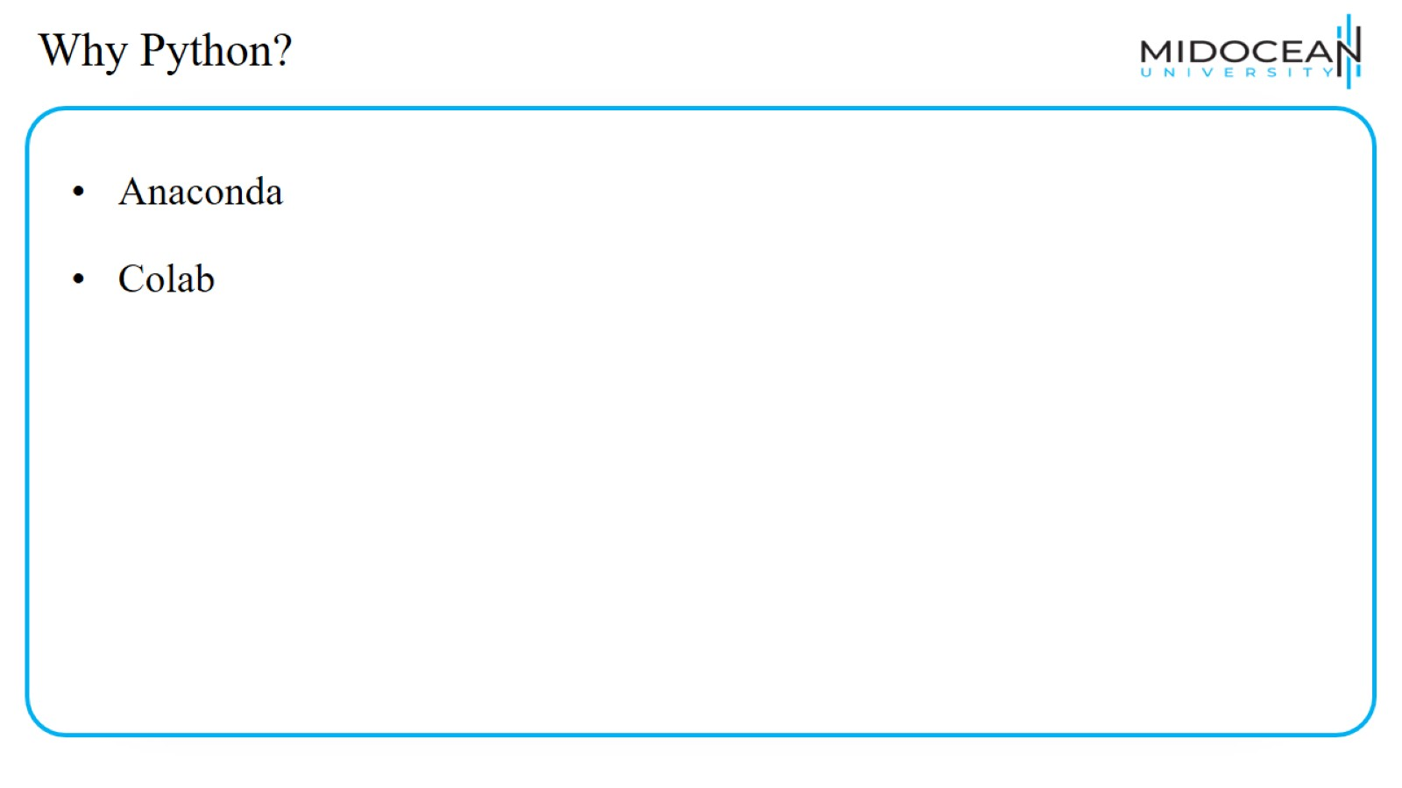
Why Python?

Slide 50
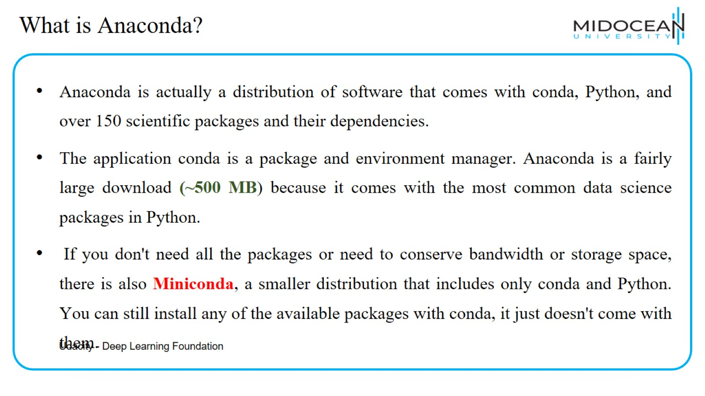
What is Anaconda?

Slide 51

Installing Anaconda

Slide 52

Google Colaboratory

Slide 53


Slide 54


