Slide 1
Ch1: Introduction

Slide 2
Chapter
01
OPERATING SYSTEM INTRODUCTION
Objectives:
  To provide coverage of basic computer system organization
  To provide a grand tour of the major operating systems components

Slide 3
Chapter
01
OPERATING SYSTEM INTRODUCTION
Topics:
  What is an Operating Systems
  Computer-System Organization
  Computer-System Architecture
  Operating-System Structure
  Operating-System Operations

Slide 4


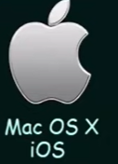

Chapter
01
What is an Operating System?
  A program that acts as an intermediary between a user of a computer and the computer hardware
  Operating system goals:
    Execute user programs and make solving user problems easier
    Make the computer system convenient to use
    Use the computer hardware in an efficient manner

Slide 5
Chapter
01
What is an Operating System?
  A program that acts as an intermediary between a user of a computer and the computer hardware
  Operating system goals:
    Execute user programs and make solving user problems easier
    Make the computer system convenient to use
    Use the computer hardware in an efficient manner

Slide 6
Chapter
01
What is an Operating System?
  A program that acts as an intermediary between a user of a computer and the computer hardware
  Operating system goals:
    Execute user programs and make solving user problems easier
    Make the computer system convenient to use
    Use the computer hardware in an efficient manner

Slide 7
Chapter
01
Computer System Structure
Computer system can be divided into four components
  Hardware – provides basic computing resources
    CPU, memory, I/O devices
  Operating system
    Controls and coordinates use of hardware among various applications and users

Slide 8
Chapter
01
Computer System Structure
  Application programs – define the ways in which the system resources are used to solve the computing problems of the users
    Word processors, compilers, web browsers, database systems, video games
  Users
    People, machines, other computers

Slide 9
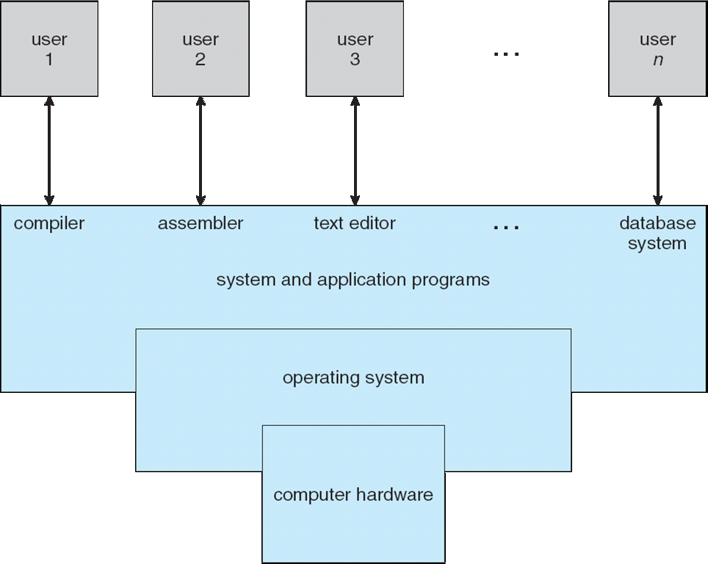
Chapter
01
Four Components of a Computer System

Slide 10
Chapter
01
Operating System Definition
OS is a resource allocator: The main functions of a resource allocator consist of The following:
Allocation of Resources: The resource allocator is in charge of allocating resources to tasks in a way that optimizes system speed and efficiency, including CPU time, memory, I/O devices, and network bandwidth.
Management of Resources: It keeps track of the availability of resources in the system and uses preset mechanisms or algorithms to decide how to allocate them among competing programs tasks.

Slide 11
Chapter
01
Operating System Definition
Scheduling of Tasks: is in charge of scheduling activities to run on the available resources as efficiently as possible, taking into consideration several factors such as priority, fairness and deadlines.
Preventing overuse of Resource Limits: It can stop programs from using up too many resources by enforcing the resource limits or restriction defined by the operating system

Slide 12
Chapter
01
Operating System Definition
OS is a control program: The main functions of a resource control Program includes the following:
  Controls execution of programs to prevent errors and improper use of the computer
  Controls access to system resources and protects the system from unauthorized access of malicious users.

Slide 13
Chapter
01
Operating System Definition
  Controls the interaction between software and hardware devices (using Device Drivers)
  Controls Files manipulation such as creation, deletion, and of files and directories on storage devices.
  Controls the allocation and deallocation of memory space for programs.

Slide 14
Chapter
01
Operating System Definition (cont)
A more common definition is that the operating system is the one program running at all times on the computer and usually called The kernel.
Along with the kernel, there are two other types of programs:
  System programs, which are associated with the operating system but are not part of the kernel such as File browsers, login program., and system services manger.
  Application programs, which include all programs not associated with the operation of the system such as web browsers, media players and calculators.

Slide 15
Chapter
01
Computer System Organization
Some basic knowledge of the structure of Computer System is mandatory to understand the work of operating systems. Operation
A modern general purpose Computer system consists of One or more CPUs, device controllers connect through common bus providing access to shared memory
Concurrent execution of CPUs and devices competing for memory cycles (all programs should loaded into memory to execute)

Slide 16
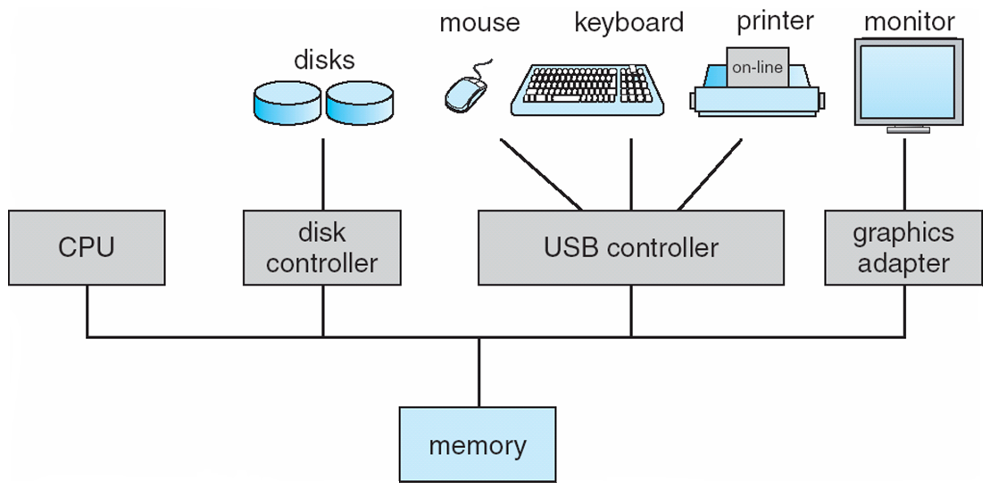
Chapter
01
Computer System Organization
Controllers are responsible for defining the way of how these devices work.
CPU is the processing unit that is responsible of doing computations and calculations. System may have more than one CPU.
All programs should be loaded into main memory to execute. Main memory is finite and has a limited size
All devices and shared memory are connected Via a common Bus

Slide 17
Chapter
01
Computer-System Operation
All devices are required to share memory to execute correctly, So a memory controller exists to ensure each of these devices get the proper and right access of memory
I/O devices and the CPU can execute concurrently
Each device controller is in charge of a particular device type
Each device controller has a local buffer
CPU moves data from/to main memory to/from local buffers
I/O is from the device to local buffer of controller
Device controller informs CPU that it has finished its operation by causing an interrupt

Slide 18
Chapter
01
Important Terms
Bootstrap Program
  The first piece of code that runs when the Computer system starts up, It is stored in ROM.
  It performs a series of tasks to initialize the computer system and prepare it for operation such as: loading the rest of operating system by locating and Loading kernel into main memory.
  Once the operating system is loaded and became running, iIt takes over and continues the boot process, loading drivers and other system components as needed.

Slide 19
Chapter
01
Some Important Terms
Interrupt
  The occurrence of event is usually signaled by Interrupt from hardware or software.
  Hardware may trigger an interrupt at any time by sending a signal to the CPU, usually by the way of system bus.

Slide 20
Chapter
01
Some Important Terms
System Call:
  Software may trigger an interrupt by executing a special operation called System Call.
  System call is the programmatic way in which a computer program request a service from the kernel of the operating system

Slide 21
Chapter
01
Some Important Terms
When the CPU is interrupted, it stops what it is doing and immediately transfers execution to fixed location.
  The fixed location usually contains the starting address where the service Routines of the interrupt is located.
The Interrupt service Routines executes.
On completion, the CPU resumes the interrupted computation.

Slide 22
Chapter
01
Storage Structure
Main memory: is the only large storage media that the CPU can access directly
Secondary storage: is an extension of main memory that provides large nonvolatile storage capacity

Slide 23
Chapter
01
Storage Hierarchy
Storage systems organized in hierarchy
  Speed
  Cost
  Volatility
    (Volatile: Looses its contents when power is removed)
    (Non Volatile: Retains its contents even when power is removed)

Slide 24
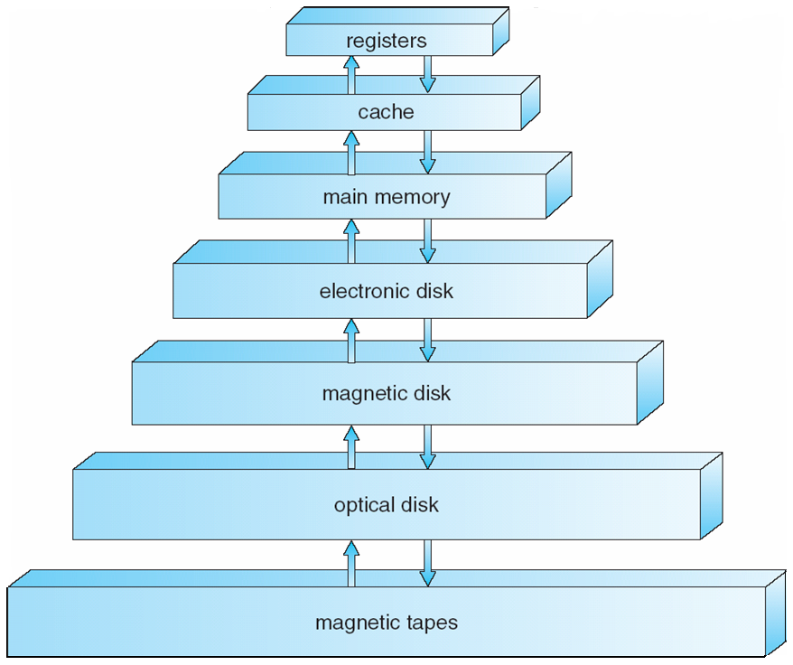
Chapter
01
Storage Device Hierarchy
Smaller in size
But more costly(price)
Volatile
Faster (smaller Access time)
Larger in size
But less costly(price)
Non-Volatile
Slower (larger Access Time)
Programs are loaded into secondary storage for storage purposes
Programs are loaded into your main memory for execution purposes

Slide 25
Chapter
01
Storage Structure
A magnetic disk is a storage device that uses a magnetization process to write, rewrite and access data.
Electronic Disks: is data storage device functionally similar to a hard disk drive but using flash memory
Cache memory: is a small-sized type of volatile computer memory that provides high-speed data access to a processor and stores frequently used computer programs, applications and data.

Slide 26
Chapter
01
Basic of Operating Systems (I/O Structure)
Storage is only one of many types of I/O devices within a computer.
A large portion of operating system code is dedicated to managing I/O, both because of its importance to the reliability and performance of system and because of the varying nature pf the devices.
A general-purpose computer system consists of CPUs and multiple device controllers that are connected through a common bus.
Notes:
Programs are loaded into secondary storage for storage purposes
Programs are loaded into your main memory for execution purposes

Slide 27
Chapter
01
Basic of Operating Systems (I/O Structure)
Typically, Operating systems have a device driver for each device controller.
This device driver understands the device controller and presents a uniform interface to the device to the rest of the operating system.

Slide 28
Chapter
01
Working of an I/O operation
To start in I/O operation (read from file for example) , the program, sends I/O request to the Operating system (the device driver), which in turn loads the appropriate registers within the device controller which in turn determine what action to take.
The controller starts the transfer of data from the device to the local buffer.
Once data transfer is completed, the device controller informs device driver via interrupt that it has finished its operation and the control is returned to the operating system

Slide 29
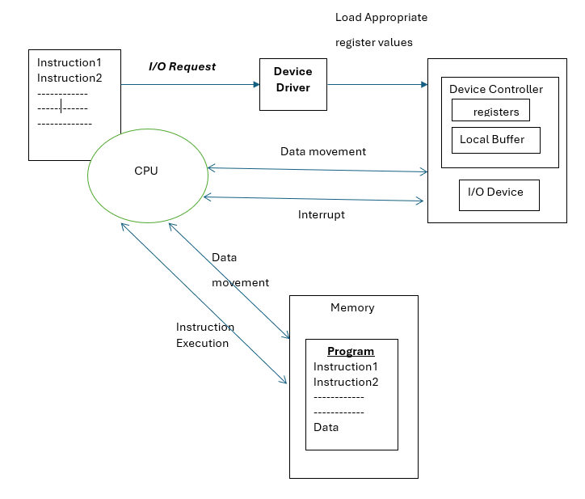
Chapter
01
Working of an I/O operation

Slide 30
Chapter
01
Basic of Operating Systems (I/O Structure)
The form presented in the last slide is called interrupt-driven I/O. it is suitable when moving small amounts of data but can produce high overhead when used for bulk of data.
To solve this problem, Direct Memory Access (DMA) is used.
Device controller with DMA capability, transfers blocks of data from buffer storage directly to main memory without CPU intervention
Only one interrupt is generated per block, rather than the one interrupt per byte

Slide 31
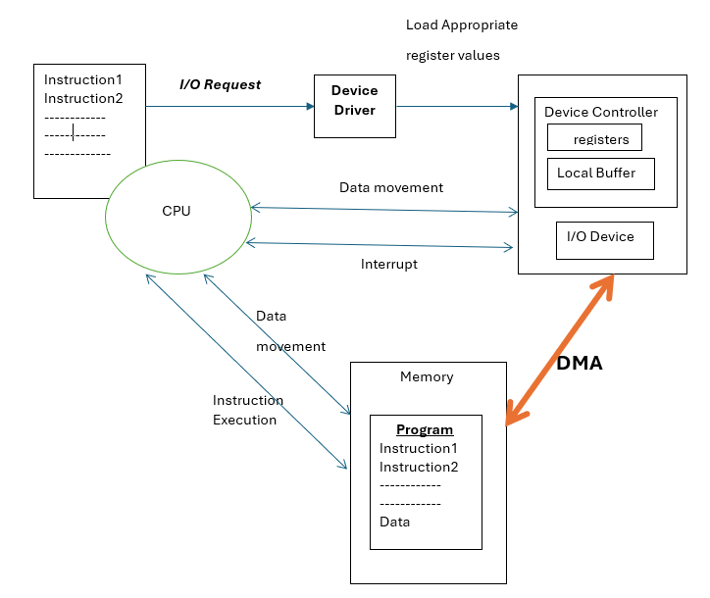
Chapter
01
Working of an I/O operation
DMA is Used for high-speed I/O devices that is able to transmit information at close to memory speeds

Slide 32
Chapter
01
Computer-System Architecture
Types of Computer Systems are based on the number of General-Purpose Processors:
    Single Processor Systems
    Multi Processor Systems
    Clustered Systems
Single Processor Systems: one main CPU capable of executing a general-purpose instruction set.
Other special purpose processors (device controllers) are also present to perform specific task.

Slide 33
Chapter
01
Computer-System Architecture
Multiprocessors systems growing in use and importance
  Also known as parallel systems, tightly-coupled systems
  Advantages include
    Increased throughput (amount of data transferred in unit of time)
    Economy of scale
    Increased reliability – graceful degradation or fault tolerance
  Two types
    Asymmetric Multiprocessing
    Symmetric Multiprocessing

Slide 34
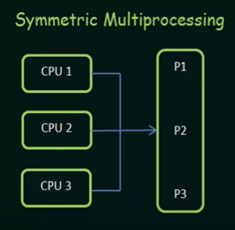
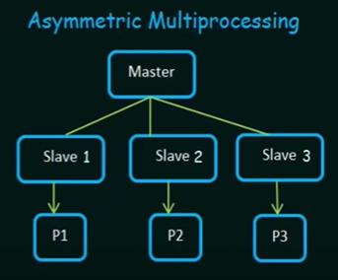
Chapter
01
Computer-System Architecture

Slide 35
Chapter
01
Computer-System Architecture
Clustered Systems:
Like multiprocessor systems, but multiple systems working together
  Usually sharing storage via a storage-area network (SAN)
  Provides a high-availability service which survives failures
    Asymmetric clustering has one machine in hot-standby mode
    Symmetric clustering has multiple nodes running applications, monitoring each other

Slide 36
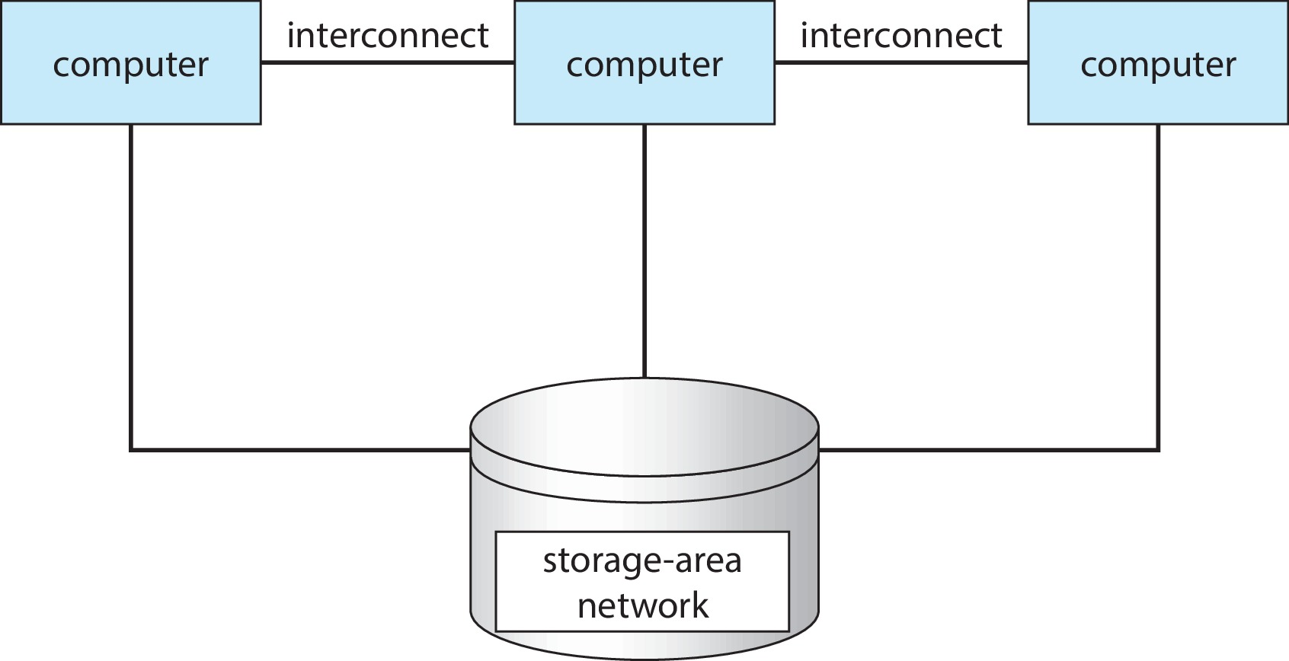
Chapter
01
Computer-System Architecture

Slide 37
Chapter
01
Operating Systems Structure
Operating Systems vary greatly in their makeup internally:
Multiprogramming
Time Sharing (Multitasking)

Slide 38
Chapter
01
Operating Systems Structure
Multiprogramming needed for efficiency
  Single user cannot keep CPU and I/O devices busy at all times
  Multiprogramming organizes jobs (code and data) so CPU always has one to execute
  A subset of total jobs in system is kept in memory
  One job selected and run via job scheduling
  When it has to wait (for I/O for example), OS switches to another job
In Multiprogramming provide efficient Resources utilization but not good in providing user interaction with the computer system

Slide 39
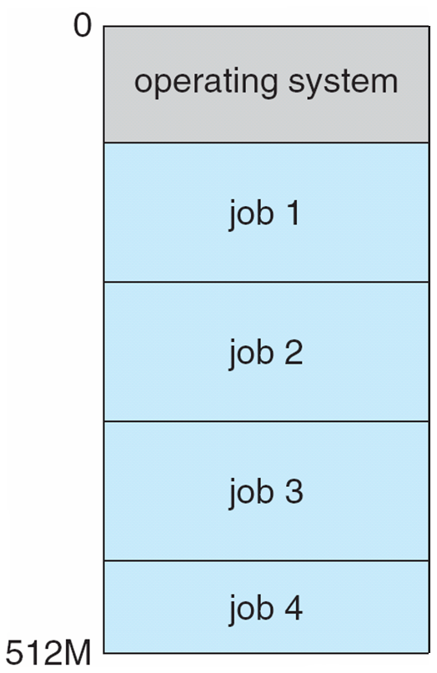
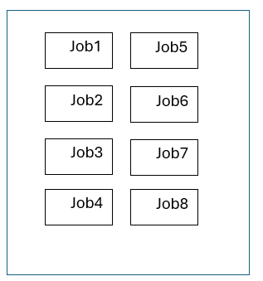
Chapter
01
Operating Systems Structure
CPU
Hard Disk
Memory layout of multiprogramming systems

Slide 40
Chapter
01
Operating Systems Structure
Timesharing (multitasking) is a logical extension of multiprogramming in which CPU switches jobs so frequently that users can interact with each job while it is running, creating interactive computing
Response time should be < 1 second
Each user has at least one program executing in memory process

Slide 41
Chapter
01
Operating Systems Structure
If several jobs ready to run at the same time  CPU scheduling
If processes don’t fit in memory, swapping moves them in and out to run
Virtual memory allows execution of processes not completely in memory

Slide 42
Chapter
01
Operating Systems Operations
Operating systems are considered as an Interrupt driven mostly by hardware
A trap is a software-generated interrupt caused either by an error or a user request
Software error or request creates exception or trap
  Division by zero, request for operating system service

Slide 43
Chapter
01
Operating Systems Operations
Dual-mode operation allows OS to protect itself and other system components
  User mode and kernel mode
  Mode bit provided by hardware
    Provides ability to distinguish when system is running user code or kernel code
    Some instructions designated as privileged, only executable in kernel mode
    System call changes mode to kernel, return from call resets it to user

Slide 44
Chapter
01
Transition from User to Kernel Mode
Timer to prevent infinite loop / process hogging resources
  Set interrupt after specific period
  Operating system decrements counter
  When counter zero generate an interrupt
  Set up before scheduling process to regain control or terminate program that exceeds allotted time

Slide 45
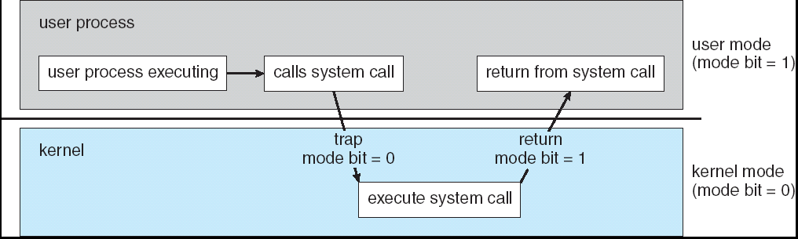
Chapter
01
Transition from User to Kernel Mode

Slide 46
Chapter
01
Transition from User to Kernel Mode
User’s code issues a system call
Mode is changed to kernel mode
OS first checks that everything (e.g., parameter values) is in order and legal
Then, OS executes system call which may contain multiple privileged instructions
mode is set again to user mode

Slide 47
Chapter
01
End of Chapter 1
End of Chapter 1

