Slide 1


Cybersecurity
Concepts
Prepared by Dr. Diaa Salama
FNT625
Classical Encryption Techniques (part 3)
Lecture 7

Slide 2




Cybersecurity
Concepts
Lecture 7
FNT625
Classical Encryption Techniques(part 3)
Prepared by
Dr. Diaa Salama
www.midocean.ae

Slide 3





Slide 4

Lecture
Lets Start the sixth Lecture
07
Classical Encryption Techniques Part 3
www.midocean.ae

Slide 5


Matric Operation
Hill Cipher
www.midocean.ae

Slide 6
Matric Operation
Hill Cipher
www.midocean.ae

Slide 7
Matrices
Lecture
07
Operations with Matrices
Properties of Matrix Operations
The Inverse of a Matrix
www.midocean.ae

Slide 8
Operations with Matrices
Lecture
07
Matrix:
(i, j)-th entry:
row: m
column: n
size: m×n
www.midocean.ae

Slide 9
Operations with Matrices
Lecture
07
i-th row vector
row matrix
j-th column vector
column matrix
Square matrix: m = n
www.midocean.ae

Slide 10
Operations with Matrices
Lecture
07
i-th row vector
row matrix
j-th column vector
column matrix
Square matrix: m = n
www.midocean.ae

Slide 11
Operations with Matrices
Lecture
07
www.midocean.ae

Slide 12
Operations with Matrices
Lecture
07
Equal matrix:
Ex 1: (Equal matrix)
www.midocean.ae

Slide 13
Lecture
07
Operations with Matrices
Matrix addition:
Ex 2: (Matrix addition)
www.midocean.ae

Slide 14
Lecture
07
Operations with Matrices
Scalar multiplication:
Matrix subtraction:
Ex 3: (Scalar multiplication and matrix subtraction)
Find (a) 3A, (b) –B, (c) 3A – B
www.midocean.ae

Slide 15
Lecture
07
Operations with Matrices
Sol:
(a)
(b)
(c)
www.midocean.ae

Slide 16
Lecture
07
Operations with Matrices
Matrix multiplication:
Size of AB
where
Notes: (1) A+B = B+A, (2)
www.midocean.ae

Slide 17
Lecture
07
Operations with Matrices
Ex 4: (Find AB)
Sol:
www.midocean.ae

Slide 18
Lecture
07
Operations with Matrices
Matrix form of a system of linear equations:
=
=
=
A
x
b
www.midocean.ae

Slide 19
Lecture
07
Operations with Matrices
Transpose of a matrix:
www.midocean.ae

Slide 20
Lecture
07
Operations with Matrices
Ex 8: (Find the transpose of the following matrix)
(a)
(b)
(c)
Sol:
(a)
(b)
(c)
www.midocean.ae

Slide 21
Lecture
07
Operations with Matrices
Properties of transposes:
www.midocean.ae

Slide 22

Lecture
07
The Inverse of a Matrix
THEOREM Inverse of a Matrix Using Its Adjoint
If A is an invertible matrix, then
www.midocean.ae

Slide 23
Lecture
07
Finding the Inverse of a 2x2 matrix
Step-1 First find what is called the Determinant
This is calculated as ad-bc
Step-2 Then swap the elements in the leading diagonal
Step-3 Then negate the other elements
Step-4 Then multiply the Matrix by 1/determinant
www.midocean.ae

Slide 24
Lecture
07
Find Inverse of A
Step 1 – Calc Determinant
Determinant (ad-cb) = 4x3-8x1 = 4
Step 2 – Swap Elements on leading diagonal
Step 3 – negate the other elements
Step 4 – multiply by 1/determinant
inverse matrix
www.midocean.ae

Slide 25
Lecture
07
Find the inverses and check them
www.midocean.ae

Slide 26
Lecture
07
Find the inverses and check them
www.midocean.ae

Slide 27
Lecture
07
We can use A-1 to solve a system of equations
To see how, we can re-write a system of equations as matrices.
coefficient matrix
variable matrix
constant matrix
www.midocean.ae

Slide 28
Lecture
07
Why will it help us solve equations?
Because if we can express a system of equations in the form
Then we can multiply both sides by the inverse matrix
And we can then know the values of X because
inverse matrix
www.midocean.ae

Slide 29
Lecture
07
Solving systems of equations
We can use our 2x2 matrices to express these systems of equations
Becomes in matrix form
constants from the right hand side
constants from the left hand side
UNKNOWNS
X ~ x1
Y ~ x2
inverse matrix
www.midocean.ae

Slide 30
Lecture
07
Your Turn solve the following
3x +4y = 5
5x = 7-6y
x+7y = 1.24
3y -x = 0.76
8x = 3y -1
x+y =-7
Answer x = -1 y = 2
Answer x = -0.16 y = 0.2
Answer x = -2 y = -5
www.midocean.ae

Slide 31

Lecture
07
DETERMINANTS BY COFACTOR EXPANSION
DETERMINANTS BY COFACTOR EXPANSION
For A (2x2) matrix
The expression is called the determinant of the matrix and is denoted by the symbol det A or |A|
the formula for A⁻¹ given in Theorem is
www.midocean.ae

Slide 32
THEOREM
www.midocean.ae

Slide 33
EXAMPLE Determinant of an Upper Triangular Matrix
www.midocean.ae

Slide 34
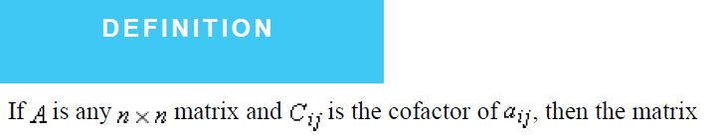
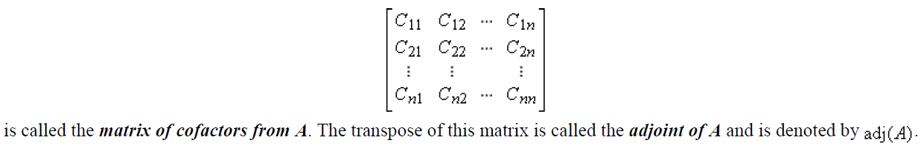
Adjoint of a Matrix
www.midocean.ae

Slide 35

EXAMPLE 6 Adjoint of a Matrix
Let
The cofactors of A are
so the matrix of cofactors is
and the adjoint of A is
www.midocean.ae

Slide 36
Find the inverse of a matrix by Gauss-Jordan Elimination:
Ex 2: (Find the inverse of the matrix)
Sol:

Slide 37
Ex : (Find the inverse of the following matrix)
Sol:
www.midocean.ae

Slide 38
So the matrix A is invertible, and its inverse is
Check:
www.midocean.ae

Slide 39
Matric Operation
Hill Cipher
www.midocean.ae

Slide 40

Hill Cipher
The Hill Cipher was invented by Lester S. Hill in 1929
The Hill Cipher based on linear algebra
Encryption
  2 x 2 Matrix Encryption
  3 x 3 Matrix Encryption
www.midocean.ae

Slide 41
Hill Cipher
square matrix 𝑀 by the equation 𝑀𝑀⁻¹= 𝑀⁻¹𝑀= 𝐼, where 𝐼 is the identity matrix.
C = P*K mod 26
www.midocean.ae

Slide 42
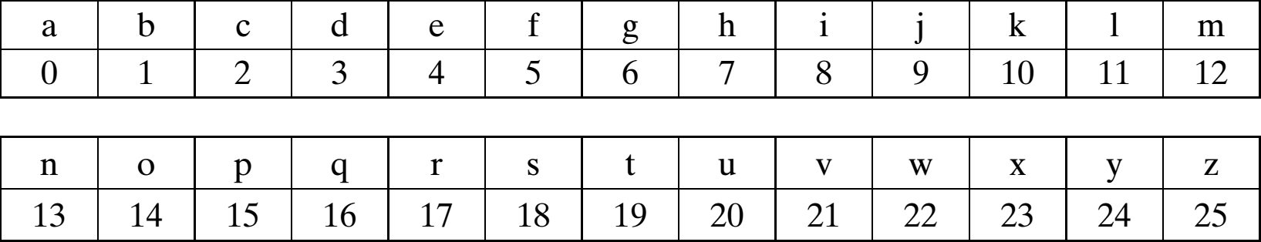
Hill Cipher
www.midocean.ae

Slide 43
Hill Cipher
Example of Key 2 x 2
𝐻 𝐼
𝐿 𝐿
7 8
11 11
𝐾 =
=
plaintext message "short example“
𝑃= short example
𝑆 ℎ
𝑜
𝑟
𝑡
𝑒
𝑥
𝑎
𝑚
𝑝
𝑙
𝑒
18 14 19 23 12 11
7 17 4 0 15 4
𝑃 =
=
www.midocean.ae

Slide 44
Hill Cipher
𝑆 ℎ
𝑜
𝑟
𝑡
𝑒
𝑥
𝑎
𝑚
𝑝
𝑙
𝑒
18 14 19 23 12 11
7 17 4 0 15 4
𝑃 =
=
𝐶 = 𝐾 ∗ 𝑃 𝑚𝑜𝑑 26
𝑘₀ 𝑘₁
𝑘₂ 𝑘₃
∗ 𝑝₀
₌ 𝑘₀ ∗ 𝑝₀ + 𝑘₁ ∗ 𝑝₁
❑
𝑝₁
𝑘₂ ∗ 𝑝₀ + 𝑘₃ ∗ 𝑝₁
7 8 ∗ 18 ₌
11 11 7
7 ∗ 18 + 8 ∗ 7 182
11 ∗ 18 + 11 ∗ 7 ⁼ 275
❑
0
15
₌ 𝑎
𝐶 = ¹⁸² 𝑚𝑜𝑑 26 =
275
𝑝
www.midocean.ae

Slide 45
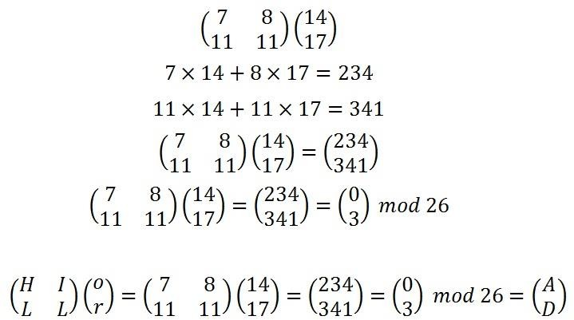
Hill Cipher Encryption
𝑆 ℎ
𝑜
𝑟
𝑡
𝑒
𝑥
𝑎
𝑚
𝑝
𝑙
𝑒
18 14 19 23 12 11
7 17 4 0 15 4
𝑃 =
=
www.midocean.ae

Slide 46
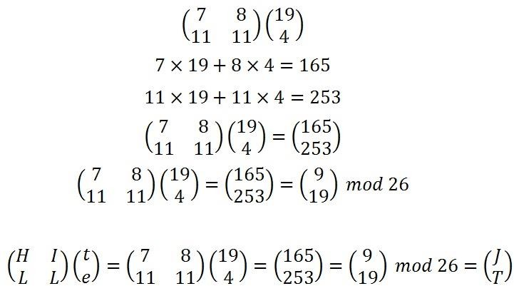
Hill Cipher Encryption
𝑆 ℎ
𝑜
𝑟
𝑡
𝑒
𝑥
𝑎
𝑚
𝑝
𝑙
𝑒
18 14 19 23 12 11
7 17 4 0 15 4
𝑃 =
=
www.midocean.ae

Slide 47
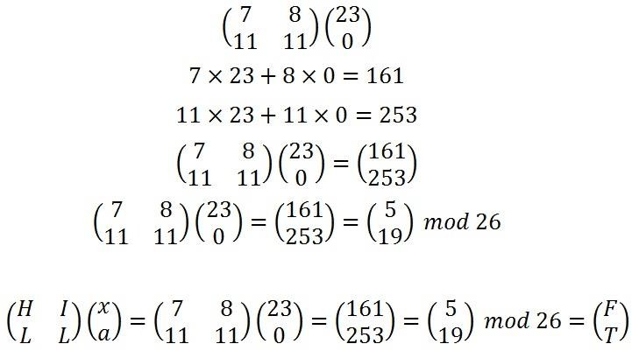
Hill Cipher Encryption
𝑆 ℎ
𝑜
𝑟
𝑡
𝑒
𝑥
𝑎
𝑚
𝑝
𝑙
𝑒
18 14 19 23 12 11
7 17 4 0 15 4
𝑃 =
=
www.midocean.ae

Slide 48
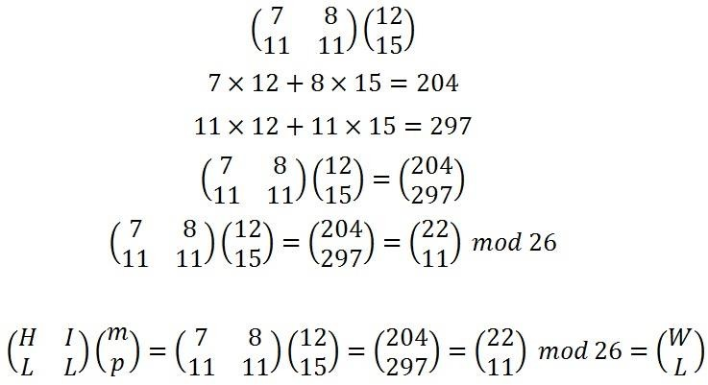
Hill Cipher Encryption
𝑆 ℎ
𝑜
𝑟
𝑡
𝑒
𝑥
𝑎
𝑚
𝑝
𝑙
𝑒
18 14 19 23 12 11
7 17 4 0 15 4
𝑃 =
=
www.midocean.ae

Slide 49
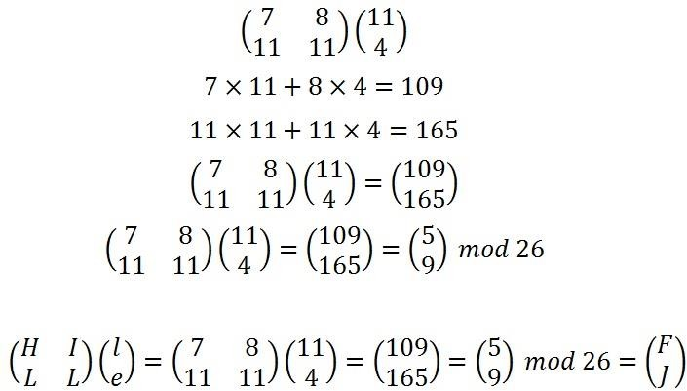
Hill Cipher Encryption
𝑆 ℎ
𝑜
𝑟
𝑡
𝑒
𝑥
𝑎
𝑚
𝑝
𝑙
𝑒
18 14 19 23 12 11
7 17 4 0 15 4
𝑃 =
=
www.midocean.ae

Slide 50
Hill Cipher Encryption
𝑎
𝑝
𝑎
𝑑
𝑗 𝑓
𝑡 𝑡
𝑤 𝑓
𝑙 𝑗
𝐶 =
This gives us a final ciphertext of "APADJ TFTWLFJ"
www.midocean.ae

Slide 51
Hill Cipher Decryption
𝑎
𝑝
𝑎
𝑑
𝑗 𝑓
𝑡 𝑡
𝑤 𝑓
𝑙 𝑗
𝐶 =
This gives us a final ciphertext of "APADJ TFTWLFJ“
𝐻 𝐼
𝐿 𝐿
7 8
11 11
𝐾 =
=
We want to find 𝐾⁻¹
www.midocean.ae

Slide 52
𝐷 (𝐾) = 7 ∗ 11 − 8 ∗ 11 = −11 𝑚𝑜𝑑 26 = 15
Hill Cipher Decryption
𝑆𝑡𝑒𝑝 1 − 𝐹𝑖𝑛𝑑 𝑡ℎ𝑒 𝑀𝑢𝑙𝑡𝑖𝑝𝑙𝑖𝑐𝑎𝑡𝑖𝑣𝑒 𝐼𝑛𝑣𝑒𝑟𝑠𝑒 𝑜𝑓 𝑡ℎ𝑒 𝐷𝑒𝑡𝑒𝑟𝑚𝑖𝑛𝑎𝑛𝑡
𝐷𝐷⁻¹ = 1 𝑚𝑜𝑑 26 = 15 ∗ 𝐷⁻¹
Try and Test 1 𝑚𝑜𝑑 26 = 105
𝐷⁻¹ = 7
www.midocean.ae

Slide 53
𝑏 𝑑 −𝑏
𝑐 𝑑 ⁼ −𝑐 𝑎
𝑆𝑡𝑒𝑝 2 − 𝐹𝑖𝑛𝑑 𝑡ℎ𝑒 𝐴𝑑𝑗𝑢𝑔𝑎𝑡𝑒 𝑀𝑎𝑡𝑟𝑖𝑥 𝑜𝑓 𝐾𝑒𝑦
𝑎𝑑𝑗 ^{𝑎}
7 8 11
11 11 −11 7
11 18
15 7
𝑎𝑑𝑗
=
⁻⁸ mod 26 =
www.midocean.ae

Slide 54
Hill Cipher Decryption
𝑆𝑡𝑒𝑝 3 𝑀𝑢𝑙𝑡𝑖𝑝𝑙𝑦 𝑡ℎ𝑒 𝑀𝑢𝑙𝑡𝑖𝑝𝑙𝑖𝑐𝑎𝑡𝑖𝑣𝑒 𝐼𝑛𝑣𝑒𝑟𝑠𝑒 𝑜𝑓 𝑡ℎ𝑒 𝐷𝑒𝑡𝑒𝑟𝑚𝑖𝑛𝑎𝑛𝑡
𝑏𝑦 𝑡ℎ𝑒 𝐴𝑑𝑗𝑢𝑔𝑎𝑡𝑒 𝑀𝑎𝑡𝑟𝑖𝑥
11 18
15 7
77 126
165 49
25 22
1 23
_{= 𝐾}−1
7 ∗
=
𝑚𝑜𝑑 26 =
www.midocean.ae

Slide 55
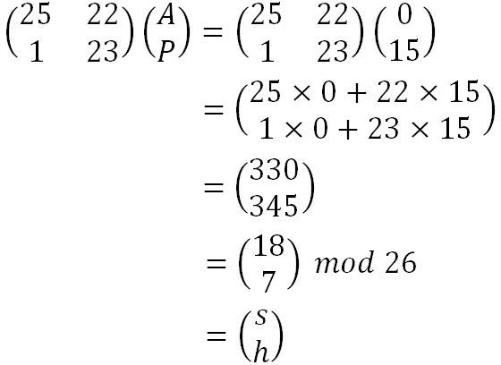
Hill Cipher Decryption
𝑎
𝑝
𝑎
𝑑
𝑗 𝑓
𝑡 𝑡
𝑤 𝑓
𝑙 𝑗
0 0 9 5 22 5
15 3 19 19 11 9
𝐶 =
=
www.midocean.ae

Slide 56
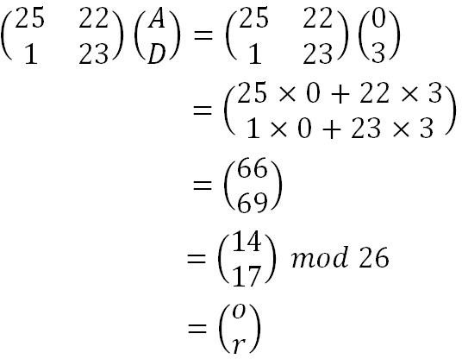
Hill Cipher Decryption
𝑎
𝑝
𝑎
𝑑
𝑗 𝑓
𝑡 𝑡
𝑤 𝑓
𝑙 𝑗
0 0 9 5 22 5
15 3 19 19 11 9
𝐶 =
=
www.midocean.ae

Slide 57

Hill Cipher Decryption
𝑎
𝑝
𝑎
𝑑
𝑗 𝑓
𝑡 𝑡
𝑤 𝑓
𝑙 𝑗
0 0 9 5 22 5
15 3 19 19 11 9
𝐶 =
=
www.midocean.ae

Slide 58
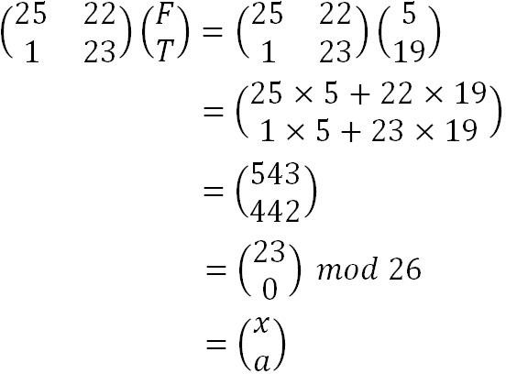
Hill Cipher Decryption
𝑎
𝑝
𝑎
𝑑
𝑗 𝑓
𝑡 𝑡
𝑤 𝑓
𝑙 𝑗
0 0 9 5 22 5
15 3 19 19 11 9
𝐶 =
=
www.midocean.ae

Slide 59
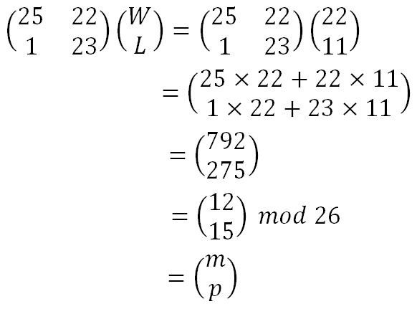
Hill Cipher Decryption
𝑎
𝑝
𝑎
𝑑
𝑗 𝑓
𝑡 𝑡
𝑤 𝑓
𝑙 𝑗
0 0 9 5 22 5
15 3 19 19 11 9
𝐶 =
=
www.midocean.ae

Slide 60
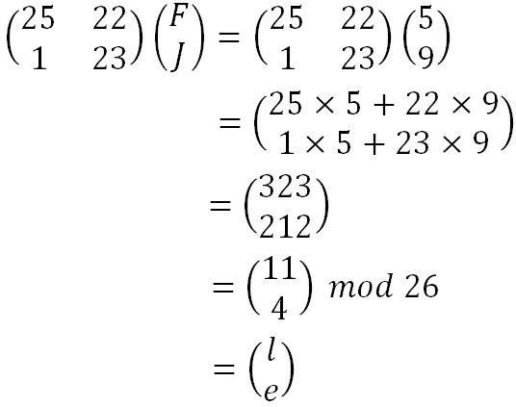
Hill Cipher Decryption
𝑎
𝑝
𝑎
𝑑
𝑗 𝑓
𝑡 𝑡
𝑤 𝑓
𝑙 𝑗
0 0 9 5 22 5
15 3 19 19 11 9
𝐶 =
=
www.midocean.ae

Slide 61

Using Hill Cipher how to implement 3x3 matrix encryption ? The key for a hill cipher is a matrix
2 4 5
e.g. 𝒌 = 9 2 1 and message= ATTACK AT DAWN
3 17 7
www.midocean.ae

Slide 62



Thank You

