Slide 1


IELTS Preparation
Mini-Course
Lecture 3
Prepared by
Ahmed Soliman

Slide 2
Mastering the IELTS Listening Test

Slide 3
🎯 Objectives
By the end of the lesson, students will be able to:
Understand the structure of the Listening test (4 parts).
Identify common question types (forms, tables, maps, MCQs, matching).
Use effective listening strategies: predicting, scanning, and listening for distractors.
Practice answering questions under timed conditions.
Improve score by recognizing accents, paraphrasing, and signal words.

Slide 4
Lead-in
What difficulties do you face in listening?
Which accents are hardest for you?
speed, unfamiliar vocabulary, distractors.

Slide 5
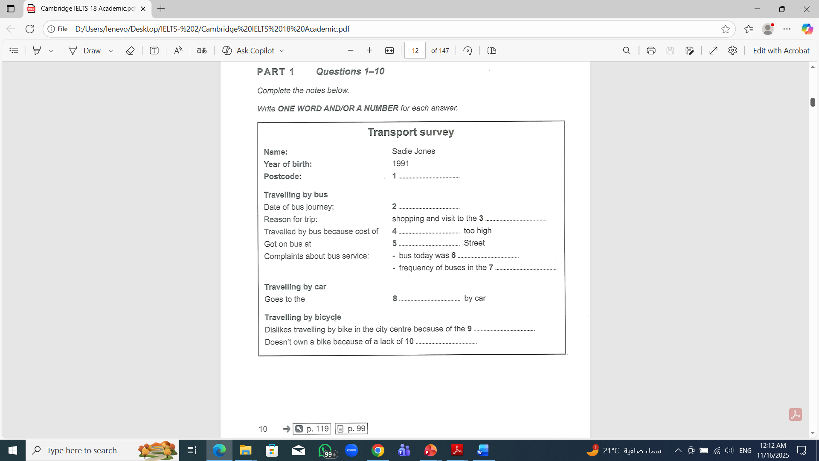

Part 1 Practice — Notes Completion

Slide 6
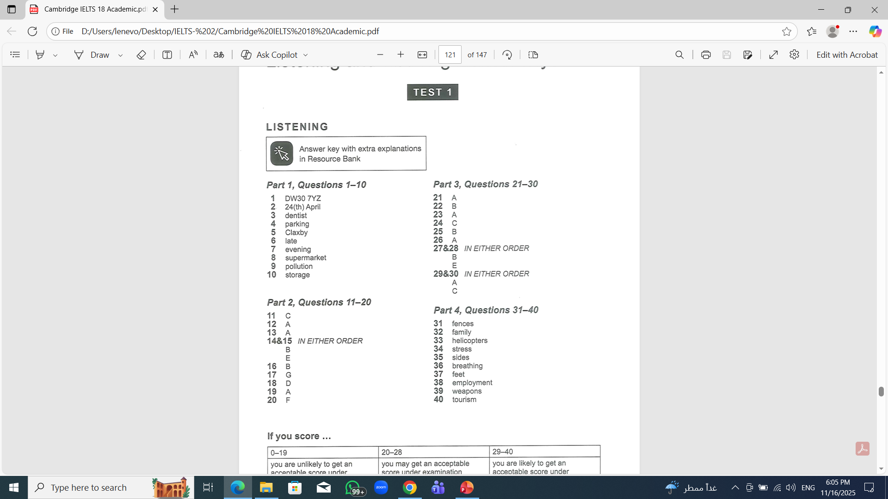
Answers

Slide 7
Test Structure
Section | Context | Focus | Questions
Part 1 | Social conversation | Everyday info | Forms, tables, notes
Part 2 | Monologue | Local info, tours, announcements | Maps, diagrams
Part 3 | Academic discussion | Students & tutor | Matching, MCQs
Part 4 | Academic lecture | Formal/complex | Sentence completion

Slide 8
Types of questions:
A- Multiple choices B- Matching C- Plan, map, diagram labelling D- Form, note, table, flow-chart, summary completion.

Slide 9
Types of questions:
E- sentence completion. F- Short answers

Slide 10
Time: 30 minutes + 10 minutes transfer (paper test).
Audio is played ONCE.

Slide 11
Understanding Different English Accents
British (UK)
Australian
American (US)
Example
UK: “Can you pass me the water?”
US: “Can you pass me the water?”
AUS: “Can you pass me the water?”

Slide 12
Identify common differences:
schedule → /ˈʃedjuːl/ (UK) vs /ˈskedʒuːl/ (US)
route → /ruːt/ (UK) vs /raʊt/ (US)

Slide 13
Read the Instructions carefully:
Word Limits matter
True/False/Not Given
Spelling: Zero Tolerance

Slide 14
Band score for listening
Band 5.5 = 18-22
Band 6 = 23-25
Band 6.5 = 26-29
Band 7 = 30-31
Band 7.5 = 32-34
Band 8 = 35-36
Band 8.5 = 37-38
Band 9 = 39-40

Slide 15
Key Listening Strategies
⭐ 1. Predict the topic
Look at keywords → guess the situation.
Example: booking a hotel, museum tour, university seminar.
⭐ 2. Predict missing words
Check grammar: noun? verb? number? adjective?
⭐ 3. Listen for paraphrasing
“Cheap” → “affordable”
“Starts at 5 p.m.” → “it begins in the early evening”

Slide 16
⭐ 4. Distractors
Trick phrases:
“I thought about going on Friday, but actually I booked Saturday.”
⭐ 5. Signal words
Firstly, however, but, although, next, finally, on the other hand.

Slide 17
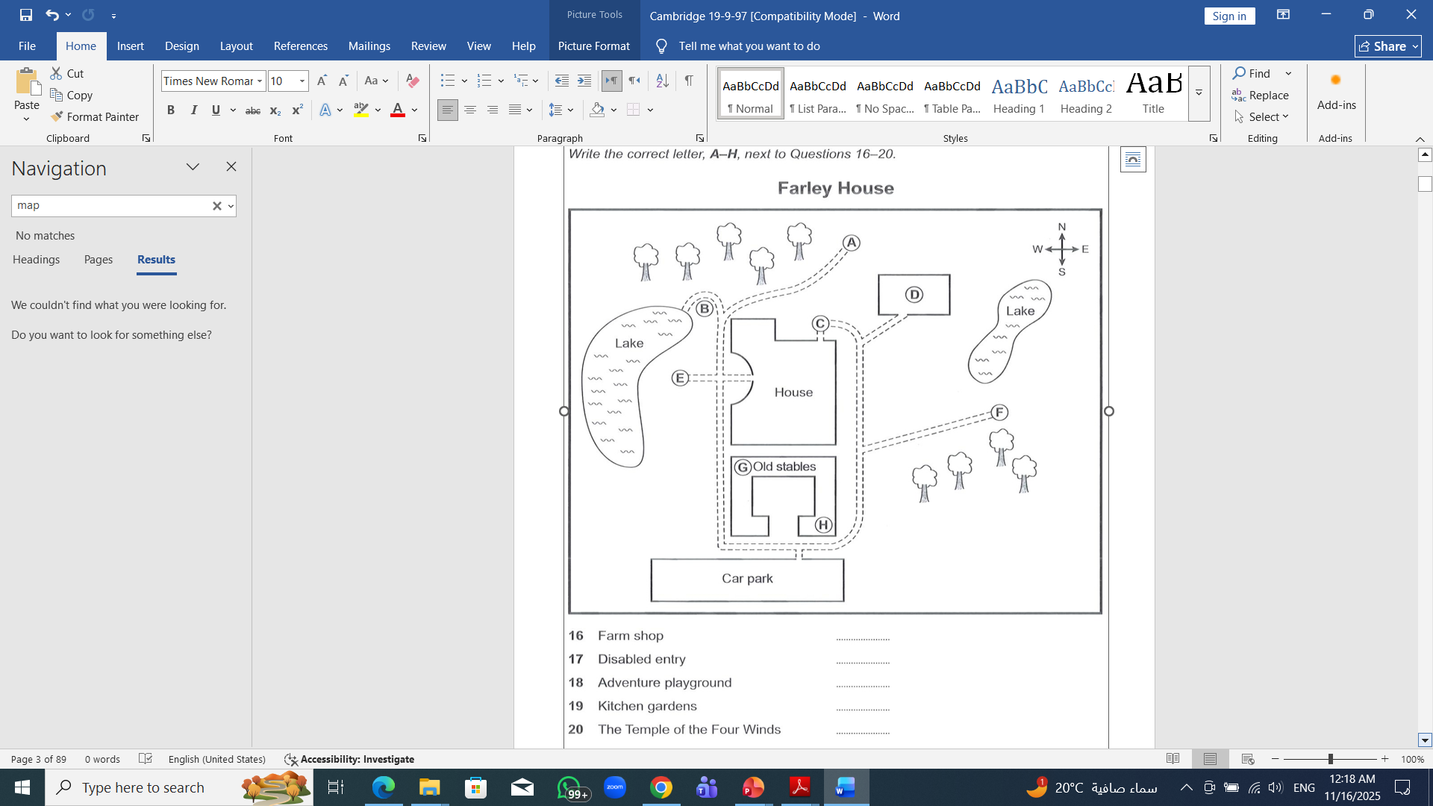
Part 2 Practice — Maps / Diagrams
S eqsaz

Slide 18
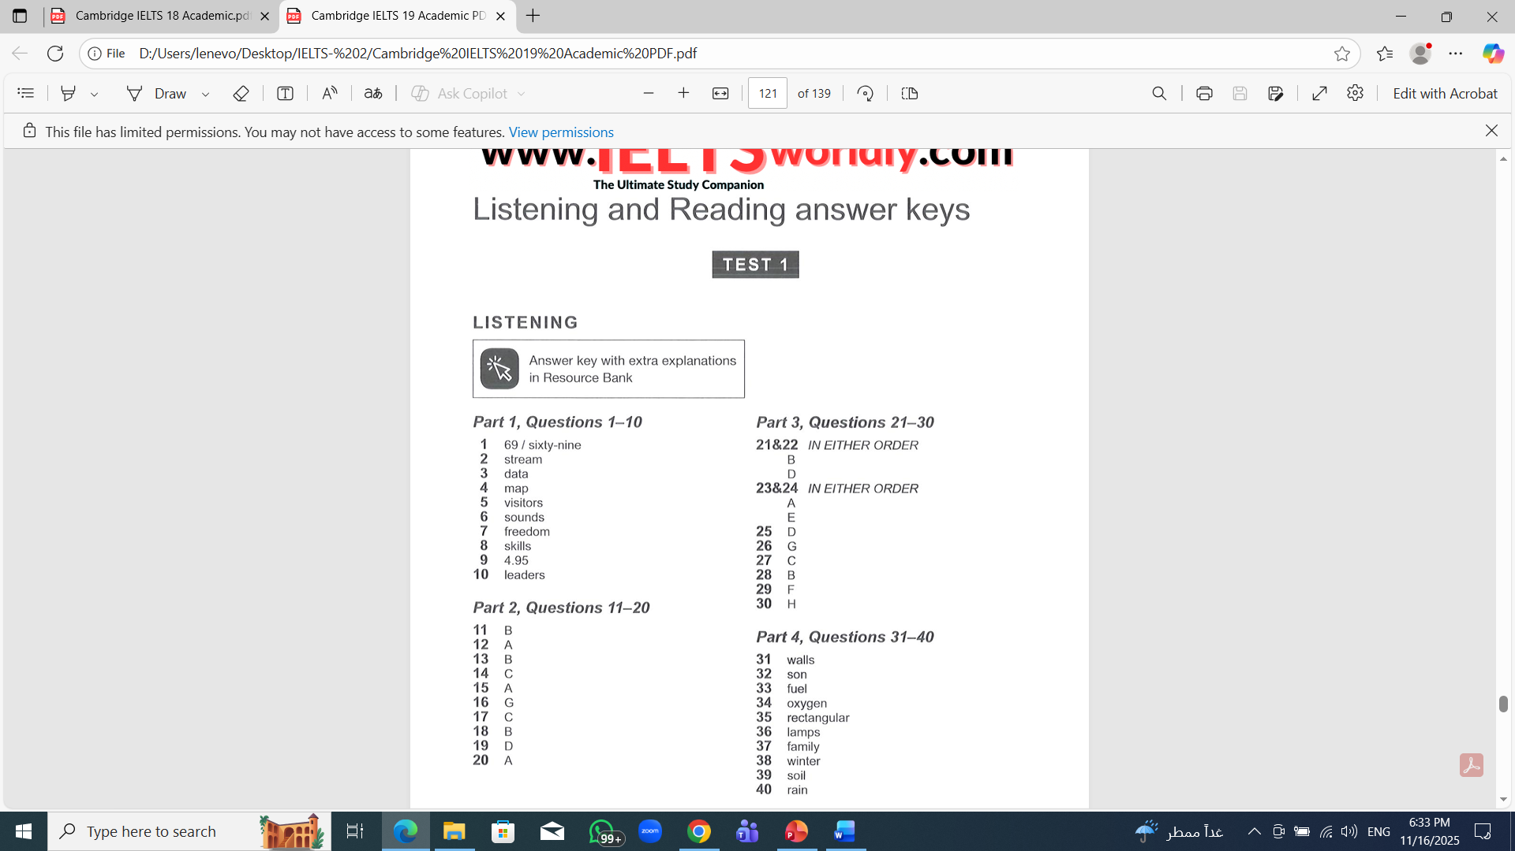
Answers

Slide 19
Assignment
Complete one Part 4 task before next class.

Slide 20
Websites
https://www.ieltsolve.com/
https://ieltstrainingonline.com/
https://takeielts.britishcouncil.org/

Slide 21


Thank You

