Slide 1









An AI-Driven Framework for
Gathering and Documenting Business Requirements
Prepared By
Supervisor
Name: Sahab Alhumaed
Dr. Khaled Eskaf
IDNo: 25100261
Master of Science in Artificial Intelligence
College of Informatics
Midocean University, UAE
[2025-Semester Three]
College of Informatics, Midocean University, Comoros
AI-Driven Requirements Engineering

Slide 2









Problem Statement
Key Challenges in Manual Requirements Classification
Time-Consuming Process
Manual categorization by analysts is lengthy and prone to personal bias
Low Accuracy in Translating Business Needs
Requirements derived from business inputs are often incomplete or incorrect, requiring multiple iterations.
Ambiguity in Requirements
Vague language and unclear criteria lead to misunderstandings and repeated rework.
Research Motivation: An automated method for accurate requirements classification and ambiguity detection is needed

Slide 3








Research Motivation
Impact of Manual Requirements Management
Extended Turnaround Time (TAT)
Manual handling significantly increases delivery time, impacting project schedules.
High Operational Costs
Large Business Analyst teams are required to produce a limited number of documents monthly.
Reduced Productivity
Business Analysts spend most of their time rewriting requirements instead of reviewing and resolving issues.
Research Motivation: An automated method for accurate requirements classification and ambiguity detection is needed

Slide 4
Research Objectives
FR/NFR Classification
Automatically classify requirements into FR / NFR
NFR Classification
Categorize NFRs into 11 quality attributes
Ambiguity Detection
Detect ambiguity in requirements text
BRD Generation
Generate structured Business Requirements Documents (BRD)

Slide 5















Methodology and Data Processing
PROMISE_exp dataset with 969 labeled requirements from eleven NFR categories
Raw Data
Preprocessing
SMOTE Balancing
TF-IDF Vectorization
Labeled FRs and NFRs with imbalance
Tokenization, lowercasing, stop-word removal
Balancing FR/NFR classes and NFR subcategories
Numerical representation with bi-grams
Preprocessing Details
Feature Engineering
Text Normalization
TF-IDF Vectorization
Lowercasing, punctuation removal, diacritic normalization
Highlights critical terms while giving low weights to common terms
SMOTE Balancing Technique
Bi-gram Features
Addresses class imbalance between FRs and NFRs, and among eleven NFR categories
Captures context beyond single words, providing richer semantic information
Key Insight: Preprocessing and feature engineering significantly improved model performance, especially for the imbalanced NFR subcategories

Slide 6




















Application features
Binary Classification
Multi-Class Categorization
Ambiguity Detection
BRD Generation
Performance Evaluation
Create structured documentation for stakeholders
Train model to distinguish between FRs and NFRs
Classify NFRs into eleven categories
Identify vague terms and unclear expressions
Compare results with existing literature
Expected Outcomes
High-performance classification models with SVM achieving 90%+ accuracy
Rule-based linguistic module identifying seven types of ambiguity
Stakeholder-oriented BRD generation for team communication

Slide 7














Proposed AI Framework Architecture
Preprocessing
Model Selection
BRD Generation
Tokenization, lowercasing, stop-word removal
Automated Business Requirements Document
Data Collection
Feature Engineering
SVM classifier for FR/NFR
Ambiguity Detection
Requirements from datasets
TF-IDF with bi-grams
Rule-based linguistic analysis
Input
Processing
Output

Slide 8



















Ambiguity Detection and Quality Assessment
The framework includes a rule-based module that identifies ambiguity patterns in requirements, improving clarity and specification quality.
Vague Adjectives
Weak Modal Verbs
Missing Quantitative Measures
Identifies terms like "fast", "user-friendly", "efficient"
Recognizes "should", "may", "could" indicating non-committal requirements
Detects requirements lacking measurable criteria
→ Suggest: specify quantitative thresholds
→ Suggest: stronger commitment indicators
→ Suggest: add specific metrics
Ambiguous Pronouns
Passive Voice Constructions
Repeated Requirements
Identifies unclear references like "it", "this", "they"
Recognizes unclear responsibility in passive voice
Detects duplicate or overlapping requirements
→ Suggest: clarify object references
→ Suggest: rephrase with active voice
→ Suggest: consolidate and prioritize
Unrelated Ideas
Identifies sentences with multiple disconnected ideas
→ Suggest: separate into distinct requirements
Quality Assessment Impact
Improved Requirement Clarity
Enhanced Specification Drafting
Ambiguity detection module identified 95% of requirements with ambiguous phrasing, significantly improving clarity and reducing misinterpretation.
The system flags ambiguous statements and provides specific suggestions for improvement, helping stakeholders create clearer requirements.
Quality Impact: Automatic ambiguity detection improves early-stage software development with higher requirement accuracy and lower misunderstanding

Slide 9



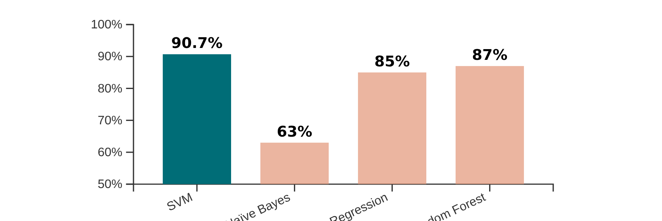

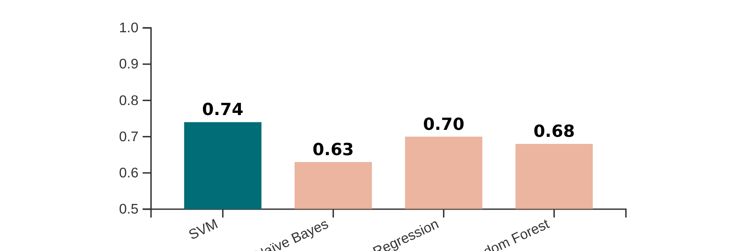



Model Performance Results
Binary FR/NFR Classification
Multi-Class NFR Subcategory Classification
Macro-F1 Score
0.74
SVM Classifier Accuracy
90.7%
Performance across eleven NFR categories
Superior performance in distinguishing FRs from NFRs
Model Comparison
Precision, Recall & F1-Score
~91%
SVM outperformed Naïve Bayes (0.63) and Linear SVM (0.815)
Best
Constantly high across all metrics
The SVM classifier demonstrated superior performance in both binary and multi-class tasks, outperforming other models like Naïve Bayes (63% accuracy) and Linear SVM (F1 score of 81.5%)

Slide 10












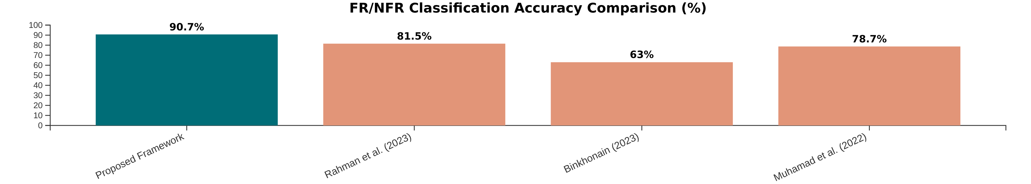




Comparison with Related Work
Study
Dataset
Features
Algorithm
Accuracy
F1-score
Proposed Framework
PROMISE_exp
TF-IDF (bi-grams)
SVM + SMOTE
90.7%
74% (macro)
Rahman et al. (2023)
PROMISE_exp
TF-IDF
Linear SVM
81.5%
81.5%
Binkhonain (2023)
PROMISE_exp
BoW
Naïve Bayes
63.0%
-
Muhamad et al. (2022)
PURE
BoW + SMOTE
SVM
78.7%
78.9%
Superior Accuracy
Integrated Ambiguity Detection
Automated BRD Generation
90.7% vs. 63-82% in previous works
Identifies 7 types of ambiguity patterns
Creates structured documentation for stakeholders

Slide 11









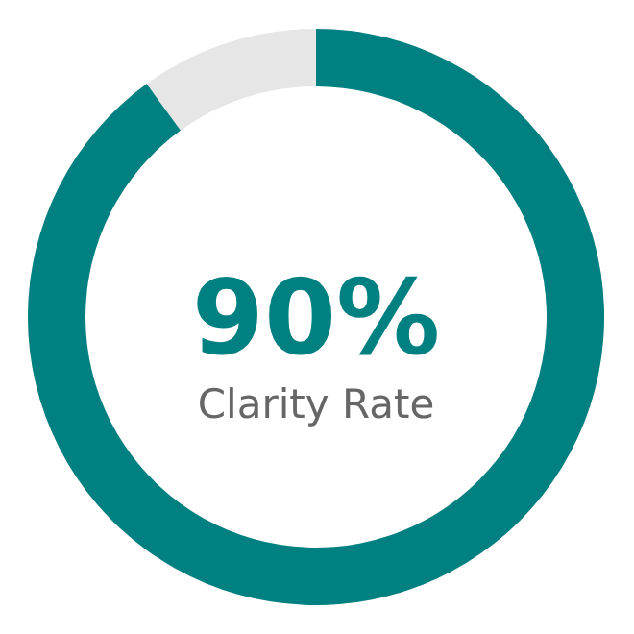


Value Proposition and Success Metrics
Key Value Propositions
Success Metrics
Structured BRD Generation
Clarity Rate
Transforms unstructured business requirements into well-structured Business Requirements Documents
Requirements clarity rate exceeds industry standard of 90%
Time Efficiency
NFR Identification
Reduces BRD preparation time from weeks to hours, allowing analysts to focus on higher-value tasks
Improved classification of Non-Functional Requirements
Role Transformation
Stakeholder Satisfaction
Shifts Business Analysts' focus from manual documentation to quality assurance and stakeholder management
Higher quality BRDs lead to better stakeholder alignment
Key Insight: AI-driven framework improves BRD quality while transforming analyst roles toward strategic value-added activities
Clarity Rate

Slide 12





Conclusion and Future Directions
Key Conclusions
High-Performance Classification
SVM classifier achieved 90.7% accuracy for FR/NFR classification with 0.74 macro-F1 score across eleven NFR categories
Effective Ambiguity Detection
Rule-based module identified seven types of ambiguity in requirements, improving clarity and specification quality
Automated BRD Generation
System produces structured Business Requirements Documents summarizing classification results and quality insights
AI-driven requirements engineering shows potential to transform software development with improved accuracy and efficiency

