Slide 1



Orientation
Lecture
Dr. Hamada I. AbdulWakel
Lecture 0

Slide 2



Introduction to
Programming
Prepared by
Dr. Hamada I. AbdulWakel
www.midocean.ae

Slide 3


Slide 4
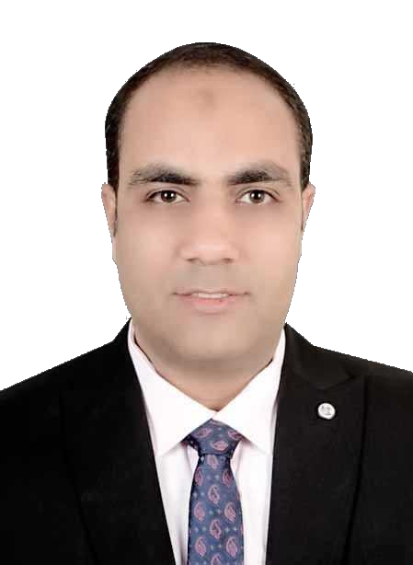
Lecture
WHO AM I?
0
Name
Hamada Ibrahim AbdulWakel
B.Sc. degree
Faculty of Computers and Information, Minia University, Minia, Egypt.
M.Sc. degree
In Computer Science from Faculty of Computers and Artificial Intelligence, Cairo University.
Semantic web & Social networking.
www.midocean.ae

Slide 5
Lecture
WHO AM I?
0
Cont'd
Ph.D. degrees
In Computer Science from Faculty of Computers and Artificial Intelligence, Cairo University.
Internet of Things.
Jobs
Lecturer at Faculty of Computers & Information, Minia University, Minia, Egypt.
Lecturer at Midocean university.
www.midocean.ae

Slide 6

Lecture
YOUR TURN
0
www.midocean.ae

Slide 7
Lecture
COURCE DETAILS
0
Course name
Programming Foundations In Python – CYB550.
Introduction to Programming – IT121.
University
Midocean University.
Departments
Cybersecurity.
Information Technology.
www.midocean.ae

Slide 8
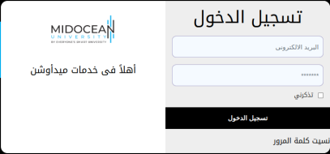
Lecture
COURSE CONTACT
0
Via the sis platform.
Via Midocean university email:
  hamada@midocean.ae
    Subject:
    "Programming Course: Question"
    If problem:
      The message must include student ID.
www.midocean.ae

Slide 9
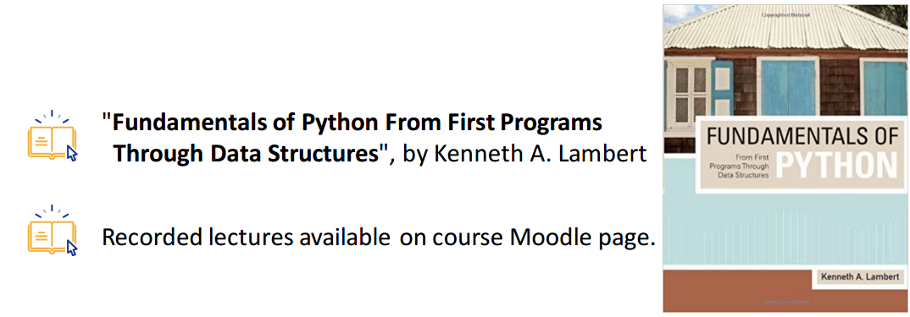
Lecture
COURSE MATERIALS
0
The main materials:
www.midocean.ae

Slide 10

Lecture
LEARNING OBJECTIVES
0
What you'll learn?
New programming language "Python".
Problem-solving techniques.
Application development and prototyping.
Best practice in software development.
www.midocean.ae

Slide 11

Lecture
COURSE TOPICS
0
The course content:
Introduction to computer programming and "Python" language.
Data types and the basics input/output operations.
The conditional and looping instructions.
Data processing using Lists and Dictionaries.
www.midocean.ae

Slide 12
Lecture
COURSE TOPICS
0
Cont'd
The course content:
Functions and modules in "Python" language.
File in "Python" language.
The Object-Oriented Programming (OOP).
The graphical user interface (GUI).
www.midocean.ae

Slide 13
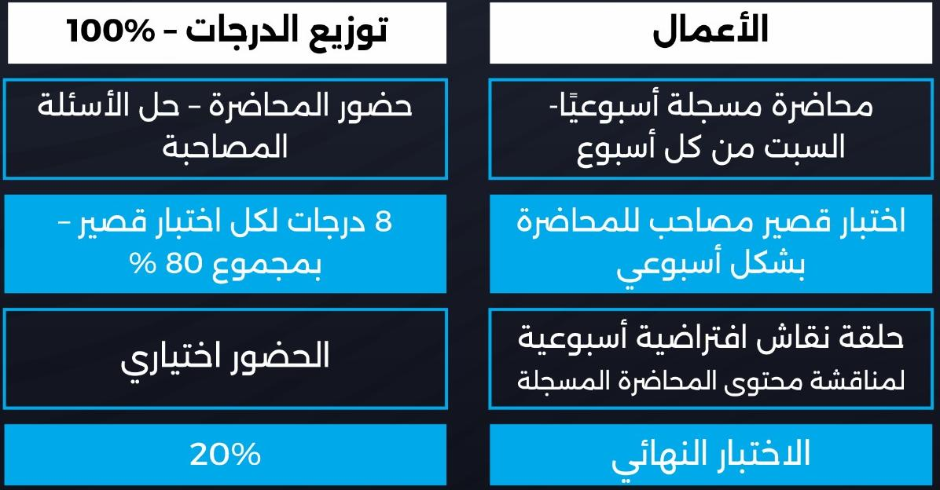
Lecture
0
COURSE ASSESSMENT
www.midocean.ae

Slide 14
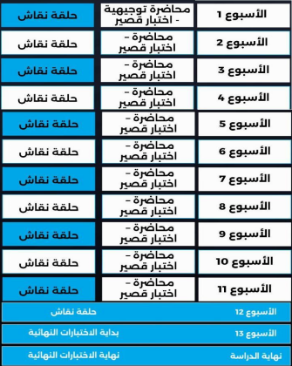
Lecture
0
COURSE ACADEMIC CALENDAR
www.midocean.ae

Slide 15


Lecture
0
COURSE EXAMS
Exam rules:
All exam password is agree.
Each exam includes eight questions.
You have only one-try for each exam.
Each exam duration is 24 minutes.
www.midocean.ae

Slide 16
Lecture
0
COURSE EXAMS
Cont'd
Exam rules:
You must sure of your question answer before
going to the next question.
Each exam begins on Saturday 10:00 PM
to next Saturday 9:00PM.
Each exam has different question types.
www.midocean.ae

Slide 17
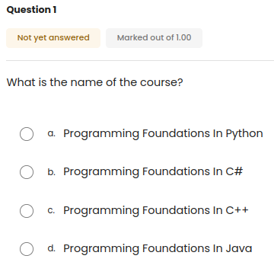
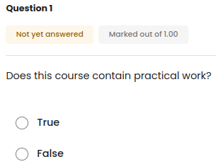
Lecture
0
EXAM QUESTION TYPES
www.midocean.ae

Slide 18
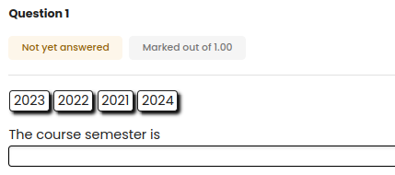
Lecture
0
EXAM QUESTION TYPES
Cont'd
www.midocean.ae

Slide 19
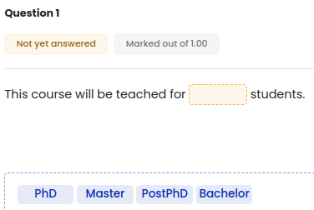
Lecture
0
EXAM QUESTION TYPES
Cont'd
www.midocean.ae

Slide 20
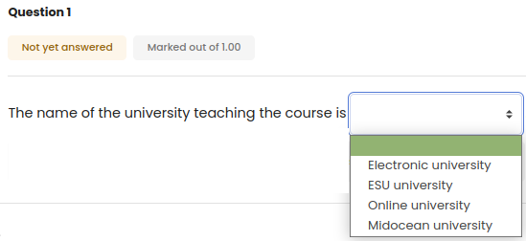
Lecture
0
EXAM QUESTION TYPES
Cont'd
www.midocean.ae

Slide 21
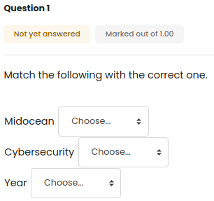
Lecture
0
EXAM QUESTION TYPES
Cont'd
www.midocean.ae

Slide 22
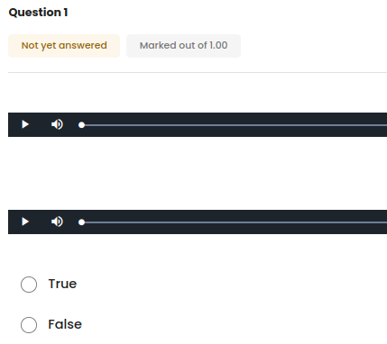
Lecture
0
EXAM QUESTION TYPES
Cont'd
www.midocean.ae

Slide 23



Slide 24

Thank You

