Slide 1

CCNA (200-301) Cisco Certified Network Associate
Prepared by Eng. Taghreed Elsayed
Lecture 9
Network Address Translation(NAT)

Slide 2

Chapter
04
NAT (Network Address Translation)
What is NAT?
NAT (Network Address Translation) is a process of changing the source and destination IP addresses and ports. Address translation reduces the need for IPv4 public addresses and hides private network address ranges. This process is usually done by routers or firewalls.
An example will help you understand the concept:
Host A request a web page from an Internet server. Because Host A uses private IP addressing, the source address of the request has to be changed by the router because private IP addresses are not routable on the Internet.

Slide 3
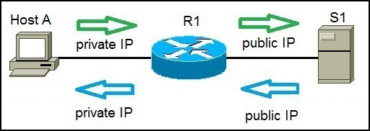
Chapter
04
NAT (Network Address Translation)
Router R1 receives the request, changes the source IP address to its public IP address and sends the packet to server S1. Server S1 receives the packet and replies to router R1. Router R1 receives the packet, changes the destination IP addresses to the private IP address of Host A and sends the packet to Host A.

Slide 4
Chapter
04
NAT (Network Address Translation)
Here are three types of address translation:
Static NAT – : translates one private IP address to a public one. The public IP address is always the same.
Dynamic NAT – : private IP addresses are mapped to the pool of public IP addresses.
Port Address Translation (PAT) – : one public IP address is used for all internal devices, but a different port is assigned to each private IP address. Also known as NAT Overload.

Slide 5
Chapter
04
NAT (Network Address Translation)
Static NAT
With static NAT, routers or firewalls translate one private IP address to a single public IP address. Each private IP address is mapped to a single public IP address.
Static NAT is not often used because it requires one public IP address for each private IP address.
To configure static NAT, three steps are required:
configure private/public IP address mapping by using the
ip nat inside source static PRIVATE_IP PUBLIC_IP command

Slide 6
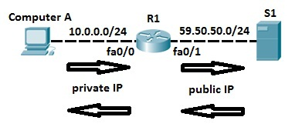
Chapter
04
NAT (Network Address Translation)
2. configure the router’s inside interface using the ip nat inside command.
3. configure the router’s outside interface using the ip nat outside command.
Here is an example.

Slide 7
Chapter
04
NAT (Network Address Translation)
Computer A requests a web resource from S1. Computer A uses its private IP address when sending the request to router R1. Router R1 receives the request, changes the private IP address to the public one and sends the request to S1. S1 responds to R1. R1 receives the response, looks up in its NAT table and changes the destination IP address to the private IP address of Computer A.
In the example above, we need to configure static NAT. To do that, the following commands are required on R1:

Slide 8


Chapter
04
NAT (Network Address Translation)
Using the commands above, we have configured a static mapping between Computer A’s private IP address of 10.0.0.2 and router’s R1 public IP address of 59.50.50.1. To check NAT, you can use the show ip nat translations command:

Slide 9
Chapter
04
NAT (Network Address Translation)
Dynamic NAT
Unlike with static NAT, where you had to manually define a static mapping between a private and public address, dynamic NAT does the mapping of a local address to a global address happens dynamically.
This means that the router dynamically picks an address from the global address pool that is not currently assigned. The dynamic entry stays in the NAT translations table as long as the traffic is exchanged.

Slide 10
Chapter
04
NAT (Network Address Translation)
The entry times out after a period of inactivity and the global IP address can be used for new translations.
With dynamic NAT, you need to specify two sets of addresses on your Cisco router:
The inside addresses that will be translated
A pool of global addresses
To configure dynamic NAT, the following steps are required:

Slide 11
Chapter
04
NAT (Network Address Translation)
1.configure the router’s inside interface using the ip nat inside command.
2. configure the router’s outside interface using the ip nat outside command.
3. configure an ACL that has a list of the inside source addresses that will be translated.
4. configure a pool of global IP addresses using the ip nat pool NAME FIRST_IP_ADDRESS LAST_IP_ADDRESS netmask SUBNET_MASK command
5. enable dynamic NAT with the ip nat inside source list ACL_NUMBER pool NAME global configuration command
Consider the following example:

Slide 12
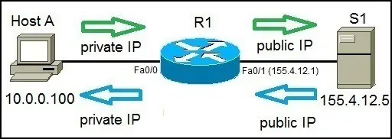
Chapter
04
NAT (Network Address Translation)
Host A requests a web resource from a internet server S1.
Host A uses its private IP address when sending the request to router R1.
Router R1 receives the request, changes the private IP address to one of the available global addresses in the pool and sends the request to S1.

Slide 13
Chapter
04
NAT (Network Address Translation)
S1 responds to R1.
R1 receives the response, looks up in its NAT table and changes the destination IP address to the private IP address of Host A.
To configure dynamic NAT, the following commands are required on R1:
1. First we need to configure the router’s inside and outside NAT interfaces:

Slide 14
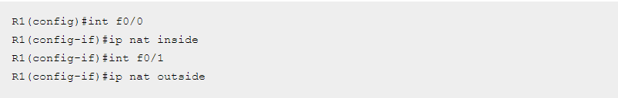
Chapter
04
NAT (Network Address Translation)
2. Next, we need to configure an ACL that will include a list of the inside source addresses that will be translated. In this example we want to translate all inside hosts on the 10.0.0.0/24 network:

Slide 15
Chapter
04
NAT (Network Address Translation)
3.We need to configure the pool of global (public) IP addresses available on the outside interface:
The pool configured above consists of 3 addresses: 155.4.12.1, 155.4.12.2, and 155.4.12.3.
4. Lastly, we need to enable dynamic NAT:
.

Slide 16
Chapter
04
NAT (Network Address Translation)
The command above tells the router to translate all addresses specified in the access list 1 to the pool of global addresses named MY POOL.
You can list all NAT translations using the show ip nat translations command.
Generate some traffic from the PC to the server first to test:

Slide 17
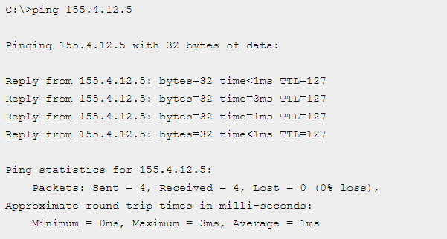
Chapter
04
NAT (Network Address Translation)

Slide 18

Chapter
04
NAT (Network Address Translation)
Then enter the show ip nat translations command quickly enough before the translation has timed out.
In the output above you can see that the translation has been made between the Host A’s private IP address (Inside local, 10.0.0.100)

Slide 19
Chapter
04
NAT (Network Address Translation)
to the first available public IP address from the pool (Inside global, 155.4.12.1) and it is connecting to the server on the outside (Outside local and Outside global, 155.4.12.5) .
NOTE
You can remove all NAT translations from the table by using the
clear ip nat translation * command.

Slide 20
Chapter
04
NAT (Network Address Translation)
Port Address Translation (PAT) configuration
With Port Address Translation (PAT), a single public IP address is used for all internal private IP addresses, but a different port is assigned to each private IP address.
This type of NAT is also known as NAT Overload and is the typical form of NAT used in today’s networks. It is even supported by most consumer-grade routers.
PAT allows you to support many hosts with only few public IP addresses. It works by creating dynamic NAT mapping, in which a global (public) IP address and a unique port number are selected.

Slide 21
Chapter
04
NAT (Network Address Translation)
The router keeps a NAT table entry for every unique combination of the private IP address and port, with translation to the global address and a unique port number.
We will use the following example network to explain the benefits of using PAT:

Slide 22
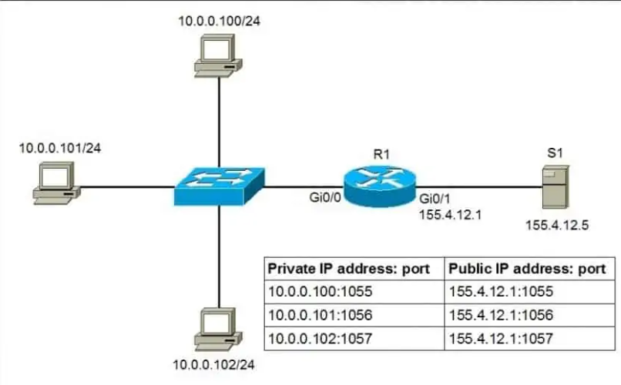
Chapter
04
NAT (Network Address Translation)

Slide 23
Chapter
04
NAT (Network Address Translation)
As you can see in the picture above, PAT uses unique source port numbers on the inside global (public) IP address to distinguish between translations.
For example, if the host with the IP address of 10.0.0.101 wants to access the server S1 on the Internet, the host’s private IP address will be translated by R1 to 155.4.12.1:1056 and the request will be sent to S1. S1 will respond to 155.4.12.1:1056.
R1 will receive that response, look up in its NAT translation table, and forward the request to the host.

Slide 24
Chapter
04
NAT (Network Address Translation)
Port Address Translation (PAT) configuration
To configure PAT, the following commands are required:
configure the router’s inside interface using the ip nat inside command.
configure the router’s outside interface using the ip nat outside command.
configure an access list that includes a list of the inside source addresses that should be translated.
enable PAT with the ip nat inside source list ACL_NUMBER interface TYPE overload global configuration command.

Slide 25
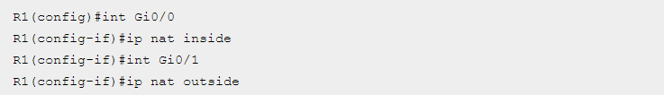
Chapter
04
NAT (Network Address Translation)
Here is how we would configure PAT for the network picture above.
First, we will define the outside and inside interfaces on R1:
Next, we will define an access list that will include all private IP addresses we would like to translate:

Slide 26
Chapter
04
NAT (Network Address Translation)
The access list defined above includes all IP addresses from the 10.0.0.0 – 10.0.0.255 range.
Now we need to enable NAT and refer to the ACL created in the previous step and to the interface whose IP address will be used for translations:

Slide 27
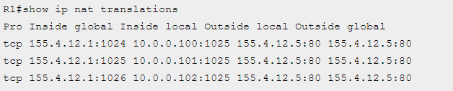
Chapter
04
NAT (Network Address Translation)
To verify the NAT translations, we can use the show ip nat translations command after hosts request a web resource from S1:

Slide 28
Chapter
04
NAT (Network Address Translation)
Notice that the same IP address (155.4.12.1) has been used to translate three private IP addresses (10.0.0.100, 10.0.0.101, and 10.0.0.102).
The port number of the public IP address is unique for each connection. So when S1 responds to 155.4.12.1:1026, R1 look into its NAT translations table and forward the response to 10.0.0.102:1025

